Slide 1
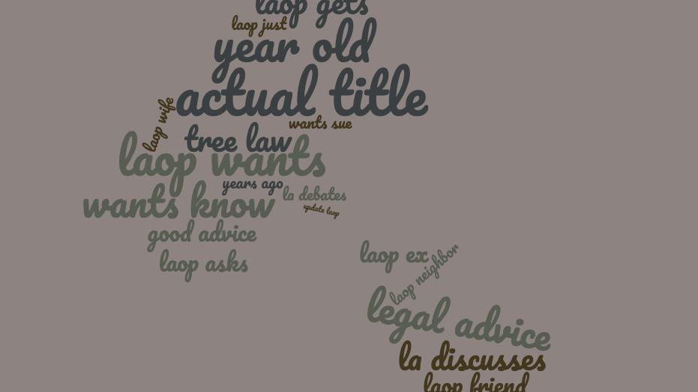
LAOP is now r/bestofLA
Using natural language processing and machine learning to classify subreddits
Notes:
/polly What’s your favorite daytime TV show?

Slide 2
Official Goal(s):
For this project, our goal is two-fold:
1. Using [Pushshift's](https://github.com/pushshift/api) API, collect posts from two subreddits
2. Use NLP to train a classifier on which subreddit a given post came from. This is a binary classification problem.

Slide 3
Subreddit Selection:
r/bestoflegaladvice
r/legaladvice
LAOP is "one man trying to run a school district's IT stuff and I often get overwhelmed" but not so overwhelmed that he can't go searching for gossip in employees' emails. LAOP is surprised that there are consequences for this.
If your employer specifically tells you not to get a lawyer, it means it's time to get a lawyer
The Only IT Admin to be Fired for Finding Someone Else Using Their Work Emails to Have an Affair?
Failed drug test though have never done drugs, fired from employment.
Notes:
https://redditblog.com/2009/10/15/reddits-new-comment-sorting-system/

Slide 4

Problem Statement:
Which classification model is able to most accurately predict whether the title of a post has come from the r/legaladvice or r/bestoflegaladvice?

Slide 5
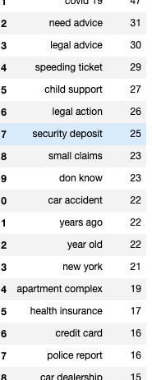
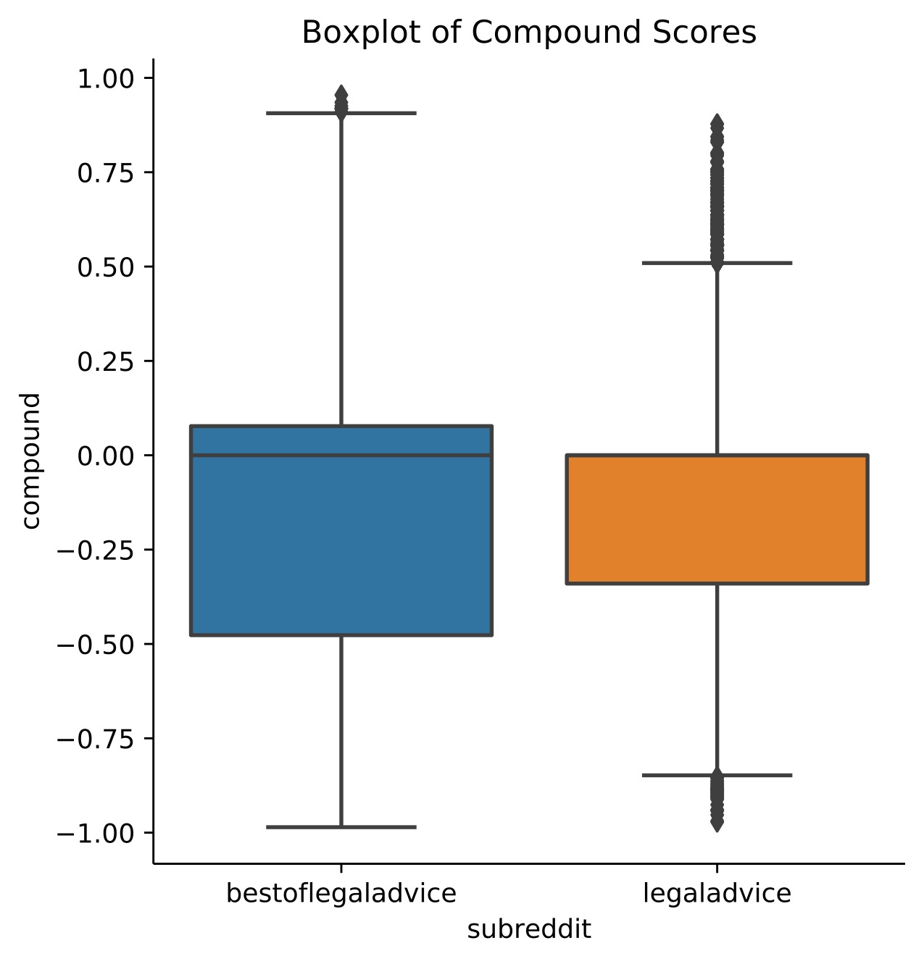
Sentiment Analysis
Looking at the sentiment scores of the titles across subreddits show a wide spread of score in the r/bestoflegaladvice subreddit

Slide 6
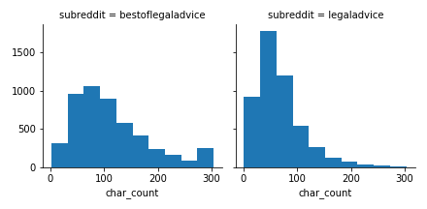
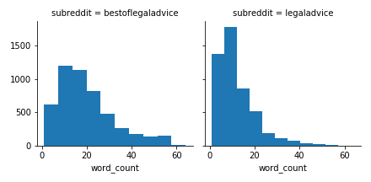
Comparison of Title Length by Subreddit
Comparing Characters
Comparing Word Counts

Slide 7
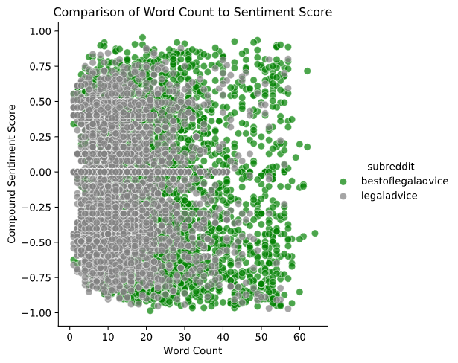
Scatterplot of Compound Sentiment Analysis vs Word Count
From the figure we can see an even spread of sentiment on either side of the neutral zone for both subreddits
A slight tendency of the r/bestoflegaladvice subreddit to have longer titles

Slide 8
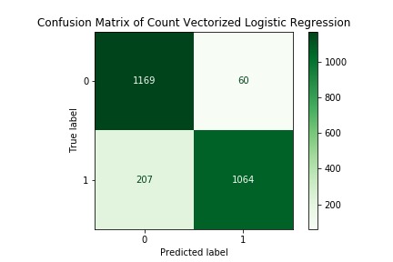
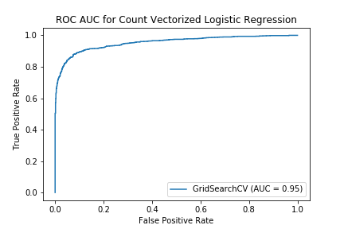
Count Vectorized Logistic Regression
Train Score :
94 %
Test Score:
89 %
Variance:
5 %
Notes:
Best Params:
{'cvec__max_df': 0.8, 'cvec__max_features': 5000, 'cvec__min_df': 3, 'cvec__ngram_range': (1, 2), 'cvec__stop_words': None, 'logregcv__penalty': 'l2', 'logregcv__solver': 'liblinear'}

Slide 9
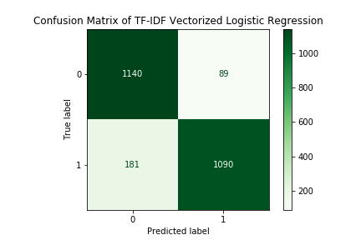
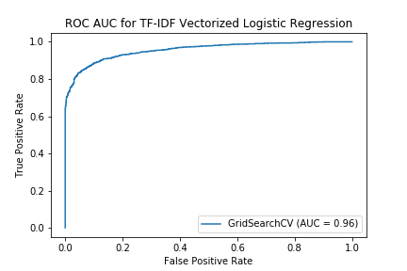
TF-IDF Logistic Regression
Train Score :
95 %
Test Score:
89 %
Variance:
6 %
Notes:
Best Params:
{'logregcv__penalty': 'l2', 'logregcv__solver': 'liblinear', 'tvec__max_features': 3500, 'tvec__ngram_range': (1, 2), 'tvec__stop_words': None}

Slide 10
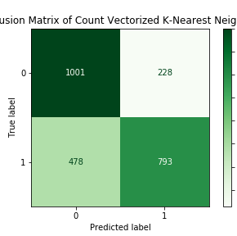
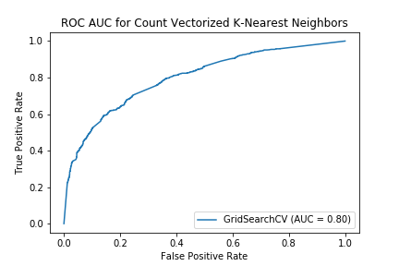
Count Vectorized K-Nearest Neighbors
Train Score :
99 %
Test Score:
72 %
Variance:
27 %
Notes:
{'cvec__max_df': 0.8, 'cvec__max_features': 2000, 'cvec__min_df': 3, 'cvec__ngram_range': (1, 2), 'cvec__stop_words': None, 'knn__n_neighbors': 5, 'knn__weights': 'distance'}

Slide 11
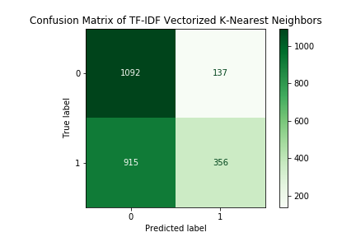
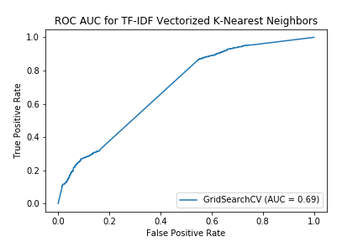
TF-IDF Vectorized K-Nearest Neighbors
Train Score :
99 %
Test Score:
58 %
Variance:
41 %
Notes:
{'knn__n_neighbors': 3, 'knn__weights': 'distance', 'tvec__max_features': 2000, 'tvec__ngram_range': (1, 2), 'tvec__stop_words': 'english'}

Slide 12
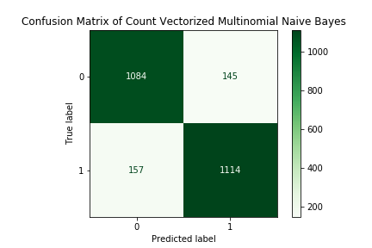
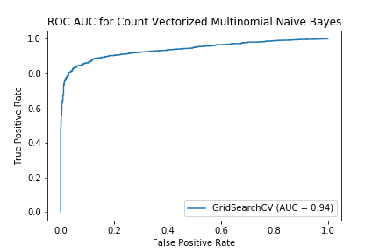
Count Vectorized Multinomial Naïve Bayes
Train Score
91 %
Test Score:
87 %
Variance:
4 %
Notes:
{'cvec__max_df': 0.8, 'cvec__max_features': 4000, 'cvec__min_df': 3, 'cvec__ngram_range': (1, 2), 'cvec__stop_words': None}

Slide 13
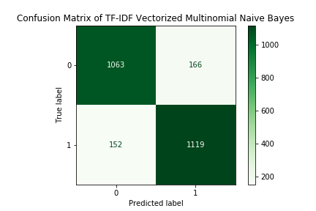

TF-IDF Vectorized Multinomial Naïve Bayes
Train Score:
91 %
Test Score:
87 %
Variance:
4 %
Notes:
{'tvec__max_features': 4000, 'tvec__ngram_range': (1, 2), 'tvec__stop_words': None}

Slide 14
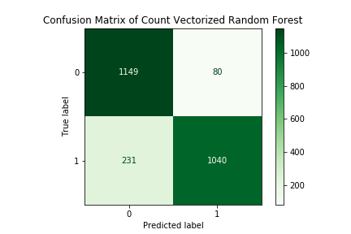
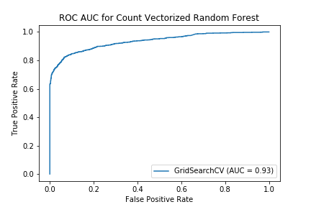
Count Vectorized Random Forest
Train Score:
91%
Test Score:
88 %
Variance:
3 %
Notes:
{'cvec__max_df': 0.9, 'cvec__max_features': 2000, 'cvec__min_df': 2, 'cvec__ngram_range': (1, 2), 'cvec__stop_words': None, 'rf__bootstrap': True, 'rf__max_depth': 50, 'rf__min_samples_leaf': 2, 'rf__min_samples_split': 5, 'rf__n_estimators': 250}

Slide 15
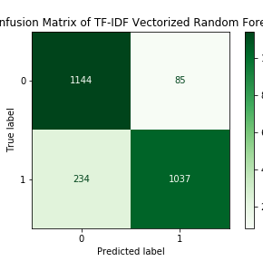
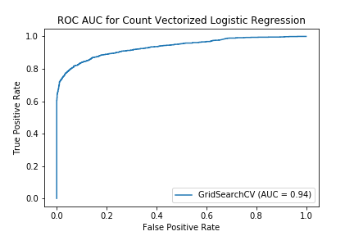
TF-IDF Vectorized Random Forest
Train Accuracy Score:
92%
Test Accuracy Score:
87%
Variance:
5 %
Notes:
{'rf__bootstrap': True, 'rf__max_depth': 50, 'rf__max_features': 'auto', 'rf__min_samples_leaf': 2, 'rf__min_samples_split': 5, 'rf__n_estimators': 500, 'tvec__max_features': 2000, 'tvec__ngram_range': (1, 2)}

Slide 16
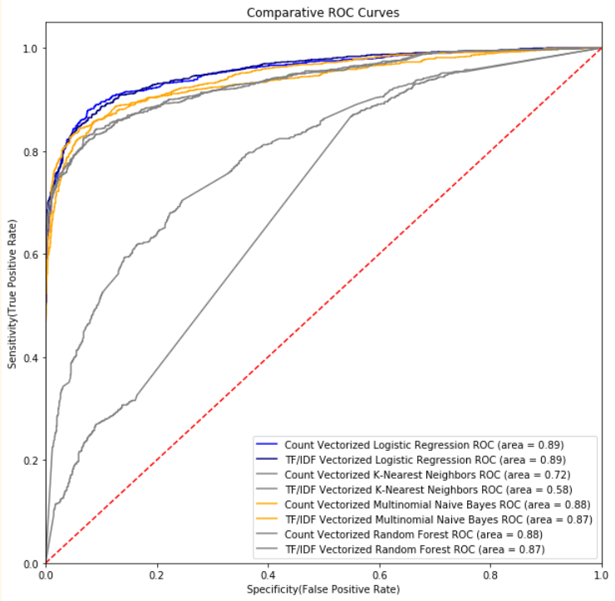
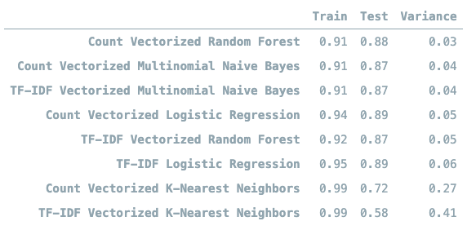
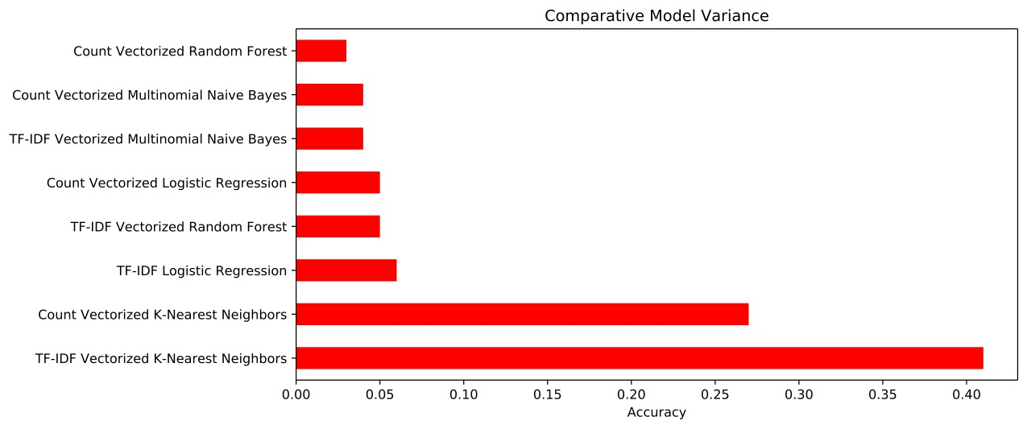
Model Selection
Notes:
If we only look at the variance in accuracy and the area under the ROC curves, we would think the Count Vectorized Random Forest or Logistic Regression would be our production model. When we examine the confusion matrixes however …

Slide 17
The Random Forest has a higher sensitivity and lower specificity while the Multinomial Naïve Bayes has a better balance of False Positives and False Negatives for an overall higher accuracy.
Notes:
Note: while for this version of the model I decided to tune for overall accuracy as there is no particular benefit to preferring sensitivity or specificity, additional research with a goal of predicting which posts will become a ‘best of’ may benefit from choosing a sensitivity or specificity optimization instead.

Slide 18
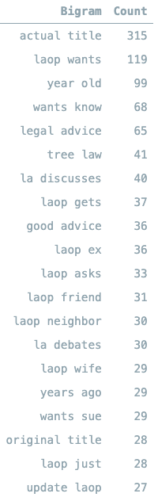
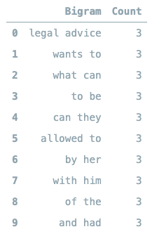
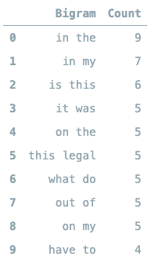
Bigram Comparison- Best of to Misclassifieds

Slide 19
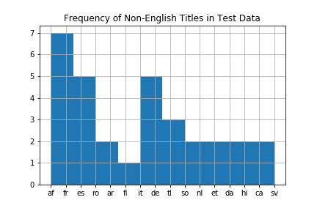
‘Non-English’ Titles in Test Data
Dopehead/hooker neighbor lady
Can your parents "control" your money?
A**hole parks in bike lane
Isro latest
Childcare Reimbursement?
Parents against love
إرهاب صهيونى.. جرافات الاحتلال تقطع جسد شاب فل..
Post study
visa vs student visa in Australia
#swatting
Aggressive neighbor

Slide 20
Conclusions:
Original Problem Statement:
How well can we train a classification model to correctly classify the title of a subreddit post as belonging to the r/legaladvice subreddit or the r/bestoflegaladvice subreddit?
Which classification model type will be the strongest?
The best model we encountered was a Count Vectorizer paired with a Multinomial Naive Bayes model looking at bigrams. As we predicted during EDA, we found that there was significant divergence between the most common bigrams of each subset, however as we looked at the misclassified data, we found that using these bigrams may be a crutch- a large portion of the misclassified titles did not include common tags that are used by the redditors who rename the posts for r/bestoflegaladvice when tagging the post in the 'best of' subreddit.

Slide 21
Recommendations for Future Research
1. gather data from the reddit text instead of the reddit title. Changing the corpus used will allow the model to potentially predict which legal advice posts will become 'best of' and serve as a model that predicts popularity and engagement from content.
2. strip out the crutch of title tags such as 'LAOP' to better tune the model.
3. incorporate a sentiment analysis transformer in the pipeline
4. train and incorporate a language filter to remove titles in a different language or potentially include this step as a transformer and add it as a feature to be examined.

Slide 22
References
Header Word Cloud Courtesy of: https://www.wordclouds.com/
EDA functions used in section 3.2 created by Susan Li: https://towardsdatascience.com/a-complete-exploratory-data-analysis-and-visualization-for-text-data-29fb1b96fb6a
Randall Munroe- Reddit's New Comment Sorting System https://redditblog.com/2009/10/15/reddits-new-comment-sorting-system/
various redditors in r/NoStupidQuestions:https://www.reddit.com/r/NoStupidQuestions/comments/6cmz29/how_does_reddit_determine_the_best_ranking_in_a/
Sentiment Analysis workflow in section 3.1 created by Caroline Schmitt- Sentiment Analysis lessonhttps://git.generalassemb.ly/DSI-12-Echelon/nlp_modeling_and_sentiment_analysis
EDA Susan Li- Exploratory Data Analysis primer for text data: https://towardsdatascience.com/a-complete-exploratory-data-analysis-and-visualization-for-text-data-29fb1b96fb6a
Edward Ma - Named Entity Recognition roundup: https://towardsdatascience.com/named-entity-recognition-3fad3f53c91e

