Slide 1
Part II: ns Internals

Slide 2

Outline
Fundamental concept
  Split object: C++/OTcl linkage
Plumbing
  Wired
  Wireless
Scaling

Slide 3
OTcl and C++: The Duality
Pure C++
objects
Pure OTcl
objects
C++/OTcl split objects
C++
OTcl
ns

Slide 4
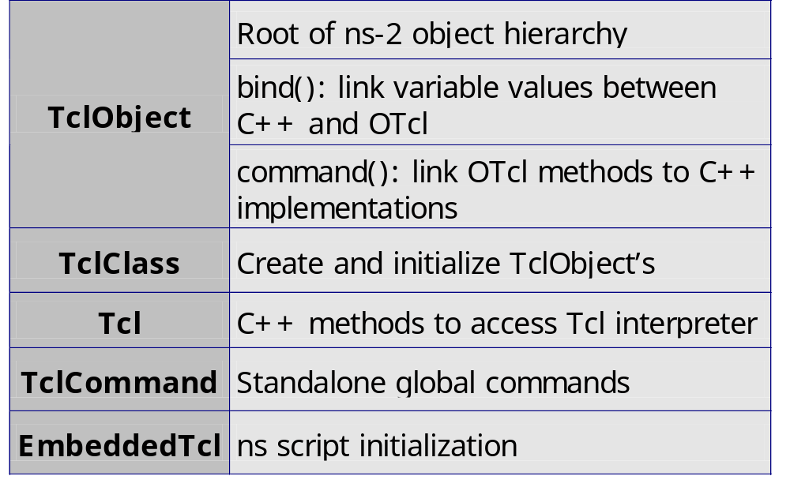
C++/OTcl Linkage

Slide 5
TclObject
Basic hierarchy in ns for split objects
Mirrored in both C++ and OTcl
Example
  set tcp [new Agent/TCP]
  $tcp set packetSize_ 1024
  $tcp advanceby 5000

Slide 6
TclObject: Hierarchy and Shadowing
TclObject
OTcl class
hierarchy
C++ class
hierarchy
TclObject
Agent
Agent
Agent/TCP
TcpAgent
_o123
*tcp
Agent/TCP OTcl
shadow object
Agent/TCP C++
object

Slide 7

TclObject::bind()
Link C++ member variables to OTcl object variables
C++
  TcpAgent::TcpAgent() {
    bind(“window_”, &wnd_);
    … …
  }
  bind_time(), bind_bool(), bind_bw()
OTcl
  set tcp [new Agent/TCP]
  $tcp set window_ 200

Slide 8
Initialization of Bound Variables
Initialization through OTcl class variables
  Agent/TCP set window_ 50
Do all initialization of bound variables in ~ns/lib/ns-default.tcl
  Otherwise a warning will be issued when the shadow object is created

Slide 9
Implementation of Bound Variables
Class InstVar
  One object per bound variable – expensive!
  InstVarInt, InstVarReal, …
Created by TclObject::bind()
  Create instance variable in OTcl stack
  Enable trap read/write to OTcl variable using Tcl_TraceVar()
  Connect to C++ variable in the trap

Slide 10
TclObject::command()
Implement OTcl methods in C++
Trap point: OTcl method cmd{}
Send all arguments after cmd{} call to TclObject::command()

Slide 11
TclObject::command()
OTcl
set tcp [new Agent/TCP]
$tcp advance 10
C++
int TcpAgent::command(int argc,
const char*const* argv) {
  if (argc == 3) {
    if (strcmp(argv[1], “advance”) == 0) {
    int newseq = atoi(argv[2]);
      ……
      return(TCL_OK);
    }
    }
  return (Agent::command(argc, argv);
}

Slide 12
TclObject::command()
OTcl space
$tcp send
no such
procedure
TclObject::unknown{}
$tcp cmd send
C++ space
TcpAgent::command()
Yes
match
“send”?
No
process and return
Invoke parent:
return Agent::command()

Slide 13
TclObject: Creation and Deletion
Global procedures: new{}, delete{}
Example
  set tcp [new Agent/TCP]
  …
  delete $tcp

Slide 14
TclObject: Creation and Deletion
Agent/TCP
constructor
parent
constructor
TclObject
constructor
invoke parent
constructor
invoke parent
constructor
create C++
object
complete
initialization
which C++
object to create?
– TclClass
complete
initialization
create OTcl
shadow object
OTcl
C++
TclObject (C++)
constructor
parent (Agent)
constructor
AgentTCP
constructor
invoke parent
constructor
invoke parent
constructor
do nothing,
return
bind variables
and return
bind variables
and return

Slide 15
TclClass
mirroring
OTcl
C++
Static class TcpClass : public TclClass {
public:
  TcpClass() : TclClass(“Agent/TCP”) {}
  TclObject* create(int, const char*const*) {
    return (new TcpAgent());
  }
} class_tcp;
TclObject
TclObject
NsObject
??
Agent
Agent
TcpAgent
Agent/TCP

Slide 16
TclClass: Mechanism
Initialization at runtime startup
TcpClass::bind()
TclClass::init()
for each statically
defined TclClass
e.g.
SplitObject::register{}
Create and register
OTcl class Agent/TCP
Agent/TCP::create-shadow{}
→TclClass::create_shadow()

Slide 17
Class Tcl
Singleton class with a handle to Tcl interpreter
Usage
  Invoke OTcl procedure
  Obtain OTcl evaluation results
  Pass a result string to OTcl
  Return success/failure code to OTcl

Slide 18
Class Tcl
Tcl& tcl = Tcl::instance();
if (argc == 2) {
  if (strcmp(argv[1], “now”) == 0) {
    tcl.resultf(“%g”, clock());
    return TCL_OK;
  }
  tcl.error(“command not found”);
  return TCL_ERROR;
  } else if (argc == 3) {
  tcl.eval(argv[2]);
  clock_ = atof(tcl.result());
  return TCL_OK;
}

Slide 19
Class TclCommand
C++ implementation of global OTcl commands
class RandomCommand : public TclCommand {
public:
RandomCommand() : TclCommand("ns-random") {}
virtual int command(int argc, const char*const* argv);
};
int RandomCommand::command(int argc, const char*const* argv)
{
Tcl& tcl = Tcl::instance();
if (argc == 1) {
sprintf(tcl.buffer(), "%u", Random::random());
tcl.result(tcl.buffer());
}

Slide 20
EmbeddedTcl
Pre-load OTcl scripts at ns runtime startup
  Recursively load ~ns/tcl/lib/ns-lib.tcl:
  source ns-autoconf.tcl
  source ns-address.tcl
  source ns-node.tcl
  .......
  Load everything into a single C++ string
  Execute this string at runtime startup
Tcl::init(): load ~tclcl/tcl-object.tcl
Tcl_AppInit(): load ~ns/tcl/lib/ns-lib.tcl

Slide 21
EmbeddedTcl
How it works
  tcl2c++: provided by TclCL, converts tcl scripts into a C++ static character array
  Makefile.in:
  tclsh8.0 bin/tcl-expand.tcl tcl/lib/ns-lib.tcl | tcl2c++ et_ns_lib > gen/ns_tcl.cc

Slide 22
Summary
TclObject
  Unified interpreted (OTcl) and compiled (C++) class hierarchies
  Seamless access (procedure call and variable access) between OTcl and C++
TclClass
  The mechanism that makes TclObject work
Tcl: primitives to access Tcl interpreter

Slide 23
Outline
Fundamental concept
  Split object
Plumbing
  Wired world
  Wireless world
Scaling

Slide 24
ns Internals
Discrete event scheduler
Network topology
Routing
Transport
Packet flow
Packet format
Application

Slide 25
Discrete Event Scheduler
time_, uid_, next_, handler_
head_ ->
head_ ->
handler_ -> handle()
reschedule
insert
time_, uid_, next_, handler_
Three types of schedulers
  List: simple linked list, order-preserving, O(N)
  Heap: O(logN)
  Calendar: hash-based, fastest, O(1)

Slide 26
Network Topology: Node
n0
n1
Port Classifier
Unicast Node
Multicast Node
dmux_
Addr Classifier
classifier_
Node entry
Node entry
dmux_
entry_
entry_
Multicast Classifier
classifier_
multiclassifier_

Slide 27
Network Topology: Link
n0
n1
duplex link
n1 entry_
head_
enqT_
queue_
deqT_
link_
ttl_
tracing
drophead_
drpT_
simplex link

Slide 28
Routing
n0
n1
Port Classifier
Addr Classifier
Node entry
0
n1 entry_
dmux_
head_
entry_
1
enqT_
queue_
deqT_
link_
ttl_
classifier_
drophead_
drpT_

Slide 29
Routing (con’t)
n0
n1
Port Classifier
Port Classifier
Addr Classifier
Addr Classifier
0
1
dmux_
Link n0-n1
dmux_
entry_
1
entry_
0
classifier_
classifier_
Link n1-n0

Slide 30
Transport
n0
n1
Port Classifier
Port Classifier
dst_=1.0
dst_=0.0
Addr Classifier
0
Agent/TCP
Addr Classifier
0
Agent/TCPSink
agents_
agents_
0
1
dmux_
Link n0-n1
dmux_
entry_
1
entry_
0
classifier_
classifier_
Link n1-n0

Slide 31
Application: Traffic Generator
n0
n1
Port Classifier
Application/FTP
Port Classifier
dst_=1.0
dst_=0.0
Addr Classifier
0
Agent/TCP
Addr Classifier
0
Agent/TCPSink
agents_
agents_
0
1
dmux_
Link n0-n1
dmux_
entry_
1
entry_
0
classifier_
classifier_
Link n1-n0

Slide 32
Plumbing: Packet Flow
n0
n1
Port Classifier
Application/FTP
Port Classifier
dst_=1.0
dst_=0.0
Addr Classifier
0
Agent/TCP
Addr Classifier
0
Agent/TCPSink
0
1
Link n0-n1
entry_
1
entry_
0
Link n1-n0

Slide 33
Packet Format
ts_
cmn header
header
ptype_
ip header
data
uid_
tcp header
size_
rtp header
iface_
trace header
...

Slide 34
Outline
Fundamental concept
  Split object
Plumbing
  Wired world
  Wireless world
ns scaling

Slide 35
Abstract the Real World
Packet headers
Mobile node
Wireless channel
Forwarding and routing
Visualization

Slide 36
Wireless Packet Format
ts_
cmn header
header
ptype_
IP header
data
uid_
......
LL
size_
MAC 802_11
iface_
wireless
headers
ARP
......

Slide 37
Mobile Node Abstraction
Location
  Coordinates (x,y,z)
Movement
  Speed, direction, starting/ending location, time ...

Slide 38
Portrait of A Mobile Node
port
classifier
Node
protocol
agent
Classifier: Forwarding
255
Agent: Protocol Entity
addr
classifier
routing
agent
defaulttarget_
Node Entry
LL
ARP
LL
LL
LL: Link layer object
IFQ
IFQ: Interface queue
IFQ
MAC
MAC
MAC: Mac object
Propagation and antenna models
PHY
PHY
PHY: Net interface
MobileNode
CHANNEL
Notes:
droped: LL (1 packet only, drop due to arp), IFQ
MAC: collision detection
PHY: Carier Sense threshold, Receive Threshold. Packets above CSThresh are able to cause a collision.
IFQ: can be any queue, droptail or priority, etc.

Slide 39
Mobile Node: Components
Link Layer
  Same as LAN, but with a separate ARP module
Interface queue
  Give priority to routing protocol packets
Mac Layer
  IEEE 802.11
  RTS/CTS/DATA/ACK for all unicast packets
  DATA for all broadcast packets

Slide 40
Mobile Node: Components
Network interface (PHY)
  Parameters based on Direct Sequence Spread Spectrum (WaveLan)
  Interface with: antenna and propagation models
  Update energy: transmission and reception
Radio Propagation Model
  Friss-space attenuation(1/r²) at near distance
  Two-ray Ground (1/r⁴) at far distance
Antenna
  Omni-directional, unity-gain

Slide 41
Wireless Channel
Duplicate packets to all mobile nodes attached to the channel except the sender
It is the receiver’s responsibility to decide if it will accept the packet
  Collision is handled at individual receiver
  O(N²) messages → grid keeper

Slide 42
Grid-keeper: An Optimization

Slide 43
Outline
Fundamental concept
  Split object
Plumbing
  Wired world
  Wireless world
ns scaling

Slide 44
ns Scaling
Limitations to simulation size
  Memory
  Run time
Solutions
  Abstraction
  Fine-tuning (next session)

Slide 45
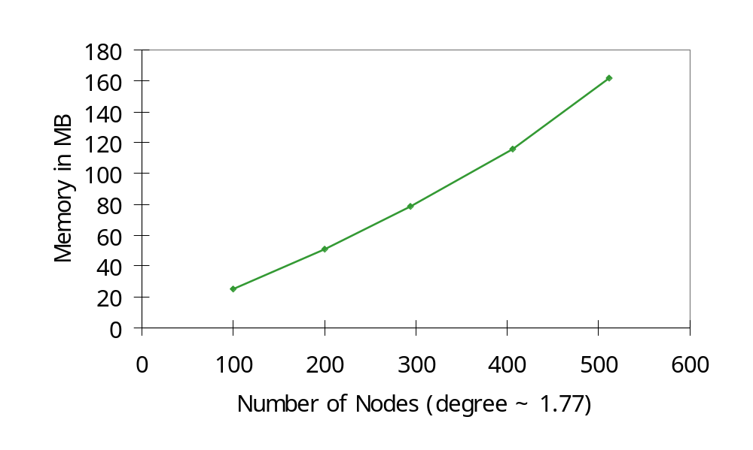
Memory Footprint of ns
430
128MB
Dense Mode
Notes:
- say it’s GT-ITM transit-stub network,

Slide 46
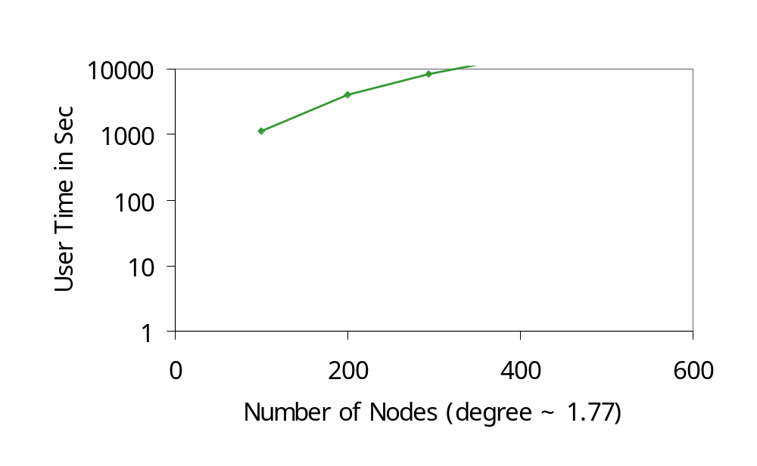
Run Time of ns
Dense Mode

Slide 47
Culprit: Details, Details
Dense mode tries to capture packet-level behavior
  Prunes, Joins, …
Let’s abstract it out
  Centralized multicast
  SessionSim

Slide 48
Centralized Multicast
Dense Mode Multicast
s
n1
n2
s
Route
Computation
Unit
n3
n4
n5
n1
n2
source
n3
n4
n5
receiver
data
Centralized Multicast
prune

Slide 49
Centralized Multicast
Usage
$ns mrtproto CtrMcast
Limitation
  No exact dynamic behavior, e.g., routing convergence time
  Does not mean to replace DM

Slide 50
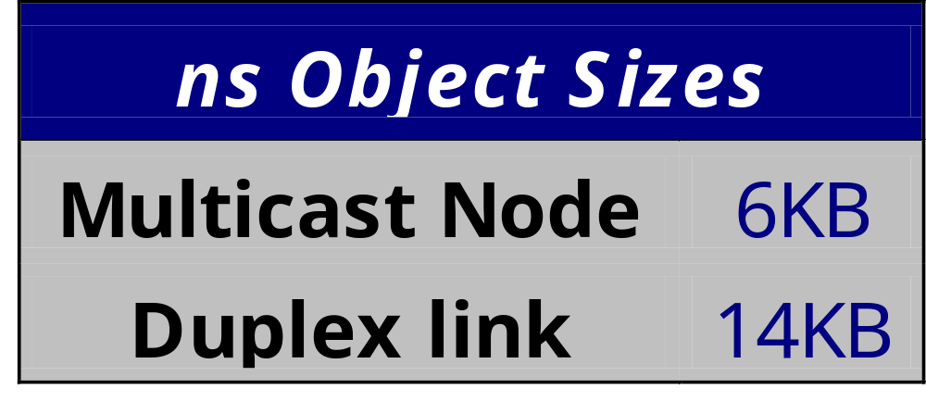
Further Abstraction
Remove all intermediate nodes and links
Do not model:
  Detailed queueing
  Detailed packet delivery

Slide 51
SessionSim
Detailed Packet Distribution
s
s
n1
n2
Session Helper:
Replication
Delay
TTL
n3
n4
n5
n4
n2
source
receiver
Session Multicast
data
Notes:
even more abstraction
replace link structure

Slide 52
SessionSim
Usage
  set ns [new SessionSim]
  instead of
  set ns [new Simulator]
Limitation
  Distorted end-to-end delay
  Packet loss due to congestion

Slide 53
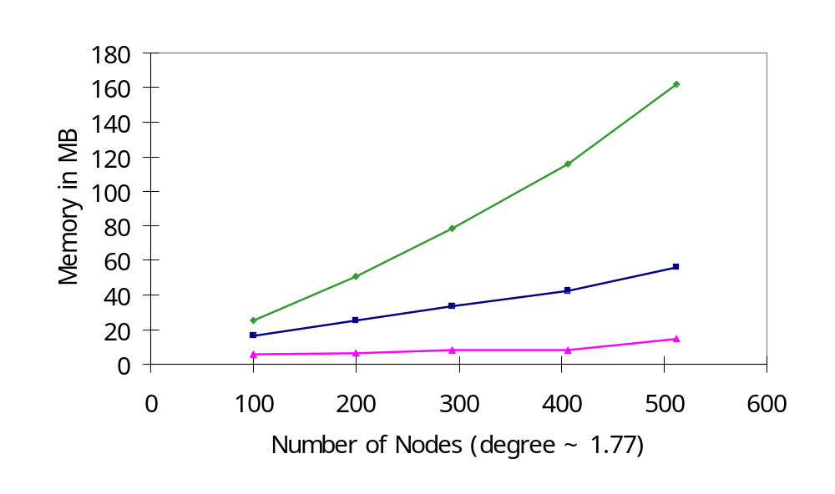
Memory Footprint of ns
Dense Mode
Centralized Multicast
SessionSim

Slide 54
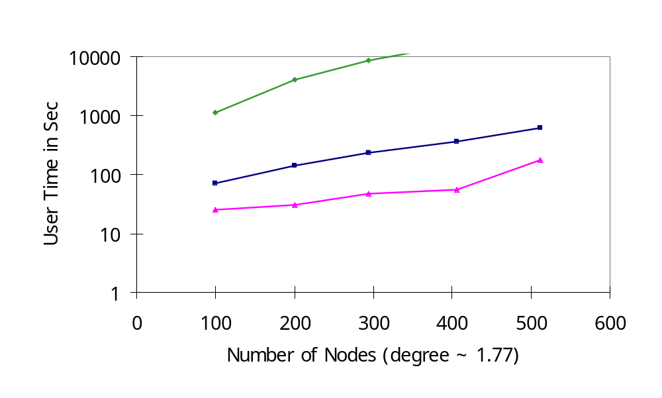
Run Time of ns
Dense Mode
Centralized
Multicast
SessionSim

Slide 55
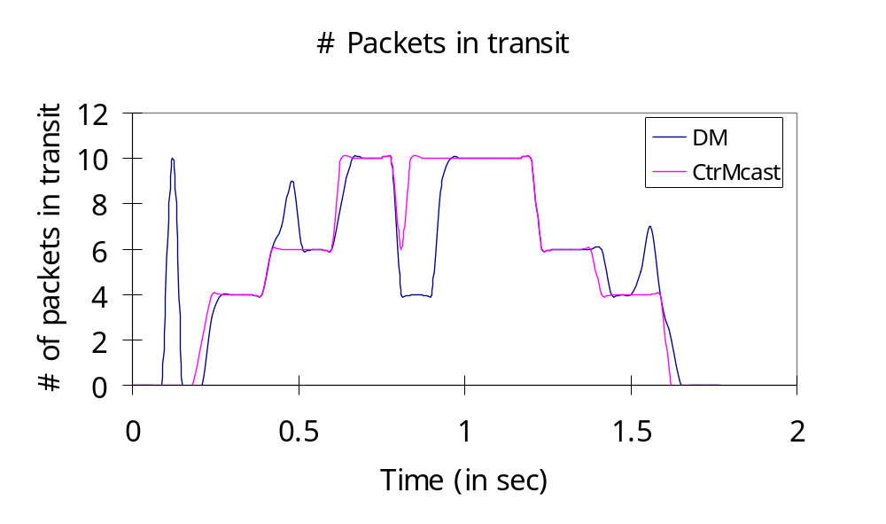
Distortion of Centralized Multicast

Slide 56
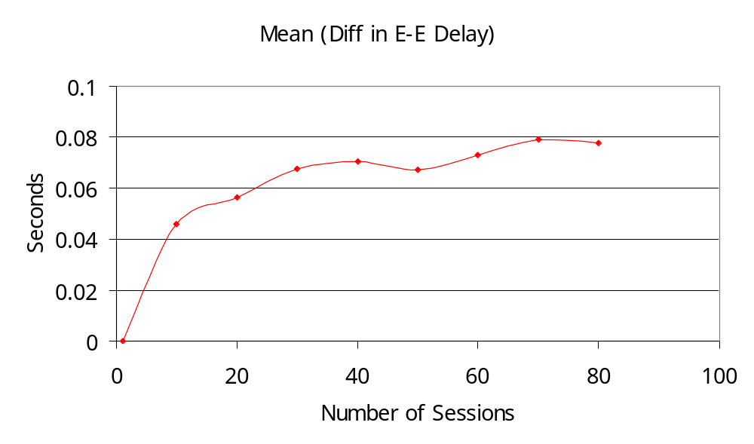
Distortion of SessionSim

Slide 57
Footnotes
My sim still uses too much memory?
Or
I want large detailed simulation, e.g., Web traffic pattern?
Fine-tune your simulator
  We’ll cover it this afternoon

