Slide 1
Work Report
Complexity analysis of the
Parallel Strassen Algorithm
Carlos Eduardo Benevides Bezerra
CMP256
Prof.: Docteur Nicolas Bruno Maillard

Slide 2
The problem
Classic algorithm for matrix multiplication:
  O(n³)
Volker Strassen published, in 1969, a recursive O(n^{2.807}) matrix multiplication algorithm
There is also another algorithm (Coppersmith–Winograd) which has O(n^{2.376}) complexity, but hides huge constants

Slide 3
Strassen’s trick
Matrix multiplication can be expressed as a recursive function
In this recursion, Strassen found redundancies
He proposed a new recursion, with one less multiplication

Slide 4


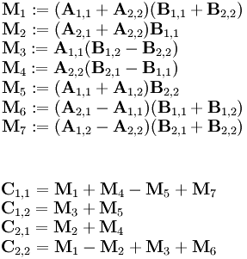


Less multiplications
Classic method
Strassen’s method
Much less additions, but each node of its recursion has 1 more child... With large matrices, it has many more operations.

Slide 5
Sequential complexity
T(N) = 7*T(n/2) + 18*(N/2)²
  By the Master Theorem:
    a = 7, b = 2, f(N) = N²*18/4
    1st case: ε = 0,8 → f(N) = O(N^{2,8 - 0,8}) = O(N²)
    T(n) = O(n^{2,8})
      We already know that...
  But, with software (R), we can approximate a non-recursive continuous function:
    T(N) =
    -11474.768 + 920.894*N - 17.314*N² + 4.851*N^{2,8}

Slide 6
Parallel Implementation (MPI-C)‏
The 0th process receives the matrix and goes deeper one level in the recursion
At the second level, 6 other processes are encharged of the 6 first branches
  They receive the sub-matrices
    Each starts its own recursion, at step 1
  Process 0 starts a new recursion, at step 1 with his new branch (7th branch of 2nd level)
  Process 0 receives the answers from the other six processes
If the matrices’ rank is equal to 2, multiply them (8 operations) and return the result

Slide 7
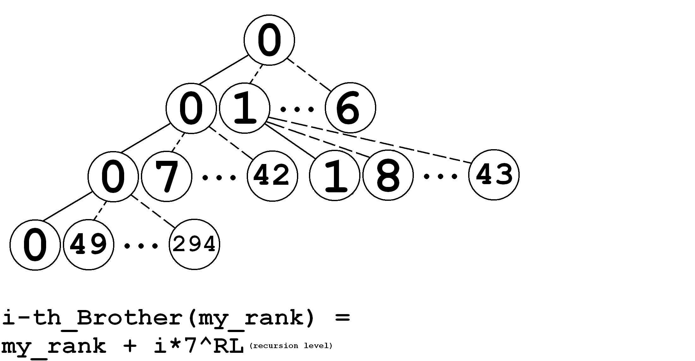
Parallel recursion example – unlimited P

Slide 8
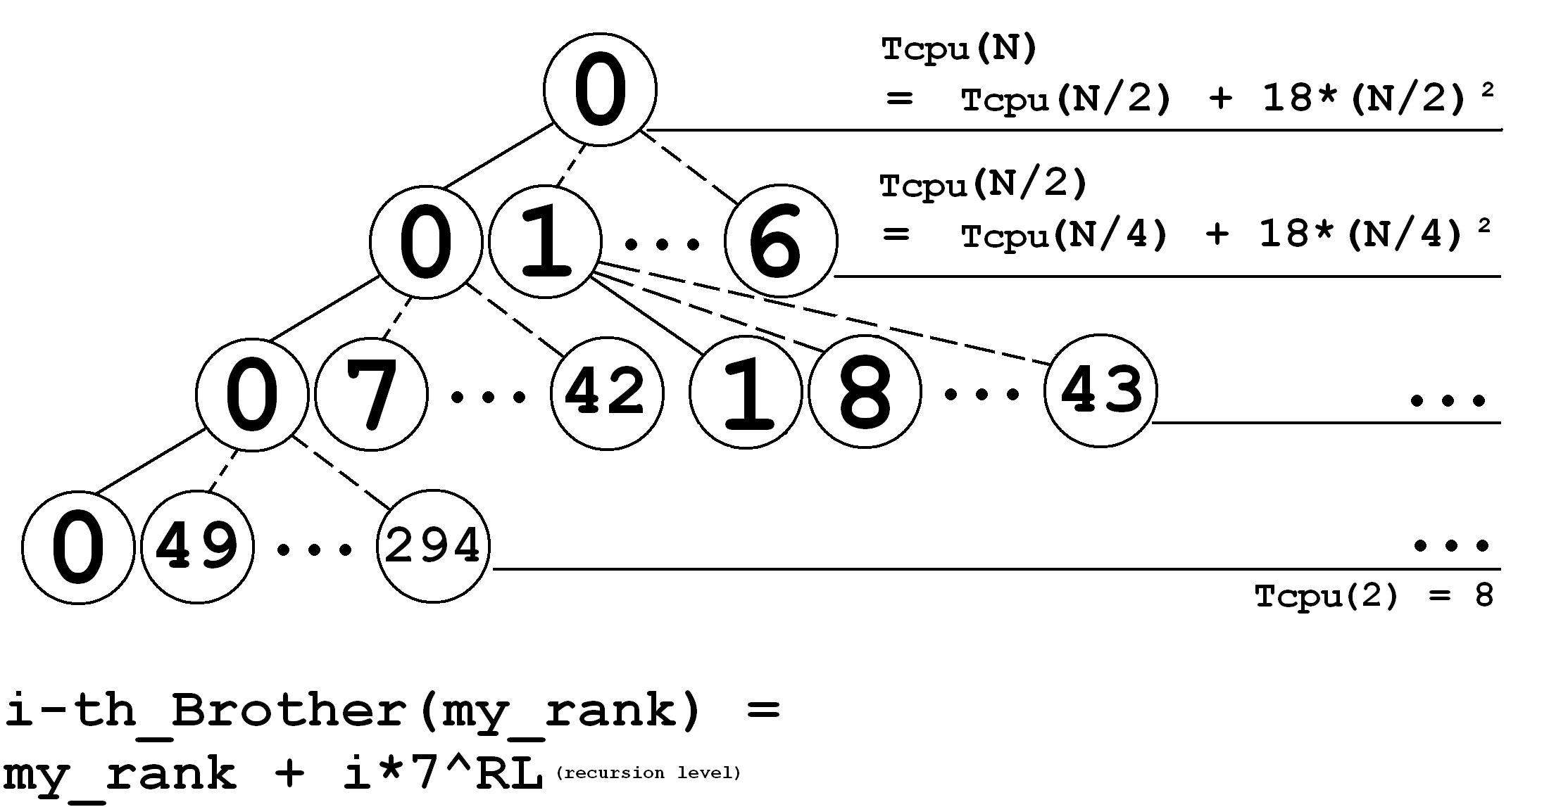
Parallel recursion example – unlimited P

Slide 9
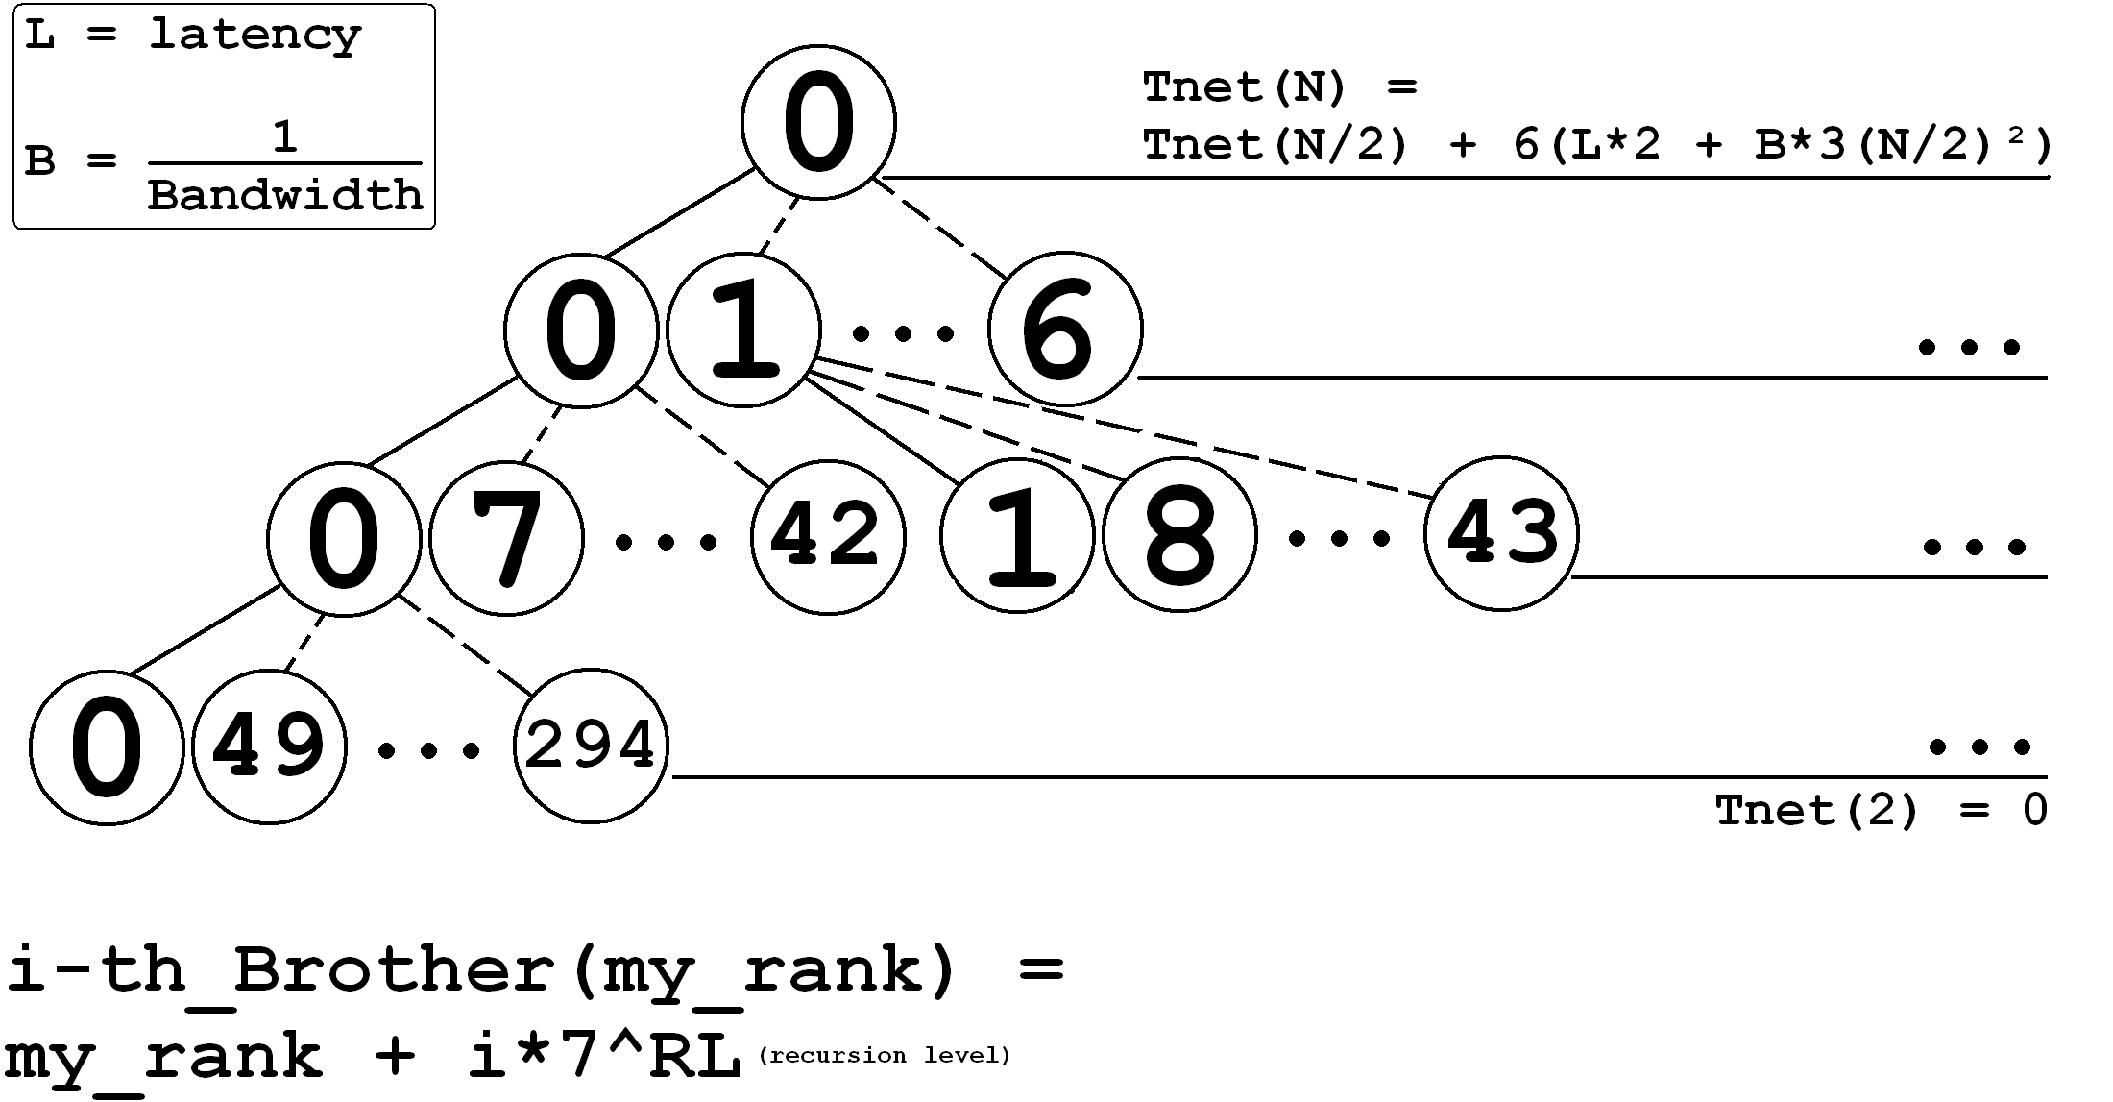
Parallel recursion example – unlimited P

Slide 10
Total complexity – unlimited P
Tp is a constant, to be measured
Total(N) = Tcpu(N)*Tp + Tnet(N)‏
Tcpu(N) = Tcpu(N/2) + 18*(N/2)²
  By the Master Theorem:
    a = 1, b = 2, f(N) = N²*9/2
    3rd case: ε = 2 and c = 0,25
    Tcpu(N) = Θ(N²)
Tnet(N) = Tnet(N/2) + 12*L + 18*B*N²/4
  By the Master Theorem:
    a = 1, b = 2, f(N) = 12*L + 18*B*N²/4
    3rd case: ε = 2 and c = 0,25 (OK for sufficiently large N)‏
    Tnet(N) = Θ(N²)
Total(N) = Θ(N²)

Slide 11
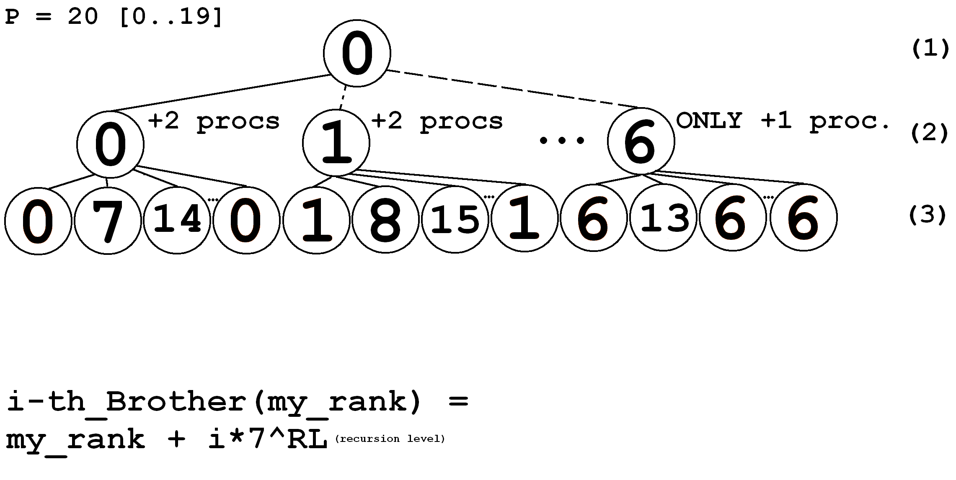
Recursion – Limited P = 20

Slide 12
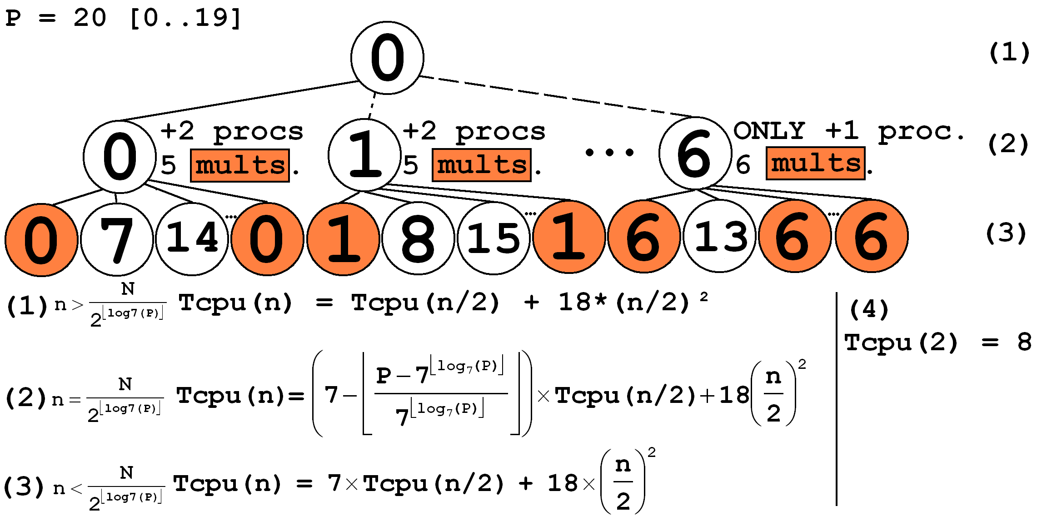
Recursion – Limited P = 20 – Processing

Slide 13
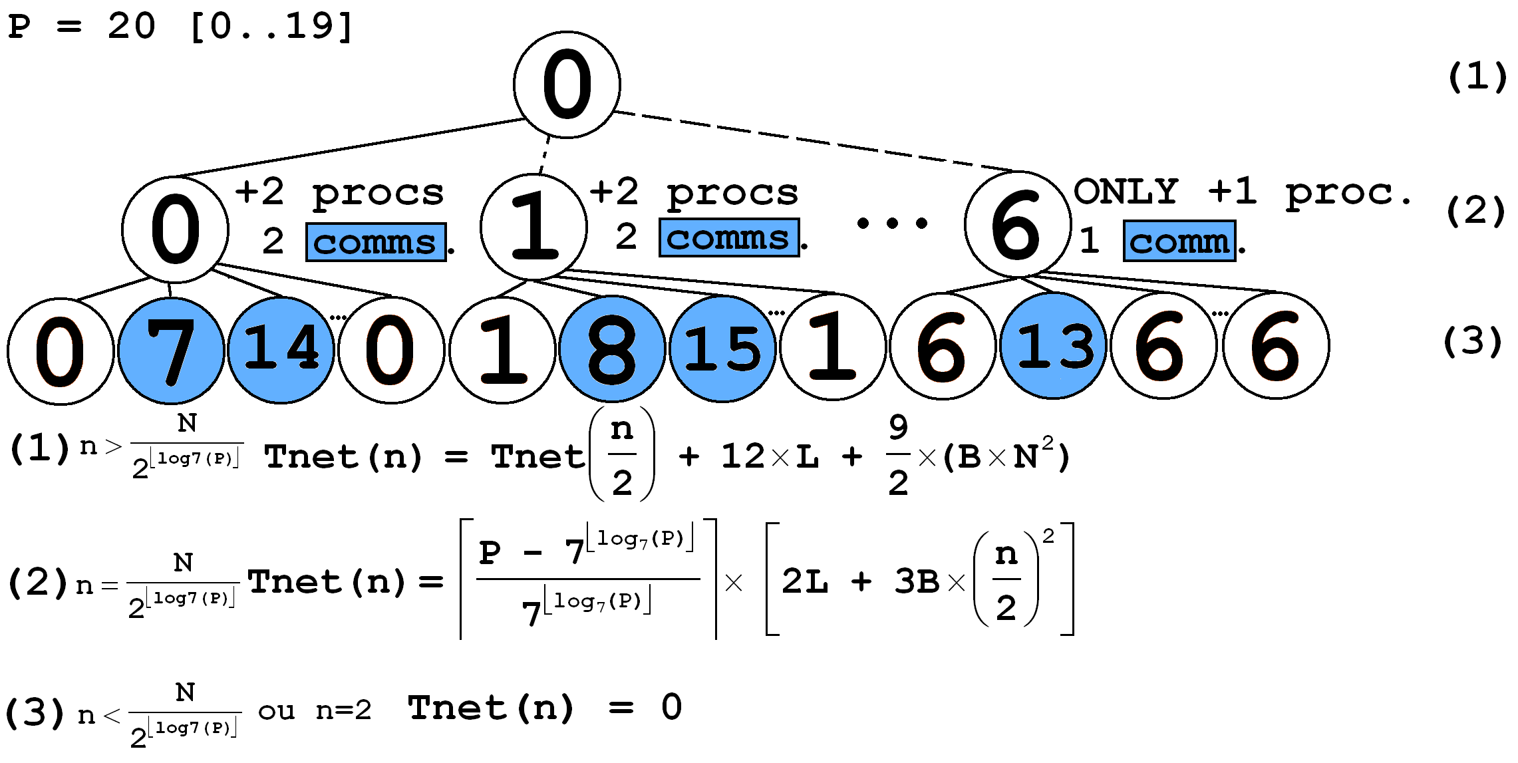
Recursion – Limited P = 20 – Communicating

Slide 14
Non-recursive approximated function
It has been found, through benchmarks in the Corisco cluster, the parameters Tp, L and B:
  Tp ≈ 0,193891
  L ≈ 755,6127 μsec
  B ≈ 0,1815 μsec
It was also necessary (to draw a continuous curve on the graphic) to transform all the recursive functions found into approximate non-recursive continuous approximate equivalents
  Selected a set of N (N₁, N₂, ...)values
  Obtained the T(N₁), T(N₂) ... with the recursive functions
  Gave the set of values and T(values) to R, which fit them to an approximate function:
    Fapproximate ← lm (Time ~ N + I(N^2) + I(N^2.8))‏

Slide 15
Non-recursive approximated function
R was used to approximate Total(n) = Tcpu(n)*Tp + Tnet(n). The function depends on P:
  P = 1:
    T₁(n) ≈ -2224,8542 + 178,5531*n – 3,3571*n² + 0,9406*n^{2.8}
  P = 7:
    T₇(n) ≈ 6568,8634 + 53,2971*n + 1.0074*n² + 0,1346*n^{2.8}
  P = 13:
    T₁₃(n) ≈ 7363,1484 + 62,2530*n + 1,0166*n² + 0,1346*n^{2.8}
  P = 19:
    T₁₉(n) ≈ 202,7343 + 67,5663*n + 1,1432*n² + 0,1155*n^{2.8}
  P = 25:
    T₂₅(n) ≈ 9042 + 72,88*n + 1,270*n² + 0,09638*n^{2.8}

Slide 16
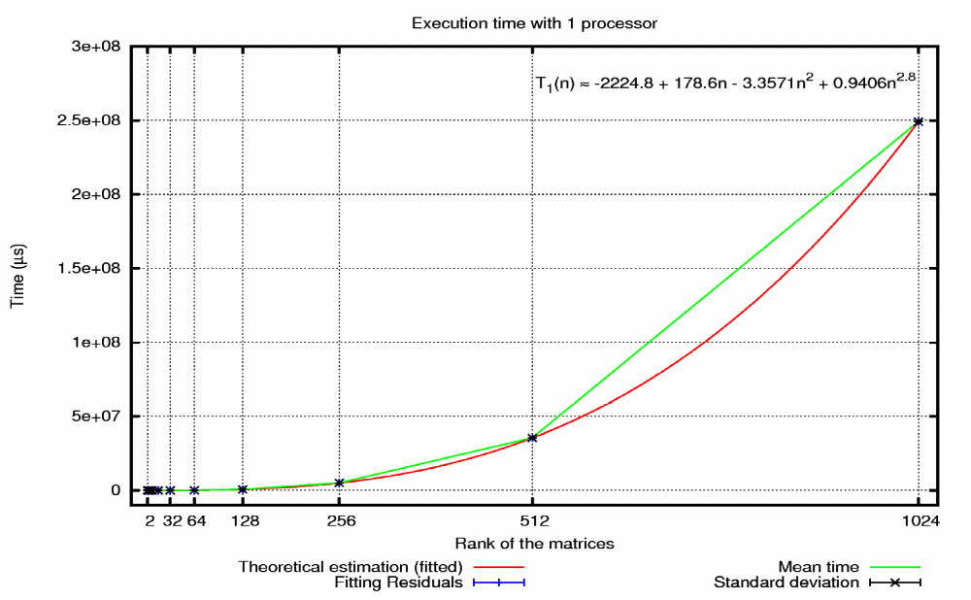
Comparison theory-reality

Slide 17

Comparison theory-reality

Slide 18

Comparison theory-reality

Slide 19
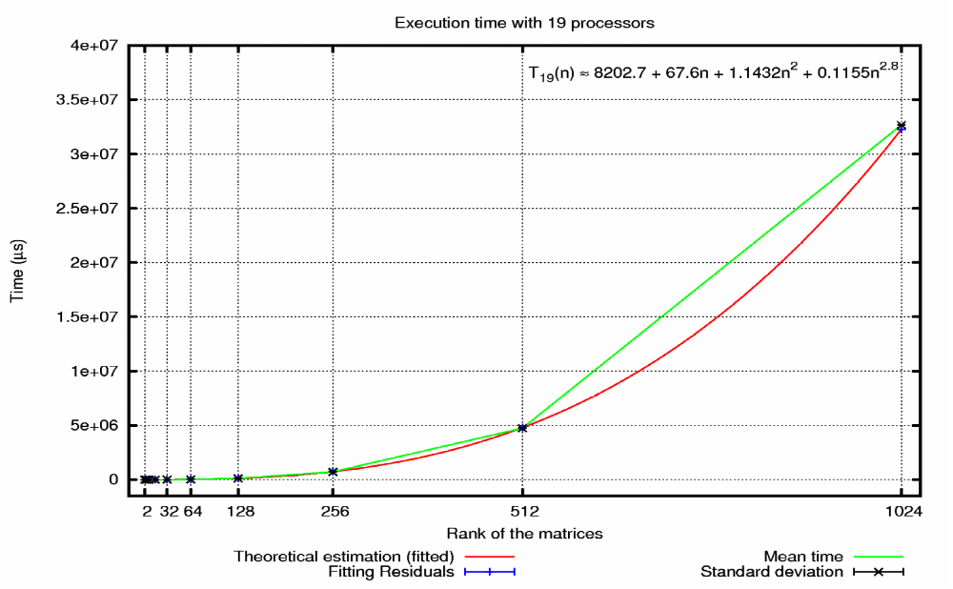
Comparison theory-reality

Slide 20

Comparison theory-reality

Slide 21
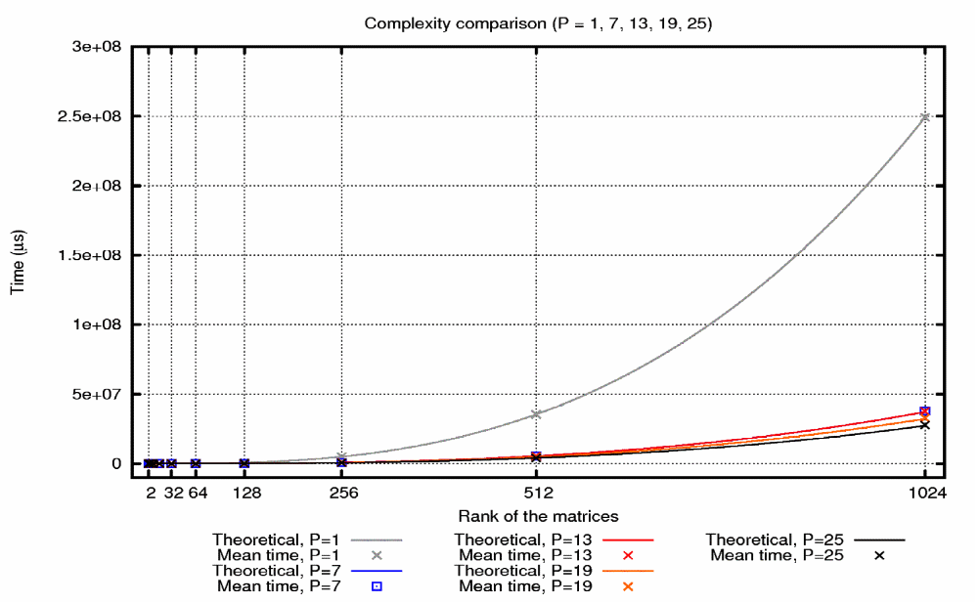
Time vs Processors

Slide 22
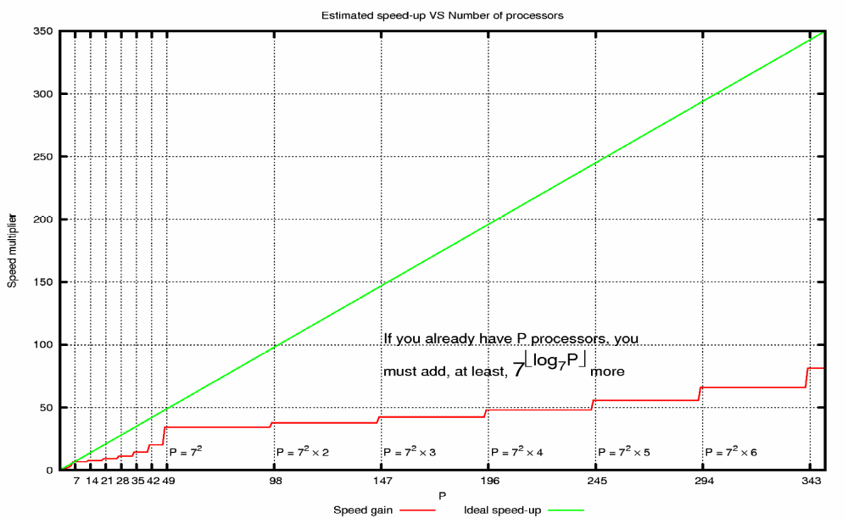
Speed vs Processors

Slide 23
Conclusions
As the input increases, so increases the algorithm’s predictability
Complex recursive functions can be transformed into non-recursive ones with software (i.e. R is really useful)
It's only worthy to give more processors to the algorithm if the final P is equal to k*7└^{log7P}┘, k is an integer.
There must be a smarter way to parallelize Strassen’s algorithm :o)

