Slide 1
A³: a novel interest management algorithm for distributed simulations of MMOGs
Carlos Eduardo Benevides Bezerra
Orientador: Prof. Dr. Cláudio F. R. Geyer
12-th Symposium on Distributed Simulation and Real Time Applications
Vancouver, BC, Oct. 27th 2008

Slide 2
Outline
MMOG Context
  Terminology
Interest management
  Related work on interest management
Graded area of interest
The A³ algorithm
Simulation and results
Acknowledgments

Slide 3
Context:
MMOGs
Massively Multiplayer Online Games

Slide 4
Context: Massively Multiplayer Online Games
Definitions
  Interactive and distributed virtual environment
    Virtual environment: “world” of the game
    Interactive: game progress depends on the actions of the players (clients)
    Distributed: it is replicated and processed in different places (server and players’ machines)
  Entity: any object in the virtual environment which has position, direction and speed attributes
  Avatar: entity that represents the player in the game world
  State: set of properties that can be observed in the game entities. The overall state of the game world is composed of the individual states of all the entities present in it
  Region: VE’s partition under the responsibility of a single server; players in the same region have their interaction benefited
  Border: line dividing the areas occupied by different regions

Slide 5
Context: Massively Multiplayer Online Games
Interaction between players
  There is a replica of the game environment in each player’s machine
  Each client keeps an up-to-date copy of the game state
  The interaction is performed by the player sending his actions to the server and receiving state updates for the entities in the game, including other players’ avatars
Massively Multiplayer
  In this kind of game, there may be tens of thousands of simultaneous players, who can interact with one another

Slide 6
Interest management:
Efficient use of network bandwidth

Slide 7
Interest management
The purpose of interest management is to reduce the amount of bandwidth used by a game application, by filtering what is relevant to a player to receive, and what is not.
With a more efficient use of the bandwidth, an application may become more scalable, allowing more players to join a game, for example.

Slide 8
Interest management: related work
A taxonomy (Morse 1996) has been proposed in order to classify different interest management techniques, according to some characteristics:
  Communication model
    unicast
    broadcast
    multicast
  Filtering focus
    intrinsic (application data)
    extrinsic (e.g. multicast group)
  Domain of responsibility
    static
    dynamic

Slide 9
Interest management: related work
Multicast is not widely supported on the Internet (El-Sayed 2004)
  (citar 15,22,)
  Interest management with this model would probably require some application level multicast
Intrinsic filtering and dynamic domain
  By increasing the CPU load, a more accurate and effective interest management may be achieved

Slide 10
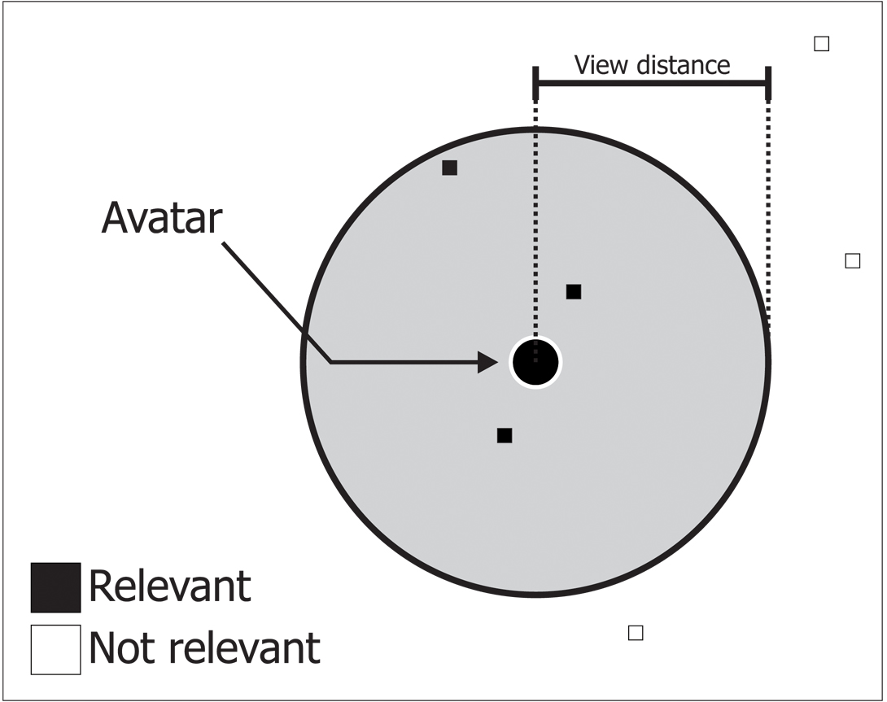
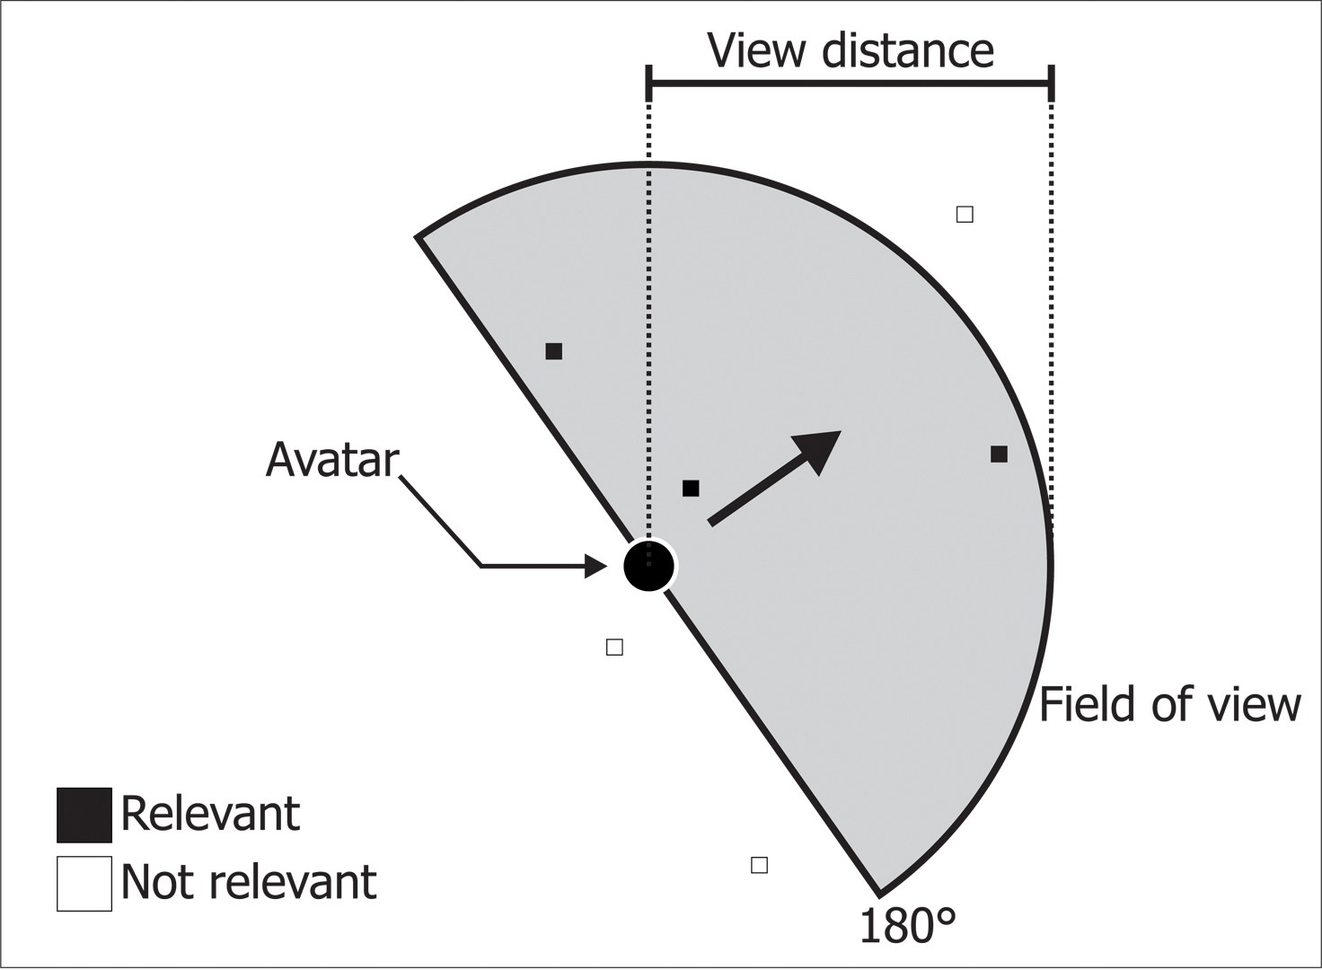
Interest management: related work
Circular area of interest
Field of view based area of interest
(about 50% of the bw of the circle)
Both with intrinsic filtering and dynamic domain of responsibility
But most interest management schemes consider only either one of two cases: relevant or not relevant

Slide 11
Graded area of interest:
Different update frequencies

Slide 12
Graded area of interest
There may be different levels of relevance
Usually, the farther an entity is from the player’s avatar, the less relevant it is
To make use of this characteristic, we may use different update frequencies. For instance:
  The farther the entity is, the less frequent is the update
  The closer it is, the more frequent its updates should be

Slide 13
Graded area of interest
For that, we can define some terms:
  Relevance: a real value ranging from 0 to 1
  Update frequency: number of updates received for an entity, divided by time
  Normal update interval: shortest possible interval between consecutive updates; it is used when relevance value equals to 1
  View distance: maximum distance from the avatar that an entity may be so that the player can see it
  Critical distance: distance, from the player’s avatar, within which any entity must be updated to that player with normal update interval

Slide 14
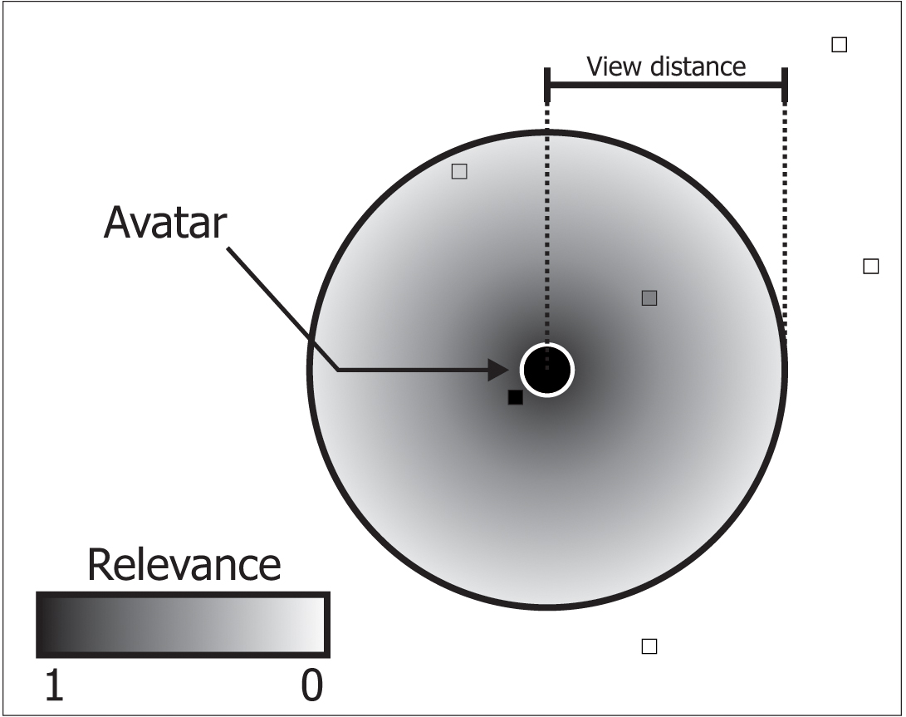
Graded area of interest
Now there are infinite grades of relevance
The farther is an entity from the avatar, the less frequent are its updates sent to the player controlling this avatar

Slide 15
The A³ Algorithm
view Angle
close Area
update frequency Attenuation

Slide 16
A³ - characteristics
It uses the direction vector to get the field of view information
  The player does not need to perceive what is behind his avatar perfectly
However, it is good to keep an area around the avatar as up-to-date as possible
  The player can rotate his character too fast and look behind before his new field of view brings the state updates
The area around the player is called Close Area
  The radius of the Close Area is called Critical Distance
The frequency attenuation is applied only on his field of view, in front of him, beyond the close area

Slide 17
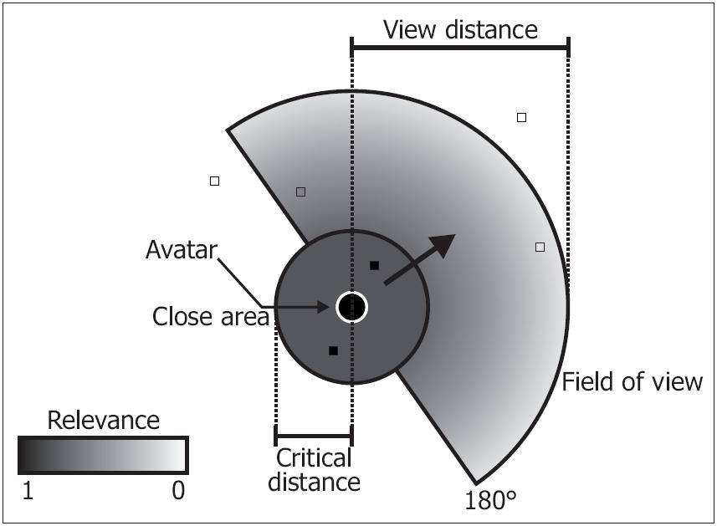
A³ - area of interest

Slide 18
A³ - parameters
The following parameters have to be given to the algorithm, for they depend on the specific application (game):
Normal update interval (I_{N})
View distance (V)
Critical distance (C)
Coordinates of the Avatar (A)
and the entity whose relevance is being evaluated (E)

Slide 19
A³ - return
Relevance (R)
  Real value x, x ∈ [0, 1]. It represents how relevant is the entity E for the avatar A.
Interval until next update: I_{P} = I_{N} / R
Example:
  I_{N} = 200 ms
  Found R = 0,8
  I_{P} = 200 / 0,8 = 250 ms

Slide 20
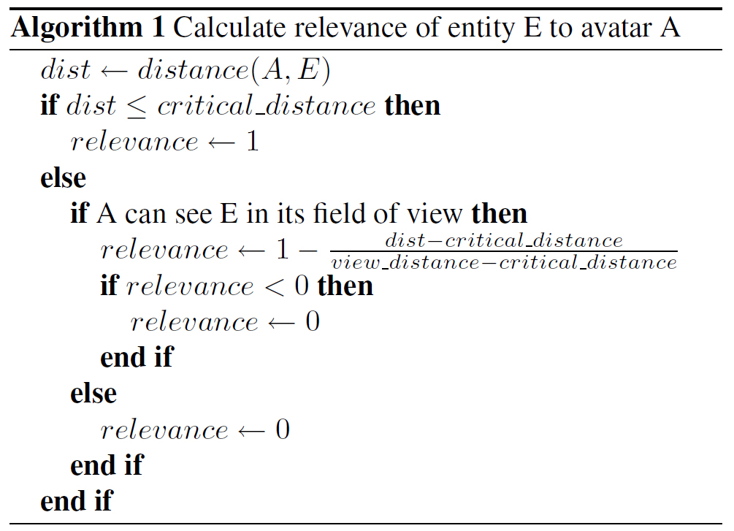
A³ - algorithm

Slide 21
Simulation and results

Slide 22
Simulation
First, a simulated virtual environment was created, imitating the behaviour of human players
  A simple bi-dimensional world was simulated, with entities whose only attributes were position and direction
  One of these entities was an avatar, whose download bandwidth usage (server’s upload) was monitored
  The bandwidth usage depended on the IM scheme employed

Slide 23
Simulation
The client (for that avatar) and the server were simulated over ns-2 (cite)
Ns-2 simulated the send and receive operations, being able to measure bandwidth usage
Four different interest management algorithms were simulated
  Circular area of interest
  Field of view
  Circular area with graded relevance
  A³ algorithm
Besides, it was also simulate a case where no IM scheme at all was used, for comparison

Slide 24
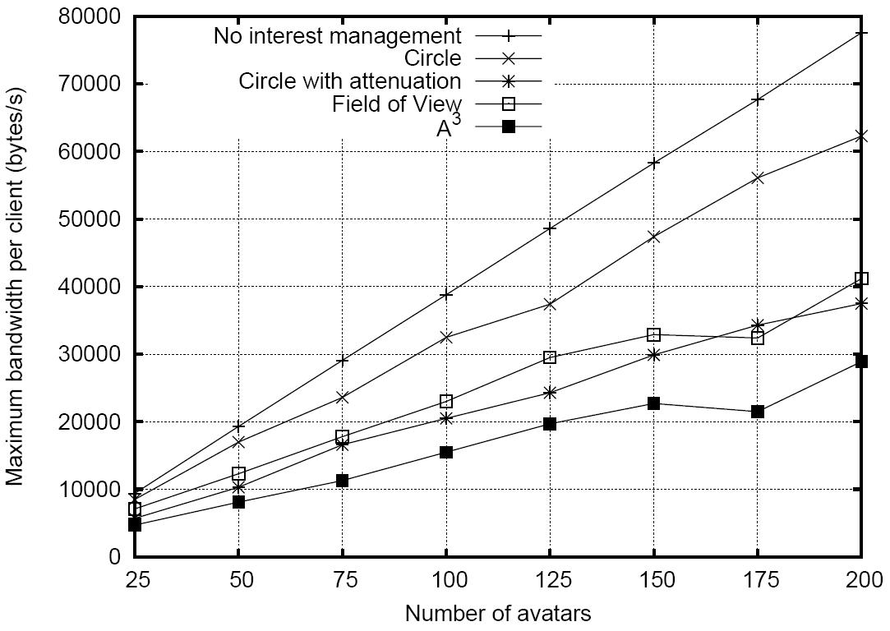
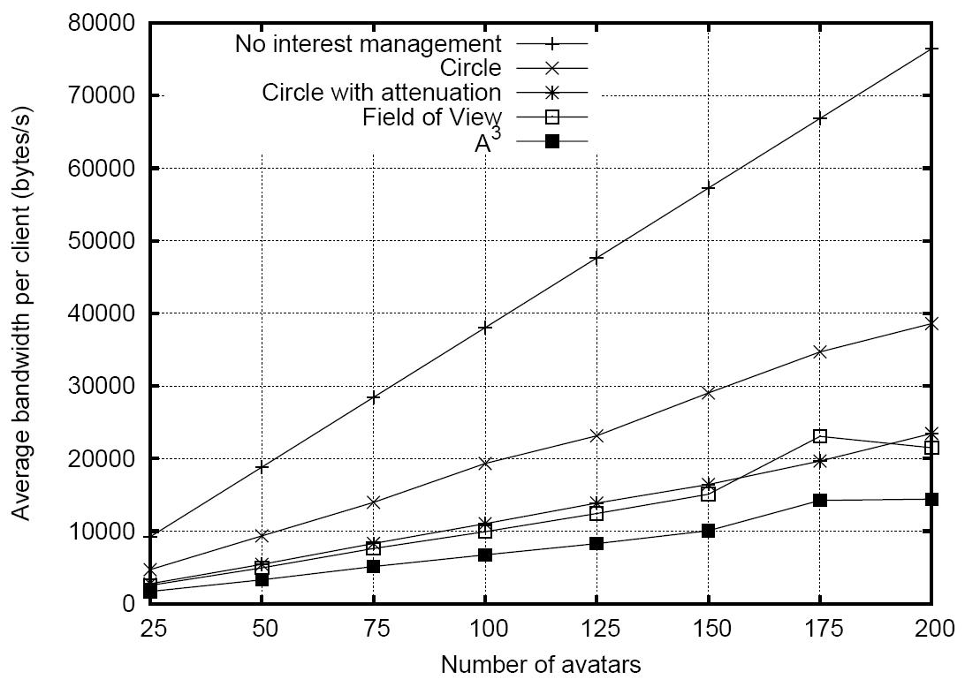
Results
It was assumed that the transmission rate from client to server is constant, and also is not affected by interest management.

Slide 25
Final remarks

Slide 26
Final remarks
Existing IM schemes may be improved by using different levels of relevance
Peer-to-peer MMOG models can use IM, but this would require additional attention:
  Each peer decides (or is told by some other entity) to whom it should send state updates
  A malicious player might hack his client to avoid sending updates to certain other players

Slide 27
Em andamento
Entrada e saída de nodos servidores
  Particiona-se o ambiente virtual recursivamente à medida em que entram nodos
  Quando um servidor sai, delega a sua região a um vizinho
Topologia da rede overlay baseada na topologia real (Ratsanamy et al., 2002)
Difusão dos estados dos jogadores
  Feita de maneira probabilística, baseado em difusão por push-gossip (Kermarrec et al., 2003)
    Regiões mais próximas tenderão a ter o estado mais recente do jogador
Balanceamento de carga
  Nodos com mais recursos administram regiões com maior carga
Detecção de hotspots (detalhar)
  Deverá ser evitado a divisão de aglomerados de jogadores entre diferentes servidores

Slide 28
Cronograma:
Estado das tarefas previstas
para este trabalho

Slide 29
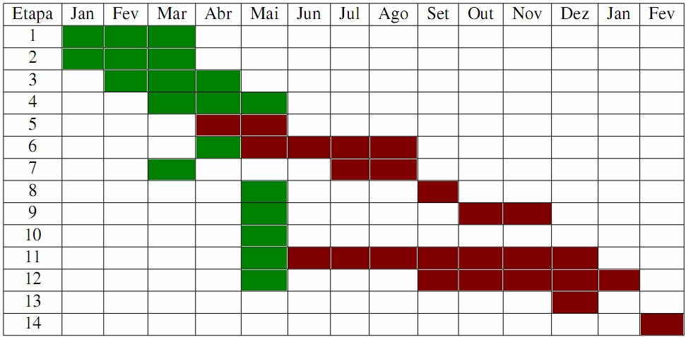
Cronograma
Levantamento de técnicas de distribuição do suporte a MMG;
Levantamento de técnicas de distribuição em geral, que possam ser aplicadas a jogos MMG;
Análise e categorização destas técnicas;
Elaboração de um modelo de distribuição;
Integração das técnicas;
Implementação do protótipo (em parte);
Levantamento de simuladores para efetuar os testes (em parte);
Execução dos testes (em parte);
Análise dos resultados (em parte);
Apresentação do seminário de andamento na semana acadêmica;
Escrita da dissertação (iniciada);
Escrita de artigos (iniciada, alguns já submetidos);
  DS-RT 2008: A³
Entrega da dissertação;
Defesa da dissertação.

Slide 30
Algumas referências
MORSE (…)
ASSIOTIS, M.; TZANOV, V. A distributed architecture for MMORPG. Proceedings of 5th ACM SIGCOMM workshop on Network and system support for games, [S.l.], 2006.
CECIN, F.; REAL, R.; OLIVEIRA JANNONE, R. de; GEYER, C.; MARTINS, M.; BARBOSA, J. FreeMMG: a scalable and cheat-resistant distribution model for internet games. IEEE Int. Sym. on Distributed Simulation and Real-Time Applications, [S.l.], p.83–90, 2004.
CHEN, A.; MUNTZ, R. Peer clustering: a hybrid approach to distributed virtual environments. Proceedings of 5th ACM SIGCOMM workshop on Network and system support for games, [S.l.], 2006.
KERMARREC, A. M.; MASSOULIÉ, L.; GANESH, A. J. Probabilistic Reliable Dissemination in Large-Scale Systems. IEEE transactions on parallel and distributed systems, 2003.
IIMURA, T.; HAZEYAMA, H.; KADOBAYASHI, Y. Zoned federation of game servers: a peer-to-peer approach to scalable multi-player online games. Proceedings of ACM SIGCOMM 2004 workshops on NetGames’ 04: Network and system support for games, [S.l.], p.116–120, 2004.
RATNASAMY, S.; HANDLEY, M; KARP, R.; SHENKER, S. Topologically-aware overlay construction and server selection. Twenty-First Annual Joint Conference of the IEEE Computer and Communications Societies, 2002.
LEE, K.; LEE, D. A scalable dynamic load distribution scheme for multi-server distributed virtual environment systems with highly-skewed user distribution. Proceedings of the ACMsymposium on Virtual reality software and technology, [S.l.], p.160–168, 2003.
NG, B.; SI, A.; LAU, R.; LI, F. A multi-server architecture for distributed virtual walkthrough. Proceedings of the ACM symposium on Virtual reality software and technology, [S.l.], p.163–170, 2002.
SCHIELE, G.; SUSELBECK, R.; WACKER, A.; HAHNER, J.; BECKER, C.; WEIS, T. Requirements of Peer-to-Peer-based Massively Multiplayer Online Gaming. Proceedings of the Seventh IEEE International Symposium on Cluster Computing and the Grid, [S.l.], p.773–782, 2007.

