Slide 1
A³: a novel interest management algorithm for distributed simulations of MMOGs
Carlos Eduardo Benevides Bezerra
Advisor: Prof. Dr. Cláudio F. R. Geyer
12-th Symposium on Distributed Simulation and Real Time Applications
Vancouver, BC, Oct. 27th 2008

Slide 2
Outline
Introduction
  Context of massively multiplayer online games
  Motivation and objective of the algorithm
Interest management
  Related work
Graded area of interest
The A³ algorithm
Simulation and results
Final remarks
  Related future work

Slide 3
Introduction:
Managing interest in MMOGs
Massively Multiplayer Online Games

Slide 4
Context: Massively Multiplayer Online Games
Massively Multiplayer
  In this kind of game, there may be tens of thousands of simultaneous players, who can interact with one another
Definitions
  Interactive and distributed virtual environment
    Virtual environment: “world” of the game
    Interactive: game progress depends on the actions of the players (clients)
    Distributed: it is replicated and processed in different places (server and players’ machines)
  Entity: any object in the virtual environment which has at least position, direction and speed attributes
  Avatar: entity that represents the player in the game world

Slide 5
Context: Massively Multiplayer Online Games
Definitions (continuing):
  State: set of properties that can be observed in the game entities. The overall state of the game world is composed of the individual states of all the entities present in it
Interaction between players
  There is a replica of the game environment in each player’s machine
  Each client keeps an up-to-date copy of the game state
  The interaction is performed by the player sending his actions to the server and receiving state updates for the entities in the game, including other players’ avatars

Slide 6
Motivation
Motivation:
  Currently, expensive server systems are required to support massively multiplayer online games properly
  P2P solutions are prone to: players’ bandwidth overloading, simulation agreement requirements and cheating
  It is possible to refine existing techniques in order to decrease the total bandwidth available at the servers and players computers

Slide 7
Objective
The objective of the present work is:
  Increment current interest management technique, further reducing the bandwidth requirement, and maintaining a similar game experience

Slide 8
Interest management:
Efficient use of network bandwidth

Slide 9
Interest management
Main purpose: reduce the bandwidth usage
  Achieved by filtering what is relevant to a participant to receive, and what is not.
Load on a server decreases
  Increased scalability: more participants can join the game
With a more efficient use of the bandwidth, the application may become more scalable, allowing more players to join a game, for example.

Slide 10
Interest management: related work
Several works propose using multicast in interest management
  Multicast is not widely supported on the Internet (El-Sayed 2004)
  Interest management with this model would probably require some application level multicast
By increasing the CPU load, a more accurate and effective interest management may be achieved on the application level

Slide 11
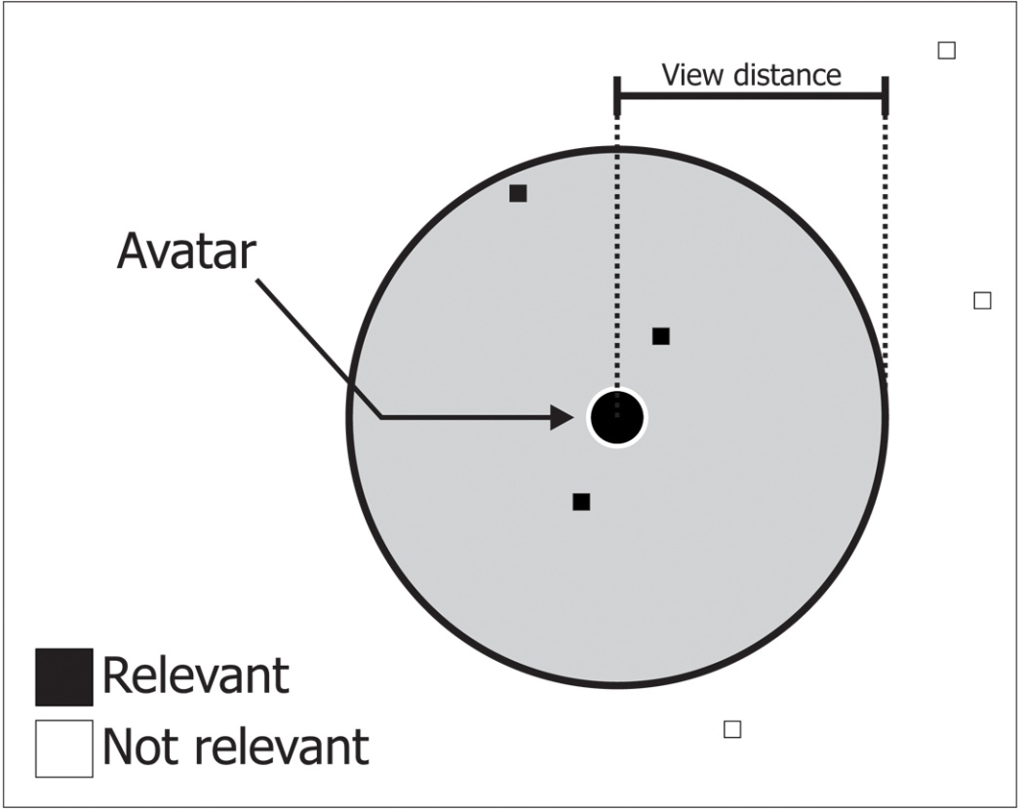
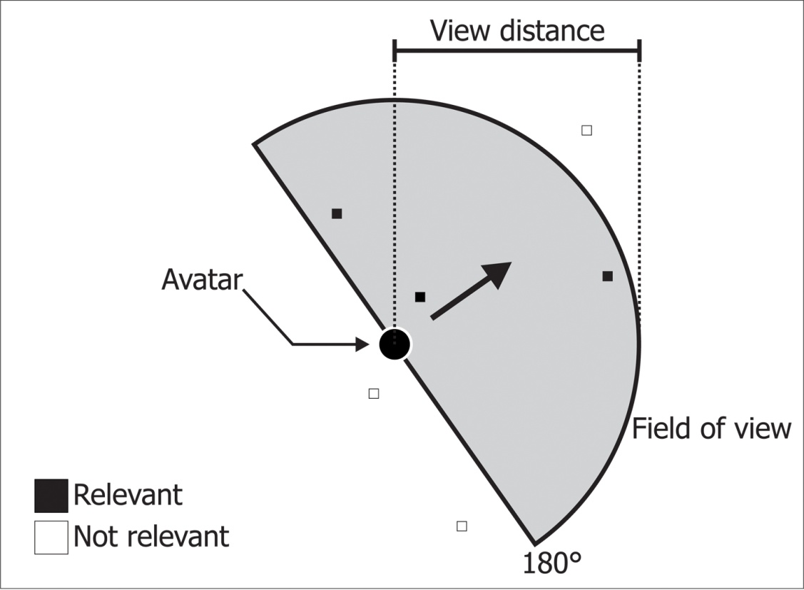
Interest management: related work
Circular area of interest
Field of view based area of interest
(about 50% of the bw of the circle)
Most interest management schemes consider only either one of two cases: relevant or not relevant

Slide 12
Graded area of interest:
Different update frequencies

Slide 13
Graded area of interest
There may be different levels of relevance
Usually, the farther an entity is from the player’s avatar, the less relevant it is
To make use of this characteristic, we may use different update frequencies. For instance:
  The farther the entity is, the less frequent is the update
  The closer it is, the more frequent its updates should be

Slide 14
Graded area of interest
For that, we can use some terms:
  Relevance: a real value ranging from 0 to 1
  Update frequency: number of updates received for an entity, divided by time
  Normal update interval: shortest possible interval between consecutive updates; it is used when relevance value equals to 1
  View distance: maximum distance from the avatar that an entity may be so that the player can see it
  Critical distance: distance, from the player’s avatar, within which any entity must be updated to that player with normal update interval

Slide 15
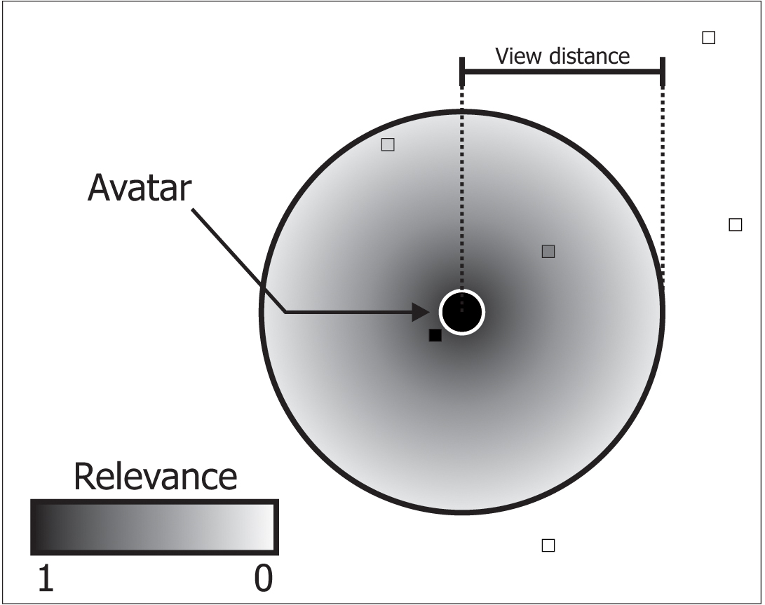
Graded area of interest
Now there are infinite grades of relevance
The farther is an entity from the avatar, the less frequent are its updates sent to the player controlling this avatar

Slide 16
The A³ Algorithm
view Angle
close Area
update frequency Attenuation

Slide 17
A³ - characteristics
It uses the direction vector to get the field of view information
  The player does not need to perceive what is behind his avatar perfectly
However, it is good to keep an area around the avatar as up-to-date as possible
  The player can rotate his character too fast and look behind before his new field of view brings the state updates
The area around the player is called Close Area
  The radius of the Close Area is called Critical Distance
  The frequency attenuation is applied only on his field of view, in front of him, beyond the close area
To mask the delay between updates for entities close to the view distance, techniques such as dead-reckoning may be employed

Slide 18
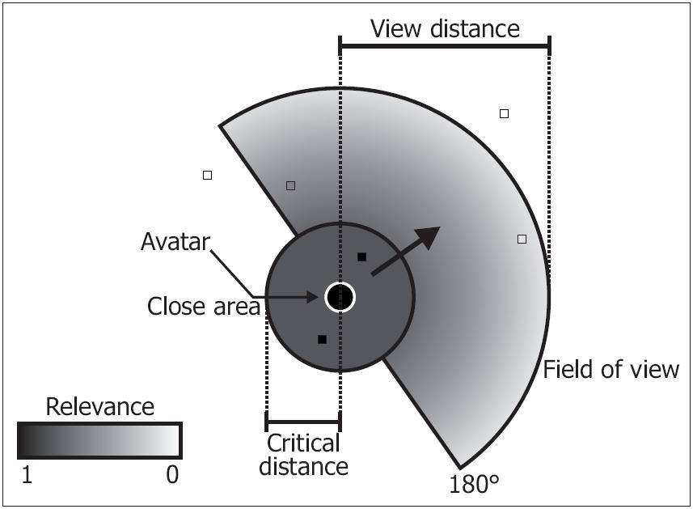
A³ - area of interest

Slide 19
A³ - parameters
The following parameters have to be given to the algorithm, for they depend on the specific application (game):
Normal update interval (I_{N})
View distance (V)
Critical distance (C)
Coordinates of the Avatar (A)
and the entity whose relevance is being evaluated (E)

Slide 20
A³ - return
Relevance (R)
  Real value x, x ∈ [0, 1]. It represents how relevant is the entity E for the avatar A.
Interval until next update: I_{P} = I_{N} / R
Example:
  I_{N} = 200 ms
  Found R = 0.8
  I_{P} = 200 / 0.8 = 250 ms

Slide 21
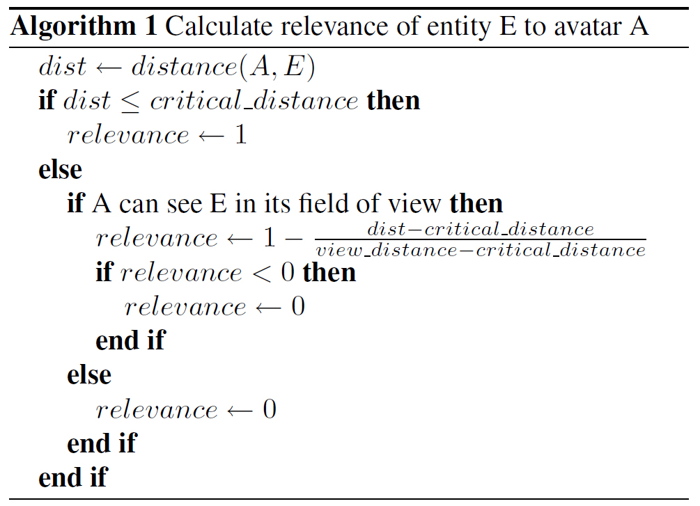
A³ - algorithm

Slide 22
Simulation and results

Slide 23
Simulation
First, a simulated virtual environment was created, imitating the behaviour of human players
  A simple two-dimensional world was simulated, with entities whose only attributes were position and direction
  One of these entities was an avatar A, whose download bandwidth usage (server’s upload) was monitored
  A kept moving across the map, changing the entities around it as it moved
  The bandwidth usage depended on the IM scheme employed

Slide 24
Simulation
The client (for that avatar) and the server were simulated over ns-2
Ns-2 simulated the send and receive operations, being able to measure bandwidth usage
Four different interest management algorithms were simulated
  Circular area of interest
  Field of view
  Circular area with graded relevance
  A³ algorithm
Besides, it was also simulated a case where no IM scheme at all was used, for comparison

Slide 25
Parameters of the simulation
The following parameters were decided based on works which analyse game traffic:
  I_{N} (normal update interval): 250 ms
  State update payload por one entity: 100 bytes
  Virtual environment area: 750 x 750 a.u.
  View distance: 120 l.u.
  Critical distance: 40 l.u.
  View angle: 180º
  Duration of each game session: 20 minutes

Slide 26
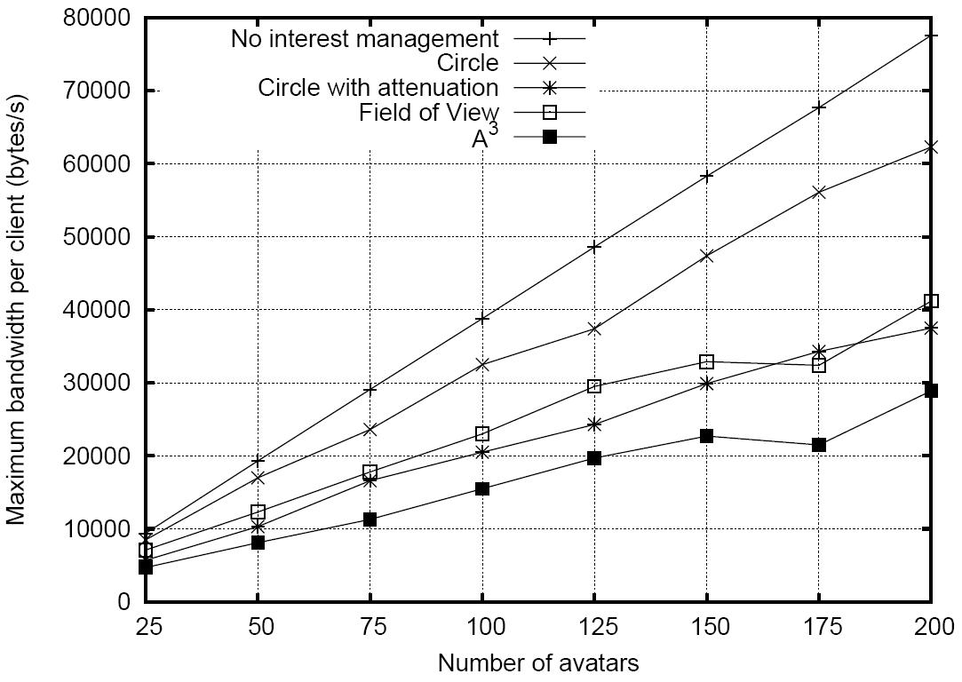
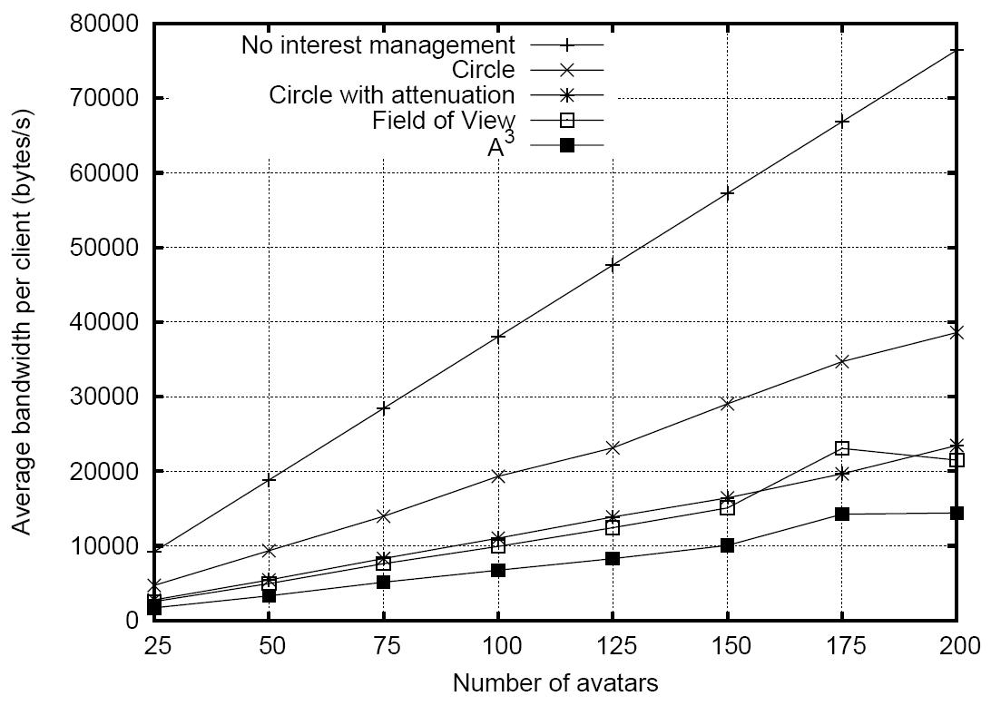
Results
It was assumed that the transmission rate from client to server is constant, and also is not affected by interest management.

Slide 27
Final remarks

Slide 28
Final remarks
Existing IM schemes may be improved by using different levels of relevance
This work is part of a master thesis, which proposes a distributed server approach
Peer-to-peer MMOG models can use IM, but this would require additional attention:
  Each peer decides (or is told by some other entity) to whom it should send state updates
  A malicious player might hack his client to avoid sending updates to certain other players

Slide 29
Related future work
Topology of the overlay network based on the real topology of the network (Ratsanamy et al., 2002)
Players’ state update dissemination
  Made through a probabilistic manner, using push-gossip broadcast (Kermarrec et al., 2003)
    Regions closer to the player’s avatar will be more likely to have its most recent state
Load balancing and hotspots detection
  Using graph partitioning and graph partition refining algorithms, the game world may be divided among servers, assigning for each of them approximately the same load, while reducing the necessary inter-server communication

Slide 30
References
MORSE , K. Interest Management in large-scale distributed simulations. Technical report ICS-TR-96-27, University of California, Irvine, 1996.
KERMARREC, A. M.; MASSOULIÉ, L.; GANESH, A. J. Probabilistic Reliable Dissemination in Large-Scale Systems. IEEE transactions on parallel and distributed systems, 2003.
RATNASAMY, S.; HANDLEY, M; KARP, R.; SHENKER, S. Topologically-aware overlay construction and server selection. Twenty-First Annual Joint Conference of the IEEE Computer and Communications Societies, 2002.
EL-SAYED, A. Application-Level Multicast Transmission Techniques over the Internet. University of Paris, 2004.
MCCANNE, S. FLOYD. Network simulator ns-2. Available for dowload at http://www.isi.edu/nsnam/ns

