Slide 1




Group Project: Computational modelling of momentary subjective experience ratings during experimental tasks by Katia Dudzikowska; Matt Apps
www.msn-lab.com
@MSNlab

Slide 2
Project Aims
Understand how to model continuous ratings of subjective experiences
Fitting a hypothesis-driven model to subjective ratings of fatigue, and how this differs from models of choice
Defining alternative models and fitting them to data
Plotting and testing how well the model fits the observed data.

Slide 3
Why model momentary changes in subjective experience?
How people feel might matter as much as behaviour!
Disentangle the impact of various external variables on affective and cognitive states.
Investigate the dynamics of changes in phenomenal states that are not always directly apparent in behaviour.
Understand the effect of context on latent processes underlying subjective feelings (e.g., social vs non-social context).
Quantify individual differences in parameters that guide development of subjective states (e.g., psychopathology/computational psychiatry).
Why are YOU interested in this project?

Slide 4
A growing research area
How people feel might matter as much as behaviour!
Happiness ratings (Rutledge et al., 2014; within social context: Rutledge et al., 2016)
Feelings of self-worth in social context (Will et al., 2017)
Confidence/evaluation of performance (Rouault et al., 2019)
Liking ratings (e.g., aesthetic value; Brielmann et al., 2024)
Perception of efficacy (Grahek et al., 2023)
Momentary fatigue (Müller et al., 2021; Matthews et al., 2023)

Slide 5
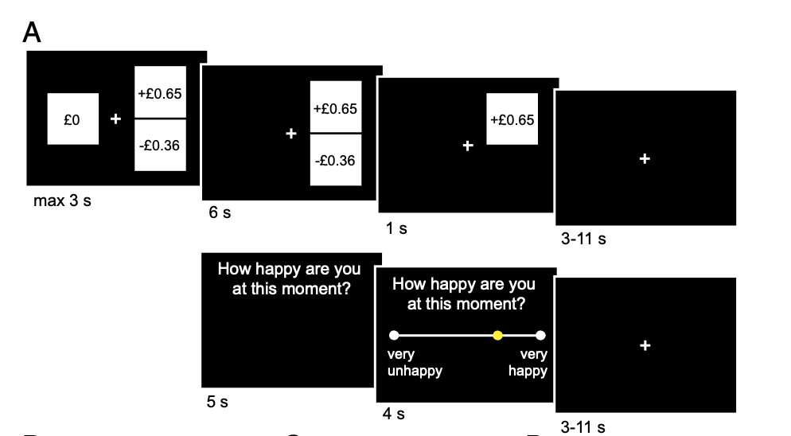
Example of a ratings model
Dynamics of momentary happiness during a gambling task.
150 trials
choice: certain option or a 50:50 gamble
every 2-3 trials:
happiness rating
Rutledge et al., 2014

Slide 6
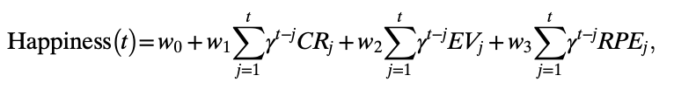
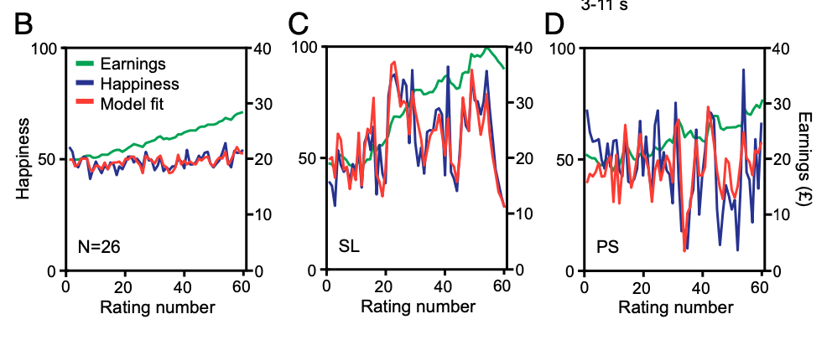
Happiness Model
Dynamics of momentary happiness during a gambling task.
w₀
a constant capturing individual variability in using the scale
w₁, w₂, w₃
weighs of different event types
γ
forgetting factor
value of certain reward if chosen
on trial j (0 if gamble chosen)
CR_{j}
expected value of a gamble
if chosen on trial j (0 if certain reward chosen)
EV_{j}
Reward Prediction Error on trial j contingent
on choice of the gamble (0 if certain reward chosen)
RPE_{j}
Rutledge et al., 2014

Slide 7
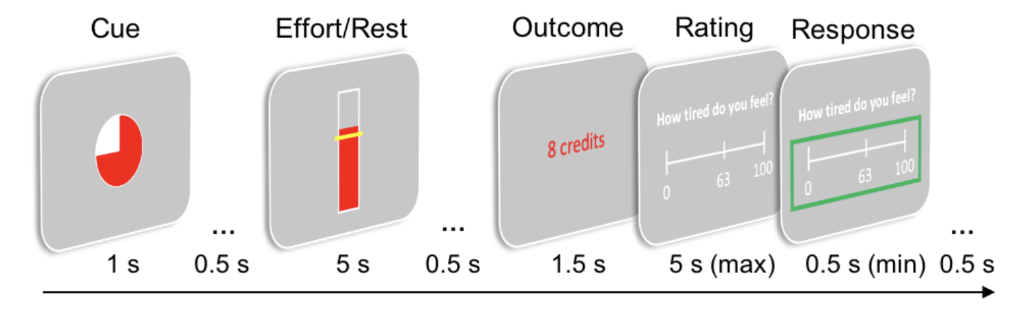
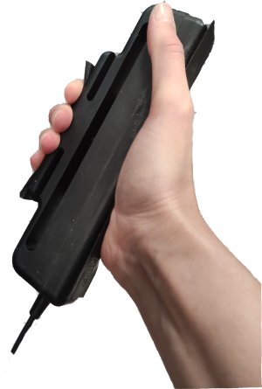
What about fatigue?
How does fatigue fluctuate during effortful tasks?
Fatigue is one of the most common symptoms in general medicine (Muller at al., 2019)
A feeling of exhaustion through effort.
But previous research only looked at declines in performance
Müller et al., 2021

Slide 8
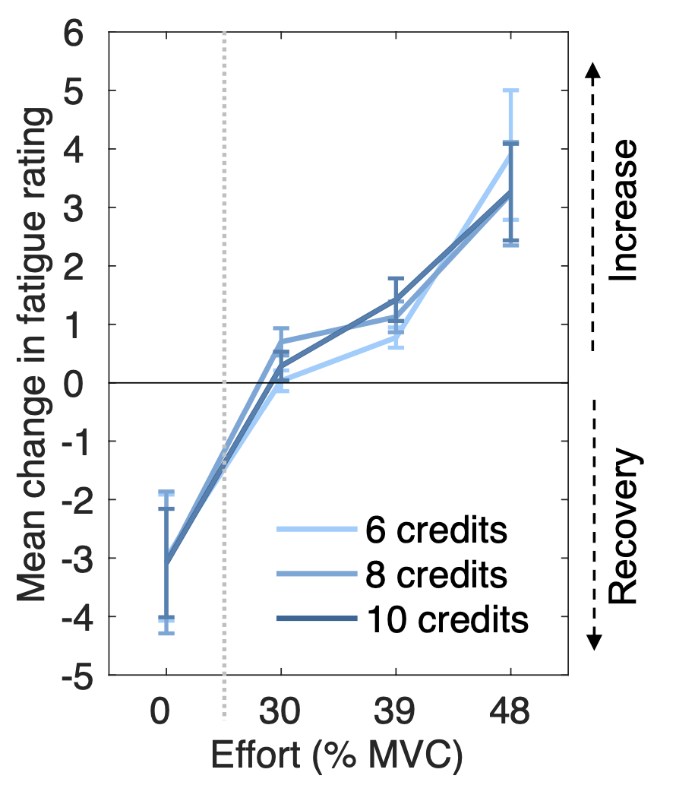
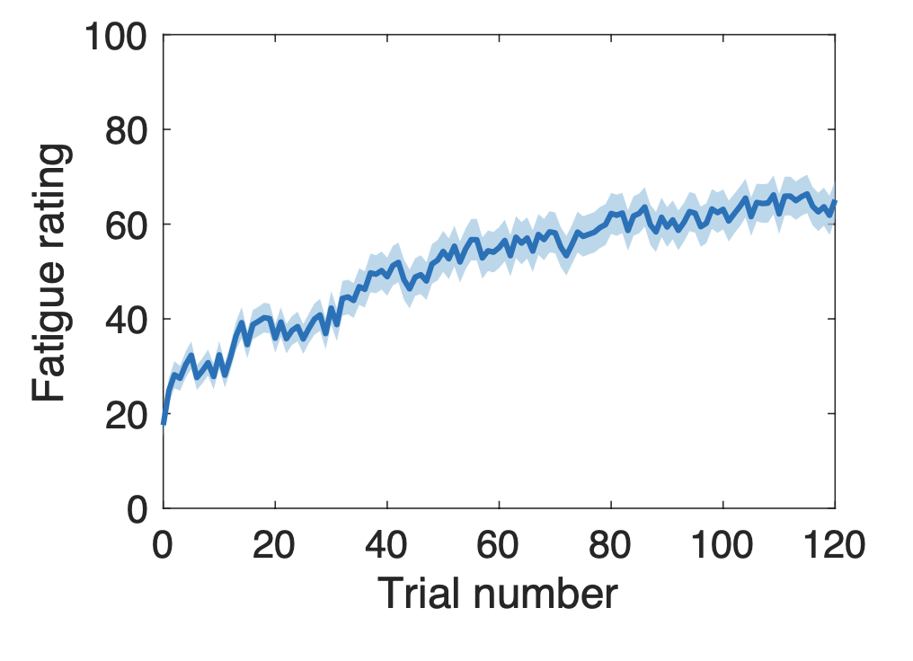
What about fatigue?
How does fatigue fluctuate during effortful tasks?
Fatigue increases over time…
…but the change depends on the level of exerted effort (and short rest can decrease it)
Müller et al., 2021

Slide 9
What underlies fatigue ratings?
Latent recoverable and unrecoverable fatigue states
Unrecoverable Fatigue
Subjective Fatigue
Recoverable Fatigue

Slide 10
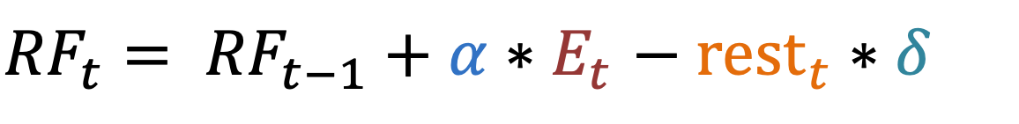
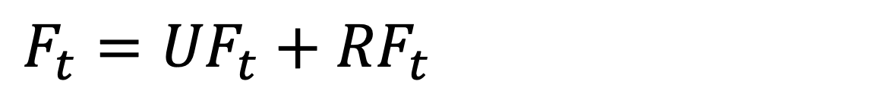

Computational model of fatigue
Equations for recoverable and unrecoverable states
$$F_{t}={UF}_{t}+{RF}_{t}$$
${RF}_{t}= {RF}_{t−1}+α∗E_{t}$ $− {rest}_{t}∗δ$
$${UF}_{t}={UF}_{t−1}+β∗E_{t}$$
We will come back to this!

Slide 11
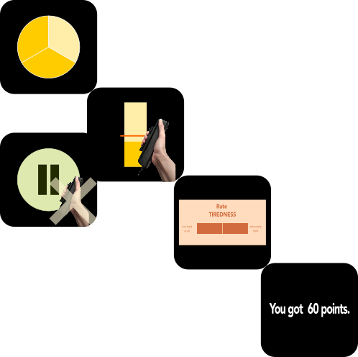
Your Project
Model fatigue ratings in a similar task in 15 new participants
Dudzikowska et al., (in prep)

Slide 12

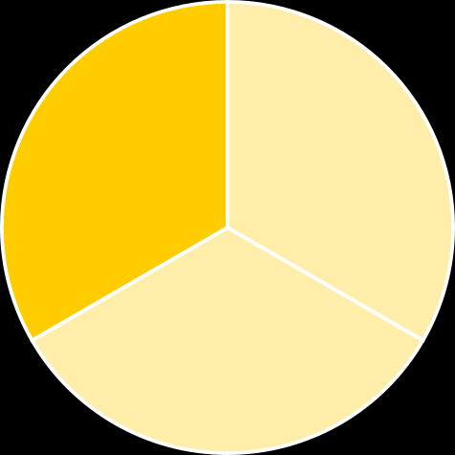
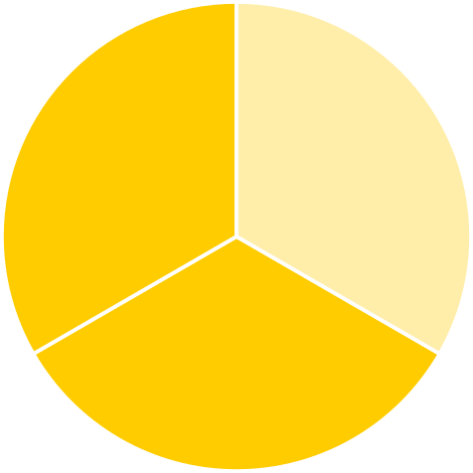
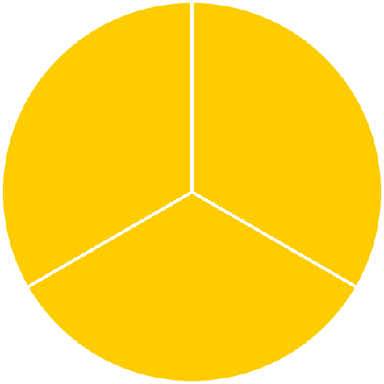
Your Project
The task
trial
1-150
effort
0
0.30
0.39
0.48
(as proportion of Maximum Voluntary Contraction)
condition
effort (80% of trials):
keep force above
the line for 5s
rest (20% of trials):
do nothing for 5s
fatigue
tiredness rating (50% of trials)
0: “Not at all tired” –
100: “Extremely tired”
success
1 if success
0 if failure
na if rest
reward
random 10-80 points
after success & after rest
Dudzikowska et al., (in prep)

Slide 13
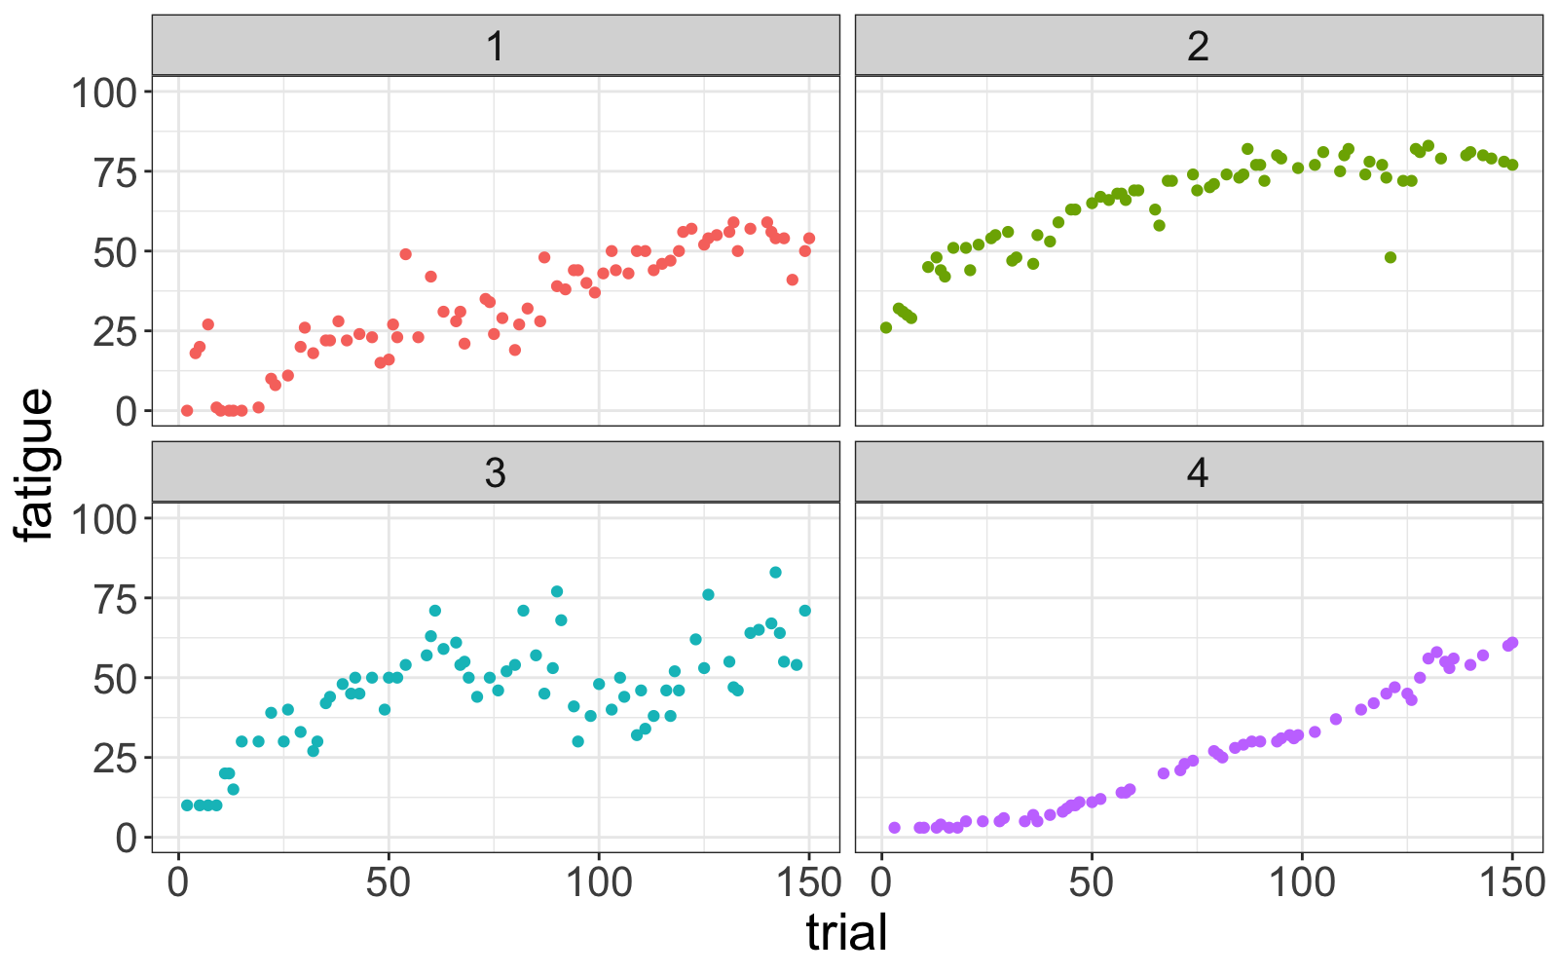
Example data from the task
Participants show different patterns of fatigue
Dudzikowska et al., (in prep)

Slide 14
Your Project
Modelling steps
Formulate your predictions into mathematical language
Estimate free parameters
Compare competing models
Compare (visually) patterns in the model with patterns observed in the data

Slide 15
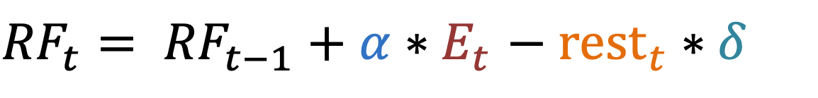
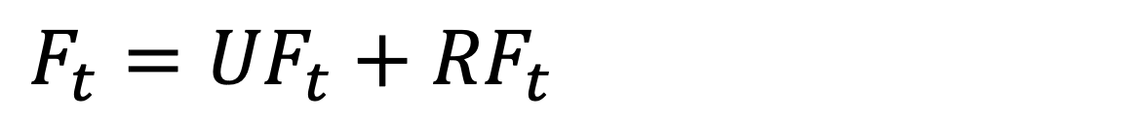
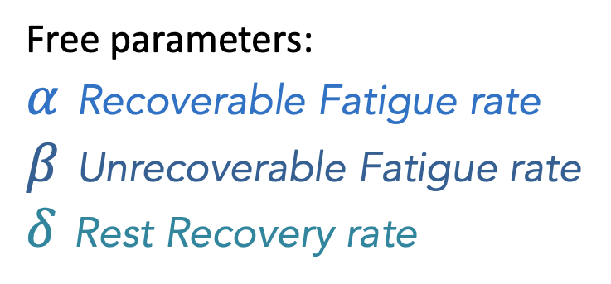
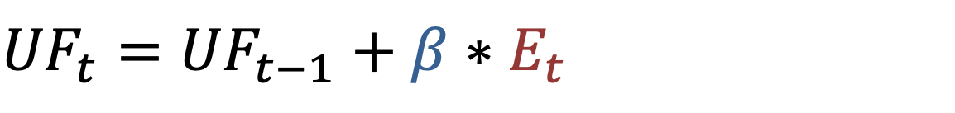
Hypothesised model of fatigue
Equations for recoverable and unrecoverable states
$$F_{t}={UF}_{t}+{RF}_{t}$$
${RF}_{t}= {RF}_{t−1}+α∗E_{t}$ $− {rest}_{t}∗δ$
$${UF}_{t}={UF}_{t−1}+β∗E_{t}$$
E_{t} proportion of MVC
on trial t (0 if rest)
rest_{t} 0 if effort, 1 if rest
Free parameters:
$α$ Recoverable Fatigue rate
$β$ Unrecoverable Fatigue rate
$δ$ Rest Recovery rate

Slide 16
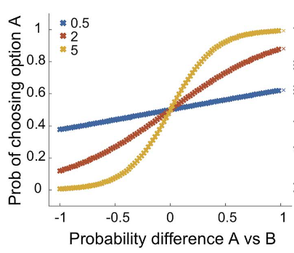
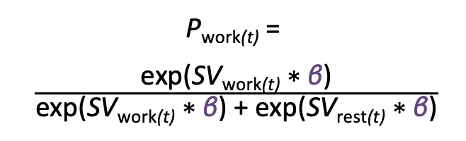
How do we fit models?
Softmax function:
What is the probability of choosing an option?
P_{work(t)} =
$\frac{\text{exp}\text{(}\text{SV}\text{work}\text{(}\text{t}\text{)} \text{∗} \text{β}\text{)}}{\text{e}\text{xp}\text{(}\text{SV}\text{work}\text{(}\text{t}\text{)} \text{∗} \text{β}\text{) + }\text{exp}\text{(}\text{SV}\text{rest}\text{(}\text{t}\text{)} \text{∗} \text{β}\text{)}}$
Probability of choosing work
Value difference (work vs. rest)

Slide 17
How do we fit models of ratings?
No choices! We cannot use softmax and maximum likelihood
Softmax function:
What is the probability of choosing an option?
P_{work(t)} =
$\frac{\text{exp}\text{(}\text{SV}\text{work}\text{(}\text{t}\text{)} \text{∗} \text{β}\text{)}}{\text{e}\text{xp}\text{(}\text{SV}\text{work}\text{(}\text{t}\text{)} \text{∗} \text{β}\text{) + }\text{exp}\text{(}\text{SV}\text{rest}\text{(}\text{t}\text{)} \text{∗} \text{β}\text{)}}$
Probability of choosing work
Value difference (work vs. rest)

Slide 18
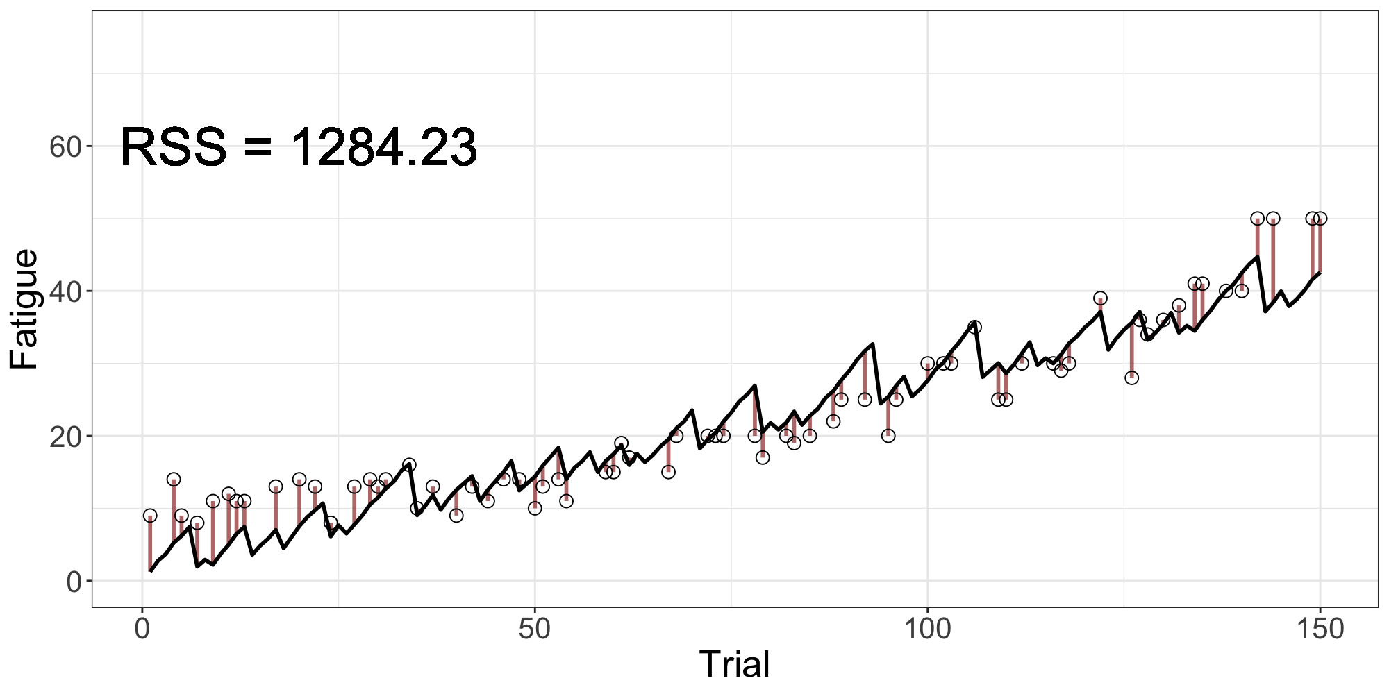

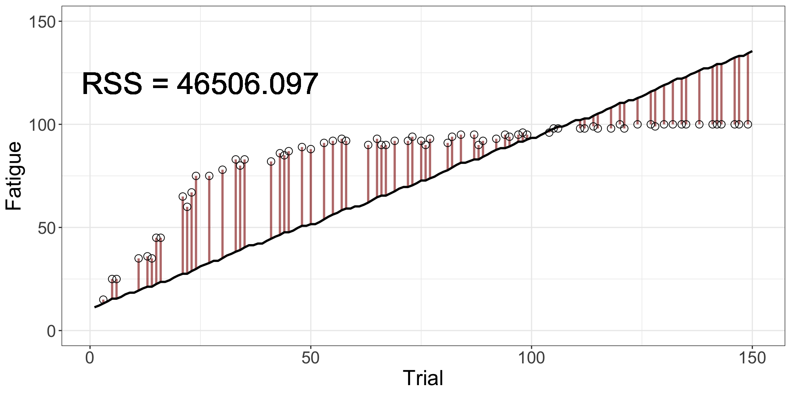
How do we fit models of ratings?
An error minimizing function - Residual Sum of Squares
minimise RSS to find optimal parameter values
fminsearch in MATLAB
(optim in R)

Slide 19
How do we know which model is best?
AIC & BIC to check goodness-of-fit
AIC = 2k + n * ln(RSS/n)
BIC = n * ln(RSS/n) + k * ln(n)
Trade-off between goodness of fit and simplicity.
Both penalise for model complexity, but BIC is stricter.
k → number of free parameters
n → number of data points
RSS → Residual Sum of Squares

Slide 20
Your project
Data, scripts
To download data and scripts go to: https://github.com/kdudzikowska/CSC_Birmingham2024_ModellingRatings
In the repository you should find:
Main MATLAB script:
CSC_Birmingham2024_ModellingRatingsScript.m
2 MATLAB scripts with functions:
fatigue_estimate_UfRfRr.m & fatigue_estimate_RfRr.m
15 MATfiles with data from 15 participants
s1.mat - s15.mat
These slides
CSC_Birmingham2024_ModellingRatingsSlides.pptx

Slide 21
Your project
Fitting, comparing and testing models
Understand data (15 subjects)
Plot ratings
Plot changes between ratings (as a function of effort on that trial)
Run a script to estimate parameters for the hypothesised-model
Plot model fit compared to observed data
Plot changes between ratings in model vs data
Run alternative models from scripts
Compare and plot the BIC
[BONUS] Run a quadratic model (Adding in a new model yourselves

Slide 22
Your project
Section I. Load the data
Finding your way around MATLAB data structures is not the purpose of this workshop, so all the code to read in the data is provided for you in this section. You're welcome :D
The only thing you should need to do here is set datadir to the directory where you saved the provided files.
But before you run the code read through it carefully to know how the data is organised.

Slide 23
Your project
Section II. Visualise the data
Learn about the data that you're working with by plotting it.
Task 1) Plot fatigue ratings over trials for each participant.
Hint: Use tiledlayout() or subplot() to display multiple plots in a single
figure.
Task 2) Plot average change in fatigue ratings for each effort level (with error bars). Code to calculate mean and se is provided.
What trends are you seeing?
How would you analyse this data without computational modelling?
What is the added value of computational modelling that these methods don't provide?

Slide 24
Your project
Section III. Standardise the ratings
When working with rating data it is useful to adjust the range and distribution of the ratings per individual to account for idiosyncratic ways people use the rating scale.
Think what standardisation method is best suited for this type of data and apply it to the ratings.

Slide 25
Your project
Section IV. Hypothesised model
Here you will define the model that you want to fit. We will start with the hypothesised model. All we are doing in this section of the main script is refer to the model function defined elsewhere, in fatigue_estimate_UfRfRr.m
Hint: the @ sign is used here to create a function handle that makes it easy to pass a predefined function to another function (like the all-important fminsearch)
Check out fatigue_estimate_UfRfRr.m where the model is formulated. That’s the cool bit! BTW, UfRfRr stands for Unrecoverable fatigue, Recoverable fatigue and Rest recovery. Catchy, I know!
See how well you can understand, step by step, what the script does. What are the assumptions of the model?
Can you see how these functions relate to the formula I showed you before? If anything is unclear, ask! :)

Slide 26
Your project
Section V. Model fitting.
Section Va. Use fminsearch to estimate best model parameters for each participant.
Quite a lot is going to happen in this for loop, so start with carefully reading through the code in the whole section.
See if you can answer the following
a) what is the purpose of nRuns = 50 in the while loop? What difference would it make if it was nRuns = 5 or nRuns = 500?
b) what are we defining in startp ?
c) what is the purpose of constrained_fit?
d) what do MaxFunEvals and MaxIter do in fminsearch?
Hint: MATLAB help can be a friend. Or even chatGPT?

Slide 27
Your project
Section V. Model fitting.
Section Vb. Fit the model with optimised parameters.
At this point, if MATLAB is kind, you should have the best estimates of model parameters for each participant!
Use them to obtain the RSS for the optimised model and the estimated values of fatigue (+ estimates of latent unrecoverable and recoverable fatigue).

Slide 28
Your project
Section V. Model fitting.
Section Vc. Calculate the model metrics, AIC and BIC, for this model for each participant
Here we determine the goodness of model fit for each participant (while rewarding simpler models). Use the below formulas to calculate both metrics. First you need to define k, n and RSS.
Hint: Be mindful when defining your n. How many observations do we actually have?
Natural log in MATLAB is log()
AIC = 2k + n * ln(RSS/n)
BIC = n * ln(RSS/n) + k * ln(n)
These metrics are useless though without having anything to compare them to. We’ll turn to this next.

Slide 29
Your project
Section VI. Alternative model
with provided model function
You were also provided with script fatigue_estimate_RfRr.m This script defines an alternative model without unrecoverable fatigue state (with 2 parameters).
Check out the function first, then copy-paste the code from sections V and VI and amend to repeat the process of parameter estimation, obtaining fatigue estimates and calculating goodness-of-fit metrics for the RfRr (Recoverable fatigue and Rest recovery) model.
Hint: You will need to adjust constrained_fit for different number of parameters.
Did you run into any issues when trying to run your code? Modelling is 99% troubleshooting :D So, any idea what went wrong?

Slide 30
Your project
Section VII. Alternative model
define your own model
This is where you practice defining alternative models:
write a script which formulates a model with a single, unrecoverable fatigue state with 1 parameter (fatigue increases as a function of effort level but doesn’t dissipate with rest). Name the function fatigue_estimate_Uf and save in fatigue_estimate_Uf.m
Make sure it has the same inputs (params, E, ratings, baseline) and outputs (ERR, Fat, Rfat, Ufat) as the other two functions.
Once your function is ready copy&paste the code from sections V and VI and amend to repeat the process for the new model.
Hint: You can first test if your function works well by plugging in observed values and random parameters.
You can also skip this section for now, try running the script with just the 2 models and return to this step later.

Slide 31
Your project
Section VIII. Determine the winning model for each participant.
You have already calculated AIC and BIC for each model for each participant.
Here find the best AIC and BIC scores per participant (best = the lowest).

Slide 32
Your project
Section IX. Determine the winning model across participants.
People can be wonderfully idiosyncratic so the same model might not be the best fit for all participants. To determine best overall model we can look at:
sum of AIC/BIC scores across participants
which model has the highest proportion of wins across participants.
Try to do this in this section.
Which goodness-of-fit metric do you think is more appropriate here? AIC or BIC?

Slide 33
Your project
Section XI. Visualise the results.
Think about the best ways to visualise your results. Some suggestions:
barplots of model comparison results
plot of observed fatigue values vs fatigue estimates obtained from the winning model
plots comparing model fits from competing models
plot the obtained parameter values

Slide 34
Your project
Section XII. BONUS
Can you think of any alternative models that make theoretical sense and you could compare with these models?
Are there any variables in the dataset that could help explain fatigue dynamics?
Could the relationship between effort and fatigue be non-linear?
What would be the best null model to which you can compare the proposed models?
If you have the time, first give yourself a massive pat on the back and then you can try to write a function for an alternative model. Otherwise just thinking about it and coming up with ideas is a massive part of the job!

