Slide 1
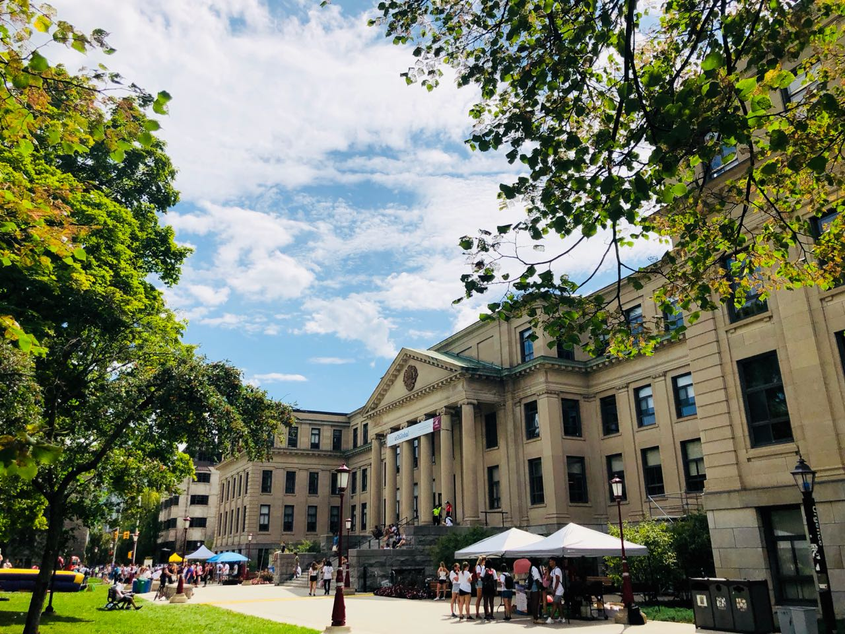


Hyperledger Fabric
EBC 6997: Research Project in E-Business
uOttawa.ca

Slide 2

Hyperledger Fabric
Asset Type and Consensus Mechanism
Chaincode
Permissions
Nodes: Peer and Ordering
Asset Tracking: Blockchain Log and State Database
Future Impacts

Slide 3
Hyperledger Fabric:
Widely used private blockchain.
Primarily used in Enterprise level.
Implement seamless Business Transactions.
Transactions are efficient
Modular design – Businesses can plugin different functionality to suit their customized needs.

Slide 4
Differences
Ethereum | Hyperledger
Decentralized platform | Hyperledger is multi project and open source
Public Network | Consortium Network
Consensus Mechanism: • Proof of Work • # function is used for transactions | No Consensus Mechanism Information is stored in a Node
Smart Contract: Solidity | Smart Contract: Chaincode
Maintenance: Ethereum Developer Community | Maintenance: Linux Foundation
Business to Customer (B2C) | Business to Business (B2B) Confidential use cases

Slide 5
Modules of Hyperledger Fabric:
The fabric records series of transactions in a chronological order.
In fabric, the definition of the item undergoing a transaction is known as an asset.
Asset- Associated with a monetary value. (like- cars, houses)
Hyperledger Fabric allows the assets to have specified parameters.

Slide 6
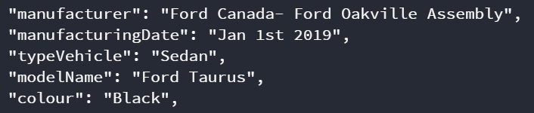
What is an Asset
Represented as a collection having a key value pair.
State changes recorded as transactions on the ledger.

Slide 7
Chaincode
Chaincode is software defined network that has an asset and the set of instructions are used to modify them.
Smart Contract executes the Chaincode (Business Logic).
Helps establish a shared ecosystem like a virtual shared database.

Slide 8
Permissions
Permissioned Network- Based on certain access/usage rights the base Chaincode can be executed.
Membership Identification- Participants are granted access based on IDs.
Access Control List- Fine grained additional layers of permissions.

Slide 9
Types of Nodes
Peer Nodes: Execute and Verify each transactions
(Batch and process more than one transactions all together)
Ordering Nodes: Order and Continuous Propagation of correct history of events to the network

Slide 10
Tracking an Asset
Blockchain Log: Immutable Sequence of the transaction blocks. –
-track when and where a Block was created
State Database: Current State of the Blockchain
-No need to see all the previous historic data to evaluate the
present state

Slide 11
Distributed Ledger
Same Business Network as Competitors.
Private Channels: Confidentiality, Privacy, Restricted Access.
Competitors can exist in the same Blockchain Network.
Distributed Ledger
Participant 1
Participant 2

Slide 12
Future Impacts of Hyperledger
Highly scalable
Secured
Shared Ecosystem
Supply Chain Management

Slide 13
Assignment Walkthrough
Log in:
http://hyperledger-uottawa.kaustubhdutta.com:8080/login

Slide 14
References
Linux Foundations. (2018). Hyperledger Architecture, Volume II, Smart Contracts for Blockchain Technology for Business. Retrieved from https://www.hyperledger.org/wp-content/uploads/2018/04/Hyperledger_Arch_WG_Paper_2_SmartContracts.pdf
Sousa, J., Bessani, A., & Vukolic, M. (2018). A byzantine Fault-Tolerant ordering service for the hyperledger fabric blockchain platform. Proceedings - 48th Annual IEEE/IFIP International Conference on Dependable Systems and Networks, DSN 2018, (1), 51–58. Retrieved from https://doi.org/10.1109/DSN.2018.00018
Thakkar, P., N, N, S., and Viswanathan, S. (2018). Performance Benchmarking and Optimizing Hyperledger Fabric Blockchain Platform. IEEE 26th Int. Symp. Model. Anal. Simul. Comput. Telecommun. Syst., pp. 264–276, 2018. Retrieved from https://doi.org/10.1109/SRDS.2017.36
Kaid, D., & Eljazzar, M, M. (2008). Applying Blockchain to Automate Installments Payment between Supply Chain Parties. 2018 14th International Computer Engineering Conference (ICENCO), 231–235. Retrieved from https://doi.org/10.1109/ICENCO.2018.8636131
Dorri, A., Steger, M., Kanhere, S. S., & Jurdak, R. (2017). BlockChain: A Distributed Solution to Automotive Security and Privacy. IEEE Communications Magazine, 55(12), 119–125. Retrieved from https://doi.org/10.1109/MCOM.2017.1700879
Johng, H., Kim, D., Hill, T., & Chung, L. (2018). Using Blockchain to Enhance the Trustworthiness of Business Processes : A Goal-Oriented Approach. 2018 IEEE International Conference on Services Computing (SCC), (Ic), 249–252. Retrieved from https://doi.org/10.1109/SCC.2018.00041

Slide 15
Questions
15
Hyperledger Fabric and Vehicular Depreciation & Ownership History
Presented by: Kaustubh Dutta

