Slide 1
Objectives
In this session, you will learn to:
  Create a workspace
  Consolidate data
  Link cells in different workbooks
  Edit links
  Export Excel data
  Import a delimited text file
  Publish a worksheet to the web
  Import data from the web
  Create a web query
  Develop XML maps
  Import and export XML data
Notes:
Share the objectives with the students.

Slide 2
Create a Workspace
A workspace:
  Is an Excel file that contains location, screen size, and screen position data about multiple workbooks.
  File is saved with the .xlw extension.
  Can be used to manage related sets of data that span across multiple workbooks.

Slide 3
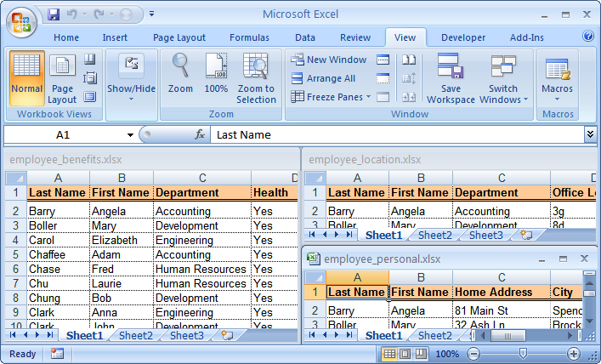
Create a Workspace (Contd.)
The following figure shows a workspace file.
A workspace containing the
location, screen size, and
screen position data of
multiple workbooks

Slide 4
Demo: Creating a Workspace
Scenario:
  You are in charge of updating employee information that is stored in three different workbooks. You have found that as your company grows, you are using these three workbooks together all the time. You want to create a single source that can open all three workbooks at the same time, with the display intact, whenever required.

Slide 5
Demo: Creating a Workspace (Contd.)
Solution:
  To solve the preceding scenario, you need to perform the following tasks:
    Arrange all open windows vertically.
    Create a workspace.
    Test your work.
Notes:
Discuss the scenario of Activity 5-1 of Lesson 5 in the Student Guide with the students.
You can access the data files for this activity from the following path in the TIRM CD:
TIRM\DATAFILES FOR FACULTY\LEVEL 3\Working with Multiple Workbooks\Employee Personal.xlsx
TIRM\DATAFILES FOR FACULTY\LEVEL 3\Working with Multiple Workbooks\Employee Benefits.xlsx
TIRM\DATAFILES FOR FACULTY\LEVEL 3\Working with Multiple Workbooks\ Employee Location.xlsx

Slide 6
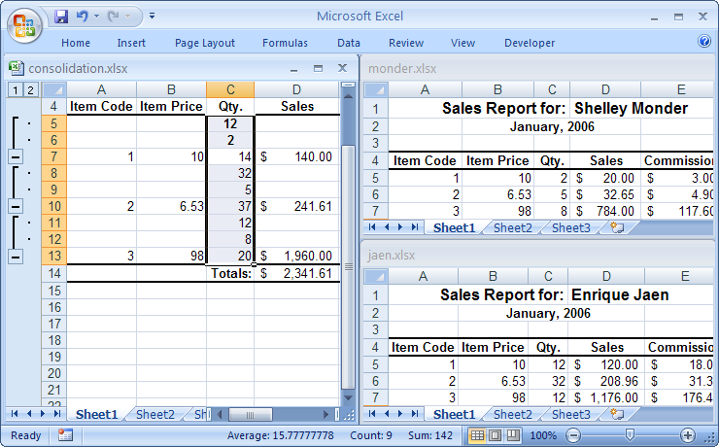
Consolidate Data
Data consolidation is the method of summarizing data from several ranges into a single range.
The following figure shows data consolidation from multiple workbooks into a single worksheet.
Data summarized
from
several ranges
into one range
Workbook
with similar
statistical data

Slide 7
Consolidate Data (Contd.)
The Consolidate dialog box:
  Consists of the following options that are used to consolidate data.
    Function
    Reference
    Browse
    All References
    Add
    Delete
    Use Labels In
    Create Links To Source Data

Slide 8
Demo: Consolidating Data
Scenario:
  You have three sales reports (Hanover, Monder, and Jaen) that need to be summarized. You need to consolidate the data in the Consolidation workbook. You will consolidate the range that contains the quantity data on each of the worksheets in the consolidation worksheet.

Slide 9
Demo: Consolidating Data (Contd.)
Solution:
  To solve the preceding scenario, you need to perform the following tasks:
    In the Consolidation workbook, select the range where you want the consolidated data to be placed.
    Reference the range that has the quantity data, from the Monder workbook.
    Reference the range that has the quantity data from the Jaen workbook and the Hanover workbook.
    Create links to the source data.
    View the hidden data in the consolidated workbook.
Notes:
Discuss the scenario of Activity 5-2 of Lesson 5 in the Student Guide with the students.
You can access the data files for this activity from the following path in the TIRM CD:
TIRM\DATAFILES FOR FACULTY\LEVEL 3\Working with Multiple Workbooks\Hanover.xlsx
TIRM\DATAFILES FOR FACULTY\LEVEL 3\Working with Multiple Workbooks\Monder.xlsx
TIRM\DATAFILES FOR FACULTY\LEVEL 3\Working with Multiple Workbooks\Consolidation.xlsx

Slide 10
Link Cells in Different Workbooks
You an link cells in different workbooks to connect the data stored in one workbook to the data in another workbook.
  The linked cells can smooth the workflow by removing the need to open workbooks that contain related data.

Slide 11
Demo: Linking Cells in Different Workbooks
Scenario:
  You need to calculate the total sales and total commission for the three sales representatives whose data is stored in the Finch, Decker, and Weckl workbooks, respectively. You have already begun developing the Summary workbook that will summarize and calculate the total for each of the files. Any update to the sales data in any of the files should be reflected in the Summary workbook.

Slide 12
Demo: Linking Cells in Different Workbooks (Contd.)
Solution:
  To solve the preceding scenario, you need to perform the following tasks:
    Create a formula that sums the sales totals from each of the sales representatives’ worksheets.
    Update the sales data for Item 3 in finch.xlsx.
Notes:
Discuss the scenario of Activity 5-3 of Lesson 5 in the Student Guide with the students.
You can access the data files for this activity from the following path in the TIRM CD:
TIRM\DATAFILES FOR FACULTY\LEVEL 3\\Working with Multiple Workbooks\Finch.xlsx
TIRM\DATAFILES FOR FACULTY\LEVEL 3\Working with Multiple Workbooks\Decker.xlsx
TIRM\DATAFILES FOR FACULTY\LEVEL 3\Working with Multiple Workbooks\Weckel.xlsx
TIRM\DATAFILES FOR FACULTY\LEVEL 3\Working with Multiple Workbooks\Summary.xlsx

Slide 13
Edit Links
Cells in different can be linked to connect the data stored in one workbook to the data in another workbook.
You edit the links to change the reference to a linked cell in your source workbook:
  Editing links can minimize upkeep time because you don’t have to create a new link from scratch.
Notes:
You can use the following link that shows how to insert hyperlinks in Excel 2007:
http://www.homeandlearn.co.uk/excel2007/excel2007s8p7.html

Slide 14
Demo: Editing Links
Scenario:
  Janet Weckl has changed her name to Janet Covington. Her workbook has to be edited and renamed to reflect this change. Additionally, you need to ensure that the link in the My Summary workbook that currently addresses the Weckl workbook will point to the new Covington workbook you will create.

Slide 15
Demo: Editing Links (Contd.)
Solution:
  To solve the preceding scenario, you need to perform the following tasks:
    Edit the Weckl workbook to reflect Ms. Covington’s name change.
    Edit the My Summary workbook so that it points to the Covington workbook.
Notes:
Discuss the scenario of Activity 5-4 of Lesson 5 in the Student Guide with the students.
You can access the data file for this activity from the following path in the TIRM CD:
TIRM\DATAFILES FOR FACULTY\LEVEL 3\Working with Multiple Workbooks\Weckel.xlsx

Slide 16
Export Excel Data
File export is a method of sending data that has been created in one application to a different application.
Excel can export a range of data, a worksheet, or an entire workbook.
The file types that can be used to export Excel data are:
  XML
  HTML
  TXT
  CSV
Notes:
Additional Input:
You can use the following link to have more information on how to export Microsoft Office Excel 2007 data to your Microsoft Office SharePoint Server 2007 site or Windows SharePoint Services 3.0 site: http://office.microsoft.com/training/training.aspx?AssetID=RC102546131033&CTT=6&Origin=RP102546121033

Slide 17
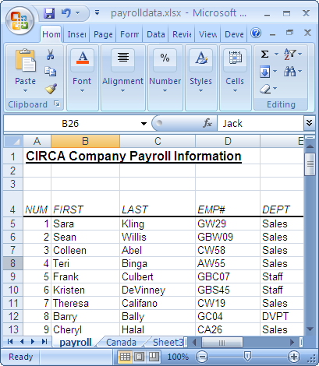
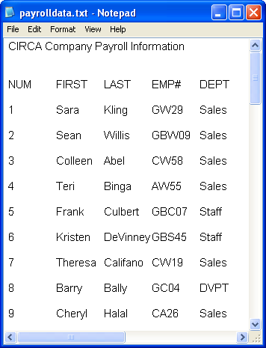
Export Excel Data (Contd.)
The following figures shows the export of Excel data to Notepad.
Data in Excel
Data after exporting to Notepad

Slide 18
Demo: Exporting Excel Data to Use in Microsoft Word
Scenario:
  Your manager has signed off on the data contained in the Payroll Data workbook. Now you need to make this data available in Word so that you can use the application’s mail merge feature to distribute payroll information to all the employees listed in the Payroll Data workbook.

Slide 19
Demo: Exporting Excel Data to Use in Microsoft Word (Contd.)
Solution:
  To solve the preceding scenario, you need to perform the following tasks:
    Save the Payroll worksheet as a tab delimited text file.
    View the content of Payroll Data.txt in Word.
Notes:
Discuss the scenario of Activity 6-1 of Lesson 6 in the Student Guide with the students.
You can access the data file for this activity from the following path in the TIRM CD:
TIRM\DATAFILES FOR FACULTY\LEVEL 3\Importing and Exporting Data\Payroll Data.xlsx

Slide 20
Import a Delimited Text File
File import is a method of capturing data from one application for use in another application.
Excel can import all the data or selected data from a file.
You can split data to different columns by importing delimited text files into Excel:
  This gives you the flexibility to format and manipulate data with Excel’s toolset.
Delimited text file is a TXT file that contains data fields separated or delimited by certain characters.

Slide 21
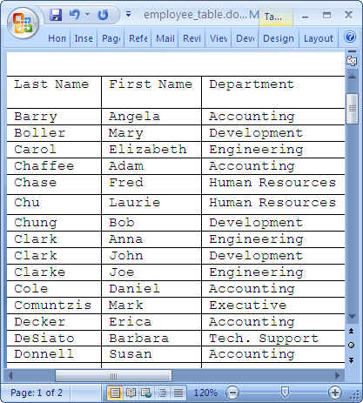
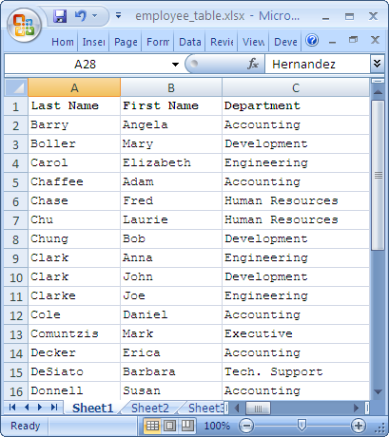
Import a Delimited Text File (Contd.)
The following figures show the data in an Excel worksheet after importing it from Word.
Table in a Word document
Table after importing to an Excel worksheet

Slide 22
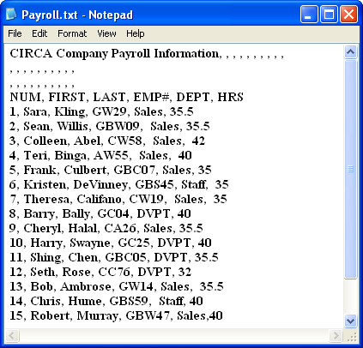
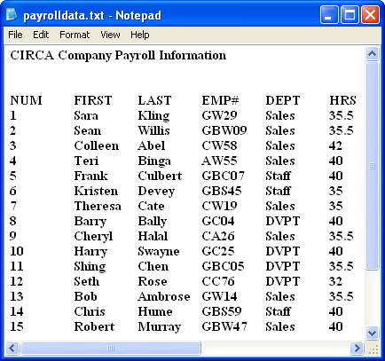
Import a Delimited Text File (Contd.)
The following figures show two delimited text files with two different characters used to delimit data in TXT files.
Data separated
by commas
Data separated
by tabs

Slide 23
Import a Delimited Text File (Contd.)
The Get External Data group contains the following commands used to import data from other applications into Excel:
  From Access
  From Web
  From Text
  From Other Sources
  Existing Connections

Slide 24
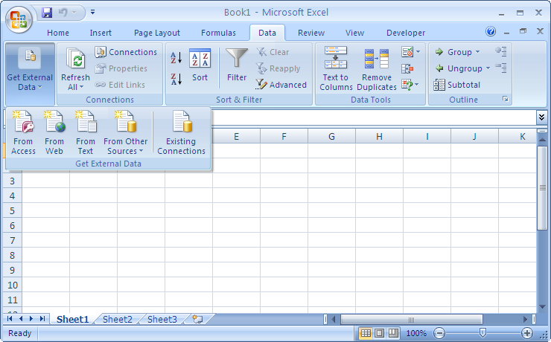
Import a Delimited Text File (Contd.)
The following figure shows different commands in the
Get External Data group.
Commands in the
Get External Data group

Slide 25
Demo: Importing a Delimited Text File
Scenario:
  The Payroll text file is a comma-delimited text file which contains the employee payroll data. You have been tasked with converting the comma-delimited file into an Excel file so that the employee payroll data can, going forward, be stored in Excel and can reflect all the changes made to the text file every time the text file is updated.

Slide 26
Demo: Importing a Delimited Text File (Contd.)
Solution:
  To solve the preceding scenario, you need to perform the following tasks:
    Select the Payroll text file to import into Excel.
    Specify the delimiter settings for the text to be imported.
    Set the import properties for the delimited text.
Notes:
Discuss the scenario of Activity 6-2 of Lesson 6 in the Student Guide with the students.
You can access the data file for this activity from the following path in the TIRM CD:
TIRM\DATAFILES FOR FACULTY\LEVEL 3\Importing and Exporting Data\Payroll.txt

Slide 27
Publish a Worksheet to the Web
File publish is a method of publishing data that has been created in an application to a web page.
The data in the published file can be manipulated from any computer that has access to the web.
Notes:
Start the session by telling the students that in Excel 2007 they can do the following activities that help in creating a Web savvy environment:
Prepare a worksheet for web viewing by using built-in HTML smarts.
Extract information from a web page and analyze it inside a worksheet by using Excel’s web query feature.
Browse between worksheets and web pages by using Web’s signature feature that creates Excel’s hyperlinks.
By creating HTML pages from worksheets we can e-mail some information to another person who doesn’t have Excel. In addition, we can also put a collection of Web pages on the local intranet of the organization, so that everyone on the organization’s network can use them by opening the HTML pages of the worksheets using a web browser.

Slide 28
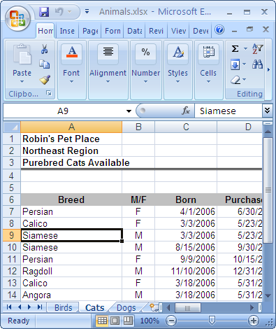
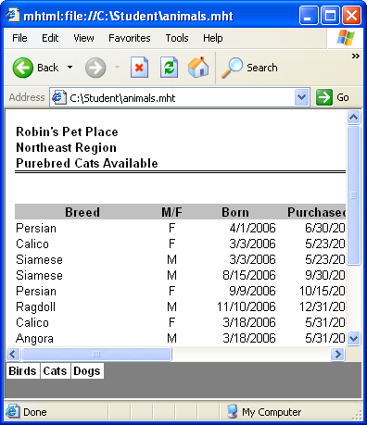
Publish a Worksheet to the Web (Contd.)
The following figure shows an Excel worksheet data
published as a Web page.
Excel worksheet data
published as a web page
Data in Excel worksheet
Notes:
Additional Input:
Tell the students that they don’t need HTML knowledge to save an Excel worksheet as a Web page. They can save a worksheet as a Web page using the Web Page or Single File Web Page format. The Web Page format saves the worksheet as an HTML file and a folder that stores supporting files, such as a file for each graphic, worksheet, and so on. Excel selects the appropriate graphic format for you based on the image's content. A Single File Web Page format saves all the elements of a Web site, including text and graphics, into a single file in the MHTML format, which is supported by Internet Explorer 4.0.1 or later.

Slide 29
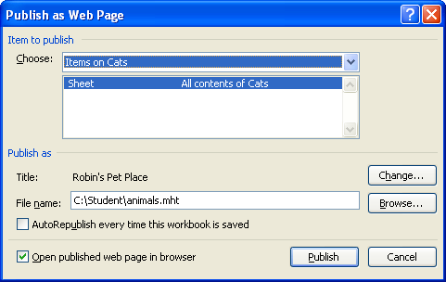
Publish a Worksheet to the Web (Contd.)
The Publish As Web Page dialog box:
  Allows you to transform Excel data into a Web page that can be uploaded to a Web server.
  Contains various options as shown in the following figure to publish Excel data to a Web page.
Notes:
Additional Input:
You can use the following link to have more information on saving a worksheet from the topic ‘Learn more about saving worksheet to a static Web page’
http://office.microsoft.com/en-us/excel/HA102200031033.aspx

Slide 30
Demo: Publishing a Worksheet to the Web
Scenario:
  For some reason, at Robin’s Pet Place, cats don’t seem to be selling as fast as the other animals. The owner has decided to have the Cats worksheet in the Animals workbook available on the Internet to see if that will generate more sales. She also wants the web page to reflect any and all changes she makes in the Animals workbook every time she saves it, so that the latest information is always available on the Internet. She has decided to name the web page Robin’s Pet Place – Purebred Cats Available, and name the file My Cats Page.

Slide 31
Demo: Publishing a Worksheet to the Web (Contd.)
Solution:
  To solve the preceding scenario, you need to perform the following tasks:
    Specify a file name for the Cats worksheet to be saved as a web page.
    Set a title for the web page.
    Publish the Cats worksheet as a web page.
Notes:
Discuss the scenario of Activity 7-1 of Lesson 7 in the Student Guide with the students.
You can access the data file for this activity from the following path in the TIRM CD:
TIRM\DATAFILES FOR FACULTY\LEVEL 3\Using Excel with Web\Animals.xlsx

Slide 32
Import Data from the Web
You can import data from Web to use it in your workbook.
In order to capture data from the web, you can import the data and be sure you get exactly the data you wanted.

Slide 33
Demo: Importing Data from the Web
Scenario:
  The President of Robin’s Pet Place is considering doing business in other countries. She asked you to download information from the web on currency rates to a new workbook so that she can review them.

Slide 34
Demo: Importing Data from the Web (Contd.)
Solution:
  To solve the preceding scenario, you need to perform the following tasks:
    Open the currency rate information to be imported from the web into the Currency Rates workbook.
    Import the currency rate information.
Notes:
Discuss the scenario of Activity 7-2 of Lesson 7 in the Student Guide with the students.
You can access the data file for this activity from the following path in the TIRM CD:
TIRM\DATAFILES FOR FACULTY\LEVEL 3\Using Excel with Web\Currency Rates.xlsx

Slide 35
Create a Web Query
A web query:
  Allows you to import data that changes frequently on the web.
  Determines what portions of the web page are available to import.
  Can be used to import a single table, multiple tables, or all of the text on a web page.
A web query is created to import dynamic data from the web.

Slide 36
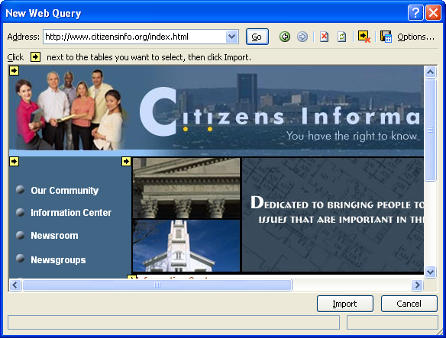
Create a Web Query (Contd.)
The New Web Query dialog box contains various options as shown in the figure to import data from the web by creating a query.
Forward Button
Address Text Box
Hide Icons/
Show Icons
Button
Back Button
Save Query
Button
Web Page
Area
Stop Button
Refresh Button

Slide 37
Discovery Demo 7-3: Identifying How to Create a Web Query
Scenario:
  You have been tracking new video release dates, and the most popular movies on DVD, by analyzing consumer rating on several websites. You need to compile the current data available into a spreadsheet for potential investors and keep the information current for future meetings.

Slide 38
Discovery Demo 7-3: Identifying How to Create a Web Query (Contd.)
Which option allows you to determine the portions of a web page that are available for import?
  A specific type of website.
  A specific format.
  The web administrator.
  The web query.
Notes:
To solve the preceding scenario place these questions and answers before the students.

Slide 39
Discovery Demo 7-3: Identifying How to Create a Web Query (Contd.)
True or False?
  The data inserted into a worksheet using a web query is updated automatically.
    True
    False

Slide 40
Discovery Demo 7-3: Identifying How to Create a Web Query (Contd.)
Which option in the Get External Data group of the Data tab allows you to open the New Web Query dialog box to import data from the web to your Excel worksheet?
  From Other Sources
  From Web
  Existing Connections
  From Text

Slide 41
Discovery Demo 7-3: Identifying How to Create a Web Query (Contd.)
Which option in the New Web Query dialog box will allow you to adjust the way Excel imports data from the web?
  Save Query
  Hide Icons / Show Icons
  Options
  Web page area

Slide 42
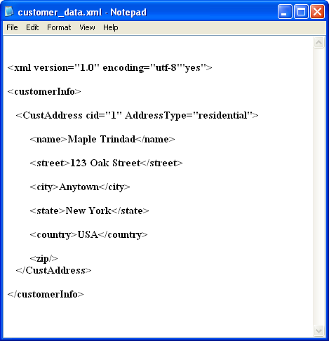
Develop XML Maps
Extensible Markup Language (XML) describes data by creating structured text files.
XML elements contain tags and the data within the tags, as shown in the following figure.
Saved with the .xml
file extension
XML Declaration
Readable and
easy to interpret
Content Within Tags
Tags

Slide 43
Develop XML Maps (Contd.)
XML components:
  The following figure shows various XML components.
Attribute of the
CustAddress element
The Root Element
Content
Opening Tag
Empty Element
Closing Tag

Slide 44
Develop XML Maps (Contd.)
An XML schema:
  Is an XML file that sets rules for XML files.
  Define the data type for the elements and attributes in XML files.
  Is saved with the .xsd file extension.

Slide 45
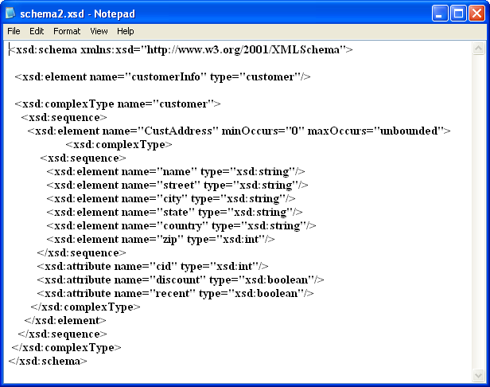
Develop XML Maps (Contd.)
The following figure shows an XML schema.
Saved with the .xsd
file extension
Definition for the
“customerInfo”
root element
Element Name
Definition for the
“CustAddress” element,
which is nested under
the “CustomerInfo”
root element
Definitions for
elements nested
under the
“CustAddress”
element
Data Type

Slide 46
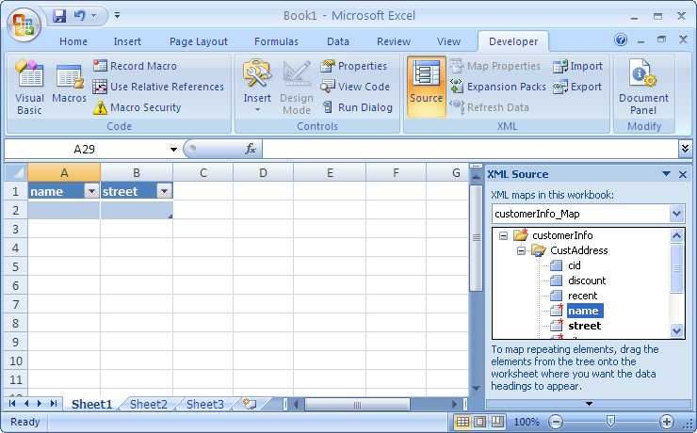
Develop XML Maps (Contd.)
An XML map is an Excel component that maps the contents of an Excel workbook to the corresponding elements of a specified XML schema.
The following figure shows an XML map based on an XML schema.
An XML map based
upon the customerInfo.xsd
XML schema
XML elements mapped
to specific cells
XML elements defined
in the schema

Slide 47
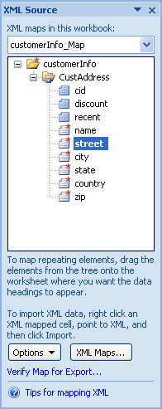
Develop XML Maps (Contd.)
The XML Source task pane contains various options, as shown in the following figure that are used to manage XML maps.

Slide 48
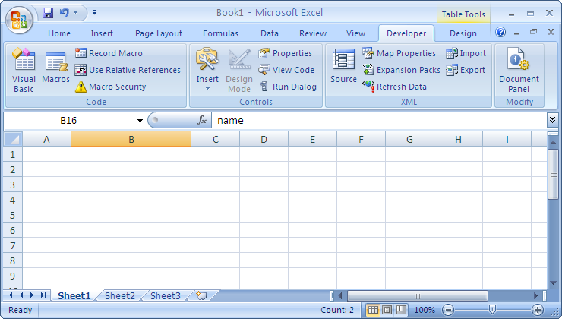
Develop XML Maps (Contd.)
The XML group on the Developer tab has various commands, as shown in the following figure that will allow you to work with XML files in Excel.
The commands in
the XML group

Slide 49
Demo: Developing XML Maps
Scenario:
  Your manager has sent you two XML schemas, Schema1 and Schema2. According to your manager, one of these files handles customer contact information; however, he doesn’t know how to tell which file is which. Once you figure out which schema handles customer contact information, the other map can be deleted. You decide to view both schemas in Excel and then delete the map you are not going to use. You will then map the contents of the correct schema to an Excel sheet and name the workbook My New Customer Data.

Slide 50
Demo: Developing XML Maps (Contd.)
Solution:
  To solve the preceding scenario, you need to perform the following tasks:
    If necessary, display the Developer tab on the Ribbon.
    Add Schema1.xsd and Schema2.xsd to a new, blank workbook.
    Map customer contact information from the XML Source task pane to the worksheet.
    Modify the map you just created.
    Delete the map that does not track
    customer contact information.
Notes:
Discuss the scenario of Activity 8-1 of Lesson 8 in the Student Guide with the students.
You can access the data files for this activity from the following path in the TIRM CD:
TIRM\DATAFILES FOR FACULTY\LEVEL 3\Structuring Workbooks with XML\Schema1.xsd
TIRM\DATAFILES FOR FACULTY\LEVEL 3\Structuring Workbooks with XML\Schema1.xsd

Slide 51
Import and Export XML Data
To manipulate data stored in XML files using the Excel interface, you need to import and export XML data in Excel.
The data in an XML-based workbook can be edited, deleted, cut, pasted, and sorted just like any other data in an Excel sheet.

Slide 52
Demo: Importing and Exporting XML Data
Scenario:
  Your manager has sent you an XML file, Customer Data, that contains customer contact data. You decide to import the XML data into the My New Customer Data workbook, which uses the Schema2 schema. Finally, he needs to create an XML version of the file because he needs to send it to another department that doesn’t use Excel. This new XML file needs to be named My Customer Data Update.

Slide 53
Demo: Importing and Exporting XML Data (Contd.)
Solution:
  To solve the preceding scenario, you need to perform the following tasks:
    Re-create the map in the My New Customer Data workbook so that the XML elements are contiguous.
    Import data for the specified field from the Customer Data XML file into the My New Customer Data workbook.
    Export the data to a new XML file.
Notes:
Discuss the scenario of Activity 8-2 of Lesson 8 in the Student Guide with the students.
You can access the data file for this activity from the following path in the TIRM CD:
TIRM\DATAFILES FOR FACULTY\LEVEL 3\Structuring Workbooks with XML\Customer Data.xml

Slide 54
Summary
In this session, you learned that:
  A workspace is used to manage related sets of data that span across multiple workbooks.
  Data consolidation is the method of summarizing data from several ranges into a single range.
  The linked cells can smooth the workflow by removing the need to open workbooks that contain related data.
  The links can be edit to change the reference to a linked cell in your source workbook.
  File export is a method of sending data that has been created in one application to a different application.
  Delimited text file is a TXT file that contains data fields separated or delimited by certain characters.
Notes:
Use the Summary slide to summarize the session.

Slide 55
Summary (Contd.)
  File publish is a method of publishing data that has been created in an application to a web page.
  A web query allows you to import data that changes frequently on the web.
  An XML schema define the data type for the elements and attributes in XML files.
  The XML group on the Developer tab has various commands that help to work with XML files in Excel.
Notes:
Use the Summary slide to summarize the session.

