Slide 1
Objectives
In this session, you will learn to:
  Sort or filter worksheet or table data
  Calculate data in a table or worksheet
  Create a chart
  Modify charts
  Format charts
  Create a PivotTable report
  Analyze data using PivotCharts
Notes:
Discuss the session objectives with the students.

Slide 2
Sort or Filter Worksheet or Table Data
Sorting:
  Sort is a method of viewing data that arranges all the data into a specific order.
  Data can be sorted in either ascending order or descending order.
  Data can be sorted on a single criterion or multiple criteria.
Notes:
Use the slide to explain how a sort method helps to manipulate the table data. When data is sort, it is possible to create different views of the same data without altering its original format.

Slide 3
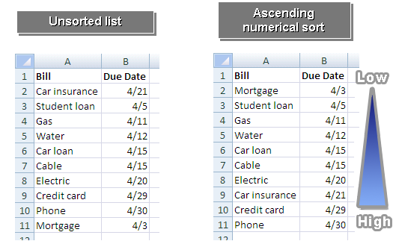
Sort or Filter Worksheet or Table Data (Contd.)
The following figures show the single-level sort in ascending order.
Ascending Numerical Sort
Unsorted List
Low
High
Notes:
Use the figures given in the slide above to explain the sort method. The sort method is applied to the Due Date column of the unsorted list, shown in the slide.

Slide 4
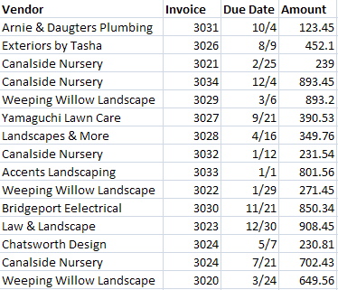
Sort or Filter Worksheet or Table Data (Contd.)
The following figure shows an unsorted list.
Unsorted List
Numerical
Alphabetical

Slide 5
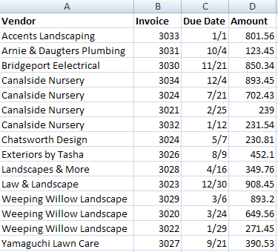
Sort or Filter Worksheet or Table Data (Contd.)
The following figure shows a multiple-level sort in both ascending and descending orders.
Criterion 1
Criterion 2
Sorted List
Low
High
Low
High
High
Low
Alphabetical Ascending Order
Numerical Descending Order
Notes:
The figure in the above slide shows how two criteria's are applied within a single worksheet on the same table. Criteria 2 has been sorted in descending according to the Vendor column. For example, for Weeping Willow Landscape and Canalside Nursery Vendors, the Amount column is sorted in descending order.

Slide 6
Sort or Filter Worksheet or Table Data (Contd.)
Filters:
  A filter is a method of viewing data that shows only the data that meets a criterion.
  Data can be filtered on a single criterion or multiple criteria using numeric and alphabetic information.
  A filter can rearrange the data in the current table or worksheet range, or copy the information to another location.
Notes:
Use the slide to discuss the filter method used to manipulate data.
Refer to Page 47 to discuss about the various filter operators.

Slide 7
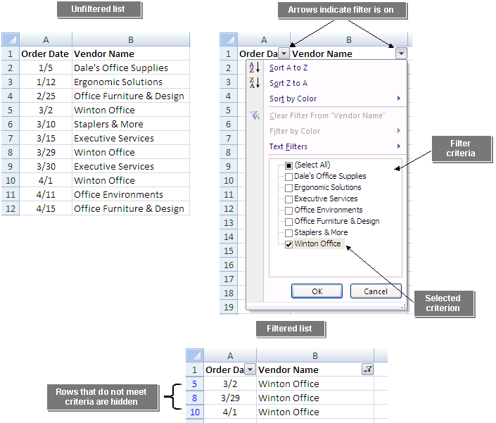
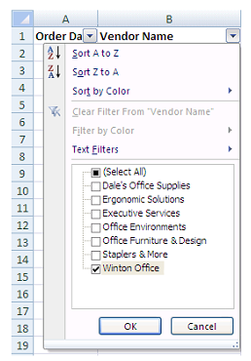
Sort or Filter Worksheet or Table Data (Contd.)
The following figures show the unfiltered and filtered data.
Unfiltered List
Arrows indicate filter is on
Filter Criteria
Filtered List
Rows that do not meet criteria are hidden
Selected Criterion
Notes:
Use the figures given in the slide above to discuss the filter method.

Slide 8
Demo: Sorting and Filtering Tables
Scenario:
  You want to quickly look up employees by having your employee table sorted. You will need to add a new employee to your list so you will be required to re-sort the employees for the new employee to be displayed in the correct physical order. Your manager has asked you for a list of only those employees in the Account Department who have been employed for 10 years or more. After you create the list, you want to display all employees to make future filters easier.
Notes:
Discuss the scenario of Activity 2-4 of Lesson 2 in the Student Guide with the students.
You can access the data file for this activity from the following path in the TIRM CD:
TIRM\DATAFILES FOR FACULTY\LEVEL 2\Organizing Worksheet and Table Data\Tables.xlsx

Slide 9
Demo: Sorting and Filtering Tables (Contd.)
Solution:
  To solve the preceding scenario, you need to perform the following tasks:
    Sort the Employees table by last name in alphabetical order.
    Add a new employee and reapply the sort by Last name.
    Sort the employee table to show the primary order by Department and then by employees who have been employed the longest as the secondary order.
    Display only those employees in the Accounting department with 10 years of service or more.
    Display all employees.
Notes:
Discuss the solution with the students. To demonstrate the solution, access the file provided at the following path in the TIRM CD:
TIRM\Data Files For Faculty\SOLUTIONS\Level 2\Organizing Worksheet and Table Data\My Tables.xlsx

Slide 10
Calculate Data in a Table or Worksheet
When you perform a calculation in a worksheet, you have to choose the data you want included in the calculation:
  This can be very time-consuming if there is a large amount of data.
A database function can find the data you are looking for and perform the calculation all in one step.
Summary functions in tables:
  If your table has a totals row, you can use the drop-down list for each total cell to insert summary results for that column of the table.

Slide 11
Calculate Data in a Table or Worksheet (Contd.)
A database function:
  Performs a calculation only on data that meets certain criteria.
  Starts with the letter D.
  Has three arguments:
    The database
    The field
    The criteria
The following figure shows a database function.
Database Function
Arguments
=DAVERAGE(B1:C17,2,I1:I2)
Function Name
Database
Criteria
Field

Slide 12
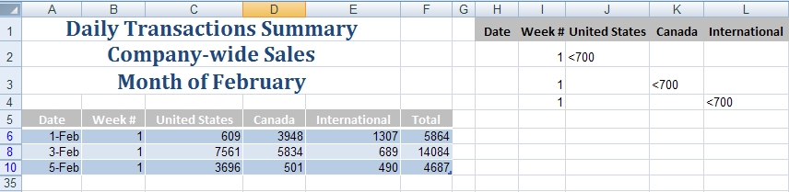
Calculate Data in a Table or Worksheet (Contd.)
AND and OR conditions:
  In an AND condition, criteria appear in multiple columns on the same row in the criteria range.
  In an OR condition, criteria appear in multiple rows in the criteria range.
The following figure shows the AND and OR conditions.
OR Criteria
(separate rows)
Filter records to display Week 1 AND United Sates OR Week 1 AND Canada OR Week 1 AND International
where less than 700 products shipped.
AND Criteria
(same row)
Notes:
Tell the students that in Excel 2007, the AND function can contain a maximum of 255 conditions. For earlier versions of Excel, the limit is 30 conditions.

Slide 13
Calculate Data in a Table or Worksheet (Contd.)
A subtotal:
  Is a function performed on a subset of the data in a worksheet data range that has been sorted.
  Can be created using several functions such as sum, average, and count.
Notes:
A worksheet can have as many subtotal functions as required. You cannot subtotal tables. If there is a need to subtotal table data, then it is required to convert the table to a data range.

Slide 14
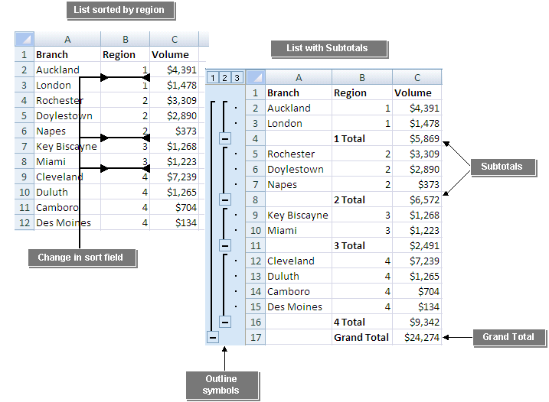
Calculate Data in a Table or Worksheet (Contd.)
The following figures show the subtotal function.
List sorted by region
List with subtotals
Subtotals
Change in sort field
Grand Total
Outline Symbols
Notes:
The figures in the above slide consist of two lists, one sorted by region and other consists of subtotals. The second list shows the grand total of all the subtotals.

Slide 15
Demo: Applying Calculations to a Table or Worksheet
Scenario:
  You have been asked to provide some figures based on the February Sales. The Sales Manager has asked for a list of all the days when total sales were in excess of $8,000. Based on that list, he would like to know the total sales, average sales, and total number of days on the list. Later he requests a list of days when any one on the regions had sales totaling less than $1,000. Finally, he would like a list of all sales for February subtotaled by week.
Notes:
Discuss the scenario of Activity 2-5 of Lesson 2 in the Student Guide with the students.
You can access the data file for this activity from the following path in the TIRM CD:
TIRM\DATAFILES FOR FACULTY\LEVEL 2\Organizing Worksheet and Table Data\Lesson 2\Tables.xlsx

Slide 16
Demo: Applying Calculations to a Table or Worksheet (Contd.)
Solution:
  To solve the preceding scenario, you need to perform the following tasks:
    Calculate the number of days when the total sales for the company is greater than 8000.
    Create a summary area on the worksheet that calculates total, average, and count of the days that the total sales is greater than 8000.
    Perform an advanced filter on the February Sales Calculations list to show all days in February when either the U.S., Canada, or International regions had sales less than 1000.
    Subtotal the February Sales data by week.
Notes:
Discuss the solution with the students. To demonstrate the solution, access the file provided at the following path in the TIRM CD:
TIRM\Data Files For Faculty\SOLUTIONS\Level 2\Organizing Worksheet and Table Data\My Tables.xlsx

Slide 17
Create a Chart
A chart:
  Is a visual representation of data from a worksheet or Excel table.
  Can include:
    Chart title
    Legend
    Scale or values on the vertical axis
    Category on the horizontal axis
  Can be embedded as a graphic object on a worksheet page.
  Can appear on a dedicated chart sheet that contains only the chart and associated chart tools and commands.
Notes:
As an example, show the following file to the students and ask them to analyze Sheet 1 of the file.
TIRM\SOLUTIONS\Level 2\Presenting Data Using Charts\Food Habits.xslx
After 15 minutes of discussion, show the second sheet, Chart 1. Discuss the solution with the students. Ask the students to figure out the difference between the two sheets, Sheet 1 and Chart 1.

Slide 18
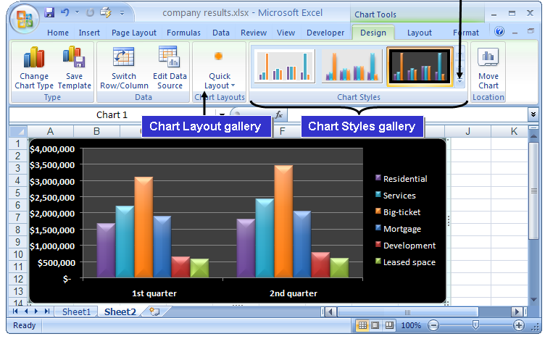
Create a Chart (Contd.)
The following figure shows a chart.
More Button
Notes:
Use the following scenario to discuss the chart given in the slide:
Residential
Services
Big-ticket
Mortgage
Development
Leased space
The Sales department of an organization keeps track of the quarterly profit of the company. In order to show the profit percentage of the company, the Sales department compares the last year’s and the current year’s earnings from these sectors. Thus, for a better understanding, the Sales department creates a chart to present the data.
For example, as shown in the figure, the company earned $3,000,000 from the Big-ticket sector in the first quarter. But in the second quarter, the amount has gone up to $3,500,000, with a profit of $500,000.

Slide 19



Create a Chart (Contd.)
Types of Charts:
Column charts are used to compare values across categories.
Line charts are used to display trends over time.
Pie charts are used to display the contribution of each value to a total.
Notes:
Use the slide to discuss about the different chart types that can be used to create the best representation of a particular data.
Then give a brief overview of the chart insertion methods given in Page 65.
You can also use the following links that discusses the different types of charts that serve different purposes.
http://spreadsheets.about.com/od/c/g/chart_def.htm and
http://office.microsoft.com/en-us/help/HA012337371033.aspx

Slide 20



Create a Chart (Contd.)
Bar charts are used for comparing multiple values.
Area charts are used to emphasize differences between several sets of data over a period of time.
Scatter charts are used to compare pairs of values.
Notes:
You can also use the following link that provides the step-by-step Excel chart tutorial, starting from entering data into the spreadsheet.
http://spreadsheets.about.com/od/excel101/ss/enter_data.htm

Slide 21
Demo: Creating Charts
Scenario:
  You have been asked to present your company’s financial sales report at a board meeting. Your manager has requested that you present the data in a way that the board members will be able to clearly see the relationships between the different sections of the data. You have determined that a bar chart will be used to compare the monthly sales of Books versus CDs and tapes. You would also like to show board members that the sales of fiction has steadily increased during the past year and you will use a line chart to show this trend. To show how the total budget amount has been allocated between departments, you have decided to use a pie chart.
Notes:
Discuss the scenario of Activity 3-1 of Lesson 3 in the Student Guide with the students.
You can access the data file for this activity from the following path in the TIRM CD:
TIRM\DATAFILES FOR FACULTY\LEVEL 2\Presenting Data Using Charts\Charts.xlsx

Slide 22
Demo: Creating Charts (Contd.)
Solution:
  To solve the preceding scenario, you need to perform the following tasks:
    Create a 3-D bar chart from the data to compare the monthly sales of products.
    Create a Line chart to display the trend in fiction sales.
    Create a 3-D Pie chart to display the 2008 budget for each department.
Notes:
Discuss the solution with the students. To demonstrate the solution, access the file provided at the following path in the TIRM CD:
TIRM\Data Files For Faculty\SOLUTIONS\Level 2\Presenting Data Using Charts\My Charts.xlsx

Slide 23
Modify Charts
You can format each chart item to appear exactly as you need to meet your business requirements.
Chart elements:
  Chart title
  Category (X) axis title
  Value (Y) axis title
  Axes
  Gridlines
  Legend
  Data labels
  Data table
Notes:
You can use the following link that provides a demo on creating a combination of Chart in Excel 2007. This link also provides examples for the same.
http://examples.oreilly.com/9780596527594/Excel/Chapter18/Combination-Chart.html

Slide 24
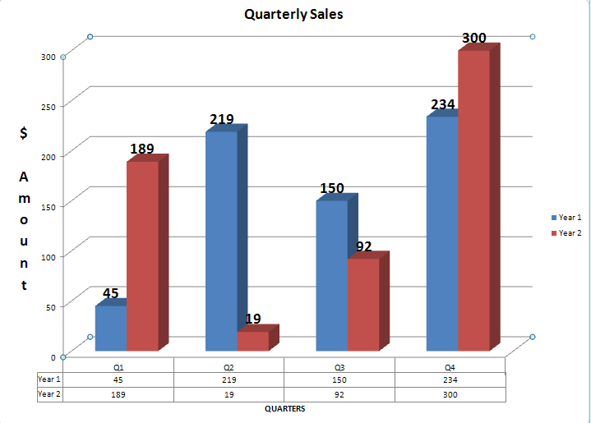
Modify Charts (Contd.)
The following figure shows the chart elements.
Vertical Axis
Title
Data Labels
Legend
Vertical Axis Title
Horizontal Axis
Gridlines
Data Table
Horizontal Axis Title
Notes:
Later, discuss the Chart Tools contextual tabs given in Page 69. These tabs are used to manipulate the appearance and layout of charts.

Slide 25
Demo: Changing a Chart Type
Scenario:
  After reviewing the bar chart, you feel that the data would be better represented in a column chart. You have also decided to increase the size of the line chart.
Notes:
Discuss the scenario of Activity 3-2 of Lesson 3 in the Student Guide with the students.
You can access the data file for this activity from the following path in the TIRM CD:
TIRM\DATAFILES FOR FACULTY\Solutions\LEVEL 2\Presenting Data Using Charts\My Charts.xlsx

Slide 26
Demo: Changing a Chart Type (Contd.)
Solution:
  To solve the preceding scenario, you need to perform the following tasks:
    Change the bar chart to a 3-D Clustered Column chart.
    Increase the size of the line chart by approximately 1 inch.
Notes:
Discuss the solution with the students. To demonstrate the solution, access the file provided at the following path in the TIRM CD:
TIRM\Data Files For Faculty\SOLUTIONS\Level 2\Presenting Data Using Charts\My Charts.xlsx
You tell the students that to use regular text formatting to format the text in chart elements, they can right-click or select the text, and then click the formatting options that they want on the Mini toolbar. They can also use the formatting buttons on the Ribbon (Home tab, Font group of Microsoft Office user interface.

Slide 27
Demo: Modifying a Chart
Scenario:
  You have just created charts for the different sets of data. You have decided to present the pie chart in a separate chart sheet and you would like to modify the chart to include percentages to show the board members how the budget has been divided between the departments. To ensure that the board members can see what the chart represents, you have decided to add a chart title as well as vertical and horizontal axis titles.
Notes:
Discuss the scenario of Activity 3-3 of Lesson 3 in the Student Guide with the students.
You can access the data file for this activity from the following path in the TIRM CD:
TIRM\DATAFILES FOR FACULTY\Solutions\Level 2\Presenting Data Using Charts\My Charts.xlsx

Slide 28
Demo: Modifying a Chart (Contd.)
Solution:
  To solve the preceding scenario, you need to perform the following tasks:
    Move the pie chart to a chart sheet and name the sheet 2008 Budget.
    Modify the pie chart to display each department’s percentage of the total budget for 2008.
    Add the chart title Sales Data to the 3-D column chart.
    On the 3–D column chart, add a horizontal and vertical axis title.
Notes:
Discuss the solution with the students. To demonstrate the solution, access the file provided at the following path in the TIRM CD:
TIRM\Data Files For Faculty\SOLUTIONS\Level 2\Presenting Data Using Charts\My Charts.xlsx

Slide 29
Format Charts
There are many styles and layouts to choose from to format the chart:
  Change the appearance of the chart elements by using options on the Chart Tools Format contextual tab.
  Implement a standard set of chart elements by applying one of the pre-defined chart layouts.
  Customize the appearance of individual chart elements by using the options on the Chart Tools Layout contextual tab.
Notes:
You can use the following link that presents good information about Excel 2007 Formatting options. http://spreadsheets.about.com/od/excelformatting/a/format_hub.htm

Slide 30
Demo: Formatting a Chart
Scenario:
  You have created a line chart to represent the sales trend of fiction book sales. You would like to format the chart to enhance its presentability by having it reflect the same color style as the table. You would also like to exaggerate the horizontal axis of the chart.
Notes:
Discuss the scenario of Activity 3-4 of Lesson 3 in the Student Guide with the students.
You can access the data file for this activity from the following path in the TIRM CD:
TIRM\DATAFILES FOR FACULTY\LEVEL 2\Presenting Data Using Charts\Charts.xlsx

Slide 31
Demo: Formatting a Chart (Contd.)
Solution:
  To solve the preceding scenario, you need to perform the following tasks:
    Apply a chart style to the line chart.
    Apply a chart layout.
    Format the border of the chart.
    Format the horizontal axis.
Notes:
Discuss the solution with the students. To demonstrate the solution, access the file provided at the following path in the TIRM CD:
TIRM\Data Files for Faculty\SOLUTIONS\Level 2\Presenting Data Using Charts\My Charts.xlsx

Slide 32
Create a PivotTable Report
PivotTables:
  A PivotTable report is an interactive worksheet table used to summarize and analyze large amounts of worksheet data quickly.
  You create a PivotTable report from source data in an Excel workbook or from an external data source.
  There are four types of PivotTable fields:
    Page
    Row
    Column
    Data fields
Notes:
Use the slide to discuss about a PivotTable and its types. A PivotTable can quickly combine and compare data to perform analysis on large amounts of data.
Discuss the Food_Habits scenario as discussed earlier in Slide 2 of this session. Now the comparison has to be made for the past four years of data. Tell the students that since the data to be used is in such a large amount, therefore, the PivotTables are used instead of the Charts.
Discuss the solution with the students. To demonstrate the solution, access the file provided at the following path in the TIRM CD:
TIRM\Data Files For faculty\SOLUTIONS\Level 2\Presenting Data Using Charts\Food Habits.xlsx
You can also tell the student that PivotTables allow rapid, dynamic, flexible data analysis. Pivot charts add to the flexibility of pivot tables, allowing the same rapid analysis of displayed data, while sacrificing substantial flexibility of normal Excel charts.
You can use the following link that provides a demo on building a PivotTable in Excel 2007. This link also provides some examples where PivotTable is used.
http://examples.oreilly.com/9780596527594/Excel/Chapter21/Pivot_Tables.html
Additional Input:
Live Microsoft Dynamics data can be delivered in refreshable Excel spreadsheets, such as PivotTables and Pivot charts, to ensure the entire organization is working with consistent, current, and accurate information. Microsoft Office SharePoint Server 2007 allows the users to share and access their Excel spreadsheets via a Web connection and is supported through automated exports directly from within the context of Microsoft Dynamics. Microsoft Dynamics forms, data, and information can be exported to Microsoft Excel from the List Pages and Task Page of Microsoft Dynamics.
By accessing Microsoft CRM information in Excel, the user has the ability to visually understand sales information, discover trends and drill into exceptions. For example, the user can understand and visualize the opportunity pipeline of Microsoft CRM using Microsoft CRM with Excel.

Slide 33
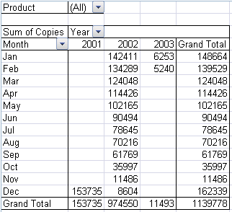
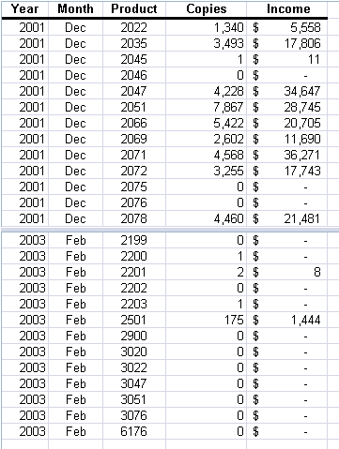
Create a PivotTable Report (Contd.)
The following figures show the four types of PivotTable fields.
Page Fields
Column Fields
Row Fields
Data Fields
Source Data
Notes:
The figures in the above slide consist of the source data from which PivotTable report is generated. The PivotTable report consists of the following four types of PivotTable fields:
Page field
Row field
Column field
Data field
You can also use the following link for having an overview of PivotTable reports and PivotChart reports.
http://office.microsoft.com/en-us/excel/HP101773841033.aspx#About%20PivotTable%20reports

Slide 34
Create a PivotTable Report (Contd.)
The PivotTable Field List pane:
  Appears when you select a PivotTable report.
  Includes Drop Zones into which you can drag and drop fields.
The Value Field Settings dialog box:
  Is used to display or hide subtotals for individual column and row fields.
  Is used to display or hide column and row grand totals for the entire report.
  Is used to calculate the subtotals and grand totals with or without filtered items.
Notes:
Discuss the PivotTable functions given in Page 83. These functions help to create a formula to work with PivotTable data.
You can use the following link that beautifully demonstrates the use of PivotTable report to analyze product sales.
http://office.microsoft.com/home/video.aspx?assetid=ES102390221033&width=884&height=540&startindex=0&CTT=11&Origin=HA102384511033

Slide 35
Demo: Creating a PivotTable
Scenario:
  You have a large volume of information about products that have shipped in the past several months in the Shipping workbook. Your manager has also asked you to print a list of products that have not shipped that were sold by the salesperson Anne Dodsworth. Your manager has requested another report to review the average price of the products Anne shipped the first week in January by company. Since you are confident that your manager will have a similar request in the future, you have decided to create a PivtotTable report to easily extract the information without constantly having to rearrange the data by sorting and re-creating formulas. You have decided to first review Anne’s data using the Sort tool before creating the report.
Notes:
Discuss the scenario of Activity 4-1 of Lesson 4 in the Student Guide with the students.
You can access the data file for this activity from the following path in the TIRM CD:
TIRM\DATAFILES FOR FACULTY\LEVEL 2\Analyzing Data Using PivotTables and PivotCharts\Shipping.xlsx

Slide 36
Demo: Creating a PivotTable (Contd.)
Solution:
  To solve the preceding scenario, you need to perform the following tasks:
    To locate products that have not shipped for Anne Dodsworth sort the worksheet by Salesperson and Shipped Date in ascending order.
    Create a PivotTable report to extract products sold by salesperson and by shipped date.
    Modify the Values field settings to calculate the average Extended Price, replace the column label in the PivotTable report to Average Amount Sold, and change the number format to Currency.
    Create a filter to group the PivotTable by Salesperson and then display products that Anne Dodsworth sold.
    Display products that Anne Dodsworth shipped the first week in January.
Notes:
Discuss the solution with the students. To demonstrate the solution, access the file provided at the following path in the TIRM CD:
TIRM\Data Files for Faculty\SOLUTIONS\Level 2\Analyzing Data Using PivotTables and PivotCharts\My Shipping.xlsx

Slide 37
Demo: Creating a PivotTable (Contd.)
    In the PivotTable report, display which company the products are shipping to.
    Include average subtotals by company and format the PivotTable report.

Slide 38
Analyze Data Using PivotCharts
Graphical representations of data make data analysis easy.
PivotChart reports help facilitate data analysis by graphically representing data from PivotTable reports.
A PivotChart report is an interactive chart that graphically represents the data in a PivotTable report.
Notes:
Students have learned to create PivotTables to analyze the data. Now, they will learn to analyze the data using PivotChart. PivotChart reports help to facilitate data analysis by graphically representing data from PivotTable reports. These PivotTable reports and PivotCharts are used in Microsoft SharePoint Services for data analysis.
You can use the following link that provides an overview of PivotTable reports and PivotChart reports.
http://office.microsoft.com/en-us/excel/HP101773841033.aspx#About%20PivotTable%20reports

Slide 39
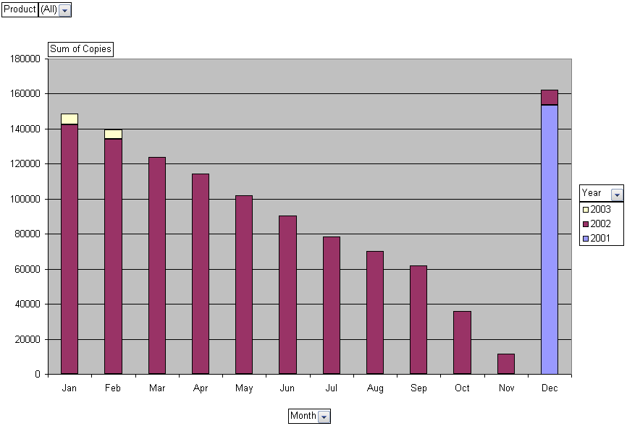
Analyze Data Using PivotCharts (Contd.)
The following figures show an existing PivotTable report and associated PivotChart.
Notes:
The figures in the above slide show a PivotChart generated from a PivotTable report.
You can use the following link that compares PivotTable report and a PivotChart report. In addition, this link also the difference between PivotChart and standard chart.
http://office.microsoft.com/en-us/excel/HP101773841033.aspx#About%20PivotTable%20reports

Slide 40
Demo: Creating a PivotChart
Scenario:
  Your sales managers has asked you to create a column chart, based on the data that is in the Invoices sheet, to show the sales people how they have been doing with their sales to Germany. This is a meeting that is held weekly, and the next week will be presentation on sales to France. You have decided to create a PivotChart to have the flexibility to switch the chart by country.
Notes:
Discuss the scenario of Activity 4-2 of Lesson 4 in the Student Guide with the students.
You can access the data file for this activity from the following path in the TIRM CD:
TIRM\DATAFILES FOR FACULTY\LEVEL 2\Solutions\Analyzing Data Using PivotTables and PivotCharts\My Shipping.xlsx

Slide 41
Demo: Creating a PivotChart (Contd.)
Solution:
  To solve the preceding scenario, you need to perform the following tasks:
    Create a PivotChart.
    Create a PivotChart report filter that will filter the chart by product and/or country, and then filter the chart to display quantity amounts for Germany by sales person.
    Format the PivotChart.
    Change the Chart Title to Germany and remove the Legend.
Notes:
Discuss the solution with the students. To demonstrate the solution, access the file provided at the following path in the TIRM CD:
TIRM\Data Files for Faculty\SOLUTIONS\Level 2\Analyzing Data Using PivotTables and PivotCharts\My Shipping.xlsx
Additional Input:
You can use the following link to know to procedure to delete a PivotTable report or a PivotChart report.
http://office.microsoft.com/en-us/excel/HP100898931033.aspx#Delete%20a%20PivotTable%20report

Slide 42
Summary
In this session, you learned that:
  A sort is a method of viewing data that arranges all the data into a specific order.
  A filter is a method of viewing data that shows only the data that meets a criterion.
  A database function performs a calculation only on data that meets certain criteria.
  A chart enables you to observe a large amount of data and draw relevant conclusions quickly.
  PivotTables and PivotCharts enable you to interactively analyze and manipulate large amounts of data.
  PivotTable reports help you quickly combine and compare data in large worksheets.
  A PivotChart report is an interactive chart that graphically represents the data in a PivotTable report.
Notes:
Use the Summary slide to summarize the session.

