Slide 1
Objectives
In this session, you will learn to:
  Insert and modify pictures and ClipArt
  Draw and modify shapes
  Illustrate workflow using SmartArt graphics
  Layer and group graphic objects
  Customize the Excel environment
  Customize workbooks
  Manage themes
  Create and use templates
Notes:
Discuss the session objectives with the students.

Slide 2
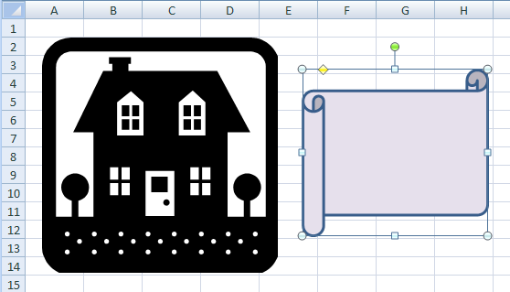
Insert and Modify Pictures and ClipArt
A graphic object is a visual element that can be inserted into a worksheet.
The following figure shows a graphic object.
Adjustment Handle
Rotate Handle
Selection Handles
Graphic Object
(Not Selected)
Graphic Object
(Selected)

Slide 3
Demo: Inserting and Modifying a Picture in a Worksheet
Scenario:
  You have been asked to improve the look of your spreadsheet reports by using graphics to create a logo. Since you have never done this before, you have created a workbook to experiment with the different types of graphics that could be used for a logo.
Notes:
Discuss the scenario of Activity 5-1 of Lesson 5 in the Student Guide with the students.
You can access the data file for this activity from the following path in the TIRM CD:
TIRM\DATAFILES FOR FACULTY\LEVEL 2\Inserting Graphic Objects\Graphics.xlsx

Slide 4
Demo: Inserting and Modifying a Picture in a Worksheet (Contd.)
Solution:
  To solve the preceding scenario, you need to perform the following tasks:
    Insert the globe graphic onto the worksheet Globe.
    Apply Picture Style 4 to the graphic.
    Resize the picture so that it is 1.5 inches wide and 1.5 inches tall.
    Apply the Sun picture shape to the globe graphic.
    Apply a blue 1 1/2 pt picture border.
    Apply a 3–D preset picture effect.
Notes:
Discuss the solution with the students. To demonstrate the solution, access the file provided at the following path in the TIRM CD:
TIRM\Data files For Faculty\SOLUTIONS\Inserting Graphic Objects\My Graphics.xlsx

Slide 5
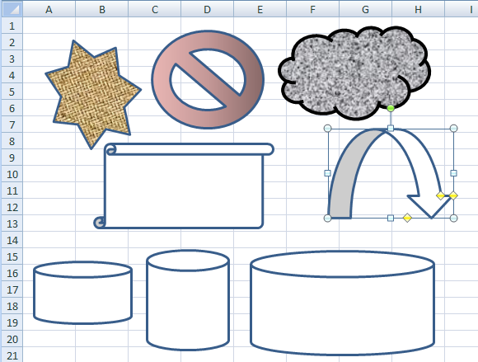
Draw and Modify Shapes
Shapes are simple geometric objects that you can draw and modify as needed to enhance your worksheets.
The following figure shows the shapes.
Formatted
Shapes
Selected
Shape
Handles
Resized Shapes
Notes:
The lines and shapes help to add emphasis to a particular area of a worksheet. They can create custom graphics easily by using Excel’s library of lines and shapes.

Slide 6
Draw and Modify Shapes (Contd.)
The various types of shapes include:
  Lines, arrows and connectors
  Rectangles and other geometric shapes
  Block-style arrows
  Mathematical symbols for equations
  Flowchart elements
  Stars and banners
  Callouts in various forms

Slide 7
Demo: Drawing and Modifying Shapes
Scenario:
  You have been trying to come up with a simple diagram to illustrate some ideas at a meeting and would like to augment the words you have chosen with graphics. Since you have never done this before, you will begin by inserting a graphic object onto a practice worksheet and then formatting the graphic so that the text displays through the graphic. You have also decided to include an arrow that will point to the next graphic.
Notes:
Discuss the scenario of Activity 5-2 of Lesson 5 in the Student Guide with the students.
You can access the data file for this activity from the following path in the TIRM CD:
TIRM\DATAFILES FOR FACULTY\Solutions\LEVEL 2\Inserting Graphic Objects\My Graphics.xlsx

Slide 8
Demo: Drawing and Modifying Shapes (Contd.)
Solution:
  To solve the preceding scenario, you need to perform the following tasks:
    On the Shape Drawing worksheet, insert a rectangular shape over the text in cell B4.
    Change the transparency of the rectangle to 75 percent.
    Draw an arrow shape whose positioning handles trace the range C5:C7.
    Rotate the Down Arrow shape counter-clockwise approximately 45 degrees to line its head up so that it points to Larger Market Share.
Notes:
Discuss the solution with the students. To demonstrate the solution, access the file provided at the following path in the TIRM CD:
TIRM\Data Files for Faculty\SOLUTIONS\Level 2\Inserting Graphic Objects\My Graphics.xlsx

Slide 9
Illustrate Workflow Using SmartArt Graphics
A SmartArt graphic:
  Is a custom-made visual representation of the relationships between data, events, or ideas.
  Combines graphic objects with text and connector symbols to create complex custom illustrations.
Notes:
SmartArt graphics are used to create a comprehensive workflow diagram that helps to present a complicated workflow process.

Slide 10
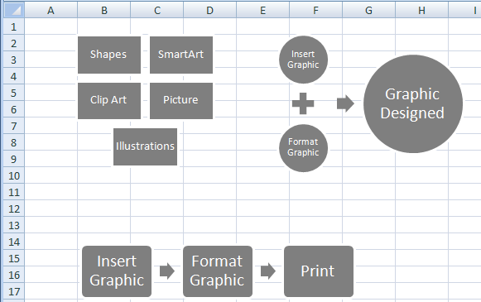
Illustrate Workflow Using SmartArt Graphics (Contd.)
The following figure shows SmartArt layouts.
Relationship
List
Process
Notes:
The SmartArt gallery, in the Illustrations group on the Insert tab, displays SmartArt layouts in seven categories. Refer to page 110 to list all the seven categories. Each category contains a variety of layouts for showing the appropriate type of relationship, sequence, or hierarchy between the components of the SmartArt object.
The figure given in the above slide shows three categories of SmartArt layouts:
List
Process
Relationship

Slide 11
Demo: Inserting a SmartArt Graphic
Scenario:
  You have an upcoming sales meeting where the intention is to motivate the sales people. You have decided to create a colorful process diagram that depicts the process steps for a successful salesperson.
Notes:
Discuss the scenario of Activity 5-3 of Lesson 5 in the Student Guide with the students.
You can access the data file for this activity from the following path in the TIRM CD:
TIRM\DATAFILES FOR FACULTY\Solutions\LEVEL 2\Inserting Graphic Objects\My Graphics.xlsx

Slide 12
Demo: Inserting a SmartArt Graphic (Contd.)
Solution:
  To solve the preceding scenario, you need to perform the following tasks:
    On the SmartArt worksheet, insert a Basic Process SmartArt graphic.
    Enter the captions for the process steps.
    Add a new “Teamwork” step between process steps 2 and 3.
    Change the colors of the four process steps.
    Reposition the process steps into a zigzag configuration.
    Apply the 3-D Inset SmartArt style to the SmartArt graphic.
    Apply a Glow effect to the SmartArt graphic.
Notes:
Discuss the solution with the students. To demonstrate the solution, access the file provided at the following path in the TIRM CD:
TIRM\Data files for Faculty\SOLUTIONS\Level 2\Inserting Graphic Objects\My Graphics.xlsx

Slide 13

Layer and Group Graphic Objects
Layering is a method of displaying graphics that overlap other graphics in a specific order.
The following figure shows the layering method.
Middle Layer
Back Layer
Back Layer
Front Layer
Middle Layer
Front Layer
Front layer
opaque
Front layer
transparent
Notes:
A worksheet may require creation of complex designs to integrate separate graphics in a narrow space. To control the position of graphics, you can use the layers and can form groups of graphics.

Slide 14
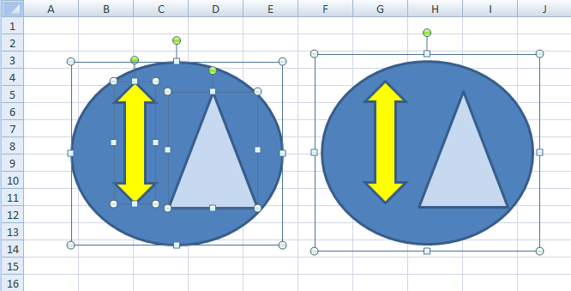
Layer and Group Graphic Objects (Contd.)
Grouping is a method of connecting multiple graphics so that you can manipulate them as a unit.
The following figure shows the grouping method.
Grouping is a method of connecting multiple graphics so that you can manipulate them as a unit.
Not Grouped
Grouped
Notes:
Use the figure given in the above slide to show the difference between ungrouped and grouped images.

Slide 15
Demo: Layering and Grouping Graphics
Scenario:
  You have been developing a simple logo graphic from three drawn shapes: a blue square, a magenta square, and a yellow parallelogram. You are trying to decide on the best perspective by changing the shapes’ layering order.
Notes:
Discuss the scenario of Activity 5-4 of Lesson 5 in the Student Guide with the students.
You can access the data file for this activity from the following path in the TIRM CD:
TIRM\DATAFILES FOR FACULTY\LEVEL 2\Inserting Graphic Objects\Graphics.xlsx

Slide 16
Demo: Layering and Grouping Graphics (Contd.)
Solution:
  To solve the preceding scenario, you need to perform the following tasks:
    On the Layering And Grouping worksheet, change the layering so that the magenta square is layered in front of the other two shapes.
    Change the layering so that the magenta square is layered in front of the yellow parallelogram but not the blue square.
    Select the two squares and the parallelogram.
    Group the shapes.
    Resize the graphic and then create a duplicate.
    Move the duplicated images.
Notes:
Discuss the solution with the students. To demonstrate the solution, access the file provided at the following path in the TIRM CD:
TIRM\Data Files for Faculty\SOLUTIONS\Level 2\Inserting Graphic Objects\My Graphics.xlsx

Slide 17
Customize the Excel Environment
Excel provides options that enable you to display the elements you require.
The Popular category in the Excel Options dialog box enables you to personalize Excel environment settings.

Slide 18
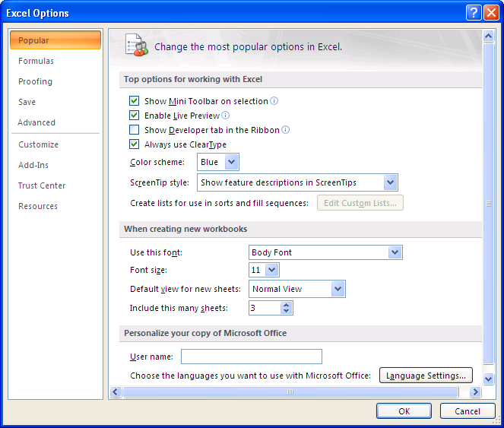
Customize the Excel Environment (Contd.)
The following figure shows the Popular category in the Excel Options dialog box.
Popular category
Notes:
Use the figure given in the above slide to discuss about various items on the Popular category in the Excel Options dialog box. Refer to page 122 to discuss these options.
These options are used to customize the Excel interface to suit our requirements.

Slide 19
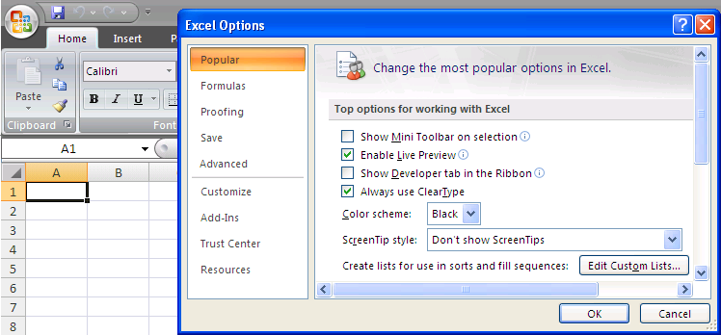
Customize the Excel Environment (Contd.)
A color scheme is a defined set of colors used to control the overall appearance of the Excel application.
The default color scheme is Blue, but you can select other color schemes.
The following figure shows a Black color scheme.
Excel environment with a different Color Scheme

Slide 20
Demo: Customizing Display Options in Excel
Scenario:
  After working with Excel for some time, you decide there are some changes to the application you would like to make. You want your initials to be attached to files that you create and would like to change the overall color scheme to silver. You have seen some people work in Excel without displaying the Ribbon all the time. You want to investigate the Ribbon display choices and choose one for your working environment.
Notes:
Discuss the scenario of Activity 6-1 of Lesson 6 in the Student Guide with the students.
You can access the data file for this activity from the following path in the TIRM CD:
TIRM\DATAFILES FOR FACULTY\LEVEL 2\Customizing and Enhancing Workbooks and the Excel Environment\Billing Statement.xlsx

Slide 21
Demo: Customizing Display Options in Excel (Contd.)
Solution:
  To solve the preceding scenario, you need to perform the following tasks:
    Change the color scheme of the Excel user interface and enter your initials as the user name.
    Investigate the Ribbon to display options and choose one to suit your preference.

Slide 22
Customize Workbooks
To provide all the information necessary to your workbook in a stylish and an efficient manner, you can customize the appearance of your workbook.
A comment:
  Is the text that pertains to the contents of a specific cell.
  Is displayed in a pop-up text box rather than a cell in the worksheet.
  Can be used in any cell, regardless of the type of data that cell contains.
  Is hidden by default.
  Is visible only when you hover the mouse pointer over the cell that contains the comment.
Notes:
Besides customizing the overall Excel interface, a user can customize individual workbooks also to suit their requirements.

Slide 23
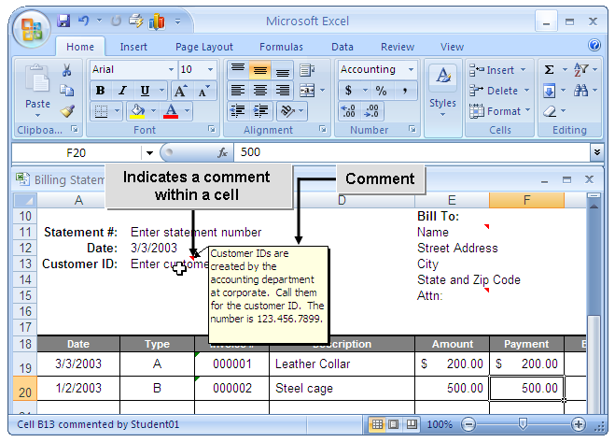
Customize Workbooks (Contd.)
The following figure shows how a comment is displayed in a workbook.
Indicates a comment within a cell
Comment
Notes:
The figure in the above slide shows an Excel worksheet with a comment added to the cell B13.

Slide 24
Customize Workbooks (Contd.)
Hyperlink:
  Is a link within a document that provides quick access to related information.
  Appears in the document as text or a picture.
  Opens the target data in the application when selected.

Slide 25
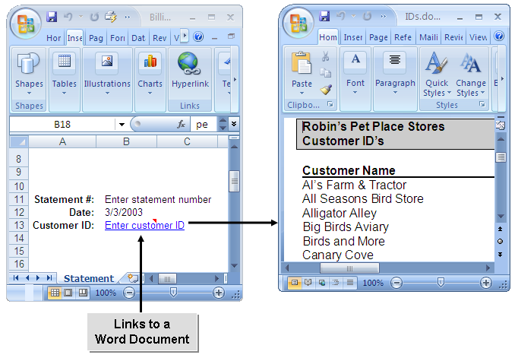
Customize Workbooks (Contd.)
The following figures show a hyperlink.
Links to a Word Document
Notes:
The figures in the above slide show an Excel file and a Word document. The Excel file consists of Customer ID as a hyperlink, which when clicked, opens the Word document. The Word document, in turn, provides the corresponding Customer’s name.

Slide 26
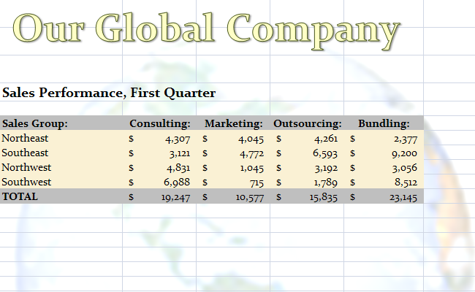
Customize Workbooks (Contd.)
Watermarks in Excel:
  Are the text or graphical element that appears as a background on every page of a printed document.
  Help identify the status, urgency, or ownership of a document.
  Are implemented by inserting a graphic of an appropriate size in the header or the footer area of the worksheet.
The following figure shows a watermark in an Excel worksheet.
Watermark

Slide 27
Demo: Adding Comments and Hyperlinks to a Workbook
Scenario:
  You created a billing statement that you want to have all stores use. After demonstrating it to an internal group, they have asked for the statement to include comments in the Customer Name and the Customer ID cells. It was also suggested that it would be helpful to quickly reference the customer ID numbers which are in a Microsoft Word file. You have decided to create a link between the two files.
Notes:
Discuss the scenario of Activity 6-2 of Lesson 6 in the Student Guide with the students.
You can access the data file for this activity from the following path in the TIRM CD:
TIRM\DATAFILES FOR FACULTY\LEVEL 2\Customizing and Enhancing Workbooks and the Excel Environment\Billing Statement.xlsx

Slide 28
Demo: Adding Comments and Hyperlinks to a Workbook (Contd.)
Solution:
  To solve the preceding scenario, you need to perform the following tasks:
    Add comments to cells A13 and E11.
    Modify the comment in cell E11.
    Add a hyperlink to quickly look up the Customer ID for Canary Cove.
    Prepare the file for printing by the Accounting department.
Notes:
Discuss the solution with the students. To demonstrate the solution, access the file provided at the following path in the TIRM CD:
TIRM\Data Files For Faculty\SOLUTIONS\Level 2\Customizing and Enhancing Workbooks and the Excel Environment\My Billing Statement.xlsx

Slide 29
Manage Themes
A theme:
  Is a unified set of formatting and appearance settings that can be applied to a workbook as a whole.
  Appears in the Themes gallery.

Slide 30
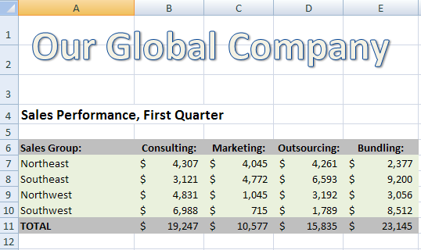
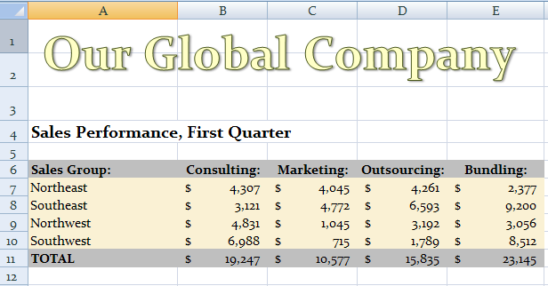
Manage Themes (Contd.)
The following figures show the use of themes in an Excel worksheet.
Office Theme
Column Letter
Style and Size
WordArt Default
Font Color/Style
Table Default
Font Color/Style
Row Number
Style and Size
Paper Theme
Column Letter
Style and Size
WordArt Default
Font Color/Style
Table Default
Font Color/Style
Notes:
The figures in the above slide show the first quarter sales performance of Our Global Company. In addition, the figures show the Paper and Office themes applied to the sales data of various regions of Our Global Company.

Slide 31
Manage Themes (Contd.)
Theme modification options:
  You can select a different set of colors, fonts, and effects to use in the theme.
  You can create new colors to apply to different theme elements.
  You can create new fonts to apply to different theme elements.
Notes:
Later discuss the options of the Theme Colors section in the Create New Theme Colors dialog box given in page 132. These options are used to set theme colors for the different elements on a worksheet.

Slide 32
Demo: Managing Themes
Scenario:
  You have been asked to create a custom theme to be applied to all workbooks that has the company’s colors and preferred fonts using the following:
    Aspect Theme
    Foundry Colors
    Office Fonts
Notes:
Discuss the scenario of Activity 6-3 of Lesson 6 in the Student Guide with the students.
You can access the data files, in the following order, for this activity from the following path in the TIRM CD:
TIRM\Data Files for Faculty\SOLUTIONS\Level 2\Customizing and Enhancing Workbooks and the Excel Environment\My Billing Statement.xlsx
TIRM\DATAFILES FOR FACULTY\LEVEL 2\Customizing and Enhancing Workbooks and the Excel Environment\Formatted Tables.xlsx

Slide 33
Demo: Managing Themes (Contd.)
Solution:
  To solve the preceding scenario, you need to perform the following tasks:
    Change the theme of the workbook to Aspect.
    Modify the Aspect theme and save the changes.
    Test the custom theme by applying it to another workbook.
Notes:
Discuss the solution with the students. To demonstrate the solution, access the file provided at the following path in the TIRM CD:
TIRM\Data Files For Faculty\SOLUTIONS\Level 2\Customizing and Enhancing Workbooks and the Excel Environment\My Formatted Tables.xlsx

Slide 34
Create and Use Templates
A template:
  Is a worksheet that contains preconfigured formatting, formulas, and text.
  May contain standard data that can be used in a combination with any other data that users can enter.
  Is saved with a file extension .xltx.
Notes:
You can tell the students that a user can reuse the basic workbook structure as a template so that there is no need to build an entire workbook from scratch.
In addition, when a workbook is created from a template, the default file name of the workbook is the same as the file name of the template with a number added to it. In addition, the file extension changes from .xltx for a template to .xlsx, indicating that a workbook has been created from that template.

Slide 35
Create and Use Templates (Contd.)
Types of templates:
  Predefined templates
  Custom templates
Some predefined templates are installed when you install Excel, such as the Billing Statement and Expense Report templates.
Notes:
You tell the students that a template is selected from the Templates section of the New Workbook window. In addition, templates can be selected by using the following ways:
Choose from templates that are already installed in Excel 2007.
Choose from the various template categories available from the Microsoft Office Online site.
Enter search text to locate a particular type of template on Office Online.

Slide 36
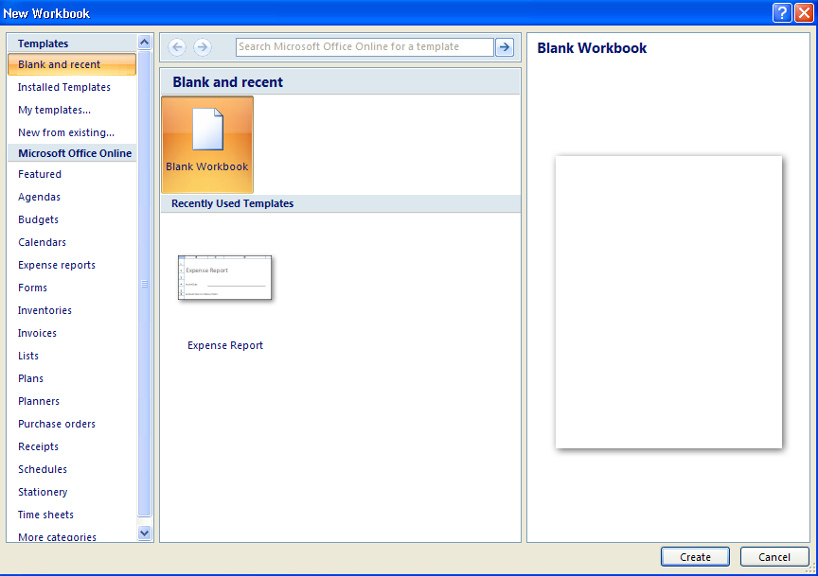
Create and Use Templates (Contd.)
The following figure shows the types of Excel templates.

Slide 37
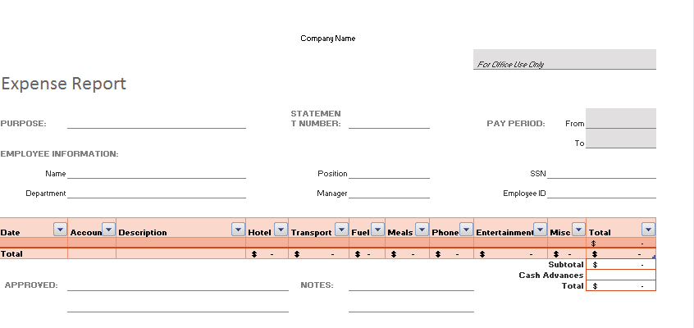
Create and Use Templates (Contd.)
The following figure shows an Expense Report template.

Slide 38
Demo: Creating a Workbook from a Template
Scenario:
  The Director would like all store managers to begin using the Billing Statement and you have been asked to create a template from the workbook. As the Store Manager of Store 1001, you want to store your company information in the template, update the template, and test it for use.
Notes:
Discuss the scenario of Activity 6-4 of Lesson 6 in the Student Guide with the students.
You can access the data file for this activity from the following path in the TIRM CD:
TIRM\DATAFILES FOR FACULTY\Solutions\LEVEL 2\Customizing and Enhancing Workbooks and the Excel Environment\My Billing Statement.xlsx

Slide 39
Demo: Creating a Workbook from a Template (Contd.)
Solution:
  To solve the preceding scenario, you need to perform the following tasks:
    As an employee at headquarters, enter generic text in the Workbook and then save it as a template.
    As the Store Manager, personalize the template and update it.
    Test the My 1001 Billing Statement template.
Notes:
Discuss the solution with the students. To demonstrate the solution, access the file provided at the following path in the TIRM CD:
TIRM\Data Files for Faculty\SOLUTIONS\Level 2\Customizing and Enhancing Workbooks and the Excel Environment\My First Statement.xlsx

Slide 40
Summary
In this session, you learned that:
  A graphic object is a visual element that can be inserted into a worksheet.
  A SmartArt graphic combines graphic objects with text and connector symbols to create complex custom illustrations.
  Lines and shapes can help to add emphasis or draw attention to a particular area of a worksheet.
  Layering is a method of displaying graphics that overlap other graphics in a specific order.
  Grouping is a method of connecting multiple graphics so that you can manipulate them as a unit.
  A color scheme is a defined set of colors used to control the overall appearance of the Excel application.
Notes:
Use the Summary slides to summarize the session.

Slide 41
Summary (Contd.)
  A comment is the text that pertains to the contents of a specific cell.
  Hyperlink is a link that appears as a text or a picture within a document and provides quick access to related information.
  Watermarks in Excel help identify the status, urgency, or ownership of a document.
  A template is a worksheet that contains preconfigured formatting, formulas, and text.

