Slide 1
Objectives
In this session, you will learn to:
  Administer digital signatures
  Restrict document access
  Trace precedents and dependents of a cell
  Troubleshoot errors in formulas
  Troubleshoot invalid data and formulas
  Watch and evaluate formulas
  Create a data list outline
  Create a trendline
  Create scenarios
  Perform what-if analysis
  Perform statistical analysis
Notes:
Share the objectives with the students.

Slide 2
Administer Digital Signatures
Digital signature:
  Is a content authentication tool that authenticates the originator of a file.
  Ensures the integrity of digital documents.
  Validates the authenticity, integrity, and origin of the document.
Notes:
You can use the following link for more information on digital signatures.
http://office.microsoft.com/en-us/excel/HA012308751033.aspx#1
Tell the students that the digital signature is lost when they use an earlier version of an Excel program to open a file that was saved in Office Excel 2007 program. This problem is because the digital signature format in Office Excel 2007, is incompatible with the digital signature format in earlier versions of these programs. ( This problem persists for other Microsoft Office programs)

Slide 3
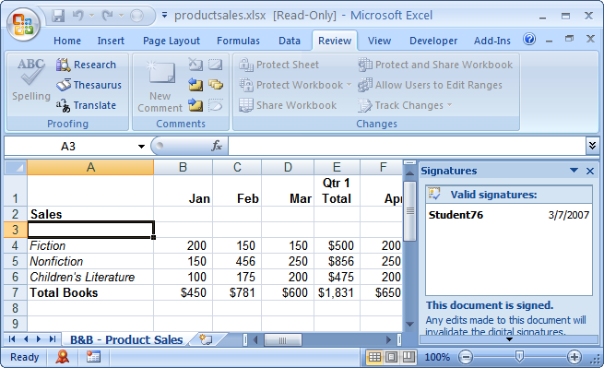
Administer Digital Signatures (Contd.)
The following figure shows a file with a digital signature.
Document with a digital
signature becomes uneditable
Details about the
digital signature
Icon indicative of a
digital signature

Slide 4
Administer Digital Signatures (Contd.)
Digital certificate:
  Is an electronic file that contains unique information about a specific person.
  Contains:
    A serial number.
    The digital signature of the certificate-issuing authority.
    Expiration dates.
    A name.
    A copy of the certificate holder’s public key.
  Is issued by a Certification Authority (CA).
Notes:
Tell the students how the digital signatures work.
Digital signatures use digital certificates that are issued by a trusted third party called a Certification Authority (CA). The CA is a server running certificate services software, such as the Certificate Services included in Windows 2000 Server, Windows Server 2003, and Windows Server 2005. The CA can be internal, running on a computer on a company’s local area network, or it can be an external or public CA, such as those run by VeriSign, Thawte, and other companies. Either way, the CA verifies the identity of the user or computer to which it issues a digital certificate. The digital certificate is based on asymmetric or public key cryptography.

Slide 5
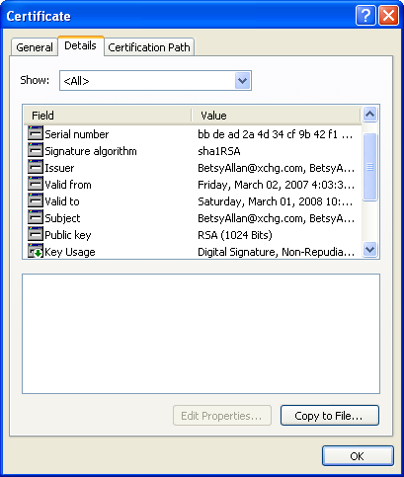
Administer Digital Signatures (Contd.)
The following figure shows a digital certificate.
Unique information about
a specific person

Slide 6
Demo: Administering Digital Signatures
Scenario:
  Your company has assigned you a digital ID. With it, you need to digitally sign the employee contact information document, so that when your manager requests the file, she can confirm that it came from you. The second thing she needs you to do is open the Allan workbook and install Betsy Allan’s certificate on your computer, because you will regularly be corresponding with her.

Slide 7
Demo: Administering Digital Signatures (Contd.)
Solution:
  To solve the preceding scenario, you need to perform the following tasks:
    Digitally sign the file.
    Install the digital certificate in the Allan workbook to your Trusted Root Certification Authorities store.
    View Betsy Allan’s digital certificate installed on your computer.
Notes:
Discuss the scenario of Activity 2-2 of Lesson 1 in the Student Guide with the students.
You can access the data files for this activity from the following path in the TIRM CD:
TIRM\DATAFILES FOR FACULTY\LEVEL 3\Collaborating with Others\Employee Contact Info.xlsx
TIRM\DATAFILES FOR FACULTY\LEVEL 3\Collaborating with Others\Allan.xlsm

Slide 8
Restrict Document Access
You can ensure that the workbook is modified only by people to whom you assign permissions by restricting the document permissions.
Information Rights Management (IRM):
  Is a service that permits users and administrators to define permissions for users to access presentations, documents, workbooks, and other Office suite application documents.
  Enables you to prohibit the printing, forwarding, or copying of sensitive data.
Notes:
Explain the need for restricting document access to the students by using the following example.
You want to report quarterly financial data only to selected members of an executive committee one month before the data becomes publically available in a financial statement, so they have time to prepare public relation responses and make appropriate business decisions. In this situation, this financial data needs to be provided restricted access.
For more information on how document permissions are assigned in Excel 2007 using IRM and workbook protect use the following link.
http://office.microsoft.com/en-us/products/FX101153381033.aspx
Additional Input:
Tell the students that they can restrict document access using Windows SharePoint Services.
Windows SharePoint Services Version 3.0 or later supports IRM on a document library and all the documents in that library (whether or not those individual documents are enabled with IRM). Once the document is uploaded to a document library enabled with IRM, the document, in effect, becomes IRM-enabled.
Excel Services is a Microsoft Office SharePoint technology that makes it simple to use, share, secure, and manage Microsoft Office Excel 2007 workbooks (.xslx, xslb) as interactive reports in a consistent way throughout the enterprise.
Excel Services does not support loading Excel workbooks that have been enabled with IRM, and it does not load an Excel workbook if it is enabled with IRM or comes from a document library enabled with IRM. However, if you want to take advantage of IRM, you can load an Excel workbook without IRM into Excel Services, open the workbook as a snapshot, and then save the snapshot to a document library that is enabled with IRM.

Slide 9
Restrict Document Access (Contd.)
The Mark As Final command:
  Enables you to certify a document as final.
  Protects a document from further modifications.
After marking a workbook final, all editing commands are disabled, and the workbook goes into a read-only mode.

Slide 10
Demo: Restricting Document Access
Scenario:
  You have a workbook that contains the quarterly sales data of the financial year. You want to send it to the finance manager, Betsy Allen, for review, and in case she has any edits to make, you also want to grant her permission to do so. Since this is confidential information, sharing the file could lead to some unnecessary tampering by external sources; therefore, you want to set permission in a manner that only the financial manager can edit the document. You also want to set an expiration date for the document so that the document cannot be accessed or opened after a certain period of time.
Notes:
The solution is provided as a simulation in the TIRM CD.
Discuss the scenario of Activity 2-9 of Lesson 2 in the Student Guide with the students.
You can access the simulation for this activity from the following path in the TIRM CD:
TIRM\DATAFILES FOR FACULTY\LEVEL 3\Collaborating with Others\Simulations\Restrict Access_guided.exe

Slide 11
Demo: Viewing a Permission-Restricted Workbook
Scenario:
  You have received quarterly sales data from one of your team members. You verify that you have change permission to the workbook. You review it and notice that the Jazz music sales data for March is incorrect. Therefore, you make the necessary change and save the document.
Notes:
The solution is provided as a simulation in the TIRM CD.
Discuss the scenario of Activity 2-10 of Lesson 2 in the Student Guide with the students.
You can access the simulation for this activity from the following path in the TIRM CD:
TIRM\DATAFILES FOR FACULTY\LEVEL 3\Collaborating with Others\Simulations\View Permission Restrict Access_guided.exe

Slide 12
Demo: Marking a Workbook as Final
Scenario:
  You have created a workbook, incorporated the necessary changes, and had it approved by your manager. Before sending it to your client, you want to share it with your colleague, but do not want her to make any changes to it.

Slide 13
Demo: Marking a Workbook as Final (Contd.)
Solution:
  To solve the preceding scenario, you need to perform the following tasks:
    Mark the workbook as final.
    Verify that the workbook has been marked as final.
Notes:
Discuss the scenario of Activity 2-11 of Lesson 2 in the Student Guide with the students.
You can access the data file for this activity from the following path in the TIRM CD:
TIRM\DATAFILES FOR FACULTY\LEVEL 3\Collaborating with Others\Final.xlsx

Slide 14
Trace Cells
You can troubleshoot a data which you know is incorrect, but you cannot determine what the problem is.
To troubleshoot a formula that is not providing you with the results you expected, you can trace cell precedents and dependents:
  By tracing precedents and dependents of a cell helps you:
    To verify the validity of a given formula.
    To locate formulas in large worksheets.
Notes:
Tell the students that cell dependents are other cells that rely on the current cell for calculation and a cell’s precedents are the cells that are referenced in the cell’s formula.

Slide 15
Trace Cells (Contd.)
Tracer arrows:
  Are graphic illustrations depicting data flow between cells that contain values and those that contain formulas.
  Point in the direction that your data flows.
  Are of the following three types:
    Formula tracer arrows
    Error tracer arrows
    External reference tracer arrows

Slide 16
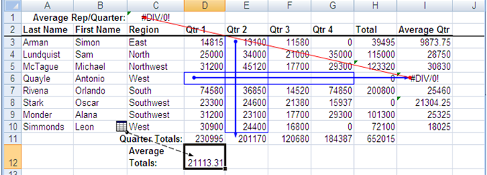
Trace Cells (Contd.)
The following figure shows the three types of tracer arrows.
Error Tracer
Arrows
Formula Tracer
Arrows
Graphic illustrations
depicting data flow
between cells that
contain values and
those that contain
formulas
External Reference
Tracer Arrows

Slide 17
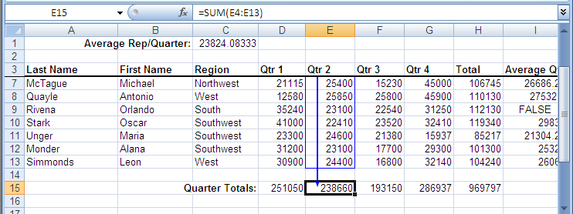
Trace Cells (Contd.)
A cell precedent is a cell reference in a formula that supplies data to the formula.
The following figure shows a cell precedent.
Formula in the
selected cell
Cell reference in a
formula that supplies
data to the formula
Arrow indicating
the cells from where
the data is fetched
for the formula

Slide 18
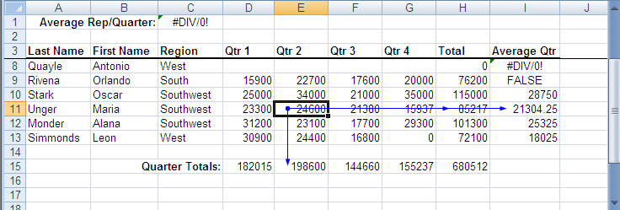
Trace Cells (Contd.)
A cell dependent is a cell that contains a formula referring to other cells.
The following figure shows a cell precedent.
A dependant cell
with a reference
to another cell that
contains a formula
Arrows indicating the
cells that are affected
by the value of the
currently selected cell

Slide 19
Demo: Tracing Precedents and Dependents of a Cell
Scenario:
  In your Auditing workbook, you have entered the details on the first quarter sales. Since this file will be distributed to a number of people, you want to make sure that the cell references used in the formula to calculate the first quarter sales as well as the grand total sales of all the quarters are correct. On completion of that, you need to display arrows that indicate what cells are affected by the value of the cell corresponding to Alana Monder’s quarter 1 sales. You also need to view all relationships for the cell in the worksheet and identify the next level of cells that provide data to the active cell.

Slide 20
Demo: Tracing Precedents and Dependents of a Cell (Contd.)
Solution:
  To solve the preceding scenario, you need to perform the following tasks:
    In the Auditing workbook, trace the precedents for the first quarter total sales.
    Remove the precedent arrows.
    Display two levels of precedent arrows for cell H15 and then remove all the arrows.
    Trace all of the dependents for Alana Monder’s quarter 1 sales.
    Remove all dependent arrows.
Notes:
Discuss the scenario of Activity 3-1of Lesson 3 in the Student Guide with the students.
You can access the data file for this activity from the following path in the TIRM CD:
TIRM\DATAFILES FOR FACULTY\LEVEL 3\Auditing Worksheets\Auditing.xlsx

Slide 21
Troubleshoot Errors in Formulas
When a formula does not display the expected results, you can troubleshoot the errors in that formula:
  This helps you to quickly locate and fix problems in formulas so that they can function properly and provide you with the expected results.
To check for the errors in a formula, you can use the options available in the Error Checking command on the Formula Auditing group of the Formula tab.

Slide 22
Troubleshoot Errors in Formulas (Contd.)
Error types:
  #DIV/0!
  #N/A
  #NAME?
  #NULL!
  #NUM!
  #REF!
  #VALUE!
  ####
Notes:
Additional Input:
You can use this link to add error message to an Excel 2007 spreadsheet:
http://www.homeandlearn.co.uk/excel2007/excel2007s8p4.html

Slide 23
Demo: Troubleshooting Errors in Formulas
Scenario:
  In the Auditing Error workbook, the formula that you have used to calculate the average sales made by each of the sales executives for the second quarter is not displaying the correct values. You need to locate the error and fix it.

Slide 24
Demo: Troubleshooting Errors in Formulas (Contd.)
Solution:
  To solve the preceding scenario, you need to perform the following tasks:
    Trace the error in the average sales per person for the second quarter.
    Make corrections to the formula.
    Test your work.
Notes:
Discuss the scenario of Activity 3-2of Lesson 3 in the Student Guide with the students.
You can access the data file for this activity from the following path in the TIRM CD:
TIRM\DATAFILES FOR FACULTY\LEVEL 3\Auditing Worksheets\Auditing Error.xlsx

Slide 25
Troubleshoot Invalid Data and Formulas
To make optimal use of the data in the worksheet, you need to ensure that the worksheet does not contain invalid information.
You can troubleshoot invalid data and formulas to keep your data accurate.
Invalid Data is any data in a cell that does not conform to the cell’s data validation scheme.

Slide 26
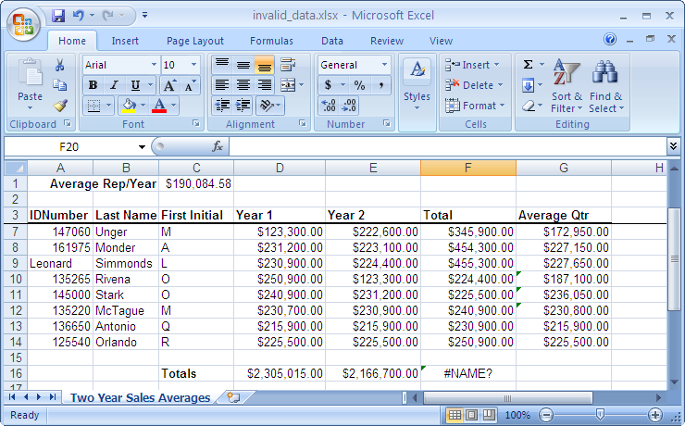

Troubleshoot Invalid Data and Formulas (Contd.)
The following figure shows an Excel file with an invalid data.
Cell with Invalid Data

Slide 27
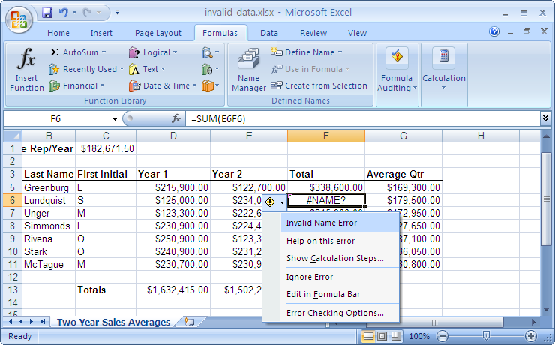
Troubleshoot Invalid Data and Formulas (Contd.)
Error checking:
  If you select a cell with an invalid formula, the Error Checking icon appears next to the cell.
The following figure shows an Excel file with an error checking option.
The Error Checking
button appears next
to the cell with the error
Error Checking
Options

Slide 28
Demo: Troubleshooting Invalid Data and Formulas
Scenario:
  You have just completed developing a worksheet that tracks the total sales for the past two years made by the sales representatives in your company. Before sending the file for review, you decide to verify that all of the data and formulas in the file are valid. During this process you discover that the ID number for Leonard Simmonds is invalid. His actual ID number is 184533. You will also need to check for invalid formulas in the worksheet and fix them.

Slide 29
Demo: Troubleshooting Invalid Data and Formulas (Contd.)
Solution:
  To solve the preceding scenario, you need to perform the following tasks:
    Locate the invalid data in the worksheet.
    Correct the invalid formulas.
Notes:
Discuss the scenario of Activity 3-3 of Lesson 3 in the Student Guide with the students.
You can access the data file for this activity from the following path in the TIRM CD:
TIRM\DATAFILES FOR FACULTY\LEVEL 3\Auditing Worksheets\Quarter Totals.xlsx

Slide 30
Watch and Evaluate Formulas
To monitor formulas during the development process, you can watch and evaluate formulas.
The Watch Window:
  Allows you to view the contents of a cell while the cell itself is off the viewable portion of your screen.
  Identifies the:
    Name of the workbook in which the cell appears.
    Name of the worksheet on which the cell lives.
    Cell reference.
    Value stored in the cell.
    Formula, if any, contained in the cell.

Slide 31
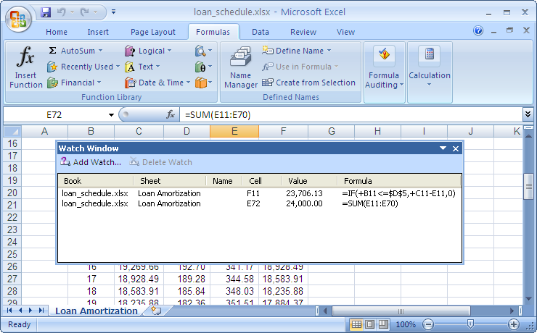
Watch and Evaluate Formulas (Contd.)
The following figure shows the Watch Window.
Watch Window displaying
the contents of the cell that
is off the viewable portion
of the screen

Slide 32
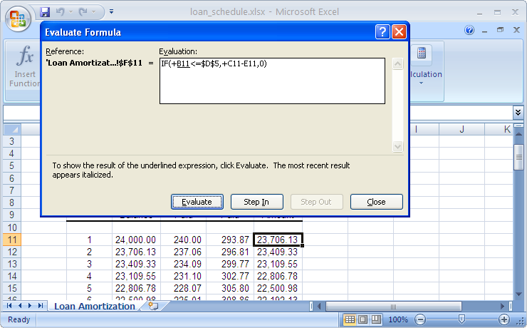
Watch and Evaluate Formulas (Contd.)
Formula evaluation:
  The Evaluate Formula dialog box displays the formula to be evaluated for the selected cell.
The following figure shows the evaluation of a formula for the cell selected in an Excel file.
Formula to be
evaluated for the
selected cell

Slide 33
Demo: Watching and Evaluating Formulas
Scenario:
  The Loan Schedule workbook tracks the amortization for loans that can be paid off in up to 60 months. You want to see the total interest that would be paid for payment terms of 24 and 36 months. Instead of scrolling down to the bottom of the worksheet every time you change the value in the Term In Months field to see the value, you decide to watch the cell that calculates the total interest paid. Additionally, you want to check whether the formula that calculates the principal amount works properly.

Slide 34
Demo: Watching and Evaluating Formulas (Contd.)
Solution:
  To solve the preceding scenario, you need to perform the following tasks:
    Add the cell with the total interest paid data to the Watch Window.
    View the results in the Watch Window for loan repayment periods of 24 months.
    Evaluate the formula for the first instance of the remaining principal amount.
Notes:
Discuss the scenario of Activity 3-4 of Lesson 3 in the Student Guide with the students.
You can access the data file for this activity from the following path in the TIRM CD:
TIRM\DATAFILES FOR FACULTY\LEVEL 3\Auditing Worksheets\Loan Schedule.xlsx

Slide 35
Create a Data List Outline
To analyze and compare a subset of data with the entire worksheet or workbook, you can use the data lists.
Data list outlines allow you to view multiple data lists at the same time.
An outline is a data organizing method in which a set of data is combined to form a group.
Notes:
You can use the following link to use Microsoft Windows® SharePoint™ Services along with the new Excel list feature to collaborate the sales forecasts of an organization:
http://office.microsoft.com/en-us/excel/HA011169271033.aspx

Slide 36
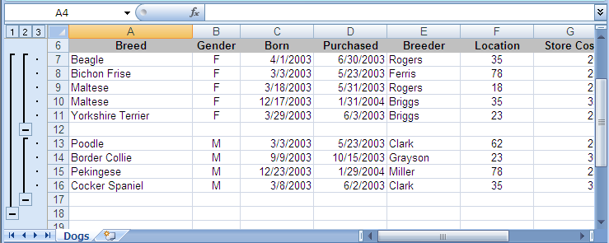
Create a Data List Outline (Contd.)
The following figure shows an outline with two groups of data.
Data sorted based
on gender
Outline with two
groups of data
Option to collapse
grouped data
Notes:
Use the following link to know the method of outlining a data list in Excel 2007.
http://www.infopackets.com/channels/en/windows/carols_corner_office/2007/20070424_outlining_a_data_list_ms_excel.htms

Slide 37
Demo: Creating a Data List Outline
Scenario:
  The northeast regional manager would like to compare the average store cost of female and male dogs to the total average. He asked if you can put the information in the Dogs workbook in an outline for him so that he can easily see the averages.

Slide 38
Demo: Creating a Data List Outline (Contd.)
Solution:
  To solve the preceding scenario, you need to perform the following tasks:
    Sort the data by gender.
    Create three averages: one for the store cost of female dogs, another for the store cost of male dogs, and the last for the overall store cost of both.
    Create individual groups for the female dogs, the male dogs, and the averages.
    Collapse the details so that only the averages for female dog, male dog, and overall dog costs are shown.
Notes:
Discuss the scenario of Activity 3-5 of Lesson 3 in the Student Guide with the students.
You can access the data file for this activity from the following path in the TIRM CD:
TIRM\DATAFILES FOR FACULTY\LEVEL 3\Auditing Worksheets\Dogs.xlsx

Slide 39
Demo: Adding Subtotals to Grouped Data
Scenario:
  You have calculated the total cost of all the dogs in the store. The regional manager would like to get the total cost of each female breed of dog alone.

Slide 40
Demo: Adding Subtotals to Grouped Data (Contd.)
Solution:
  To solve the preceding scenario, you need to perform the following tasks:
    Display the Subtotal dialog box.
    Subtotal the store cost of female breed dogs.
Notes:
Discuss the scenario of Activity 3-6 of Lesson 3 in the Student Guide with the students.
You can access the data file for this activity from the following path in the TIRM CD:
TIRM\DATAFILES FOR FACULTY\LEVEL 3\Auditing Worksheets\Grouped Dogs.xlsx

Slide 41
Create a Trendline
To forecast future values based on the chart data, you can create a trendline.
Trendlines:
  Are the graphical representation of trends in a data series that allows you to study predictions in data.
  Can be added to data series in column, line, bar, area, stock, or bubble charts.
  Are of the following six types:
    Exponential
    Linear
    Logarithmic
    Polynomial
    Power
    Moving Average
Notes:
Additional Input:
You can use the following link that explains how to add, change, or remove a trendline in a Excel chart:
http://office.microsoft.com/en-us/excel/HP051984621033.aspx?pid=CH010003771033

Slide 42
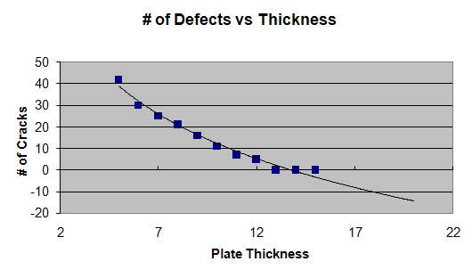
Create a Trendline (Contd.)
The following figure shows a trendline.
Polynomial trendline
to graphically represent
data in a series
Trendline Forecasting
Future Data
Trends in
Existing Data
Notes:
You can use the following link for more information on how to add a trendline to an Excel chart.
http://www.tech-recipes.com/rx/2097/excel_2007_how_to_add_trendline_chart

Slide 43
Demo: Creating a Trendline
Scenario:
  You need to forecast the thickness of plates which, when manufactured, will be of good quality and will have fewer cracks. You have a scatter plot chart to use for your reports. You find that there is a sudden decrease in the value in the chart, and then it levels out. You need to forecast the data graphically by applying a dark red color and a dash style.

Slide 44
Demo: Creating a Trendline (Contd.)
Solution:
  To solve the preceding scenario, you need to perform the following tasks:
    Add a trendline that will forecast the plate thickness data forward five units.
    Apply line color and line style to the trendline.
Notes:
Discuss the scenario of Activity 4-1 of Lesson 3 in the Student Guide with the students.
You can access the data file for this activity from the following path in the TIRM CD:
TIRM\DATAFILES FOR FACULTY\LEVEL 3\Analyzing Data\Pottery Performance.xlsx

Slide 45
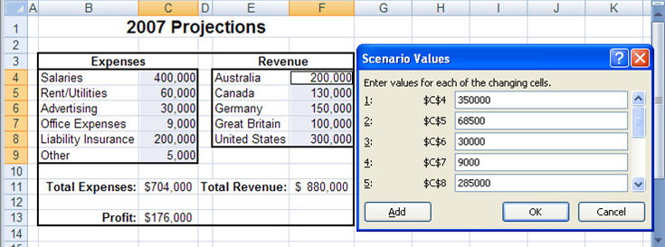
Create Scenarios
To forecast different values based on the criteria set, you can create scenarios.
A scenario is a set of input values that are substituted for the primary data in a worksheet.
The following figure shows a scenario created for the worksheet containing the primary data.
Primary
Data
Set of input values that
can be substituted
for primary data
Notes:
You can use the following link for more information and examples on Scenarios in Excel 2007.
http://www.homeandlearn.co.uk/excel2007/excel2007s7p3.html

Slide 46
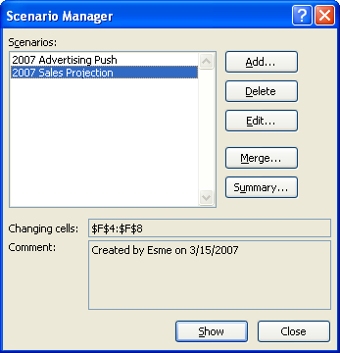
Create Scenarios (Contd.)
The Scenario Manager dialog box allows you to create, edit, delete, and merge scenarios.
The following figure shows the different options of the Scenario Manager dialog box.

Slide 47
Demo: Creating Scenarios
Scenario:
  You would like to analyze the expense and revenue data of the previous year, and want to forecast a particular outcome and plan accordingly for the current year. You would like to retain the value of the existing data and compare this with a situation where the advertising budget is increased by $40,000 and each country’s revenue by 10 percent.

Slide 48
Demo: Creating Scenarios (Contd.)
Solution:
  To solve the preceding scenario, you need to perform the following tasks:
    Create a scenario that maintains the original projection numbers for 2007.
    Create another scenario to specify the values for the first range of cells.
    Specify the values for the second range of cells.
    Test your work.
Notes:
Discuss the scenario of Activity 4-2 of Lesson 3 in the Student Guide with the students.
You can access the data file for this activity from the following path in the TIRM CD:
TIRM\DATAFILES FOR FACULTY\LEVEL 3\Analyzing Data\2007 Projections.xlsx

Slide 49
Perform What-If Analysis
The Solver option:
  Is used to set the value stored in a single cell that has a formula, to a specified value.
  Allows you to either retain the Solver solution or restore the original values.
You can perform what-if analysis to forecast potential values by changing variables in formulas without affecting your original data.
Notes:
Use the following link for more information and examples on Goal Seek in Excel 2007.
http://www.homeandlearn.co.uk/excel2007/excel2007s7p4.html

Slide 50
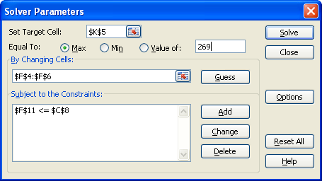
Perform What-If Analysis (Contd.)
The Solver Parameters dialog box consists of options that can be used to set the solver parameters.
The following figure shows the various options of the Solver Parameters dialog box.

Slide 51
Demo: Using Goal Seek to Analyze Data
Scenario:
  You have developed a worksheet named Loan Schedule that amortizes a car loan. The worksheet currently amortizes a $24,000 loan over 60 months with a 12 percent interest rate. However, after reviewing some of your other monthly expenses, you have come to realize that you can only afford a $17,500 loan with a monthly payment set at $350.00. You need to determine the term of the loan based on this new data.

Slide 52
Demo: Using Goal Seek to Analyze Data (Contd.)
Solution:
  To solve the preceding scenario, you need to perform the following tasks:
    Decrease the value of the principal loan amount.
    Find the new loan term for the defined principal amount and monthly payment of $350.
Notes:
Discuss the scenario of Activity 4-3 of Lesson 4 in the Student Guide with the students.
You can access the data file for this activity from the following path in the TIRM CD:
TIRM\DATAFILES FOR FACULTY\LEVEL 3\Analyzing Data\Loan Schedule.xlsx

Slide 53
Demo: Using Solver to Analyze Data
Scenario:
  A windfall has come your way and you can now afford to spend a little more on your new car. Based on other expenses in your long-term budget, you have decided that you can now afford a $500 monthly payment as long as the interest rate stays between 10 and 15 percent, and your payments are for less than 36 months. Now, you want to find out how much you can borrow.

Slide 54
Demo: Using Solver to Analyze Data (Contd.)
Solution:
  To solve the preceding scenario, you need to perform the following tasks:
    Load the Solver add-in.
    Change the monthly payment from $350 to $500.
    Specify the cells with the principal amount value, interest rate, and term in months as changing cells.
    Add constraints to set the interest rate between 10 between 15 percent, and the term to be less than35 months.
    Calculate the new principal amount.
Notes:
Discuss the scenario of Activity 4-4 of Lesson 4 in the Student Guide with the students. Before you being open TIRM\DATAFILES FOR FACULTY\LEVEL 3\Analyzing Data\My Loan Schedule.xlsx

Slide 55
Perform Statistical Analysis with the Analysis ToolPak
The Analysis ToolPak:
  Is an add-in that contains a wide variety of tools to help you perform statistical analysis.
  Includes tools to create:
    Histograms.
    Derive random samples.
    Perform regression analysis.
To derive the desired value from complex data sets, you can perform statistical analysis using the tools available in the Analysis ToolPak.

Slide 56
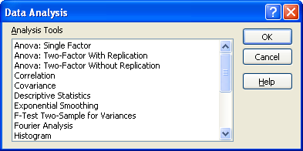
Perform Statistical Analysis with the Analysis ToolPak (Contd.)
The following figure shows the tools available in the Analysis ToolPak.
Tools to perform
sophisticated
statistical analysis

Slide 57
Demo: Performing Statistical Analysis
Scenario:
  Your company has collected the names of 60 people who are willing to participate in a focus group to help you refine your flagship product. However, you can only have 10 people in the focus group. The team overseeing the focus group needs a way to randomly select 10 people from the list of 60. The random list needs to include the focus group candidates’ ID number and last name.

Slide 58
Demo: Performing Statistical Analysis (Contd.)
Solution:
  To solve the preceding scenario, you need to perform the following tasks:
    Load the Analysis ToolPak add-in.
    Open the Sampling analysis tool.
    In a new worksheet, create a random sample of 10 people.
    In the new worksheet, look up the last name of each unique ID.
    Display the last name for all the unique IDs in the worksheet.
Notes:
Discuss the scenario of Activity 4-5 of Lesson 4 in the Student Guide with the students.
You can access the data file for this activity from the following path in the TIRM CD:
TIRM\DATAFILES FOR FACULTY\LEVEL 3\Analyzing Data\Randomize.xlsx

Slide 59
Summary
In this session, you learned that:
  Digital signatures add an extra level of security to shared files by confirming the identity of the person who originated the files.
  Information Rights Management enables you to prohibit the printing, forwarding, or copying of sensitive data.
  Tracer arrows are graphic illustrations depicting data flow between cells that contain values and those that contain formulas.
  Invalid Data is any data in a cell that does not conform to the cell’s data validation scheme.
  The Watch Window allows you to view the contents of a cell while the cell itself is off the viewable portion of your screen.
  Data list outlines allow you to view multiple data lists at the same time.
Notes:
Use the Summary slides to summarize the session.

Slide 60
Summary (Contd.)
  Data list outlines allow you to view multiple data lists at the same time.
  Trendlines are the graphical representation of trends in a data series that allows you to study predictions in data.
  A scenario is a set of input values that are substituted for the primary data in a worksheet.
  The Solver Parameters dialog box consists of options that can be used to set the solver parameters.
  The Analysis ToolPak is an add-in that contains a wide variety of tools to help you perform statistical analysis.
Notes:
Use the Summary slides to summarize the session.

