Slide 1
Objectives
In this session, you will learn to:
  Create and execute C++ programs
  Identify the built-in data types in C++
  Use variables in C++ programs
  Use arrays in C++ programs

Slide 2
Components of a C++ Program
Example:
  #include <iostream.h>
  int main()
  {
  cout << "Hello, World";
  return 0;
  }

Slide 3
Compiling, Linking, and Executing a Program
Is done by following the listed steps:
  1. The C++ program should contain the #include
  statement, the class declaration and member
  function definition, and the main() function.
  2. Save the file with a .cpp extension.
  3. Compile the file.
  4. Execute the file.

Slide 4
Executing C++ Programs
Execute the initial startup code
The startup code executes the main() function
When the main() function finishes execution, it sends a status of execution to the operating system

Slide 5
Variables
Variables:
  Refer to specific locations in memory
  Contain specific values
  Should not have any embedded spaces or symbols
  Should be unique
  Can have any number of characters
  Must begin with a letter or an underscore, which may be followed by a sequence of letters, digits, or underscores
  Keywords cannot be used as variable names

Slide 6
Data Types
Defines the type of data that can be stored in a variable
Built-in data types are:
  char - For characters and strings
  int - For integers
  float - For numbers with decimals
Data Type
Number of Bytes on a
32-bit Computer
Minimum Value
Maximum Value
char
1
-128
127
int
4
-2^31
(2^31)-1
float
4
-10^39
10^39

Slide 7
Instantiating Classes
To create an instance of a class, or an object, you can use the following code:
Class_name object;
Objects have attributes or properties.
Member variables are used to implement attributes in C++.
Member variables are declared inside the class body.
Example:
class Car
  {
  int model_no;
  };

Slide 8
Accepting and Storing Values in Member Variables
The cin object is used to accept input from the user and store it in a member variable.
Example:
class Car
  {
  int model_no;
  public:
  void acceptModel()
  {
  cout << “Enter Model number :”;
  cin >> model_no;
  }
  };

Slide 9
Array
Is a collection of elements of a single data type stored in adjacent memory locations
Syntax:
<data_type> <variable_name>[<dimension_size>];
Example:
int high_scores[5];

Slide 10
Declaring and Initializing an Array
Example:
high_scores[0] = 14;
high_scores[1] = 15;
high_scores[2] = 17;
high_scores[3] = 45;
high_scores[4] = 81;
Example:
int high_scores[5] = {14, 15, 17, 45, 81};
Example:
int high_scores[] = {14, 15, 17, 45, 81};

Slide 11
Declaring and Initializing an Array (Contd.)
Size of an array should be specified at the time of its declaration.
Example:
char err[]; //ERROR!! will not compile
An array cannot be initialized with another array.
Example:
xyz = abc; // ERROR!!

Slide 12
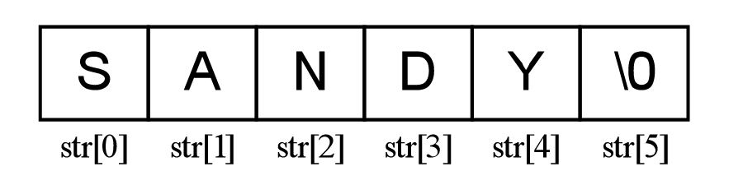
Strings-One-Dimensional char Arrays
A character array is used to represent a string terminated by a NULL(‘\0’) character.
Example:
char tennisPlayerName[] = “SANDY”;
Can be schematically represented as:

Slide 13
Demonstration 1: Creating a C++ Program
As a member of a team that is developing the Automating Ranking software for a tennis tournament, you have been assigned the task of creating a software module that accepts the following details of a tennis player and display it:
1. Name, containing a maximum of 25 characters
2. Rank as integer
3. Winning average as a decimal value

Slide 14
Practice: Exercise 6
As a part of the team that is developing the software for a library, you have been assigned the task of writing a program that accepts Book details. The details to be captured are:
1. ISBN Number
2. Book Category (Fiction or Nonfiction)
3. Author
4. Number of copies available
Write a C++ program to accept and display the book details.

Slide 15
Practice: Learn…Create…Play
Create a data member for the Player class created in the earlier session. The data member needs to represent the board for the Tic Tac Toe game using a 3x3 matrix.

Slide 16
Summary
In this session, you learned that:
  The contents of header files are inserted into a program by using the #include directive.
  The C++ program execution starts from the first statement of the main()function.
  The compiler software translates a program written in a language like C++ into machine language. The file containing the translated program is called the object code of the program.
  A variable is a named location in the memory that contains a specific value.
  A data type defines the type of data that can be stored in a variable.
  Member variables are declared inside the class body.
  The cin object is used to accept input from the keyboard.

Slide 17
Summary (Contd.)
  Comment entries are notes written by a programmer in the code so that others reading that code understand it better.
  An object is an instance of a class.
  An array is a collection of elements of a single data type stored in adjacent memory locations.
  An array can be initialized when it is defined or later.
  An array must be given a constant dimension size, which should be at least 1.
  Each element of an array can be accessed by using its subscript number.

