Slide 1
RETAIL SALES ANALYSIS OF GEOCART E-COMMERCE
Name PS No
1) Kushal Wankhede 10731201
2) Adesh Sonawane 10731315
3) Krushna Mane 10731181
4) Harika Adapa 10731128
5) Madhuri 10731069
6) Sreekanth Byalla 10731055

Slide 2
Problem Statement
The Geocart e-commerce ordering and delivery application aims to analyze the sales and revenue generation country-wise and wants to enhance the sales. The project focuses on designing and implementing a robust data pipeline to process and analyze a large relational dataset.

Slide 3
Azure Cloud Platform
Microsoft Azure is a cloud computing platform created by Microsoft.
It provides a broad range of cloud services, including compute, analytics, storage and networking. Users can pick and choose from these services to develop and scale new applications or run existing applications in the public cloud.
The Azure platform aims to help business manage challenges and meet their organizational goals. It offers tools that support all industries including e-commerce, finance and is compatible with open and is compatible with open source technologies.
Azure offers four different forms of cloud computing: infrastructure as a service (IaaS), platform as a service (PaaS), software as a service (SaaS) and serverless functions.

Slide 4
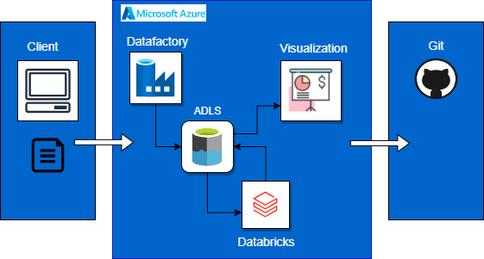
Architecture

Slide 5
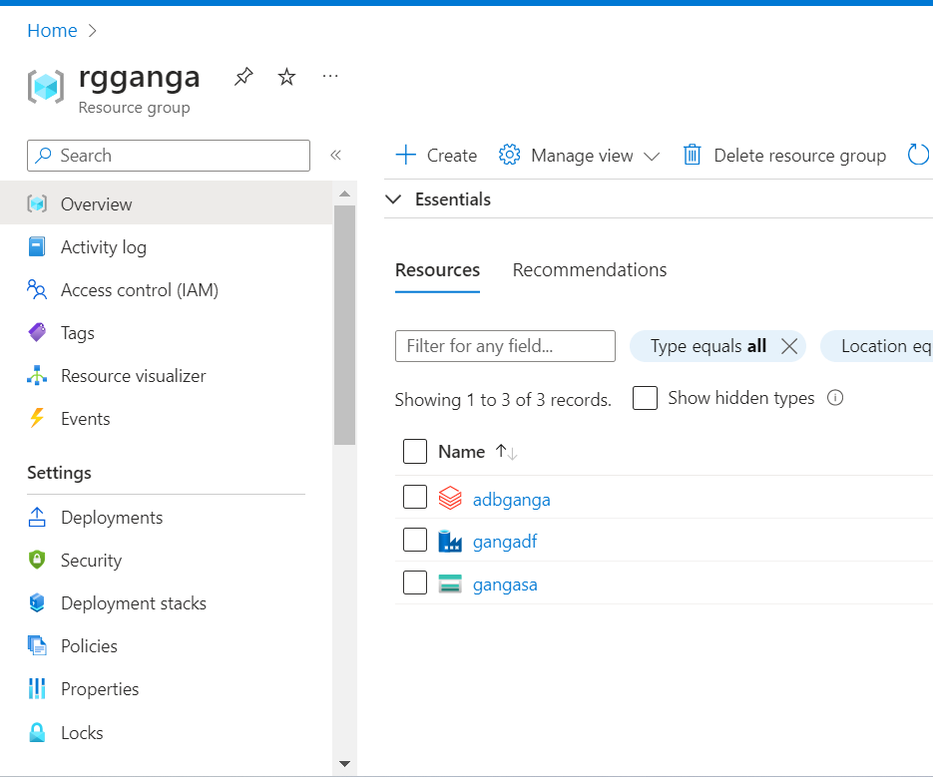
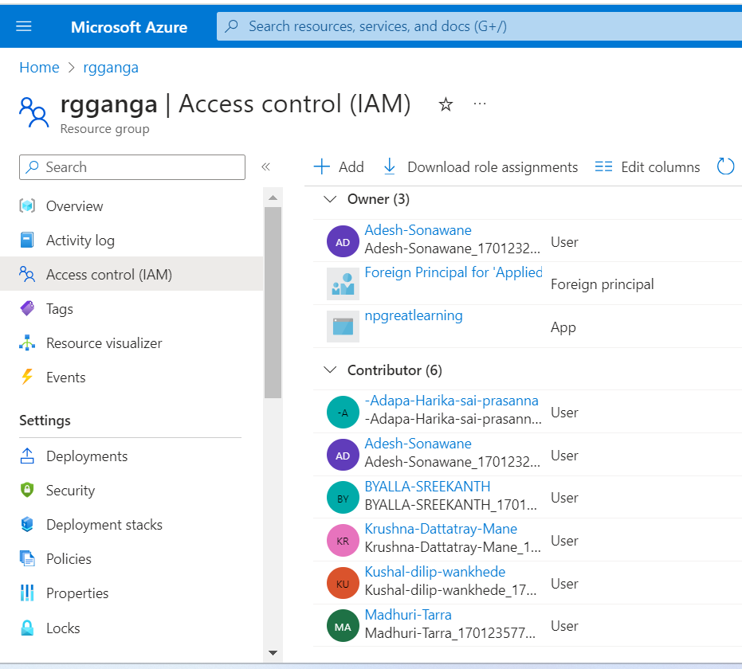
Resource Group

Slide 6
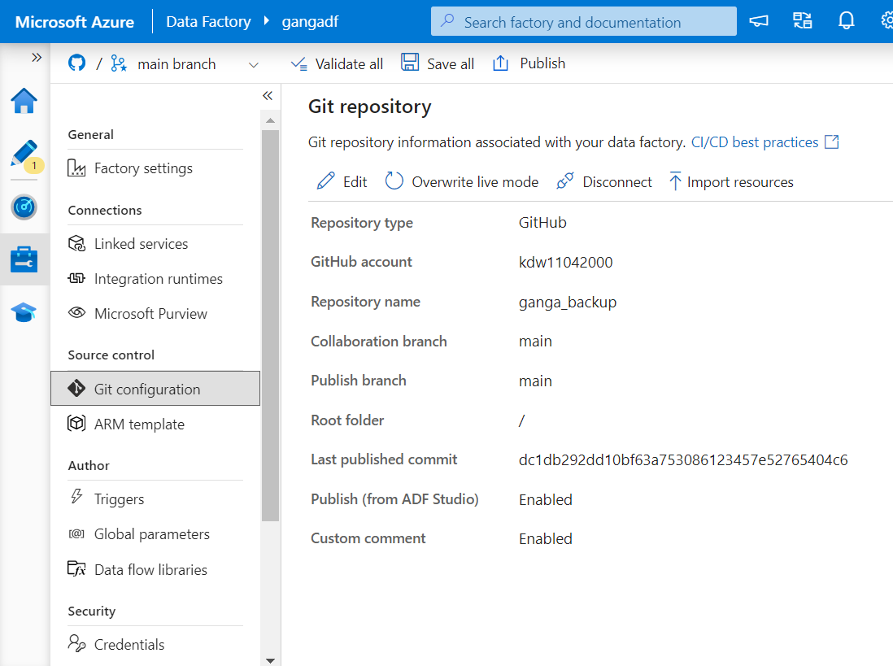
ADF Git Config

Slide 7
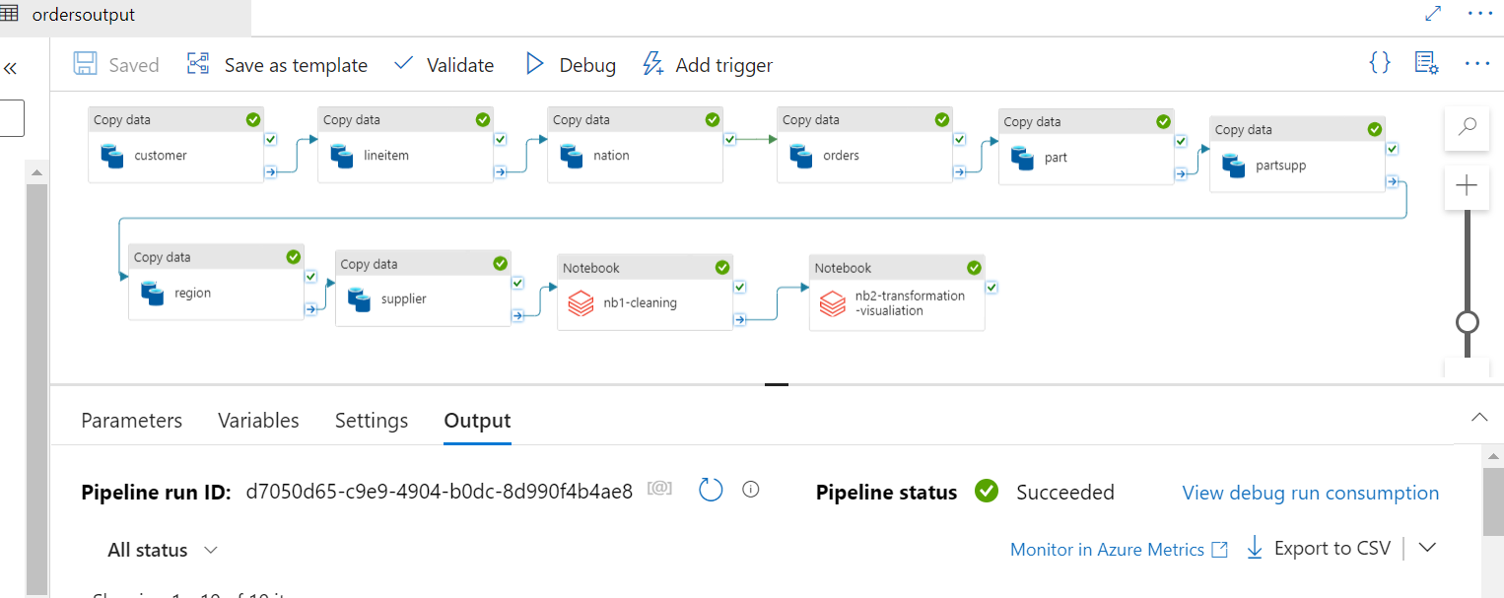
ADF Pipeline

Slide 8
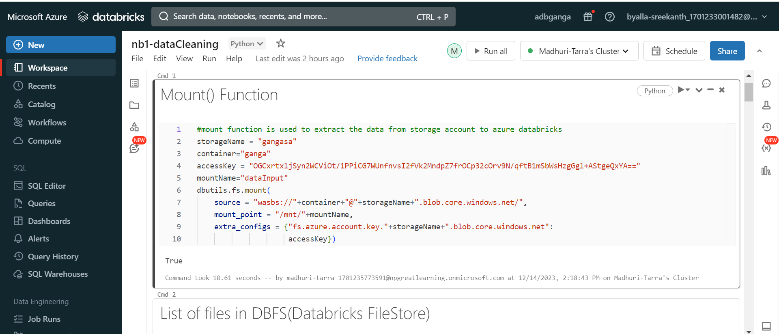
ADB Mount Function

Slide 9
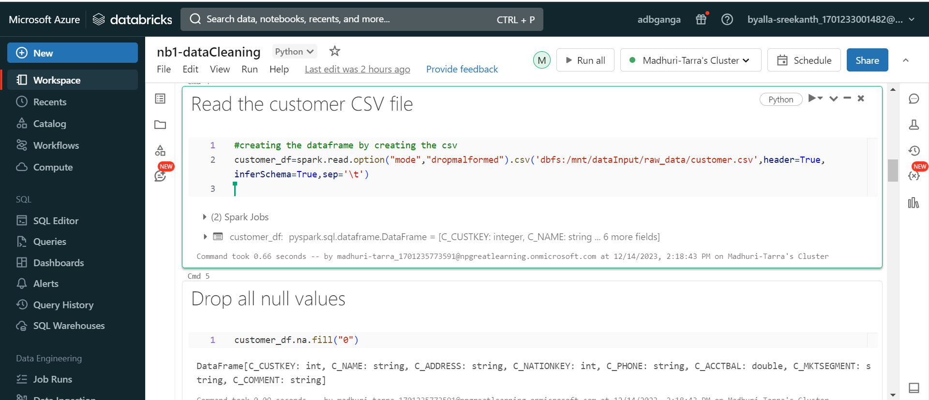
Data Cleansing Through ADB

Slide 10
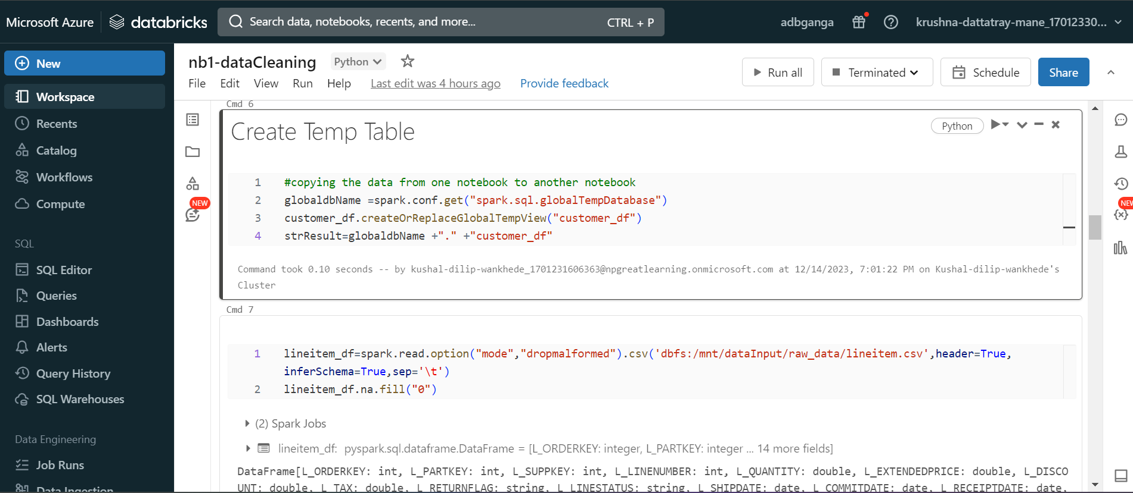
Copying Data From Different Notebooks

Slide 11
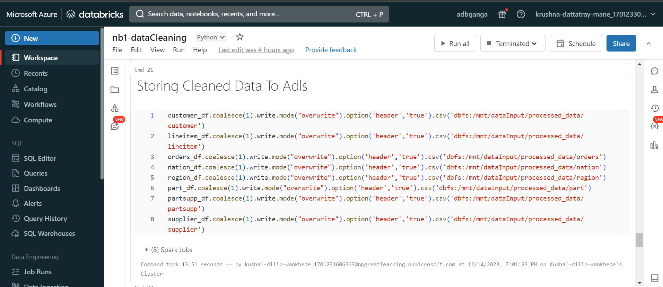
Storing cleansed Data To Adls

Slide 12
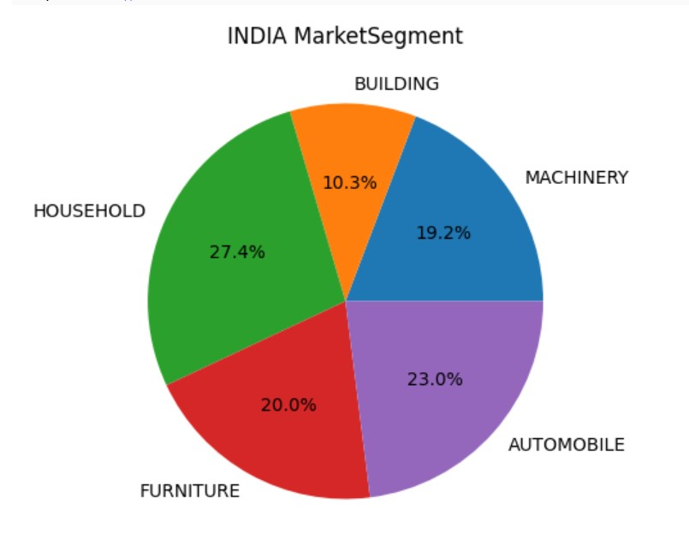
Transformations and Visualization
Company wants to analyse the market share of each segment for India.

Slide 13
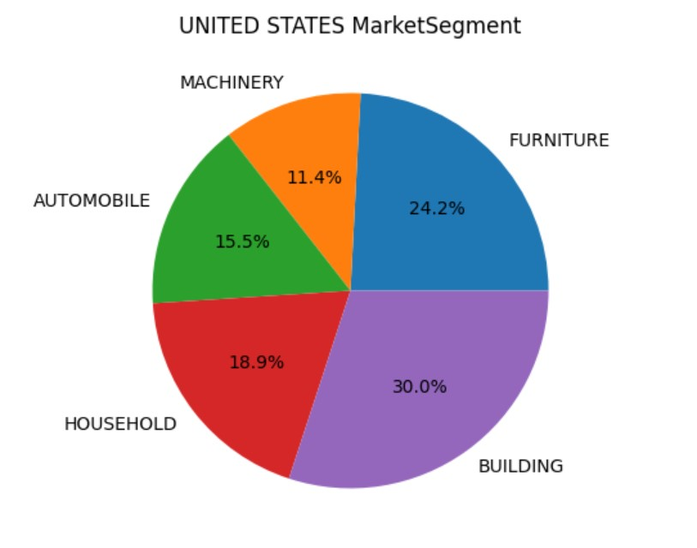
Transformations and Visualization
Market share by segment for United States.

Slide 14
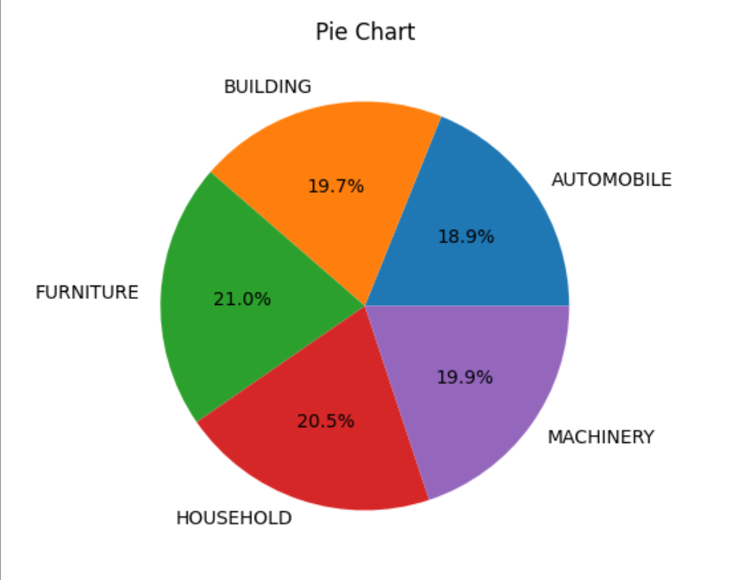
Transformations and Visualization
To analyse the share of each segment for total revenue.

Slide 15
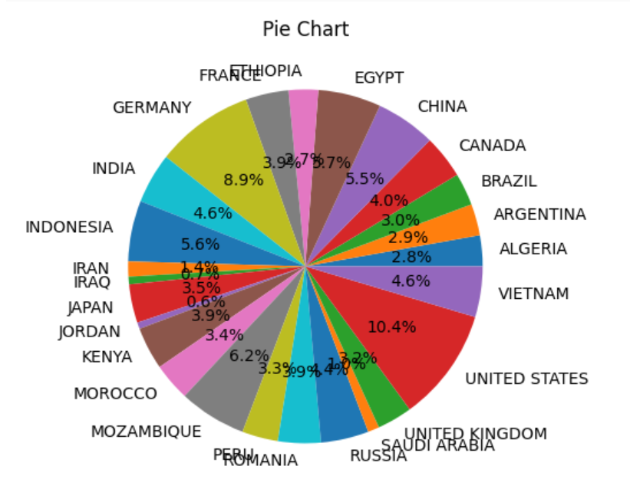
Transformations and Visualization
Total account balance by country name

Slide 16
Thank You

