Slide 1
Project design

Slide 2
Structure idea
Server + client
Socket programming
Voice and video -> java media framework(JMF)
Voice recognition -> google API
Hotword detection ->snowboy
Speech recognition -> google API

Slide 3
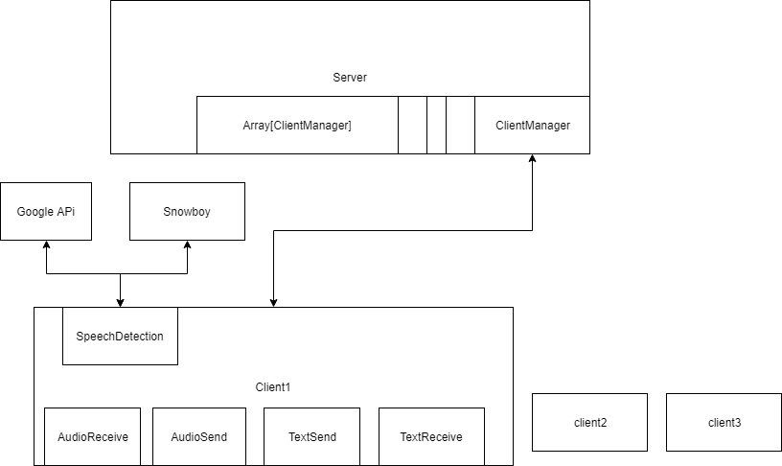
Overall structure

Slide 4
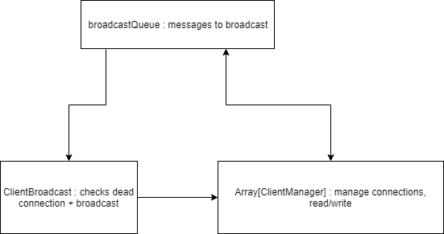
Server

Slide 5
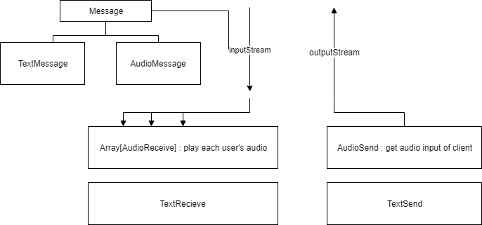
Client

