Slide 1
CS434 Project Proposal
20150560 CSE Dongwon Kim

Slide 2
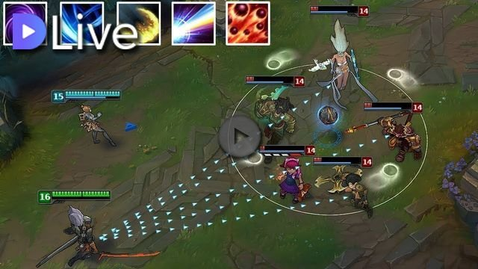
Inspiration
Want to use external audio source while gaming. example
But , you know, searching/playing audio while gaming is extremely hard.(impossible)
Moreover, voice chat only recognize input to mic, so you have to play audio in other device!
How about using speech recognition?

Slide 3
Objective
Text/audio/video chatting server – client
Full GUI
Additional features useful for gaming
Match history search
Auto counting recent win rate as team
Play sound effect using speech recognition while call

Slide 4
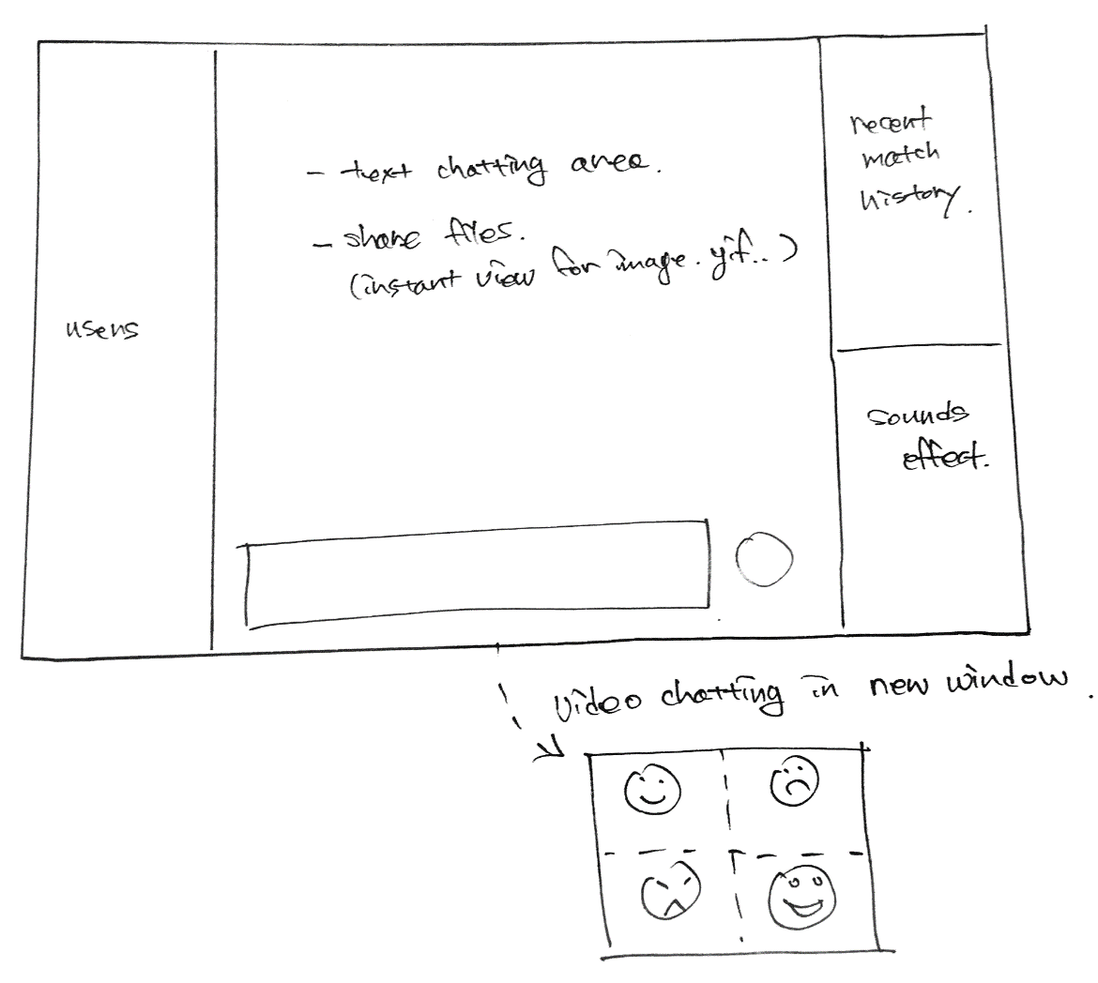
UI Sketch

Slide 5
Requirements
Server application that can handle 5~ users
Concurrent programming for server & client
Server needs to handle multiple requests.
Client : voice chatting + speech recognition + text chat
Connection to RIOT API to load match history.
Use of speech recognition API

