Slide 1


SMART INDIA HACKATHON 2026
Problem Statement ID – 26043
Problem Statement Title – A digital platform to crowdsource societal challenges and facilitate collaborative problem solving through universities and industry partnerships
Theme – Smart Education
PS Category – Software
Team ID –
Team Name – BilluSena

Slide 2

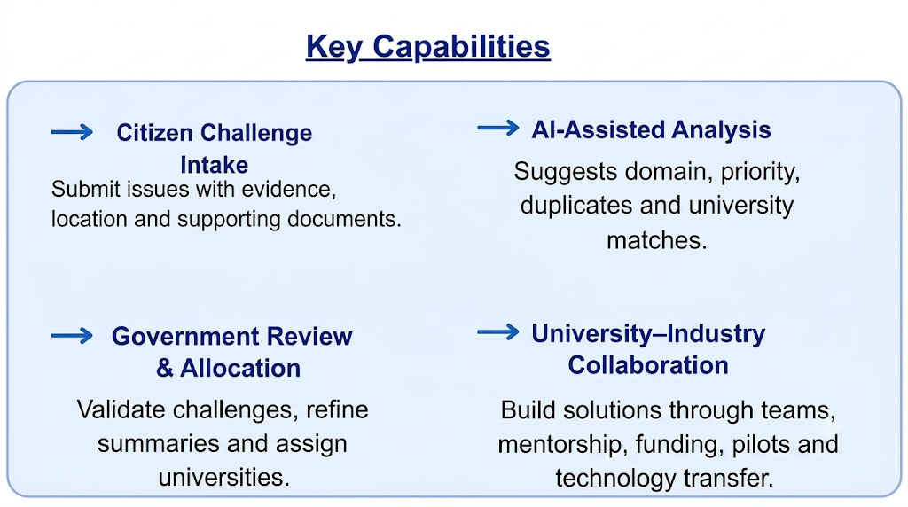
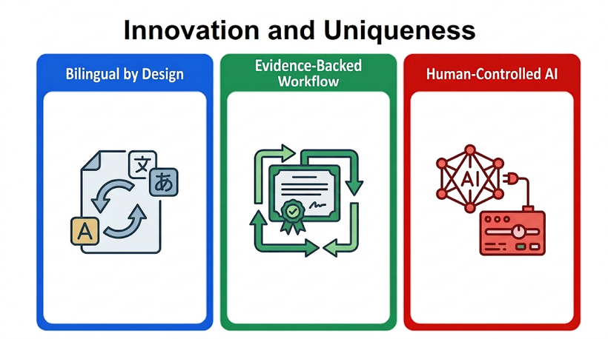
JanSetu
BilluSena
JanSetu is a bilingual societal innovation collaboration portal that transforms community-reported challenges in Jharkhand into reviewed, university-led and industry-supported projects with measurable outcomes.
How it addresses the solution
01
03
?
REPORT THE CHALLENGE
BUILD & MEASURE
Submit a real community problem with evidence, location and context.
University and industry collaborate through milestones, evidence and outcome validation.
02
REVIEW & MATCH
Government validates the challenge and matches it to an appropriate university.
Bilingual by Design: English + Hindi public fields, with human-reviewed bilingual summaries while preserving the original submission.
Human-Controlled AI: Gemini assists with classification, prioritisation, duplicate detection and matching — but never publishes, assigns, approves, rejects or resolves a challenge.
End-to-End Lifecycle: One connected workflow from challenge intake → review → university allocation → proposal → partnership → milestones → outcome validation.
Evidence + Accountability: Private evidence, role-based access, activity history and government-validated outcomes create a transparent and auditable innovation pipeline.

Slide 3
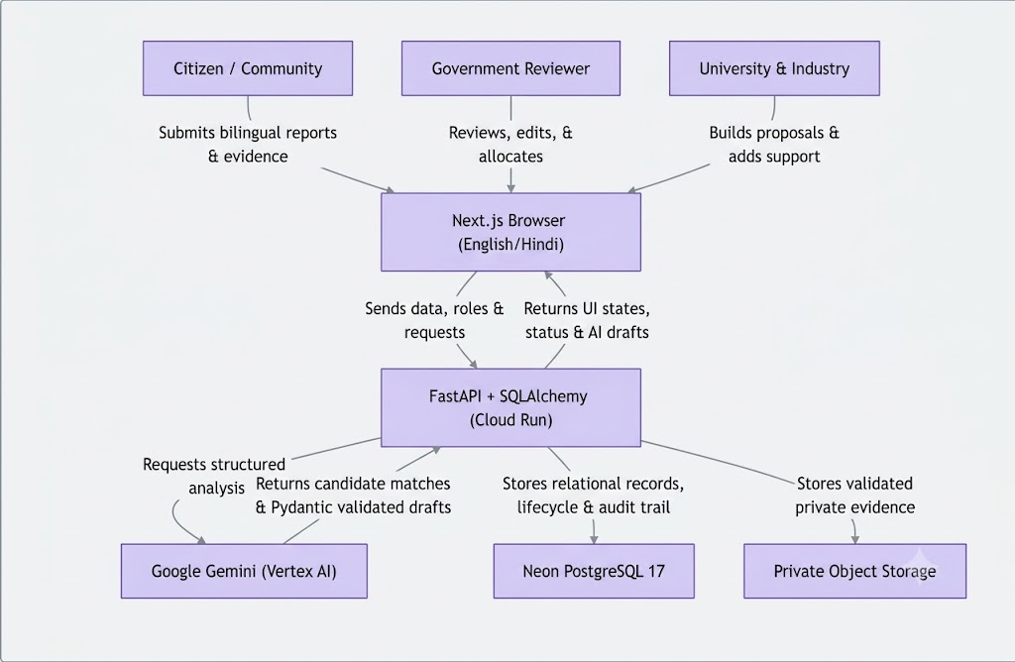












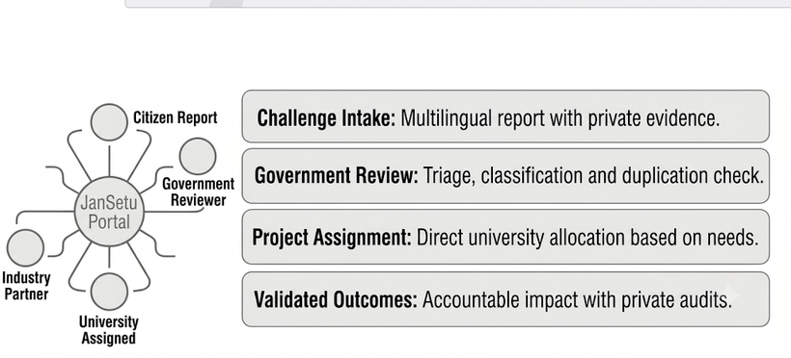
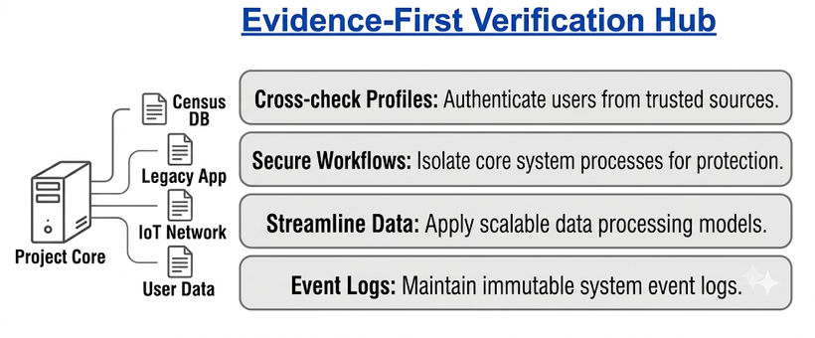
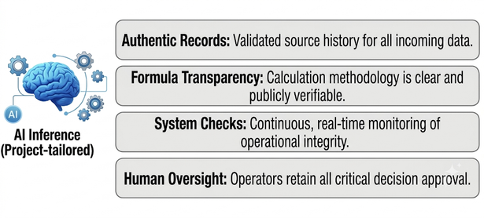
TECHNICAL APPROACH
BilluSena
WORKFLOW
TECH STACK
01
JanSetu Innovation Workflow
02
Evidence-First Verification Hub
03
Conflict-Aware State & Decision

Slide 4
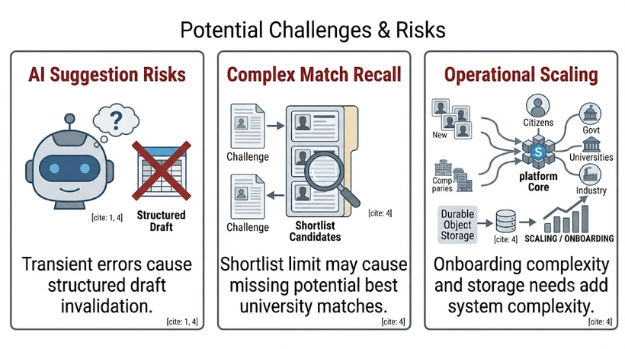
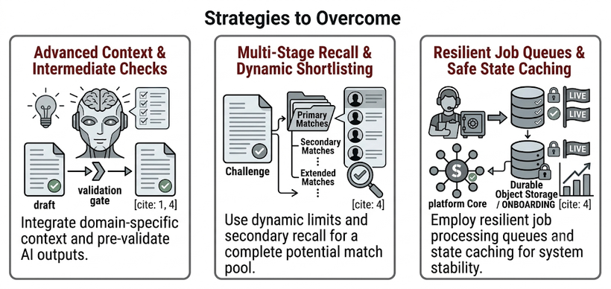


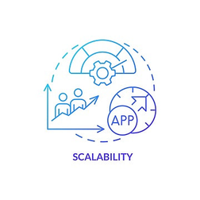



FEASIBILITY AND VIABILITY
BilluSena
Potential Challenges & Risks
Strategies to Overcome
Analysis of Feasibility
Technical
Built on a mature open-source stack (Next.js, FastAPI, PostgreSQL). Enforces access control via REST endpoints and uses schema-validated AI output to prevent invalid categorizations.
Economic
Cost-effective through open-source technologies and usage-based scaling via Cloud Run and Vercel. Reduces manual triage workloads while leaving all final decisions to authorized human officials.
Operational
Integrates naturally by providing separate, dedicated workspaces for citizens, government, universities, and industry. Built-in notifications handle coordination without needing complex real-time external services.

Slide 5
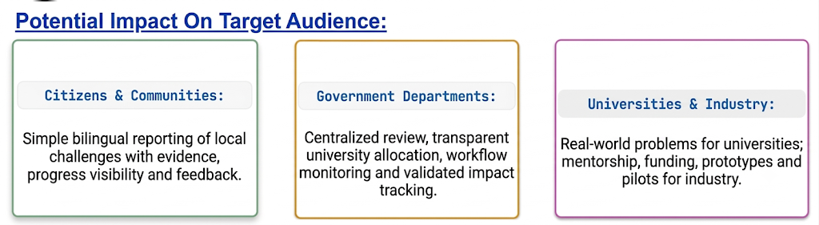

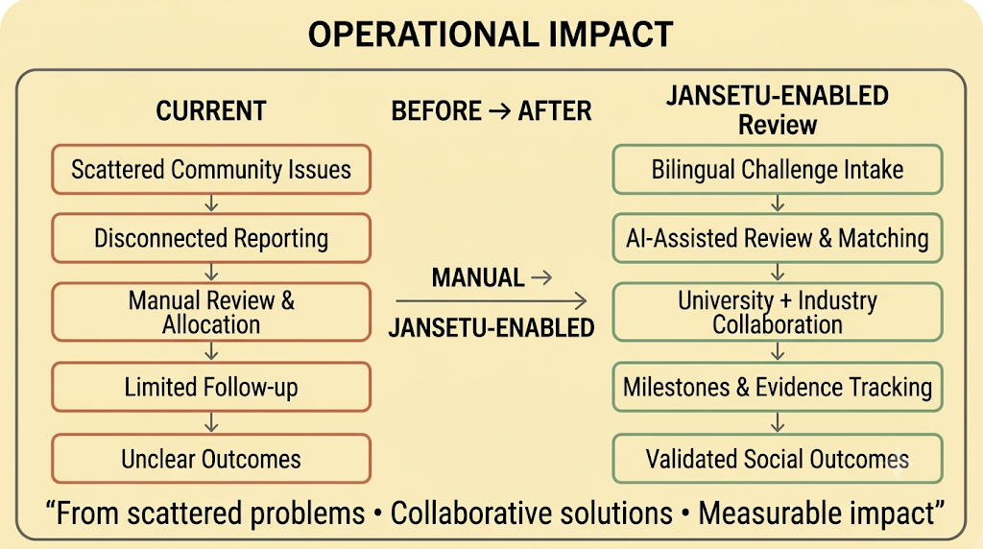
IMPACT AND BENEFITS
BilluSena
Potential Impact On Target Audience:
Key Metrics:
• Challenges by district & domain
• Active universities & projects
• Partnerships & funding
commitments
• Validated outcomes &
beneficiaries
Benefits Of The Solution:
Faster Problem Resolution: Connects challenges to the right university and supporting partners.
Better Collaboration: One platform for citizens, government, universities and industry.
Transparency & Accountability: Reviews, milestones, evidence and outcomes remain traceable.
Bilingual & Inclusive: English/Hindi reporting and communication.
Measurable Social Impact: Tracks beneficiaries, results, testing evidence, patents and startups.

Slide 6
RESEARCH AND REFERENCES
Project Links:
Live Demo: https://jansetu-jharkhand.vercel.app/
Frontend: jansetu-jharkhand.vercel.app
Backend: jansetu-api-595351864949.us-east4.run.app/api/v1/health
Demo Video:
https://drive.google.com/drive/folders/1-sVTEnGEMpwg4abO0D2a-73zSsLiS5oR?usp=sharing
Research Papers:
Smart Civic Issue Reporting System (Vikas Path): https://www.researchgate.net/publication/359118551_Smart_Civic_Issue_Reporting_System
IN-PART / Connect — University-Industry Matchmaking: https://in-part.com/blog/university-industry-matchmaking/
NLP-Based Grievance Management System with Code-Mixer Speech Analysis: https://papers.ssrn.com/sol3/Delivery.cfm/6369498.pdf?abstractid=6369498&mirid=1
AI and Technical References:
Gemini Structured Output: https://ai.google.dev/gemini-api/docs/structured-output
Vertex AI — ADC Quickstart: https://cloud.google.com/vertex-ai/generative-ai/docs/start/quickstart
FastAPI: https://fastapi.tiangolo.com/
Neon: https://neon.tech/docs
Google Cloud Run: https://cloud.google.com/run/docs

