Slide 1


SMART INDIA HACKATHON 2026
PS 26043 / SMART EDUCATION / SOFTWARE
JANSETU
Community challenges to validated solutions.
A bilingual platform to crowdsource local problems and coordinate Government, universities and industry through one accountable lifecycle.
Organization Government of Jharkhand Department Higher & Technical Education Team BilluSena Team ID [Registered Team ID]
WORKING MVP · DEPLOYED

Slide 2
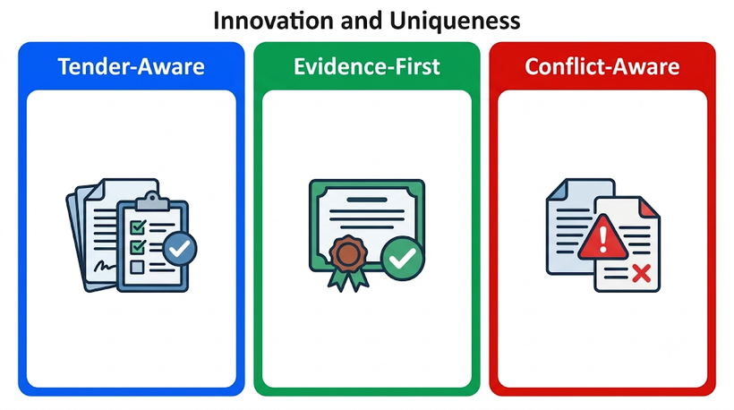

BILLUSENA
IDEA TITLE / PROPOSED SOLUTION
ONE PLATFORM · ONE ACCOUNTABLE LIFECYCLE
01
COMMUNITY
02
GOVERNMENT
03
HEI / UNIVERSITY
04
PROJECT TEAM
Report need + evidence
Review + bilingual public copy
Accept assignment + form team
Proposal + faculty/student roster
08
COMMUNITY / PUBLIC
07
GOVERNMENT
06
UNIVERSITY
05
INDUSTRY
Feedback + approved results
Approve milestones + validate outcome
Build + submit milestone evidence
Mentorship · funding · pilot
CONTROLLED BRANCHES
INFORMATION REQUEST
Government asks the citizen for missing detail
DECLINE / REALLOCATE
A university decline returns the challenge for allocation
REVISION LOOP
Proposal, milestone or outcome changes return to the university
GEMINI ASSISTS
HUMANS DECIDE
Classification / priority rationale / bilingual drafts / duplicate hints / university matches / outcome evidence gaps
Publish · assign · approve · validate
BilluSena · JanSetu
02 / 06

Slide 3
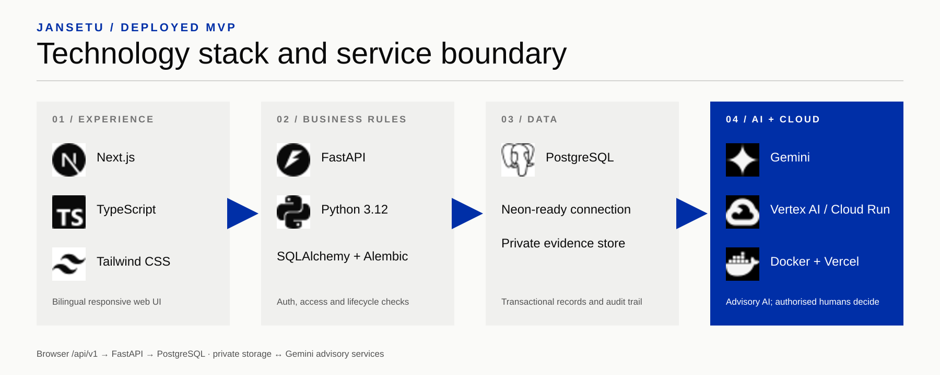



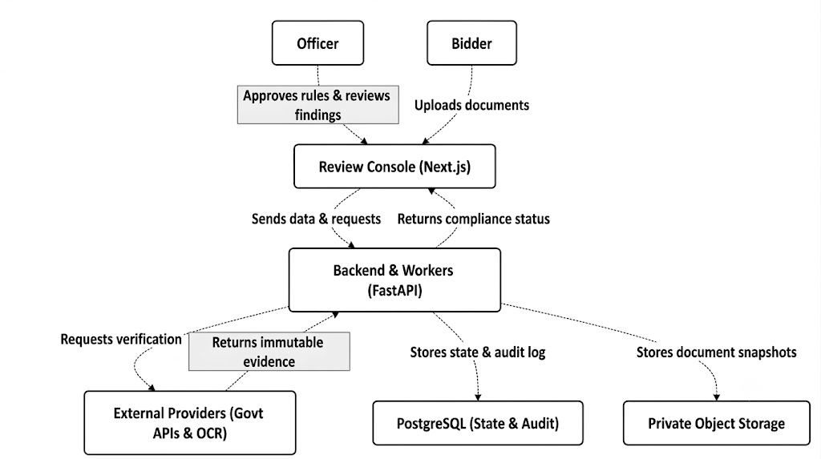
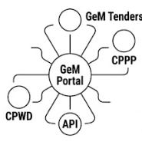
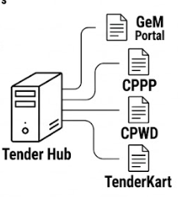
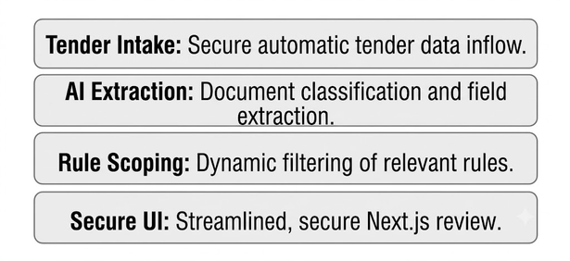
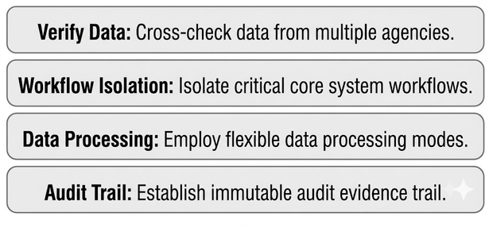
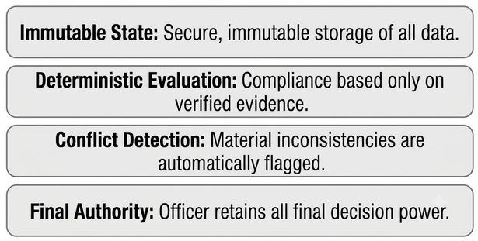







BILLUSENA
TECHNICAL APPROACH
Browser /api/v1 → FastAPI business rules → PostgreSQL + private evidence ↔ Gemini advisory services
SECURITY
Argon2 · random DB sessions · HttpOnly cookies · origin checks · role + ownership rules
EVIDENCE
Private disk storage · signature checks · 5 files × 20 MB · authorised downloads
BilluSena · JanSetu
03 / 06

Slide 4
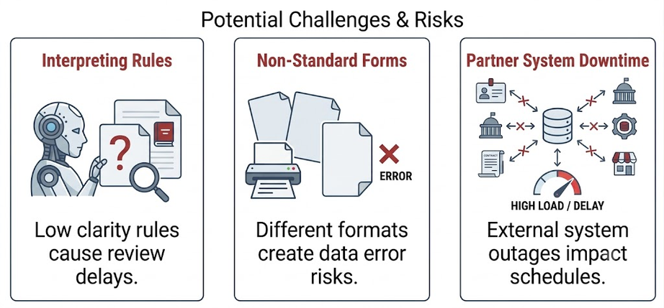
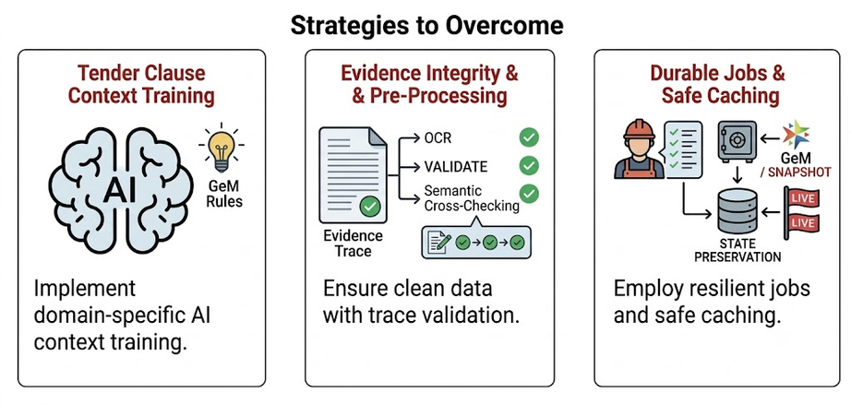
BILLUSENA
FEASIBILITY AND VIABILITY
BUILDABLE NOW · EXPANDABLE WITH GOVERNMENT ADOPTION
01 / TECHNICAL
- Next.js, FastAPI and PostgreSQL are proven production technologies.
- Transactional lifecycle and access rules stay in the API.
- Structured AI responses are validated before display.
02 / ECONOMIC
- Open-source core with usage-based hosting.
- Neon, Cloud Run and Vercel scale independently.
- Funding commitments remain separate from money received.
03 / OPERATIONAL
- Four workspaces follow real stakeholder responsibilities.
- Human approval protects government accountability.
- Seed and migrations provide a repeatable demonstration.
RISKS → BUILT-IN RESPONSE
PROPOSED ROLLOUT
AI unavailable
Save first; retry transient failures; keep manual review.
NOW
Deployed MVP
Unsafe public copy
Minimum lengths + bilingual government approval.
01
Pilot districts
Access / upload abuse
Role checks, origin validation and file signatures.
02
Participating HEIs
Ephemeral file storage
Move evidence to private object storage before rollout.
03
Statewide network
Rollout phases are proposed; field adoption is not claimed.
BilluSena · JanSetu
04 / 06

Slide 5
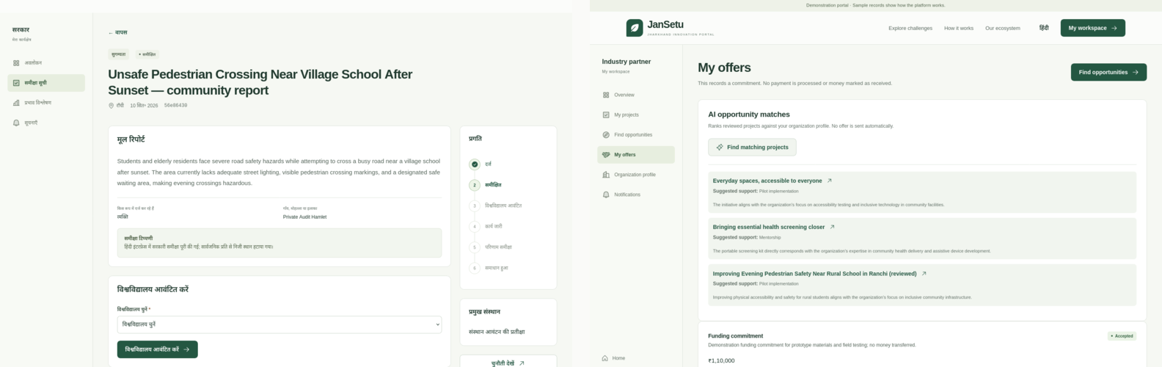


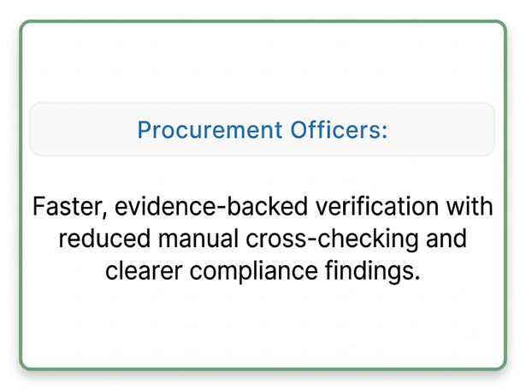
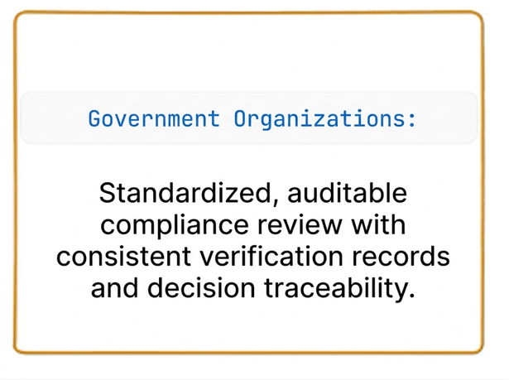
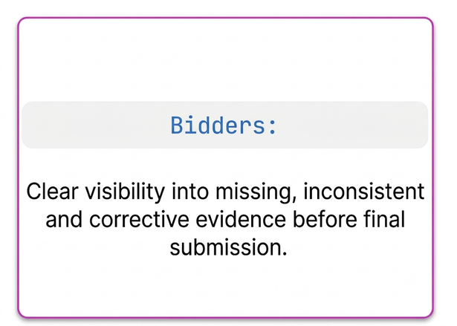
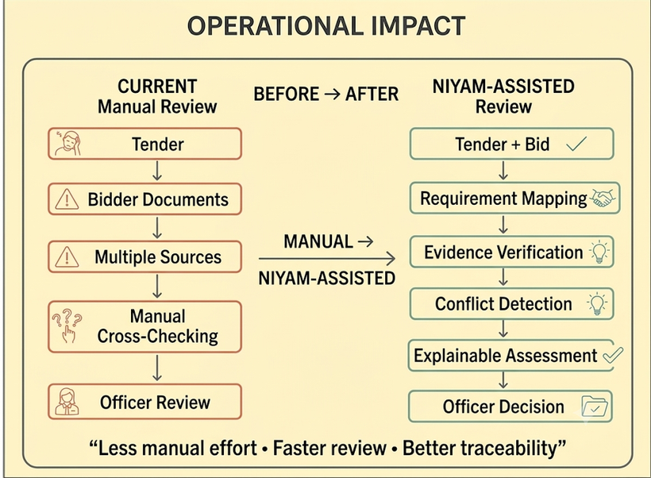
BILLUSENA
IMPACT AND BENEFITS
MEASUREMENT CHAIN
REPORTED
ASSIGNED
DELIVERED
VALIDATED
VALUE FOR EACH PARTICIPANT
WORKING MVP EVIDENCE
01 / CITIZEN
Bilingual reporting, progress visibility and optional feedback.
02 / GOVERNMENT
Review, allocation, approvals, audit history and analytics.
03 / UNIVERSITY
Real problem statements, multidisciplinary teams and delivery.
GOVERNMENT REVIEW · HINDI
INDUSTRY AI MATCHING
SEEDED DEMO SCALE
04 / INDUSTRY
Reviewed opportunities matched to practical support.
7
10
5
6
demo accounts
demo challenges
institutions
lifecycle stages
Public pages expose approved summaries and aggregate outcomes only. These numbers demonstrate MVP coverage, not measured field impact.
BilluSena · JanSetu
05 / 06

Slide 6
BILLUSENA
RESEARCH AND REFERENCES
DEMO + SOURCE
PRIMARY TECHNICAL REFERENCES
FRONTEND
AI
Gemini structured output · ai.google.dev/gemini-api/docs/structured-output
jansetu-jharkhand.vercel.app
AUTH
Vertex ADC · cloud.google.com/vertex-ai/generative-ai/docs/start/quickstart
API HEALTH
jansetu-api-595351864949.us-east4.run.app/api/v1/health
Next.js · nextjs.org/docs
WEB
PRIVATE REPOSITORY
API
FastAPI · fastapi.tiangolo.com
github.com/kdxgautam/SIH-jansetu
DATA
PostgreSQL · postgresql.org/docs / Neon · neon.tech/docs
PROBLEM CONTEXT
WHY JANSETU
- SIH 26043 asks for crowdsourced societal challenges and collaborative problem solving.
- NEP 2020 supports experiential, multidisciplinary and industry-linked learning.
- The portal connects those goals through an auditable government workflow.
CLOUD
Cloud Run · cloud.google.com/run/docs / Vercel · vercel.com/docs
DEMO STATUS
Seeded data · no field-impact claims · not an official government service
BilluSena · JanSetu
06 / 06

