Slide 1

A Construction of Locality-Aware Overlay Network: mOverlay and Its Performance
Tsung-Han Lin 09/14/2005
Found in:IEEE JOURNAL ON SELECTED AREAS IN COMMUNICATIONS, VOL. 22, NO. 1, JANUARY 2004
Author:Xin Yan Zhang, Student Member, IEEE, Qian Zhang, Member, IEEE, Zhensheng Zhang, Senior Member, IEEE,Gang Song, and Wenwu Zhu, Senior Member, IEEE

Slide 2
Introduction
One of the crucial issues in deploying an overlay network is the potential performance degradation
Routing overhead is a key performance metric for overlay infrastructures.

Slide 3
Introduction
Efficiency
  An overlay construction scheme should make sure that the communication on the overlay is not too costly, compared with the underlying network.
Scalability
  The overlay network should remain tractable with the increasing number of hosts and data traffic.
    The cost of overlay network maintenance should be as small as possible
the locality is an essential characteristic for the overlay construction

Slide 4
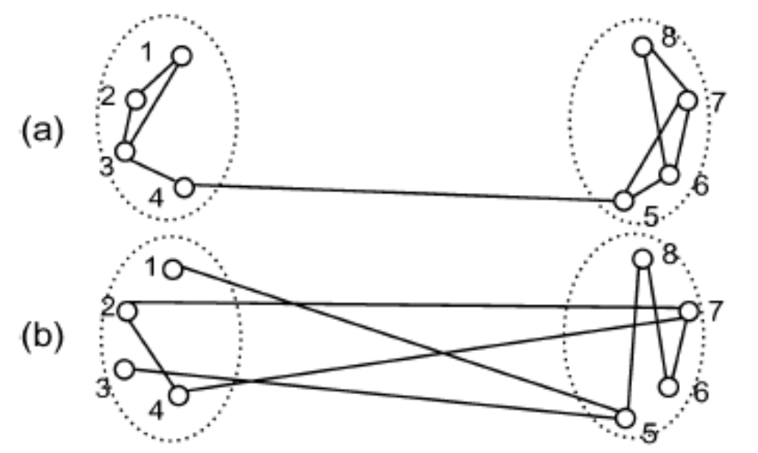
Introduction

Slide 5
Introduction
Highly structured overlay: are designed to enhance the search performance
in the face of a very transient user population
  Highly structured ->low flexibility
  (because it’s hard to maintain the structure)
  It does not consider network proximity at all (ex: Chord)
  =>its message may travel arbitrarily long distances in overlay
In this paper:
  By using the locality in the underlying network to build an overlay network .
  (use Group concept and Dynamic landmarks)
  still has higher scalability and robustness and by using the locating scheme ,a new host can find its nearby group within O(logN) steps

Slide 6
Locality-Aware Overlay Construction
Neighbor: two hosts have a connection through the overlay
If nearby hosts are neighbors and neighbor groups are connected
  =>delivery time low
Two-level hierarchical network:
  Top level: consists of groups
  Bottom level: consists of hosts within groups

Slide 7
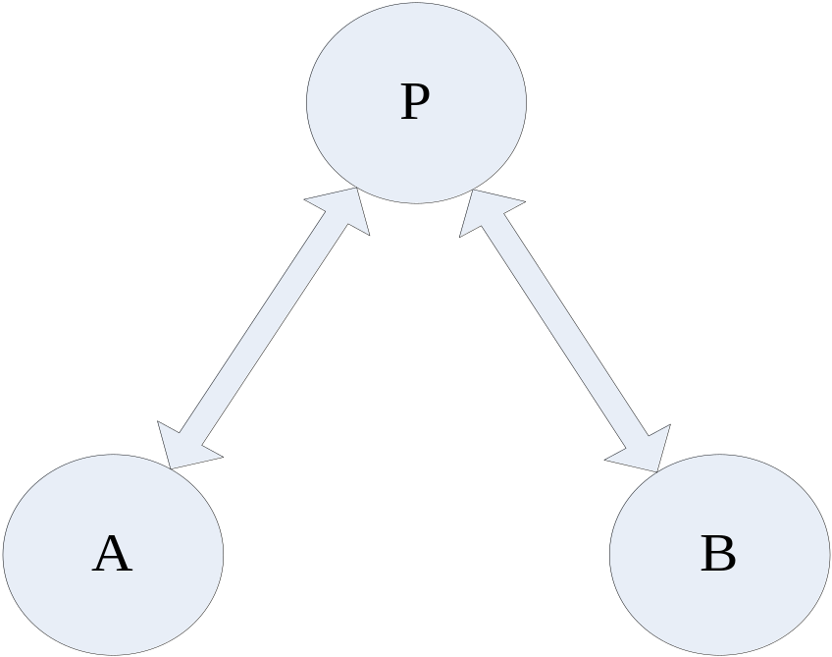
Locality-Aware Overlay Construction
Group: consist a set of hosts that are close to each other
  Each group maintain H hosts in a local host cache
    used to communication with other groups’ hosts
    Leader
  Each group also maintain information about its M neighbor groups
For any position P if PA=PB then we say that host A and host B are in the same group
=
<-same group->

Slide 8
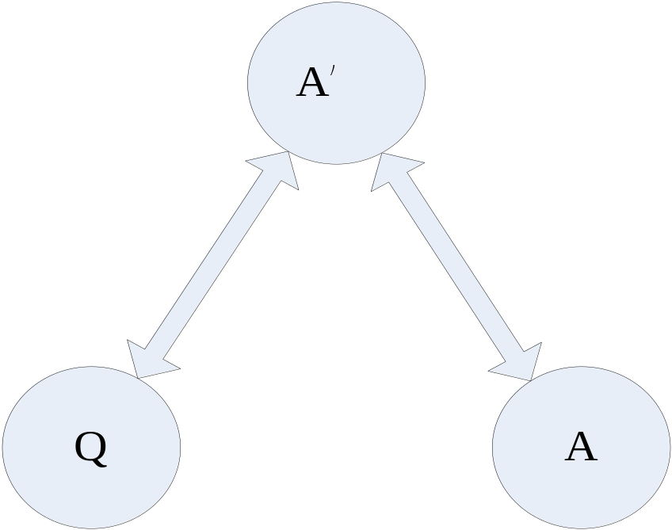
Locality-Aware Overlay Construction
Neighbor groups
  Groups nearby in underlying and also in overlay network
  A group can exchange messages with its neighbor groups
Group criterion
(used to decide which group the new host should belong)
  A: group
  A’:A’s neighbor group
  Q: a new host
  If QA’=AA’ then Q belong Group A
=
<-same group->

Slide 9
Locating Process
Locating process=>the way to find the nearest group
  There is a global host cache called the rendezvous point (RP) in the overlay network
  All new host know where the RP is
  RP usually a machine or a set of machines, which give the new host the start point in the overlay
Use group criterion and locating process make a group’s neighbors acting as a dynamic landmarks: always chose the neatest Groups to be such landmarks

Slide 10
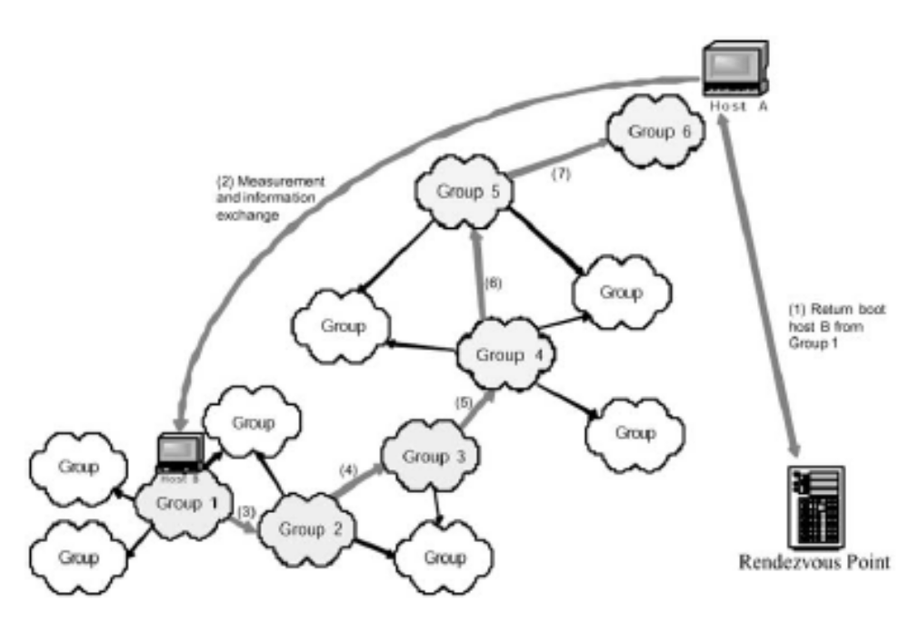
Locating Process
Join

Slide 11
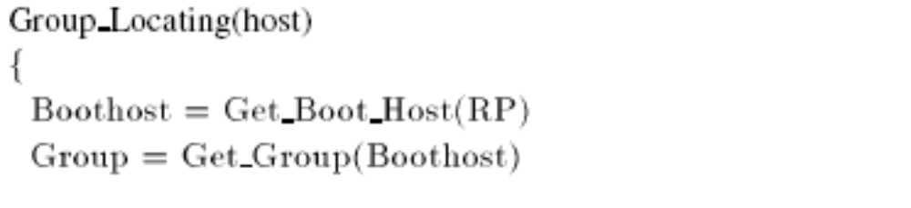
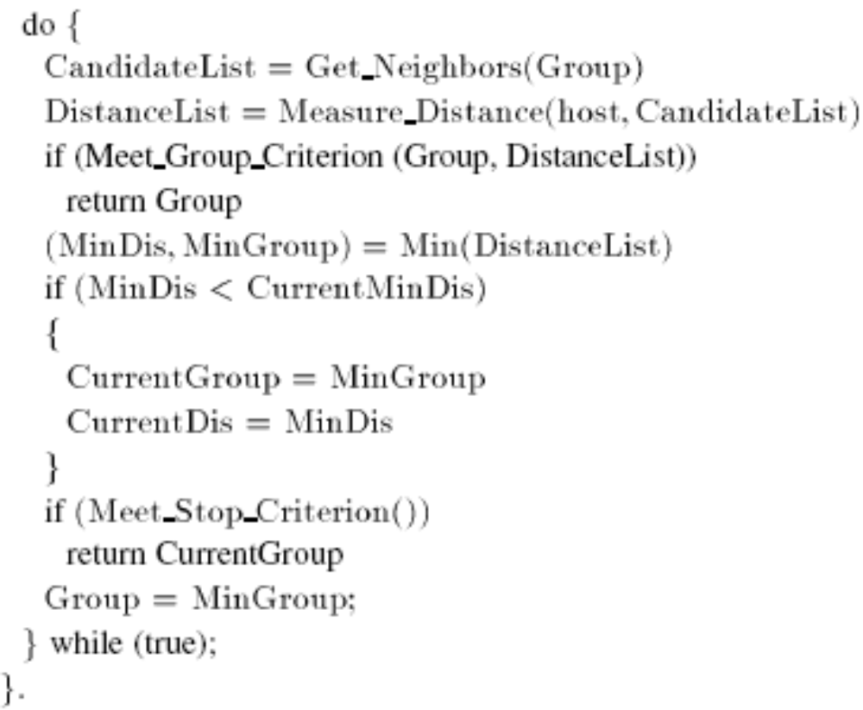
Locating Process

Slide 12
General Overlay Operations
Forming new group
  In the initialization stage of overlay network formation
  When the nearest group for the new host does not meet the grouping criterion.
Host declares a new Group with a group ID ,at the same time , finds its M neighbors
Use locating procedure to find neighbors
Step1:find the new host’s nearby groups
Step2:由nearest neighbor 得到neighbor information
Step3:用locality characteristic =>一個group的neighbor有可能是該group其他某一neighbor的neighbor

Slide 13
General Overlay Operations
Group joining
  if a host has located its proper group, the new host joins that group and directly connects to several hosts in the group.
Information sharing
  hosts in the same group has similar network characteristics,(ex:AX=AgX)
  Information about the measurement performed between A host and X group should be sent to all other hosts in A’s group, with low overhead
  (因同一group的host均nearby 所以同group的information傳遞可用flooding來傳播=>overhead低)

Slide 14
General Overlay Operations
Information updating
  A local host cache is used to complete the updating task.
  the H hosts in the cache will take the responsibilities in its natural sequential order.
  Leader periodically send out “alive” message to whole group
  If leader fail=>the next host in the cache will become new leader
  If H is big enough, group operations could be run normally

Slide 15
General Overlay Operations
Information updating
  If H hosts all fail
    All other host in group might declare its leadership at the same time
    Use time stamp handle
  There are two kinds of information should be update
    Host cache: when new host join
      Leader send alive=>hosts in cache receive and reply a message to leader to indicate its existence
      New host will replace failed host which assigned by leader
      Make sure that hosts in host cache are all alive
    information of neighbor groups:when a nearby group is generated.
      新group的leader會找出自己和nearby group的distance, nearby group也會依此distance來決定是否要flush neighbors list
      If so, leader會通知group中所有host有關此neighbor的information

Slide 16
General Overlay Operations
Host failure/leaving
  Because cache update periodically, so it does not have any impact to its group when a single host failure
  a host does not need to take any action when it leaves the overlay network
  But in order to improve performance, it is required that the host informs the leader when a host leaves(若leave的為leader 會通知second host in cache)

Slide 17

Overlay performance analysis-Efficiency
D: the average neighbor distance in our locality-aware overlay
N: number of Groups
n: number of hosts in each group
m: each host has m neighbor hosts
M: Every group has M neighbor groups
D: The average distance between neighbor groups
D: The average distance between two hosts in the same group
:The total number of intragroup neighborhood links
:The total number of intergroup neighborhood links

Slide 18

Overlay performance analysis-Efficency
D : the average neighbor distance in a randomly connected overlay
m : Each host has neighbor hosts in the same group
m : number of neighbor hosts in all other groups
The average distances of intergroup links and intragroup links are denoted by and
rgfh

Slide 19
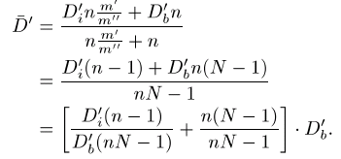


Overlay performance analysis-Efficency
In randomly connected overlay: Any two hosts in the underlying network have the same probability to become neighbors
=>
=>
.

Slide 20
Overlay performance analysis-Efficency
=(Dinm+MDb)/(Db’nm+M)
The smaller the ration is , the shorter the average neighbor distance in locality-aware overlay is
In order to increase the efficiency (decrease the ratio) of the overlay, we should try to
  shorten the neighbor links’ distance between different groups (to decrease )
  A host have more neighbors hosts in the same group if possible (to increase m)
  always place hosts to their proper group if possible
  (to decrease )

Slide 21
Overlay performance analysis-Robustness, Scalability
Robustness
  If there is several isolated sub-network in the underlying network, then it may not find the nearest group for the new host
  Solution:
    each group will select a random group as its special neighbor group
Scalability
  Use dynamic landmarks location algorithm will limit the cost compare with traditional mesh-based or tree-based overlays

Slide 22
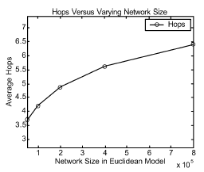
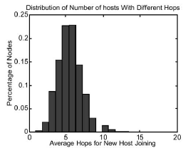
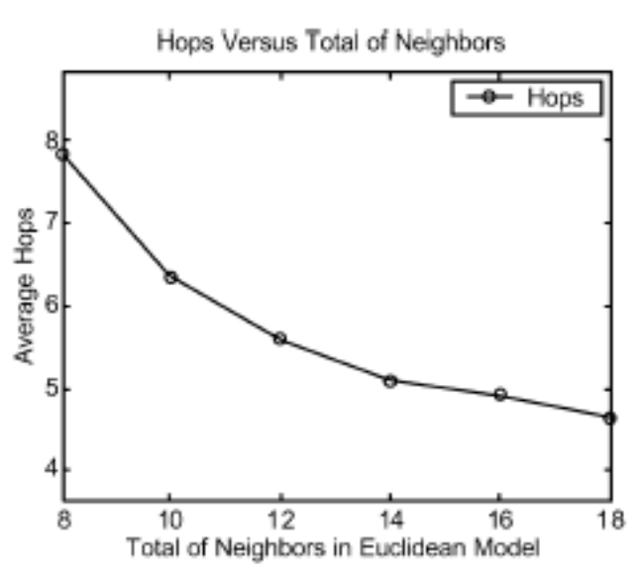
Simulation
O(logN)

Slide 23
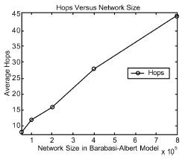
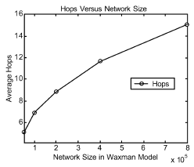
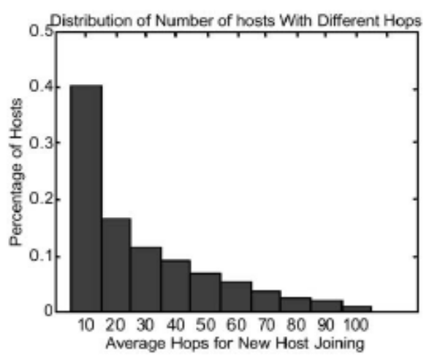
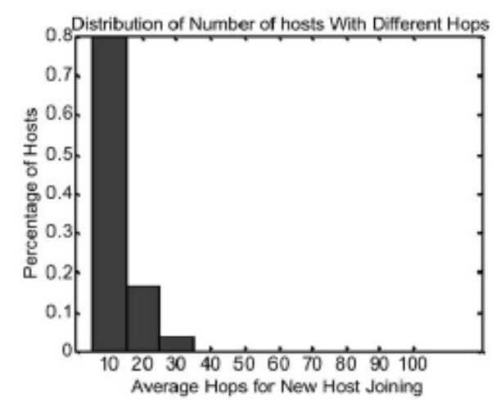
Simulation
Barabasi-Albert
and Waxman model

Slide 24
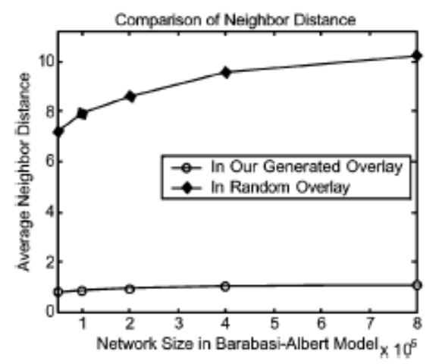
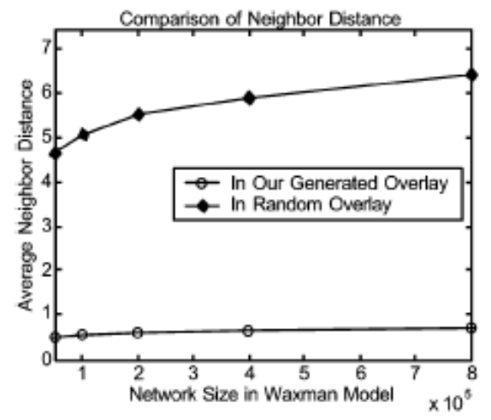
Simulation

Slide 25
Conclusion
This paper present a protocol to generate an unstructured overlay to achieve locality characteristic
Key characteristic: Dynamic landmark
  it can achieve locality-aware in unstructured overlay network
  Strong scalability and high robustness and low locating complexity
Simulation show that:
  This locating algorithm will limit the overhead in the level of O(logN)
  This overlay is more efficiently than in traditional unstructured overlays

