Slide 1
Selenium
Aaron Xu
Notes:
IE Driver Executable: http://code.google.com/p/selenium/downloads/list
Chrome Driver Executable: http://code.google.com/p/chromium/downloads/list
Opera Driver Executable: https://github.com/operasoftware/operadriver/downloads
Firefox Driver does not require a download as it is bundled with the Java client bindings

Slide 2
Selenium IDE
Selenium IDE is a Firefox plugin which records and plays back user interactions with the browser. Use this to either create simple scripts or assist in exploratory testing. It can also export Remote Control or WebDriver scripts, though they tend to be somewhat brittle and should be overhauled into some sort of Page Object-y structure for any kind of resiliency.
Run with IE: http://blog.reallysimplethoughts.com/2013/02/18/webdriver-playback-in-selenium-ide-is-here/

Slide 3
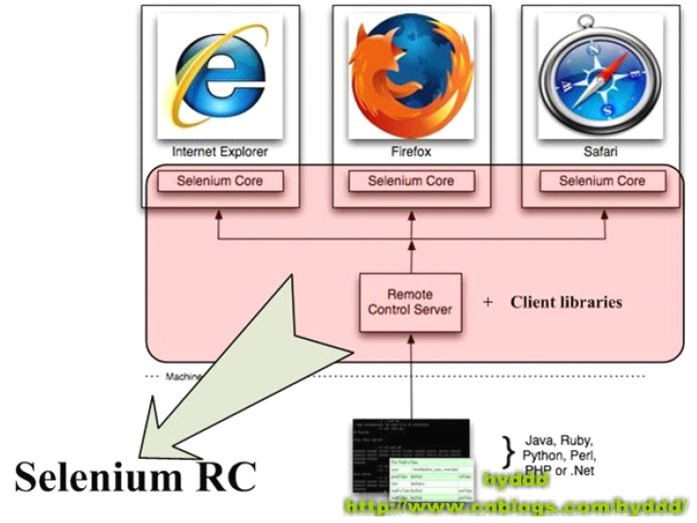
Selenium 1.0(Selenium RC)
The RC server bundles Selenium Core and automatically injects it into the browser
Notes:
Selenium RC components are:
The Selenium Server which launches and kills browsers, interprets and runs the Selenese commands passed from the test program, and acts as an HTTP proxy, intercepting and verifying HTTP messages passed between the browser and the AUT.
Client libraries which provide the interface between each programming language and the Selenium RC Server.

Slide 4
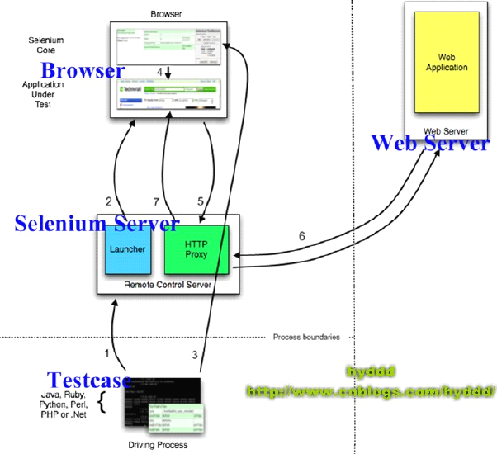
Selenium RC与Testcase的关系
HTTP Proxy的设计使得采用多种语言编写Selenium成为可能：它们只需把HTTP请求发送到特定URL
Notes:
(1).测试案例（Testcase）通过Client Lib的接口向Selenium Server发送Http请求，要求和Selenium Server建立连接。
为什么要通过发送Http请求控制Selenium Server而不采用其他方式呢？从上文可以看出，Selenium Server是一个独立的中间服务器（确切地说是代理服务器），它可以架设在其他机器上！所以测试案例通过发送HTTP请求去控制Selenium Server是很正常的。
(2).Selenium Server的Launcher启动浏览器，把Selenium Core加载入浏览器页面当中，并把浏览器的代理设置为Selenium Server的Http Proxy。
(3).测试案例通过Client Lib的接口向Selenium Server发送Http请求，Selenium Server对请求进行解析，然后通过Http Proxy发送JS命令通知Selenium Core执行操作浏览器的动作。
(4).Selenium Core接收到指令后，执行操作。
(5).浏览器收到新的页面请求信息（因为在(4)中，Selenium Core的操作可能引发新的页面请求），于是发送Http请求，请求新的Web页面。
由于Selenium Server在启动浏览器时做了手脚，所以Selenium Server会接收到所有由它启动的浏览器发送的请求。
(6).Selenium Server接收到浏览器的发送的Http请求后，自己重组Http请求，获取对应的Web页面。
(7).Selenium Server的Http Proxy把接收的Web页面返回给浏览器。

Slide 5
Selenium RC—Selenium Server
Selenium Server receives Selenium commands from your test program, interprets them, and reports back to your program the results of running those tests.
The RC server bundles Selenium Core and automatically injects it into the browser. This occurs when your test program opens the browser (using a client library API function). Selenium-Core is a JavaScript program, actually a set of JavaScript functions which interprets and executes Selenese commands using the browser’s built-in JavaScript interpreter.
The Server receives the Selenese commands from your test program using simple HTTP GET/POST requests. This means you can use any programming language that can send HTTP requests to automate Selenium tests on the browser.
Notes:
Selenium Server 负责控制浏览器行为，总的来说，Selenium Server主要包括3个部分：Launcher，Http Proxy，Selenium Core。其中 Selenium Core是被 Selenium Server嵌入到浏览器页面中的。其实Selenium Core就是一堆 JS 函数的集合，就是通过这些JS 函数，我们才可以实现用程序对浏览器进行操作。

Slide 6
Selenium RC—Client Libraries
The client libraries provide the programming support that allows you to run Selenium commands from a program of your own design. There is a different client library for each supported language. A Selenium client library provides a programming interface (API), i.e., a set of functions, which run Selenium commands from your own program. Within each interface, there is a programming function that supports each Selenese command.
The client library takes a Selenese command and passes it to the Selenium Server for processing a specific action or test against the application under test (AUT). The client library also receives the result of that command and passes it back to your program. Your program can receive the result and store it into a program variable and report it as a success or failure, or possibly take corrective action if it was an unexpected error.
So to create a test program, you simply write a program that runs a set of Selenium commands using a client library API. And, optionally, if you already have a Selenese test script created in the Selenium-IDE, you can generate the Selenium RC code. The Selenium-IDE can translate (using its Export menu item) its Selenium commands into a client-driver’s API function calls. See the Selenium-IDE chapter for specifics on exporting RC code from Selenium-IDE.

Slide 7
Selenium RC 原理
早期的Selenium使用的是Javascript注入技术与浏览器打交道，需要SeleniumRC启动一个Server，将操作Web元素的API调用转化为一段段Javascript，在Selenium内核启动浏览器之后注入这段Javascript。开发过Web应用的人都知道，Javascript可以获取并调用页面的任何元素，自如的进行操作。由此才实现了Selenium的目的：自动化Web操作。这种Javascript注入技术的缺点是速度不理想，而且稳定性大大依赖于Selenium内核对API翻译成的Javascript质量高低。

Slide 8
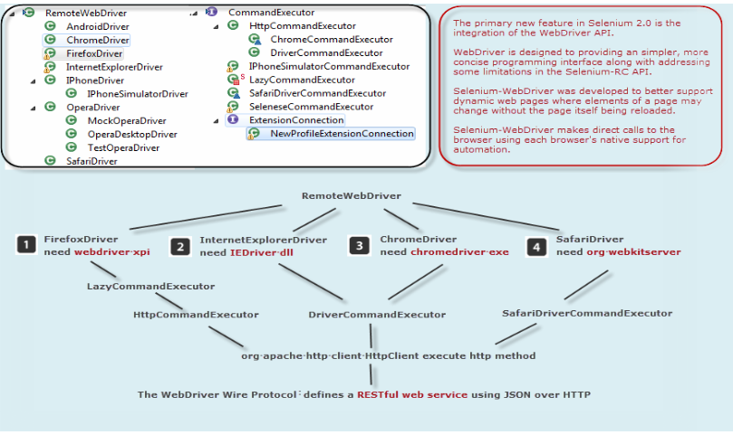
WebDriver 原理
当Selenium2.x提出了WebDriver的概念之后，它提供了完全另外的一种方式与浏览器交互。那就是利用浏览器原生的API，封装成一套更加面向对象的SeleniumWebDriverAPI，直接操作浏览器页面里的元素，甚至操作浏览器本身（截屏，窗口大小，启动，关闭，安装插件，配置证书之类的）。由于使用的是浏览器原生的API，速度大大提高，而且调用的稳定性交给了浏览器厂商本身，显然是更加科学。然而带来的一些副作用就是，不同的浏览器厂商，对Web元素的操作和呈现多少会有一些差异，这就直接导致了SeleniumWebDriver要分浏览器厂商不同，而提供不同的实现。例如Firefox就有专门的FirefoxDriver，Chrome就有专门的ChromeDriver等等。（甚至包括了AndroidDriver和iOSWebDriver）

Slide 9
Selenium WebDriver
Selenium 2.0=Selenium1.0+WebDriver
WebDriver is designed in a simpler and more concise programming interface along with addressing some limitations in the Selenium-RC API.
WebDriver is a compact Object Oriented API when compared to Selenium1.0
It drives the browser much more effectively and overcomes the limitations of Selenium 1.x which affected our functional test coverage, like the file upload or download, pop-ups and dialogs barrier
WebDriver overcomes the limitation of Selenium Rc's Single Host origin policy
Selenium-RC worked the same way for each supported browser. It ‘injected’ javascript functions into the browser when the browser was loaded and then used its javascript to drive the AUT within the browser
Selenium-WebDriver makes direct calls to the browser using each browser’s native support for automation. How these direct calls are made, and the features they support depends on the browser you are using
Notes:
在2009年8月，Selenium 和 WebDriver 两个项目宣布合并，Selenium WebDriver就是合并的成果；
为何把两个项目合并？部分原因是WebDriver解决了Selenium存在的缺点（比如，能够绕过JS沙箱。我们有出色的API），部分原因是 Selenium解决了WebDriver存在的问题（例如支持广泛的浏览器），部分原因是因为Selenium的主要贡献者和我都觉得合并项目是为用户提供最优秀框架的最佳途径。
WebDriver的API被定位为“基于对象的”

Slide 10
Java环境配置
安装JDK
配置环境变量
  打开我的电脑--属性--高级--环境变量
  新建系统变量JAVA_HOME 和CLASSPATH
  变量名：JAVA_HOME
  变量值：C:\Program Files\Java\jdk1.7.0
  变量名：CLASSPATH
  变量值：.;%JAVA_HOME%\lib\dt.jar;%JAVA_HOME%\lib\tools.jar
  选择“系统变量”中变量名为“Path”的环境变量，双击该变量，把JDK安装路径中bin目录的绝对路径，添加到Path变量的值中，并使用半角的分号和已有的路径进行分隔。
  变量名：Path
  变量值：%JAVA_HOME%\bin;%JAVA_HOME%\jre\bin
Notes:
Test in cmd
Java -version

Slide 11

Maven环境配置
下载并解压到指定文件夹（最好不在C盘）
配置环境变量
  打开我的电脑--属性--高级--环境变量
  新建系统变量M2_HOME
  变量名： M2_HOME
  变量值： C:\Program Files\apache-maven-3.1.1
  选择“系统变量”中变量名为“Path”的环境变量，双击该变量，把Maven安装路径中bin目录的绝对路径，添加到Path变量的值中，并使用半角的分号和已有的路径进行分隔。
  变量名：Path
  变量值： %M2_HOME%\bin
Test in cmd
mvn -version
Notes:
Maven主要服务于基于Java平 台的项目构建、依赖管理和项目信息管理
Pom.xml是创建maven程序之后才有的

Slide 12

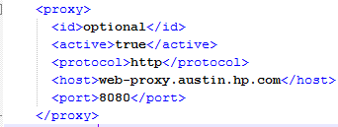
配置代理
本地仓库默认在c盘用户下的.m2文件夹，这里可以新的添加localRepository指定下载到其他盘
  由于在公司使用代理，故需要设置C:\Program Files\apache-maven-3.1.1\conf\settings.xml如下：

Slide 13
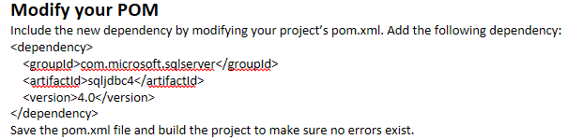
安装SQL Server驱动到Maven仓库
Visit the MSDN site for SQL Server and download the latest version of the JDBC driver for your operating system.
Unzip the package
Open a command prompt and switch into the expanded directory where the jar file is located.
Execute the following command. Be sure to modify the jar file name and version as necessary:
mvn install:install-file -Dfile=sqljdbc4.jar -Dpackaging=jar -DgroupId=com.microsoft.sqlserver -DartifactId=sqljdbc4 -Dversion=4.0

Slide 14
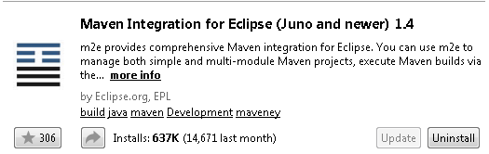
Eclipse
Eclipse是一款非常优秀的IDE, 但是没有集成对Maven的支持.
Help->Eclipse MarketPace and then search it in below picture

Slide 15
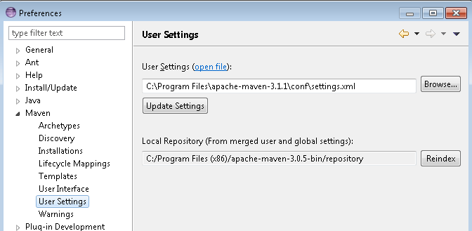
Eclipse->Preference

Slide 16
Steps
Create a Maven project
Right click the maven project and create a JUnit test case
Right click the maven project and create a Class so that you can new some functions to be called by Junit
Or
File->Import, and then select “General”->”Existing projects into workspace”

Slide 17


AssertJ

Slide 18
driver.findElement(By.xx)
By ID
  <div id="coolestWidgetEvah">...</div>
  WebElement element = driver.findElement(By.id("coolestWidgetEvah"));
By Class Name
  <div class="cheese"><span>Cheddar</span></div>
  <div class="cheese"><span>Gouda</span></div>
  List<WebElement> cheeses = driver.findElements(By.className("cheese"));
By Tag Name
  <iframe src="..."></iframe>
  WebElement frame = driver.findElement(By.tagName("iframe"));
By Name
  <input name="cheese" type="text"/>
  WebElement cheese = driver.findElement(By.name("cheese"));
By Link Text
  <a href="http://www.google.com/search?q=cheese">cheese</a>>
  WebElement cheese = driver.findElement(By.linkText("cheese"));

Slide 19
driver.findElement(By.xx)
By Partial Link Text
  <a href="http://www.google.com/search?q=cheese">search for cheese</a>>
  WebElement cheese = driver.findElement(By.partialLinkText("cheese"));
By CSS
  <div id="food"><span class="dairy">milk</span><span class="dairy aged">cheese</span></div>
  WebElement cheese = driver.findElement(By.cssSelector("#food span.dairy.aged"));
By Xpath
  <input type="text" name="example" />
  <INPUT type="text" name="other" />
  List<WebElement> inputs = driver.findElements(By.xpath("//input"));
  driver.findElement(By.xpath("//button[contains(@class,'btn btn-primary center-block ng-scope') and contains(@type,'button')]")).click();
  driver.findElement(By.xpath("//button[@class='btn btn-primary center-block' and @onclick='window.close()' and @type='button']")).click();
Notes:
The only thing we are sure here is that the text ‘Visit Us On Linkedin’ will always be included in the ‘src’ of this image, so we can utilize this hint in our xpath like this: //img[starts-with(@alt,’Visit Us On Linkedin’)]
//*[text()=‘View my complete profile’]=//a[contains(text(),’ View my complete profile’)]

Slide 20
Using JavaScript
WebElement element = (WebElement) ((JavascriptExecutor)driver).executeScript("return $('.cheese')[0]");
Finding all the input elements to the every label on a page:
List<WebElement> labels = driver.findElements(By.tagName("label"));
List<WebElement> inputs = (List<WebElement>) ((JavascriptExecutor)driver).executeScript(
"var labels = arguments[0], inputs = []; for (var i=0; i < labels.length; i++){" +
"inputs.push(document.getElementById(labels[i].getAttribute('for'))); } return inputs;", labels);

Slide 21
User Input - Filling In Forms
WebElement select = driver.findElement(By.tagName("select"));
List<WebElement> allOptions = select.findElements(By.tagName("option"));
for (WebElement option : allOptions) {
System.out.println(String.format("Value is: %s", option.getAttribute("value")));
option.click();
}
Select select = new Select(driver.findElement(By.tagName("select")));
select.deselectAll();
select.selectByVisibleText("Edam");

Slide 22
Moving Between Windows and Frames
  driver.switchTo().window("windowName");
  for (String handle : driver.getWindowHandles()) {
  driver.switchTo().window(handle);
  }
  driver.switchTo().frame("frameName");
Popup Dialogs
  Alert alert = driver.switchTo().alert();
Drag And Drop
  WebElement element = driver.findElement(By.name("source"));
  WebElement target = driver.findElement(By.name("target"));
  (new Actions(driver)).dragAndDrop(element, target).perform();

Slide 23
Refresh Browser in Different Ways
driver.get("https://www.toolsqa.com");
driver.navigate().refresh();
// Element "s" is a Seach Text box on my website
driver.findElement(By.name("s")).sendKeys(Keys.F5);
driver.findElement(By.name("s")).sendKeys("\uE035");//ASCII code
driver.get(driver.getCurrentUrl());
driver.navigate().to(driver.getCurrentUrl());

Slide 24
CheckBox & Radio Button Operations
By ‘ID’
  WebElement radioBtn = driver.findElement(By.id("toolsqa"));
  radioBtn.click();
With ‘IsSelected’
  List oRadioButton = driver.findElements(By.name("toolsqa"));
  // Create a boolean variable which will hold the value (True/False)
  boolean bValue = false;
  // This statement will return True, in case of first Radio button is selected
  bValue = oRadioButton.get(0).isSelected();
  // This will check that if the bValue is True means if the first radio button is selected
  if(bValue = true){
  // This will select Second radio button, if the first radio button is selected by default
  oRadioButton.get(1).click();
  }else{
  // If the first radio button is not selected by default, the first will be selected
  oRadioButton.get(0).click();
  }
Notes:
Operations on Checkboxes and Radio Buttons are easy to perform and most of the times the simple ID attributes work fine for both of these. But selection and d-selection is not the only thing we want with checkboxes and radio buttons. We might like to check that if the checkbox is already checked or if the radio button is selected by default or anything. Checkboxes and Radio button deals exactly the same way and you can perform below mentioned operations on either of them.
By ‘ID’
If ID is given for the radio button/checkbox and you just want to click the radio button/checkbox Irrespective of its value, then the command will be like this:
With ‘IsSelected’
If your choice is based on the pre-selection of the Radio button/Checkbox and you just need to select the deselected radio button/checkbox. Assume there are two radio buttons/checkboxes, one is selected by default and you want to select the other one for your test. With IsSelected statement, you can get to know that the radio button or the check box is selected or not.
Note: Name is always same for the same group of radio buttons/checkboxes but their Values are different. So if you find the checkbox/radio button element with the name attribute then it means that it may contain more than one element, hence we need to use findElements method and store it the list of WebElements.

Slide 25
CheckBox & Radio Button Operations
By ‘CssSelector’
  ebElement oCheckBox = driver.findElement(By.cssSelector("input[value='Tools QA']"));
  oCheckBox.click();
With ‘Value’
  // Find the checkbox or radio button element by Name
  List oCheckBox = driver.findElements(By.name("tool"));
  int iSize = oCheckBox.size(); // This will tell you the number of checkboxes are present
  // Start the loop from first checkbox to last checkboxe
  for(int i=0; i < iSize ; i++ ){
  // Store the checkbox name to the string variable, using 'Value' attribute
  String sValue = oCheckBox.get(i).getAttribute("value");
  // Select the checkbox it the value of the checkbox is same what you are looking for
  if (sValue.equalsIgnoreCase("toolsqa")){
  oCheckBox.get(i).click();
  // This will take the execution out of for loop
  break; }}
Notes:
With ‘Value’
You can even select Radio buttons/Checkboxes with their Values.
By ‘CssSelector’
A simple way of selecting a check-box or radio button is by using its value:

Slide 26
DropDown & Multiple Select Operations
Selecting Dropdown/Multiple Select Box
  Select oSelection = new Select(driver.findElement(By.id(id)));
  oSelection.selectByVisibleText(text); //Selecting an option using ‘selectByVisibleText’
  oSelection.selectByIndex(index); //Selecting an option using ‘selectByIndex’
  oSelection.selectByValue(value); //Selecting an option using ‘selectByValue’
Getting the Size of Select item and Printing the Options
  Select oSelection = new Select(driver.findElement(By.id(id)));
  List<WebElement> oSize = oSelection.getOptions();
  int iListSize = oSize.size();
  for(int i =0; i<iListSize ; i++){
    String sValue = oSelection.getOptions().get(i).getText();
    System.out.println(sValue);
  }

Slide 27
DropDown & Multiple Select Operations
Deselect methods
  Select oSelection = new Select(driver.findElement(By.id(id)));
  oSelection.deselectAll();
  oSelection.deselectByIndex(index);
  oSelection.deselectByValue(value);
  oSelection.deselectByVisibleText(text);
Multiple selection method
  Select oSelection = new Select(driver.findElement(By.id(id)));
  oSelection.selectByIndex(index)
  oSelection.selectByIndex(index)
  // Or
  oSelection.selectByVisibleText(text)
  oSelection.selectByVisibleText(text)
  // Or
  oSelection.selectByValue(value)
  oSelection.selectByValue(value)

Slide 28
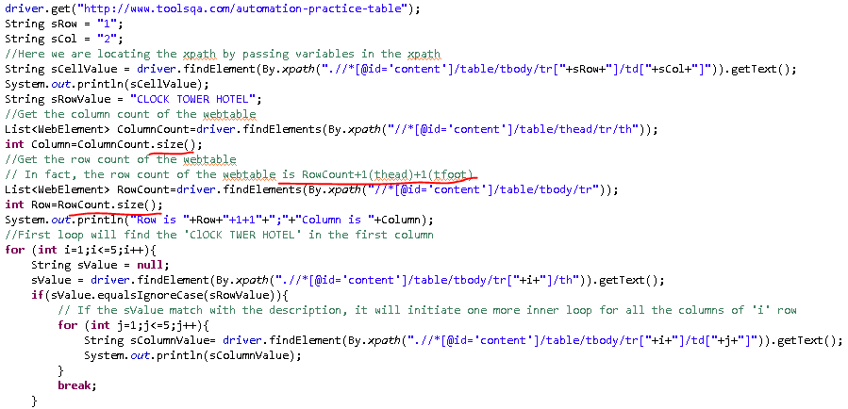
How to handle Tables in Selenium WebDriver?

Slide 29
Wait Commands
ImplicitlyWait Command
  WebDriver driver => new FirefoxDriver();
  // Put an Implicit wait, this means that any search for elements on the page could take the time the implicit wait is set for before throwing exception
  driver.manage().timeouts().implicitlyWait(10, TimeUnit.SECONDS);
  driver.get("http://url_that_delays_loading");
  WebElement myDynamicElement = driver.findElement(By.id("myDynamicElement"));
FluentWait Command
  // Waiting 30 seconds for an element to be present on the page, checking for its presence once every 5 seconds.
  Wait wait = new FluentWait(driver)
  .withTimeout(30, SECONDS)
  .pollingEvery(5, SECONDS)
  .ignoring(NoSuchElementException.class);
  WebElement foo = wait.until(new Function() {
  public WebElement apply(WebDriver driver) {
  return driver.findElement(By.id("foo"));
  }});
Notes:
ImplicitlyWait Command
Purpose: Selenium WebDriver has borrowed the idea of implicit waits from Watir. This means that we can tell Selenium that we would like it to wait for a certain amount of time before throwing an exception that it cannot find the element on the page. We should note that implicit waits will be in place for the entire time the browser is open. This means that any search for elements on the page could take the time the implicit wait is set for.
FluentWait Command
Purpose: Each FluentWait instance defines the maximum amount of time to wait for a condition, as well as the frequency with which to check the condition. Furthermore, the user may configure the wait to ignore specific types of exceptions whilst waiting, such as NoSuchElementExceptions when searching for an element on the page.

Slide 30
Wait Commands
ExpectedConditions Command
  WebDriverWait wait = new WebDriverWait(driver, 10);
  WebElement element = wait.until(ExpectedConditions.elementToBeClickable(By.id(“someid”)));
  Or
  (new WebDriverWait(driver, 30)).until(new ExpectedCondition<Boolean>() {
  public Boolean apply(WebDriver d) {
  return d.getTitle().startsWith("Order Review");
  }
  }
  );
  Or
  (new WebDriverWait(driver, 30)).until(ExpectedConditions.titleContains("Order Review"));
Notes:
ExpectedConditions Command
Purpose: Models a condition that might reasonably be expected to eventually evaluate to something that is neither null nor false.

Slide 31
Wait Commands
PageLoadTimeout Command
  driver.manage().timeouts().pageLoadTimeout(100, SECONDS);
SetScriptTimeout Command
  driver.manage().timeouts().setScriptTimeout(100,SECONDS);
Sleep Command
  thread.sleep(1000);
Notes:
PageLoadTimeout Command
Purpose: Sets the amount of time to wait for a page load to complete before throwing an error. If the timeout is negative, page loads can be indefinite.
SetScriptTimeout Command
Purpose: Sets the amount of time to wait for an asynchronous script to finish execution before throwing an error. If the timeout is negative, then the script will be allowed to run indefinitely.
Sleep Command
Purpose: This is rarely used, as it always force the browser to wait for a specific time. Thread.Sleep is never a good idea and that’s why Selenium provides wait primitives. If you use them you can specify much higher timeout value which makes tests more reliable without slowing them down as the condition can be evaluated as often as it’s required.

Slide 32
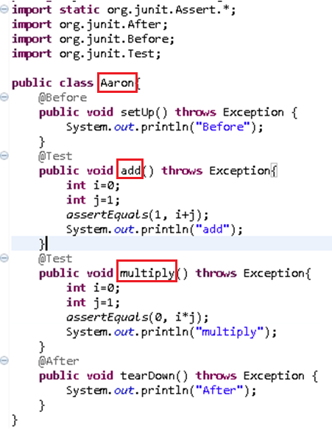
Create Junit4 Test Case Class
Notes:
Junite4 not extends TestCase

Slide 33
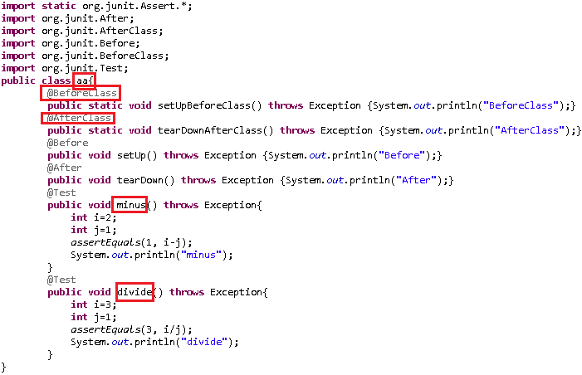
Create Junit4 Test Case Class
Notes:
Junite4 not extends TestCase

Slide 34
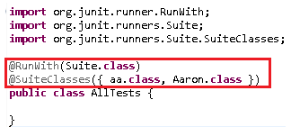
Create Test Suite
Go to -> New -> Other -> Java -> Junit -> Select 'JUnit Test Suite'

Slide 35
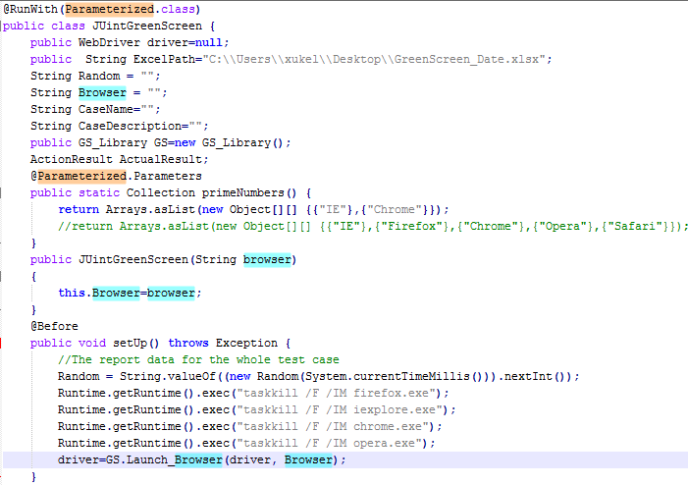
JUnit - Parameterized Test

Slide 36
Apache Ant
Apache Ant,是一个将软件编译、测试、部署等步骤联系在一起加以自动化的一个工具，大多用于Java环境中的软件开发。是Apache基金会下的跨平台的构件工具; Ant可以代替使用javac、java和jar等命令来执行java操作，从而达到轻松的构建和部署Java工程的目的
下载地址：http://ant.apache.org/
配置环境变量
  打开我的电脑--属性--高级--环境变量
  新建系统变量ANT_HOME
  变量名：ANT_HOME
  变量值：C:\Program Files\Ant\apache-ant-1.9.4
  选择“系统变量”中变量名为“Path”的环境变量，双击该变量，把JDK安装路径中bin目录的绝对路径，添加到Path变量的值中，并使用半角的分号和已有的路径进行分隔。
  变量名：Path
  变量值：%ANT_HOME%\bin
Test in cmd
and -version

Slide 37
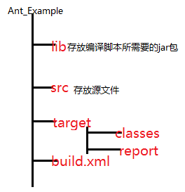

Ant和Junit4的结合

Slide 38
Selenium Grid
Starting a Hub
java -jar selenium-server-standalone-2.40.0.jar -role hub
Or you can specify the different port:
java -jar selenium-server-standalone-2.40.0.jar -role hub -port 4441
Starting a Node
java -jar selenium-server-standalone-2.40.0.jar -role node -hub http://localhost:4444/grid/register
Notes:
WARNING: Be sure to turn off the firewalls on the machine running your hub and nodes. Otherwise you may get connection errors.

Slide 39
Log4j
Log4j is a brilliant logging API available both on Java and .net framework. Advantages are:
- Log4j allows you to have a very good logging infrastructure without putting in any efforts.
– Log4j gives you the ability to categorize logs at different levels (Trace, Debug, Info, Warn, Error and Fatal).
– Log4j gives you the ability to direct logs to different outputs. For e.g. to a file, Console or a Database.
– Log4j gives you the ability to define the format of output logs.
– Log4j gives you the ability to write Asynchronous logs which helps to increase the performance of the application.
– Loggers in Log4j follow a class hierarchy which may come handy to your applications.

Slide 40
Firefox Plugins
Firebug/FirePath/FireFinder/Xpath Checker
WebDriver Element Locator(Search “Selenium”, go to 3rd page)

Slide 41
SEARCH
设置(Setup) 设置指的是将软件准备好，让实际的测试操作可以开始执行。
执行(Execution) 这是测试的核心，包括检验软件功能的特定步骤，充分的错误处理，或者一些其他的相关工作。
分析(Analysis) 分析是确定测试通过还是失败的过程。这是最重要的步骤，也常常是测试中最复杂的步骤。
报告(Reporting) 报告包括分析结果的显示和传播，例如日志文件、数据库、或者其他分析过程所生成的文件。
清理(Cleanup) 清理阶段将软件返回到已知状态使得接下来的测试能继续执行。
帮助(Help) 指的是使测试用例在其生存周期中保持可维护性和健壮性的帮助系统。

Slide 42
Web Sites
http://www.toolsqa.com/
http://m.oschina.net/blog/28119
http://www.tutorialspoint.com/junit/index.htm
http://www.tutorialspoint.com/java/index.htm
http://blog.sina.com.cn/s/blog_505bf9af01016a4q.html
http://blog.csdn.net/hanqionglaaa/article/category/1427166
http://my.oschina.net/dyhunter/blog?catalog=270621
http://www.youtube.com/user/TestLeaf

Slide 43
Q&A

Slide 44
Thanks

