Slide 1

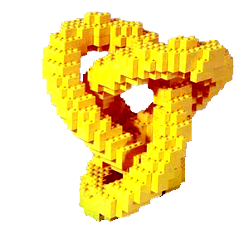
Building Classifiers from Pattern Teams
Knobbe, Valkonet

Slide 2
Building Pattern Teams from Classifiers
Knobbe, Valkonet

Slide 3

Pattern Team Definition
Pattern Team:
Collection of important patterns, where each pattern brings something unique to the team.
Quality measure over pattern set
  max relevance
  min redundancy
Typically a small set
Computation
  exhaustive, |P| = k, slow
  greedy, fast(er)

Slide 4
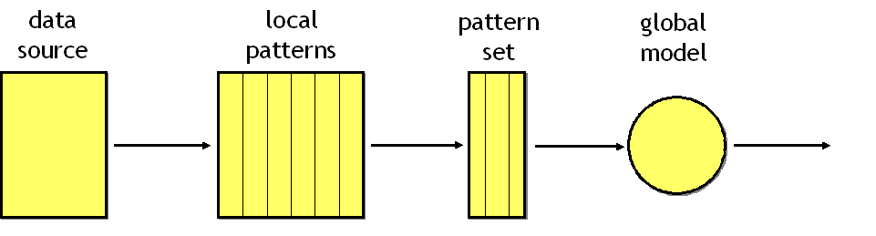
PT’s and Classifiers in the LeGo process
wrapper
Pattern team well understood
Pattern=feature, so any classifier can be used
Use classifier in the pattern selection process
Classification good setting for selection

Slide 5
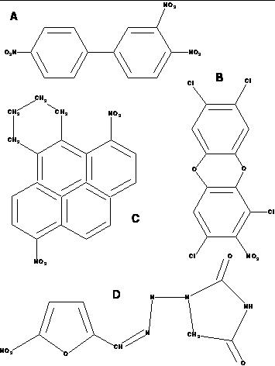
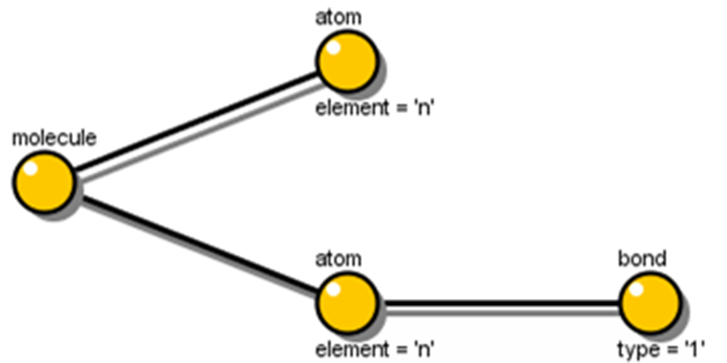
Example: Mutagenesis database
mutagenesis DB
Local Pattern Discovery
188 molecules (125+63)
use SD to find patterns
patterns describe fragments of molecules
  frequent
  predictive
large pattern collection, redundancy, repetition
Subgroup Discovery

Slide 6
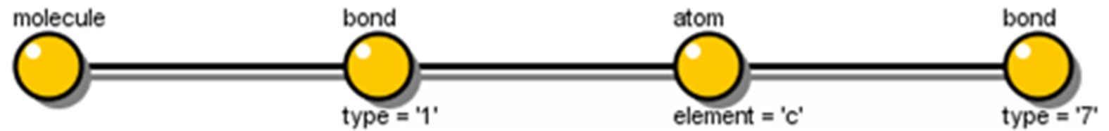
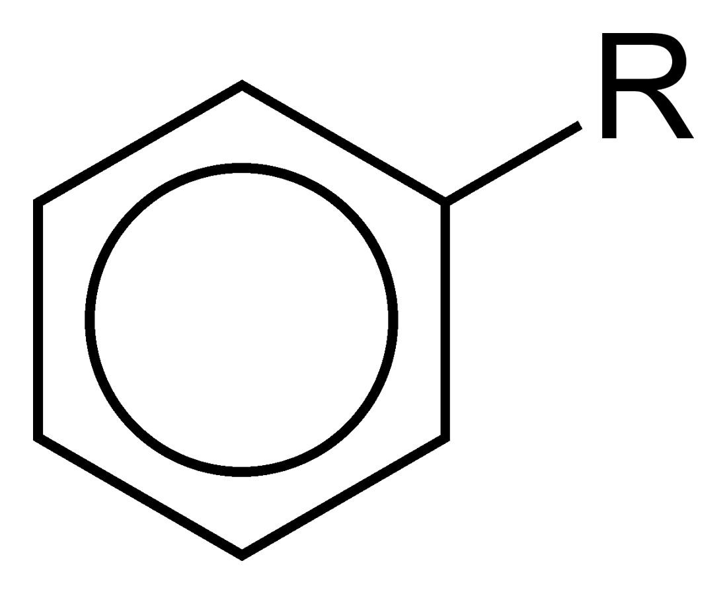
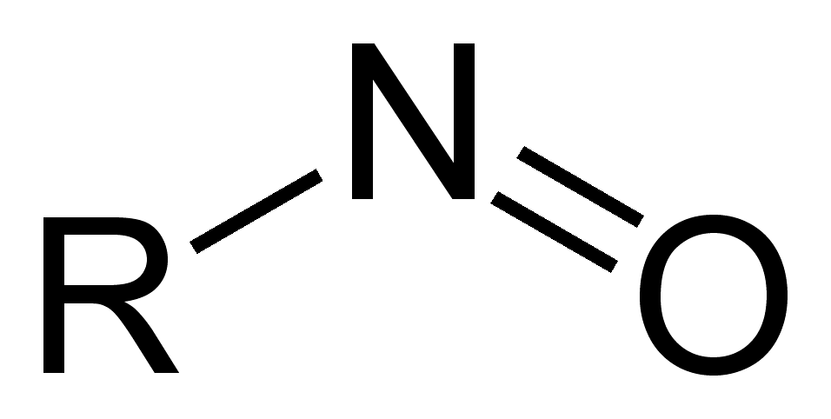
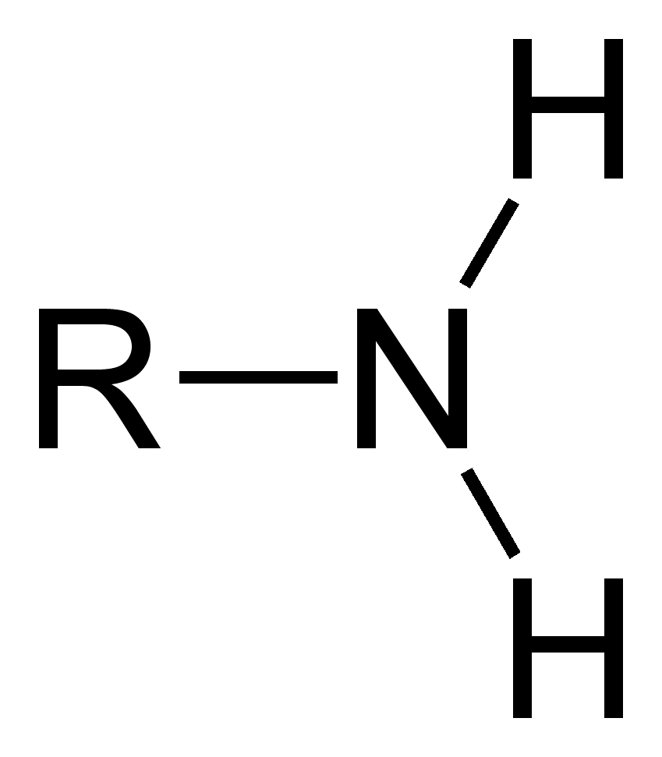
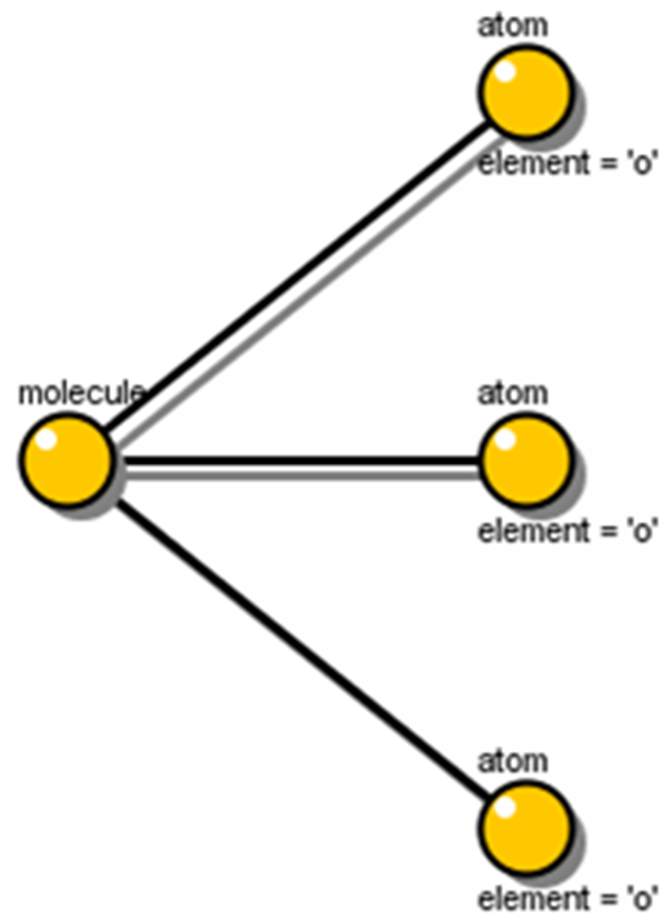
Pattern Team, k=3
support
126
p₁
58
p₂
27
88
p₃

Slide 7
Contingency Tables over Pattern Team
Any 0/1 assignment to p₁, p₂, p₃ provides a contingency
2^{k} = 8 contingencies:
A classifier is an assignment of 0/1 to all contingencies
p₁ | p₂ | p₃ | support | class
0 | 0 | 0 | 22 | 1
0 | 0 | 1 | 21 | 1
0 | 1 | 0 | 15 | 0
0 | 1 | 1 | 4 | 0
1 | 0 | 0 | 47 | 1
1 | 0 | 1 | 40 | 1
1 | 1 | 0 | 16 | 0
1 | 1 | 1 | 23 | 1
Classifiers:
Decision Table Majority DTM_{p}, BDeu, Joint Entropy
Linear
  Support Vector Machine SVM_{p}, SVM_{q}
  Linear Classifier LC_{p}

Slide 8
“Don’t be Afraid of Small Pattern Teams”
( ) candidate teams to consider
  exhaustively or greedily
Small teams work well in practice
Trade-off complexity pattern and classifier
  Local Pattern Discovery captures complexities of data
k patterns imply 2^{k} subgroups
e.g. 3 patterns equivalent to decision tree of 15 nodes.
n
k

Slide 9
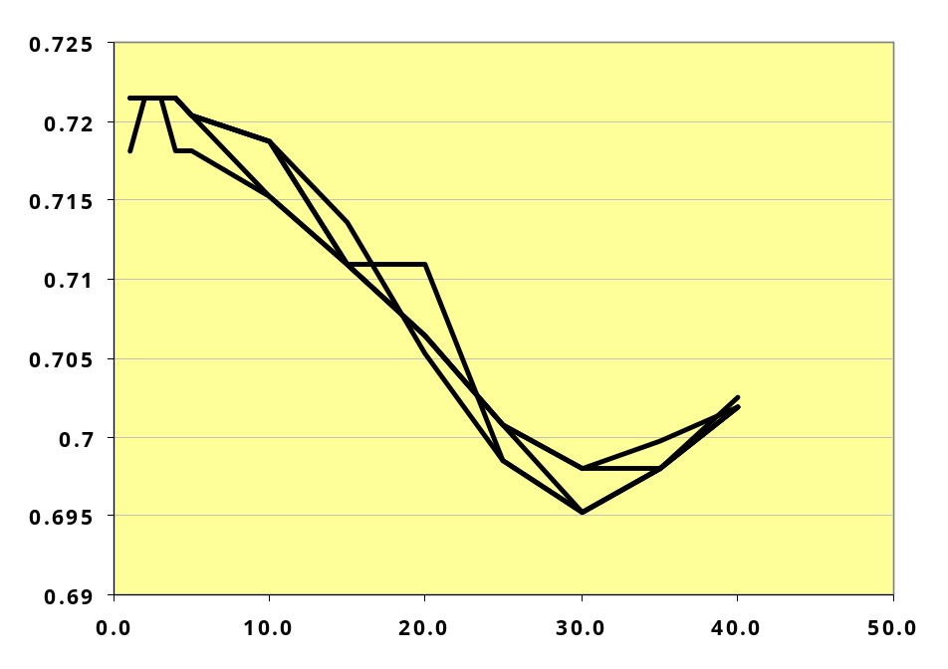
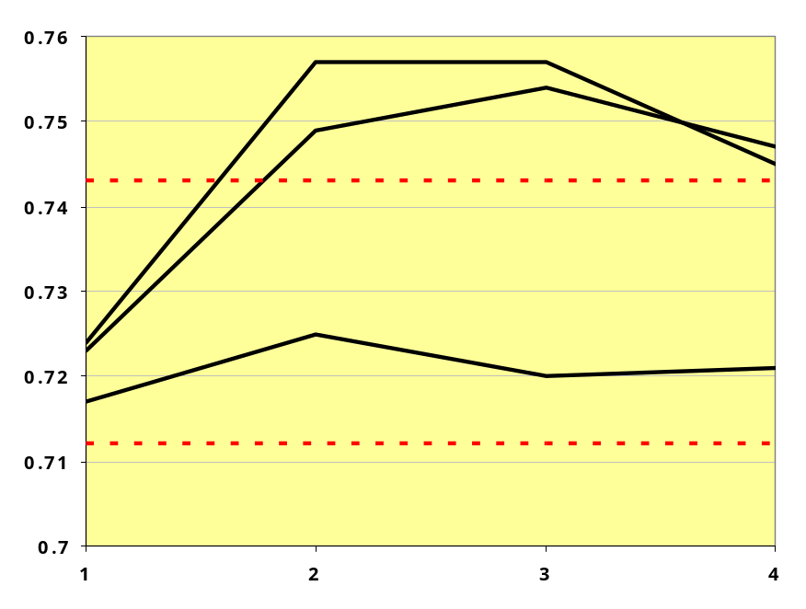
“Don’t be Afraid of Small Pattern Teams”
greedy
based on relevance and redundancy (k ∈ [2..40])
exhaustive
pattern team (k ∈ [1..4]), for simple to complex patterns (d ∈ [1..3])
ANN
J48

Slide 10
Specifics of Classification over Patterns
Few patterns in team, k<5?
Patterns are binary
All patterns in team (strongly) relevant
Exploit specifics of classification over patterns
Support Vector Machines/linear classifiers
  few dimensions
  only ‘discrete’ hyperplanes
  never axis-parallel

Slide 11
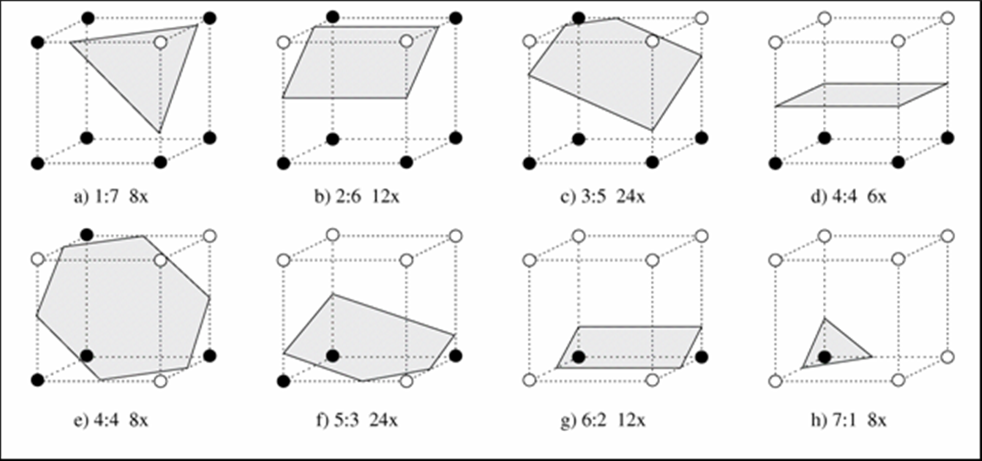
Hyperplanes (k=3)
courtesy O. Aichholzer
all three patterns relevant
one or two irrelevant patterns

Slide 12
How Many (Relevant) Hyperplanes?
k | configurations | linear decision functions | hyperplanes | relevant hyperplanes
1 | 4 | 4 | 1 | 1
2 | 16 | 14 | 6 | 4
3 | 256 | 104 | 51 | 36
4 | 65,536 | 1,882 | 940 | 768
5 | 4.29·10⁹ | 94,572 | 47,285 | 43,040
6 | 1.84·10¹⁹ | 1.50·10⁷ | 7,514,066 | ?

Slide 13
Compared to regular SVM iterations
k | hyperplanes | relevant hyperplanes | SMO WDBC | SMO Ionosphere
2 | 6 | 4 | 4,218 | 15,149
3 | 51 | 36 | 29,141 | 6,610
4 | 940 | 768 | 10,704 | 56,026
5 | 47,285 | 43,040 | 24,109 | 44,245
6 | 7,514,066 | ? | 20,114 | 39,522
enumeration of hyperplanes quicker when k < 5

Slide 14
Experiments
Test SD+wrapper(PT+Cl) on UCI datasets
Try different quality measure
  Filter: Joint Entropy, BDeu
  Wrapper: DMT_{p}, SVM_{p}, SVM_{q}, LC_{p}
Try different classifiers
  DTM
  SVM, LC
  SVM (all patterns)
  Weka: J48, ANN, PART

Slide 15
Results
Best results obtained with Decision Table Majority
Tendency: more ‘pure’ → better accuracy
  only for small teams
Best Pattern Team always outperforms SVM on all patterns
Best Pattern Team competitive with J48, ANN, PART
Joint Entropy not a good measure
Joint Entropy/DMT
BDEU/DTM
SVMp/DTM
DTMp/SVM
DTMp/DTM
LCp/LC
SVMp/SVM
SVMq/SVM
1 2 3 4 5 6 7 8
CD
pure
large margin

Slide 16
Conclusion
Classification is a good framework for pattern selection…
… and vice versa
Small pattern teams tend to work well
  also happen to be more efficient
‘Pure’ classifiers work best
  also happen to be more efficient

