Slide 2
Stereotypes
Extreme music is for extreme people
“We've never given in to the ways of the world… Yet it is the tenacity that encourages people to find their own ways to step up and deal with whatever issues they may have. There is that type of connection.” --- David Vincent (Morbid Angel)
Nerds/introverts/socially awkward prefer metal
Violence are inspired by the music
In our own countries…

Slide 3
Phenomena – THERE ARE MUCH VIOLENCE HAPPENING WITHIN HEAVY METAL…
Types of violence - physical/actions
Mosh pit
Circle pit
Wall of death
Diving/crowd surfing
Arson (black metal)
…

Slide 4
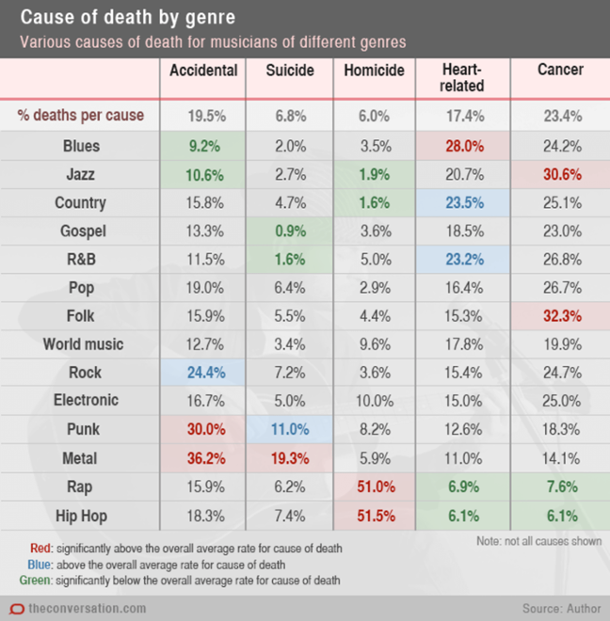
Accidents and riots (0:32-1:55)
Death count (indicating physical violence)

Slide 5
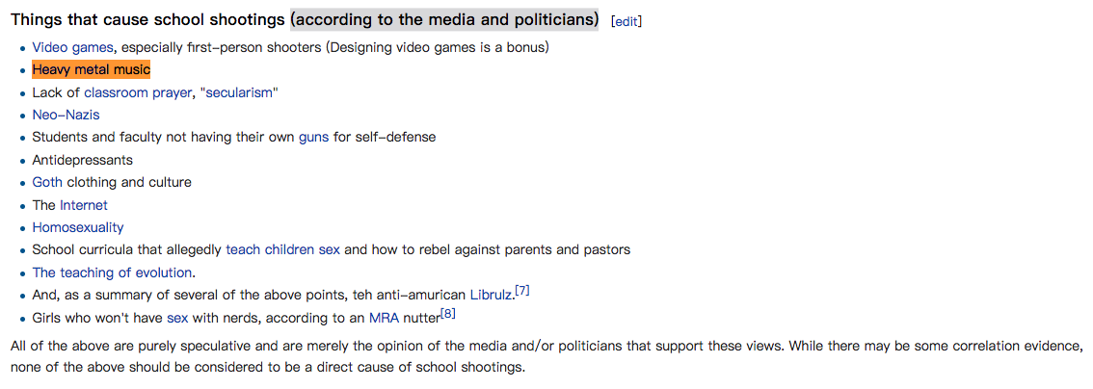
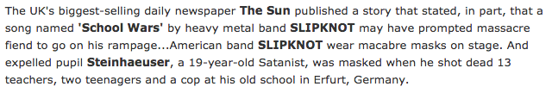

Types of violence – suicide/murder
Some notorious cases…
Suicide:
Judas Priest's "Better by You, Better Than Me”
Ozzy Osbourne's "Suicide Solution”
School shooting:
Erfurt school massacre & Slipknot’s “School War”
Columbine High School massacre & Marilyn Manson
Red Lake shooting
Alexis de Tocqueville school shooting
Serial killing:
AC/DC’s "Night Prowler" & Serial Killer Richard Ramirez

Slide 6
More general correlation?
Heavy metal popularity and crime index geographically
# of bands per capita
% of active bands
not really correlation
Sales and charts
# of listeners per capita
Quality

Slide 7
Why stereotype? Reasons…
Heavy metal
Musical/extra-musical elements
Elements have impact on cerebral/emotional activity
→ Activities lead to violence

Slide 8
The sound/music itself
Loudness (amplification)
Noisiness (distortion)

Slide 9
Loudness
What is “loud”?
(Demo) Sound wave visualisation
Loudness map by genre
Loudness war and dynamic range compression
Example: Smell Like Teen Spirit (0:13/0:38)
Dynamic range compression —> overall increase in loudness, low dynamic range value —> high in loudness level

Slide 10
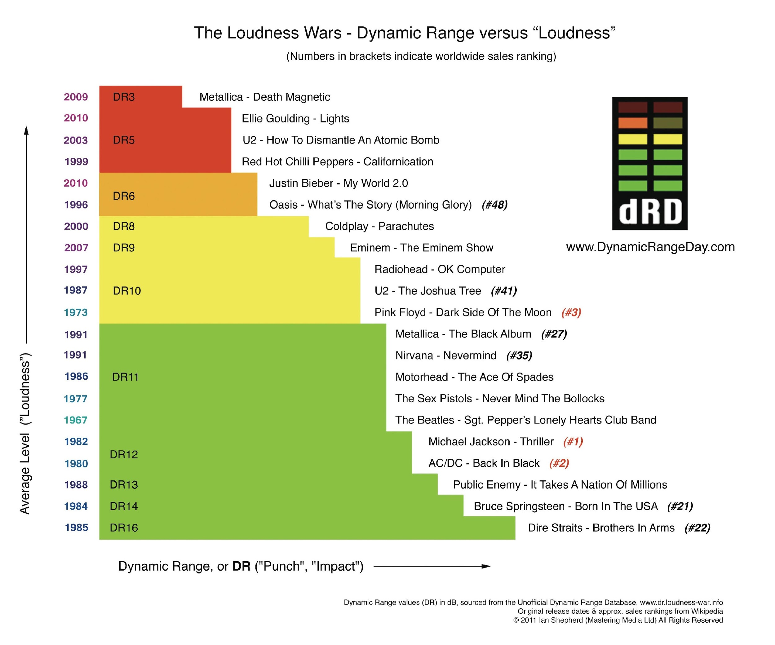
Loudness cont.
(Data)
Heavy metal is LOUD.
?...

Slide 11
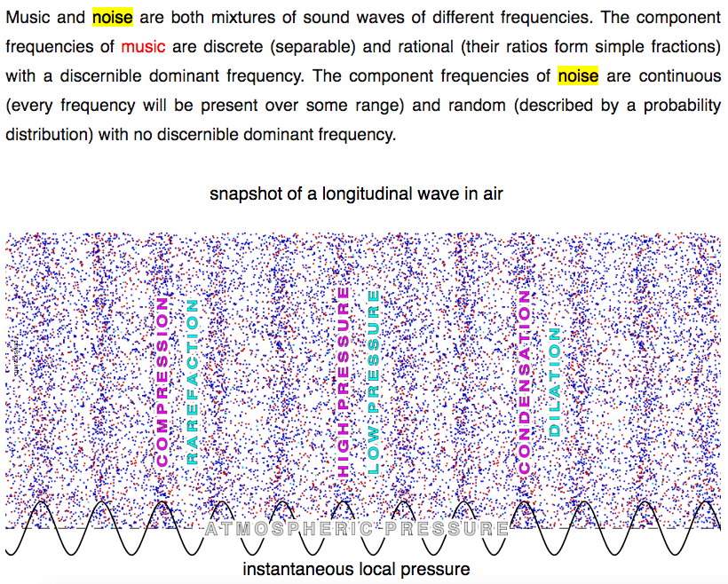
Noisiness
What is noise?
Difference from music?

Slide 12
Noisiness cont.
Where does noise come from?
Amplification (raise of voltage) —> distortion (waveform tends to be “continuous”) —> “noisy”
“non-harmonic distortion”
Heavy metal is perceivably NOISIER than other genres
?..

Slide 13
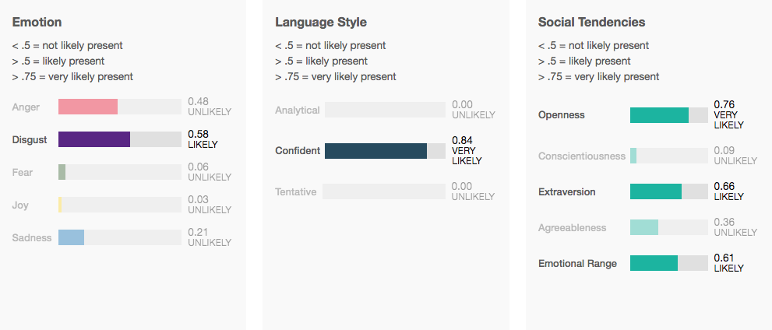
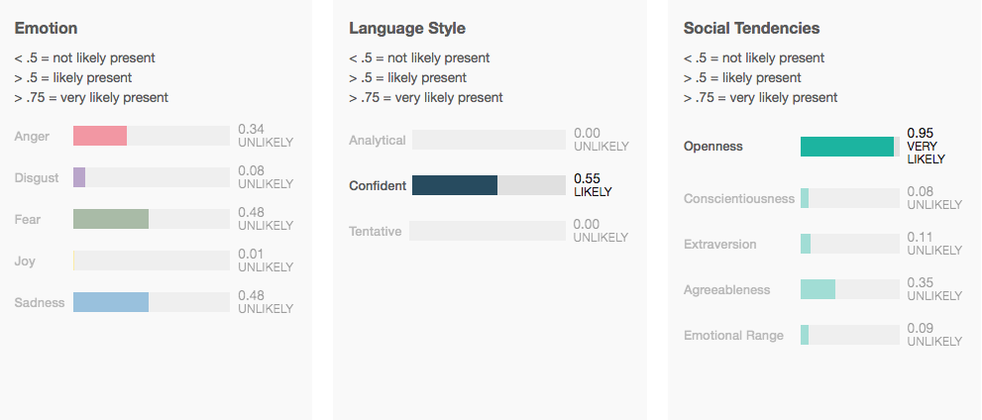
Extra-musical elements
Themes and lyrics
(Data) Most words used in heavy metal lyrics
Intuitive
Word length
Semantic analyser
→No clear conclusion

Slide 14
Lyrics cont.
Revisit: the triggering songs
(Demo) Example: Ozzy Osbourne's "Suicide Solution”
How? Can we trust the machine? Related: Spotify web API: get audio features of a track
(For geeks: Algorithm used is called Truffle Pig)

Slide 15
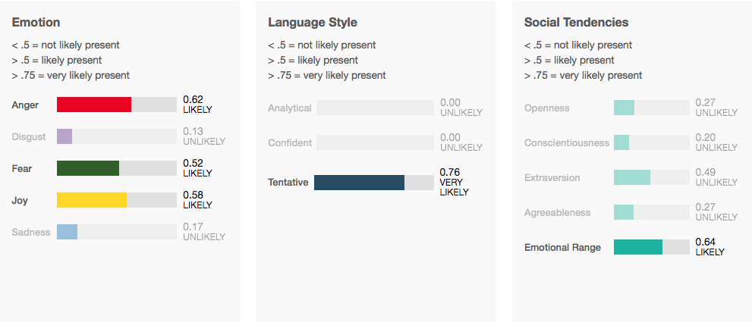
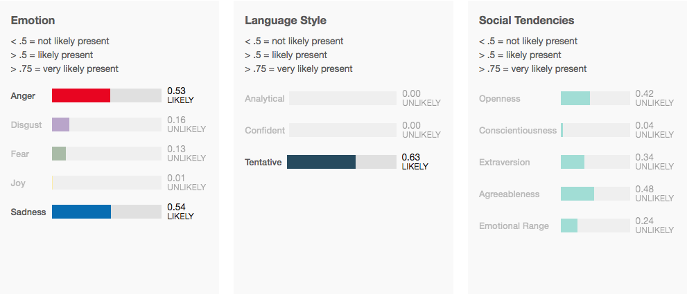
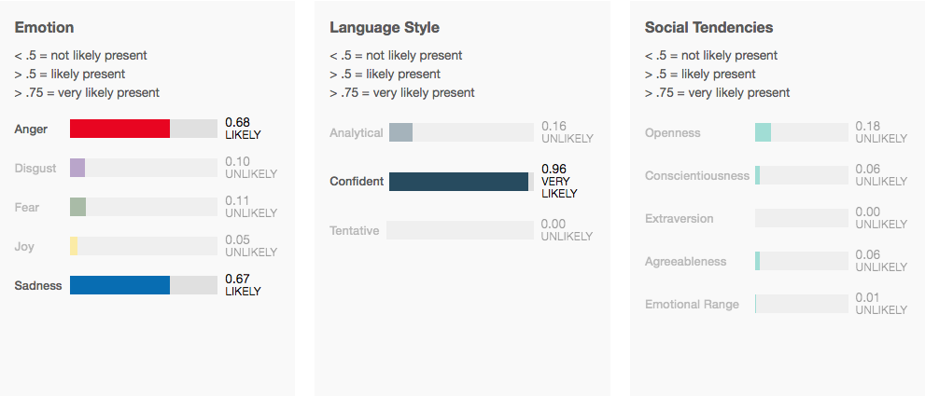
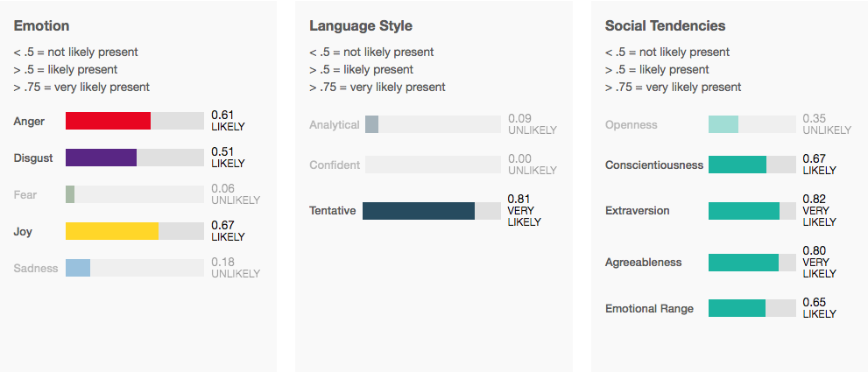
AC/DC’s “Night Prowler”
Ozzy Osbourne's "Suicide Solution”
Slipknot’s “Duality”
Marilyn Manson’s “The Beautiful People”

Slide 16
Mastodon’s “Oblivion”: sadness
Gojira’s “The Heaviest Matter of the Universe”: fear
Opeth’s “Forest of October”: sadness
Baroness’s “Take My Bones Away”: sadness
Heavy metal song lyrics express sadness and anger, tentative, but differ from sub genres
A venting-out?...

Slide 17
Music and lyrics combined
(Demo) KLANGSPEKTRUM
→ Heavy metal music is highly energetic
→ A venting-out?...

Slide 18
Visual elements: artwork/appearance (opt.)

Slide 19
Emotions
“Heavy metal fans had less strong reasons for living (especially male fans) and had more thoughts of suicide (especially female fans). For a large majority, listening to music (all types) had a positive effect on mood. Overall, the results indicate that preference for heavy metal music among adolescents may be a "red flag" for increased suicidal vulnerability, but also suggest that the source of the problem may lie more in personal and familial characteristics than in any direct effects of the music.” --- Heavy metal music and adolescent suicidality: An empirical investigation

Slide 20
Emotions cont.
Revisit
Suicide:
Judas Priest's "Better by You, Better Than Me” (30:56-31:42)
Ozzy Osbourne's "Suicide Solution”

Slide 21
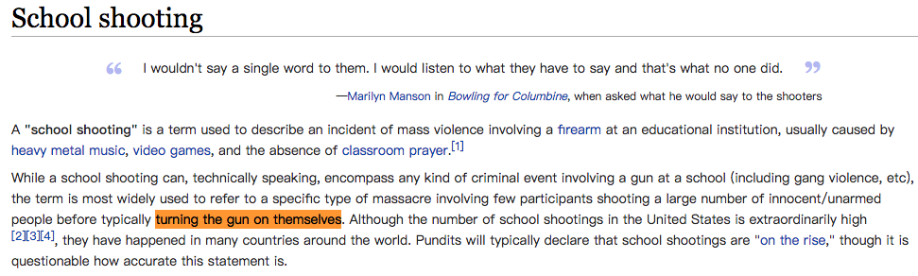
School shooting:
Erfurt school massacre & Slipknot’s “School War”
Columbine High School massacre & Marilyn Manson
Red Lake shooting
Alexis de Tocqueville school shooting
Serial killing:
AC/DC’s "Night Prowler" & Serial Killer Richard Ramirez

Slide 22
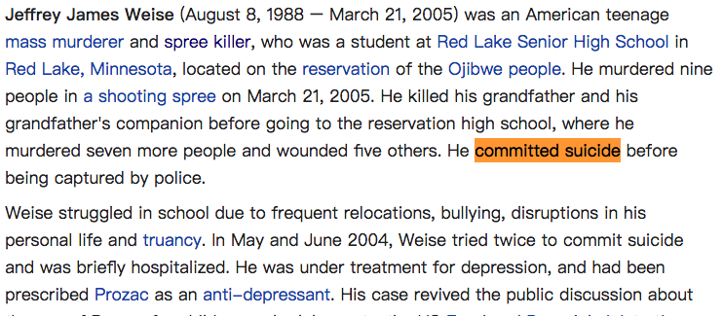
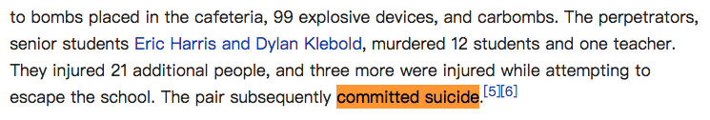
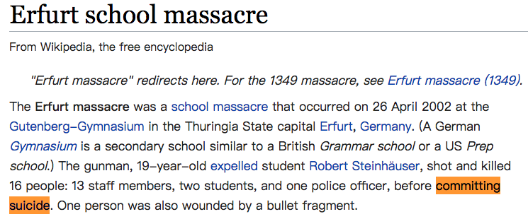
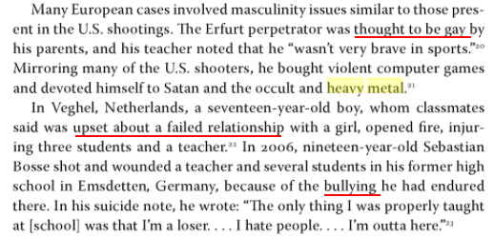

Slide 23
→ 7/7 cases related to heavy metal show correlation with personal and familial reasons.
→ coincide with heavy metal, music is not to blame.
“I think people look at heavy metal and label it for all sorts of things because we need easy answers to complex questions. I think that it's easy to target a heavy metal band for inciting violence or making kids turn to a cult than it is to actually look at real problems in the real world.” --- Sam Dunn

Slide 24
From data
Question still remains…

Slide 25
Reference
https://arena.com/article/morbid-angel-still-extreme-music-for-extreme-people

