Slide 1
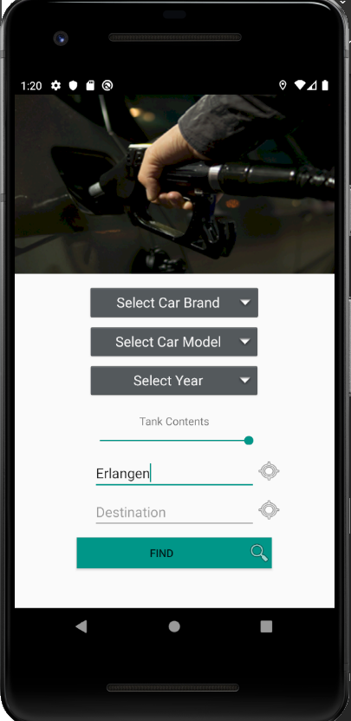
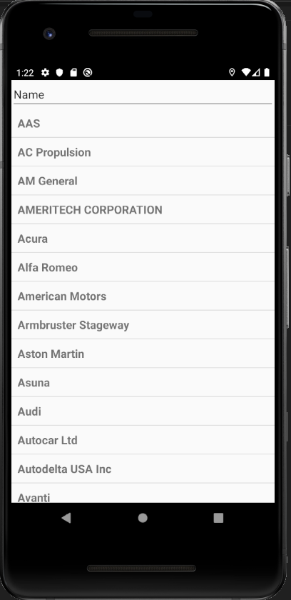
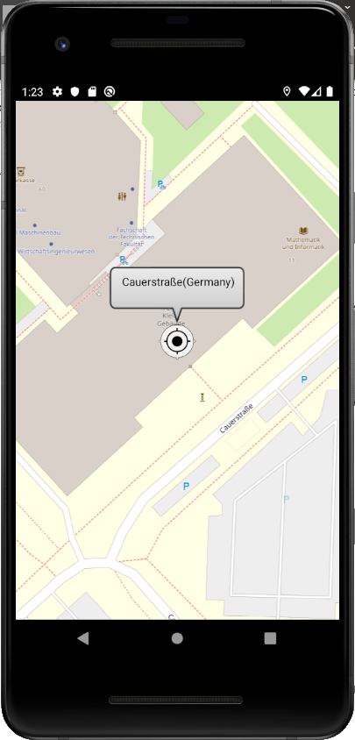







CheapTrip app
current state 02.12.2019
Done last week:
Conceptual Design
Reevaluating existent Sources
Todo next week:
Experiment with CalculationActivity (route calculations)
MainActivity
CarBrandActivity
CarModelActivity
CarYearActivity
MapActivity
TODO:
CalculationActivity
Calculation-Activity
This activity takes care of the Calculation of best routes, regarding these Aspects:
      Distances (to the gas stations along the route)
      Fuel Prices
      Fuel Consumption
      Gas Tank Contents
Result:
The routes will be listed, sorted descendant by Overall Costs.

Slide 2
1. Distances
Elements:
  Starting Point
        Properties: Longitude, Latidute
        Source: Openstreet Map
  Destination:
        Properties: Longitude, Latitude
        Source: Openstreet Map
  Gas Stations:
        Properties: Longitude,Latitude
        Source: TankerKönig
  Routes:
        Properties: List of Coordinates
        Source: OpenRouteService
Calculation of distances:
        Calculate Route between Start Point and End Point
        Get Coordinates of Gas Stations along the Route
        Calculate multiple “3-Point” route distances
        ( Start-Point → Gas Station → Destination)
        Result: List of Distances (km) of “3-Point” Routes
Calculation of several Routes.

Slide 3
2. Fuel Prices
Elements:
  Gas Stations:
        Properties: Longitude,Latitude
        Source: TankerKönig
Getting Fuel Prices :
        Use previously determined list of gas stations (list of IDs) along the route
        to
        get fuel price for each gas station.
        Result:
Get the Fuel Prices
Gas Station ID | Distance | Price
1 | 10,9 km | 1,45 €
2 | 11,2 km | 1,44 €
3 | 10.7 km | 1,47 €
n | … | …

Slide 4
3. Fuel Consumption
Elements:
        n/a
Getting Fuel Consumption :
  Fuel Consumption is determined previously
  by selecting the Car Brand and Model
  (using National Highway and Safety Administration API)
        Result:
Get Fuel Consumption
Gas Station ID | Distance | Price | Consumpt. l /100 km
1 | 10,9 km | 1,45 € | 8.7
2 | 11,2 km | 1,44 € | 6.9
3 | 10.7 km | 1,47 € | 12.9
n | … | …

Slide 5
4. Tank Contents
Elements:
        n/a
Getting Fuel Consumption :
  Based on what the Consumer has chosen within the slidebar,
  a mandatory (sooner) stop will be considered along the way.
  As feature: Different Consumptions on different Routes
        Result:
Factor Tank Contents
Gas Station ID | Distance | Price | Consumpt. l /100 km
1 | 10,9 km | 1,45 € | 8.7
2 | 11,2 km | 1,44 € | 6.9
3 | 10.7 km | 1,47 € | 12.9
n | … | …

Slide 6
CALCULATION
Formula:
  Distance * Consumption * Price
Example
10.9 km * 1.45 € * 8.7 l/100km = 1,375035 €
Calculate the best Route
Gas Station ID | Distance | Price | Consumpt. l /100 km | Ranking
1 | 10,9 km | 1,45 € | 8.7
2 | 11,2 km | 1,44 € | 6.9
3 | 10.7 km | 1,47 € | 12.9
n | … | …

Slide 7
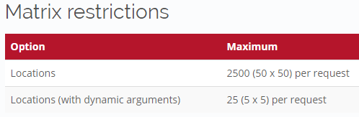
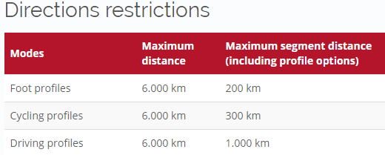
Feasability/
Restrictions
NHTSA
    n/a
Fuel Economy:
    n/a
Tankerkönig:
    25 km Umkreis suche max.
    Abfragen nicht öfter als einmal in 5 Minuten durchführen
    Abfragezeiten sollten, um Lastspitzen zu vermeiden, nicht an runden Zeiten stattfinden - besser ist es, eine zufällige Anzahl Sekunden Verzögerung einzubauen
Photon (Location-AutoCompletion)
    You can use the API for your project, but please be fair - extensive usage will be throttled. We do not guarantee for the availability and usage might be subject of change in the future.
OpenRouteServices:
Restrictions of current APIs in use

Slide 8
Licence
Bound to CreativeCommons-Licence
Die Daten stehen unter der Creative-Commons-Lizenz “CC BY 4.0”, siehe https://creativecommons.org/licenses/by/4.0/deed.de , insbesondere ist eine Namensnennung nötig (z.B. ein Link auf www.tankerkoenig.de) Für Apps ist diese Namensnennung auch im Info-Text im Store zu erfolgen.

