Slide 1
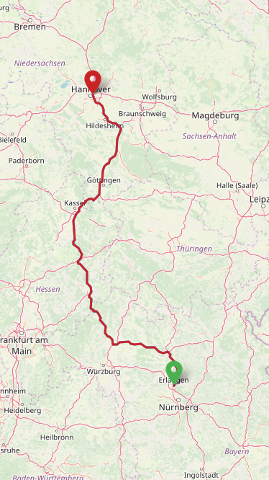






CheapTrip Android App
current state 11.12.2019
Done last week:
Develop an algorithm for route calculation (presented today)
Implementation of the algorithm (work in progress)
Design user interface for CalculationActivity (work in progress)
Todo next week:
Finish implementation of algorithm
Finish CalculationActivity
Choose appropriate license for our software
Algorithm for route calculation
1. The app calculates a „provisional“ route [openrouteservice] based on user start and destination input [openstreetmap + photon]

Slide 2
CheapTrip Android App
current state 11.12.2019
Done last week:
Develop an algorithm for route calculation (presented today)
Implementation of the algorithm (work in progress)
Design user interface for CalculationActivity (work in progress)
Todo next week:
Finish implementation of algorithm
Finish CalculationActivity
Choose appropriate license for our software
Algorithm for route calculation
1. The app calculates a „provisional“ route [openrouteservice] based on user start and destination input [openstreetmap + photon]
2. The current range is calculated based on
tank capacity and consumption of the car model [ODS ← NHTSA or fueleconomy]
← current range

Slide 3
CheapTrip Android App
current state 11.12.2019
Done last week:
Develop an algorithm for route calculation (presented today)
Implementation of the algorithm (work in progress)
Design user interface for CalculationActivity (work in progress)
Todo next week:
Finish implementation of algorithm
Finish CalculationActivity
Choose appropriate license for our software
Algorithm for route calculation
1. The app calculates a „provisional“ route [openrouteservice] based on user start and destination input [openstreetmap + photon]
2. The current range is calculated based on
tank capacity and consumption of the car model [ODS ← NHTSA or fueleconomy]
3. The app finds all gas stations within a radius of 3 km [ODS ← tankerkönig repo]
← find gas stations in
this radius

Slide 4
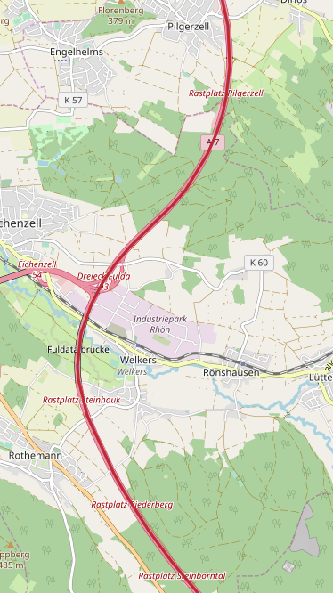

CheapTrip Android App
current state 11.12.2019
Done last week:
Develop an algorithm for route calculation (presented today)
Implementation of the algorithm (work in progress)
Design user interface for CalculationActivity (work in progress)
Todo next week:
Finish implementation of algorithm
Finish CalculationActivity
Choose appropriate license for our software
Algorithm for route calculation
1. The app calculates a „provisional“ route [openrouteservice] based on user start and destination input [openstreetmap + photon]
2. The current range is calculated based on
tank capacity and consumption of the car model [ODS ← NHTSA or fueleconomy]
3. The app finds all gas stations within a radius of 3 km [ODS ← tankerkönig repo]
4. The prices are retrieved and the gas station with lowest price is selected [tankerkönig API]
← gas station with
lowest price is
found

Slide 5
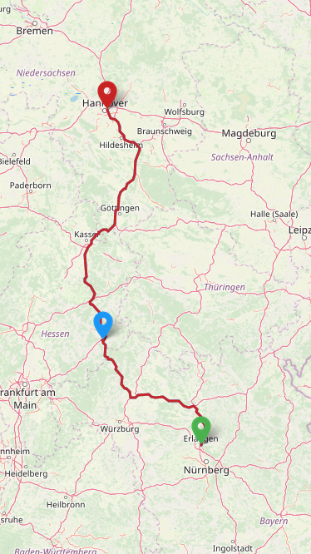
CheapTrip Android App
current state 11.12.2019
Done last week:
Develop an algorithm for route calculation (presented today)
Implementation of the algorithm (work in progress)
Design user interface for CalculationActivity (work in progress)
Todo next week:
Finish implementation of algorithm
Finish CalculationActivity
Choose appropriate license for our software
Algorithm for route calculation
1. The app calculates a „provisional“ route [openrouteservice] based on user start and destination input [openstreetmap + photon]
2. The current range is calculated based on
tank capacity and consumption of the car model [ODS ← NHTSA or fueleconomy]
3. The app finds all gas stations within a radius of 3 km [ODS ← tankerkönig repo]
4. The prices are retrieved and the gas station with lowest price is selected [tankerkönig API]
5. New multi stop route is calculated [openrouteservice]

Slide 6
CheapTrip Android App
current state 11.12.2019
Done last week:
Develop an algorithm for route calculation (presented today)
Implementation of the algorithm (work in progress)
Design user interface for CalculationActivity (work in progress)
Todo next week:
Finish implementation of algorithm
Finish CalculationActivity
Choose appropriate license for our software
Algorithm for route calculation
1. The app calculates a „provisional“ route [openrouteservice] based on user start and destination input [openstreetmap + photon]
2. The current range is calculated based on
tank capacity and consumption of the car model [ODS ← NHTSA or fueleconomy]
3. The app finds all gas stations within a radius of 3 km [ODS ← tankerkönig repo]
4. The prices are retrieved and the gas station with lowest price is selected [tankerkönig API]
5. New multi stop route is calculated [openrouteservice]
← LOOP

Slide 7
CheapTrip Android App
current state 11.12.2019
Done last week:
Develop an algorithm for route calculation (presented today)
Implementation of the algorithm (work in progress)
Design user interface for CalculationActivity (work in progress)
Todo next week:
Finish implementation of algorithm
Finish CalculationActivity
Choose appropriate license for our software
Algorithm for route calculation
1. The app calculates a „provisional“ route [openrouteservice] based on user start and destination input [openstreetmap + photon]
2. The current range is calculated based on
tank capacity and consumption of the car model [ODS ← NHTSA or fueleconomy]
3. The app finds all gas stations within a radius of 3 km [ODS ← tankerkönig repo]
4. The prices are retrieved and the gas station with lowest price is selected [tankerkönig API]
5. New multi stop route is calculated [openrouteservice]
← current range
← LOOP

Slide 8
CheapTrip Android App
current state 11.12.2019
Done last week:
Develop an algorithm for route calculation (presented today)
Implementation of the algorithm (work in progress)
Design user interface for CalculationActivity (work in progress)
Todo next week:
Finish implementation of algorithm
Finish CalculationActivity
Choose appropriate license for our software
Algorithm for route calculation
1. The app calculates a „provisional“ route [openrouteservice] based on user start and destination input [openstreetmap + photon]
2. The current range is calculated based on
tank capacity and consumption of the car model [ODS ← NHTSA or fueleconomy]
3. The app finds all gas stations within a radius of 3 km [ODS ← tankerkönig repo]
4. The prices are retrieved and the gas station with lowest price is selected [tankerkönig API]
5. New multi stop route is calculated [openrouteservice]
← find gas stations
in this radius
← LOOP

Slide 9
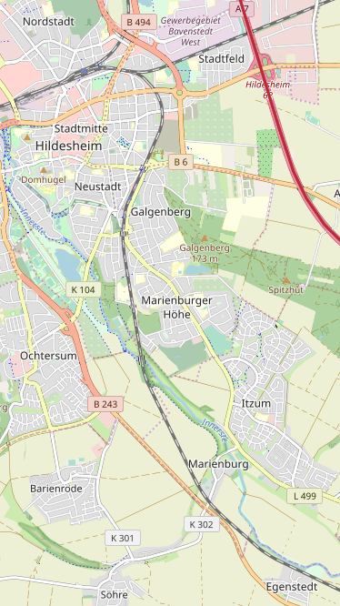
CheapTrip Android App
current state 11.12.2019
Done last week:
Develop an algorithm for route calculation (presented today)
Implementation of the algorithm (work in progress)
Design user interface for CalculationActivity (work in progress)
Todo next week:
Finish implementation of algorithm
Finish CalculationActivity
Choose appropriate license for our software
Algorithm for route calculation
1. The app calculates a „provisional“ route [openrouteservice] based on user start and destination input [openstreetmap + photon]
2. The current range is calculated based on
tank capacity and consumption of the car model [ODS ← NHTSA or fueleconomy]
3. The app finds all gas stations within a radius of 3 km [ODS ← tankerkönig repo]
4. The prices are retrieved and the gas station with lowest price is selected [tankerkönig API]
5. New multi stop route is calculated [openrouteservice]
← gas station with
lowest price is
found
← LOOP

Slide 10
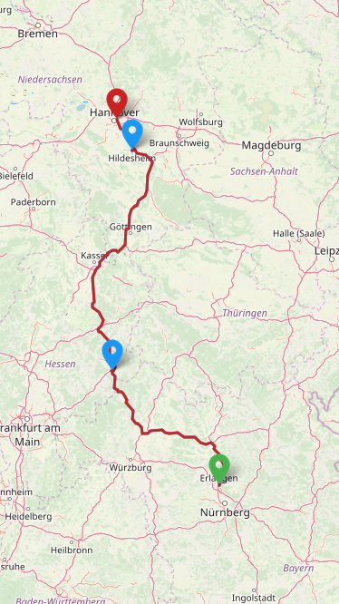
CheapTrip Android App
current state 11.12.2019
Done last week:
Develop an algorithm for route calculation (presented today)
Implementation of the algorithm (work in progress)
Design user interface for CalculationActivity (work in progress)
Todo next week:
Finish implementation of algorithm
Finish CalculationActivity
Choose appropriate license for our software
Algorithm for route calculation
1. The app calculates a „provisional“ route [openrouteservice] based on user start and destination input [openstreetmap + photon]
2. The current range is calculated based on
tank capacity and consumption of the car model [ODS ← NHTSA or fueleconomy]
3. The app finds all gas stations within a radius of 3 km [ODS ← tankerkönig repo]
4. The prices are retrieved and the gas station with lowest price is selected [tankerkönig API]
5. New multi stop route is calculated [openrouteservice]
← LOOP

Slide 11
CheapTrip Android App
current state 11.12.2019
Done last week:
Develop an algorithm for route calculation (presented today)
Implementation of the algorithm (work in progress)
Design user interface for CalculationActivity (work in progress)
Todo next week:
Finish implementation of algorithm
Finish CalculationActivity
Choose appropriate license for our software
Current thoughts on UI of CalculationActivity
Show map with the multi stop route and make the icons of gas stations clickable
User may click on the icon to get the address and fuel price shown
The address may be copied or the user clicks the button „Navigate“ to drive directly to the gas station using their preferred navigation app (G Maps, HERE…)
Further thoughts
The user may want to fill its fuel tank as soon as possible within the current radius
→ Provide a button „Refuel now“ (this corresponds to tank content 0%)
Raiffeisen RHV - Tankstelle
Am Langen Acker 17
36124 Eichenzell
Diesel price: 1,12 € / l
Navigate ↑
This button invokes a geo link with coordinates for launching a navigation app

Slide 12
CheapTrip Android App
current state 11.12.2019
Done last week:
Develop an algorithm for route calculation (presented today)
Implementation of the algorithm (work in progress)
Design user interface for CalculationActivity (work in progress)
Todo next week:
Finish implementation of algorithm
Finish CalculationActivity
Choose appropriate license for our software
Further thoughts
If no fuel station is found within the radius, return 6 km along the route and search there
User may want to fill its fuel tank as soon as possible within the current radius
→ Provide a button „Refuel now“ (this corresponds to tank content 0%)
← no stations found
← search here
„Refuell now“ →

