Slide 1
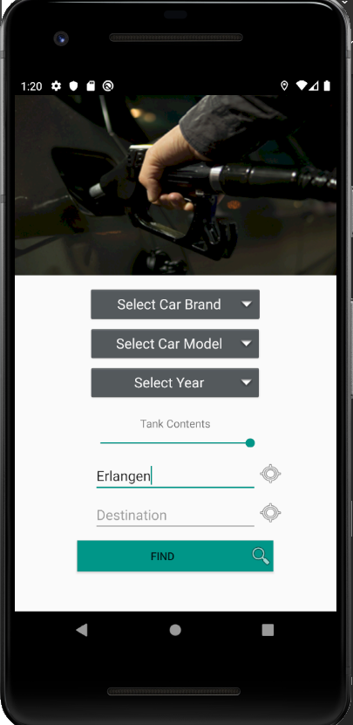
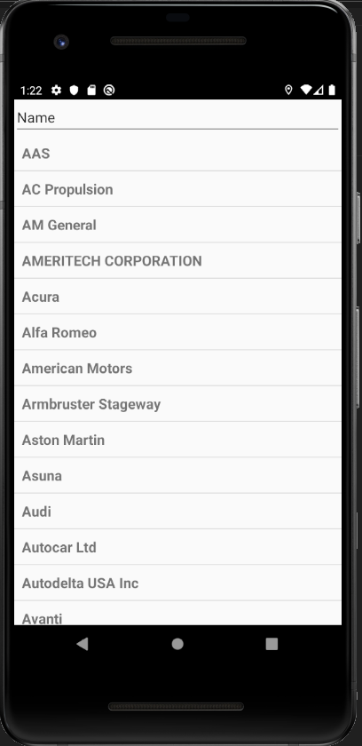
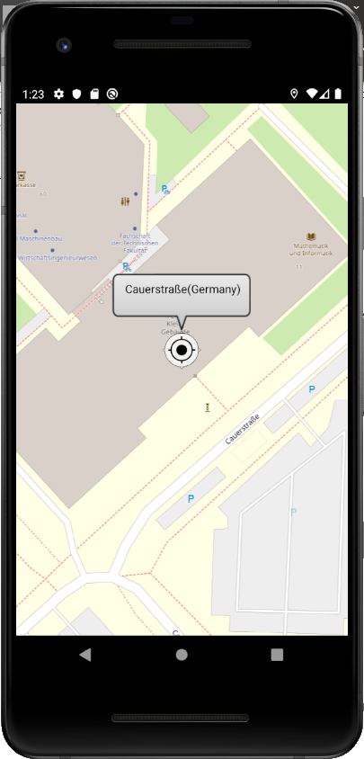







CheapTrip app
current state 04.12.2019
Done last week:
Conceptual design
Reevaluating existent sources
Todo next week:
Experiment with CalculationActivity (route calculations)
License
MainActivity
CarBrandActivity
CarModelActivity
CarYearActivity
MapActivity
TODO:
CalculationActivity
Calculation-Activity
This activity takes care of the calculation of best routes regarding these aspects:
      Distances (to the gas stations along the route)
      Fuel prices
      Fuel consumption
      Gas tank content
Result:
The routes will be listed, sorted descendant by overall costs

Slide 2
1. Distances
Elements:
  Starting Point
        Properties: Longitude, Latidute
        Source: Openstreet Map
  Destination:
        Properties: Longitude, Latitude
        Source: Openstreet Map
  Gas Stations:
        Properties: Longitude, Latitude
        Source: Tankerkönig
  Routes:
        Properties: List of coordinates
        Source: OpenRouteService
Calculation of distances:
        Calculate route between start point and end point
        Get coordinates of gas stations along the route
        Calculate multiple “3-point” route distances
        (Start point → Gas station → Destination)
        Result: List of distance (km) of “3-point” routes
Calculation of several routes

Slide 3
2. Fuel prices
Elements:
  Gas stations:
        Properties: Longitude, Latitude
        Source: Tankerkönig
Getting fuel prices:
        Use previously determined list of gas stations (list of IDs) along the route to get fuel price for each gas station
        Result:
Get the fuel prices
Gas station ID | Distance | Price
1 | 109 km | 1,45 €
2 | 112 km | 1,44 €
3 | 107 km | 1,47 €
n | … | …

Slide 4
3. Fuel consumption
Elements:
        n/a
Getting fuel consumption:
  Fuel consumption is determined previously by selecting the car brand and model
  (using National Highway and Safety Administration API)
        Result:
Get fuel consumption
Gas station ID | Distance | Price | Consumpt. l /100 km
1 | 109 km | 1,45 € | 8.7
2 | 112 km | 1,44 € | 6.9
3 | 107 km | 1,47 € | 12.9
n | … | …

Slide 5
4. Tank contents
Elements:
        n/a
Getting fuel consumption:
  Based on what the Consumer has chosen within the slidebar,
  a mandatory (sooner) stop will be considered along the way
  As feature: Different consumptions on different routes
  Result:
Factor tank contents
Gas station ID | Distance | Price | Consumpt. l /100 km
1 | 109 km | 1,45 € | 8.7
2 | 112 km | 1,44 € | 6.9
3 | 107 km | 1,47 € | 12.9
n | … | …

Slide 6
CALCULATION
Formula:
  Distance * Consumption * Price
Example:
109 km * 1.45 € * 8.7 l/100km = 13,75035 €
Calculate the best route
Gas station ID | Distance | Price | Consumpt. l /100 km | Ranking
1 | 109 km | 1,45 € | 8.7
2 | 112 km | 1,44 € | 6.9
3 | 107 km | 1,47 € | 12.9
n | … | …

Slide 7
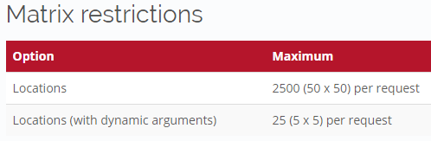
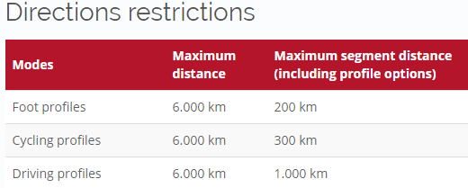
Feasability/
Restrictions
NHTSA
    n/a
Fuel Economy:
    n/a
Tankerkönig:
    25 km Umkreis Suche max.
    Abfragen nicht öfter als einmal in 5 Minuten durchführen
    Abfragezeiten sollten, um Lastspitzen zu vermeiden, nicht an runden Zeiten stattfinden - besser ist es, eine zufällige Anzahl Sekunden Verzögerung einzubauen
Photon (Location-Autocompletion)
    You can use the API for your project, but please be fair - extensive usage will be throttled. We do not guarantee for the availability and usage might be subject of change in the future.
OpenRouteServices:
Restrictions of current APIs in use

