Slide 1
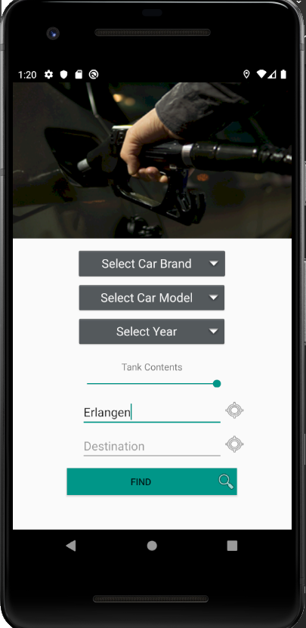
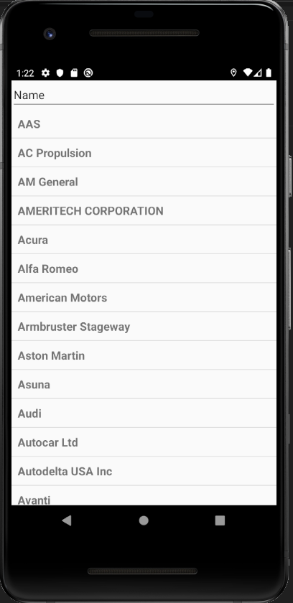
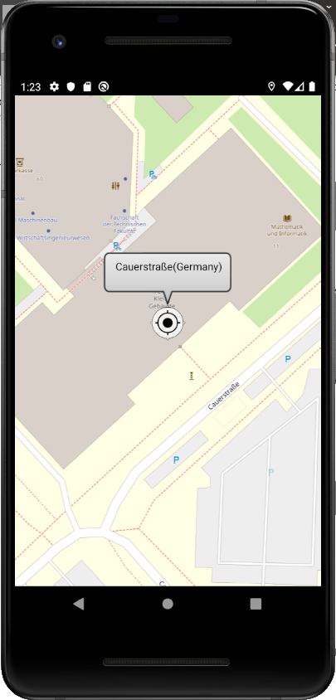
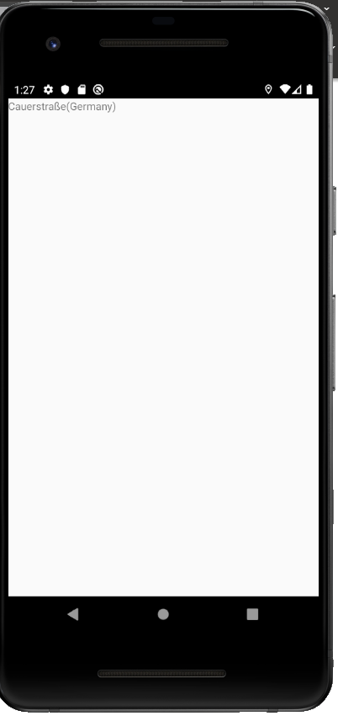





CheapTrip app
current state 20.11.2019
Done last week:
Refactoring of our code
Problems with introducing APIs in JValue ODS ☹
Todo next week:
Introduce APIs in JValue ODS
Experiment with CalculationActivity (route calculations)
MainActivity
CarBrandActivity
CarModelActivity
CarYearActivity
MapActivity
TODO:
CalculationActivity
MainActivity: starting activity: user chooses his car model, tank content and start location and destination
CarBrandActivity: list of all brands (populated by REST API call)
CarModelActivity: list of car models (populated by REST API call)
CarYearActivity: list of years (populated by REST API call)
MapActivity: shows either current location or location(s) provided by user
CalculationActivity: TODO: shows the calculated route
e.g. start -> gas station A -> gas station B -> destination (on a map or as text)

Slide 2
Folder structure:
Activities: All activities of CheapTrip so far
dao (Data Access Objects): Interfaces defining REST API calls for usage by the retrofit client (client for REST API calls)
database: TODO: Implement caching/storing of some data from previous REST calls to increase performance
handlers:
- rest: Handling results of REST API calls (data aggregation of the REST responses)
- other: e.g. AutoCompletionHandler for TextEdits
models:
- rest: Objects of these classes get initialized with the data of entities of the REST response
- db: Objects referring to database entities
services: Services, providing functionalities (e.g. GPSService → provides current location)
CheapTrip app
current state 20.11.2019
Done last week:
Refactoring of our code
Problems with introducing APIs in JValue ODS ☹
Todo next week:
Introduce APIs in JValue ODS
Experiment with CalculationActivity (route calculations)

