Slide 1
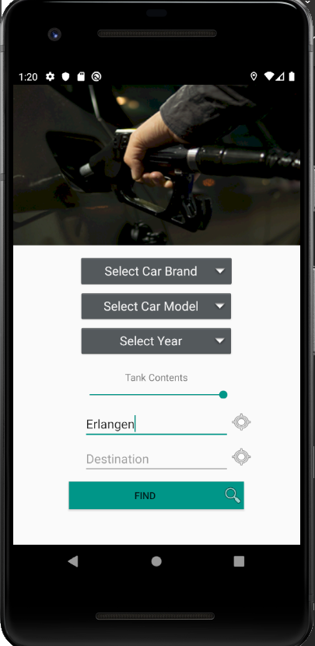
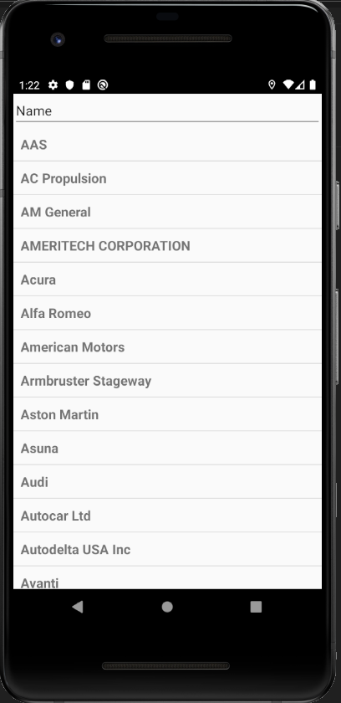
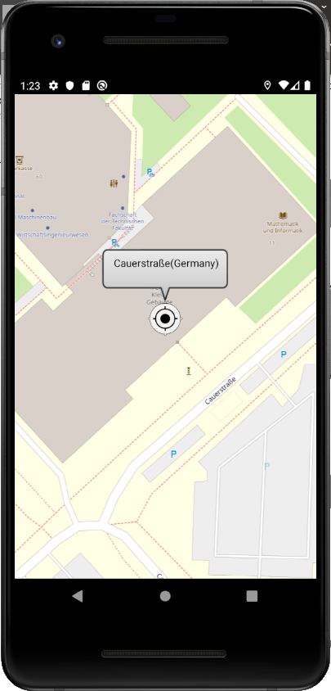
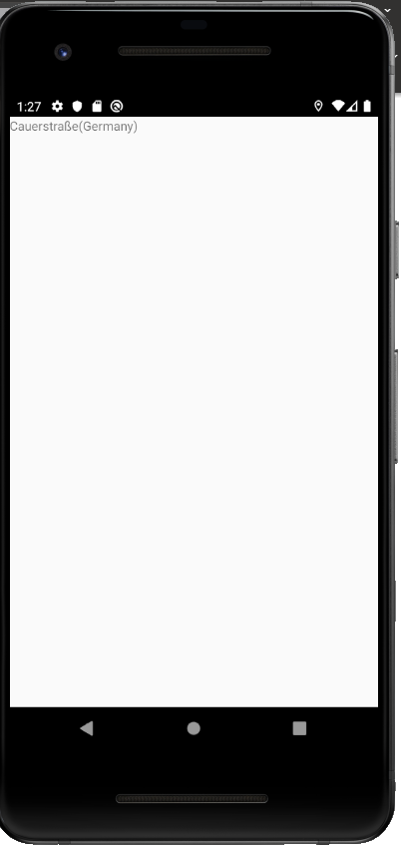





CheapTrip app
current state 27.11.2019
Done last week:
Introduced NHTSA (car brands) API in JValue ODS
Todo next week:
Experiment with CalculationActivity (route calculations)
MainActivity
CarBrandActivity
CarModelActivity
CarYearActivity
MapActivity
TODO:
CalculationActivity
Open Data Sources:
List with car brands is provided by JValue ODS (from NHTSA and Fuel Economy)
Model and year directly from API (NHTSA and Fuel Economy)
Gas stations: JValue ODS not possible due to free API key limitation of Tankerkönig API (possible only with paid access)
Typeahead suggestion from Photon API
Map data from OpenStreetMap API

