Slide 1

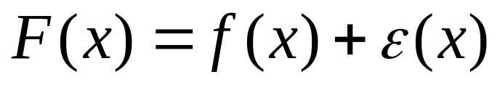
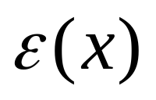
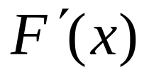
The Derivative of Experimental Data
The Effect is shown of the fact that even if f(x) is smooth so that exists but experimentally you measure
where is a Random Function so that
No longer exists!

Slide 2
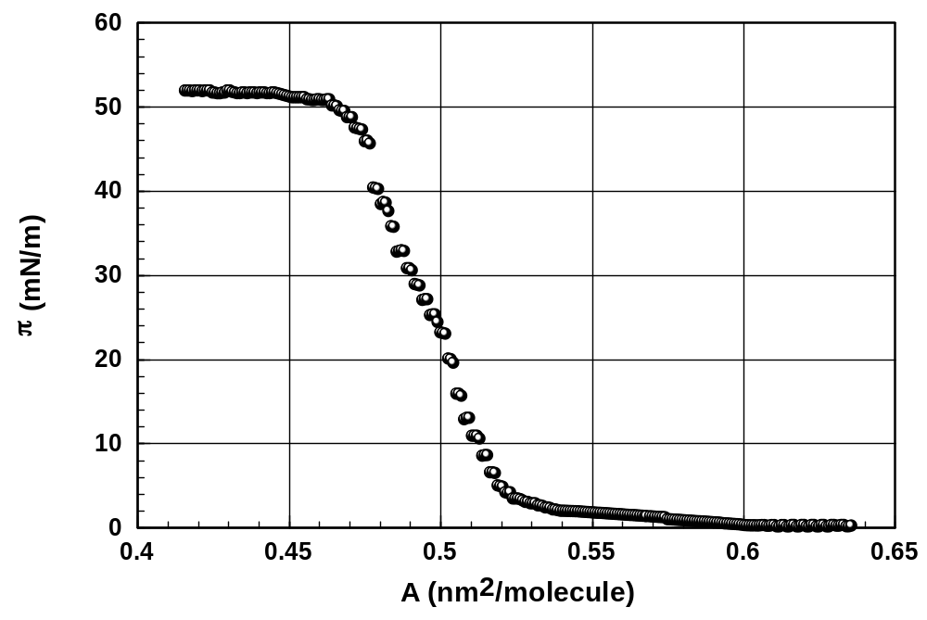
Raw Isotherm: π(A) is Smooth but ε(A) is Not Smooth!

Slide 3
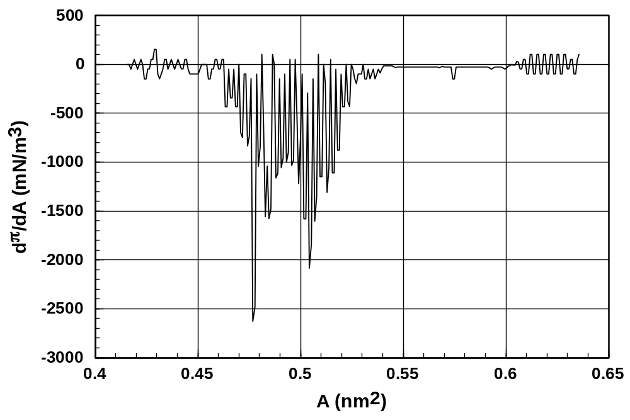
Numerical Derivative Shows the Effect of ε(A)!

Slide 4
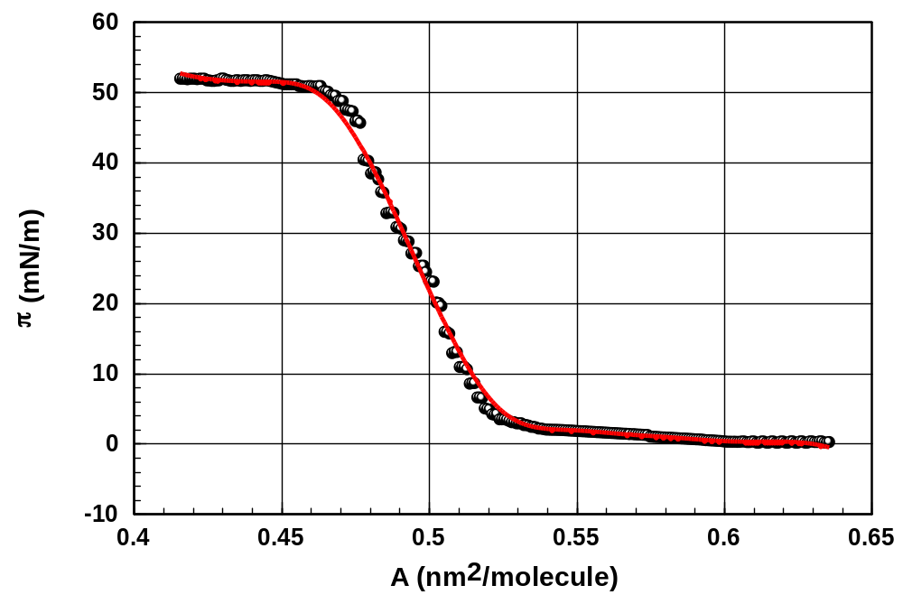
Result of Numerical Smoothing, One approach to using the fact That <ε(x)>=0.

Slide 5
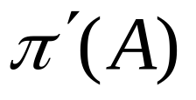
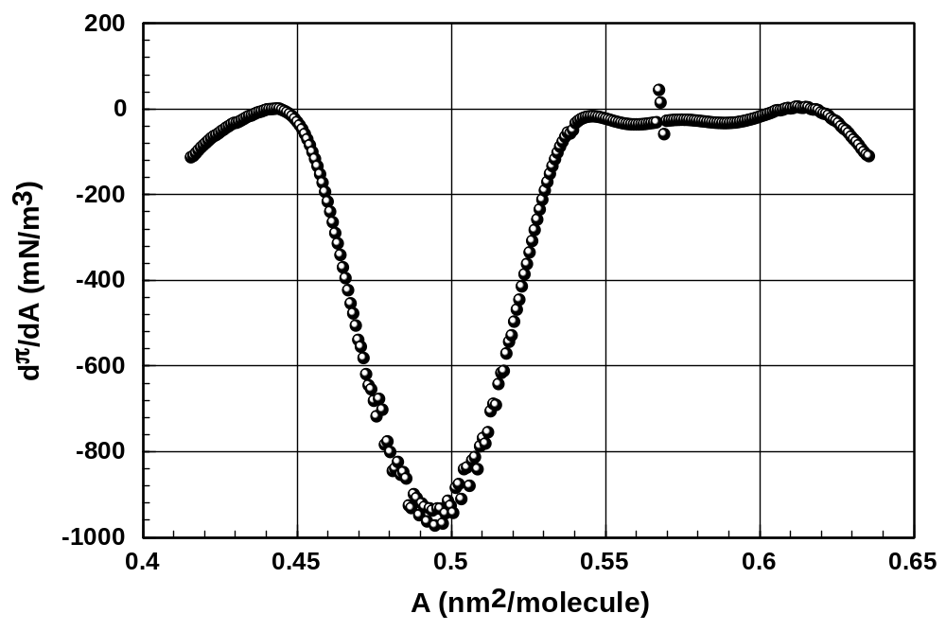
Numerical Derivative of Smooth Data.
A Better Representation of but not ‘perfect.’

