Slide 1

Airport Data Analysis and Predictive Modeling
CS777 Project
Xizhao Zhang

Slide 2
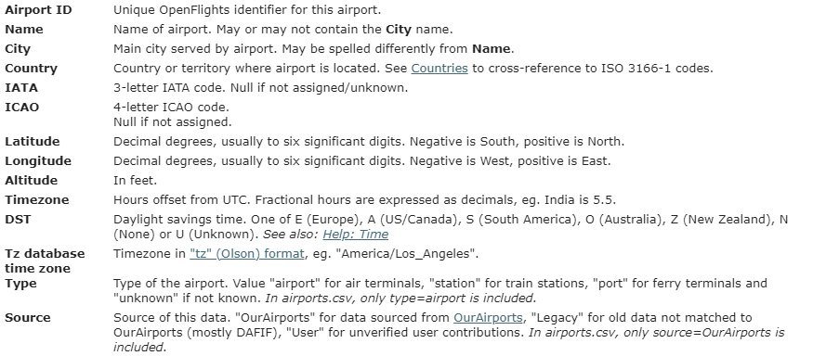
Dataset and Preprocessing

Slide 3
Models
Clustering for different features
K-means
GMM
Classification for airport type
Logistic Regression
Random Forest

Slide 4
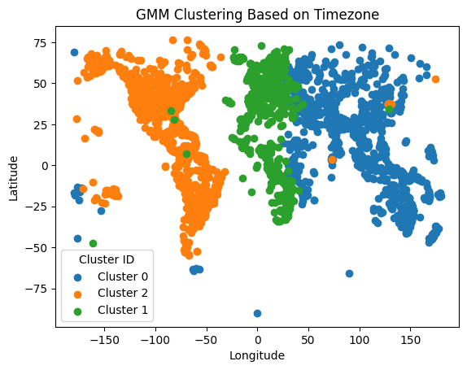
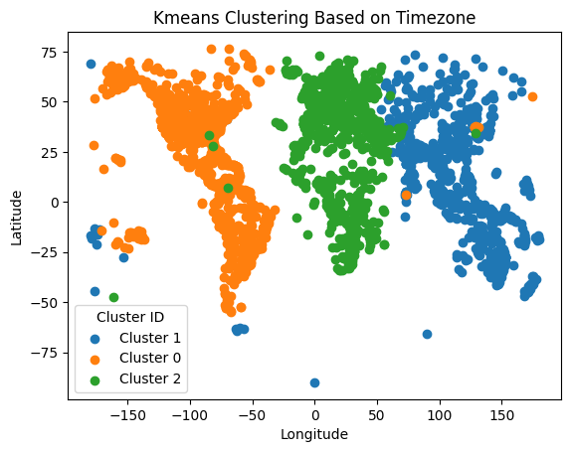
Clustering - Timezone
K-Means: Train (0.868), Test (0.859)
GMM: Train (0.740), Test (0.746)

Slide 5
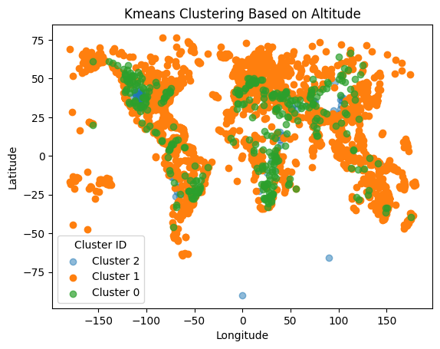
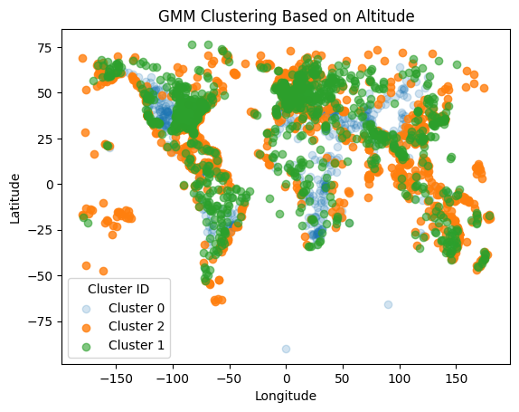
Clustering - Altitude
K-Means: Train (0.871), Test (0.875)
GMM: Train (0.368), Test (0.391)

Slide 6
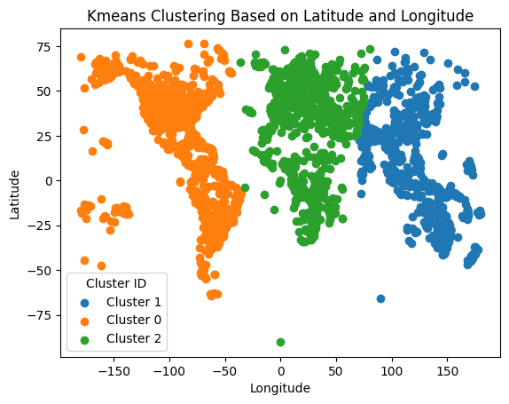
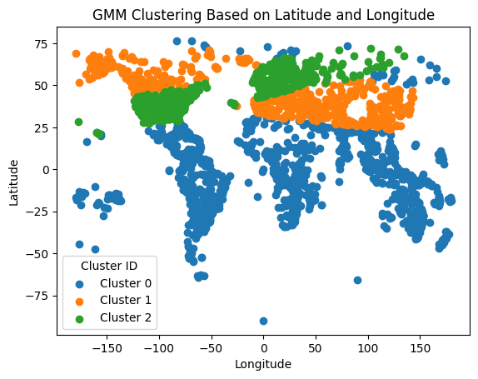
Clustering – Latitude & Longitude
K-Means: Train (0.774), Test (0.761)
GMM: Train (0.081), Test (0.072)

Slide 7
Classification
LogisticRegression
accuracy: 0.739
RandomForest
accuracy: 0.762

Slide 8
Conclusion
K-Means consistently outperformed GMM in terms of silhouette scores
Both K-Means and GMM yielded similar and meaningful clusters when the features were limited to "Timezone" and "Altitude.“
GMM's clusters were less interpretable when use "Latitude" and "Longitude“
GMM's performance is highly sensitive to the choice of features
Random Forest showed a slightly better performance

