Slide 1

ACCEPTANCE TEST
Efficient And Simple
Maroon Solutions

Slide 2
WELCOME
Our Client:
Ms. Mary Partridge-Brown
Co-Director
Ms. Roberta Sandler
Co-Director
Guests:
Dr. Meg Fryling
Dr. Darren Lim
Notes:
KATHLEEN

Slide 3
AGENDA
Introduction
Problem Overview
Project Progression
Testing
Requirements
Product
What’s Next?
Notes:
KATHLEEN

Slide 4
TEAM INTRODUCTION
Mathew Banville - Data Analysist
Kyle Flack - Database Administrator
Marissa Gasparro - Team Leader
Kathleen Rotondo - Assistant Developer
Kean Smullen - Head Developer
Notes:
ALL

Slide 5
AGENDA
Introduction
Problem Overview
Project Progression
Testing
Requirements
Product
What’s Next?
Notes:
MAT

Slide 6
PROBLEM OVERVIEW
Easy and convenient
Track donations, donors, sold items, customers, and employees
Web application capable of storing donated items
Tracks when it leaves the store
Employees to enter in donor information so that donor receipts can be printed
Customer’s history will be kept
Track for suspicious activity
The past year’s worth of activity in the store will be collected so the store can use it for future references
Notes:
MAT

Slide 7
AGENDA
Introduction
Problem Overview
Project Progression
Testing
Requirements
Product
What’s Next?
Notes:
KYLE

Slide 8
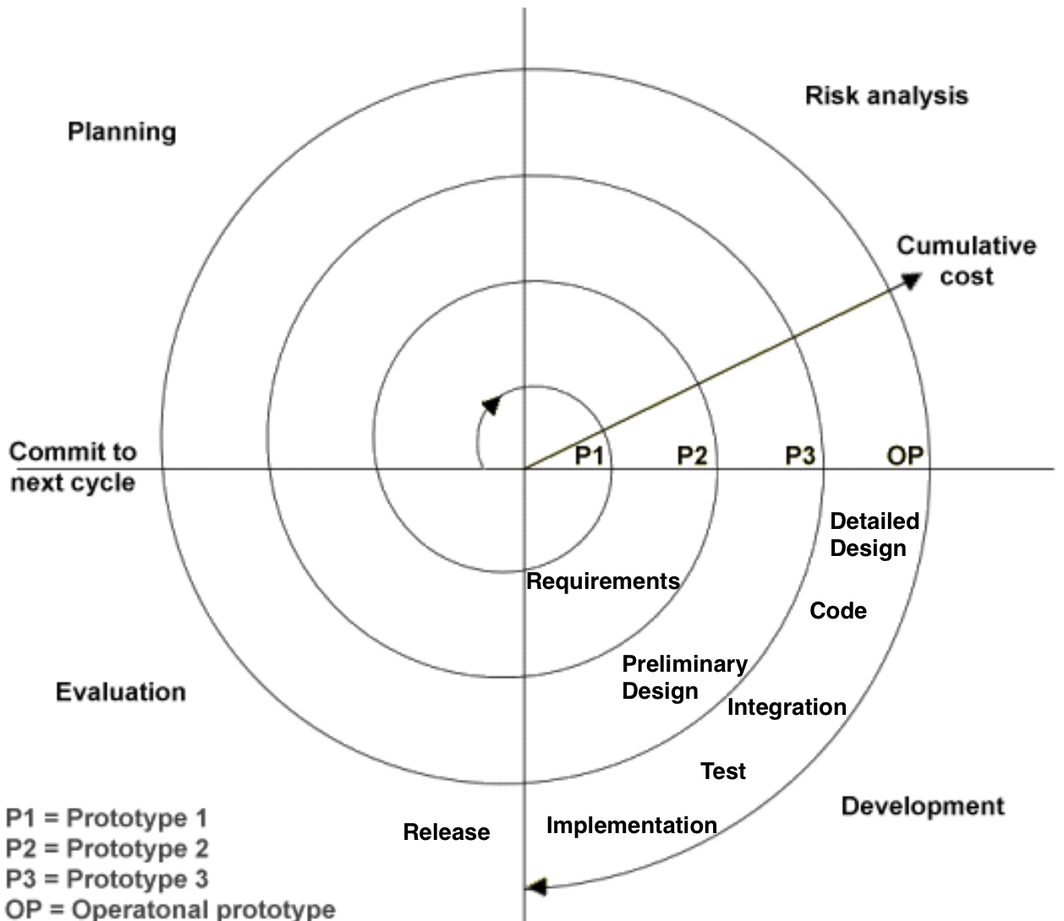
PROJECT PROGRESSION
Notes:
KYLE

Slide 9
AGENDA
Introduction
Problem Overview
Project Progression
Testing
Requirements
Product
What’s Next?
Notes:
MAT

Slide 10
TESTING OVERVIEW
Tested on Chrome, IE, Firefox, Opera, Safari, Android, and iOS
Checked both regular user and Admin
Notes:
MAT

Slide 11
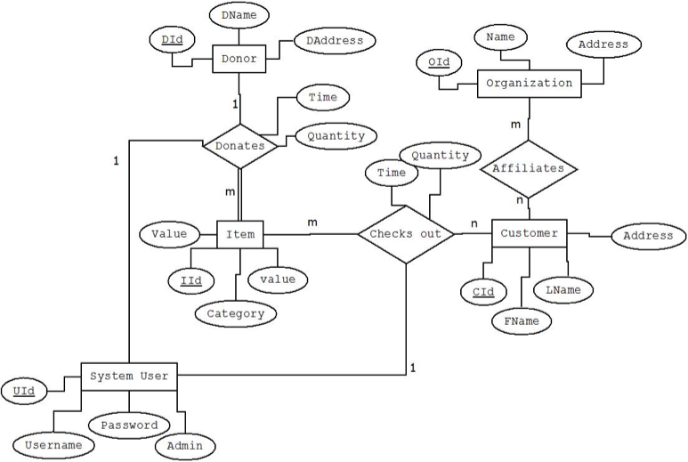
INTEGRATION TESTS
Notes:
KATHLEEN

Slide 12
DIRECTORY OF UNIT TESTS
PUT PICTURE HERE WHEN DONE
Notes:
KATHLEEN

Slide 13
LOG IN UNIT TESTING
Description | Action to perform test (input) | Steps to be Executed | State Before Test | Expected result | Observed result | Comments
text box | type into textbox | none | blank login screen displayed | text box displays text and sends info to right destination | types in text box
open session | open page | none | blank login screen displayed | session is created / user logged in
Admin rights | admin rights login | none | no admin rights given or options shown | admin rights are given to user | view additional tabs once logged in
user restricted rights | user can't access admin rights | none | no admin rights given or options shown | basic rights given to user | non admin unable to change prices and access certain pages
null user id | null user id | click submit button | blank login screen displayed | prompt to enter user id displayed | not allowing you to log in
null password | null password | click submit button | blank login screen displayed | prompt to enter password displayed | not allowing you to log in
Correct user id with password into textboxes | User id and corresponding password entered | enter text; click submit button | blank login screen displayed | allow submit button to redirect user | allows log in
Notes:
MAT

Slide 14
incorrect user id | incorrect user id | enter text; click submit button | blank login screen displayed | display message that id is incorrect | returns to login
incorrect password | incorrect password | enter text; click submit button | blank login screen displayed | display message that password is incorrect | returns to login
back arrow in browser | back arrow | click button | blank login screen displayed | return to previous page | returns to login screen still logged in
resize window | resize window | drag window size or specify dimensions | blank login screen displayed | scale page elements properly | rescales properly
disconnect from internet | disconnect from internet | end connection | blank login screen displayed | reload page when connection resumes | remains logged in for the session
refresh page | refresh webpage | click button | blank login screen displayed | refresh web page with information reset | refreshes page and clears out username and password
submit information | click submit information button | click button | blank login screen displayed | submit information and redirect to next page if authorized | allows user to log in properly | Correct password with correct id
Notes:
MAT

Slide 15
ADDING ITEM UNIT TEST
Description | Action to perform test (input) | Steps to be Executed | State Before Test | Expected result | Observed result | Comments
Load Page | Loading Page | entering page | blank | page successfully loads | page successfully loads
Refresh Page | Refresh page | loading page | page loaded | successful refresh | page refreshed successfully
Change page | change to a different page on the website | click another page to enter | on "Add to Inventory" page | successful page change | page changed successfully | when logged in as the masteradmin, I was able to switch to every page seamlessly
Heading back to page | clicking the back arrow to get back on to the page | being on any other page and clicking the back arrow to get on to it | on pages other than "Add to Inventory" | successful page change | page changed successfully | this was performed from every page but the log out page
Select Donor | selecting donor | click and select donor | non-selected donor | donor successfully selected | donor successfully selected
Notes:
KATHLEEN

Slide 16
Select Category | selecting category | click and select category | non-selected category | category successfully selected | category successfully selected
Select Item | selecting Item | click and select Item | non-selected Item | Item successfully selected | Item successfully selected
quantity | decrease or increase number | type in number or use arrows | null | number successfully entered | successful
submit | submitting the new information | fill out all areas and hit submit | filled out | submitted and appearing in inventory | appears in inventory
Notes:
KATHLEEN

Slide 17
NEW ITEM TYPE UNIT TEST
Description | Action to perform test (input) | Steps to be Executed | State Before Test | Expected result | Observed result | Comments
Load Page | Loading Page | entering page | blank | page successfully loads | page successfully loads
Refresh Page | Refresh page | loading page | page loaded | successful refresh | page refreshed successfully
Change page | change to a different page on the website | click another page to enter | on "Add to Inventory" page | successful page change | page changed successfully | when logged in as the masteradmin, I was able to switch to every page seamlessly
Heading back to page | clicking the back arrow to get back on to the page | being on any other page and clicking the back arrow to get on to it | on pages other than "Add to Inventory" | successful page change | page changed successfully | this was performed from every page but the log out page
Select Donor | selecting donor | click and select donor | non-selected donor | donor successfully selected | donor successfully selected
Notes:
KATHLEEN

Slide 18
Select Previous Category | selecting category | click and select category | possibly selected category | category successfully selected | category successfully selected
Select New Category | creating a new category | type in new name for category | possibly selected category | new category added | category successfully added | even if the field for the new name for the category is left empty, it still adds as "(null)"
Entering a new item name | creating a new item type | typing in a new items name | empty field | new item type added to database | successful addition to database | a catch is thrown if the item field is blank, so it won't do what happens with category additions
quantity | decrease or increase number | type in number or use arrows | null | number successfully entered | successful
submit | submitting the new information | fill out all areas and hit submit | filled out | submitted and appearing in inventory | appears in inventory
Notes:
KATHLEEN

Slide 19
VIEW INVENTORY UNIT TEST
Description | Action to perform test (input) | Steps to be Executed | State Before Test | Expected result | Observed result | Comments
Load Page | Loading Page | entering page | blank | page successfully loads | page successfully loads
Refresh Page | Refresh page | loading page | page loaded | successful refresh | page refreshed successfully
Change page | change to a different page on the website | click another page to enter | on "Add to Inventory" page | successful page change | page changed successfully | when logged in as the masteradmin, I was able to switch to every page seamlessly
Heading back to page | clicking the back arrow to get back on to the page | being on any other page and clicking the back arrow to get on to it | on pages other than "Add to Inventory" | successful page change | page changed successfully | this was performed from every page but the log out page
Select Donor | selecting donor | click and select donor | non-selected donor | donor successfully selected | donor successfully selected
Notes:
KATHLEEN

Slide 20
Select Previous Category | selecting category | click and select category | possibly selected category | category successfully selected | category successfully selected
Select New Category | creating a new category | type in new name for category | possibly selected category | new category added | category successfully added | even if the field for the new name for the category is left empty, it still adds as "(null)"
Entering a new item name | creating a new item type | typing in a new items name | empty field | new item type added to database | successful addition to database | a catch is thrown if the item field is blank, so it won't do what happens with category additions
quantity | decrease or increase number | type in number or use arrows | null | number successfully entered | successful
submit | submitting the new information | fill out all areas and hit submit | filled out | submitted and appearing in inventory | appears in inventory
Notes:
KATHLEEN

Slide 21
AGENDA
Introduction
Problem Overview
Project Progression
Testing
Requirements
Product
What’s Next?
Notes:
KYLE

Slide 22
FUNCTIONAL REQUIREMENTS
User
Log in
Print receipts
Sell and add items
Add customer profiles
Manage donor and customer accounts
Admin
Inherits all abilities of user
Edit prices
Manage employee accounts
Change password
Notes:
KYLE

Slide 23
NON-FUNCTIONAL REQUIREMENTS
Easy to use
Efficient
Low maintenance
User friendly
Work with multiple internet browsers
Notes:
KYLE

Slide 24
FUTURE ENHANCEMENTS
Expand History Log
6 months
Simple and user friendly
Item attributes
Store credit system
Notes:
MAT

Slide 25
AGENDA
Introduction
Problem Overview
Project Progression
Testing
Development Environment
Product
What’s Next?
Notes:
KEAN and MARISSA

Slide 26
OUR PRODUCT
http://oraserv.cs.siena.edu/~perm_maroon/Grassroot/home.php
Other Slides
Notes:
KEAN and MARISSA

Slide 27
AGENDA
Introduction
Problem Overview
Project Progression
Testing
Development Environment
Product
What’s Next?

Slide 28
DELIVERABLES
CD-ROM/Flash Drive:
A full copy of all of the team files from the team directory. This includes all website files, folders, and images
README.txt files that explain what every file, folder, and image is and where they are used/locate
The lyrics to the team song, a copy of the music file for the team song, and the audio/visual recording of the team song
Notes:
MAT

Slide 29
LESSONS LEARNED
Don’t procrastinate
Don’t stress too much
Notes:
MAT

Slide 30



WHAT’S NEXT?
GRADUATION!

Slide 31
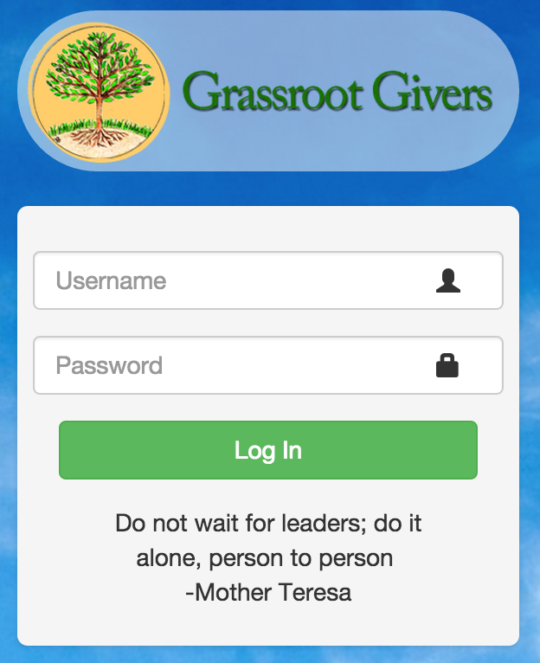

Slide 32
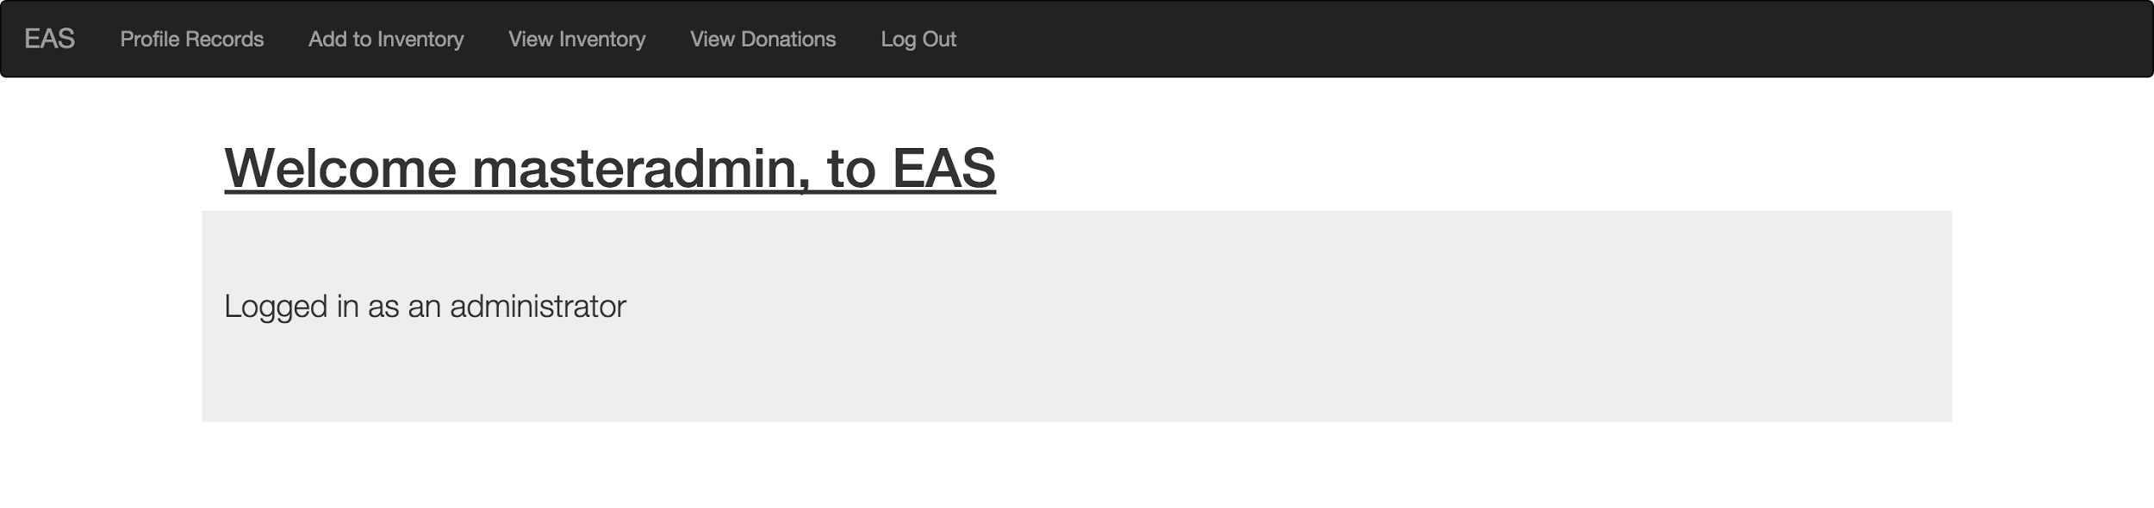

Slide 33
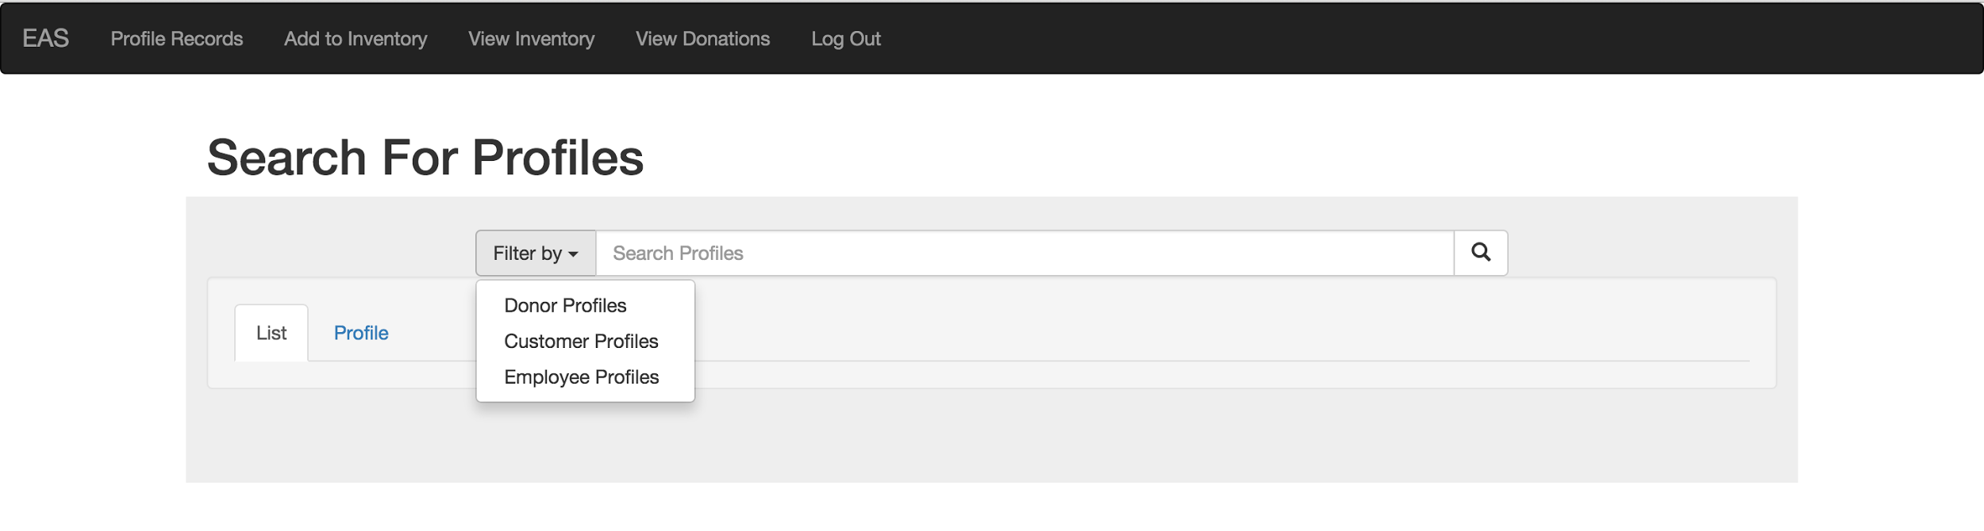

Slide 34
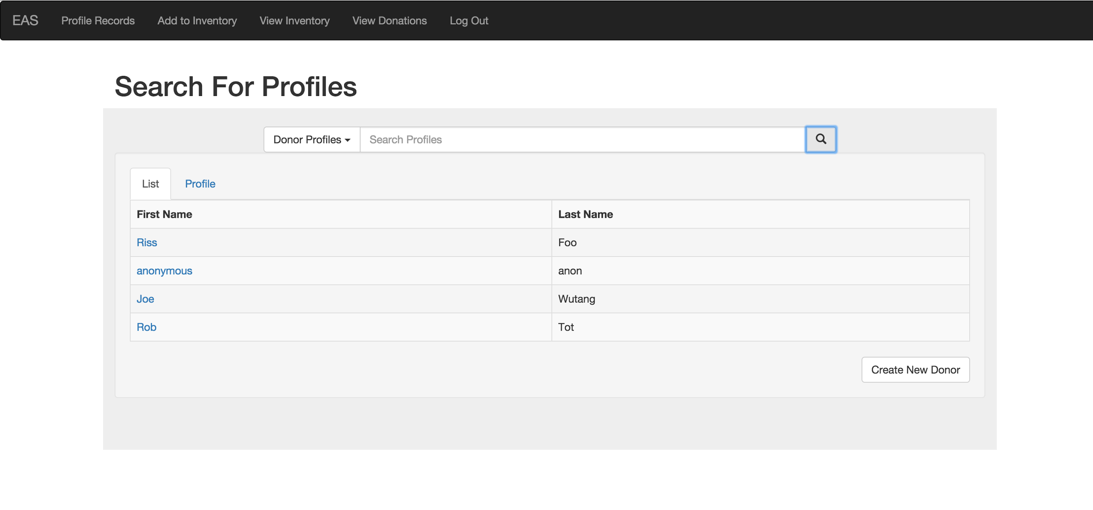

Slide 35
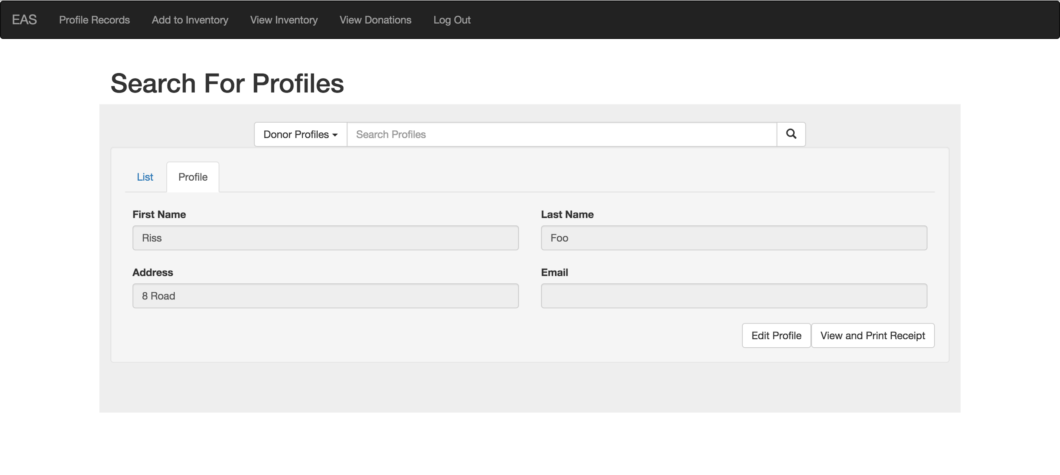

Slide 36
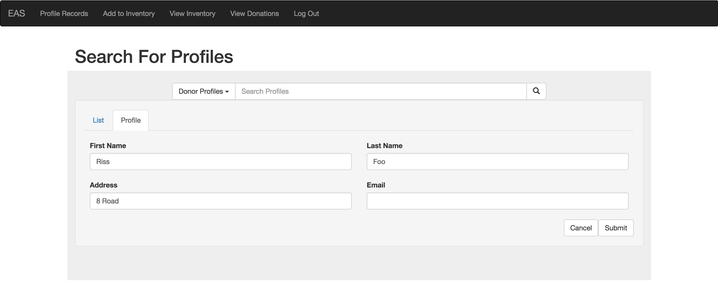

Slide 37
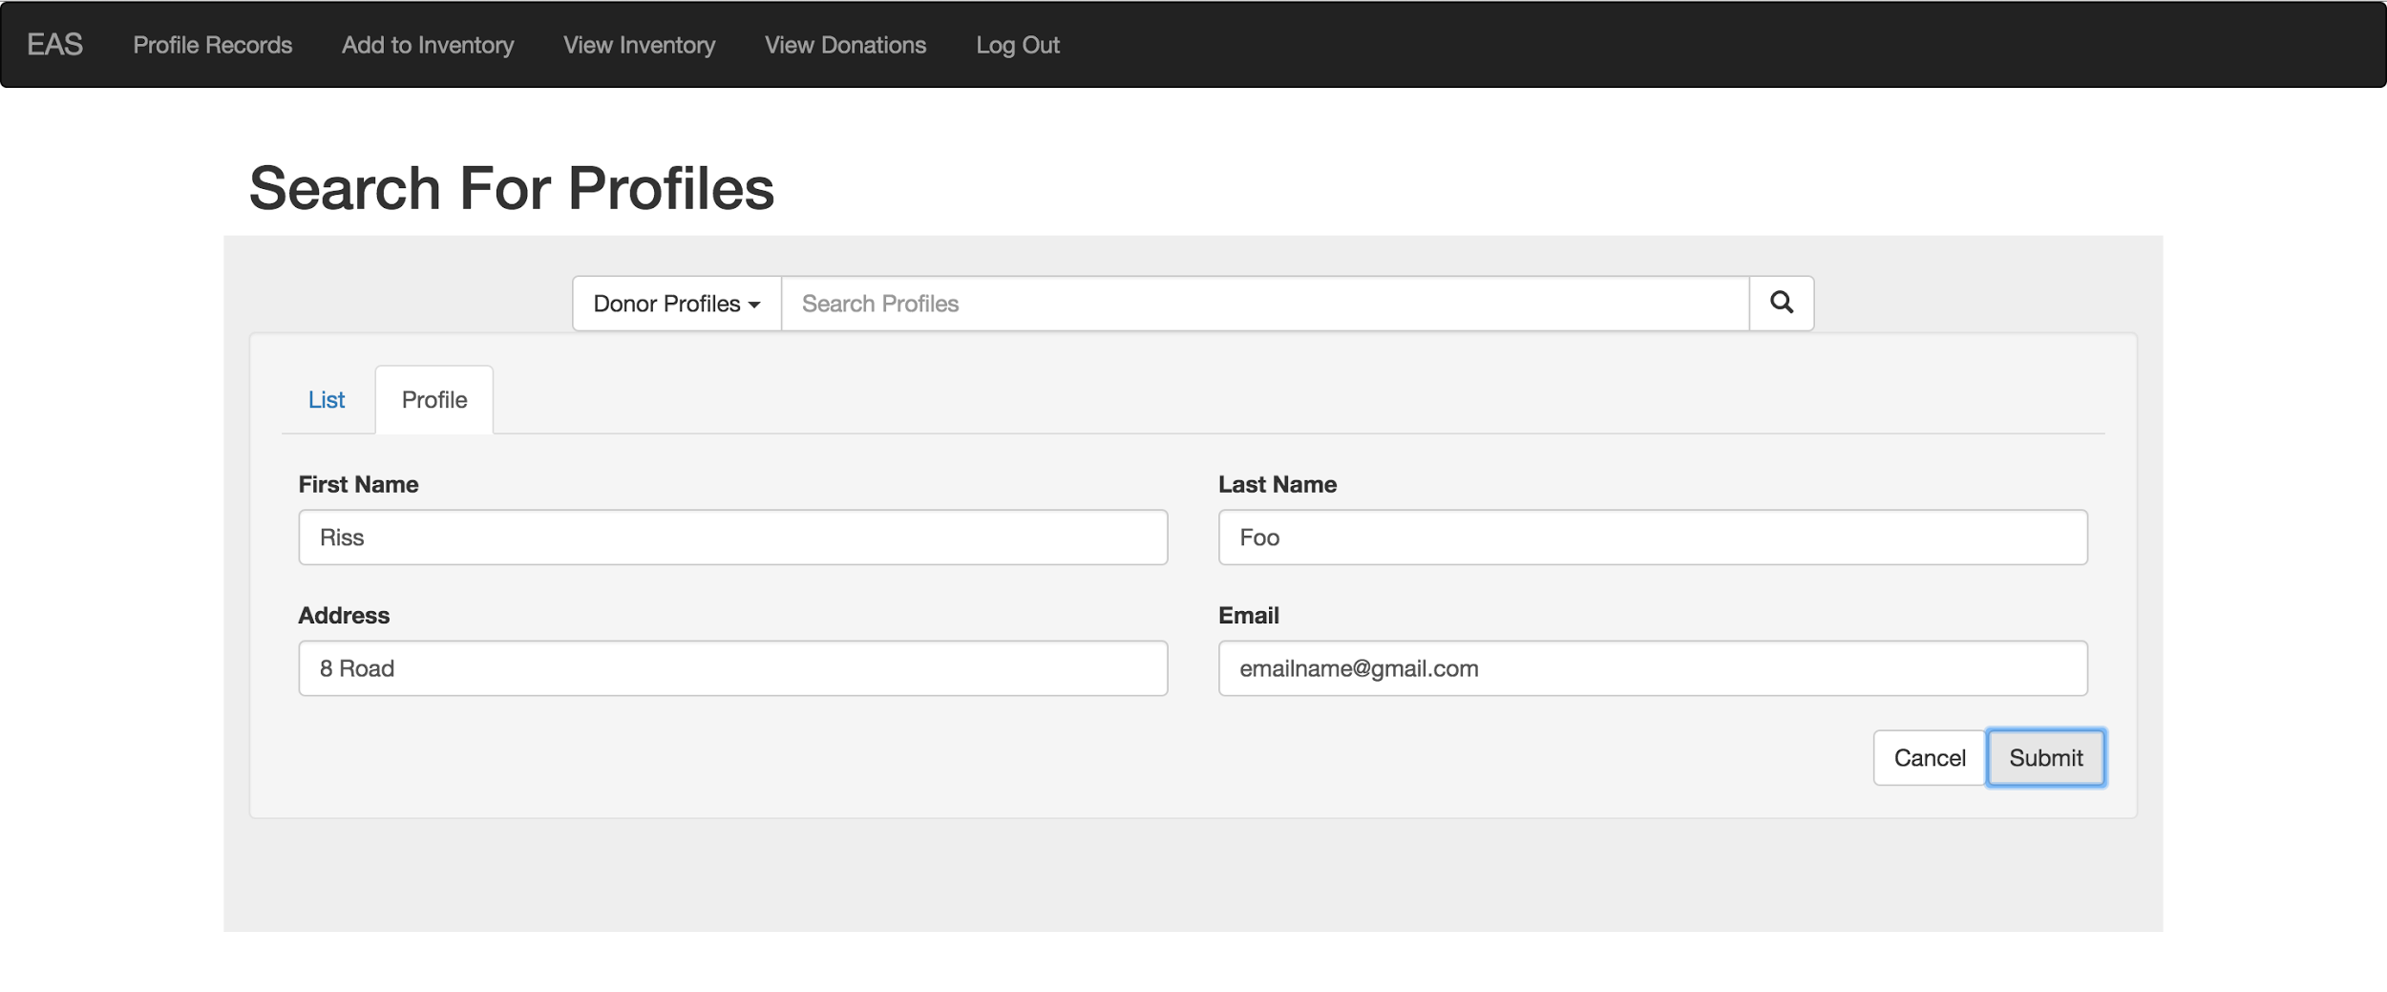

Slide 38


Slide 39
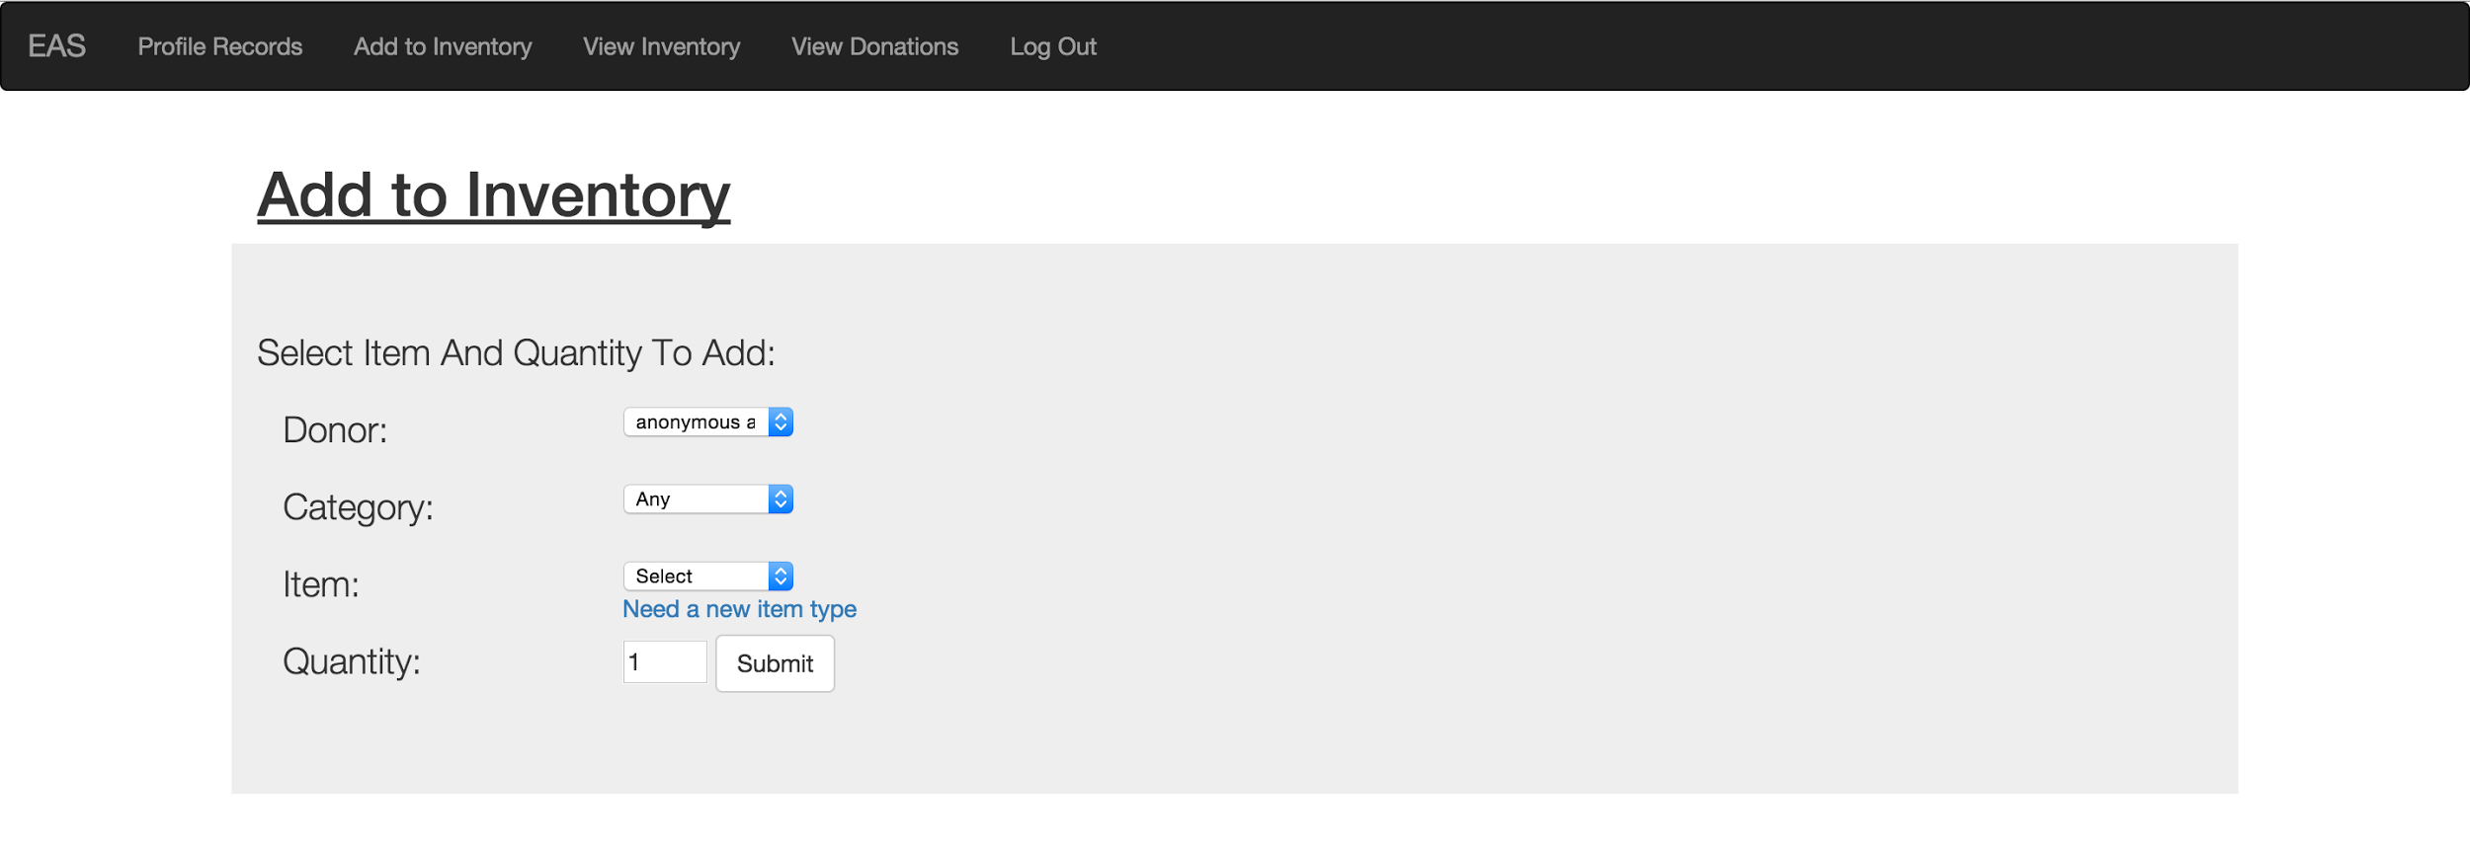

Slide 40
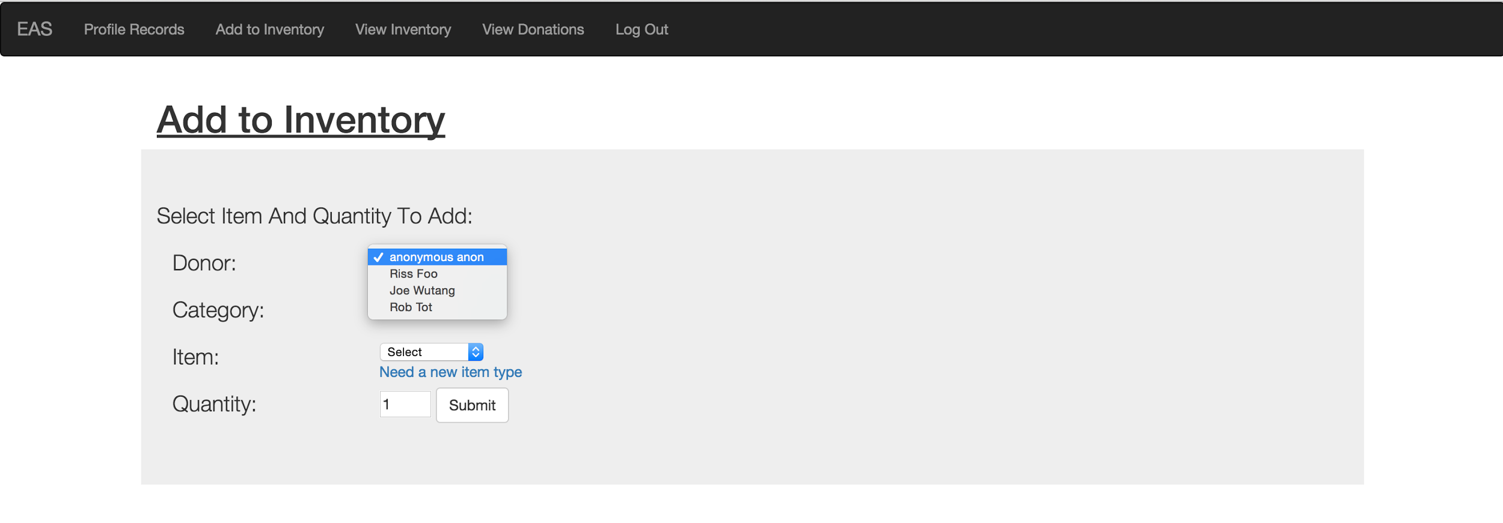

Slide 41
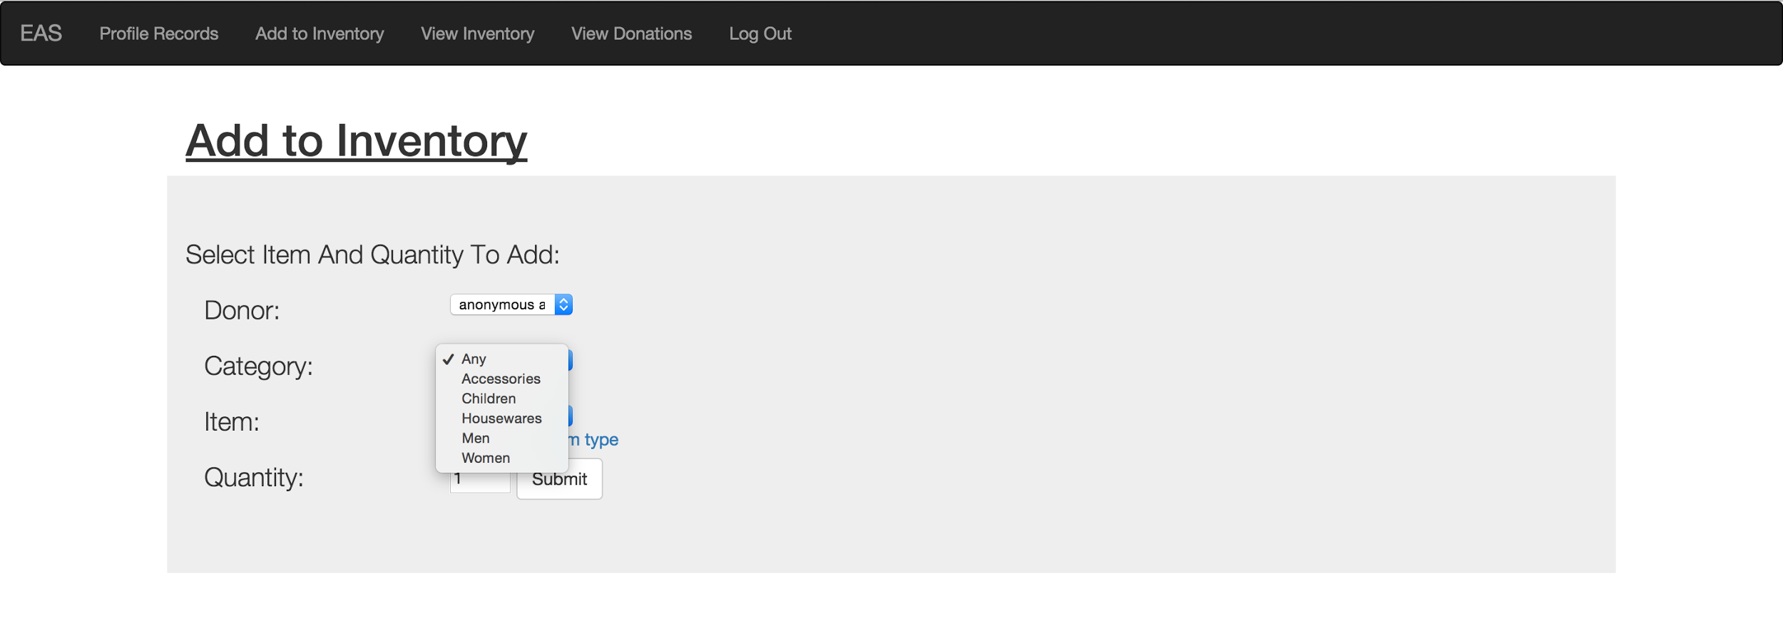

Slide 42
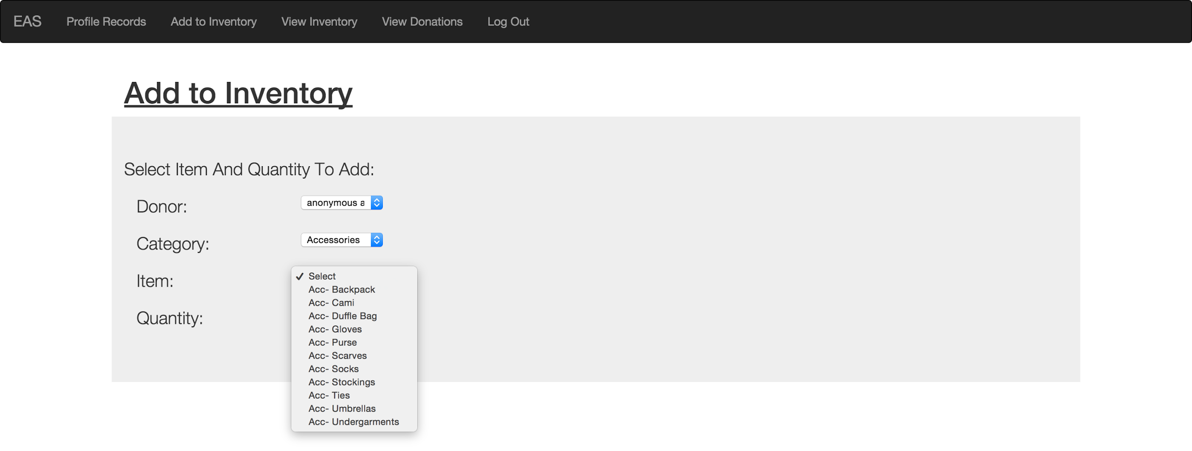

Slide 43
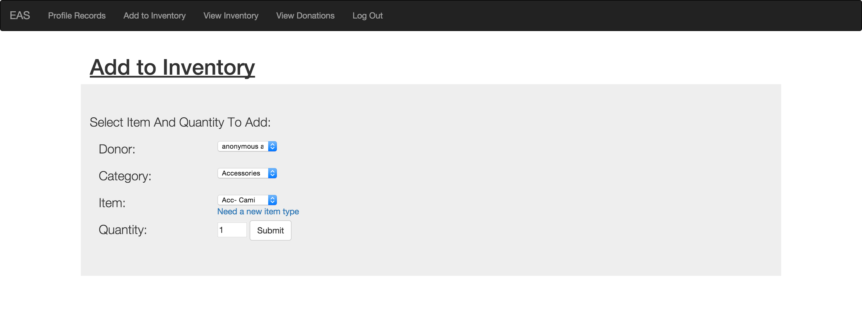

Slide 44
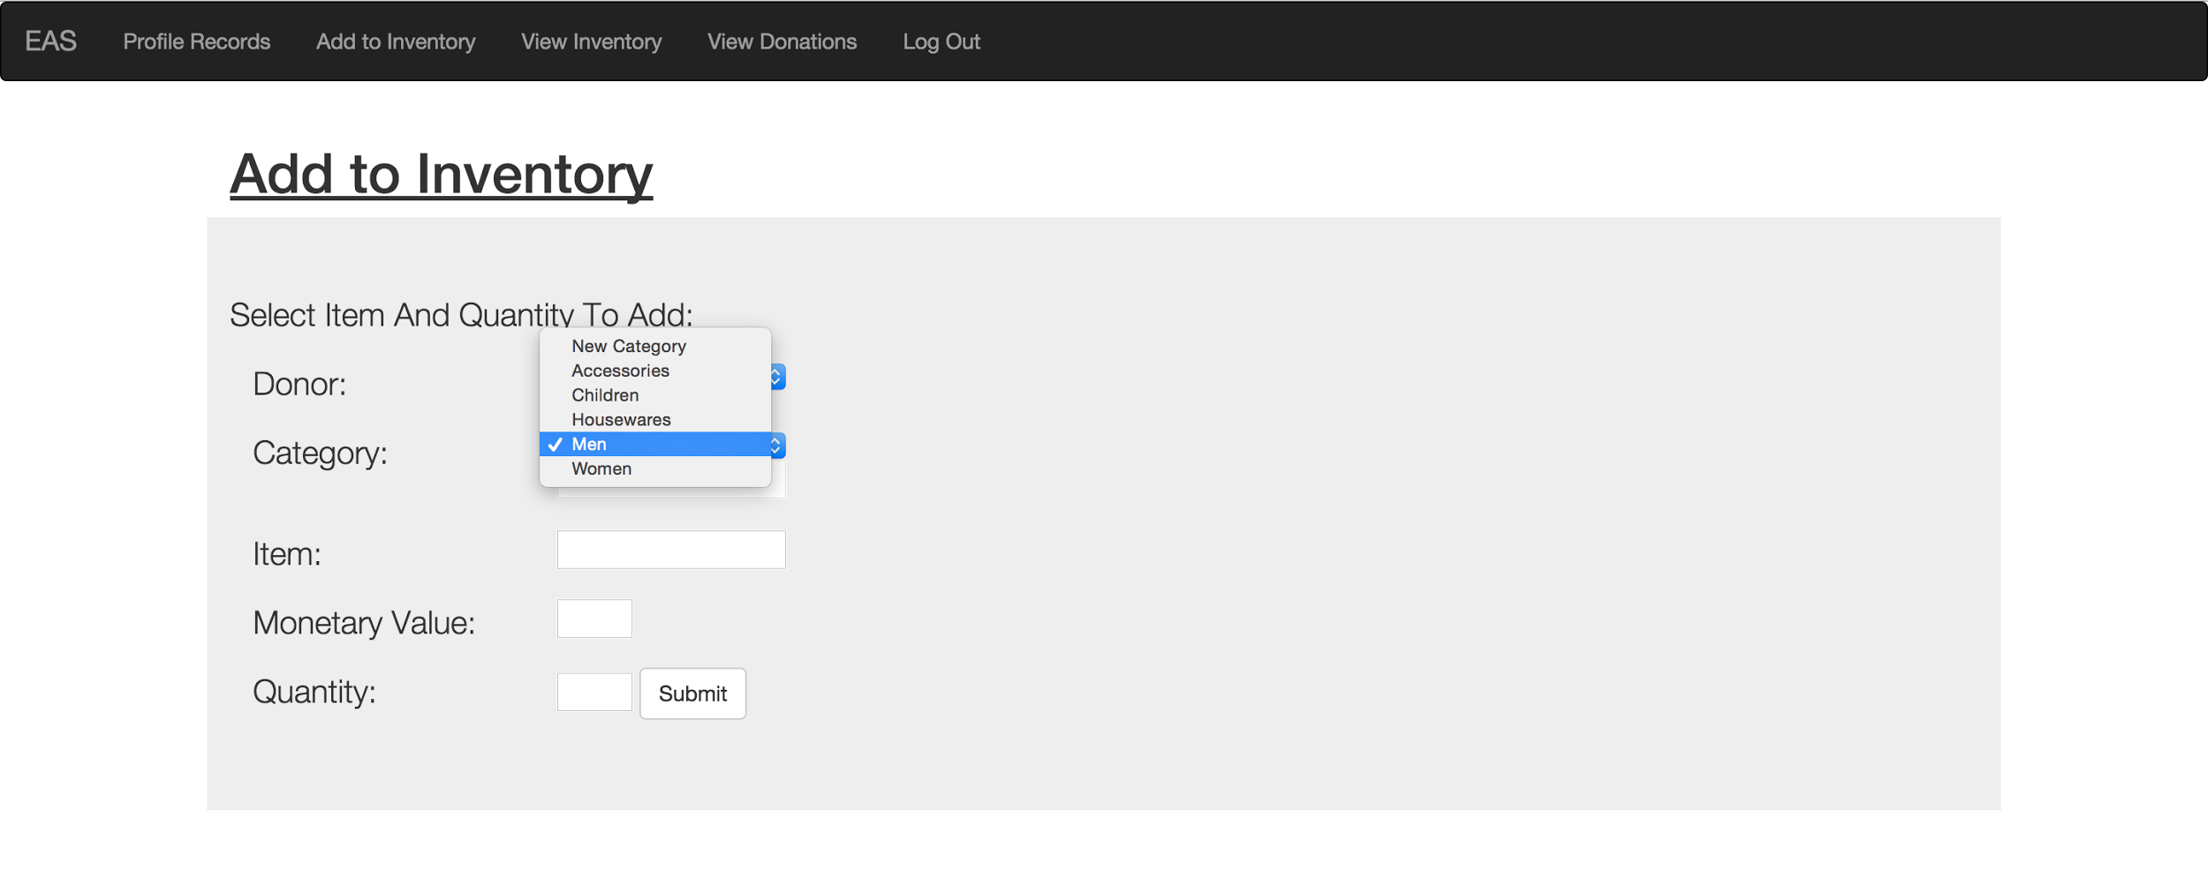

Slide 45
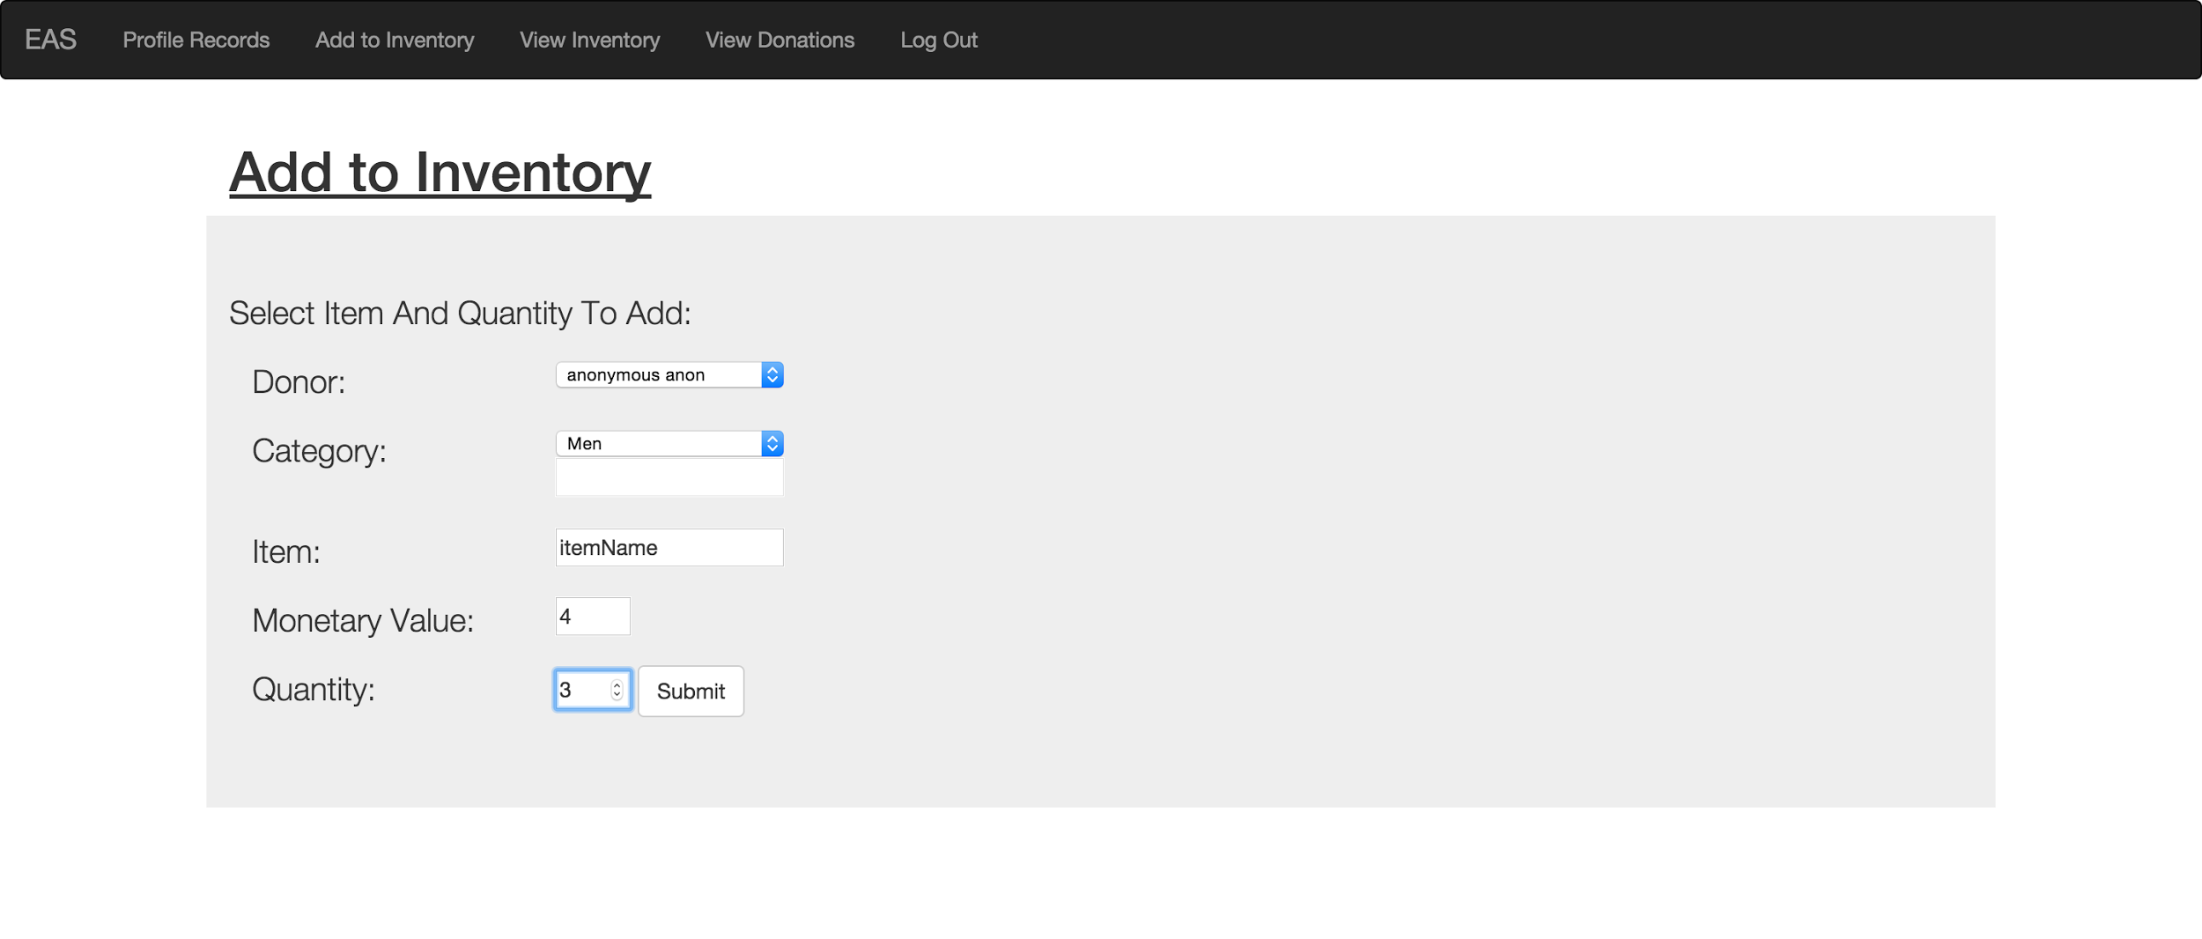

Slide 46
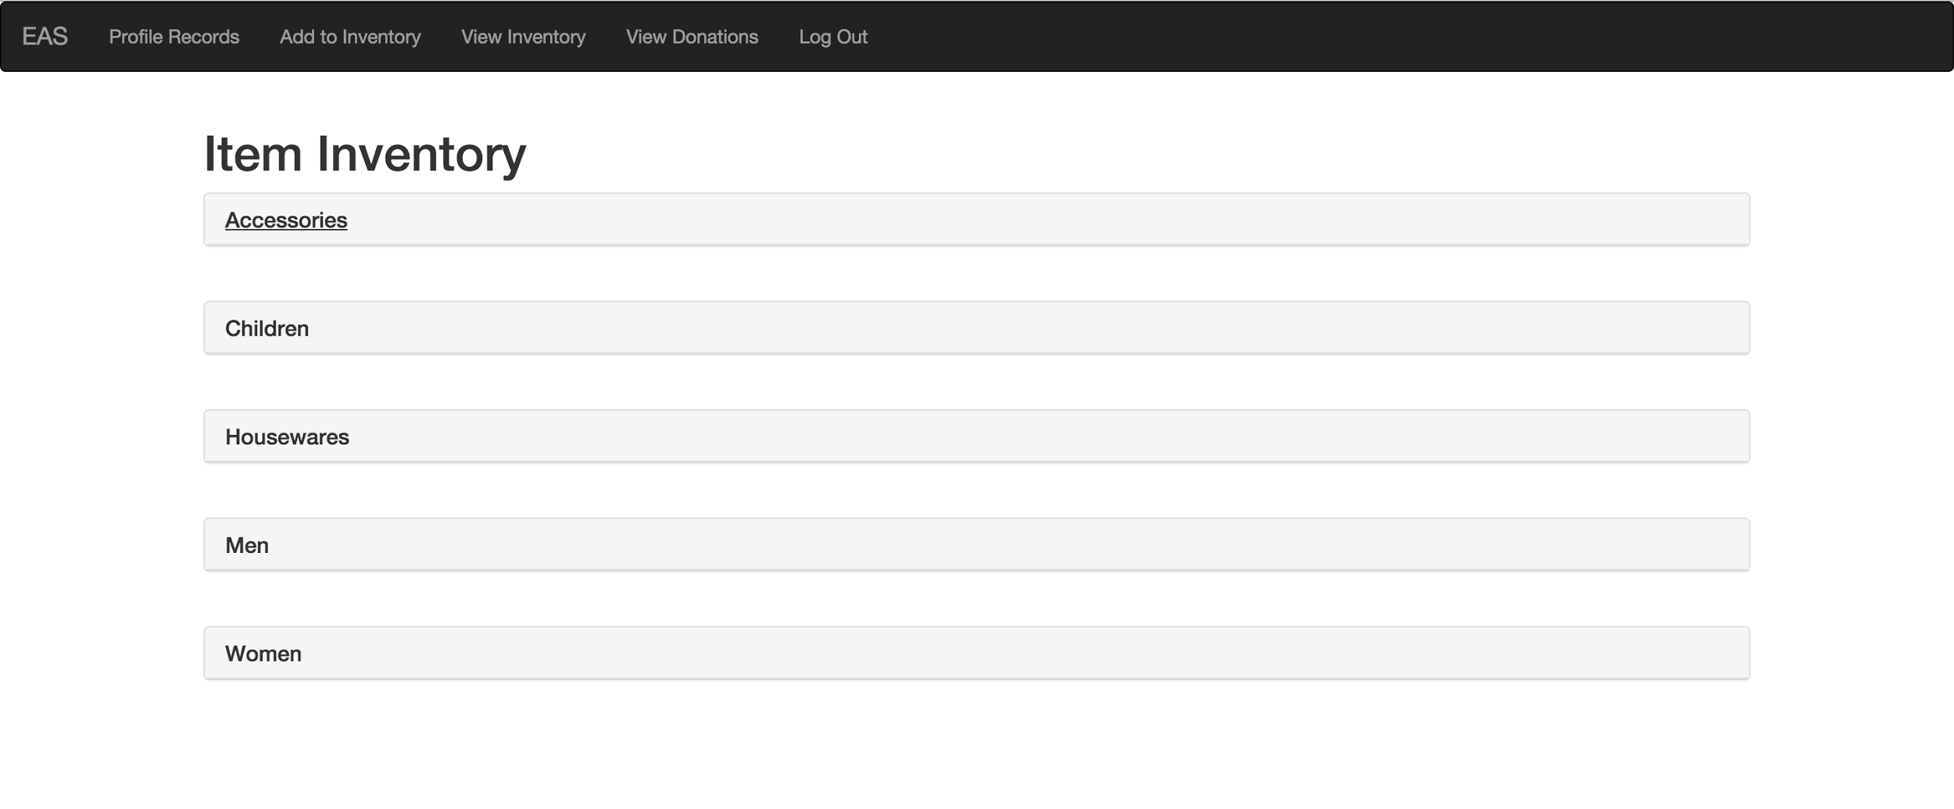

Slide 47
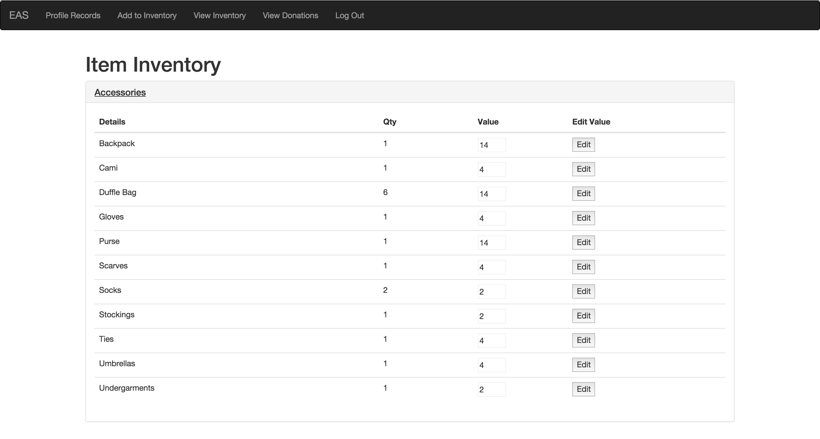

Slide 48
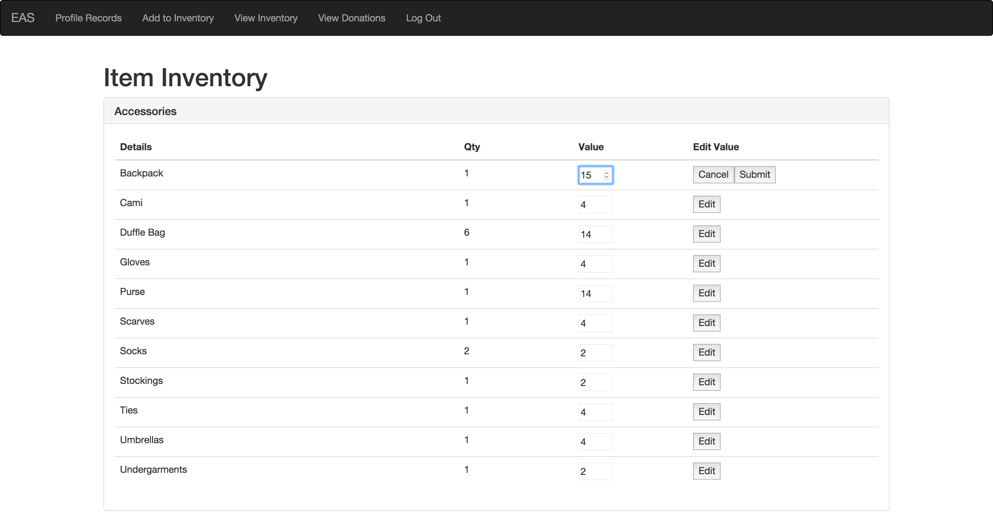

Slide 49
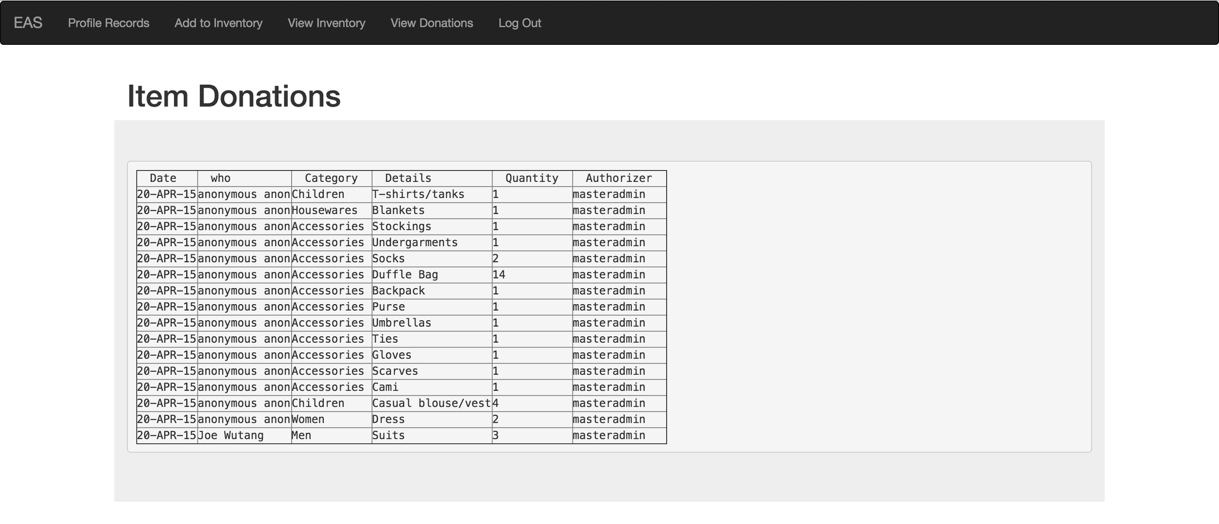

Slide 50
LAST SLIDE

