Slide 1

Detailed Design
Efficient and Simple
Maroon Solutions

Slide 2
Welcome
Our Client:
Ms. Mary Partridge-Brown
Co-Director
Ms. Roberta Sandler
Co-Director
Guests:
Dr. Meg Fryling
Dr. Darren Lim

Slide 3

Agenda
Introduction
Problem Overview
Project Progression
Website Map
Data Flow Diagrams
Priorities and Modifications
Database Diagrams
Modules
Testing
What’s Next?

Slide 4
Team Introduction
Kathleen Rotondo – Assistant Developer
Mathew Banville – Data Analyst
Kyle Flack – Database Administrator
Marissa Gasparro – Team Lead
Kean Smullen – Head Developer

Slide 5
Agenda
Introduction
Problem Overview
Project Progression
Website Map
Data Flow Diagrams
Priorities and Modifications
Database Diagrams
Modules
Testing
What’s Next?

Slide 6
Problem Overview
Easy and convenient
Track donations, donors, sold items, customers, and employees
Web application capable of storing donated items
Employees can enter in donor information so donor receipts can be printed
Customer’s history will be kept
Track for suspicious activity
The past year’s worth of activity in the store will be collected for future references

Slide 7
Agenda
Introduction
Problem Overview
Project Progression
Website Map
Data Flow Diagrams
Priorities and Modifications
Database Diagrams
Modules
Testing
What’s Next?

Slide 8
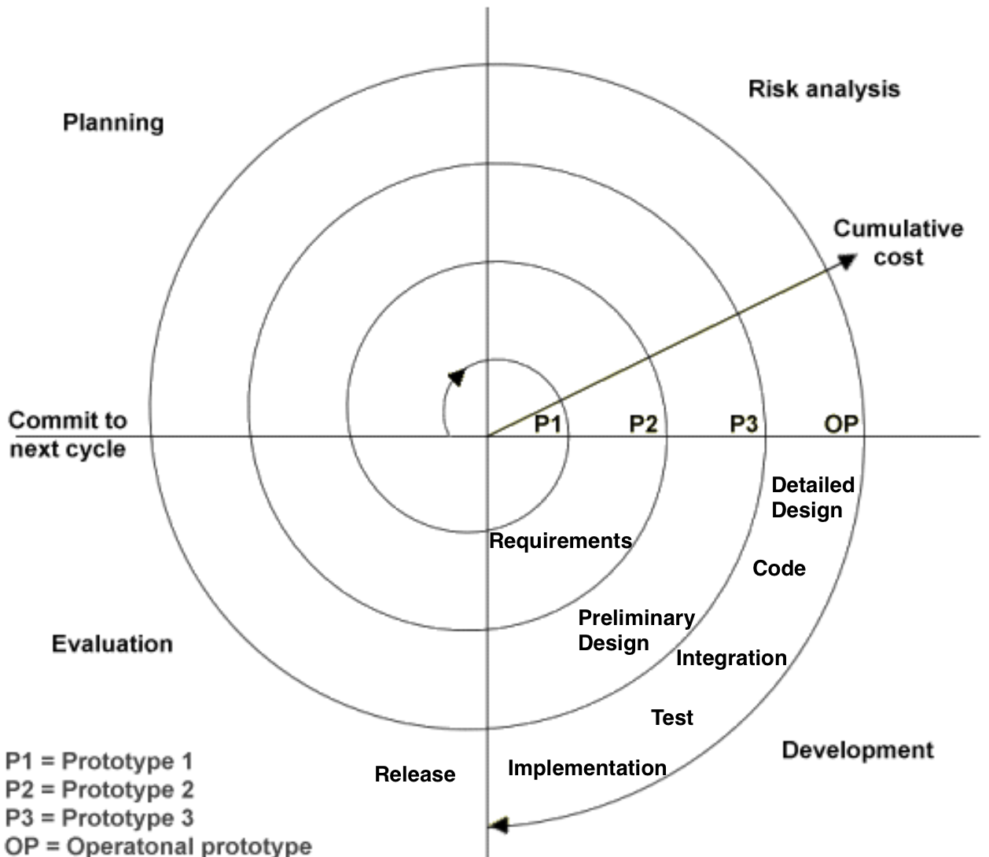
Project Progression

Slide 9
Agenda
Introduction
Problem Overview
Project Progression
Website Map
Data Flow Diagrams
Priorities and Modifications
Database Diagrams
Modules
Testing
What’s Next?

Slide 10
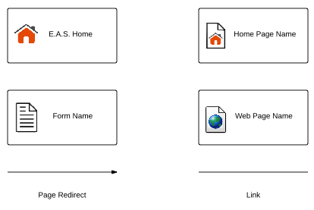
Website Map Legend
Home - This represents the main page of E.A.S. prior to a user logging in. Various options will be presented at this time.
Home Page - Represents the user’s main page when they initially login to their account.
Form - Represents data fields which require user input.
E.A.S. Home
Home Page
Name
Form Name
Web Page
Name
Page Redirect
Link
Web Page - Represents a web page within the E.A.S. system.
Link - Represents a page being accessible from another page.
Page Redirect - Indicates a forced reroute to a new page depending on the user’s action

Slide 11
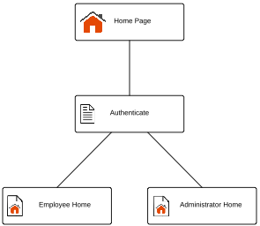
Website Map: Context

Slide 12
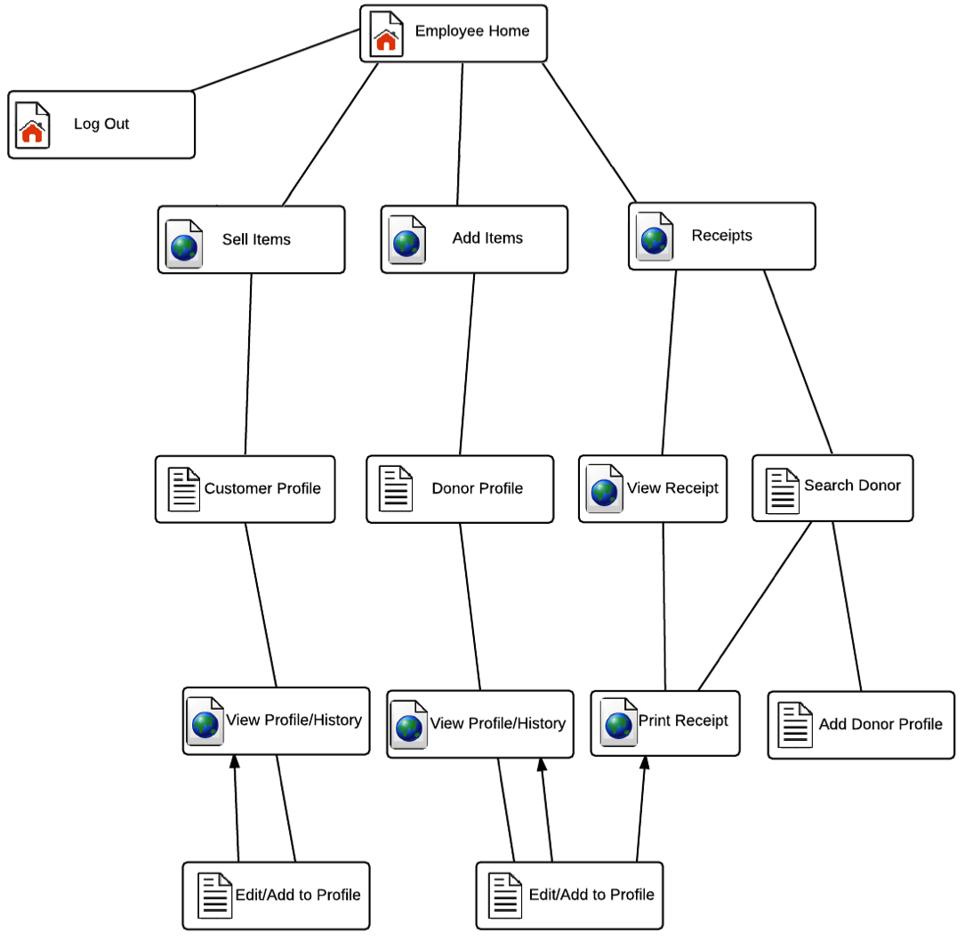
Website Map: Employee

Slide 13
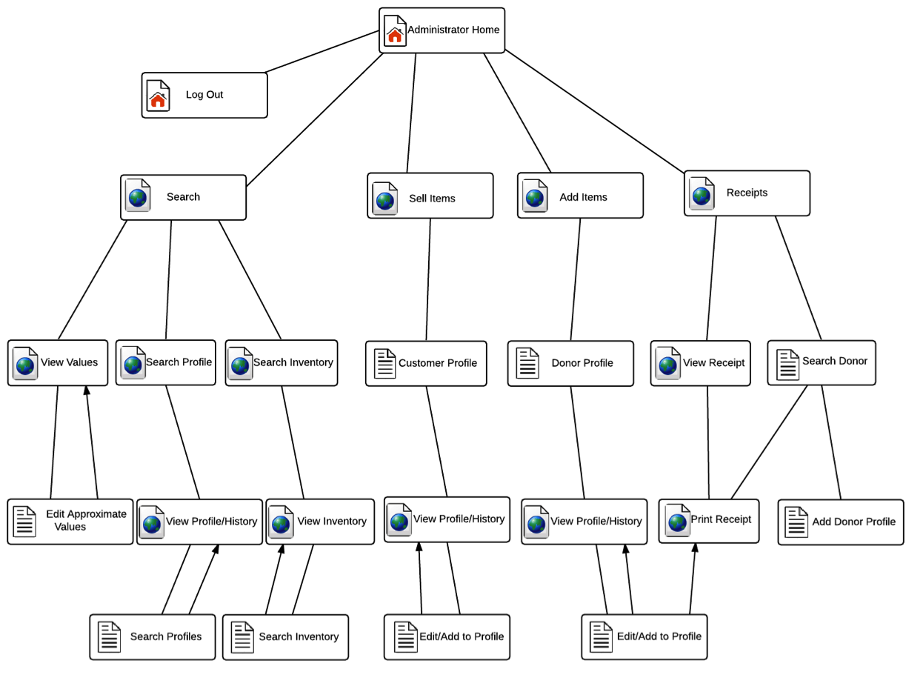
Website Map: Administrator

Slide 14
Agenda
Introduction
Problem Overview
Project Progression
Website Map
Data Flow Diagrams
Priorities and Modifications
Database Diagrams
Modules
Testing
What’s Next?

Slide 15
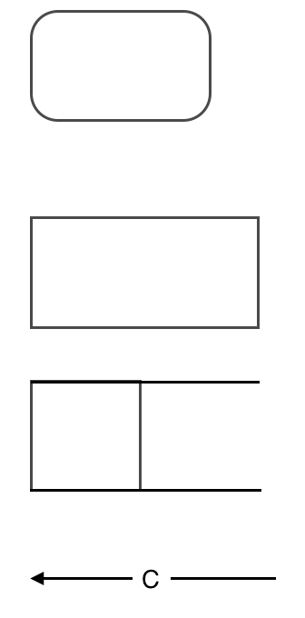
DFD Legend
Process: Transforms or manipulates data.
External Entity: Contributes data or information to the system or which receive data/information from it.
Data Store: Location where data is held temporarily or permanently.
Data Flow: Data/information flowing to or from a process where C is the data/information.

Slide 16
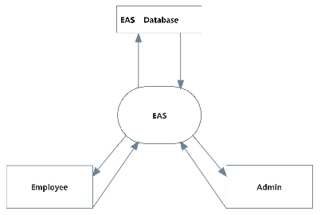
Context Diagram

Slide 17
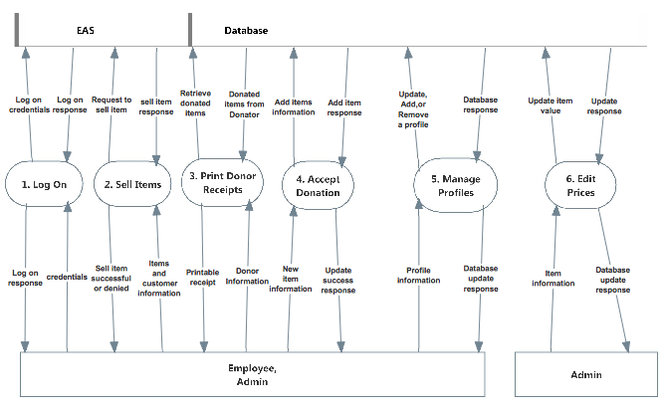
Level 0 Diagram

Slide 18
Agenda
Introduction
Problem Overview
Project Progression
Website Map
Data Flow Diagrams
Priorities And Modifications
Database Diagrams
Modules
Testing
What’s Next?

Slide 19
Implementation Priorities
Employees/Admins (Users) login – (Completed)
Users to update inventory – (Add Items Completed)
Users to print receipts for donors
User friendly design

Slide 20
Foreseeable Modifications
Expand History Log
6 months
Simple and user friendly
Item attributes
Store credit system

Slide 21
Agenda
Introduction
Problem Overview
Project Progression
Website Map
Data Flow Diagrams
Priorities and Modifications
Database Diagrams
Modules
Testing
What’s Next?

Slide 22
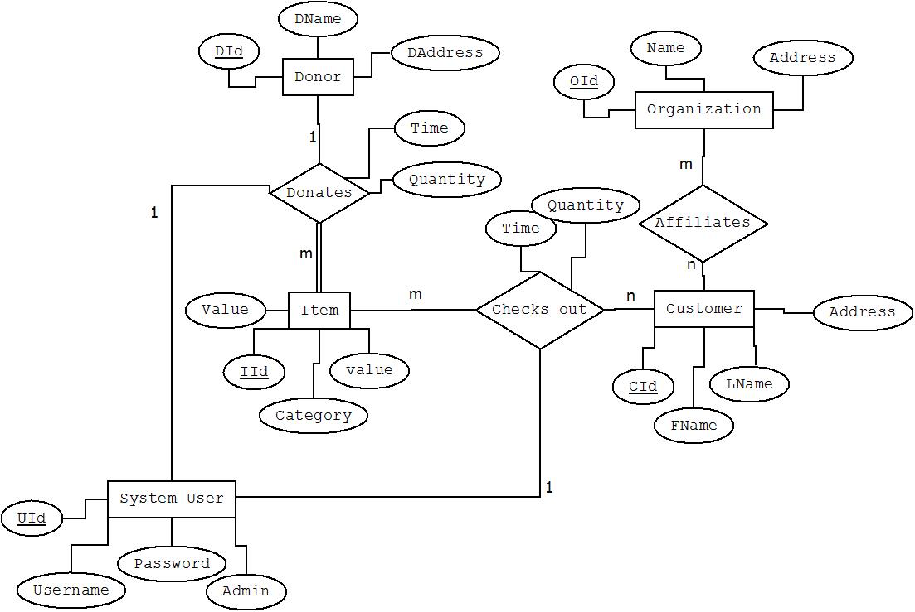
E/R Diagram

Slide 23
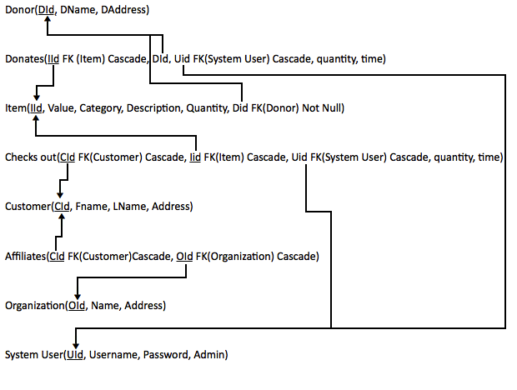
Relational Schema

Slide 24
Agenda
Introduction
Problem Overview
Project Progression
Website Map
Data Flow Diagrams
Priorities and Modifications
Database Diagrams
Modules
Testing
What’s Next?

Slide 25
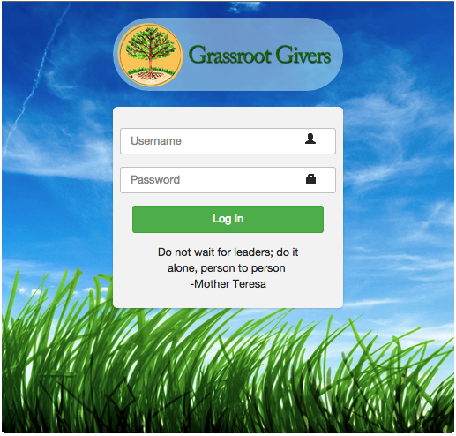
Module: LogIn

Slide 26
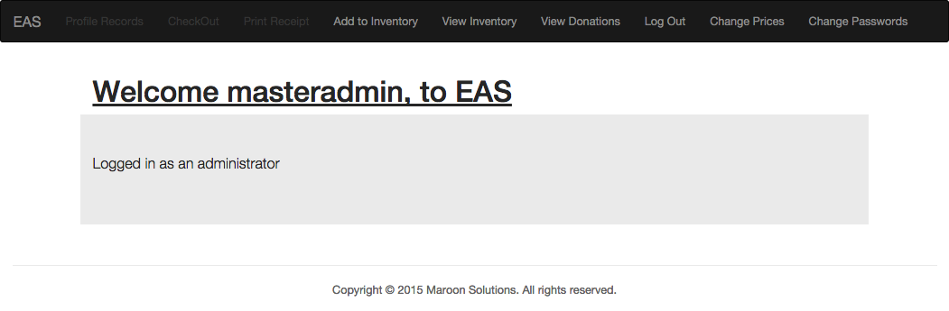
Module: Home Page

Slide 27
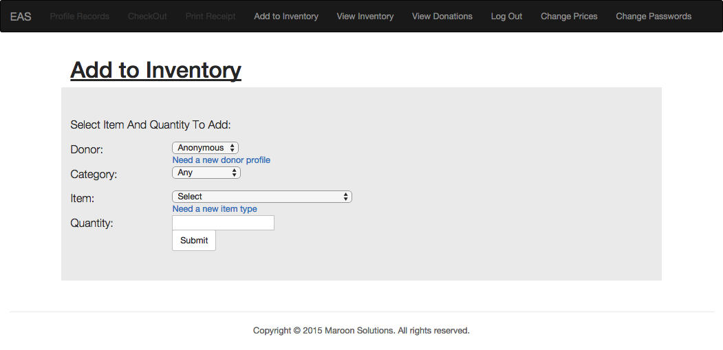
Module: Add to inventory

Slide 28
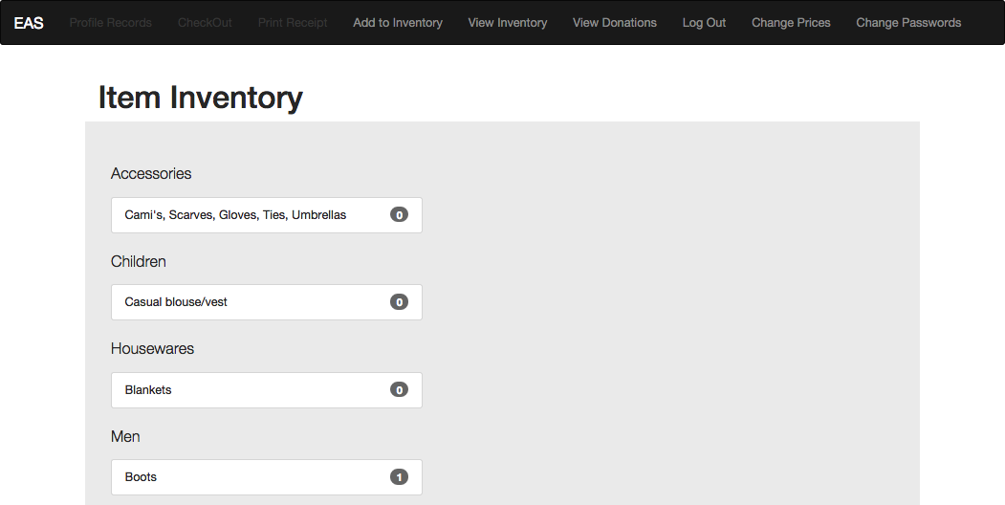
Module: View Inventory

Slide 29
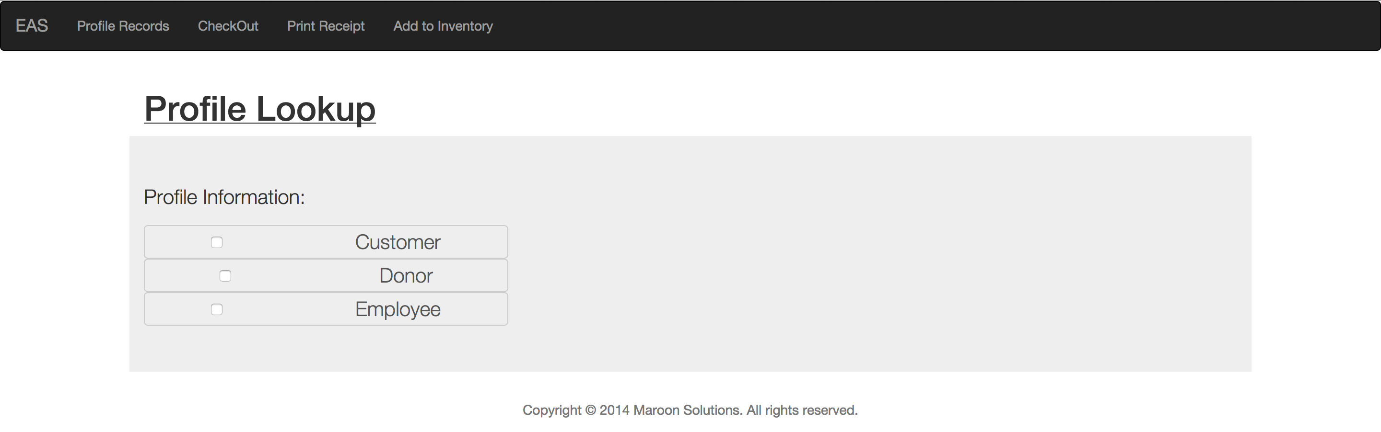
Module: Managing Profiles

Slide 30
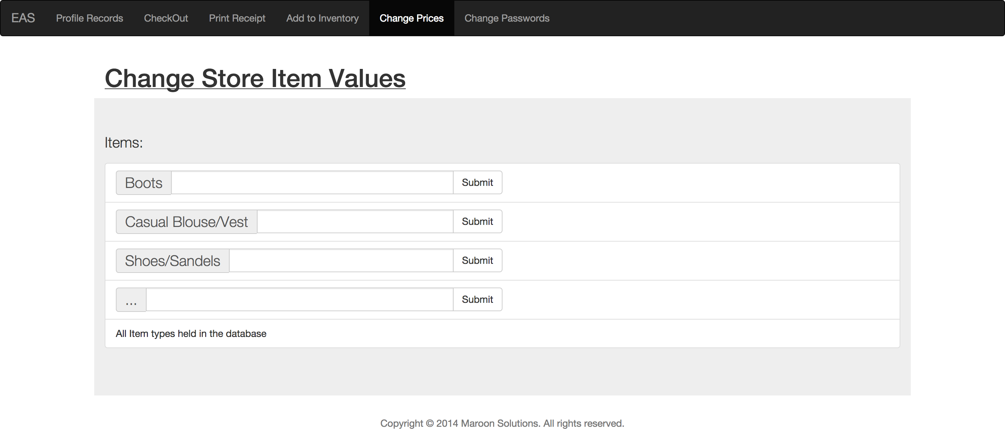
Module: Edit Prices

Slide 31
Agenda
Introduction
Problem Overview
Project Progression
Website Map
Data Flow Diagrams
Priorities and Modifications
Database Diagrams
Modules
Testing
What’s Next?

Slide 32
Testing Requirements
User Friendly
Maintainability
Test the major web browsers
IE, Firefox, Chrome, Safari
Mobile

Slide 33
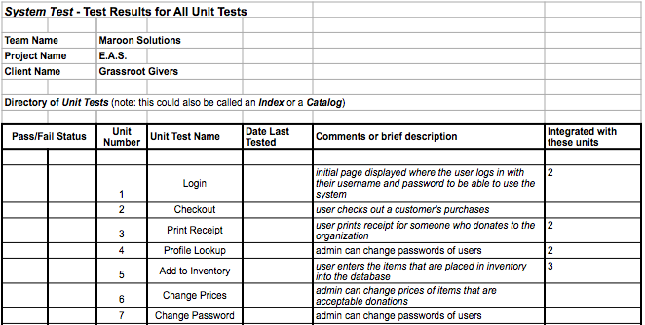
Unit Testing

Slide 34
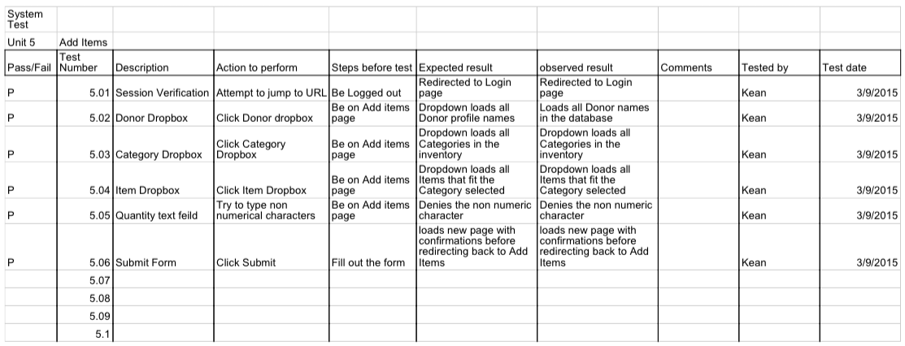
Unit 5: Add to Inventory

Slide 35
Agenda
Introduction
Problem Overview
Project Progression
Website Map
Data Flow Diagrams
Priorities and Modifications
Database Diagrams
Testing
Modules
What’s Next?

Slide 36
What’s next?
Acceptance Test
Graduation (hopefully)

Slide 37
Maroon Solutions
Questions?

