Slide 1

Preliminary Design
Efficient and Simple
Maroon Solutions

Slide 2
Welcome
Our Client:
Ms. Mary Partridge-Brown
Co-Director
Ms. Roberta Sandler
Co-Director
Guests:
Dr. Meg Fryling
Dr. Darren Lim

Slide 3

Agenda
Introduction
Problem Overview
Project Progression
User Case Narratives
UML Use Case Diagrams
UML Deployment Diagrams
Website Map
UML Activity Diagrams
Data Flow Diagrams
Requirements Inventory
Data Dictionary
Testing
Development Environment
Prototype Screens
What’s Next?

Slide 4
Team Introduction
Kathleen Rotondo - Team Leader
Mathew Banville - Data Analyst
Kyle Flack - Database Administrator
Marissa Gasparro - Web Master
Kean Smullen - Head Developer

Slide 5
Agenda
Introduction
Problem Overview
Project Progression
User Case Narratives
UML Use Case Diagrams
UML Deployment Diagrams
Website Map
UML Activity Diagrams
Data Flow Diagrams
Requirements Inventory
Data Dictionary
Testing
Development Environment
Prototype Screens
What’s Next?

Slide 6
Problem Overview
Easy and convenient
Track donations, donors, sold items, customers, and employees
Web application capable of storing donated items
Tracks when it leaves the store
Employees to enter in donor information so that donor receipts can be printed
Customer’s history will be kept
Track for suspicious activity
The past year’s worth of activity in the store will be collected so the store can use it for future references

Slide 7
Agenda
Introduction
Problem Overview
Project Progression
User Case Narratives
UML Use Case Diagrams
UML Deployment Diagrams
Website Map
UML Activity Diagrams
Data Flow Diagrams
Requirements Inventory
Data Dictionary
Testing
Development Environment
Prototype Screens
What’s Next?

Slide 8
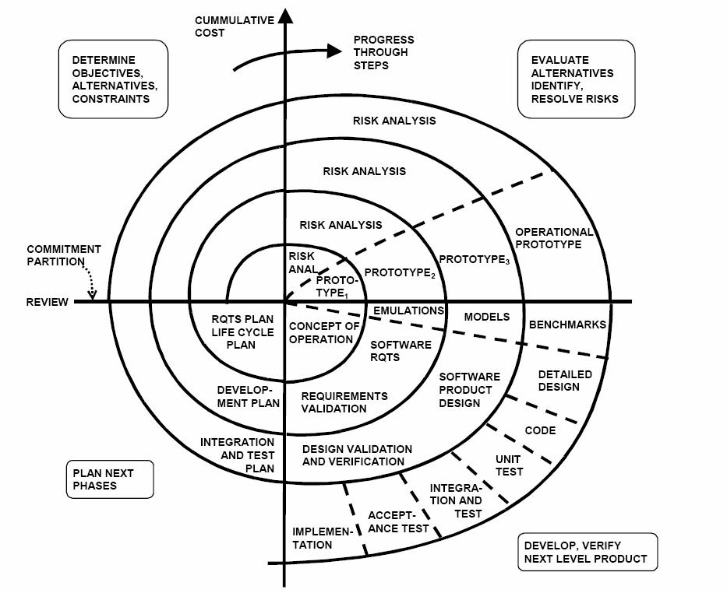
Project Progression

Slide 9
Agenda
Introduction
Problem Overview
Project Progression
User Case Narratives
UML Use Case Diagrams
UML Deployment Diagrams
Website Map
UML Activity Diagrams
Data Flow Diagrams
Requirements Inventory
Data Dictionary
Testing
Development Environment
Prototype Screens
What’s Next?

Slide 10
Two Different Users
Employee
Log On
Sell Items
Print Receipts
Add Customer or Donor
Accept Donation
Manage Profiles
Administrator
Edit Prices

Slide 11
Agenda
Introduction
Problem Overview
Project Progression
User Case Narratives
UML Use Case Diagrams
UML Deployment Diagrams
Website Map
UML Activity Diagrams
Data Flow Diagrams
Requirements Inventory
Data Dictionary
Testing
Development Environment
Prototype Screens
What’s Next?

Slide 12
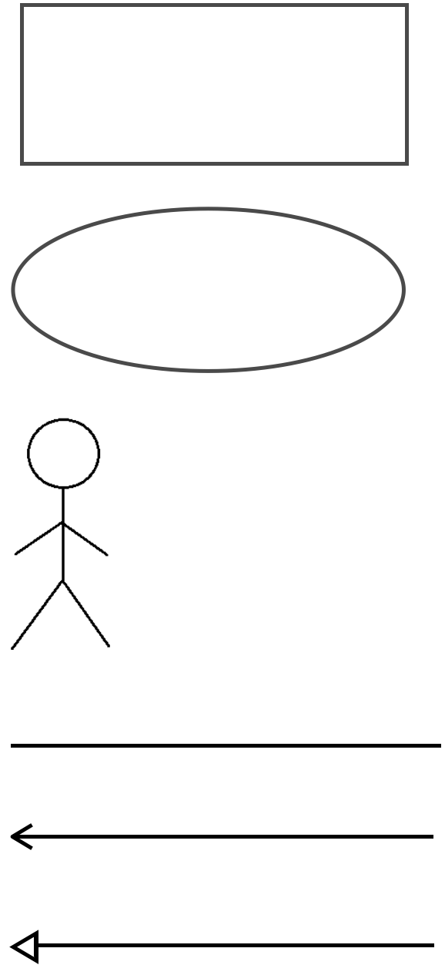
UML Use Case Legend
System Boundary: This is where all the interaction occurs. Represents what is within the system and outside of it. Uses go on the inside and actors go on the outside.
Scenarios: The actions that occur within a system and how the user interacts with the system.
Actor: Actors interact with the system through uses. Actors can be human or non-human. Human actors go on the left side of the system boundary. Non-human actors go on the right side. Actor name gets displayed below the actor.
Participation Line: Shows what scenarios an actor can interact with.
Inclusion Arrow: An arrow that points from a scenario to another scenario to show that something must be included for the scenario.
Inheritance Arrow: An arrow that points from one use to another. The use being pointed at is the parent and the other is the sub.

Slide 13
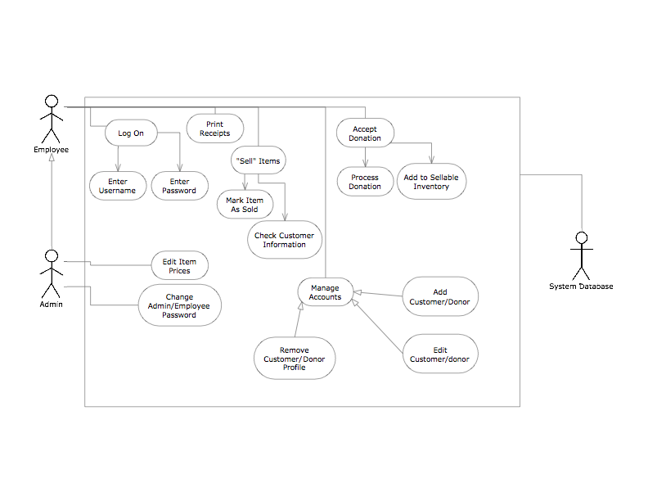
UML Use Case Diagram
E.A.S.

Slide 14
Agenda
Introduction
Problem Overview
Project Progression
User Case Narratives
UML Use Case Diagrams
UML Deployment Diagrams
Website Map
UML Activity Diagrams
Data Flow Diagrams
Requirements Inventory
Data Dictionary
Testing
Development Environment
Prototype Screens
What’s Next?

Slide 15
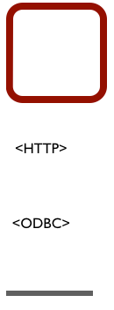
UML Deployment Diagram Legend
System Boundary - This is where all the interactions occur.
Represents what is within the system and outside of it.
HTTP - Hypertext Transfer Protocol defines how messages are formatted and transmitted, and what actions web servers and browsers should take in response to various commands.
ODBC - Open Database Connectivity is a standard programming language middleware for accessing database management systems.
Connection - Displays a relationship between boundaries.

Slide 16
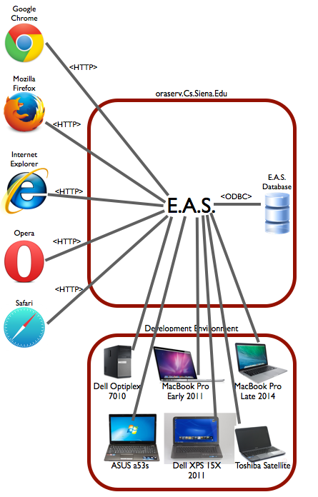
UML Deployment Diagram

Slide 17
Agenda
Introduction
Problem Overview
Project Progression
User Case Narratives
UML Use Case Diagrams
UML Deployment Diagrams
Website Map
UML Activity Diagrams
Data Flow Diagrams
Requirements Inventory
Data Dictionary
Testing
Development Environment
Prototype Screens
What’s Next?

Slide 18
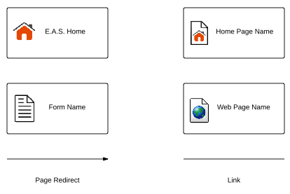
Website Map Legend
Home - This represents the main page of E.A.S. prior to a user logging in. Various options will be presented at this time.
Home Page - Represents the user’s main page when they initially login to their account.
Form - Represents data fields which require user input.
Web Page - Represents a web page within the E.A.S. system.
Link - Represents a page being accessible from another page.
Page Redirect - Indicates a forced reroute to a new page depending on the user’s action

Slide 19
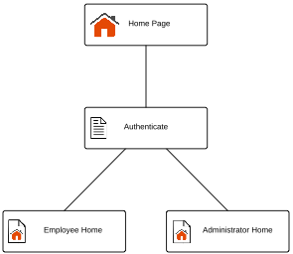
Website Map: Context

Slide 20
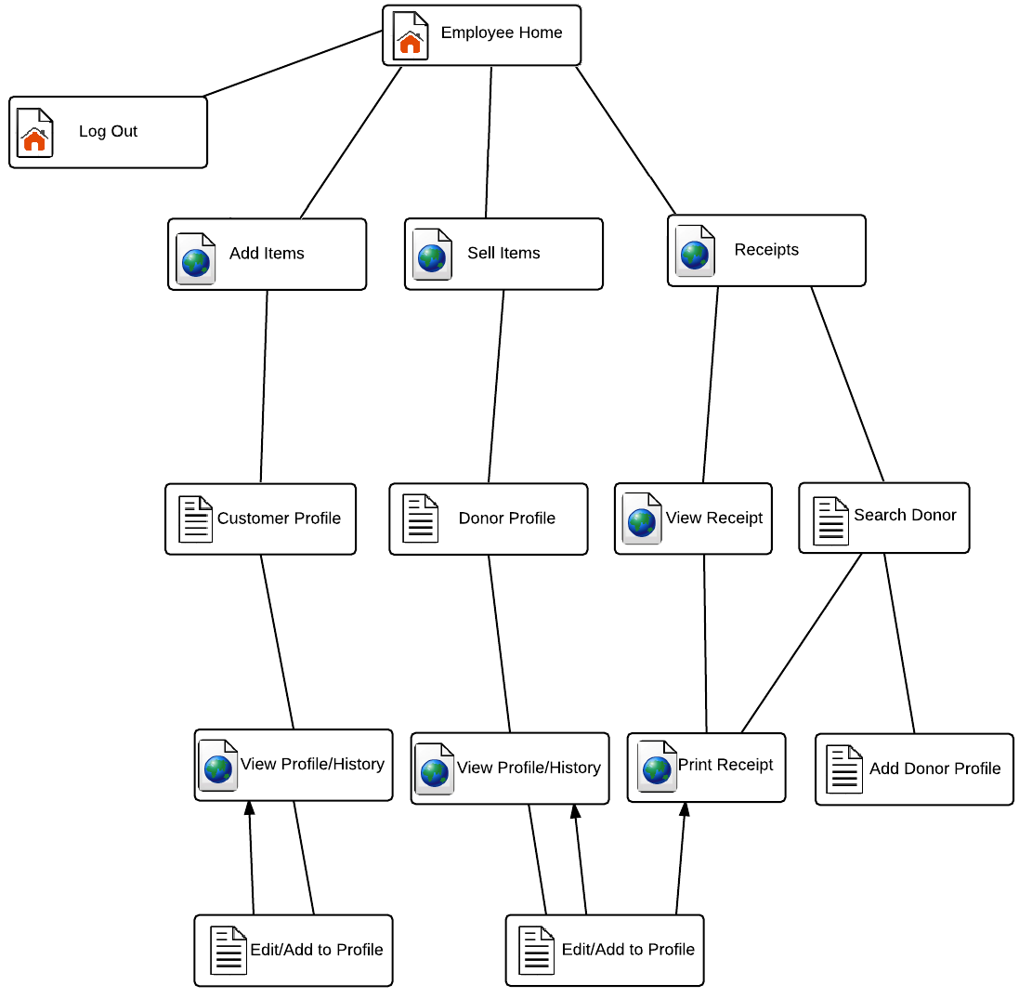
Website Map: Employee

Slide 21
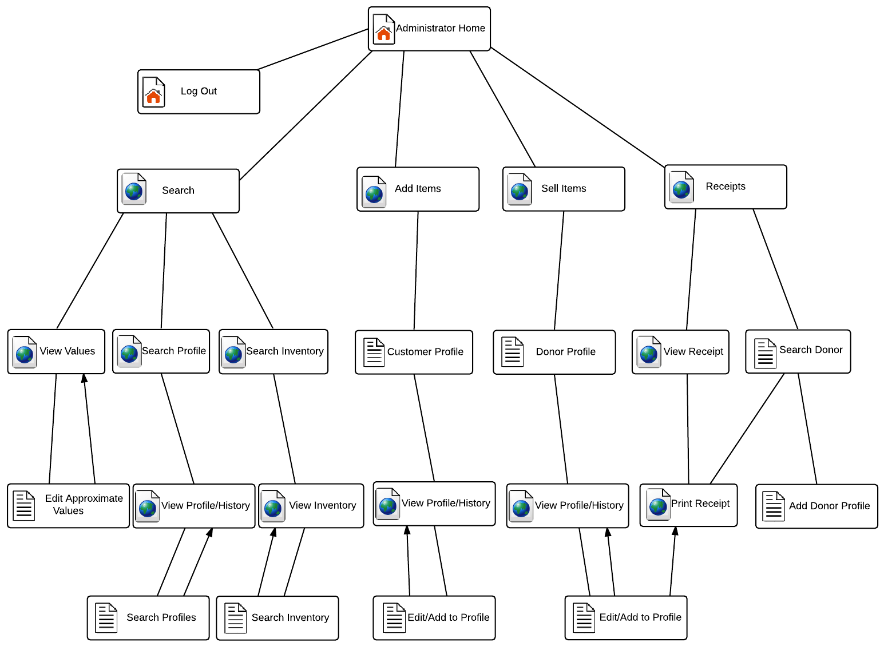
Website Map: Administrator

Slide 22
Agenda
Introduction
Problem Overview
Project Progression
User Case Narratives
UML Use Case Diagrams
UML Deployment Diagrams
Website Map
UML Activity Diagrams
Data Flow Diagrams
Requirements Inventory
Data Dictionary
Testing
Development Environment
Prototype Screens
What’s Next?

Slide 23
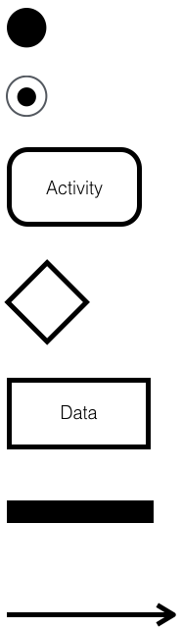
UML Deployment Diagram Legend
Initial Node – This is the first node in the process. The initial node is the starting point for all movement.
Final Node – The final node is the last node in the process. When the activity flow has reached here, the process is over.
Activity Node – The activity node describes the activity or step to be done to help complete the process when the flow reaches the node.
Decision Node – The decision node is used to branch the activity. A decision node is usually posed in question form, with multiple unique answers. The flow must follow one of the branches after the decision.
Data Object - Data that is used during the process. The data object can be either input or output.
Split/Join – Can either separate activity flow to run two activities simultaneously or join them back together after simultaneous activities are completed.
Flow – Shows the movement of action from one node to another

Slide 24
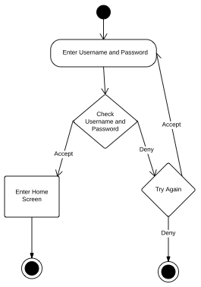
Activity Diagram: Log on

Slide 25
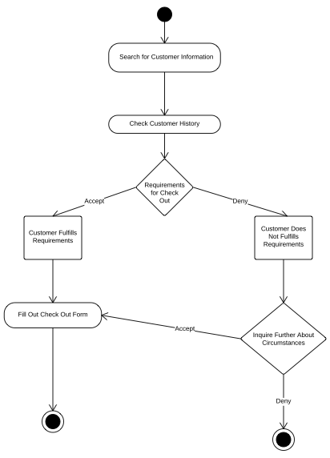
Activity Diagram: Sell Items

Slide 26
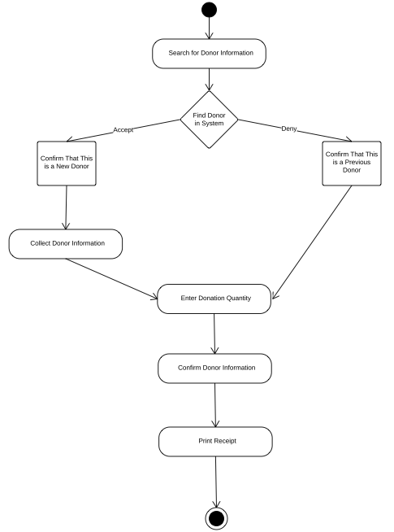
Activity Diagram: Print Receipts

Slide 27
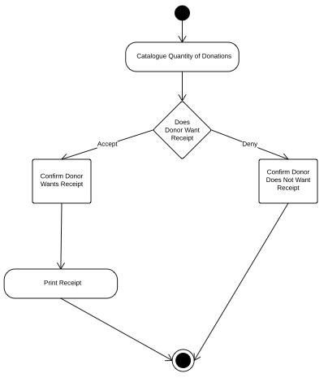
Activity Diagram: Accept Donations

Slide 28
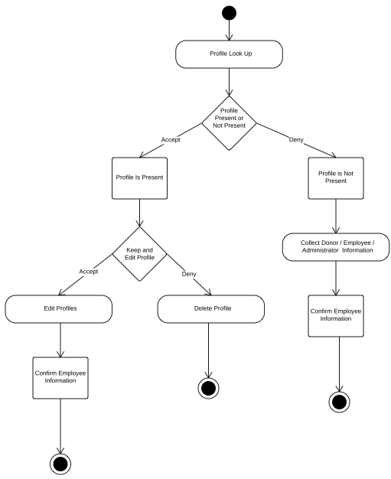
Activity Diagram: Manage Profiles

Slide 29
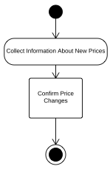
Activity Diagram: Edit Prices

Slide 30
Agenda
Introduction
Problem Overview
Project Progression
User Case Narratives
UML Use Case Diagrams
UML Deployment Diagrams
Website Map
UML Activity Diagrams
Data Flow Diagrams
Requirements Inventory
Data Dictionary
Testing
Development Environment
Prototype Screens
What’s Next?

Slide 31
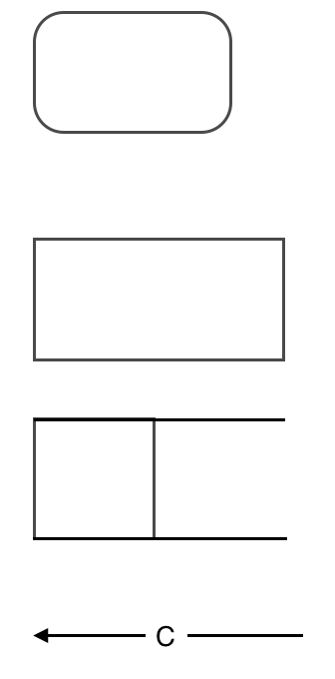
UML Use Case Legend
Process: Transforms or manipulates data.
External Entity: Contributes data or information to the system or which receive data/information from it.
Data Store: Location where data is held temporarily or permanently.
Data Flow: Data/information flowing to or from a process where C is the data/information.

Slide 32
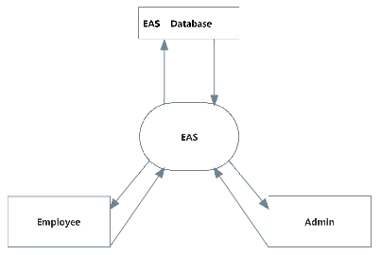
Context Diagram

Slide 33
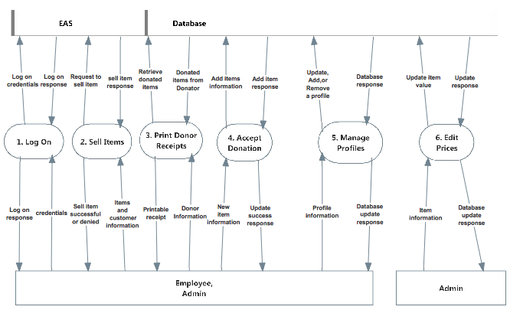
Level 0 Diagram

Slide 34
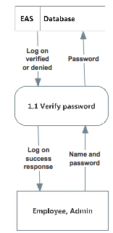
Level 1:1 Log on

Slide 35
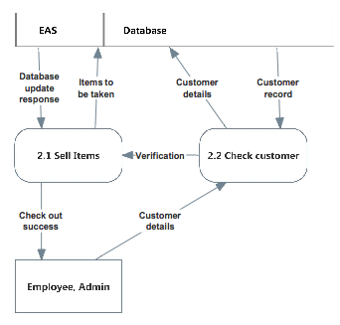
Level 1:2 Sell Items

Slide 36
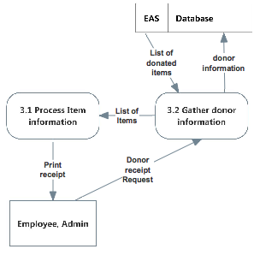
Level 1:3 Print Receipts

Slide 37
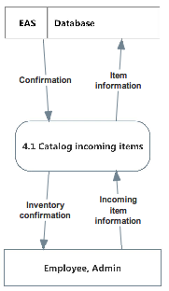
Level 1:4 Accept Donation

Slide 38
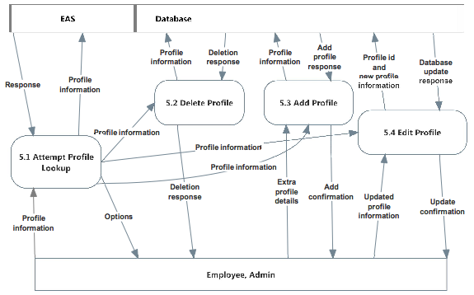
Level 1:5 Manage Profiles

Slide 39
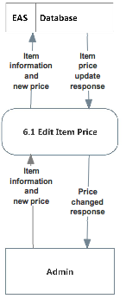
Level 1:6 Edit Prices

Slide 40
Agenda
Introduction
Problem Overview
Project Progression
User Case Narratives
UML Use Case Diagrams
UML Deployment Diagrams
Website Map
UML Activity Diagrams
Data Flow Diagrams
Requirements Inventory
Data Dictionary
Testing
Development Environment
Prototype Screens
What’s Next?

Slide 41
Functional Requirements
Employee
Log in
Print receipts
Sell and add items
Add customer profiles
Manage donor and customer accounts
Admin
Inherits all abilities of employee
Edit prices
Manage employee accounts
Change password

Slide 42
Non-Functional Requirements
Easy to use
Efficient
Low maintenance
User friendly
Work with multiple internet browsers

Slide 43
Implementation Priorities
Employees/Admins (Users) login
Users to update inventory
Users to print receipts for donors
User friendly design

Slide 44
Foreseeable Modifications
Expand History Log
6 months
Simple and user friendly
Item attributes
Store credit system

Slide 45
Testing Requirements
User Friendly
Maintainability
Test the major web browsers
IE, Firefox, Chrome, Safari

Slide 46
Agenda
Introduction
Problem Overview
Project Progression
User Case Narratives
UML Use Case Diagrams
UML Deployment Diagrams
Website Map
UML Activity Diagrams
Data Flow Diagrams
Requirements Inventory
Data Dictionary
Testing
Development Environment
Prototype Screens
What’s Next?

Slide 47
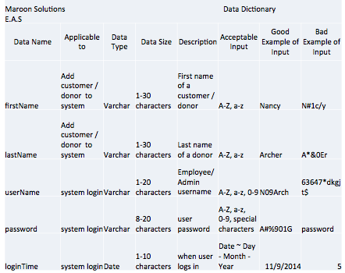
Data Dictionary

Slide 48
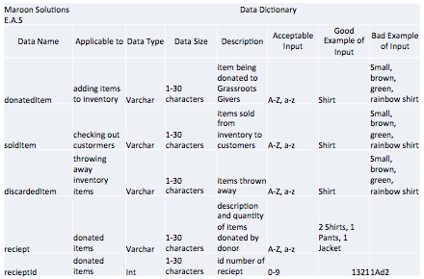
Data Dictionary

Slide 49
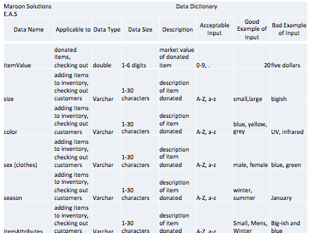
Data Dictionary

Slide 50
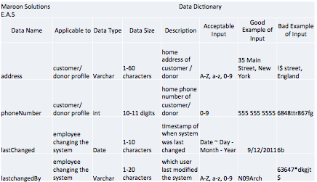
Data Dictionary

Slide 51
Agenda
Introduction
Problem Overview
Project Progression
User Case Narratives
UML Use Case Diagrams
UML Deployment Diagrams
Website Map
UML Activity Diagrams
Data Flow Diagrams
Requirements Inventory
Data Dictionary
Testing
Development Environment
Prototype Screens
What’s Next?

Slide 52
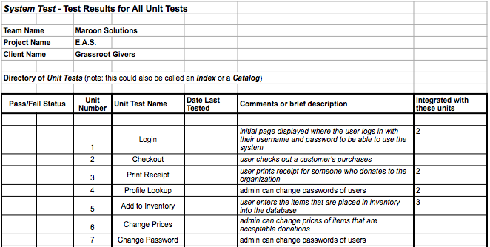
Unit Testing

Slide 53
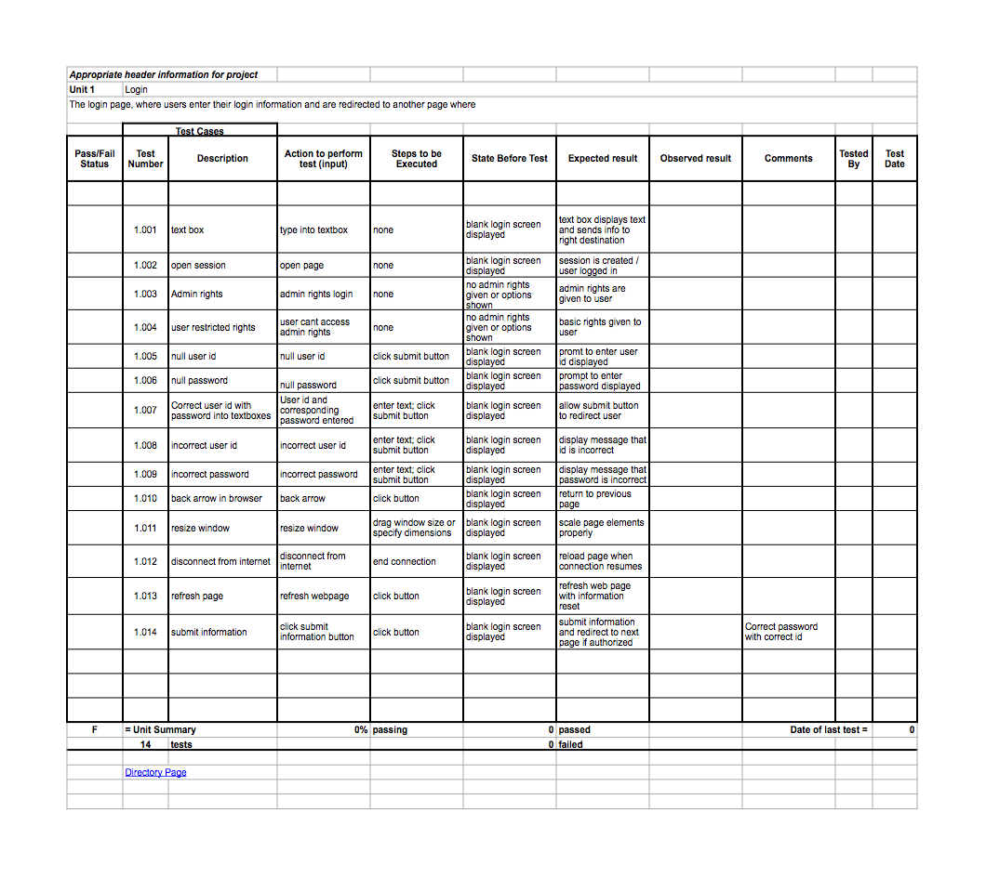
Unit 1: Log On

Slide 54
Unit 1: Log On

Slide 55
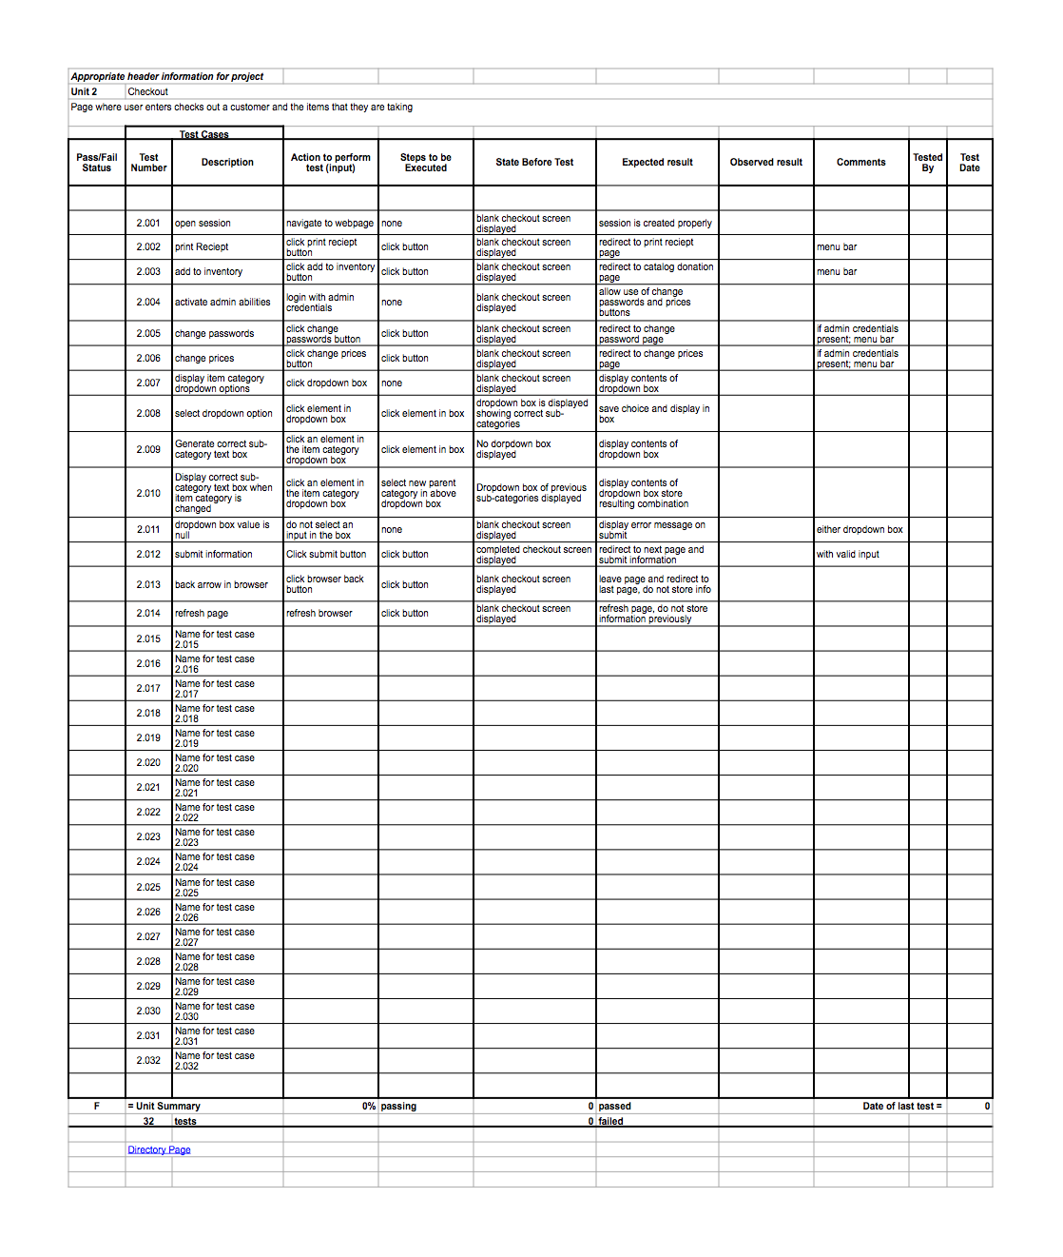
Unit 2: Check Out

Slide 56
Unit 2: Check Out

Slide 57
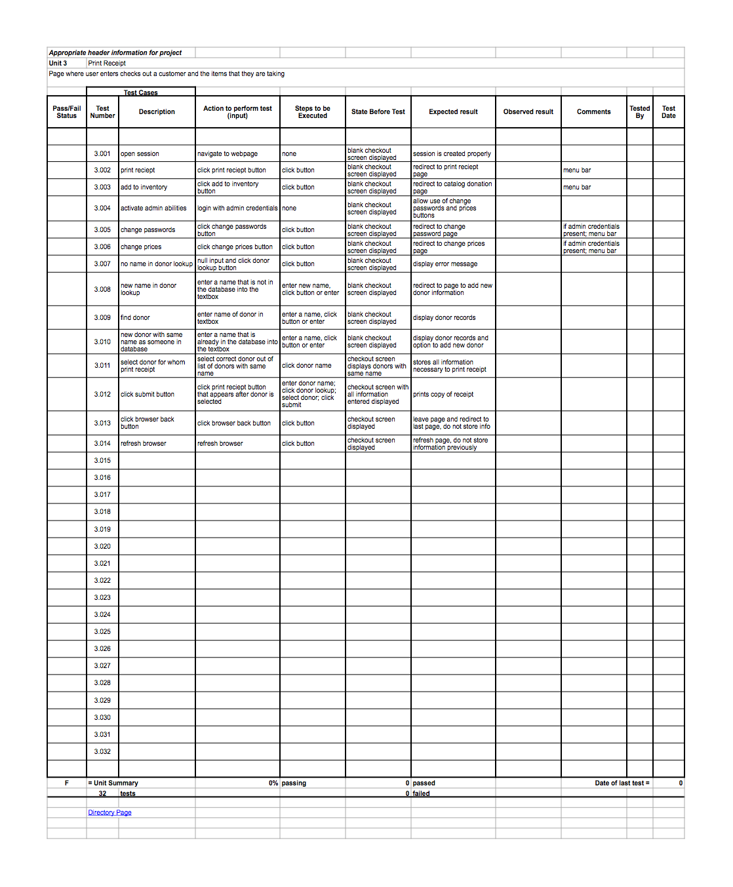
Unit 3: Print Receipt

Slide 58
Unit 3: Print Receipt

Slide 59
Agenda
Introduction
Problem Overview
Project Progression
User Case Narratives
UML Use Case Diagrams
UML Deployment Diagrams
Website Map
UML Activity Diagrams
Data Flow Diagrams
Requirements Inventory
Data Dictionary
Testing
Development Environment
Prototype Screens
What’s Next?

Slide 60
Environment
Development Environment: Software Engineering Lab, personal computers
Operating Environment: Mac and PC, Internet, Siena servers
Maintenance Environment: to be determined

Slide 61
Tools and Applications
Google Chrome
Mozilla Firefox
Safari
Internet Explorer
Notepad++
SQL Developer
Eclipse

Slide 62
Agenda
Introduction
Problem Overview
Project Progression
User Case Narratives
UML Use Case Diagrams
UML Deployment Diagrams
Website Map
UML Activity Diagrams
Data Flow Diagrams
Requirements Inventory
Data Dictionary
Testing
Development Environment
Prototype Screens
What’s Next?

Slide 63
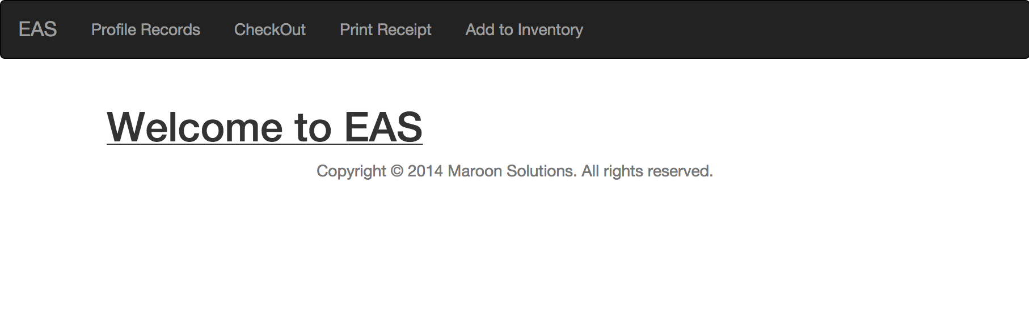
Prototype

Slide 64
Agenda
Introduction
Problem Overview
Project Progression
User Case Narratives
UML Use Case Diagrams
UML Deployment Diagrams
Website Map
UML Activity Diagrams
Data Flow Diagrams
Requirements Inventory
Data Dictionary
Testing
Development Environment
Prototype Screens
What’s Next?

Slide 65
Spring Semester
Detailed Design
Acceptance Test

Slide 66
Maroon Solutions
Questions?

