Slide 1

Requirement Specifications
Efficient and Simple
Maroon Solutions

Slide 2

Agenda
Introduction
Problem Restate
Project Progression
Use Case Narratives
UML Use Case Diagram
Data Flow Diagrams
Functional Requirements and Testing
Prototype Screens
What’s Next?

Slide 3
Welcome
Our Client:
Ms. Mary Partridge-Brown
Co-Director
Ms. Roberta Sandler
Co-Director
Guests:
Dr. Meg Fryling
Dr. Darren Lim

Slide 4
Team Introduction
Kathleen Rotondo - Team Leader
Mathew Banville - Data Analyst
Kyle Flack - Database Administrator
Marissa Gasparro - Web Master
Kean Smullen - Head Developer

Slide 5
Agenda
Introduction
Problem Restate
Project Progression
Use Case Narratives
UML Use Case Diagram
Data Flow Diagrams
Functional Requirements and Testing
Prototype Screens
What’s Next?

Slide 6
Problem Restate
Easy and convenient
Track donations, donors, sold items, customers, and employees
Web application capable of storing donated items
Tracks when it leaves the store
Employees to enter in donor information so that donor receipts can be printed
Customer’s history will be kept
Track for suspicious activity
The past year’s worth of activity in the store will be collected so the store can use it for future references

Slide 7
Agenda
Introduction
Problem Restate
Project Progression
Use Case Narratives
UML Use Case Diagram
Data Flow Diagrams
Functional Requirements and Testing
Prototype Screens
What’s Next?

Slide 8
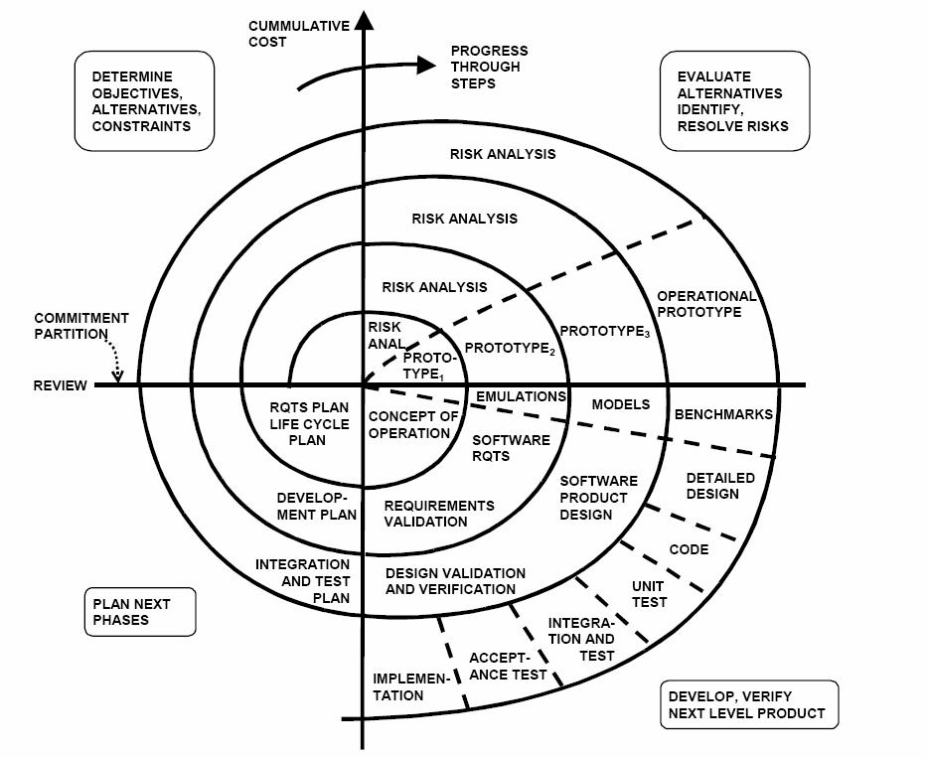
Project Progression

Slide 9
Agenda
Introduction
Problem Restate
Project Progression
Use Case Narratives
UML Use Case Diagram
Data Flow Diagrams
Functional Requirements and Testing
Prototype Screens
What’s Next?

Slide 10
Two Different Users
Employee
Log On
Sell Items
Print Receipts
Add Customer or Donor
Accept Donation
Manage Profiles
Administrator
Edit Prices

Slide 11
Agenda
Introduction
Problem Restate
Project Progression
Use Case Narratives
UML Use Case Diagram
Data Flow Diagrams
Functional Requirements and Testing
Prototype Screens
What’s Next?

Slide 12
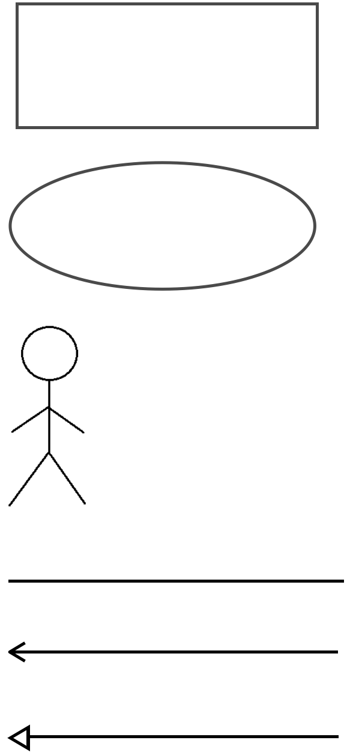
UML Use Case Legend
System Boundary: This is where all the interaction occurs. Represents what is within the system and outside of it. Uses go on the inside and actors go on the outside.
Scenarios: The actions that occur within a system and how the user interacts with the system.
Actor: Actors interact with the system through uses. Actors can be human or non-human. Human actors go on the left side of the system boundary. Non-human actors go on the right side. Actor name gets displayed below the actor.
Participation Line: Shows what scenarios an actor can interact with.
Inclusion Arrow: An arrow that points from a scenario to another scenario to show that something must be included for the scenario.
Inheritance Arrow: An arrow that points from one use to another. The use being pointed at is the parent and the other is the sub.

Slide 13
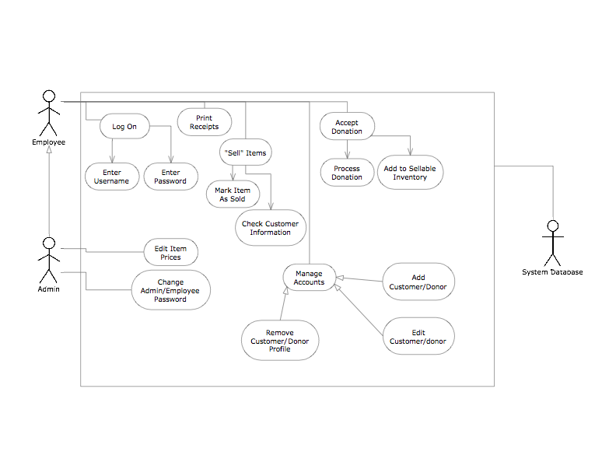
UML Use Case Diagram

Slide 14
Agenda
Introduction
Problem Restate
Project Progression
Use Case Narratives
UML Use Case Diagram
Data Flow Diagrams
Functional Requirements and Testing
Prototype Screens
What’s Next?

Slide 15
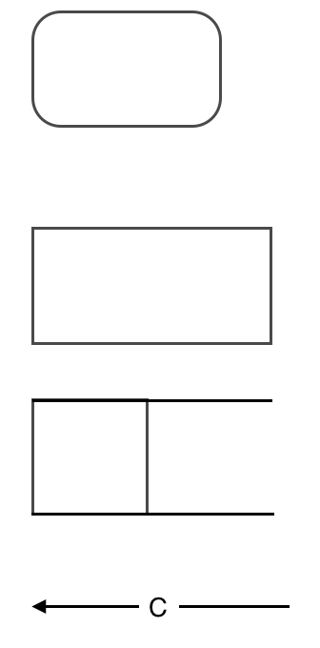
UML Use Case Legend
Process: Transforms or manipulates data.
External Entity: Contributes data or information to the system or which receive data/information from it.
Data Store: Location where data is held temporarily or permanently.
Data Flow: Data/information flowing to or from a process where C is the data/information.

Slide 16
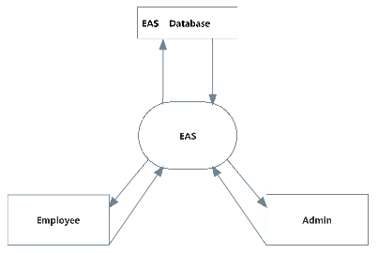
Context Diagram

Slide 17
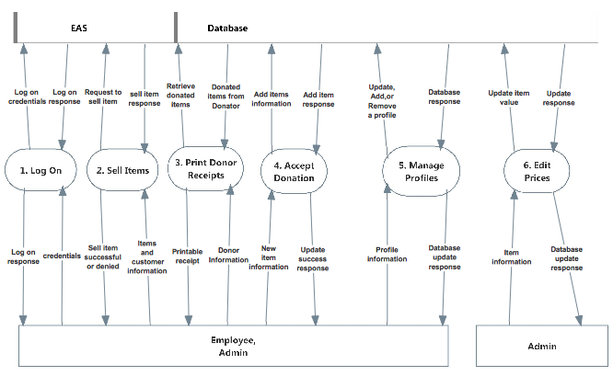
Level 0 Diagram

Slide 18
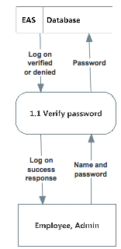
Level 1:1 Log on

Slide 19
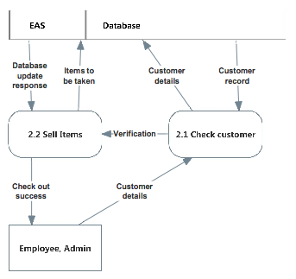
Level 1:2 Sell Items

Slide 20
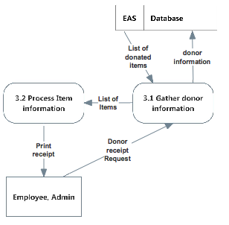
Level 1:3 Print Receipts

Slide 21
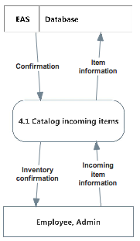
Level 1:4 Accept Donation

Slide 22
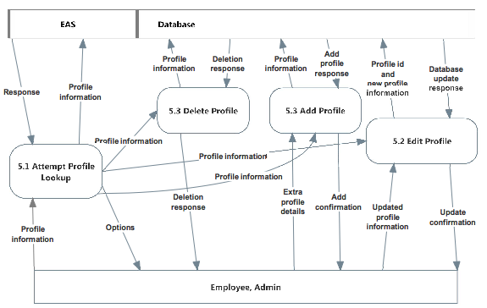
Level 1:5 Manage Profiles

Slide 23
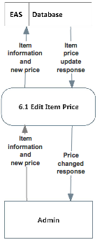
Level 1:6 Edit Prices

Slide 24
Agenda
Introduction
Problem Restate
Project Progression
Use Case Narratives
UML Use Case Diagram
Data Flow Diagrams
Functional Requirements and Testing
Prototype Screens
What’s Next?

Slide 25
Functional Requirements
Employee
Log in
Print receipts
Sell items
Add customer profiles
Manage donor and customer accounts
Admin
Inherits all abilities of employee
Edit prices
Manage employee accounts
Change password

Slide 26
Non-Functional Requirements
Easy to use
Efficient
Low maintenance
User friendly
Work with multiple internet browsers

Slide 27
Implementation Priorities
Employees/Admins (Users) login
Users to print receipts for donors
Users to update inventory
User friendly design

Slide 28
Foreseeable Modifications
Expand History Log
6 months
Simple and user friendly
Item attributes
Donation process
Store credit system

Slide 29
Testing Requirements
User Friendly
Maintainability
Test the major web browsers
IE, Firefox, Chrome, Safari

Slide 30
Agenda
Introduction
Problem Restate
Project Progression
Use Case Narratives
UML Use Case Diagram
Data Flow Diagrams
Functional Requirements and Testing
Prototype Screens
What’s Next?

Slide 31
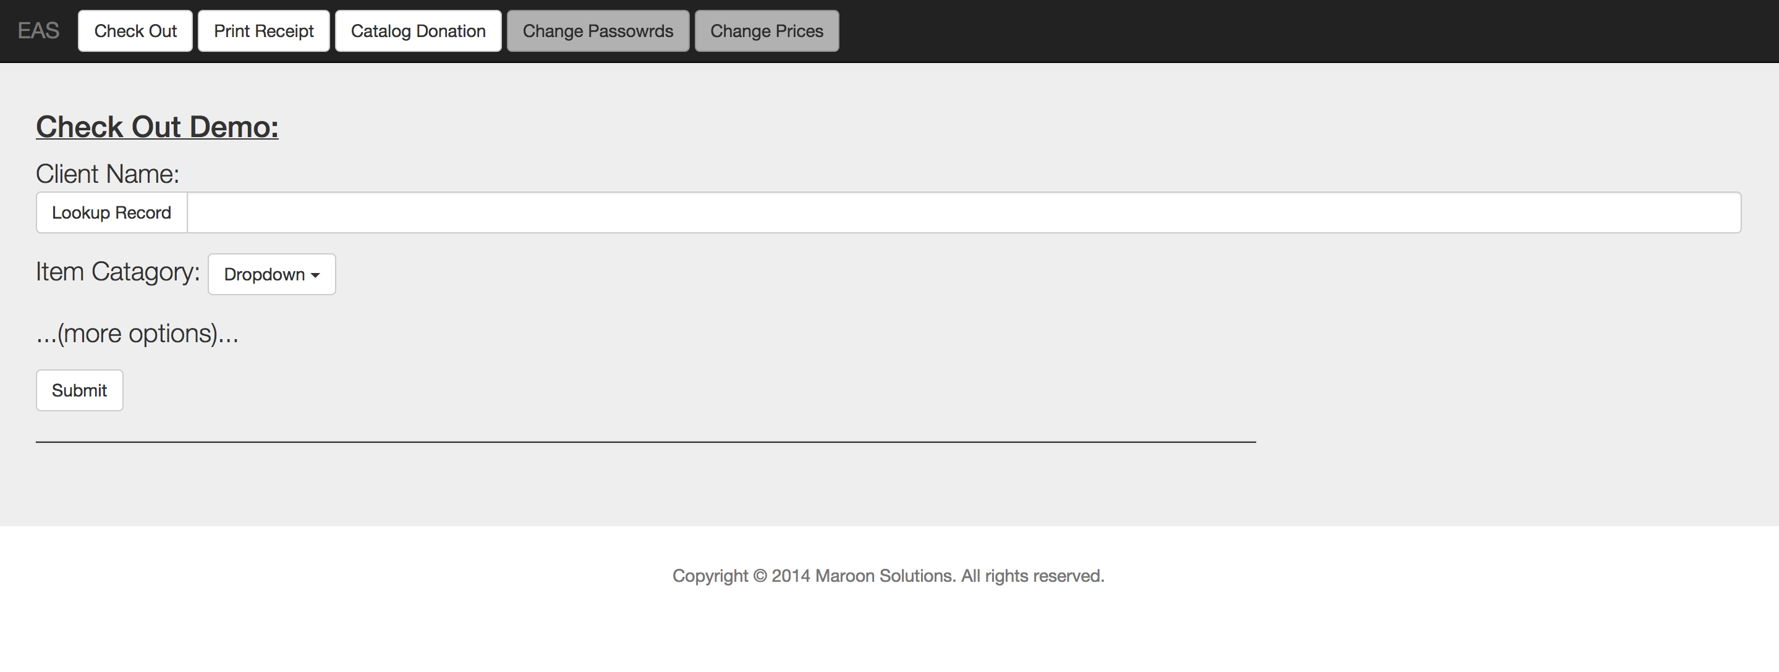
Prototype

Slide 32
Agenda
Introduction
Problem Restate
Project Progression
Use Case Narratives
UML Use Case Diagram
Data Flow Diagrams
Functional Requirements and Testing
Prototype Screens
What’s Next?

Slide 33
Due Dates
Preliminary Design: December 2nd
Detailed Design: Spring 2015
Acceptance Test: Spring 2015

Slide 34
Maroon Solutions
Questions?

