Slide 1
Efficient and Simple
(E.A.S.)
Maroon Solutions

Slide 2


Our Agenda
Project Overview
Resource Overview
Company Overview
Delivery Overview

Slide 3
Problem Definition
Tracking “sold” items
Recites for donors

Slide 4
System Justification
The need to get off paper
Tracking suspicious activity
Giving recites to donors

Slide 5
Goals for the System and the Project
Simplicity
Ease of use
Multi-user functionality

Slide 6
Constraints
Potential for laptop to be stolen again
High information traffic
Wifi
User friendly

Slide 7
Our Agenda
Project Overview
Resource Overview
Company Overview
Delivery Overview

Slide 8
Environment
Development Environment: Software Engineering Lab, personal computers
Operating Environment: Mac and PC, Internet, Siena servers
Maintenance Environment: to be determined

Slide 9
Tools and Techniques
Google Chrome
Mozilla Firefox
Safari
Internet Explorer
Notepad++
SQL Developer
Eclipse

Slide 10
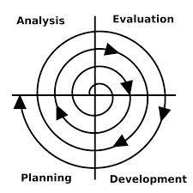
Project Management and Development Model
Spiral Method

Slide 11
Solution Strategy
Spiral Method:
Define and Obtain Requirements
Development of Design
Implementation/Coding of Project
Testing the Solution
Installation and Maintenance of the System
Repeat

Slide 12
Acceptance Criteria
Directors/Employees will be able to
Add/remove/edit items to the inventory database
Add/remove/edit customer profiles
Add/remove/edit donor profiles

Slide 13
Sources of Information
Dr. Meg Fryling
Dr. Darren Lim
Ms. Mary Partridge-Brown
Ms. Roberta Sandler

Slide 14
Our Agenda
Project Overview
Resource Overview
Company Overview
Delivery Overview

Slide 15
Team Structure
Kathleen Rotondo: Team Leader
Mathew Banville: Web Master
Kyle Flack: Database Administrator
Marissa Gasparro: Data Analyst
Kean Smullen: Head Developer

Slide 16
Preliminary Staffing and Resources
Assigning roles to ensure efficiency
All team members will keep all other team members on task
Laptops and Software Engineering lab computers
Meetings in Software Engineering Lab

Slide 17
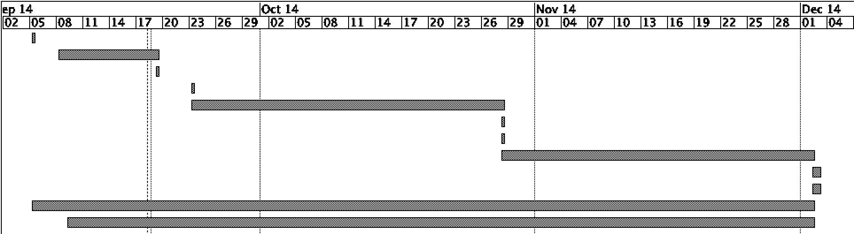
Development Schedule
Task | Duration | Start | Finish
Establish Team | 1 day | 9/5/14 | 9/5/14
Software Plan | 10 days | 9/6/14 | 9/19/14
Software Plan Due | 1 day | 9/19/14 | 9/19/01
Software Plan Presentation | 1 day | 9/23/14 | 9/23/14
Requirement Specifications | 26 days | 9/23/14 | 10/28/14
Required Document Due Date | 1 day | 10/28/14 | 10/28/14
Requirement Presentation | 1 day | 10/28/14 | 10/28/14
Preliminary Design | 26 days | 10/28/14 | 12/2/14
Preliminary Design Due Date | 1 day | 12/2/14 | 12/3/14
Preliminary Design Presentation | 1 day | 12/2/14 | 12/3/14
Team Meetings | 63 days | 9/5/14 | 12/2/14
Client Meetings | 61 days | 9/9/14 | 12/2/14
Gantt Chart

Slide 18
Project Monitoring and Control
Timely fashion
Meeting weekly with Dr. Fryling
Emails with questions pertaining to the project
Daily form of communication

Slide 19
Our Agenda
Project Overview
Resource Overview
Company Overview
Delivery Overview

Slide 20
Programming Languages
HTML
CSS
Javascript
PHP
SQL

Slide 21
Testing Requirements
Testing regularly
Look at every scenario to remove bugs
Test with non-skilled users for feedback
Continuous client meetings

Slide 22
Supporting Documentation
Software Plan
Requirement Specifications
Preliminary Design
Detailed Design
Acceptance Test

Slide 23
Documentation and Delivery
Presentations on documentation
Presentation dates:
Software Plan: September 23rd
Requirement Specifications: October 28th
Preliminary Design: December 2nd
Detailed Design and Acceptance Test: Spring 2015

Slide 24
Questions?

