Slide 1

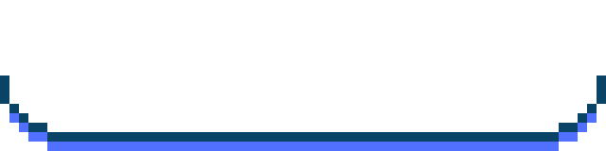
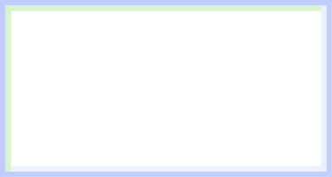

01
Propane
MoleculaR formula
lewis structure
C₃H₈
condensed structural formula
Bond-line formula
CH₃CH₂CH₃
ATOM COUNT : ✓
VALENCE : ✓
SAME CONNECTIVITY : ✓

Slide 2


02
Ethanol
MoleculaR formula
lewis structure
C₂H₆O
condensed structural formula
Bond-line formula
CH₃CH₂OH
ATOM COUNT : ✓
VALENCE : ✓
SAME CONNECTIVITY : ✓

Slide 3


03
Acetone
MoleculaR formula
lewis structure
C₃H₆O
condensed structural formula
Bond-line formula
CH₃COCH₃
ATOM COUNT : ✓
VALENCE : ✓
SAME CONNECTIVITY : ✓

Slide 4


04
Acetic Acid
MoleculaR formula
lewis structure
C₂H₄O₂
condensed structural formula
Bond-line formula
CH₃COOH
ATOM COUNT : ✓
VALENCE : ✓
SAME CONNECTIVITY : ✓

Slide 5


05
Ethyl Acetate
MoleculaR formula
lewis structure
C₄H₈O₂
condensed structural formula
Bond-line formula
CH₃COOCH₂CH₃
ATOM COUNT : ✓
VALENCE : ✓
SAME CONNECTIVITY : ✓

Slide 6
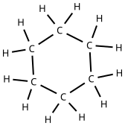

06
Cyclohexane
MoleculaR formula
lewis structure
C₆H₁₂
condensed structural formula
Bond-line formula
(CH₂)₆
ATOM COUNT : ✓
VALENCE : ✓
SAME CONNECTIVITY : ✓

Slide 7
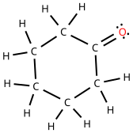

07
Cyclohexanone
MoleculaR formula
lewis structure
C₆H₁₀O
condensed structural formula
Bond-line formula
(CH₂)₅C=O
ATOM COUNT : ✓
VALENCE : ✓
SAME CONNECTIVITY : ✓

Slide 8
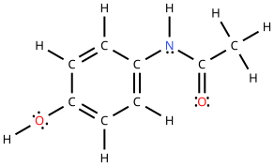
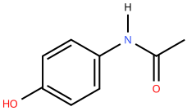
08
Acetaminophen
MoleculaR formula
lewis structure
C₈H₉NO₂
condensed structural formula
Bond-line formula
CH₃CONHC₆H₄OH
ATOM COUNT : ✓
VALENCE : ✓
SAME CONNECTIVITY : ✓

Slide 9
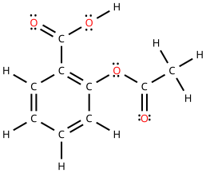
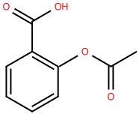
09
Aspirin
MoleculaR formula
lewis structure
C₉H₈O₄
condensed structural formula
Bond-line formula
CH₃COOC₆H₄COOH
ATOM COUNT : ✓
VALENCE : ✓
SAME CONNECTIVITY : ✓

Slide 10
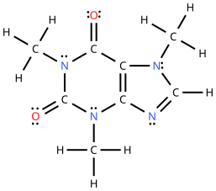
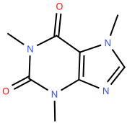
10
Caffeine
MoleculaR formula
lewis structure
C₈H₁₀N₄O₂
condensed structural formula
Bond-line formula
(CH₃)₃C₅HN₄O₂
ATOM COUNT : ✓
VALENCE : ✓
SAME CONNECTIVITY : ✓

