Slide 1
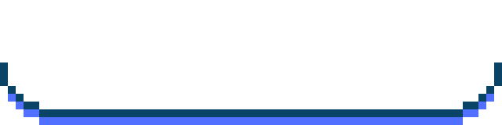
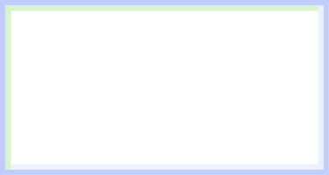
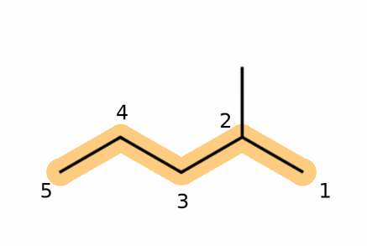
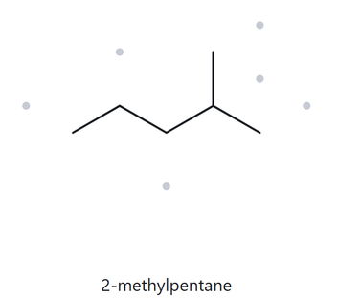
CARD A01 - STRUCTURE → NAME
LEVEL : FOUNDATION MOLECULAR FORMULA : C₆H₁₄
  Numbered parent
  Naming Trail
1. Parent Chain: The longest continuous carbon chain contains five carbon atoms; therefore, the parent name is pentane.
2. Numbering: Numbering from the right gives the methyl substituent a locant of 2, while numbering from the left gives it a locant of 4. The lower locant (2) is selected.
3. Substituent: One methyl group is attached to carbon 2. Thus, the substituent is identified as 2-methyl.
  My name
  The Alkane Check
2-methylpentane
MATCH ✓
LONGEST CHAIN CONFIRMED ✓ LOWEST LOCANTS ✓ ALPHABETICAL ORDER ✓ PUNCTUATION ✓ FORMULA COUNTED ✓

Slide 2
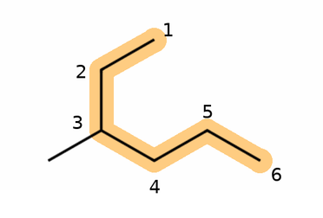
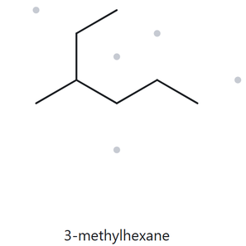
CARD A02 - STRUCTURE → NAME
LEVEL : FOUNDATION MOLECULAR FORMULA : C₇H₁₆
  Numbered parent
  Naming Trail
  Parent Chain: The longest continuous chain contains six carbon atoms, so the parent name is hexane.
  Numbering: Numbering from the upper end gives the methyl group locant 3, which is lower than 4 when numbered from the opposite end.
  Substituent: A methyl group is attached to carbon 3, giving the prefix 3-methyl.
  My name
  The Alkane Check
3-methylhexane
MATCH ✓
LONGEST CHAIN CONFIRMED ✓ LOWEST LOCANTS ✓ ALPHABETICAL ORDER ✓ PUNCTUATION ✓ FORMULA COUNTED ✓

Slide 3
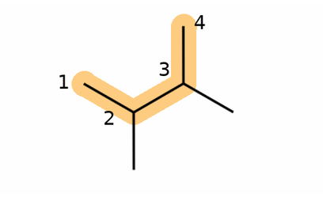
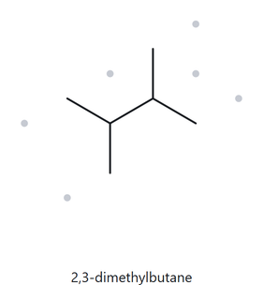
CARD A03 - STRUCTURE → NAME
LEVEL : FOUNDATION MOLECULAR FORMULA : C₆H₁₄
  Numbered parent
  Naming Trail
  Parent Chain: The longest continuous chain contains four carbon atoms, so the parent name is butane.
  Numbering: Both directions give the same locants (2,3), so either direction is acceptable.
  Substituents: Two methyl groups are attached to carbons 2 and 3, giving the prefix 2,3-dimethyl.
  My name
  The Alkane Check
2,3-dimethylbutane
MATCH ✓
LONGEST CHAIN CONFIRMED ✓ LOWEST LOCANTS ✓ ALPHABETICAL ORDER ✓ PUNCTUATION ✓ FORMULA COUNTED ✓

Slide 4
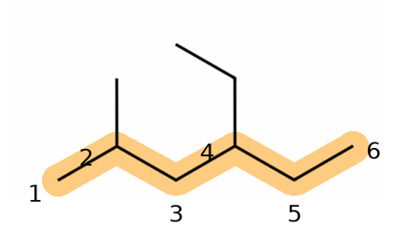
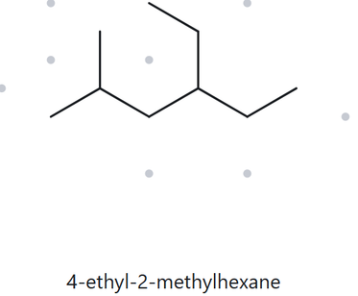
CARD A04 - STRUCTURE → NAME
LEVEL : DEVELOPING MOLECULAR FORMULA : C₉H₂₀
  Numbered parent
  Naming Trail
  Parent Chain: The longest continuous chain contains six carbon atoms, so the parent name is hexane.
  Numbering: Numbering from the left gives locants 2 and 4, which are lower than 3 and 5 from the opposite direction.
  Substituents: An ethyl group is attached to C-4 and a methyl group to C-2. They are arranged alphabetically, with ethyl before methyl.
  My name
  The Alkane Check
4-ethyl-2-methylhexane
MATCH ✓
LONGEST CHAIN CONFIRMED ✓ LOWEST LOCANTS ✓ ALPHABETICAL ORDER ✓ PUNCTUATION ✓ FORMULA COUNTED ✓

Slide 5
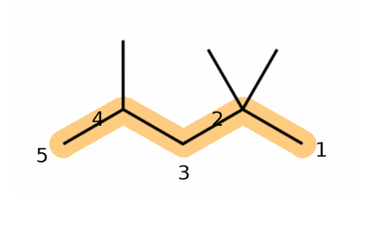
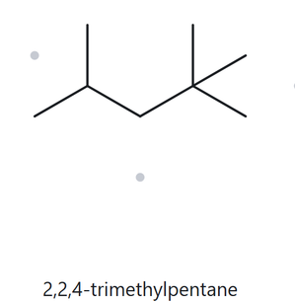
CARD A05 - STRUCTURE → NAME
LEVEL : DEVELOPING MOLECULAR FORMULA : C₈H₁₈
  Numbered parent
  Naming Trail
  Parent Chain: The longest continuous chain contains five carbon atoms, so the parent name is pentane.
  Numbering: Numbering from the right gives locants 2,2,4, which are lower than 2,4,4 from the opposite direction.
  Substituents: Three methyl groups are attached to C-2, C-2, and C-4, giving the prefix 2,2,4-trimethyl.
  My name
  The Alkane Check
2,2,4-trimethylpentane
MATCH ✓
LONGEST CHAIN CONFIRMED ✓ LOWEST LOCANTS ✓ ALPHABETICAL ORDER ✓ PUNCTUATION ✓ FORMULA COUNTED ✓

Slide 6
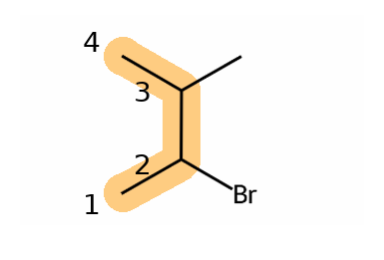
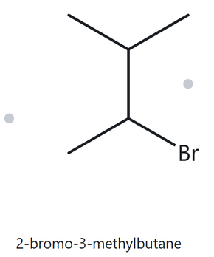
CARD A06 - STRUCTURE → NAME
LEVEL : DEVELOPING MOLECULAR FORMULA : C₅H₁₁Br
  Numbered parent
  Naming Trail
  Parent Chain: The longest continuous chain contains four carbon atoms, so the parent name is butane.
  Numbering: Both directions give locants 2 and 3. Since the locants are tied, the bromo substituent gets the lower number because it comes first alphabetically.
  Substituents: A bromo group is attached to C-2 and a methyl group to C-3.
  My name
  The Alkane Check
2-bromo-3-methylbutane
MATCH ✓
LONGEST CHAIN CONFIRMED ✓ LOWEST LOCANTS ✓ ALPHABETICAL ORDER ✓ PUNCTUATION ✓ FORMULA COUNTED ✓

Slide 7
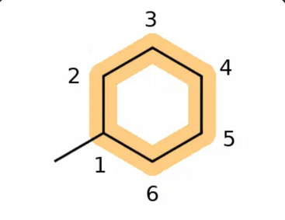
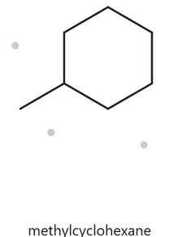
CARD A07 - STRUCTURE → NAME
LEVEL : DEVELOPING MOLECULAR FORMULA : C₇H₁₄
  Numbered parent
  Naming Trail
  Parent Chain: The structure contains a six-carbon ring, so the parent name is cyclohexane.
  Numbering: The carbon bearing the methyl group is assigned locant 1. No direction comparison is needed since there is only one substituent.
  Substituent: One methyl group is attached to the ring, giving the name methylcyclohexane.
  My name
  The Alkane Check
methylcyclohexane
MATCH ✓
LONGEST CHAIN CONFIRMED ✓ LOWEST LOCANTS ✓ ALPHABETICAL ORDER ✓ PUNCTUATION ✓ FORMULA COUNTED ✓

Slide 8
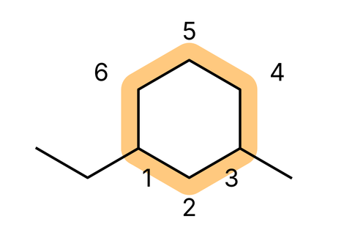
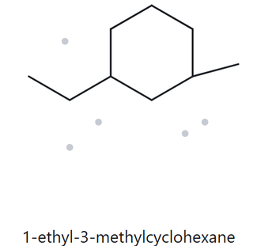
CARD A08 - STRUCTURE → NAME
LEVEL : CHALLENGE MOLECULAR FORMULA : C₉H₁₈
  Numbered parent
  Naming Trail
  Parent Chain: The structure contains a six-carbon ring, so the parent name is cyclohexane.
  Numbering: Both directions give locants 1 and 3. Ethyl gets locant 1 because it comes first alphabetically.
  Substituents: An ethyl group is attached to C-1 and a methyl group to C-3.
  My name
  The Alkane Check
1-ethyl-3-methylcyclohexane
MATCH ✓
LONGEST CHAIN CONFIRMED ✓ LOWEST LOCANTS ✓ ALPHABETICAL ORDER ✓ PUNCTUATION ✓ FORMULA COUNTED ✓

Slide 9
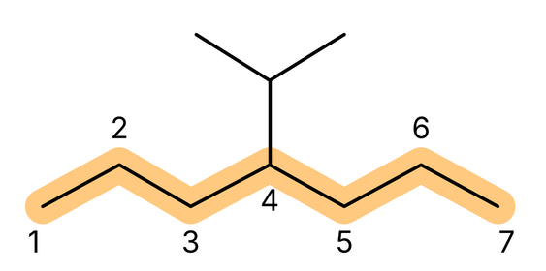
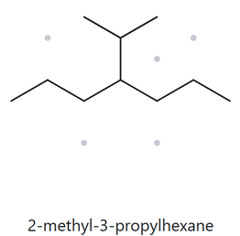
CARD A09 - STRUCTURE → NAME
LEVEL : CHALLENGE MOLECULAR FORMULA : C₁₀H₂₂
  Numbered parent
  Naming Trail
  Parent Chain: The longest continuous chain contains seven carbon atoms, so the parent name is heptane.
  Numbering: Both directions give the same locant, 4, for the substituent.
  Substituent: An isopropyl group is attached to C-4, giving the name 4-isopropyl.
  My name
  The Alkane Check
4-isopropylheptane
misMATCHed ✗
Same structure, but not the longest chain (6 vs 7 C)
LONGEST CHAIN CONFIRMED ✓ LOWEST LOCANTS ✓ ALPHABETICAL ORDER ✓ PUNCTUATION ✓ FORMULA COUNTED ✓

Slide 10
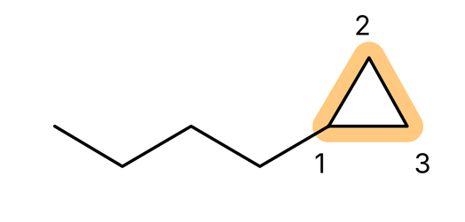
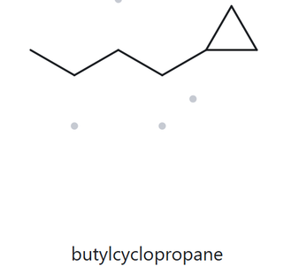
CARD A10 - STRUCTURE → NAME
LEVEL : CHALLENGE MOLECULAR FORMULA : C₇H₁₄
  Numbered parent
  Naming Trail
  Parent Ring: The structure contains a three-carbon ring, so the parent name is cyclopropane.
  Numbering: The ring has only one substituent, so the attachment point is automatically assigned locant 1.
  Substituent: A four-carbon chain is attached to the ring, giving the substituent name butyl.
  My name
  The Alkane Check
butylcyclopropane
MATCH ✓
LONGEST CHAIN CONFIRMED ✓ LOWEST LOCANTS ✓ ALPHABETICAL ORDER ✓ PUNCTUATION ✓ FORMULA COUNTED ✓

Slide 11
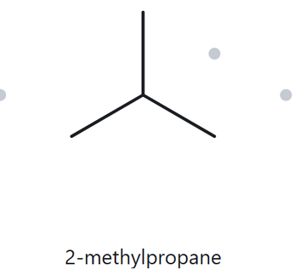
CARD B01 - NAME → STRUCTURE
LEVEL : foundation given name : 2-methylpropane
  Name DECODED
  BOND-LINE STRUCTURE (THE ALKANE)
  Parent: Propane → a 3-carbon chain.
  Substituent: Methyl group attached to C-2.
  Expected Formula: 3 + 1 = 4 carbons; therefore, C₄H₁₀.
  FORMULA CHECK
  BACK-CHECK
  Counted: 4 carbon atoms and 10 hydrogen atoms.
  Alkane Formula: CₙH₂ₙ₊₂ = C₄H₁₀ ✓
  Expected Returned Name: 2-methylpropane.
  Same as the given name ✓
PARENT LENGTH MATCHES ✓ SUBSTITUENT POSITIONS MATCH ✓ FORMULA AGREES ✓ BACK-CHECK RECORDED ✓

Slide 12
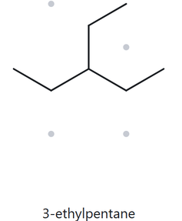
CARD B02 - NAME → STRUCTURE
LEVEL : foundation given name : 3-ethylpentane
  Name DECODED
  BOND-LINE STRUCTURE (THE ALKANE)
  Parent: Pentane → a 5-carbon chain.
  Substituent: One ethyl group attached to C-3.
  Expected Formula: 5 + 2 = 7 carbons; therefore, C₇H₁₆.
  FORMULA CHECK
  BACK-CHECK
  Counted from the name:
C₇H₁₆ — 7 carbon atoms and 16 hydrogen atoms.
  Alkane:
CₙH₂ₙ₊₂ = C₇H₁₆ ✓
  Expected Returned Name: 3-ethylpentane.
  Same as the given name ✓
PARENT LENGTH MATCHES ✓ SUBSTITUENT POSITIONS MATCH ✓ FORMULA AGREES ✓ BACK-CHECK RECORDED ✓

Slide 13
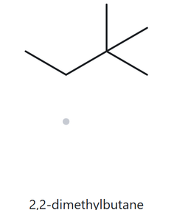
CARD B03 - NAME → STRUCTURE
LEVEL : foundation given name : 2,2-dimethylbutane
  Name DECODED
  BOND-LINE STRUCTURE (THE ALKANE)
  Parent: Butane → a 4-carbon chain.
  Substituents: Two methyl groups attached to C-2.
  Expected Formula: 4 + 2 = 6 carbons; therefore, C₆H₁₄.
  FORMULA CHECK
  BACK-CHECK
  Counted from the name: C₆H₁₄ — 6 carbon atoms and 14 hydrogen atoms.
  Alkane:
CₙH₂ₙ₊₂ = C₆H₁₄ ✓
  Expected Returned Name: 2,2-dimethylbutane
  ✓ Same as the given name.
PARENT LENGTH MATCHES ✓ SUBSTITUENT POSITIONS MATCH ✓ FORMULA AGREES ✓ BACK-CHECK RECORDED ✓

Slide 14
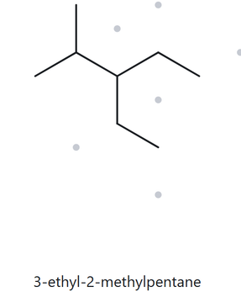
CARD B04 - NAME → STRUCTURE
LEVEL : Developing given name : 3-ethyl-2-methylpentane
  Name DECODED
  BOND-LINE STRUCTURE (THE ALKANE)
  Parent: Pentane → a 5-carbon chain.
  Substituents: Ethyl group on C-3 and methyl group on C-2.
  Expected Formula: 5 + 2 + 1 = 8 carbons; therefore, C₈H₁₈.
  FORMULA CHECK
  BACK-CHECK
  Counted from the name: C₈H₁₈ — 8 carbon atoms and 18 hydrogen atoms.
  Alkane:
  CₙH₂ₙ₊₂ = C₈H₁₈ ✓
  Expected Returned Name: 3-ethyl-2-methylpentane
  ✓ Same as the given name.
PARENT LENGTH MATCHES ✓ SUBSTITUENT POSITIONS MATCH ✓ FORMULA AGREES ✓ BACK-CHECK RECORDED ✓

Slide 15
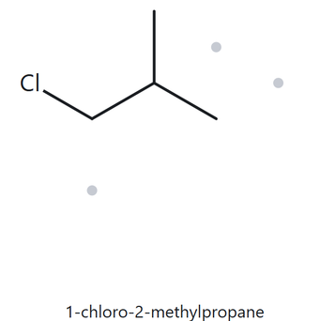
CARD B05 - NAME → STRUCTURE
LEVEL : Developing given name : 1-chloro-2-methylpropane
  Name DECODED
  BOND-LINE STRUCTURE (THE ALKANE)
  Parent: propane → a 3-carbon chain.
  Substituents: one chloro group on C-1 and one methyl group on C-2.
  Expected formula: 3 + 1 = 4 carbons; therefore, C₄H₉Ci.
  FORMULA CHECK
  BACK-CHECK
  Counted from the name: C₄H₉Ci → 4 carbon atoms, 9 hydrogen atoms, and 1 chlorine atom.
  Parent alkane: CₙH₂ₙ₊₂ = C₄H₁₀; replace 1 H with Ci = C₄H₉Ci ✓
  Expected returned name: 1-chloro-2-methylpropane
  ✓ Same as the given name.
PARENT LENGTH MATCHES ✓ SUBSTITUENT POSITIONS MATCH ✓ FORMULA AGREES ✓ BACK-CHECK RECORDED ✓

Slide 16
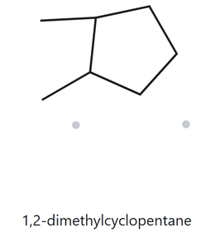
CARD B06 - NAME → STRUCTURE
LEVEL : Developing given name : 1,2-dimethylcyclopentane
  Name DECODED
  BOND-LINE STRUCTURE (THE ALKANE)
  Parent: cyclopentane → a 5-carbon ring.
  Substituents: two methyl groups, one on C-1 and one on C-2.
  Expected formula: 5 + 2 = 7 carbons; therefore, C₇H₁₄.
  FORMULA CHECK
  BACK-CHECK
  Counted from the name: C₇H₁₄ → 7 carbon atoms and 14 hydrogen atoms.
  Cycloalkane: CₙH₂ₙ = C₇H₁₄ ✓
  Expected returned name: 1,2-dimethylcyclopentane
  ✓ Same as the given name.
PARENT LENGTH MATCHES ✓ SUBSTITUENT POSITIONS MATCH ✓ FORMULA AGREES ✓ BACK-CHECK RECORDED ✓

Slide 17
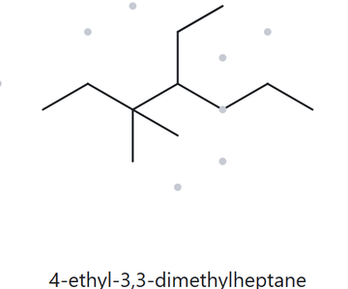
CARD B07 - NAME → STRUCTURE
LEVEL : Developing given name : 4-ethyl-3,3-dimethylheptane
  Name DECODED
  BOND-LINE STRUCTURE (THE ALKANE)
  Parent: heptane → a 7-carbon chain.
  Substituents: two methyl groups on C-3 and one ethyl group on C-4.
  Expected formula: 7 + 2 + 2 = 11 carbons; therefore, C₁₁H₂₄.
  FORMULA CHECK
  BACK-CHECK
  Counted from the name: C₁₁H₂₄ → 11 carbon atoms and 24 hydrogen atoms.
  Alkane: CₙH₂ₙ₊₂ = C₁₁H₂₄ ✓
  Expected returned name: 4-ethyl-3,3-dimethylheptane
  ✓ Same as the given name.
PARENT LENGTH MATCHES ✓ SUBSTITUENT POSITIONS MATCH ✓ FORMULA AGREES ✓ BACK-CHECK RECORDED ✓

Slide 18
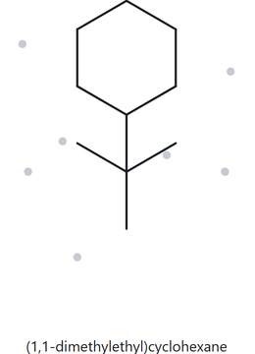
CARD B08 - NAME → STRUCTURE
LEVEL : challenge given name : tert-butylcyclohexane
  Name DECODED
  BOND-LINE STRUCTURE (THE ALKANE)
  Parent: cyclohexane → a 6-carbon ring.
  Substituents: one tert-butyl group, –C(CH₃)₃, attached to C-1.
  Expected formula: 6 + 4 = 10 carbons; therefore, C₁₀H₂₀.
  FORMULA CHECK
  BACK-CHECK
  Counted from the name: C₁₀H₂₀ → 10 carbon atoms and 20 hydrogen atoms.
  Cycloalkane ring: C₆H₁₂; replace 1 H with C₄H₉ = C₁₀H₂₀ ✓
  Expected returned name: tert-butylcyclohexane
  Returned: (1,1-dimethylethyl)cyclohexane
  ✓ Same as the given name.
PARENT LENGTH MATCHES ✓ SUBSTITUENT POSITIONS MATCH ✓ FORMULA AGREES ✓ BACK-CHECK RECORDED ✓

Slide 19
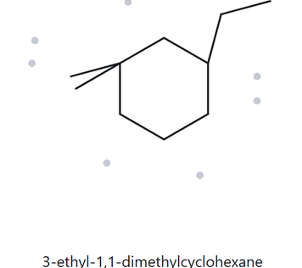
CARD B09 - NAME → STRUCTURE
LEVEL : challenge given name : 3-ethyl-1,1-dimethylcyclohexane
  Name DECODED
  BOND-LINE STRUCTURE (THE ALKANE)
  Parent: cyclohexane → a 6-carbon ring.
  Substituents: two methyl groups on C-1 and one ethyl group on C-3.
  Expected formula: 6 + 2 + 2 = 10 carbons; therefore, C₁₀H₂₀.
  FORMULA CHECK
  BACK-CHECK
  Counted from the name: C₁₀H₂₀ → 10 carbon atoms and 20 hydrogen atoms.
  Cycloalkane ring: C₆H₁₂; replace 3 H with 2 CH₃ and 1 C₂H₅ = C₁₀H₂₀ ✓
  Expected returned name: 3-ethyl-1,1-dimethylcyclohexane
  ✓ Same as the given name.
PARENT LENGTH MATCHES ✓ SUBSTITUENT POSITIONS MATCH ✓ FORMULA AGREES ✓ BACK-CHECK RECORDED ✓

Slide 20
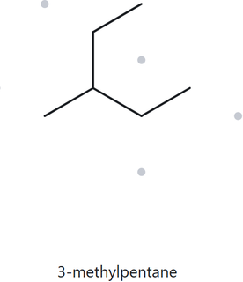
CARD B10 - NAME → STRUCTURE
LEVEL : challenge given name : 2-ethylbutane
  Name DECODED
  BOND-LINE STRUCTURE (THE ALKANE)
  Parent: butane → a 4-carbon chain.
  Substituents: one ethyl group attached to C-2.
  Expected formula: 4 + 2 = 6 carbons; therefore, C₆H₁₄.
  FORMULA CHECK
  BACK-CHECK
  Counted from the name: C₆H₁₄ → 6 carbon atoms and 14 hydrogen atoms.
  Alkane: CₙH₂ₙ₊₂ = C₆H₁₄ ✓
  Expected returned name: 3-methylpentane
  ✗ Not the same as the given name. The longest chain is 5 carbons (pentane), so the ethyl group becomes part of the main chain.
PARENT LENGTH MATCHES ✗ SUBSTITUENT POSITIONS MATCH ✗ FORMULA AGREES ✓ BACK-CHECK RECORDED ✓

