Slide 1

Team Details
a. Team name: Tekno Animo
b. Team leader name: Simon Surya Keban
c. Problem statement: Casting SMEs in Southeast Asia rely on manual visual inspection, so quality depends on who is on shift, the best inspector's judgment leaves when they retire, and every escaped defect costs days of 8D work. Vision AI that needs thousands of labelled images per part is out of their reach.
Notes:
Team SenpaiQC, led by Simon Surya Keban. Problem: manual visual inspection in casting SMEs.

Slide 2
Brief about the idea
SenpaiQC is an expert-taught inspection and rework cell for casting SMEs. A senior inspector teaches it once on video; it checks every part, decides pass / rework / scrap, guides the fix in the operator's language, and when defects spike it alerts the QC team, finds the root cause and drafts the 8D report. A person stays in charge of every scrap and every rule.
1
2
3
4
5
Teach
Inspect
Act
Learn
Improve
Expert video becomes rule cards (Gemini on Vertex AI); the expert approves
YOLO on CPU decides easy parts; Gemini points at hard ones and cites the rule
Rework steps in 4 languages, or a robot sort behind a safety gate
BigQuery + p-chart → Telegram alert → ADK agent finds the cause, drafts the 8D
Confirmed Gemini cases retrain YOLO, so cost falls over time
Notes:
The closed quality loop: Teach, Inspect, Act, Learn, Improve.

Slide 3
Opportunities
How different is it from existing ideas?
USP of the proposed solution
How will it solve the problem?
Expert-taught, not label-trained: one narrated video per part instead of thousands of labelled images.
Explains itself: every AI decision points at the defect and cites the approved rule, not just a score.
Goes past detection: fix steps, alert, root cause and 8D in one loop.
Same check every shift: 99% recall, 0% false rejects on 200 held-out images.
Knowledge stays: a 2-min video became 4 rule cards in 9.4 s.
Faster response: spike → Telegram alert → root cause + 8D draft in about 30 s.
Affordable: 99% of parts stay on CPU; Gemini $0.07 per 1,000 parts.
Teach once, new part numbers work on day one.
Explainable by construction: uncited defects never pass; scrap needs a person.
One decision drives a person or a robot.
Closed Kaizen loop from detection to 8D and retraining.
Phone + browser + one Cloud Run URL.
Notes:
Different: expert-taught, explainable, closes the loop. Solves: consistency, kept knowledge, fast 8D, low cost.

Slide 4
List of features offered by the solution
Teach from video Senior inspector
Rule approval Senior inspector
Inspect Line operator
Narrated video (≤10 min / 500 MB) → rule cards with timestamps
Edit, approve, version; drafts never reach the line
Phone photo → pass / rework / scrap, defect circled, rule cited
Rework guide Line operator
Needs confirmation Supervisor
Quality analytics QC engineer
Tick-box steps in English, Bahasa Indonesia, Thai, Vietnamese
Every scrap, unknown defect and invalid result waits for a person
p-chart per defect and shift, Pareto, live cost and latency
Spike alerts QC engineer
Root-cause agent QC engineer
8D reports QC engineer
Pub/Sub → Telegram or Google Chat, with retries
ADK agent ranks machine, mould, lot hypotheses with evidence
D1–D8 pre-filled; approve; export .docx for Word / Google Docs
Ask SenpaiQC Everyone
Robot cell Optional
Guardrails Platform
Answers only from plant records, with citations
Gemini plans moves; safety gate; hold bin; 3D replay
Schema-checked AI, AI budgets, CSP, Secret Manager
Notes:
Twelve features across five roles.

Slide 5
Process flow diagram
Teach
Narrated video
senior inspector
Gemini drafts
rule cards + timestamps
Expert approves
or edits
Approved rules
Firestore
Inspect & Act
Phone photo
operator
YOLO on CPU
confident → decide
Gemini
unsure / new part, cites rule
Decision
scrap → person confirms
Rework steps
or robot sort
Learn & Improve
BigQuery
every decision
p-chart
spike?
Pub/Sub alert
Telegram
ADK agent
root cause
8D draft
approve, .docx
Dashed: approved rules feed Gemini; every final decision is written to BigQuery. Confirmed Gemini cases become YOLO training labels.
Notes:
Three lanes: teach, inspect and act, learn and improve.

Slide 6
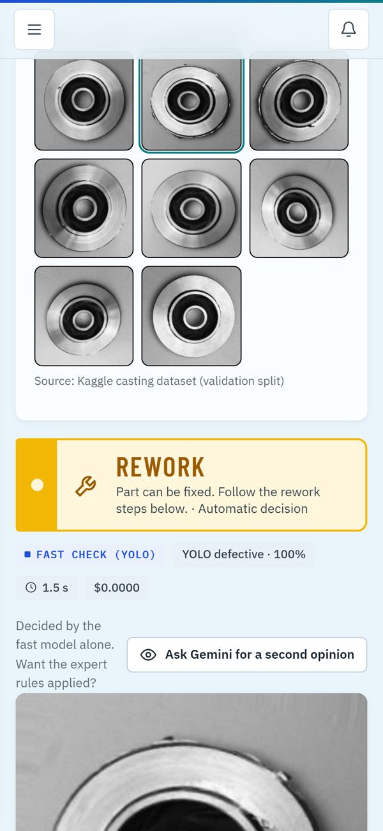
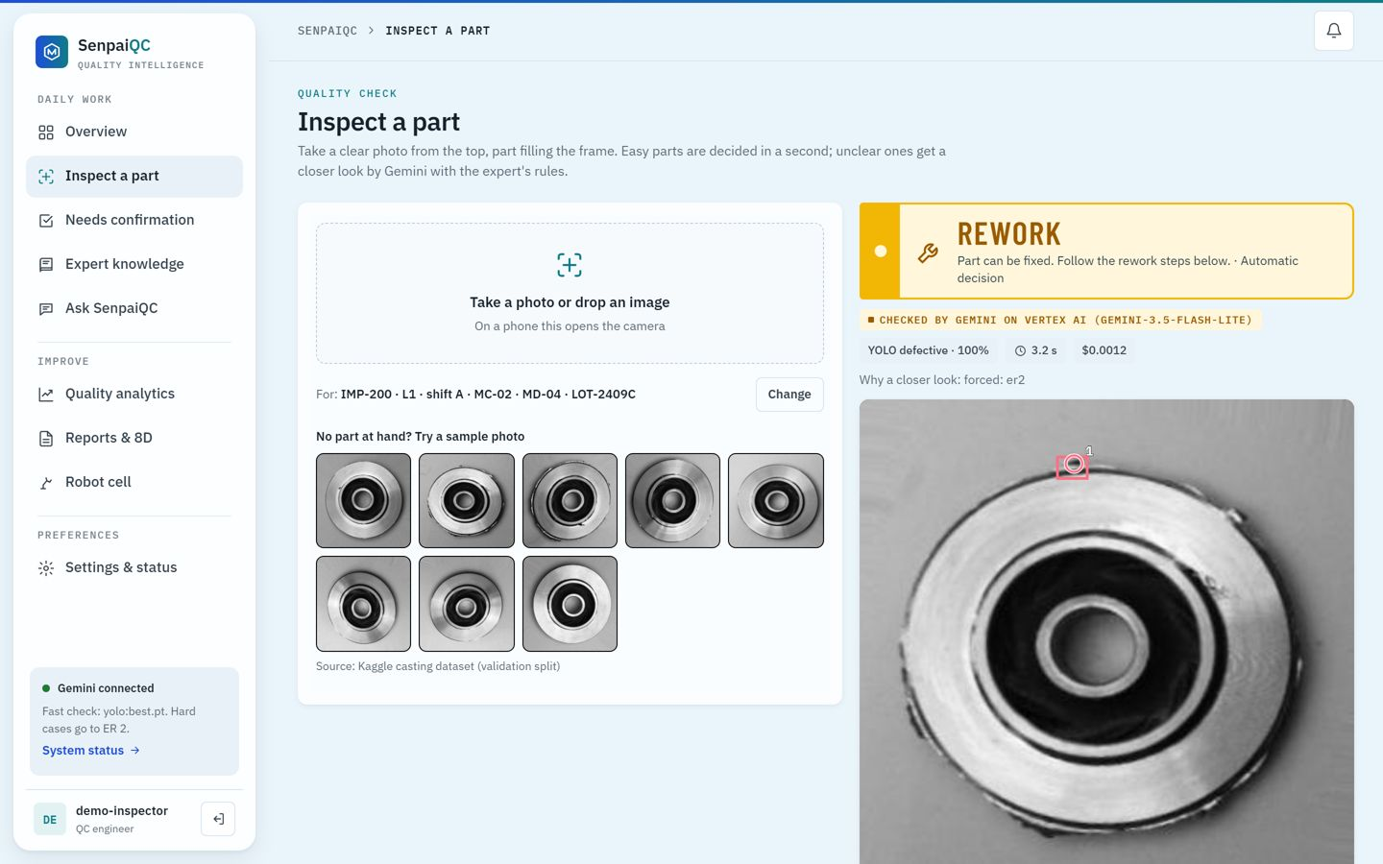
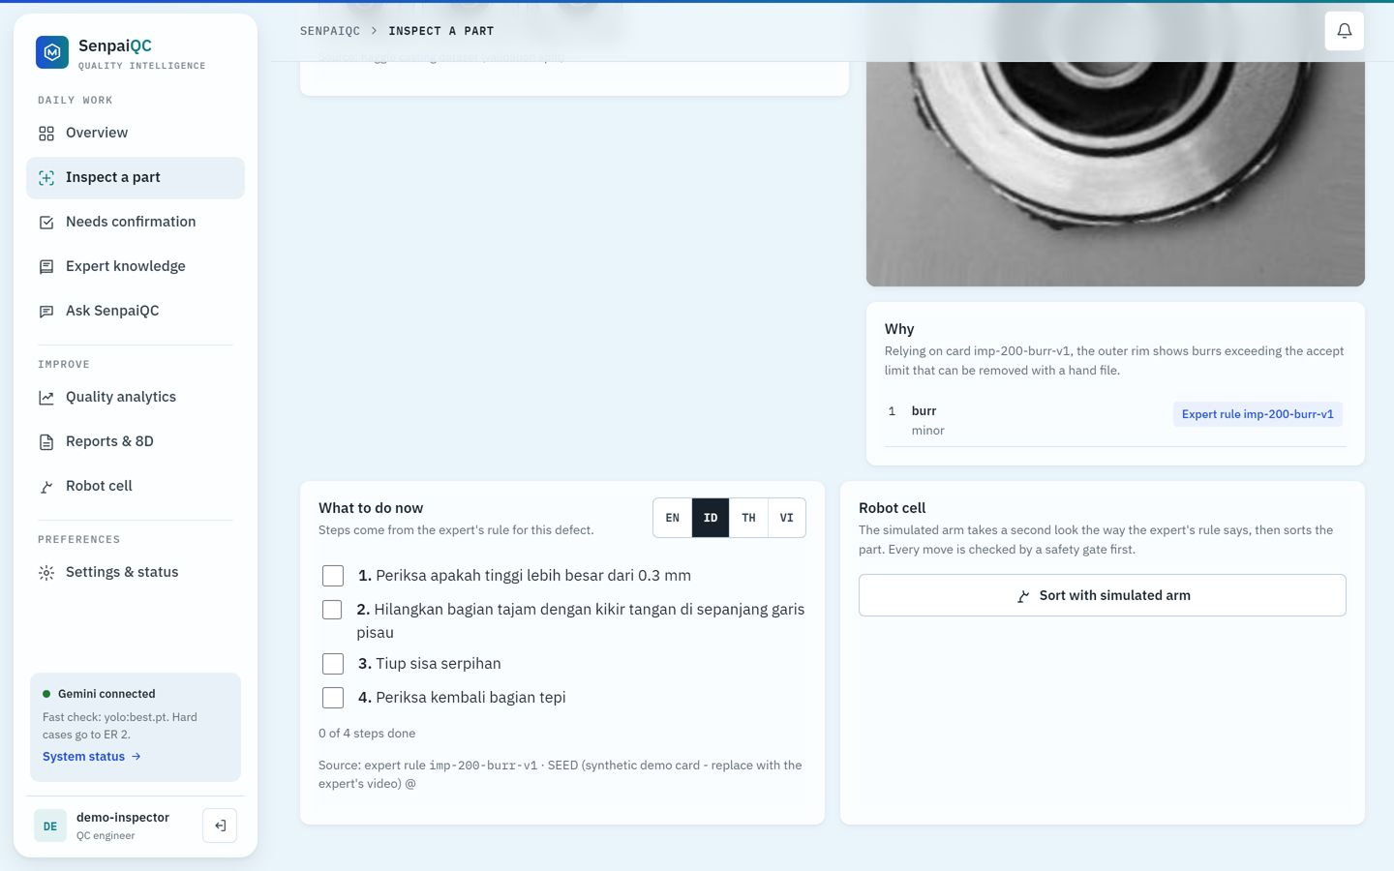
Wireframes / mock diagrams of the proposed solution
Gemini decision: defect circled, rule cited
Rework steps in the operator's language
Phone at the line: one-tap inspect
Notes:
The prototype is built, so these are real screens.

Slide 7
Architecture diagram of the proposed solution
Shop floor
Cloud Run (one service)
Google AI
Google Cloud data
Browser
phone or laptop
FastAPI web + API
Teach · Inspect · Act · Learn · Ask
Gemini Robotics ER 2
points + cites rule
Firestore
rules, decisions, 8D
YOLO11n
CPU fast path
Policy
escalate?
Gemini on Vertex AI
3.5 Flash-Lite: video, steps, Q&A, fallback
Cloud Storage
photos, videos (signed URL)
Hexagonal design: models and stores sit behind ports, so ER 2 falls back to Flash-Lite automatically.
Safety gate
robot calls
SO-101 sim
3D replay
ADK agent
root cause, read-only SQL
BigQuery
every inspection event
AI budget · CSP · auth
Operations
Pub/Sub
spike alerts, OIDC push
Telegram / Chat
QC team
Secret Manager
keys, tokens
Cloud Build
+ Artifact Registry
Notes:
One Cloud Run service; Gemini on Vertex AI and ER 2; ADK agent; Firestore, Storage, BigQuery; Pub/Sub alerts; Secret Manager.

Slide 8
Technologies to be used in the solution
Google AI
Gemini Robotics ER 2 · Gemini 3.5 Flash-Lite on Vertex AI · Agent Development Kit (ADK) · google-genai SDK
Google Cloud (11)
Cloud Run · Cloud Build · Artifact Registry · Vertex AI · Gemini API · Firestore · Cloud Storage · BigQuery · Pub/Sub · Secret Manager · IAM Credentials
Vision
Ultralytics YOLO11n-cls on CPU (PyTorch CPU) · OpenCV
Backend
Python 3.12 · FastAPI · Pydantic · hexagonal architecture with vertical slices · python-docx (8D export)
Frontend
React + Vite + TypeScript · mobile-first web app · Three.js 3D robot replay
Alerts
Pub/Sub push with OIDC → Telegram Bot API / Google Chat webhook
Quality & data
pytest (45 tests, no keys) · eval/run_all.py · Kaggle casting dataset · synthetic process history
Notes:
Google AI, eleven Google Cloud services, and the open-source stack.

Slide 9
Estimated implementation cost
Action (measured on the live service) | Gemini cost
Easy part, YOLO fast path | $0
Hard part, escalated to Gemini on Vertex AI | $0.001–0.002
Teach video (2 min) → 4 rule cards | $0.005
Ask SenpaiQC question | $0.0008–0.0016
Root cause + 8D draft | $0.027
Per 1,000 parts (golden set, 1% escalated) | $0.07
≈ $6 / month
Gemini for one line, 3 shifts × 5,000 parts, 1% escalated (projection, not measured in a plant)
$2–3 total
Demo and judging period, capped by a daily AI budget and one Cloud Run instance
No new hardware
Cloud Run scales to zero; Firestore, BigQuery, Storage and Pub/Sub stay near their free tiers at one-line volume (estimate). Region us-central1, the lowest-price tier.
A phone or tablet and a browser; a robot arm is optional
Notes:
Measured cost per action and a labelled projection per line.

Slide 10
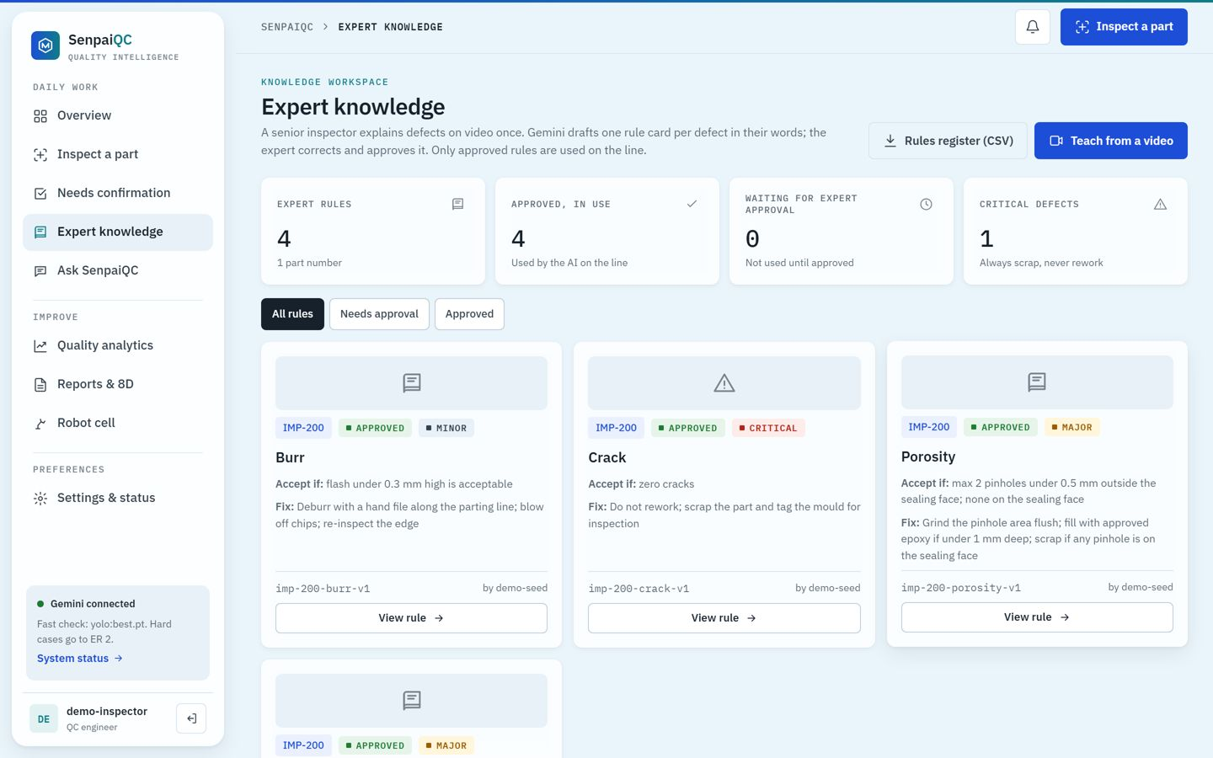
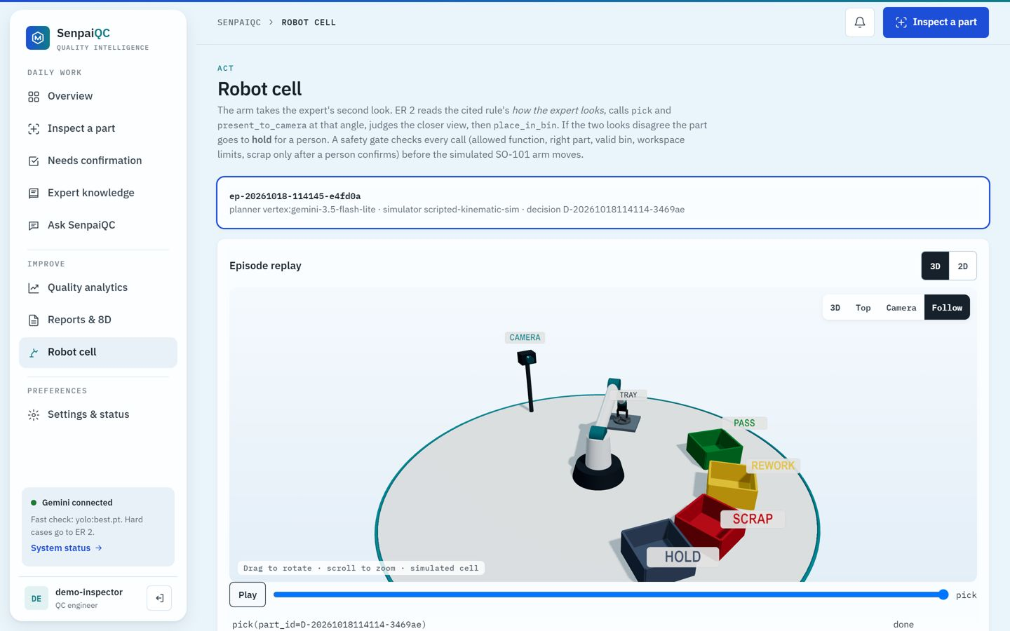
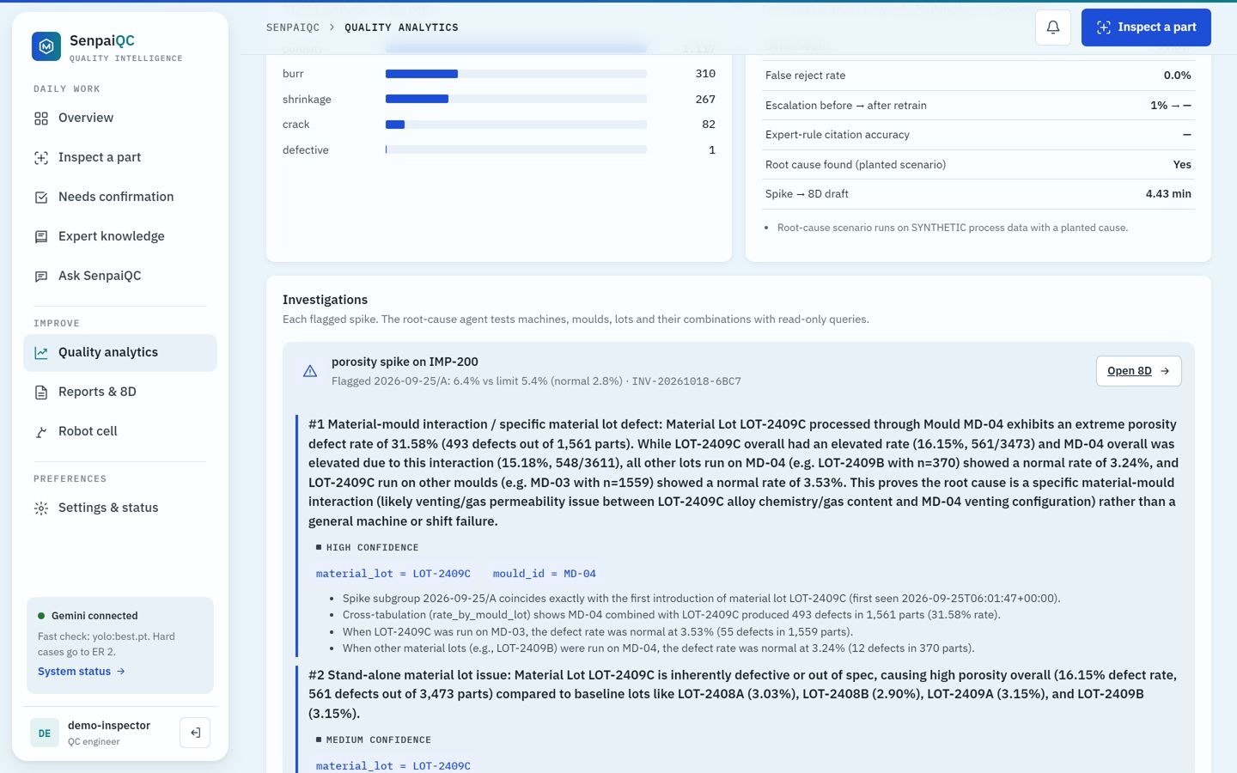
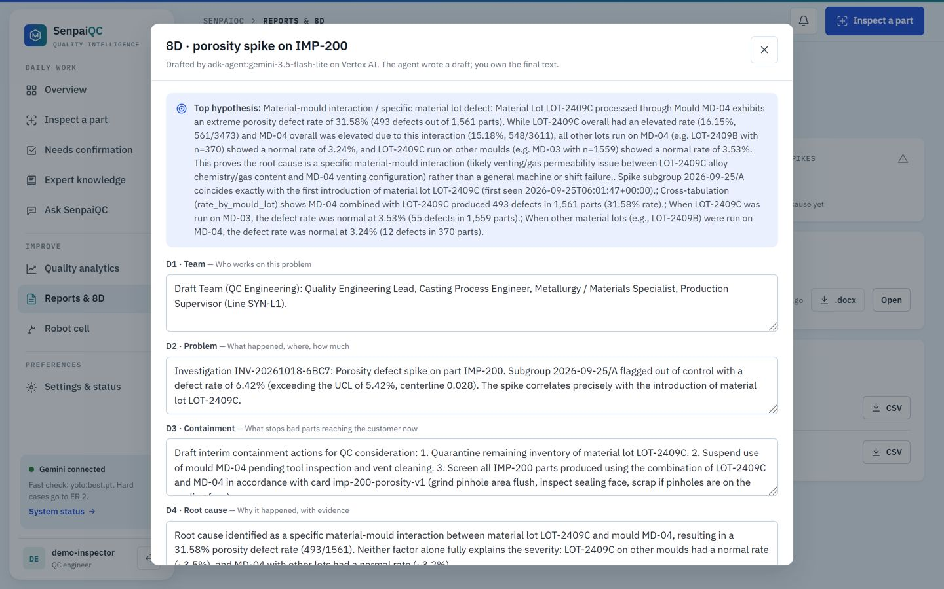
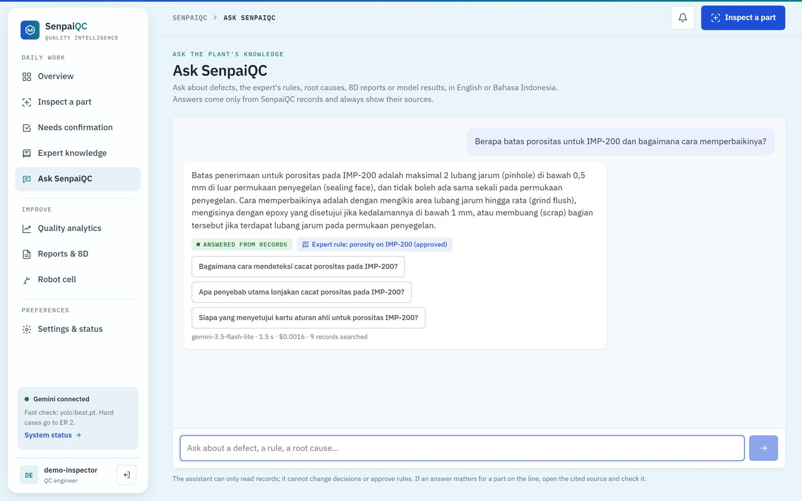
Snapshots of the prototype
Teach: approved rule cards
Inspect: Gemini cites the rule
Act: simulated robot cell
Learn: ADK root cause
8D draft, export .docx
Ask, in English or Bahasa Indonesia
Notes:
Live at senpaiqc-568251697792.us-central1.run.app.

Slide 11
Prototype performance report / benchmarking
99%
0%
171 ms
$0.07
defect recall
false rejects
p95, YOLO fast path
Gemini per 1,000 parts
Held-out golden set: 200 images (100 good, 100 defective) from the test split, never used for training. 99% decided by YOLO on CPU; 1% escalated to Gemini.
Live benchmark (Cloud Run + Vertex AI) | Result | Time | Gemini cost
Teach video 1:58 → rule cards | 4/4 defects, 24/24 fields correct | 9.4 s | $0.005
Hard part escalated to Gemini | Rework, approved rule cited | 1.4–3.3 s | $0.001–0.002
Root cause on the planted scenario (synthetic) | MD-04 + LOT-2409C, 8D drafted | ≈30 s | $0.027
Ask SenpaiQC in Bahasa Indonesia | Correct limit, rule cited | 1.3 s | $0.0008
Spike alert via Pub/Sub | Delivered to Telegram, retried on failure | seconds | $0
Honest limits: the Gemini path saw only 2 golden-set parts (its one pass on a defective part was the only miss); rule cards and process data are illustrative or synthetic; the robot is simulated.
Notes:
Golden set metrics and live benchmarks, with limits.

Slide 12
Additional details / future development
Next 3 months
Next 6–12 months
Pilot at one casting SME (Ceper, Klaten): real inspector video, real photos, real inspection log.
Measure what is designed: rule-citation accuracy, escalation drop after retraining.
Harder test set: blurred, angled and new parts.
Every escalated pass to a person until citation accuracy is proven.
More processes: stamping, moulding, machining; only the rules change.
Real robot: LeRobot SO-101, then a real arm on the same safety gate.
Fully multilingual interface for operator screens.
Multi-line scale: events through Pub/Sub, Firebase Auth per plant.
Data residency in Jakarta (asia-southeast2); edge YOLO for weak connectivity.
Expected impact (to measure in the pilot): every part checked the same way on every shift, the expert's judgment kept after they retire, spike to 8D in minutes, AI spend in cents per shift.
Notes:
Pilot first, then scale across processes and lines.

Slide 13
Provide links to your:
GitHub Public Repository
https://github.com/keane13/SenpaiQC
Demo Video Link (3 Minutes)
[to insert: YouTube / Google Drive link]
Final Product Link
https://senpaiqc-568251697792.us-central1.run.app
Sign in: choose a role and paste the access token given in the submission notes.
Notes:
GitHub, demo video and the live product.

Slide 14


