Slide 1
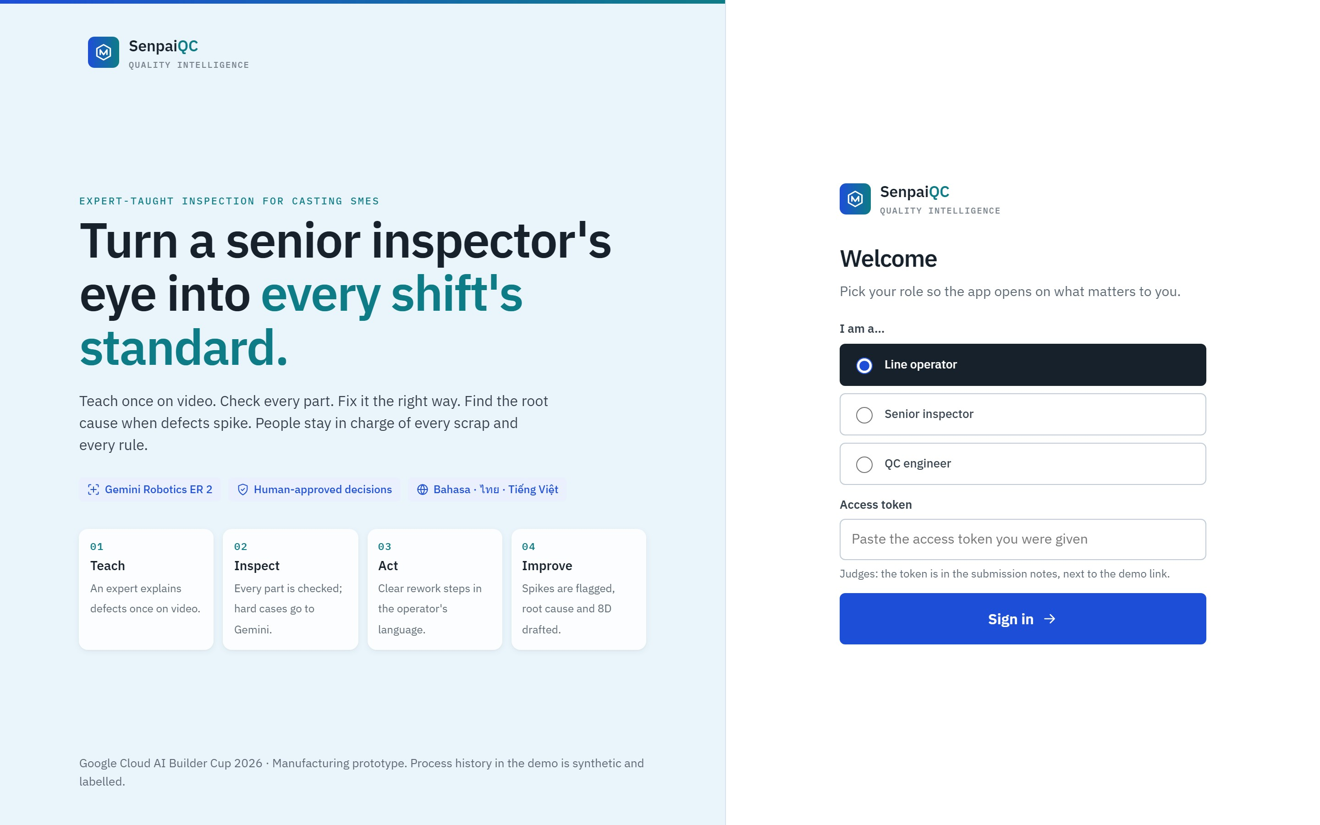
SenpaiQC
GOOGLE CLOUD AI BUILDER CUP 2026
Turn a senior inspector's eye into every shift's standard
Teach once on video. Check every part. Fix it the right way.
An expert-taught inspection cell for casting SMEs.
Notes:
Hi, I'm Simon. This is SenpaiQC: it turns a senior inspector's eye into every shift's standard.

Slide 2

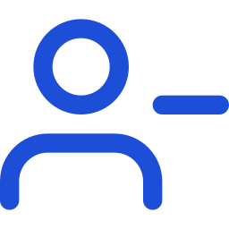


Quality depends on who is on shift
THE PROBLEM
Inconsistent shifts
Expertise walks out
Vision AI is out of reach
Escapes cost days
Manual visual checks. A tired or new inspector lets defects through or scraps good parts.
A senior inspector's judgment is never written down and leaves when they retire.
Thousands of labelled images per part number, plus an integrator. SMEs launch new parts often.
A defect at the customer means sorting, chargebacks and an 8D report that takes days to compile.
Notes:
In casting plants across Southeast Asia, quality depends on who is on shift. Expert judgment retires with the expert, vision AI needs thousands of labels, and every escape costs days of 8D work.

Slide 3





One closed quality loop, with a person in charge
THE SOLUTION
Teach
Inspect
Act
Learn
Improve
Expert video becomes rule cards
YOLO first, Gemini for hard parts
Rework steps or a robot sort
Spike found, root cause, 8D
Confirmed cases retrain YOLO
AI only where judgment is needed. Statistics and plain code do the rest, and a person signs off every scrap and every rule.
Notes:
SenpaiQC closes the loop: Teach, Inspect, Act, Learn and Improve. AI only where judgment is needed, and a person signs off every scrap and every rule.

Slide 4
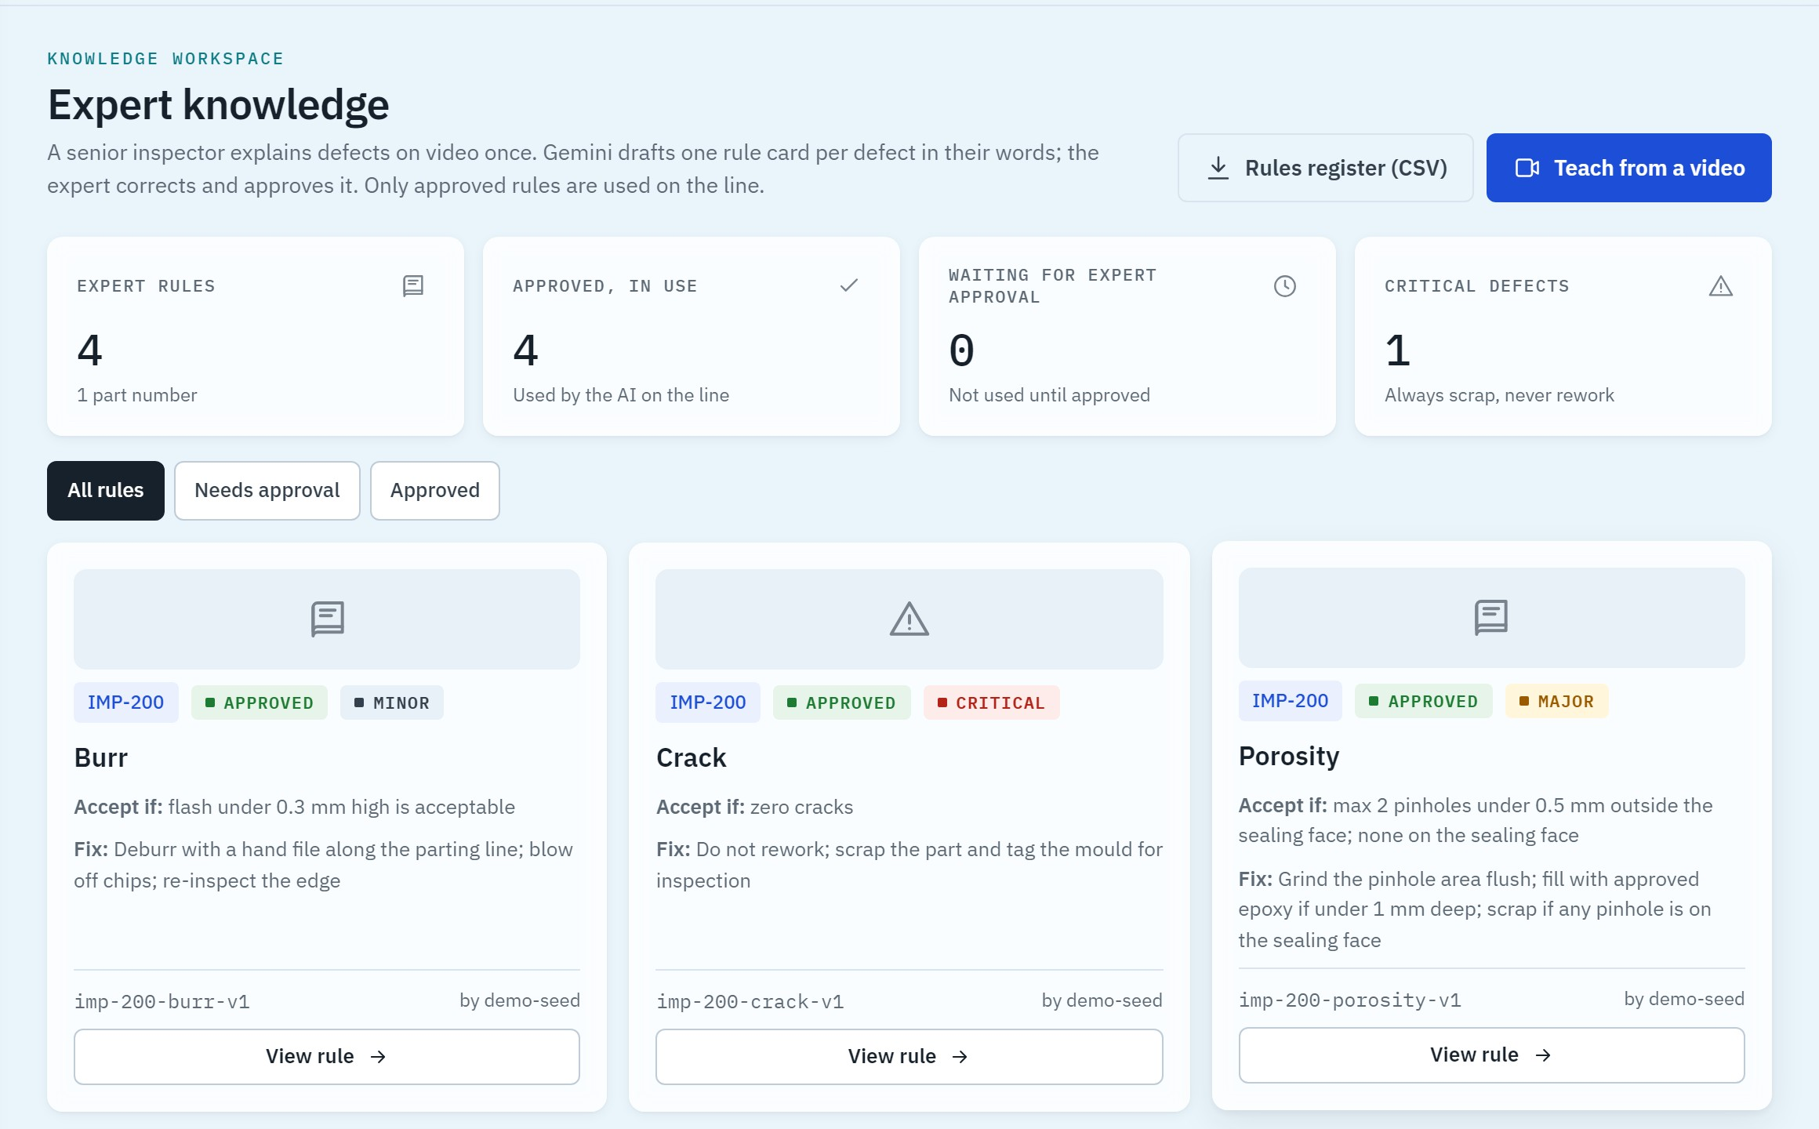
The expert teaches once, on video
01 · TEACH
1
Narrated video
Up to 10 minutes, uploaded straight to Cloud Storage
2
Gemini drafts rule cards
Look, accept limit, fix and video timestamp, in the expert's words
3
Expert approves
Drafts never reach the line
Notes:
A senior inspector records a short narrated video. Gemini on Vertex AI drafts rule cards: the look, the accept limit and the fix. Nothing reaches the line until the expert approves it.

Slide 5
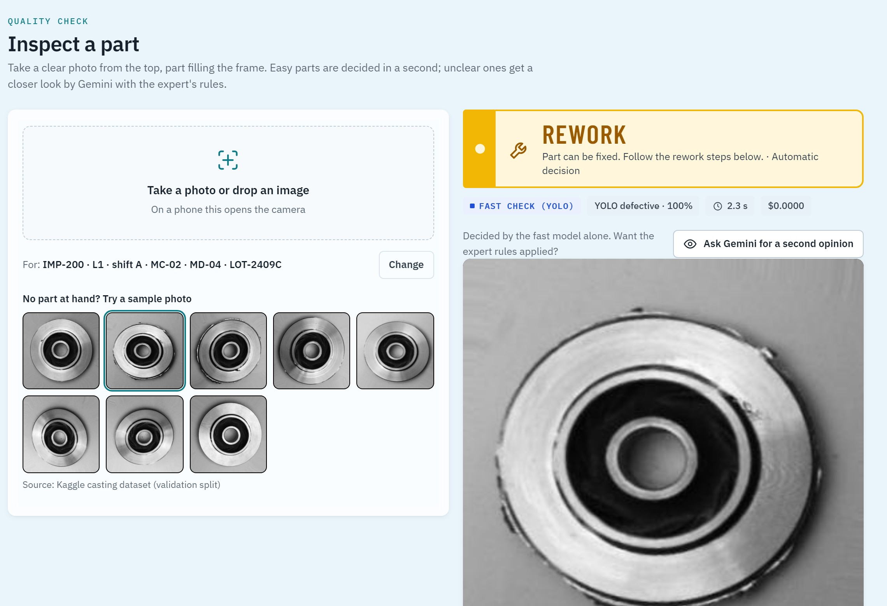
Easy parts are decided in a second, on CPU
02 · INSPECT
1
Phone photo
Or a sample part; the line context is remembered
2
YOLO fast path
Confident parts never leave the server: about 1 s, $0
3
99% of parts
Handled by the fast path on 200 held-out images
Notes:
The operator takes a photo. YOLO on CPU decides the easy parts in about a second, at zero AI cost. That was 99 percent of parts in our test.

Slide 6
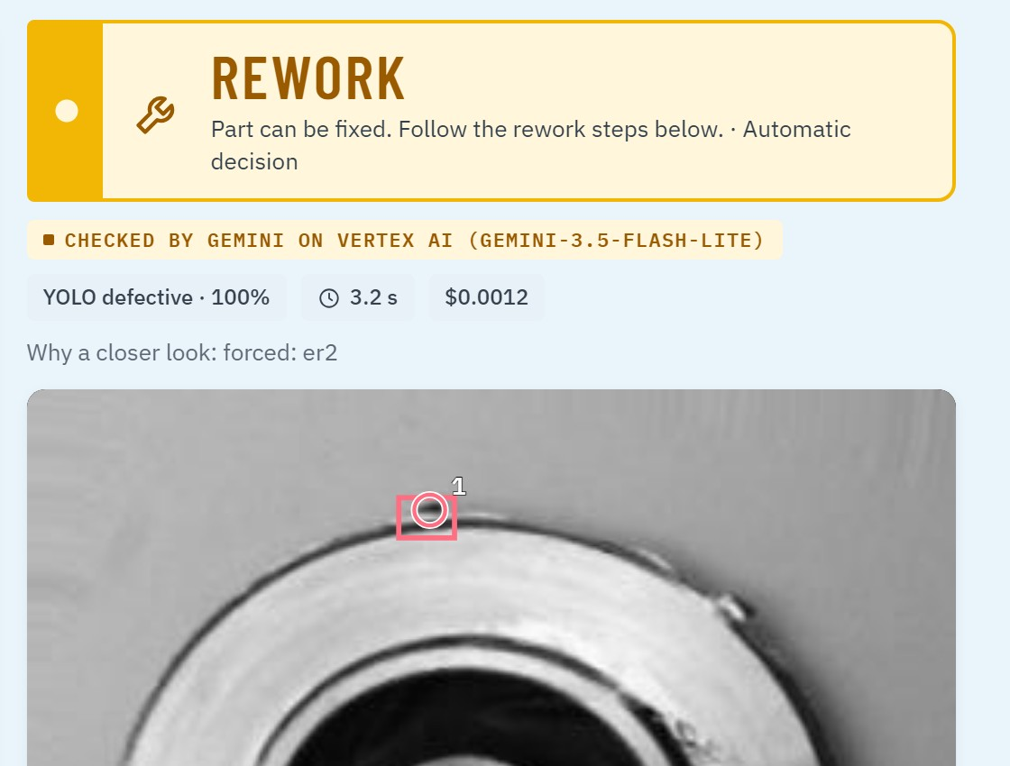
Hard parts go to Gemini, with evidence
02 · INSPECT
1
Points at the defect
Marked on the photo, so a person can check it
2
Cites the expert rule
Here: imp-200-burr-v1, approved by the expert
3
About 3 s, $0.001
Gemini on Vertex AI; ER 2 when its key has credit
Notes:
Hard or new parts go to Gemini. It circles the defect and cites the expert rule it used, so the inspector can check its reasoning. Three seconds, a tenth of a cent.

Slide 7
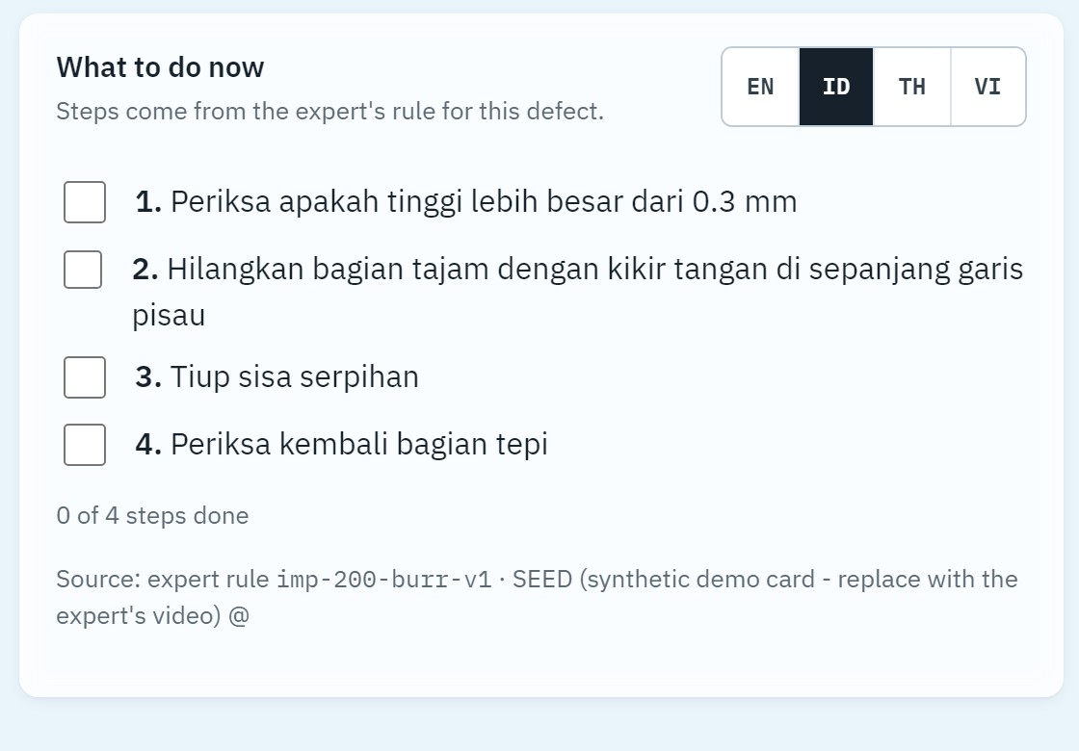
Fix steps in the operator's own language
03 · ACT
1
From the expert's rule
Steps come from the cited card, not invented
2
Four languages
English, Bahasa Indonesia, Thai, Vietnamese
3
Scrap needs a person
A second tap, and it waits in the confirm queue
Notes:
The decision becomes the expert's rework steps, in the operator's language: English, Bahasa Indonesia, Thai or Vietnamese. Scrap always needs a person.

Slide 8
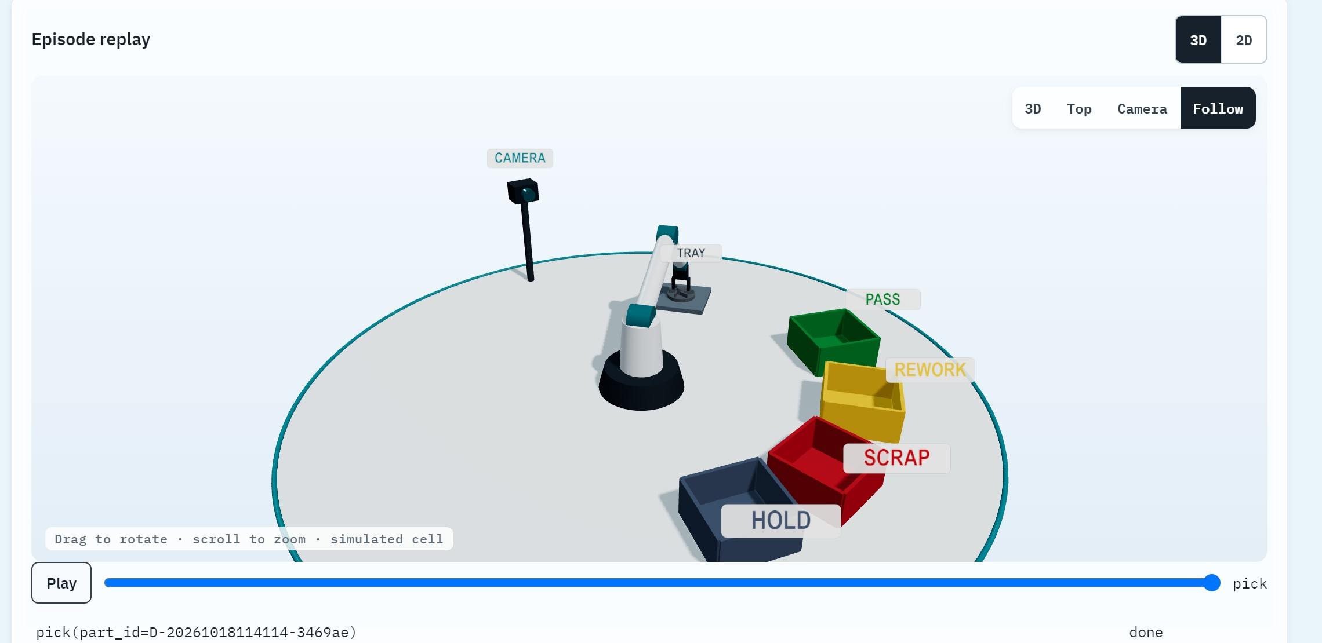
Or the same decision drives a robot arm
03 · ACT
Simulated SO-101: Gemini plans each move, a safety gate checks it, doubts go to HOLD.
Notes:
The same decision can drive a robot. In our simulated SO-101 cell, every move passes a safety gate, and any doubt sends the part to the hold bin.

Slide 9
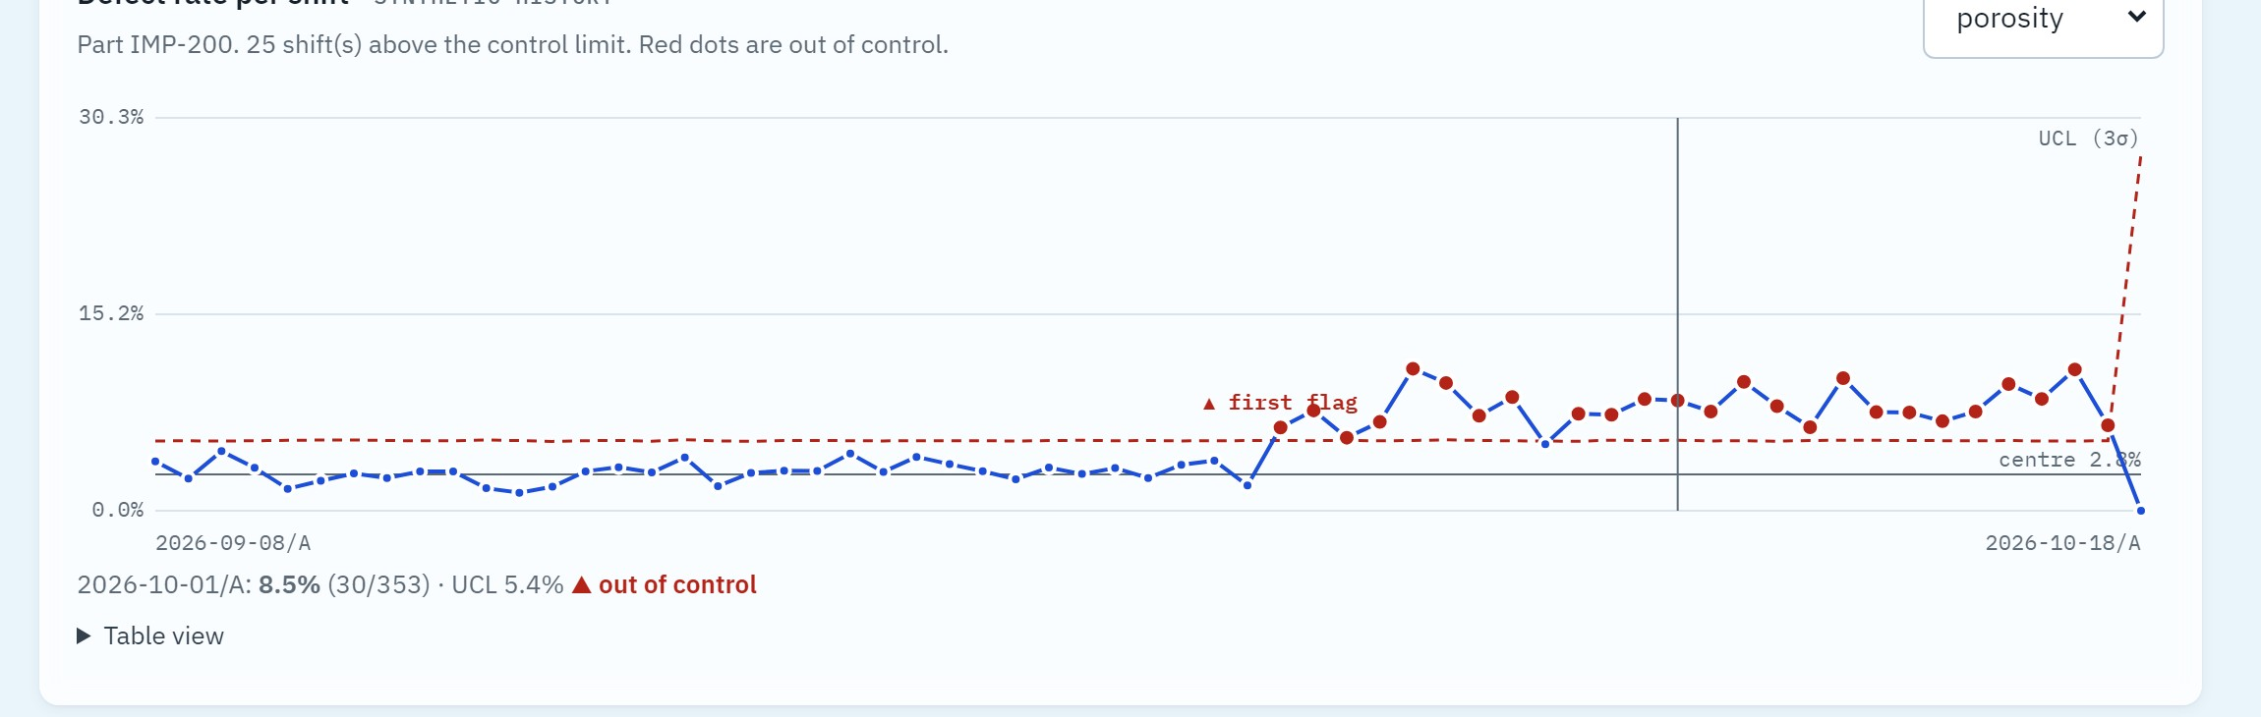
A p-chart in BigQuery flags the spike
04 · LEARN
Plain 3σ statistics, no AI. Process history in the demo is synthetic, with one cause planted on purpose.
Notes:
Every decision lands in BigQuery, and a plain three-sigma p-chart flags spikes. This process history is synthetic, with one planted cause.

Slide 10
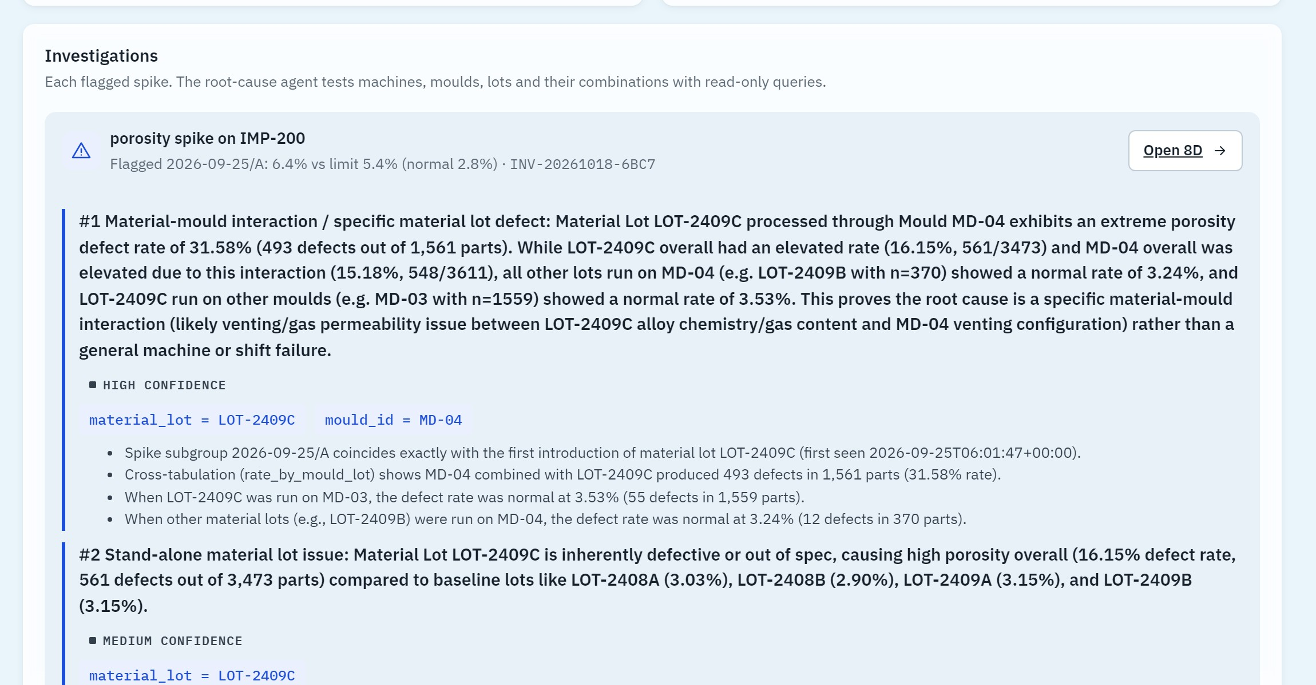
An ADK agent finds the root cause in 30 s
04 · LEARN
Read-only SQL templates only. Named mould MD-04 + lot LOT-2409C, the planted cause, for under 3 cents.
Notes:
One click, and an ADK agent queries BigQuery through read-only templates. In thirty seconds, for under three cents, it found mould MD-04 with lot LOT-2409C: the planted cause.

Slide 11
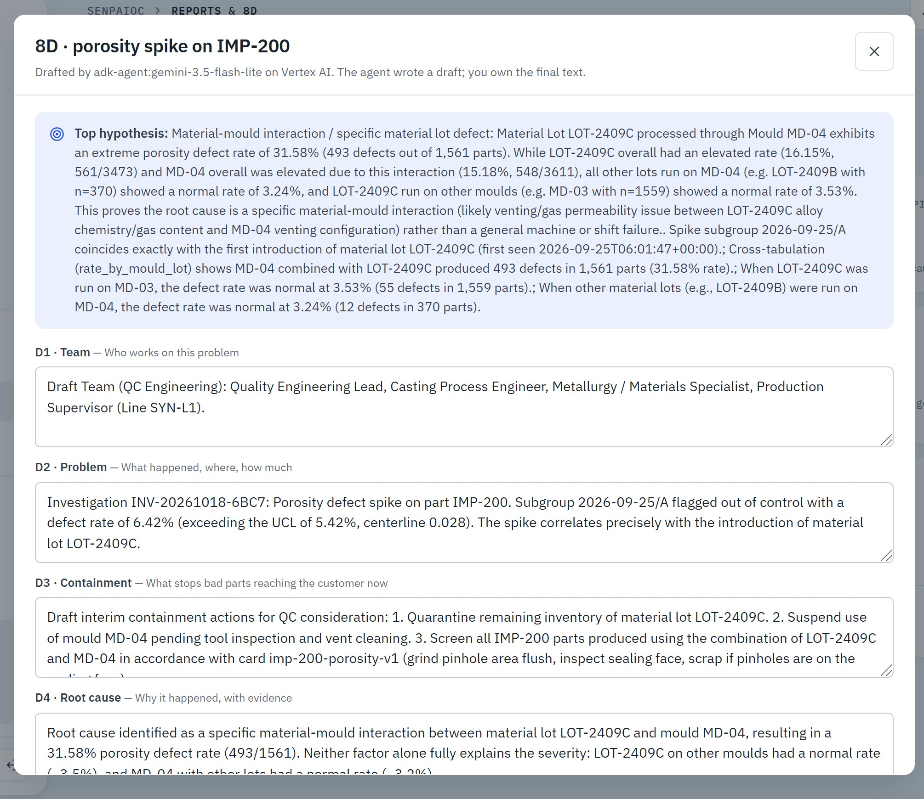
The 8D draft is ready for the engineer
04 · LEARN
1
D1 to D8 pre-filled
From the agent's evidence and the expert's rules
2
The engineer owns it
Edit, approve, keep the audit trail
3
Google Docs or Word
One-click .docx export for the customer
Notes:
It drafts the 8D report. The engineer edits, approves and exports it to Google Docs or Word: minutes instead of days.

Slide 12
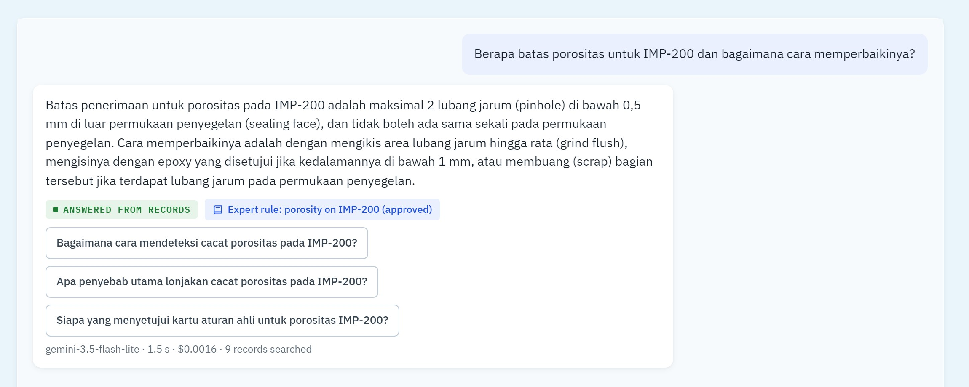
Answers only from the plant's own records
ASK SENPAIQC
Asked in Bahasa Indonesia, answered in 1.5 s with the source cited. No source, no answer.
Notes:
Anyone can ask SenpaiQC in their own language. Answers come only from the plant's records, with citations, or it says not found.

Slide 13
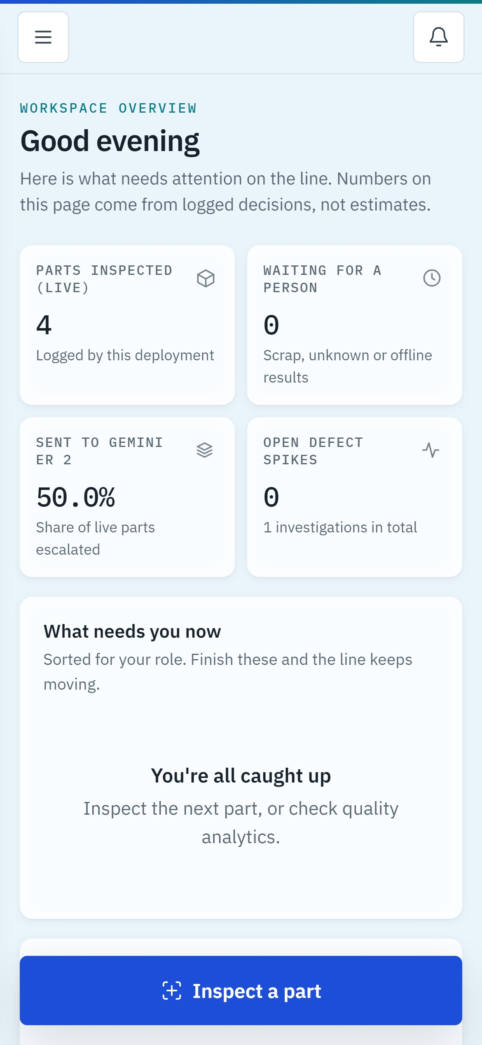
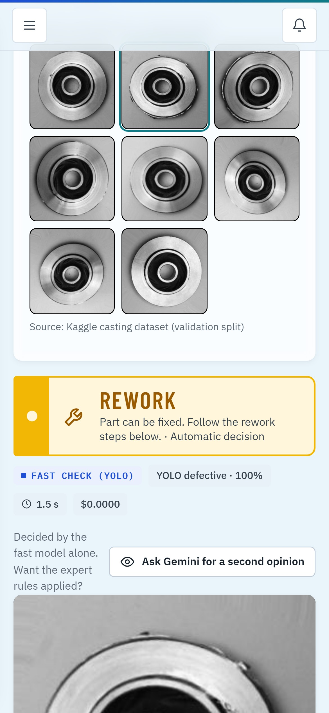
A phone at the line, a laptop in the QC office
ON THE LINE
1
Any browser
No app install, no new hardware
2
Role-aware
Operators see the next part; engineers see spikes
3
One Cloud Run URL
Scales to zero when the line is idle
Notes:
It all runs in a browser: a phone at the line, a laptop in the QC office. No install, no new hardware.

Slide 14



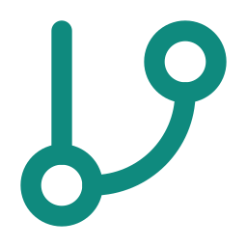



One Cloud Run service on Google Cloud
ON GOOGLE CLOUD
Cloud Run
FastAPI · YOLO11n on CPU · escalation policy · robot safety gate · AI budget
Gemini on Vertex AI
Flash-Lite · Robotics ER 2 via API key
Browser
Phone or laptop
ADK root-cause agent
Read-only SQL templates
Pub/Sub alerts
Spike to Telegram or Google Chat
Firestore · Storage · BigQuery
Rules, photos, every decision
Secret Manager
No keys in code or image
Notes:
It's one Cloud Run service with Gemini on Vertex AI, an ADK agent, Firestore, Cloud Storage and BigQuery. A new spike goes through Pub/Sub to the QC team's Telegram or Google Chat, and secrets live only in Secret Manager.

Slide 15

Measured on 200 held-out images
RESULTS
99%
0%
171 ms
$0.07
defect recall
false rejects
p95, YOLO fast path
Gemini per 1,000 parts
Honest limits. Rule cards and process history in this demo are synthetic; the robot is simulated; the Gemini path is measured on only 2 golden-set parts. Next: one real expert video and one real plant log.
Notes:
On 200 held-out images: 99 percent recall, zero false rejects, 171 milliseconds, and seven cents per thousand parts. Honestly, the demo's rules and process data are synthetic, and the robot is simulated.

Slide 16
Teach once. Inspect every part. Fix it right.
TRY IT LIVE
senpaiqc-568251697792.us-central1.run.app
Access token in the submission notes
Notes:
SenpaiQC: teach once, inspect every part, fix it right. Try it at the link on screen. Thank you.

