Slide 1
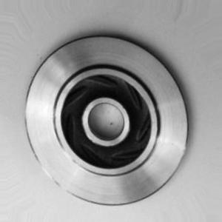
Four casting defects on the impeller
Part IMP-200
When a part passes, goes to rework, or is scrapped. Explained by a senior QC inspector.
GOOD PART smooth hub, no dark spots
Images: Kaggle casting dataset (illustrative)
Notes:
[0:00-0:15] OPENING
"I'm [name], a QC inspector. This is part IMP-200, a cast impeller. I'll walk through the four most common defects, and when a part passes, needs rework, or must be scrapped. This is a good part: the hub surface is smooth, with no dark spots."

Slide 2
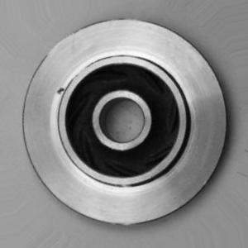
porosity
REWORK
scrap if on the sealing face
CUES
Round pinholes; clusters of small dark dots; dull spots near the hub
LOCATION
Hub and blade root
HOW TO LOOK
Tilt 30° so light rakes across the hub: dark dots with a bright rim
ACCEPT LIMIT
Max 2 pinholes under 0.5 mm outside the sealing face; none on it
FIX
Grind flush; fill with approved epoxy if under 1 mm deep
Defect 1 of 4 · example dataset image
Notes:
[0:15-0:50] POROSITY
"First defect: porosity. You see round pinholes, clusters of small dark dots, or dull spots near the hub. It usually shows up at the hub and the blade root. To see it, tilt the part about 30 degrees so the light rakes across the hub surface. The pinholes show as dark dots with a bright rim. The limit: at most 2 pinholes under 0.5 millimetres outside the sealing face, and none at all on the sealing face. This is rework: grind the area flush, and fill it with approved epoxy if it is less than 1 millimetre deep. If any pinhole is on the sealing face, scrap the part."
(Point at the small dots on the left side of the rim.)

Slide 3
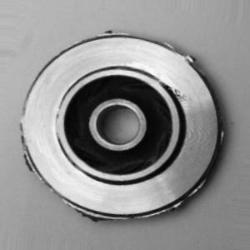
shrinkage
REWORK
weld repair
CUES
Irregular, jagged cavity; branch-like texture inside; sunken surface
LOCATION
Thick sections at the hub
HOW TO LOOK
Tilt 45° toward the light and look into the thick hub section
ACCEPT LIMIT
No visible shrinkage cavity on machined faces
FIX
Mark the cavity; weld repair; re-machine and re-inspect
Defect 2 of 4 · example dataset image
Notes:
[0:50-1:20] SHRINKAGE
"Second: shrinkage. The cavity is irregular and jagged, with a branch-like, dendritic texture inside, and the surface looks sunken. It forms in the thick sections at the hub. Tilt the part 45 degrees toward the light and look into the thick hub section. The limit: no visible shrinkage cavity on any machined face. This is rework: mark the cavity, send it to weld repair, re-machine it, and inspect it again."

Slide 4
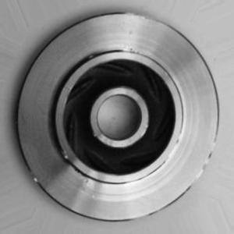
crack
SCRAP
never rework
CUES
Thin dark line that follows a blade edge or the outer rim
LOCATION
Blade edges and outer rim
HOW TO LOOK
Rotate -20° and follow each blade edge and the rim under low-angle light
ACCEPT LIMIT
Zero. No tolerance
FIX
Scrap the part; tag the mould for inspection
Defect 3 of 4 · example dataset image
Notes:
[1:20-1:50] CRACK
"Third, and the most dangerous: crack. It is a thin dark line that follows a blade edge or the outer rim. Rotate the part about minus 20 degrees and follow each blade edge and the outer rim under low-angle light. The limit is zero, there is no tolerance. This is scrap. Do not rework it, and tag the mould for inspection."
(Point at the line on the lower-left of the rim.)

Slide 5
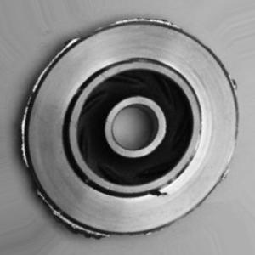
burr
MINOR
under 0.3 mm passes
CUES
Raised, rough edge; flash along the parting line
LOCATION
Outer rim and parting line
HOW TO LOOK
View edge-on at about 80° so raised flash stands out
ACCEPT LIMIT
Flash under 0.3 mm high is acceptable
FIX
Deburr with a hand file; blow off chips; check the edge again
Defect 4 of 4 · example dataset image
Notes:
[1:50-2:20] BURR
"Fourth: burr, or flash. You see a raised, rough edge, a thin fin of metal along the parting line of the mould, on the outer rim. View the part edge-on, at about 80 degrees, so the raised flash stands out against the background. Flash under 0.3 millimetres high is acceptable. Above that it is a minor defect: deburr it with a hand file along the parting line, blow off the chips, and re-inspect the edge."
(Point at the rough edge along the rim.)

Slide 6
When in doubt, hold the part
porosity
REWORK
shrinkage
REWORK
crack
Ask QC before the part moves on to the next process.
SCRAP
burr
MINOR
Notes:
[2:20-2:30] CLOSING
"Those are the four defects for IMP-200. When in doubt, hold the part and ask QC."

