Slide 1


Slide 2
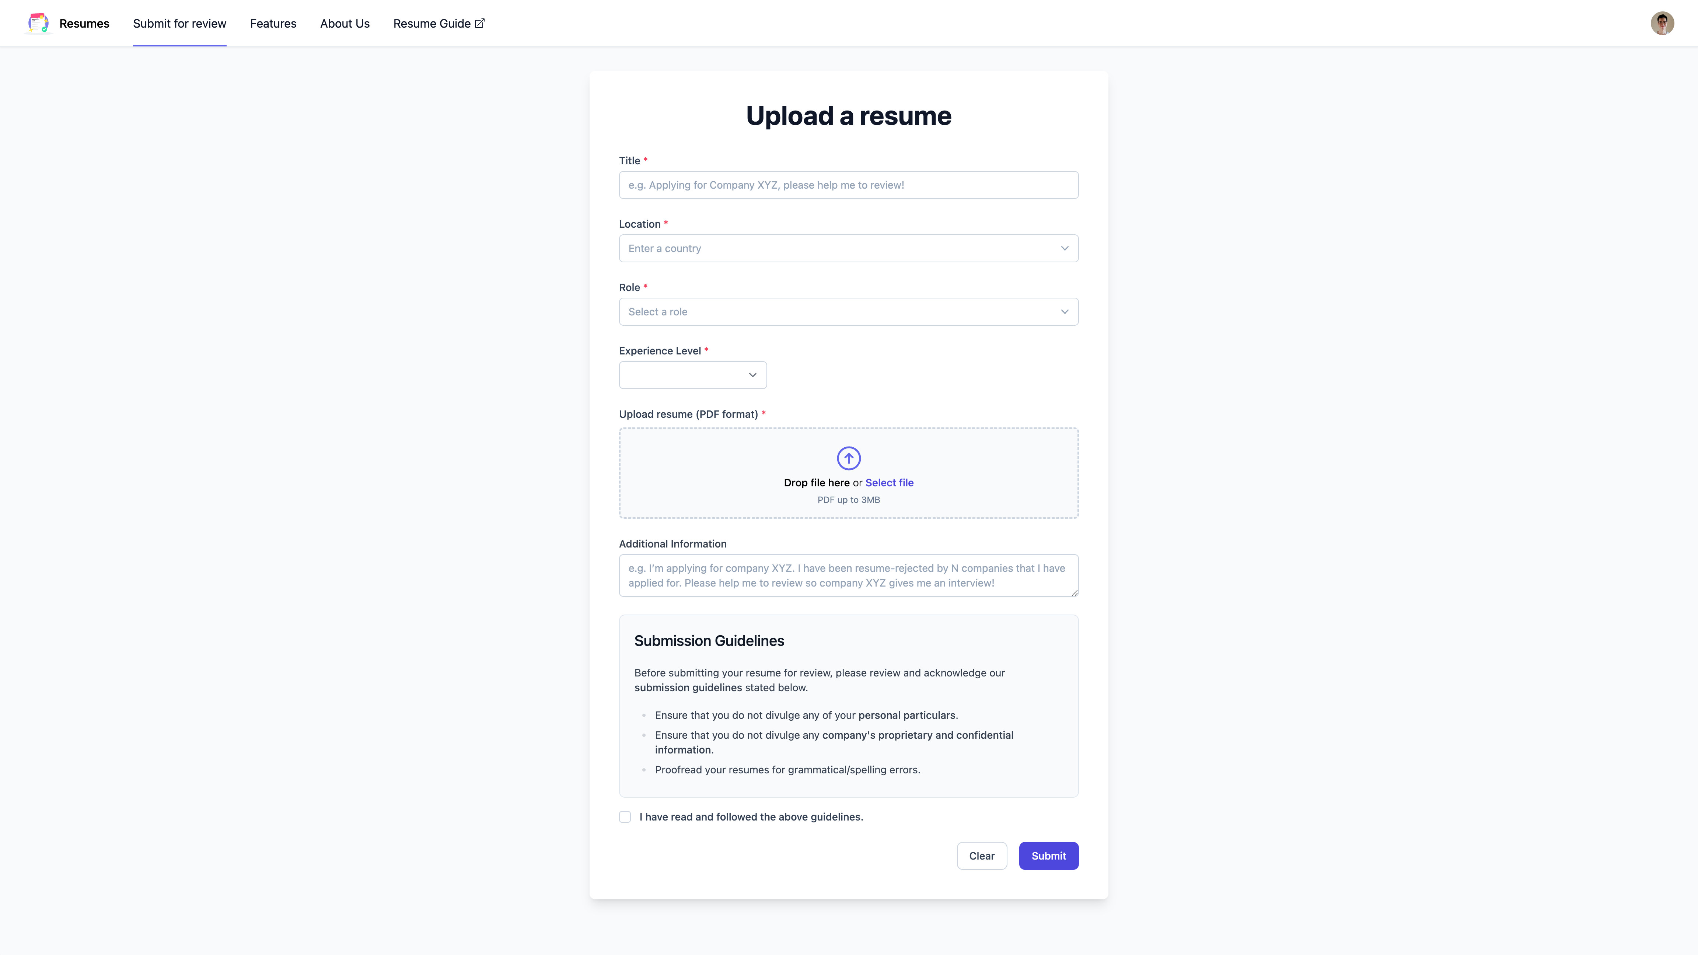
Submit your resume

Slide 3
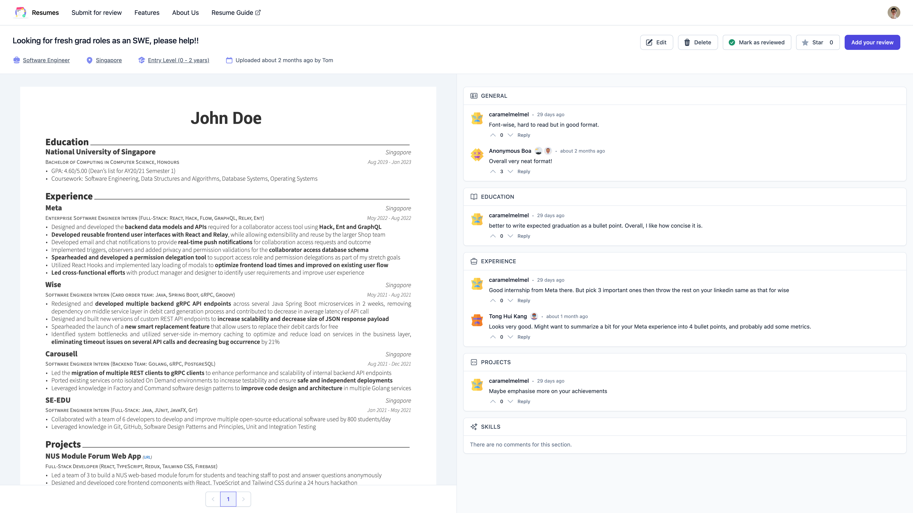
Get curated feedback on your resume

Slide 4
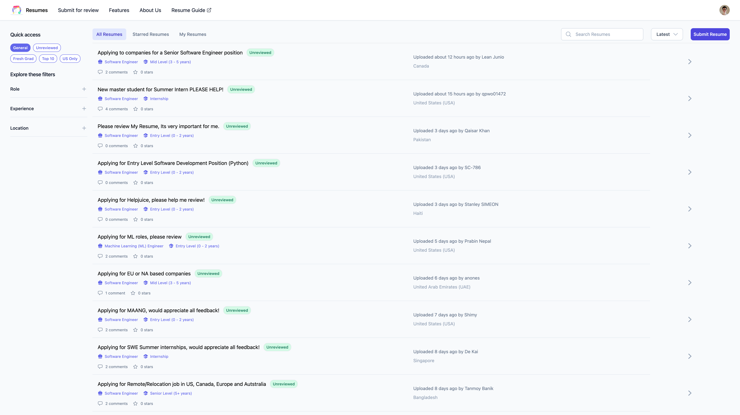
Browse other people’s resumes

Slide 5
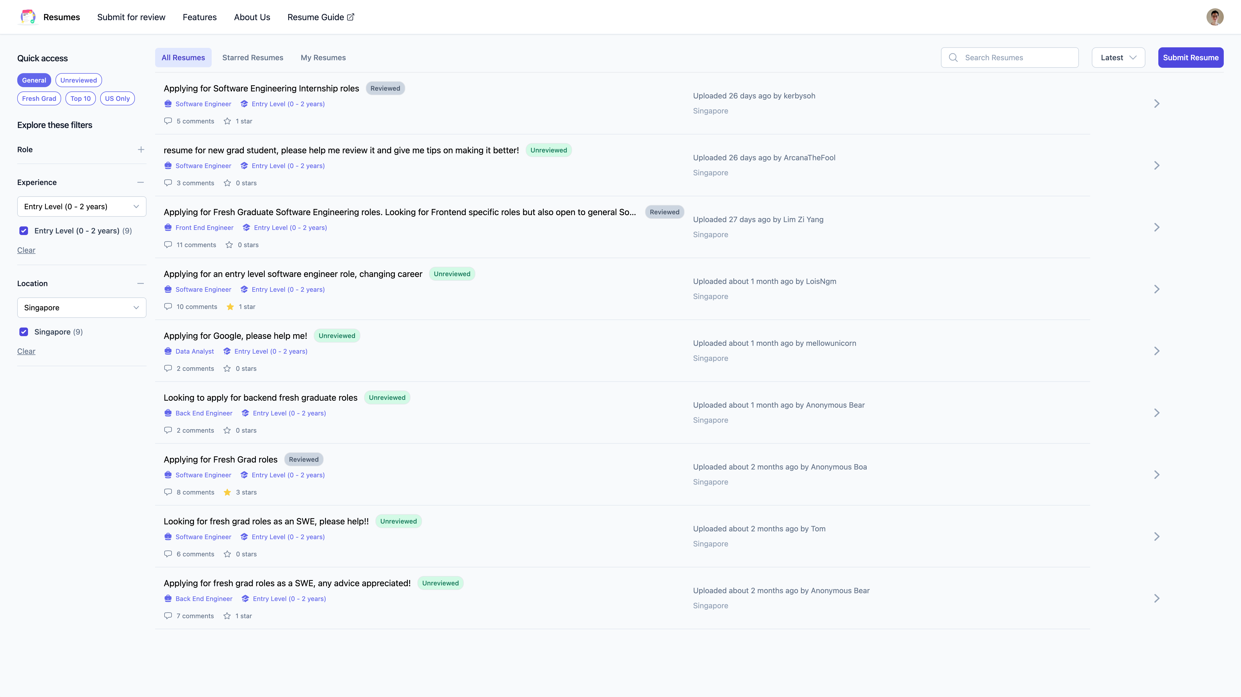
Apply filters to see relevant resumes

