Slide 1
Wildfire Prediction
Thanh Le, Keane Johnson, Laura Chutny
Notes:
Thanh

Slide 2
Project Wildfire
Calculate FWI Data
Fire Location (Lat, Long)
Prediction Tool
Collect Weather Data
Other Data (Terrain
Fire Area Spread
Notification to Response Team
Model
Assets Dataset
Notification to Assets Team

Slide 3
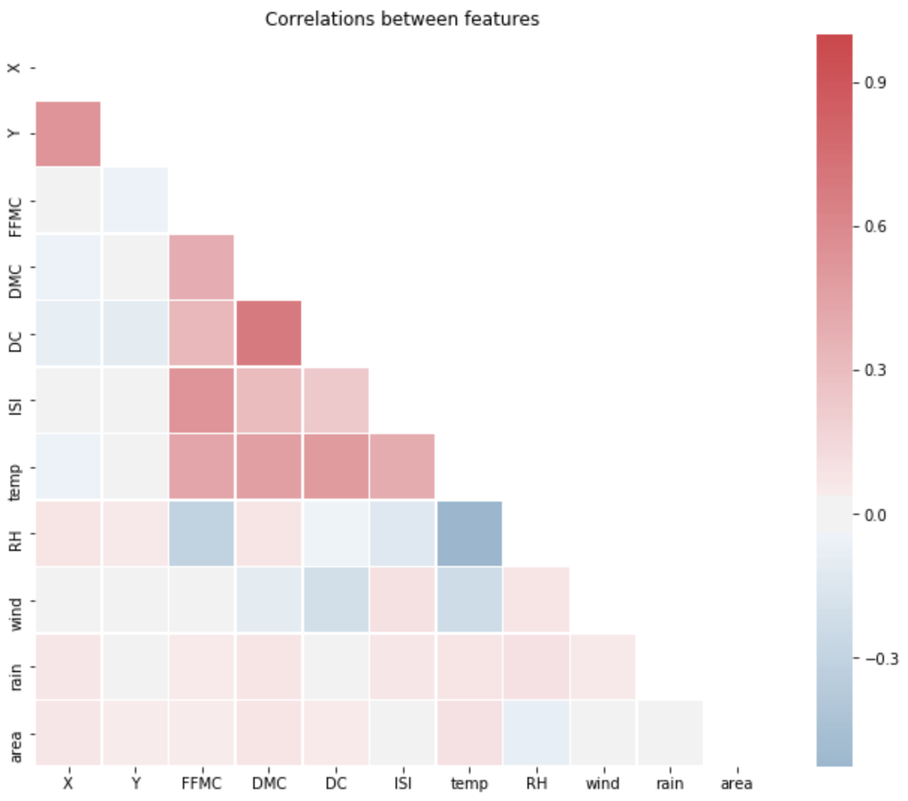
Correlations …
Notes:
- Checking correlations (DC and DMC is highly correlated)

Slide 4
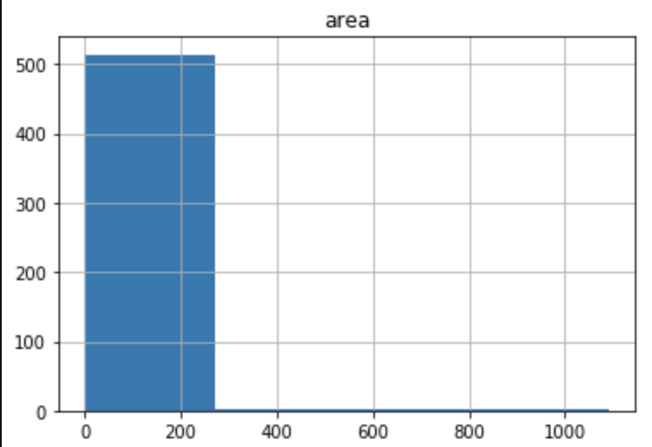
Dependent Variable
highly skewed

Slide 5
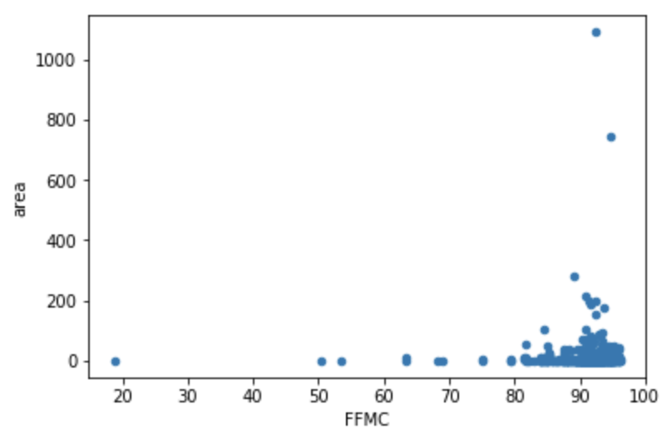
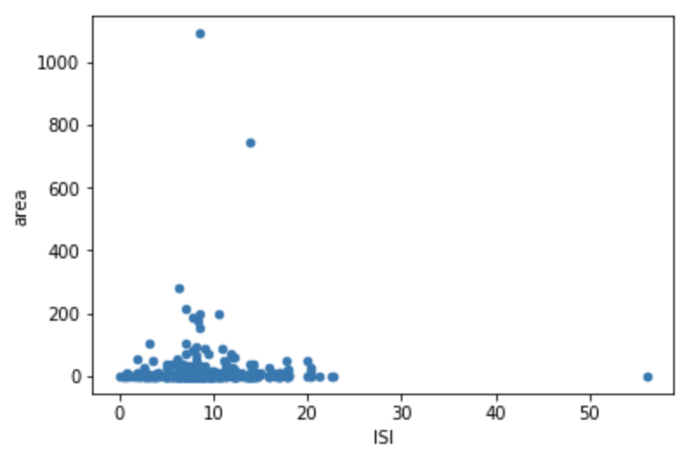
Independent Variables
Of the independent variables, these 2 (FFMC, ISI) show clustering
Fine Fuel Moisture Code (FFMC) - numeric rating of the moisture content of litter and other cured fine fuels. An indicator of the relative ease of ignition and the flammability of fine fuel.
Initial Spread Index (ISI) - numeric rating of the expected rate of fire spread. It combines the effects of wind and the FFMC on rate of spread without the influence of variable quantities of fuel.

