Slide 1
Wildfire Prediction
Thanh Le, Keane Johnson, Laura Chutny
Notes:
Thanh

Slide 2
Predict Assets at Risk from Wildfires
Using global data on past fires:
Ignition point
Start and end dates
Weather conditions (%RH/Temp/Wind/rain)
FWI (if available or calculate-able)
Predict Burned area size and geolocation
Overlay asset geolocations (transmission towers, buildings, gas plants)
Provide early warning of more exact at-risk locations (vs. current practice).
Determine possible warning period and indicate probability of burn

Slide 3
Project Wildfire
Calculate FWI Data
Other Data (Terrain
Weather Data for Location
Prediction Tool (predict burned area)
Fire Ignition Location (Lat, Long)
PREDICT: Fire Area Spread
Notification to Response Team
Model
Assets Dataset
Notification to Assets Team

Slide 4
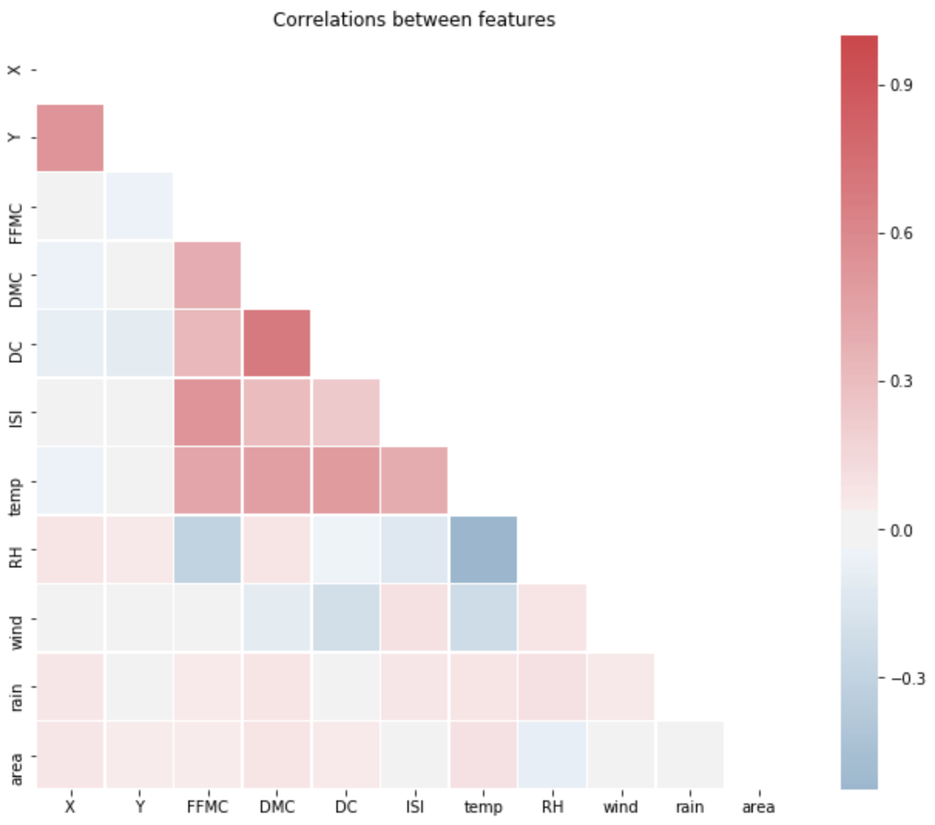
Correlations: Montesinho Data
Notes:
- Checking correlations (DC and DMC is highly correlated)

Slide 5
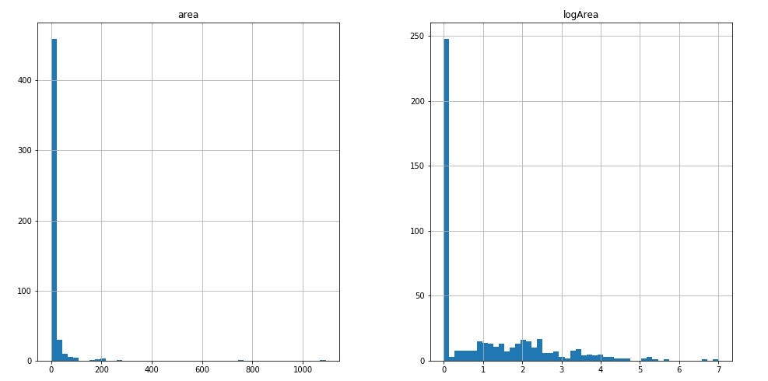
Dependent Variable
highly skewed

Slide 6
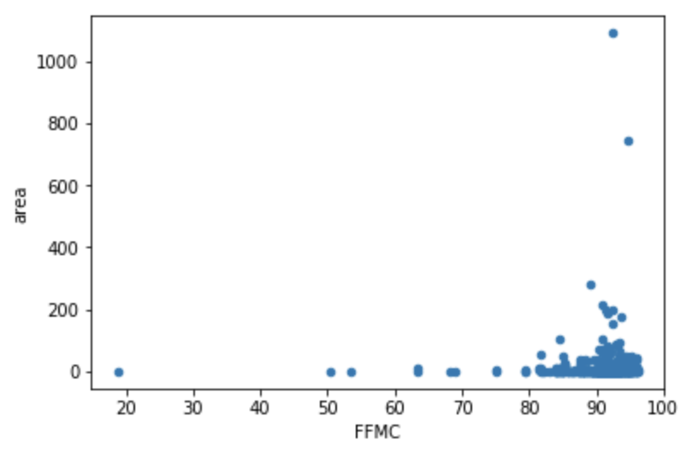
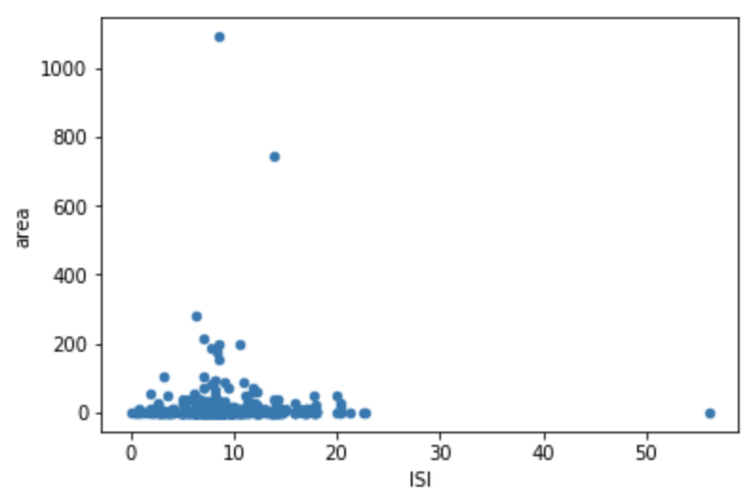
Independent Variables
Of the independent variables, these 2 (FFMC, ISI) show clustering
Fine Fuel Moisture Code (FFMC) - numeric rating of the moisture content of litter and other cured fine fuels. An indicator of the relative ease of ignition and the flammability of fine fuel.
Initial Spread Index (ISI) - numeric rating of the expected rate of fire spread. It combines the effects of wind and the FFMC on rate of spread without the influence of variable quantities of fuel.

