Slide 1
MOBEAST - Nutrients
Keanu Rochette

Slide 2
Load Libraries

Slide 3
Load Data

Slide 4
Data visualization theme

Slide 5
Data Clean Up

Slide 6
12PM Nutrient analysis
Iterative statistical modeling
Iterative graphing
Nitrate-Nitrite

Slide 7
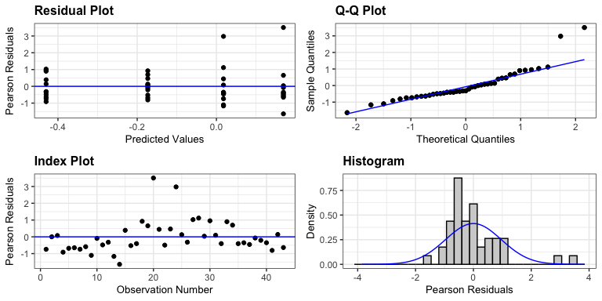
Linear mixed model fit by REML. t-tests use Satterthwaite's method [ lmerModLmerTest] Formula: conc_norm ~ treatment + (1 | tank_number) Data: df REML criterion at convergence: 75.7 Scaled residuals: Min 1Q Median 3Q Max -1.6385 -0.5563 -0.3186 0.4176 3.5046 Random effects: Groups Name Variance Std.Dev. tank_number (Intercept) 0.0000 0.0000 Residual 0.3195 0.5652 Number of obs: 43, groups: tank_number, 16 Fixed effects: Estimate Std. Error df t value Pr(>|t|) (Intercept) 0.01782 0.17042 39.00000 0.105 0.9173 treatmentCoral 0.15128 0.24697 39.00000 0.613 0.5437 treatmentCCA -0.19109 0.24101 39.00000 -0.793 0.4327 treatmentAlgae -0.44773 0.24101 39.00000 -1.858 0.0708 . --- Signif. codes: 0 '***' 0.001 '**' 0.01 '*' 0.05 '.' 0.1 ' ' 1 Correlation of Fixed Effects: (Intr) trtmnC trtCCA treatmntCrl -0.690 treatmntCCA -0.707 0.488 treatmntAlg -0.707 0.488 0.500 optimizer (nloptwrap) convergence code: 0 (OK) boundary (singular) fit: see help('isSingular')
Type II Analysis of Variance Table with Satterthwaite's method Sum Sq Mean Sq NumDF DenDF F value Pr(>F) treatment 2.1285 0.70949 3 39 2.2208 0.101
$emmeans treatment emmean SE df lower.CL upper.CL Control 0.0178 0.171 10.9 -0.359 0.3949 Coral 0.1691 0.180 12.9 -0.220 0.5587 CCA -0.1733 0.171 10.9 -0.550 0.2038 Algae -0.4299 0.171 10.9 -0.807 -0.0528 Degrees-of-freedom method: kenward-roger Confidence level used: 0.95 $contrasts contrast estimate SE df t.ratio p.value Coral - Control 0.151 0.249 11.9 0.609 0.8493 CCA - Control -0.191 0.242 10.9 -0.789 0.7550 Algae - Control -0.448 0.242 10.9 -1.849 0.2167 Degrees-of-freedom method: kenward-roger P value adjustment: dunnettx method for 3 tests

Slide 8
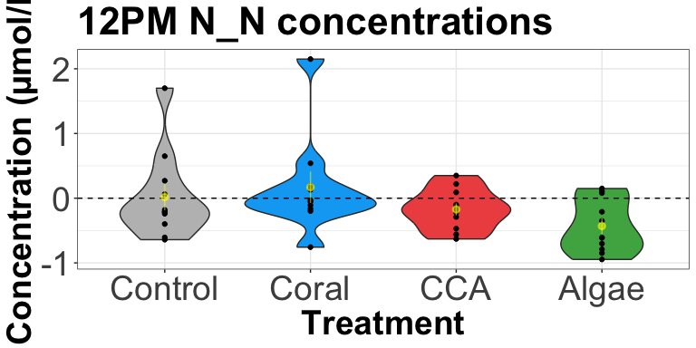

Slide 9
Nitrite - Significant !

Slide 10
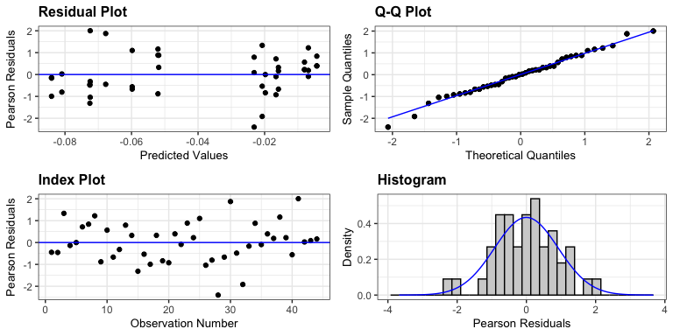
Linear mixed model fit by REML. t-tests use Satterthwaite's method [ lmerModLmerTest] Formula: conc_norm ~ treatment + (1 | tank_number) Data: df REML criterion at convergence: -138 Scaled residuals: Min 1Q Median 3Q Max -2.40244 -0.58583 0.01229 0.60325 2.00335 Random effects: Groups Name Variance Std.Dev. tank_number (Intercept) 0.0002162 0.01470 Residual 0.0013069 0.03615 Number of obs: 44, groups: tank_number, 16 Fixed effects: Estimate Std. Error df t value Pr(>|t|) (Intercept) -0.0140459 0.0127656 10.5796521 -1.100 0.29561 treatmentCoral -0.0007137 0.0183523 11.1583527 -0.039 0.96966 treatmentCCA -0.0450051 0.0183523 11.1583527 -2.452 0.03183 * treatmentAlgae -0.0622439 0.0186882 11.9182096 -3.331 0.00604 ** --- Signif. codes: 0 '***' 0.001 '**' 0.01 '*' 0.05 '.' 0.1 ' ' 1 Correlation of Fixed Effects: (Intr) trtmnC trtCCA treatmntCrl -0.696 treatmntCCA -0.696 0.484 treatmntAlg -0.683 0.475 0.475
Type II Analysis of Variance Table with Satterthwaite's method Sum Sq Mean Sq NumDF DenDF F value Pr(>F) treatment 0.02216 0.0073865 3 11.798 5.6518 0.01224 * --- Signif. codes: 0 '***' 0.001 '**' 0.01 '*' 0.05 '.' 0.1 ' ' 1
$emmeans treatment emmean SE df lower.CL upper.CL Control -0.0140 0.0128 10.6 -0.0423 0.0142 Coral -0.0148 0.0132 11.7 -0.0436 0.0141 CCA -0.0591 0.0132 11.7 -0.0879 -0.0302 Algae -0.0763 0.0137 13.2 -0.1058 -0.0467 Degrees-of-freedom method: kenward-roger Confidence level used: 0.95 $contrasts contrast estimate SE df t.ratio p.value Coral - Control -0.000714 0.0184 11.1 -0.039 0.9994 CCA - Control -0.045005 0.0184 11.1 -2.449 0.0817 Algae - Control -0.062244 0.0187 11.9 -3.323 0.0165 Degrees-of-freedom method: kenward-roger P value adjustment: dunnettx method for 3 tests

Slide 11
Nitrate - need to log the data

Slide 12
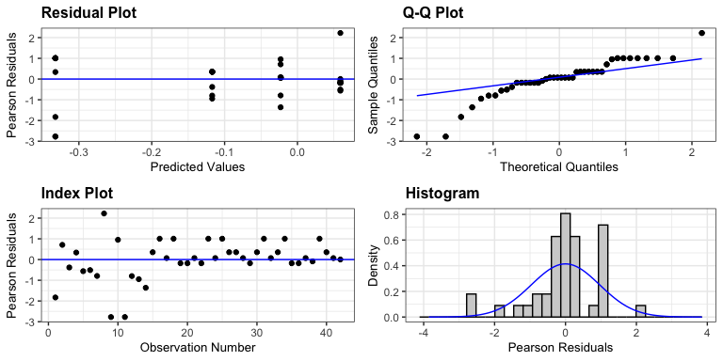
Linear mixed model fit by REML. t-tests use Satterthwaite's method [ lmerModLmerTest] Formula: conc_norm ~ treatment + (1 | tank_number) Data: df REML criterion at convergence: 33.1 Scaled residuals: Min 1Q Median 3Q Max -2.7741 -0.1782 0.0700 0.3543 2.2230 Random effects: Groups Name Variance Std.Dev. tank_number (Intercept) 0.0000 0.0000 Residual 0.1092 0.3304 Number of obs: 42, groups: tank_number, 16 Fixed effects: Estimate Std. Error df t value Pr(>|t|) (Intercept) -0.02313 0.09963 38.00000 -0.232 0.8177 treatmentCoral 0.08203 0.14090 38.00000 0.582 0.5639 treatmentCCA -0.30916 0.14090 38.00000 -2.194 0.0344 * treatmentAlgae -0.09393 0.14852 38.00000 -0.632 0.5309 --- Signif. codes: 0 '***' 0.001 '**' 0.01 '*' 0.05 '.' 0.1 ' ' 1 Correlation of Fixed Effects: (Intr) trtmnC trtCCA treatmntCrl -0.707 treatmntCCA -0.707 0.500 treatmntAlg -0.671 0.474 0.474 optimizer (nloptwrap) convergence code: 0 (OK) boundary (singular) fit: see help('isSingular')
Type II Analysis of Variance Table with Satterthwaite's method Sum Sq Mean Sq NumDF DenDF F value Pr(>F) treatment 0.93858 0.31286 3 38 2.8652 0.04926 * --- Signif. codes: 0 '***' 0.001 '**' 0.01 '*' 0.05 '.' 0.1 ' ' 1
$emmeans treatment emmean SE df lower.CL upper.CL Control -0.0231 0.100 10.5 -0.245 0.199 Coral 0.0589 0.100 10.5 -0.163 0.281 CCA -0.3323 0.100 10.5 -0.554 -0.111 Algae -0.1171 0.111 15.2 -0.353 0.119 Degrees-of-freedom method: kenward-roger Confidence level used: 0.95 $contrasts contrast estimate SE df t.ratio p.value Coral - Control 0.0820 0.142 10.5 0.579 0.8636 CCA - Control -0.3092 0.142 10.5 -2.183 0.1303 Algae - Control -0.0939 0.149 12.8 -0.628 0.8394 Degrees-of-freedom method: kenward-roger P value adjustment: dunnettx method for 3 tests

Slide 13
Ammonium

Slide 14
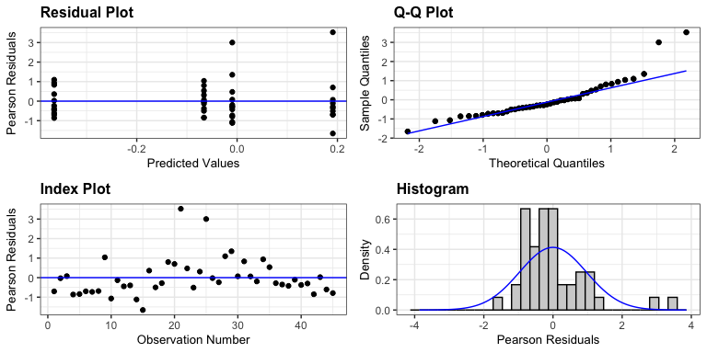
Linear mixed model fit by REML. t-tests use Satterthwaite's method [ lmerModLmerTest] Formula: conc_norm ~ treatment + (1 | tank_number) Data: df REML criterion at convergence: 79.9 Scaled residuals: Min 1Q Median 3Q Max -1.6570 -0.6063 -0.2376 0.3593 3.5275 Random effects: Groups Name Variance Std.Dev. tank_number (Intercept) 0.0000 0.0000 Residual 0.3244 0.5696 Number of obs: 45, groups: tank_number, 16 Fixed effects: Estimate Std. Error df t value Pr(>|t|) (Intercept) -0.009621 0.164419 41.000000 -0.059 0.954 treatmentCoral 0.200473 0.243872 41.000000 0.822 0.416 treatmentCCA -0.056440 0.232523 41.000000 -0.243 0.809 treatmentAlgae -0.355029 0.237749 41.000000 -1.493 0.143 Correlation of Fixed Effects: (Intr) trtmnC trtCCA treatmntCrl -0.674 treatmntCCA -0.707 0.477 treatmntAlg -0.692 0.466 0.489 optimizer (nloptwrap) convergence code: 0 (OK) boundary (singular) fit: see help('isSingular')
Type II Analysis of Variance Table with Satterthwaite's method Sum Sq Mean Sq NumDF DenDF F value Pr(>F) treatment 1.679 0.55965 3 41 1.7252 0.1768
$emmeans treatment emmean SE df lower.CL upper.CL Control -0.00962 0.164 10.6 -0.373 0.3539 Coral 0.19085 0.181 14.1 -0.198 0.5797 CCA -0.06606 0.164 10.6 -0.430 0.2975 Algae -0.36465 0.172 12.0 -0.740 0.0111 Degrees-of-freedom method: kenward-roger Confidence level used: 0.95 $contrasts contrast estimate SE df t.ratio p.value Coral - Control 0.2005 0.245 12.3 0.819 0.7369 CCA - Control -0.0564 0.233 10.6 -0.243 0.9766 Algae - Control -0.3550 0.238 11.3 -1.490 0.3594 Degrees-of-freedom method: kenward-roger P value adjustment: dunnettx method for 3 tests

Slide 15
Phosphate

Slide 16
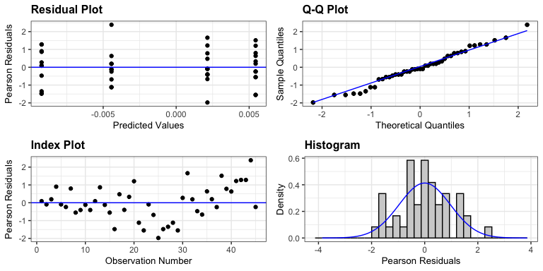
Linear mixed model fit by REML. t-tests use Satterthwaite's method [ lmerModLmerTest] Formula: conc_norm ~ treatment + (1 | tank_number) Data: df REML criterion at convergence: -183.9 Scaled residuals: Min 1Q Median 3Q Max -1.97727 -0.55212 -0.09374 0.63759 2.38429 Random effects: Groups Name Variance Std.Dev. tank_number (Intercept) 0.0000000 0.00000 Residual 0.0005212 0.02283 Number of obs: 45, groups: tank_number, 16 Fixed effects: Estimate Std. Error df t value Pr(>|t|) (Intercept) -0.004432 0.007219 41.000000 -0.614 0.543 treatmentCoral 0.009876 0.009775 41.000000 1.010 0.318 treatmentCCA 0.006572 0.009775 41.000000 0.672 0.505 treatmentAlgae -0.004788 0.009975 41.000000 -0.480 0.634 Correlation of Fixed Effects: (Intr) trtmnC trtCCA treatmntCrl -0.739 treatmntCCA -0.739 0.545 treatmntAlg -0.724 0.535 0.535 optimizer (nloptwrap) convergence code: 0 (OK) boundary (singular) fit: see help('isSingular')
Type II Analysis of Variance Table with Satterthwaite's method Sum Sq Mean Sq NumDF DenDF F value Pr(>F) treatment 0.0014755 0.00049185 3 41 0.9437 0.4284
$emmeans treatment emmean SE df lower.CL upper.CL Control -0.00443 0.00727 14.1 -0.02002 0.01115 Coral 0.00544 0.00659 10.6 -0.00913 0.02002 CCA 0.00214 0.00659 10.6 -0.01243 0.01671 Algae -0.00922 0.00691 12.0 -0.02428 0.00584 Degrees-of-freedom method: kenward-roger Confidence level used: 0.95 $contrasts contrast estimate SE df t.ratio p.value Coral - Control 0.00988 0.00981 12.3 1.006 0.6257 CCA - Control 0.00657 0.00981 12.3 0.670 0.8186 Algae - Control -0.00479 0.01000 13.1 -0.477 0.9067 Degrees-of-freedom method: kenward-roger P value adjustment: dunnettx method for 3 tests

Slide 17
Silicate

Slide 18
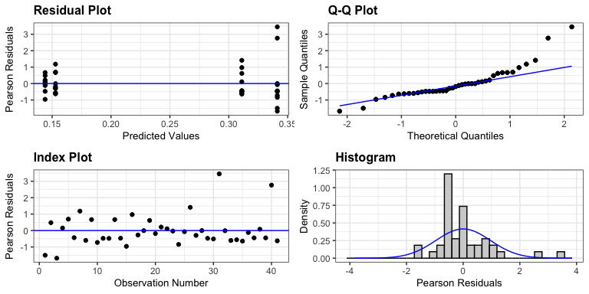
Linear mixed model fit by REML. t-tests use Satterthwaite's method [ lmerModLmerTest] Formula: conc_norm ~ treatment + (1 | tank_number) Data: df REML criterion at convergence: 55.5 Scaled residuals: Min 1Q Median 3Q Max -1.6826 -0.5113 -0.1833 0.2123 3.4495 Random effects: Groups Name Variance Std.Dev. tank_number (Intercept) 0.0000 0.0000 Residual 0.2042 0.4519 Number of obs: 41, groups: tank_number, 16 Fixed effects: Estimate Std. Error df t value Pr(>|t|) (Intercept) 0.31106 0.14290 37.00000 2.177 0.036 * treatmentCoral -0.15821 0.20209 37.00000 -0.783 0.439 treatmentCCA -0.16702 0.20209 37.00000 -0.826 0.414 treatmentAlgae 0.03012 0.19745 37.00000 0.153 0.880 --- Signif. codes: 0 '***' 0.001 '**' 0.01 '*' 0.05 '.' 0.1 ' ' 1 Correlation of Fixed Effects: (Intr) trtmnC trtCCA treatmntCrl -0.707 treatmntCCA -0.707 0.500 treatmntAlg -0.724 0.512 0.512 optimizer (nloptwrap) convergence code: 0 (OK) boundary (singular) fit: see help('isSingular')
Type II Analysis of Variance Table with Satterthwaite's method Sum Sq Mean Sq NumDF DenDF F value Pr(>F) treatment 0.33113 0.11038 3 37 0.5405 0.6575
$emmeans treatment emmean SE df lower.CL upper.CL Control 0.311 0.144 11.69 -0.00396 0.626 Coral 0.153 0.144 11.69 -0.16217 0.468 CCA 0.144 0.144 11.69 -0.17098 0.459 Algae 0.341 0.137 9.92 0.03561 0.647 Degrees-of-freedom method: kenward-roger Confidence level used: 0.95 $contrasts contrast estimate SE df t.ratio p.value Coral - Control -0.1582 0.204 11.7 -0.776 0.7617 CCA - Control -0.1670 0.204 11.7 -0.819 0.7372 Algae - Control 0.0301 0.199 10.8 0.151 0.9911 Degrees-of-freedom method: kenward-roger P value adjustment: dunnettx method for 3 tests

Slide 19
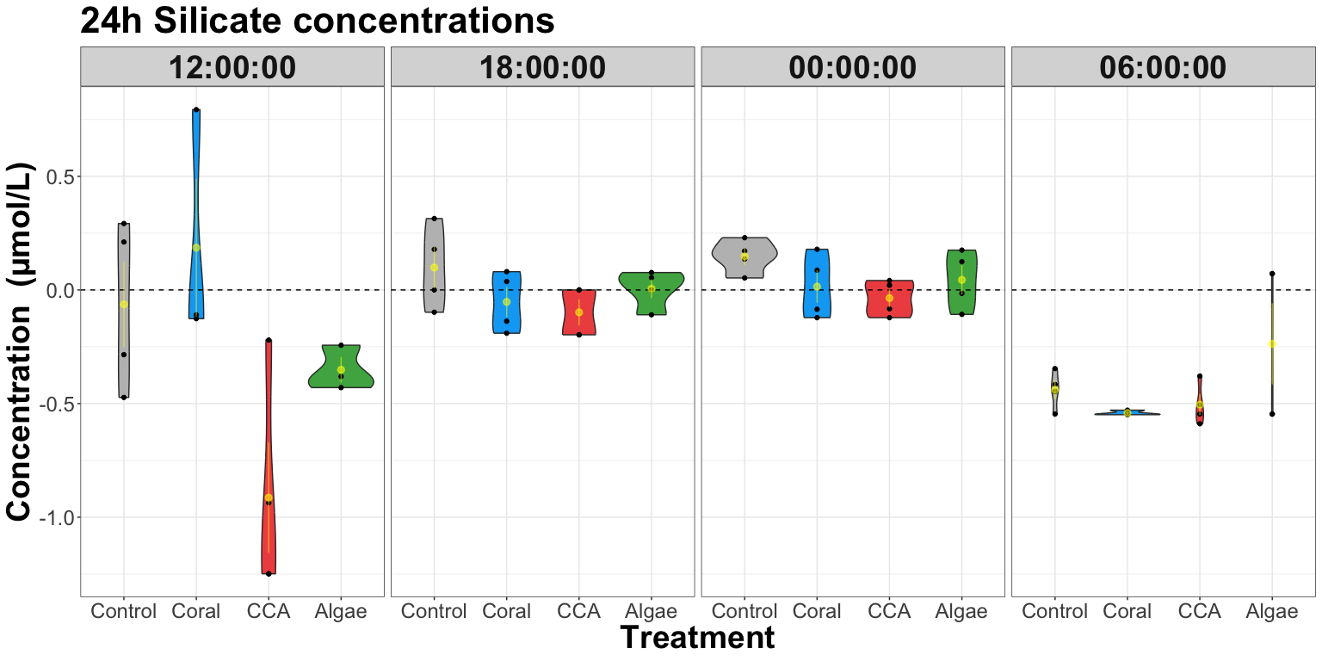
24h Nutrient Analysis

Slide 20
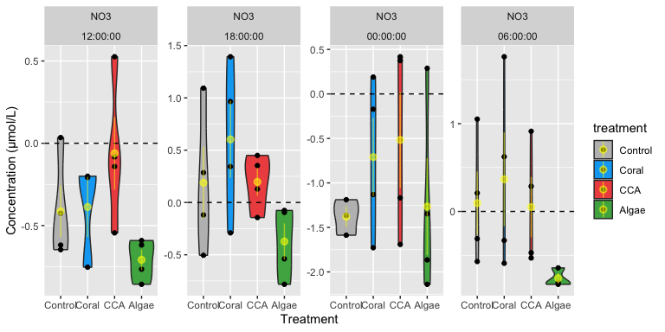
Data viz

Slide 21
Iterative stats
Iterative graphing
Nitrate-Nitrite

Slide 22
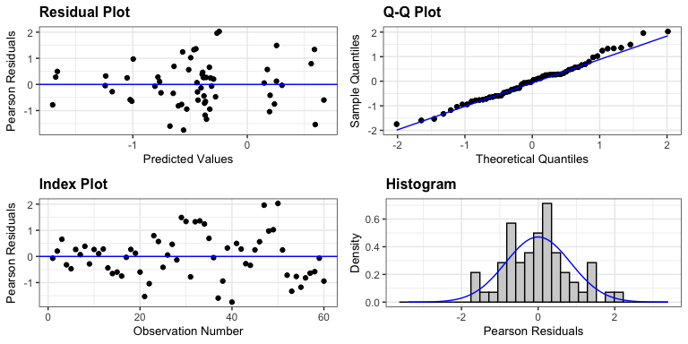
Linear mixed model fit by REML. t-tests use Satterthwaite's method [ lmerModLmerTest] Formula: conc_norm ~ treatment * time_fac + (1 | tank_number) Data: df REML criterion at convergence: 102.4 Scaled residuals: Min 1Q Median 3Q Max -1.74671 -0.61001 0.01041 0.47247 2.02764 Random effects: Groups Name Variance Std.Dev. tank_number (Intercept) 0.01504 0.1226 Residual 0.35745 0.5979 Number of obs: 60, groups: tank_number, 16 Fixed effects: Estimate Std. Error df t value Pr(>|t|) (Intercept) -0.39600 0.30516 43.76260 -1.298 0.2012 treatmentCoral 0.04541 0.46598 43.88307 0.097 0.9228 treatmentCCA 0.06781 0.46598 43.88307 0.146 0.8850 treatmentAlgae -0.38125 0.43156 43.76260 -0.883 0.3818 time_fac18:00:00 0.63425 0.42276 30.34409 1.500 0.1439 time_fac00:00:00 -0.80200 0.45785 32.81210 -1.752 0.0892 . time_fac06:00:00 0.06650 0.42276 30.34409 0.157 0.8760 treatmentCoral:time_fac18:00:00 0.31859 0.62317 31.67094 0.511 0.6127 treatmentCCA:time_fac18:00:00 -0.10231 0.62317 31.67094 -0.164 0.8706 treatmentAlgae:time_fac18:00:00 -0.25725 0.59787 30.34409 -0.430 0.6700 treatmentCoral:time_fac00:00:00 0.52059 0.64749 32.81210 0.804 0.4272 treatmentCCA:time_fac00:00:00 0.62994 0.64749 32.81210 0.973 0.3377 treatmentAlgae:time_fac00:00:00 -0.09103 0.64749 32.81210 -0.141 0.8891 treatmentCoral:time_fac06:00:00 -0.02841 0.62317 31.67094 -0.046 0.9639 treatmentCCA:time_fac06:00:00 -0.28381 0.62317 31.67094 -0.455 0.6519 treatmentAlgae:time_fac06:00:00 -0.30900 0.59787 30.34409 -0.517 0.6090 --- Signif. codes: 0 '***' 0.001 '**' 0.01 '*' 0.05 '.' 0.1 ' ' 1
Type II Analysis of Variance Table with Satterthwaite's method Sum Sq Mean Sq NumDF DenDF F value Pr(>F) treatment 4.7076 1.5692 3 9.8671 4.3900 0.0328990 * time_fac 9.8843 3.2948 3 31.3679 9.2175 0.0001601 *** treatment:time_fac 1.3655 0.1517 9 31.4810 0.4245 0.9119322 --- Signif. codes: 0 '***' 0.001 '**' 0.01 '*' 0.05 '.' 0.1 ' ' 1
$emmeans treatment emmean SE df lower.CL upper.CL Control -0.421 0.168 11.6 -0.789 -0.0541 Coral -0.173 0.168 11.6 -0.540 0.1940 CCA -0.293 0.168 11.6 -0.660 0.0747 Algae -0.967 0.168 11.6 -1.334 -0.5997 Results are averaged over the levels of: time_fac Degrees-of-freedom method: kenward-roger Confidence level used: 0.95 $contrasts contrast estimate SE df t.ratio p.value Coral - Control 0.248 0.238 11.6 1.045 0.6039 CCA - Control 0.129 0.238 11.6 0.542 0.8799 Algae - Control -0.546 0.238 11.6 -2.297 0.1034 Results are averaged over the levels of: time_fac Degrees-of-freedom method: kenward-roger P value adjustment: dunnettx method for 3 tests
treatment emmean SE df lower.CL upper.CL Control -0.421 0.168 11.6 -0.789 -0.0541 Coral -0.173 0.168 11.6 -0.540 0.1940 CCA -0.293 0.168 11.6 -0.660 0.0747 Algae -0.967 0.168 11.6 -1.334 -0.5997 Results are averaged over the levels of: time_fac Degrees-of-freedom method: kenward-roger Confidence level used: 0.95

Slide 23
Nitrite - Significant !

Slide 24
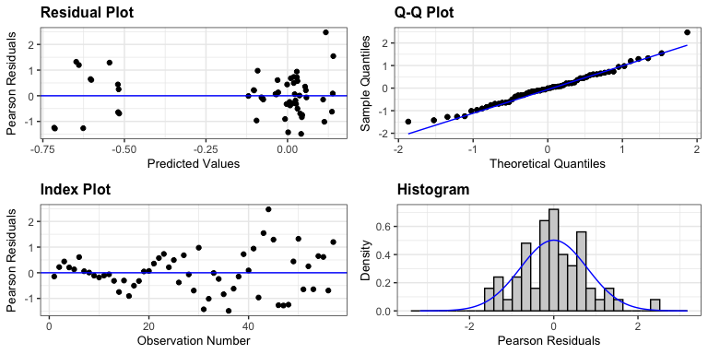
Linear mixed model fit by REML. t-tests use Satterthwaite's method [ lmerModLmerTest] Formula: conc_norm ~ treatment * time_fac + (1 | tank_number) Data: df REML criterion at convergence: -79.3 Scaled residuals: Min 1Q Median 3Q Max -1.48591 -0.62084 -0.00984 0.49512 2.47117 Random effects: Groups Name Variance Std.Dev. tank_number (Intercept) 0.001158 0.03402 Residual 0.004281 0.06543 Number of obs: 57, groups: tank_number, 16 Fixed effects: Estimate Std. Error df t value Pr(>|t|) (Intercept) 0.017862 0.036873 37.205749 0.484 0.6309 treatmentCoral -0.012199 0.052146 37.205749 -0.234 0.8163 treatmentCCA -0.106770 0.056023 38.543025 -1.906 0.0642 treatmentAlgae -0.101494 0.055964 38.711330 -1.814 0.0775 time_fac18:00:00 0.031757 0.046265 30.166749 0.686 0.4977 time_fac00:00:00 0.114120 0.046265 30.166749 2.467 0.0195 time_fac06:00:00 -0.542022 0.050502 31.491190 -10.733 4.76e-12 treatmentCoral:time_fac18:00:00 -0.037914 0.065429 30.166749 -0.579 0.5666 treatmentCCA:time_fac18:00:00 0.064082 0.068558 31.160002 0.935 0.3571 treatmentAlgae:time_fac18:00:00 0.056002 0.071721 32.104137 0.781 0.4406 treatmentCoral:time_fac00:00:00 -0.041733 0.065429 30.166749 -0.638 0.5284 treatmentCCA:time_fac00:00:00 -0.008815 0.068558 31.160002 -0.129 0.8985 treatmentAlgae:time_fac00:00:00 -0.131390 0.071721 32.104137 -1.832 0.0762 treatmentCoral:time_fac06:00:00 -0.142447 0.068490 30.886993 -2.080 0.0459 treatmentCCA:time_fac06:00:00 0.099811 0.073515 30.791882 1.358 0.1844 treatmentAlgae:time_fac06:00:00 0.018325 0.074524 32.565388 0.246 0.8073 (Intercept) treatmentCoral treatmentCCA . treatmentAlgae . time_fac18:00:00 time_fac00:00:00 * time_fac06:00:00 *** treatmentCoral:time_fac18:00:00 treatmentCCA:time_fac18:00:00 treatmentAlgae:time_fac18:00:00 treatmentCoral:time_fac00:00:00 treatmentCCA:time_fac00:00:00 treatmentAlgae:time_fac00:00:00 . treatmentCoral:time_fac06:00:00 * treatmentCCA:time_fac06:00:00 treatmentAlgae:time_fac06:00:00 --- Signif. codes: 0 '***' 0.001 '**' 0.01 '*' 0.05 '.' 0.1 ' ' 1
Type II Analysis of Variance Table with Satterthwaite's method Sum Sq Mean Sq NumDF DenDF F value Pr(>F) treatment 0.0479 0.01598 3 12.455 3.7324 0.04055 * time_fac 3.5293 1.17645 3 31.335 274.8134 < 2e-16 *** treatment:time_fac 0.1025 0.01139 9 31.473 2.6606 0.02025 * --- Signif. codes: 0 '***' 0.001 '**' 0.01 '*' 0.05 '.' 0.1 ' ' 1
$emmeans treatment emmean SE df lower.CL upper.CL Control -0.0812 0.0242 11.0 -0.134 -0.0279 Coral -0.1489 0.0236 10.1 -0.201 -0.0964 CCA -0.1492 0.0250 11.6 -0.204 -0.0945 Algae -0.1969 0.0254 13.6 -0.252 -0.1423 Results are averaged over the levels of: time_fac Degrees-of-freedom method: kenward-roger Confidence level used: 0.95 $contrasts contrast estimate SE df t.ratio p.value Coral - Control -0.0677 0.0338 10.5 -2.005 0.1724 CCA - Control -0.0680 0.0348 11.3 -1.956 0.1823 Algae - Control -0.1158 0.0351 12.3 -3.300 0.0166 Results are averaged over the levels of: time_fac Degrees-of-freedom method: kenward-roger P value adjustment: dunnettx method for 3 tests

Slide 25
Nitrate - Significant different in the CCA

Slide 26
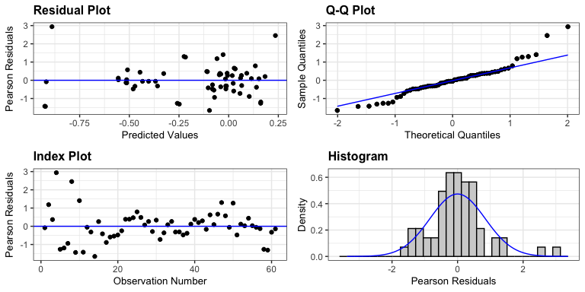
Linear mixed model fit by REML. t-tests use Satterthwaite's method [ lmerModLmerTest] Formula: conc_norm ~ treatment * time_fac + (1 | tank_number) Data: df REML criterion at convergence: 18.4 Scaled residuals: Min 1Q Median 3Q Max -1.65464 -0.41477 -0.05407 0.37622 2.94028 Random effects: Groups Name Variance Std.Dev. tank_number (Intercept) 0.003455 0.05878 Residual 0.051750 0.22749 Number of obs: 61, groups: tank_number, 16 Fixed effects: Estimate Std. Error df t value Pr(>|t|) (Intercept) -0.06361 0.11748 44.45720 -0.541 0.59090 treatmentCoral 0.25391 0.17932 44.71323 1.416 0.16372 treatmentCCA -0.85019 0.16614 44.45720 -5.117 6.39e-06 treatmentAlgae -0.28334 0.17932 44.71998 -1.580 0.12113 time_fac18:00:00 0.16227 0.16086 32.16945 1.009 0.32061 time_fac00:00:00 0.21109 0.16086 32.16945 1.312 0.19871 time_fac06:00:00 -0.37505 0.16086 32.16945 -2.332 0.02614 treatmentCoral:time_fac18:00:00 -0.40516 0.23728 33.41268 -1.707 0.09701 treatmentCCA:time_fac18:00:00 0.65287 0.22749 32.16945 2.870 0.00720 treatmentAlgae:time_fac18:00:00 0.19005 0.23728 33.39624 0.801 0.42883 treatmentCoral:time_fac00:00:00 -0.38664 0.23728 33.41268 -1.629 0.11261 treatmentCCA:time_fac00:00:00 0.66704 0.22749 32.16945 2.932 0.00615 treatmentAlgae:time_fac00:00:00 0.18015 0.23728 33.39624 0.759 0.45303 treatmentCoral:time_fac06:00:00 -0.34154 0.24703 35.30433 -1.383 0.17548 treatmentCCA:time_fac06:00:00 0.78392 0.22749 32.16945 3.446 0.00160 treatmentAlgae:time_fac06:00:00 0.48482 0.23728 33.39624 2.043 0.04899 (Intercept) treatmentCoral treatmentCCA *** treatmentAlgae time_fac18:00:00 time_fac00:00:00 time_fac06:00:00 * treatmentCoral:time_fac18:00:00 . treatmentCCA:time_fac18:00:00 ** treatmentAlgae:time_fac18:00:00 treatmentCoral:time_fac00:00:00 treatmentCCA:time_fac00:00:00 ** treatmentAlgae:time_fac00:00:00 treatmentCoral:time_fac06:00:00 treatmentCCA:time_fac06:00:00 ** treatmentAlgae:time_fac06:00:00 * --- Signif. codes: 0 '***' 0.001 '**' 0.01 '*' 0.05 '.' 0.1 ' ' 1
Type II Analysis of Variance Table with Satterthwaite's method Sum Sq Mean Sq NumDF DenDF F value Pr(>F) treatment 0.80386 0.26795 3 10.781 5.1779 0.018418 * time_fac 2.27468 0.75823 3 32.885 14.6519 3.143e-06 *** treatment:time_fac 1.78415 0.19824 9 33.005 3.8307 0.002124 ** --- Signif. codes: 0 '***' 0.001 '**' 0.01 '*' 0.05 '.' 0.1 ' ' 1
$emmeans treatment emmean SE df lower.CL upper.CL Control -0.0640 0.0640 10.9 -0.205 0.0771 Coral -0.0935 0.0685 13.5 -0.241 0.0539 CCA -0.3883 0.0640 10.9 -0.529 -0.2472 Algae -0.1336 0.0664 12.1 -0.278 0.0109 Results are averaged over the levels of: time_fac Degrees-of-freedom method: kenward-roger Confidence level used: 0.95 $contrasts contrast estimate SE df t.ratio p.value Coral - Control -0.0294 0.0937 12.2 -0.314 0.9602 CCA - Control -0.3242 0.0905 10.9 -3.581 0.0118 Algae - Control -0.0696 0.0922 11.5 -0.755 0.7738 Results are averaged over the levels of: time_fac Degrees-of-freedom method: kenward-roger P value adjustment: dunnettx method for 3 tests

Slide 27
Ammonium

Slide 28
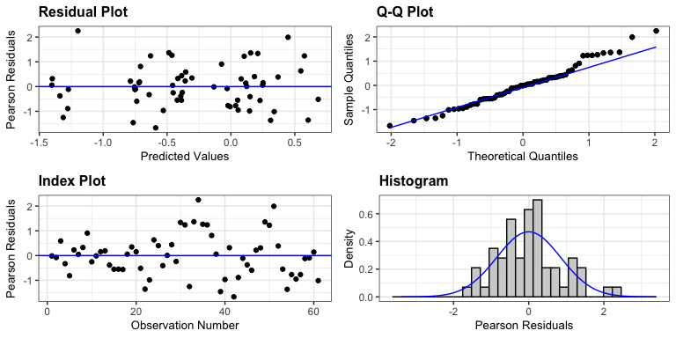
Linear mixed model fit by REML. t-tests use Satterthwaite's method [ lmerModLmerTest] Formula: conc_norm ~ treatment * time_fac + (1 | tank_number) Data: df REML criterion at convergence: 113.6 Scaled residuals: Min 1Q Median 3Q Max -1.66721 -0.55275 -0.01165 0.38606 2.24935 Random effects: Groups Name Variance Std.Dev. tank_number (Intercept) 0.01969 0.1403 Residual 0.43668 0.6608 Number of obs: 61, groups: tank_number, 16 Fixed effects: Estimate Std. Error df t value Pr(>|t|) (Intercept) -0.41386 0.33778 44.69735 -1.225 0.2269 treatmentCoral 0.05368 0.51577 44.84736 0.104 0.9176 treatmentCCA 0.35318 0.47769 44.69735 0.739 0.4636 treatmentAlgae -0.29392 0.47769 44.69735 -0.615 0.5415 time_fac18:00:00 0.60249 0.46727 30.69630 1.289 0.2069 time_fac00:00:00 -0.94637 0.50614 33.24832 -1.870 0.0703 . time_fac06:00:00 0.50878 0.46727 30.69630 1.089 0.2847 treatmentCoral:time_fac18:00:00 0.36043 0.68885 32.06729 0.523 0.6044 treatmentCCA:time_fac18:00:00 -0.34499 0.66082 30.69630 -0.522 0.6054 treatmentAlgae:time_fac18:00:00 -0.26779 0.66082 30.69630 -0.405 0.6881 treatmentCoral:time_fac00:00:00 0.59650 0.71578 33.24832 0.833 0.4106 treatmentCCA:time_fac00:00:00 0.49040 0.68885 32.06729 0.712 0.4817 treatmentAlgae:time_fac00:00:00 0.38860 0.68885 32.06729 0.564 0.5766 treatmentCoral:time_fac06:00:00 0.21771 0.68885 32.06729 0.316 0.7540 treatmentCCA:time_fac06:00:00 -0.39862 0.66082 30.69630 -0.603 0.5508 treatmentAlgae:time_fac06:00:00 -0.54021 0.68885 32.06729 -0.784 0.4387 --- Signif. codes: 0 '***' 0.001 '**' 0.01 '*' 0.05 '.' 0.1 ' ' 1
Type II Analysis of Variance Table with Satterthwaite's method Sum Sq Mean Sq NumDF DenDF F value Pr(>F) treatment 4.4193 1.4731 3 9.5232 3.3734 0.0651958 . time_fac 10.4560 3.4853 3 31.4502 7.9815 0.0004256 *** treatment:time_fac 1.6858 0.1873 9 31.5943 0.4289 0.9093466 --- Signif. codes: 0 '***' 0.001 '**' 0.01 '*' 0.05 '.' 0.1 ' ' 1
$emmeans treatment emmean SE df lower.CL upper.CL Control -0.3726 0.187 12.1 -0.779 0.0334 Coral -0.0253 0.187 12.1 -0.431 0.3808 CCA -0.0828 0.179 10.8 -0.479 0.3131 Algae -0.7714 0.187 12.1 -1.177 -0.3653 Results are averaged over the levels of: time_fac Degrees-of-freedom method: kenward-roger Confidence level used: 0.95 $contrasts contrast estimate SE df t.ratio p.value Coral - Control 0.347 0.264 12.1 1.317 0.4457 CCA - Control 0.290 0.259 11.4 1.120 0.5595 Algae - Control -0.399 0.264 12.1 -1.512 0.3464 Results are averaged over the levels of: time_fac Degrees-of-freedom method: kenward-roger P value adjustment: dunnettx method for 3 tests

Slide 29
Phosphate

Slide 30
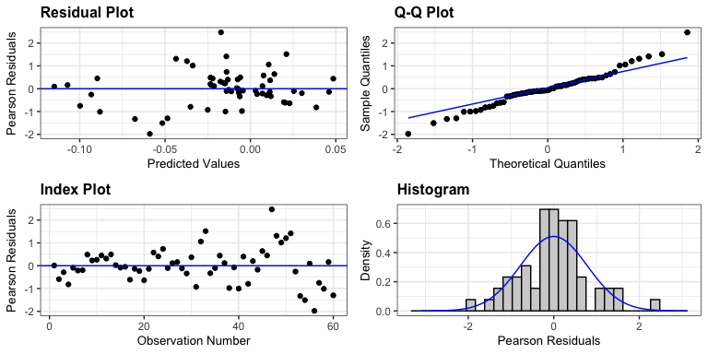
Linear mixed model fit by REML. t-tests use Satterthwaite's method [ lmerModLmerTest] Formula: conc_norm ~ treatment * time_fac + (1 | tank_number) Data: df REML criterion at convergence: -140.4 Scaled residuals: Min 1Q Median 3Q Max -1.97899 -0.33049 -0.05958 0.41532 2.47027 Random effects: Groups Name Variance Std.Dev. tank_number (Intercept) 0.0006076 0.02465 Residual 0.0011066 0.03327 Number of obs: 60, groups: tank_number, 16 Fixed effects: Estimate Std. Error df t value (Intercept) -0.0021095 0.0232473 37.9978802 -0.091 treatmentCoral 0.0044417 0.0311286 35.5134729 0.143 treatmentCCA -0.0014707 0.0311286 35.5134729 -0.047 treatmentAlgae 0.0040046 0.0311286 35.5134729 0.129 time_fac18:00:00 0.0018106 0.0257915 32.5477933 0.070 time_fac00:00:00 0.0011754 0.0257915 32.5477933 0.046 time_fac06:00:00 -0.0991249 0.0281524 34.1957766 -3.521 treatmentCoral:time_fac18:00:00 0.0141269 0.0349074 32.0263220 0.405 treatmentCCA:time_fac18:00:00 -0.0009643 0.0349074 32.0263220 -0.028 treatmentAlgae:time_fac18:00:00 -0.0070712 0.0364674 32.5152085 -0.194 treatmentCoral:time_fac00:00:00 0.0172583 0.0349074 32.0263220 0.494 treatmentCCA:time_fac00:00:00 0.0077255 0.0364674 32.5152085 0.212 treatmentAlgae:time_fac00:00:00 -0.0187027 0.0349074 32.0263220 -0.536 treatmentCoral:time_fac06:00:00 0.0549030 0.0366862 33.0463817 1.497 treatmentCCA:time_fac06:00:00 0.0622965 0.0366862 33.0463817 1.698 treatmentAlgae:time_fac06:00:00 0.0169068 0.0366862 33.0463817 0.461 Pr(>|t|) (Intercept) 0.92817 treatmentCoral 0.88734 treatmentCCA 0.96258 treatmentAlgae 0.89836 time_fac18:00:00 0.94446 time_fac00:00:00 0.96393 time_fac06:00:00 0.00124 ** treatmentCoral:time_fac18:00:00 0.68839 treatmentCCA:time_fac18:00:00 0.97813 treatmentAlgae:time_fac18:00:00 0.84746 treatmentCoral:time_fac00:00:00 0.62440 treatmentCCA:time_fac00:00:00 0.83355 treatmentAlgae:time_fac00:00:00 0.59581 treatmentCoral:time_fac06:00:00 0.14400 treatmentCCA:time_fac06:00:00 0.09889 . treatmentAlgae:time_fac06:00:00 0.64793 --- Signif. codes: 0 '***' 0.001 '**' 0.01 '*' 0.05 '.' 0.1 ' ' 1
Type II Analysis of Variance Table with Satterthwaite's method Sum Sq Mean Sq NumDF DenDF F value Pr(>F) treatment 0.002142 0.0007140 3 11.219 0.6452 0.6017 time_fac 0.047967 0.0159892 3 31.867 14.4484 4.081e-06 *** treatment:time_fac 0.006662 0.0007402 9 31.959 0.6689 0.7304 --- Signif. codes: 0 '***' 0.001 '**' 0.01 '*' 0.05 '.' 0.1 ' ' 1
$emmeans treatment emmean SE df lower.CL upper.CL Control -0.02614 0.0153 12.6 -0.0593 0.00705 Coral -0.00013 0.0149 11.3 -0.0328 0.03250 CCA -0.01035 0.0151 11.9 -0.0433 0.02259 Algae -0.02436 0.0151 11.9 -0.0573 0.00859 Results are averaged over the levels of: time_fac Degrees-of-freedom method: kenward-roger Confidence level used: 0.95 $contrasts contrast estimate SE df t.ratio p.value Coral - Control 0.02601 0.0213 11.9 1.219 0.5009 CCA - Control 0.01579 0.0215 12.2 0.734 0.7845 Algae - Control 0.00179 0.0215 12.2 0.083 0.9974 Results are averaged over the levels of: time_fac Degrees-of-freedom method: kenward-roger P value adjustment: dunnettx method for 3 tests

Slide 31
Silicate - May need to log transform

Slide 32
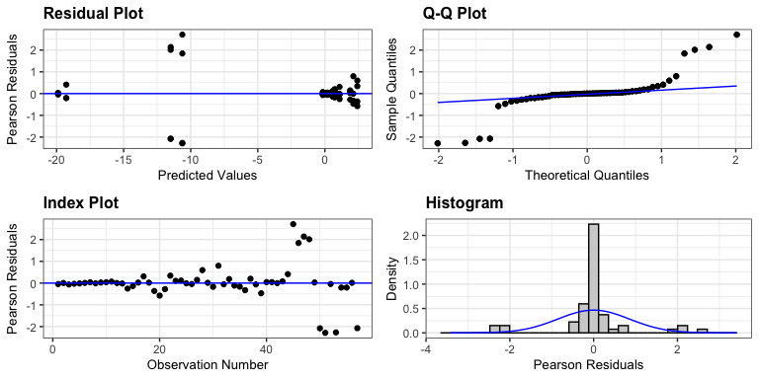
Linear mixed model fit by REML. t-tests use Satterthwaite's method [ lmerModLmerTest] Formula: conc_norm ~ treatment * time_fac + (1 | tank_number) Data: df REML criterion at convergence: 252.2 Scaled residuals: Min 1Q Median 3Q Max -2.28690 -0.13726 0.00288 0.07830 2.70997 Random effects: Groups Name Variance Std.Dev. tank_number (Intercept) 0.00 0.000 Residual 16.79 4.097 Number of obs: 57, groups: tank_number, 16 Fixed effects: Estimate Std. Error df t value Pr(>|t|) (Intercept) 0.08354 2.36561 41.00000 0.035 0.9720 treatmentCoral 0.45263 3.34548 41.00000 0.135 0.8930 treatmentCCA 0.25661 3.34548 41.00000 0.077 0.9392 treatmentAlgae -0.23780 3.12941 41.00000 -0.076 0.9398 time_fac18:00:00 1.79976 3.12941 41.00000 0.575 0.5684 time_fac00:00:00 2.03679 3.12941 41.00000 0.651 0.5188 time_fac06:00:00 -19.96573 3.34548 41.00000 -5.968 4.81e-07 treatmentCoral:time_fac18:00:00 0.08180 4.42566 41.00000 0.018 0.9853 treatmentCCA:time_fac18:00:00 -1.56470 4.58099 41.00000 -0.342 0.7344 treatmentAlgae:time_fac18:00:00 -0.54963 4.26467 41.00000 -0.129 0.8981 treatmentCoral:time_fac00:00:00 -1.83449 4.42566 41.00000 -0.415 0.6807 treatmentCCA:time_fac00:00:00 -1.65777 4.42566 41.00000 -0.375 0.7099 treatmentAlgae:time_fac00:00:00 -1.70562 4.42566 41.00000 -0.385 0.7019 treatmentCoral:time_fac06:00:00 7.93632 4.58099 41.00000 1.732 0.0907 treatmentCCA:time_fac06:00:00 9.00031 4.58099 41.00000 1.965 0.0562 treatmentAlgae:time_fac06:00:00 0.84136 4.58099 41.00000 0.184 0.8552 (Intercept) treatmentCoral treatmentCCA treatmentAlgae time_fac18:00:00 time_fac00:00:00 time_fac06:00:00 *** treatmentCoral:time_fac18:00:00 treatmentCCA:time_fac18:00:00 treatmentAlgae:time_fac18:00:00 treatmentCoral:time_fac00:00:00 treatmentCCA:time_fac00:00:00 treatmentAlgae:time_fac00:00:00 treatmentCoral:time_fac06:00:00 . treatmentCCA:time_fac06:00:00 . treatmentAlgae:time_fac06:00:00 --- Signif. codes: 0 '***' 0.001 '**' 0.01 '*' 0.05 '.' 0.1 ' ' 1
optimizer (nloptwrap) convergence code: 0 (OK) boundary (singular) fit: see help('isSingular')
Type II Analysis of Variance Table with Satterthwaite's method Sum Sq Mean Sq NumDF DenDF F value Pr(>F) treatment 63.94 21.31 3 41 1.2695 0.2975 time_fac 2641.64 880.55 3 41 52.4498 4.297e-14 *** treatment:time_fac 202.77 22.53 9 41 1.3420 0.2460 --- Signif. codes: 0 '***' 0.001 '**' 0.01 '*' 0.05 '.' 0.1 ' ' 1
$emmeans treatment emmean SE df lower.CL upper.CL Control -3.95 1.12 10.7 -6.42 -1.478 Coral -1.95 1.07 10.3 -4.33 0.425 CCA -2.25 1.12 10.7 -4.72 0.223 Algae -4.54 1.11 11.8 -6.97 -2.112 Results are averaged over the levels of: time_fac Degrees-of-freedom method: kenward-roger Confidence level used: 0.95 $contrasts contrast estimate SE df t.ratio p.value Coral - Control 1.999 1.55 10.5 1.291 0.4645 CCA - Control 1.701 1.58 10.7 1.076 0.5873 Algae - Control -0.591 1.58 11.2 -0.375 0.9429 Results are averaged over the levels of: time_fac Degrees-of-freedom method: kenward-roger P value adjustment: dunnettx method for 3 tests

