Slide 1
PREDICTIVE ANALYTICS
Predicting Medical Insurance Charges Using Demographic & Lifestyle Factors
Keaton Ludwig
Bellevue University · Dr. Andrew Hua · August 22, 2026
Notes:
Hello, my name is Keaton Ludwig, and this is my final project for DSC 630, Predictive Analytics. The project is titled Predicting Medical Insurance Charges Using Demographic and Lifestyle Factors. Over the next several minutes I'll walk through the problem, the data, the methods I used, the results the models produced, and what I would recommend based on those findings.

Slide 2
BACKGROUND
Why Predicting Healthcare Costs Matters
1
Costs keep climbing
Rising healthcare spending burdens individuals, providers, and insurers alike.
The core problem
Medical charges vary enormously from one person to the next, and it is not always obvious which characteristics explain that variation.
2
Coverage is at stake
That pressure surfaces as higher premiums, claim rejections, and coverage denials.
Some factors are fixed — age, sex, region.
3
Data is consolidating
Others are modifiable — smoking, BMI.
Prediction is in growing demand as firms merge health data into large central databases.
Separating the two is what makes the analysis actionable.
2
Notes:
Healthcare costs in the United States continue to rise, and that pressure falls on individuals, providers, and insurers alike, often showing up as higher premiums, coverage denials, or claim rejections. At the same time, the ability to predict those costs is one of the fastest growing demands in the sector as artificial intelligence improves. Companies like Palantir are actively consolidating data from many sources into large centralized databases. The core problem is that medical charges vary enormously from person to person, and it isn't always obvious which characteristics explain that variation. Some factors, like age, are outside a person's control. Others, like smoking, are modifiable, and separating the two is what makes the analysis actionable.

Slide 3
OBJECTIVE
Two Research Questions
01
02
Which variables are most strongly associated with higher annual insurance charges?
How accurately can those charges be predicted from demographic and lifestyle data?
Approach
Two regression models were trained on the same data and compared on the same held-out test set: a multiple linear regression as an interpretable baseline, and a random forest regression able to capture nonlinear relationships and interactions.
3
Notes:
That framing led to two research questions. First, which demographic and lifestyle variables are most strongly associated with higher annual insurance charges? And second, how accurately can those charges actually be predicted from the information available? To answer them, I built two models, a multiple linear regression as an interpretable baseline, and a random forest regression capable of capturing nonlinear relationships, and compared their performance on the same held-out data.

Slide 4
DATA
1,338 Insured Individuals, Seven Variables
1,338
7
0
$1,122 – $63,770
records
variables
missing values
range of annual charges
PREDICTORS
TARGET VARIABLE
Numeric
age · bmi · children
Categorical
sex · smoker · region
charges
Annual medical insurance charges billed, in dollars.
Mean $13,270 · Median $9,382
The mean sits well above the median — an early sign of right skew.
Source: Patil, P. (n.d.). Healthcare dataset. Kaggle.
4
Notes:
The dataset came from Kaggle and contains 1,338 records of insured individuals with seven variables. Three are numeric: age, BMI, and number of dependents. Three are categorical: sex, smoking status, and geographic region. The seventh, annual charges, is the target variable I'm predicting. Charges range from about eleven hundred dollars to nearly sixty-four thousand, with a mean of just over thirteen thousand and a median of about ninety-four hundred. That gap between the mean and the median is the first hint that the distribution is skewed.

Slide 5
METHODS
Preparing the Data
1
2
3
4
5
Inspect quality
Split roles
Train / test split
Encode categories
Bundle a pipeline
No missing values. One duplicate row retained — it may be two genuinely identical people.
Charges set as the target; the remaining six variables set as predictors.
80/20 split — 1,070 training and 268 testing records, fixed random seed for reproducibility.
One-hot encoding with the first category dropped to avoid redundant columns.
Identical preprocessing for both models, which prevents test data leaking into training.
All preprocessing, model fitting, and evaluation were performed in Python with pandas and scikit-learn.
5
Notes:
Data preparation followed five steps. First, I inspected quality: there were no missing values anywhere in the dataset, and one duplicated row, which I kept because it could plausibly represent two different people with identical attributes. Second, I separated the predictors from the target. Third, I split the data eighty-twenty, giving 1,070 training records and 268 testing records, with a fixed random seed so everything is reproducible. Fourth, I one-hot encoded the categorical variables, dropping the first category of each to avoid redundancy. And fifth, I bundled all of it into a single pipeline, which guarantees identical preprocessing for both models and prevents test data from leaking into training.

Slide 6
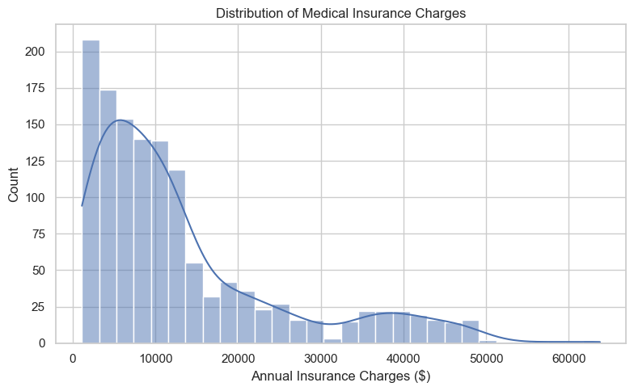
EXPLORATORY ANALYSIS
Charges Are Strongly Right-Skewed
What it shows
Most individuals fall below roughly $20,000 per year.
A long tail extends beyond $40,000.
A log transformation may help the linear model.
Error metrics that punish large misses will be inflated by that tail.
6
Notes:
Looking at the target variable itself, the distribution is strongly right-skewed. Most individuals fall below about twenty thousand dollars a year, but a long tail extends past forty thousand. This matters for two reasons. It suggests a log transformation might improve a linear model, and it means error metrics that punish large misses will be inflated by that high-cost tail. I'll come back to both points.

Slide 7
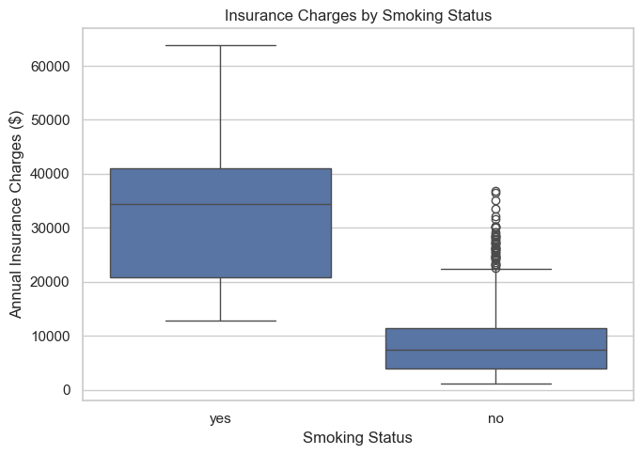
EXPLORATORY ANALYSIS
Smoking Splits the Population in Two
0.79
correlation with charges — the highest of any variable
Smokers and non-smokers behave almost like two separate populations.
Non-smokers cluster tightly at the low end of the cost range.
Smokers span a much wider and much higher band.
The two groups barely overlap.
7
Notes:
The single clearest pattern in the entire dataset is smoking status. Smokers and non-smokers form two almost separate populations. Non-smokers cluster tightly at the low end of the cost range, while smokers span a much wider and much higher band, with very little overlap between the two groups. Smoking status also shows the strongest correlation with charges of any variable, at 0.79. This pattern drove essentially everything that followed.

Slide 8
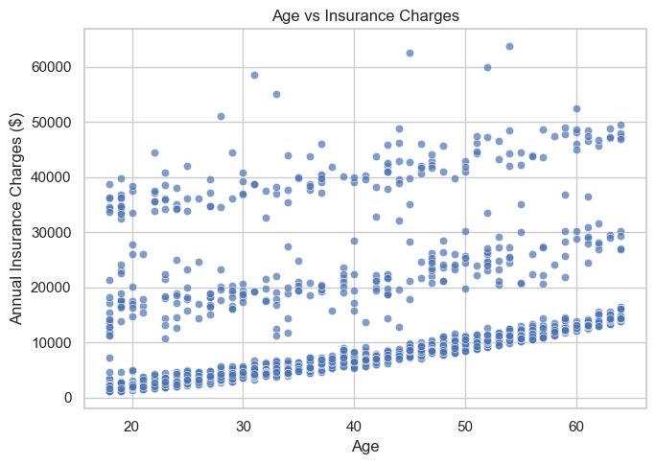
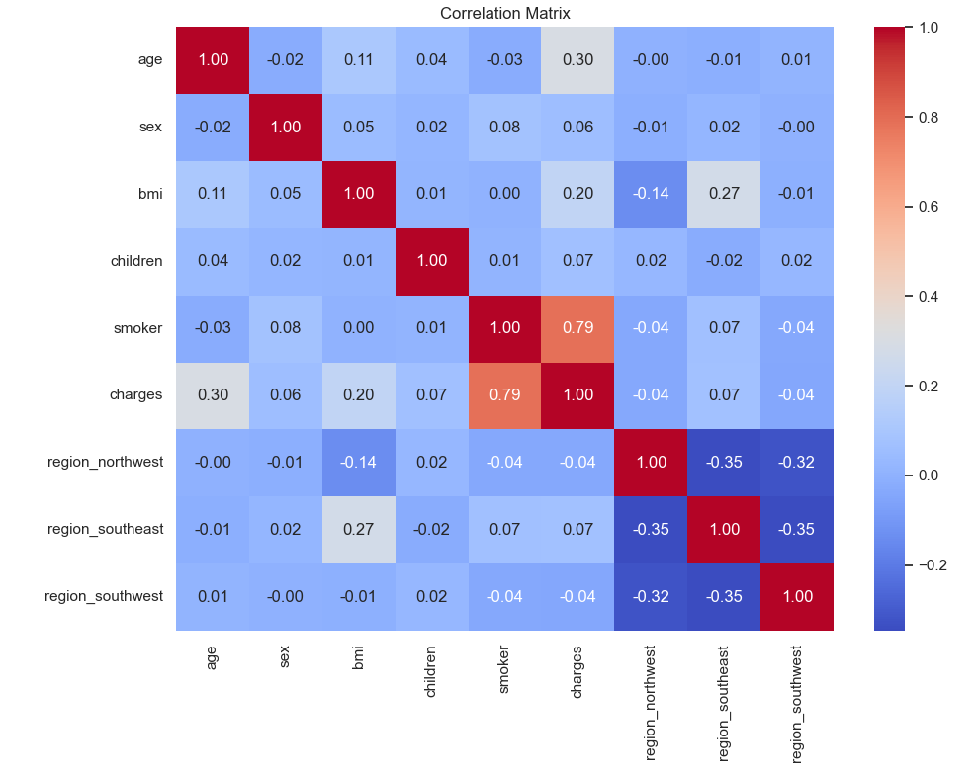
EXPLORATORY ANALYSIS
Age Trends Upward — in Three Distinct Bands
Age vs. charges
Correlation matrix
The banding by age is the smoker / non-smoker divide reappearing within every age group. Correlations: smoking 0.79 · age 0.30 · BMI 0.20.
8
Notes:
Age tells a subtler story. There's a clear upward trend, older individuals cost more, but the points separate into three distinct bands rather than one clean line. In hindsight, that banding is largely the smoker and non-smoker divide reappearing within every age group. The correlation matrix confirms the ordering: smoking at 0.79, then age at 0.30 and BMI at 0.20. Region and number of children show almost no correlation on their own.

Slide 9
METHODS
Two Models, Chosen to Fail Differently
BASELINE
COMPARISON
Multiple Linear Regression
Random Forest Regression
Fits one global equation across all predictors.
Coefficients read directly in dollars, so results are easy to explain.
Assumes effects are strictly linear and additive.
Builds 500 decision trees and averages their predictions.
Captures nonlinear relationships and interactions between predictors.
Reports feature importance rather than dollar coefficients.
EVALUATED ON A HELD-OUT TEST SET WITH THREE METRICS
R²
RMSE
MAE
Share of variance in charges the model explains.
Average error magnitude, penalizing large misses.
Typical error, expressed in plain dollars.
9
Notes:
I chose two models deliberately, because they fail in different ways. Multiple linear regression is the baseline. It fits a single global equation and produces coefficients I can read directly in dollars, which makes it easy to explain, but it assumes effects are strictly linear and additive. Random forest regression works differently. It builds five hundred decision trees on different portions of the data and averages their predictions, which lets it capture nonlinear relationships and interactions. Running both means the performance gap between them tells me something real about the structure of the data.

Slide 10
RESULTS
Random Forest Wins on Every Metric
Metric | Multiple Linear Regression | Random Forest Regression
R² (variance explained) | 0.7836 | 0.8635
RMSE (large errors weighted) | $5,796.28 | $4,603.40
MAE (typical dollar error) | $4,181.19 | $2,560.21
86%
of the variance in annual charges explained by the random forest
≈ 40% lower typical error than the linear baseline
RMSE exceeds MAE for both models — a subset of very high-cost individuals produces unusually large individual errors, exactly as the skewed distribution predicted.
10
Notes:
Here are the results on the held-out test set. The random forest outperformed the linear baseline on every metric. It explained about eighty-six percent of the variance in charges, an R-squared of 0.8635, compared with roughly seventy-eight percent for the linear model. Its root mean square error was about forty-six hundred dollars versus fifty-eight hundred, and its mean absolute error was about twenty-five hundred sixty dollars versus forty-one hundred eighty-one. In practical terms, the random forest cut typical prediction error by nearly forty percent. Notice also that RMSE is much larger than MAE for both models. That is the expensive tail inflating the errors.

Slide 11
RESULTS
Checking for Overfitting
Reading the gap
Linear model: 0.74 → 0.78
Nearly identical, so it generalizes reliably and does not overfit.
Random forest: 0.98 → 0.86
A twelve-point gap — the classic signature of mild overfitting.
It still generalizes better, but constraining tree depth should narrow the gap.
11
Notes:
Accuracy alone isn't enough, so I compared training and testing performance to check for overfitting. The linear model scored 0.74 on training and 0.78 on testing, nearly identical, which means it generalized reliably and if anything underfits. The random forest scored 0.98 on training but 0.86 on testing. That twelve-point gap is the classic signature of mild overfitting. It still generalizes better than the linear model, but it tells me there is room to improve by constraining the tree depth.

Slide 12
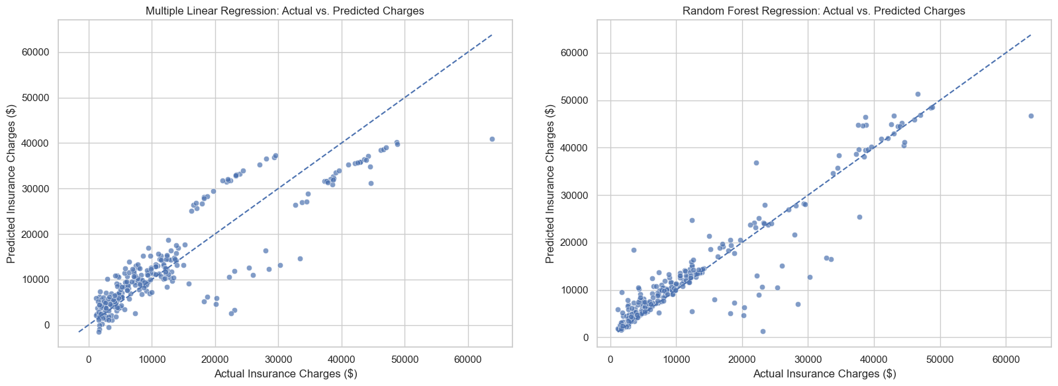
DIAGNOSTICS
Predicted vs. Actual Charges
Points on the dashed diagonal would be perfect predictions.
Left: the linear model underpredicts high-cost individuals and even returns a few predictions at or below zero. Right: the random forest tracks the diagonal closely across the full range.
12
Notes:
These plots compare predicted charges against actual charges, where points on the diagonal would be perfect predictions. On the left, the linear model deviates systematically. It underpredicts many high-cost individuals, and it even produces a few predictions at or below zero, which isn't physically meaningful for insurance charges. On the right, the random forest tracks the diagonal much more closely across the full range, though scatter remains among the most expensive cases.

Slide 13
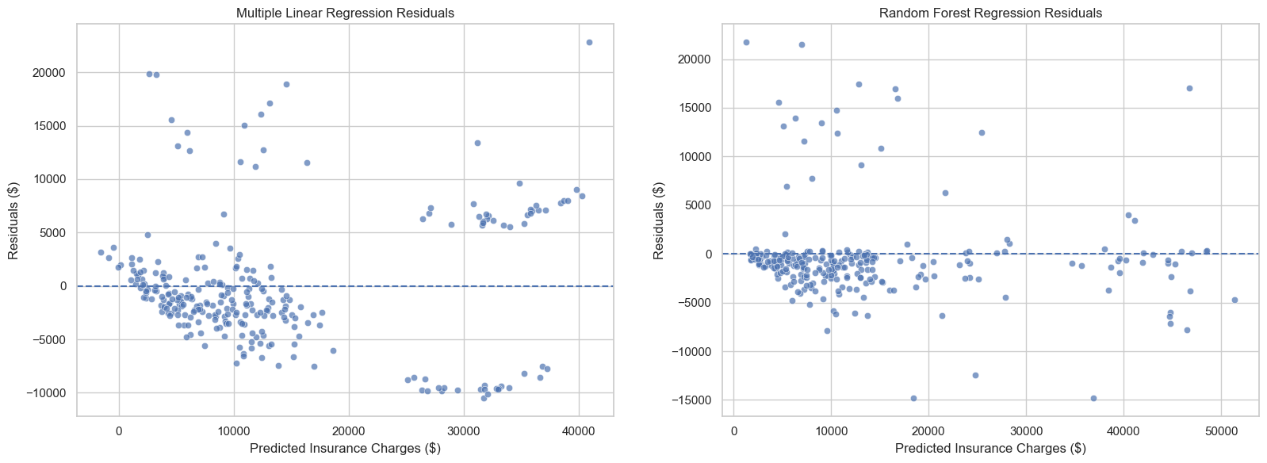
DIAGNOSTICS
Residuals Expose the Linear Model's Limits
Residuals should scatter randomly around zero with no visible pattern.
Left: distinct groups and a systematic curve — violating the linearity and constant-variance assumptions. Right: far more random dispersion in a tighter band around zero.
13
Notes:
The residual plots make the difference even clearer. Residuals should scatter randomly around zero with no visible pattern. The linear model's residuals, on the left, separate into distinct groups and fan outward in a systematic curve. That violates the constant variance and linearity assumptions underlying linear regression, and the grouping is once again the smoker divide. The random forest residuals on the right are far more randomly dispersed and form a much tighter band around zero.

Slide 14
FINDINGS
What Actually Drives Insurance Charges
Top three predictors
61%
Smoking status
22%
BMI
13%
Age
Together these three account for roughly 96% of the model's predictive power.
Random forest feature importance
14
Notes:
So what actually drives medical insurance charges? The random forest's feature importance scores are unambiguous. Smoking status accounts for about sixty-one percent of the model's predictive contribution. BMI is a distant second at twenty-two percent, and age third at thirteen percent. Everything else, number of dependents, sex, and all three geographic regions, contributes two percent or less. Those top three variables together account for roughly ninety-six percent of the model's predictive power.

Slide 15
FINDINGS
The Same Story, Measured in Dollars
SMOKER vs. NON-SMOKER
+$23,651
estimated increase in annual charges, holding every other variable constant
Nearly double the average annual charge across the entire dataset.
Remaining linear regression coefficients — note the far smaller scale.
15
Notes:
The linear model tells the same story, but in dollars. Holding everything else constant, being a smoker is associated with an estimated increase of about twenty-three thousand six hundred fifty-one dollars in annual charges, nearly double the average charge across the entire dataset. The remaining effects are far smaller. Each additional point of BMI adds about three hundred thirty-seven dollars, each year of age about two hundred fifty-seven, and each dependent about four hundred twenty-five. Region effects are modest and sex is negligible at about negative nineteen dollars.

Slide 16
CONCLUSIONS & RECOMMENDATIONS
What the Models Tell Us
KEY FINDING
MODEL RECOMMENDATION
NEXT STEPS
Smoking status is by far the strongest predictor of annual charges.
BMI and age are meaningful secondary factors.
Sex, dependents, and region contribute very little.
Use the random forest for prediction — it is the more accurate model.
Keep the linear model alongside it for explanation in plain dollars.
The gap between them proves the relationships are not purely linear.
Apply a log transformation to the charges variable.
Tune hyperparameters to reduce the overfitting shown earlier.
Engineer a smoking × BMI interaction term and validate on more data.
For cost management, smoking is the most influential modifiable factor by a wide margin — making cessation the single largest lever available, with BMI as a secondary one.
Notes:
To summarize the findings: smoking status is by far the strongest predictor of medical insurance charges, with BMI and age as meaningful secondary factors and everything else contributing very little. The random forest is the more accurate model and is what I would recommend for prediction, with the linear model retained alongside it for explanation, because its coefficients communicate effect sizes in plain dollars. For cost management, smoking is the most influential modifiable factor by a wide margin, which makes cessation the single largest lever available, with BMI as a secondary one. For the modeling itself, my next steps would be a log transformation of charges, hyperparameter tuning to reduce the overfitting I showed earlier, and an interaction term combining smoking with BMI.

Slide 17
CLOSING
Limitations & Ethical Considerations
LIMITATIONS
ETHICAL CONSIDERATIONS
Just over 1,300 records — may not generalize to all healthcare markets.
Only seven variables; omits pre-existing conditions, income, and plan type.
Models demonstrate association, not causation.
A model that flags smokers as high-cost can deny them coverage as easily as help them.
Large-scale consolidation of health data is under active legislative scrutiny.
These models belong in decision support — not discriminatory pricing.
REFERENCES
Fed Spend. (2025). Palantir government contracts deep dive.
Patil, P. (n.d.). Healthcare dataset. Kaggle.
Pedregosa, F., et al. (2011). Scikit-learn: Machine learning in Python. JMLR, 12, 2825–2830.
Senate Committee on Finance. (2025). Wyden, Ocasio-Cortez demand answers from Palantir.
U.S. Census Bureau. (2025). Health insurance coverage in the United States: 2024.
17
Notes:
Finally, the limitations. The dataset holds just over thirteen hundred records and only seven variables. It omits pre-existing conditions, income, and plan type, any of which could matter a great deal. These models demonstrate association, not causation. And there is a real ethical dimension here. A model that accurately flags smokers as high-cost individuals can just as easily be used to deny them coverage as to help them lower their risk. Given the current scrutiny of large-scale healthcare data consolidation, models like these should function as decision-support tools, not as instruments for discriminatory pricing. Thank you for watching, and I am happy to take any questions.

