Slide 1
QF600 · ASSET PRICING · EMPIRICAL STUDY
Do Congressional Traders Generate
Risk-Adjusted Alpha?
Two independent selection hypotheses, tested out-of-sample on 33,522 disclosed trades.
Neither survives the market factor.
Evaluation window 2020-01 → 2024-12 · N = 60 months · CAPM & Carhart 4-factor, Newey–West HAC

Slide 2
THE QUESTION
Beating the market is not the same as alpha
In 2020–2024 almost everything went up.
The question is not whether a member's portfolio rose. It is whether any group earned a return the market factor cannot explain — that is what α measures.
Track A — performance selection.
Rank members on trading performance in a formation window (2014–2019); test the top quartile in 2020–2024. Asks whether past winners PERSIST — the difference between skill and luck.
Track B — committee oversight.
Select members by an ex-ante characteristic — which committee they sat on — and test them only in the sectors that committee regulates. Selection never touches returns, so this group cannot have been chosen for being lucky.
Both tracks share one holding-period construction and one regression specification, and both are reported in full.
QF600 · Congressional trading alpha · 1

Slide 3
METHOD
Four rules, enforced in code — not by good intentions
01
Enter on the disclosure date
Filings lag the trade by a median of 29 days — 438 at the 95th percentile. Trade-date entry credits a price move that was neither public nor investable.
02
Quarantine selection
Track A ranks on formation months only. A hard assertion fails the run if an evaluation month leaks in; validation re-derives the group independently.
03
Mechanical exit
Positions exit exactly 12 months after entry — a fixed function of entry, so it cannot encode what the price did next.
04
Report every variant
Run enough specifications and one crosses t = 2 by chance. The defence is showing all 44, so a starred cell reads against its neighbours.
One deliberately conservative choice: a filing lands mid-month, so positions earn from the FOLLOWING month. This can only reduce measured alpha, never inflate it.
QF600 · Congressional trading alpha · 2

Slide 4
DATA
From 68,167 disclosures to 33,522 usable trades
Filter step | Rows in | Rows out | Dropped
Branch = congress | 68,167 | 54,396 | 13,771
Asset type ∈ {ST, Stock, CS} | 54,396 | 34,107 | 20,289
Directional transactions only | 34,107 | 33,871 | 236
Ticker present | 33,871 | 33,525 | 346
Both dates parse (99.99%) | 33,525 | 33,522 | 3
Filing date ≥ transaction date | 33,522 | 33,522 | 0
259
members with disclosed trades
2,075
tickers with price coverage
99.6%
committee name-match rate
617
tickers unpriced — 10.5% of trades
Delisting bias is not neutral: most unpriced names were acquired, and targets typically jump on announcement — so dropping them most likely UNDERSTATES returns.
QF600 · Congressional trading alpha · 3

Slide 5
TRACK A
Who the formation ranking selected
# | Member |  | Formation α | Trades
1 | Bradley S. Schneider | D-IL | +38.2% | 63
2 | Suzan K. DelBene | D-WA | +28.7% | 16
3 | Lamar Smith | R-TX | +27.6% | 41
4 | Katherine M. Clark | D-MA | +23.4% | 32
5 | Alan S. Lowenthal | D-CA | +21.5% | 161
6 | Bob Gibbs | R-OH | +18.2% | 27
7 | Pete Sessions | R-TX | +18.1% | 18
8 | Dwight Evans | D-PA | +15.7% | 13
30
members cleared the eligibility floor: ≥10 formation trades AND ≥12 invested months
8
selected — the top quartile. 5 Democrats, 3 Republicans, all House.
The formation column is the SELECTION, not a result.
They were picked because those numbers are high. The test is what happened next.
QF600 · Congressional trading alpha · 4

Slide 6
TRACK A — RESULTS
No detectable alpha out-of-sample
Group / construction | Model | α %/yr | t | 95% CI | β | R² | N
Selected — long-only | CAPM | +3.49 | 1.34 | [−1.6, +8.6] | 1.03 | 0.90 | 60
Selected — long-only | FF4 | +3.42 | 1.56 | [−0.9, +7.7] | 1.03 | 0.90 | 60
Selected — long–short | CAPM | −0.40 | -0.09 | [−8.8, +8.0] | -0.18 | 0.09 | 60
Eligible pool (all 30) | CAPM | −1.30 | -0.60 | [−5.5, +2.9] | 1.00 | 0.95 | 60
Rejected (control) | CAPM | −3.38 | -1.26 | [−8.6, +1.9] | 0.99 | 0.92 | 60
The confidence interval comfortably contains zero. The honest reading is UNDERPOWERED, not “proven absent”.
Two details matter more than the headline. The control group works — the members the ranking REJECTED did no better. And β = 1.03 with R² = 0.90 means the market explains 90% of this portfolio's variance.
QF600 · Congressional trading alpha · 5

Slide 7
TRACK B — RESULTS
Oversight confers no measurable edge
Committee group | Sectors tested | α %/yr | t | 95% CI | β
COMBINED | all mapped | −5.34 | -1.11 | [−14.8, +4.1] | 1.10
Science / Commerce | Info Tech, Comm Svcs | +6.33 | 1.80 | [−0.6, +13.2] | 0.99
Health | Health Care | +3.10 | 0.76 | [−4.9, +11.1] | 0.74
Agriculture | Consumer Staples | −0.68 | -0.09 | [−15.4, +14.0] | 0.56
Transportation | Industrials, Materials | −1.40 | -0.28 | [−11.3, +8.5] | 1.14
Armed Services | Industrials | −2.11 | -0.31 | [−15.2, +11.0] | 1.24
Energy & Commerce | Energy, Utilities | −17.03 | -0.96 | [−51.9, +17.8] | 1.26
Financial Services | Financials, Real Estate | −19.66 | -1.40 | [−47.2, +7.9] | 1.40
Committee membership reconstructed POINT-IN-TIME for the 116th–118th Congresses from git history — the upstream dataset ships only a current snapshot, which would test 2020 trades against 2025 committee seats.
Not one committee group clears significance under CAPM.
QF600 · Congressional trading alpha · 6

Slide 8
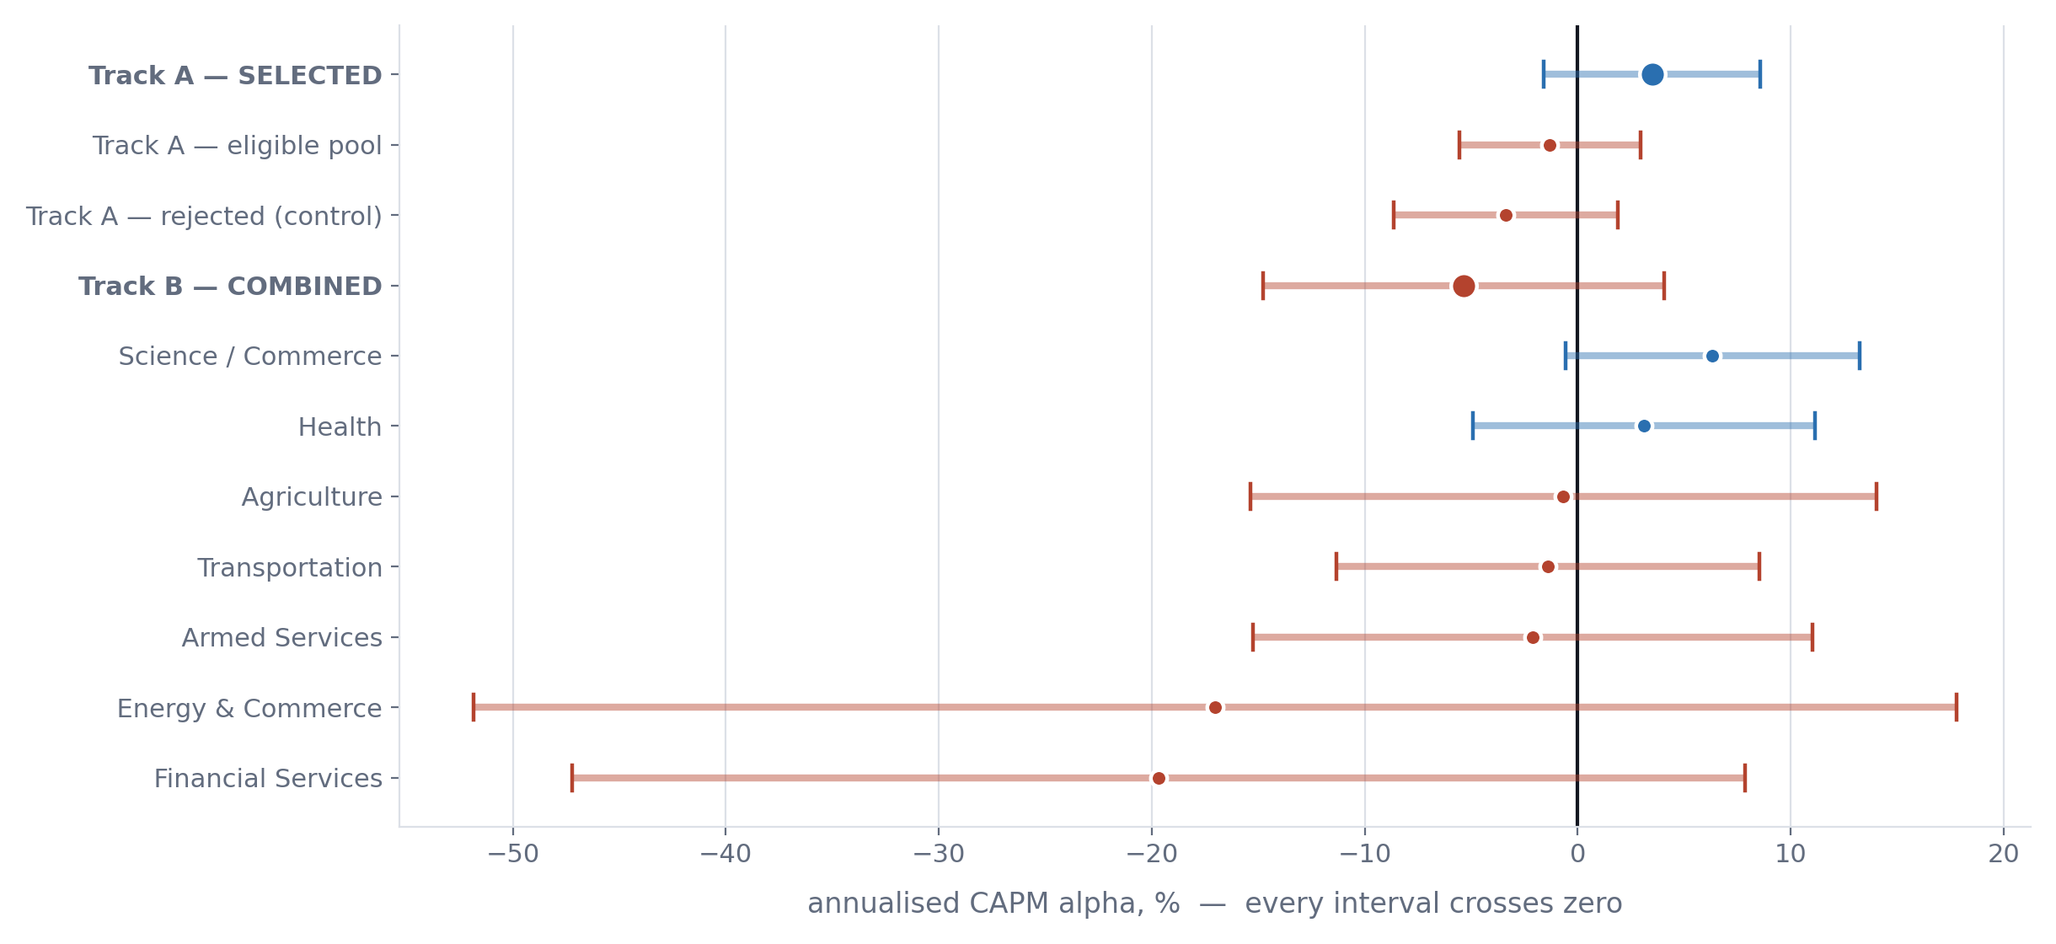
EVERY ESTIMATE
Significance stars compress; the intervals inform
The two widest — Energy & Commerce and Financial Services — span nearly 70 and 55 percentage points, on 64 and 353 trades. Those are not findings; they are the absence of a measurement.
QF600 · Congressional trading alpha · 7

Slide 9
ROBUSTNESS
The result hinges on where the window was cut
Specification | α %/yr | t | 95% CI | β | N
Baseline — equal-weight, 1-month lag | +3.49 | 1.34 | [−1.6, +8.6] | 1.03 | 60
Midpoint-size weighted | +1.79 | 0.91 | [−2.1, +5.6] | 1.00 | 60
Zero entry lag (less conservative) | +4.01 | 1.44 | [−1.5, +9.5] | 1.02 | 60
De-duplicated legs | +3.08 | 1.28 | [−1.6, +7.8] | 1.05 | 60
Split A — form 14–18 / eval 19–24 | −0.77 | −0.12 | [−13.2, +11.7] | 1.10 | 32
Split B — form 14–20 / eval 21–24 | −2.13 | −0.51 | [−10.3, +6.0] | 1.29 | 48
The split-boundary rows are the most informative in the study.
Re-running the entire selection under two other defensible split dates flips the sign. The baseline's positive alpha is not a stable property of these members — it is a property of where the window was cut.
QF600 · Congressional trading alpha · 8

Slide 10
MULTIPLE COMPARISONS
Three significant cells is what chance predicts
44
specifications estimated in the main table
3
cross the 5% threshold
≈ 2.2
expected by chance under the null of zero alpha everywhere
Read this before quoting the one positive result
Two of the three significant cells are NEGATIVE — the rejected-members control group.
The single positive one — Science/Commerce under the 4-factor model, +6.78%/yr, t = 2.16 — does not survive its own CAPM specification (t = 1.80), and rests on 463 trades by 24 members.
It is reported because everything is reported. It is not evidence of a tradeable information advantage.
QF600 · Congressional trading alpha · 9

Slide 11
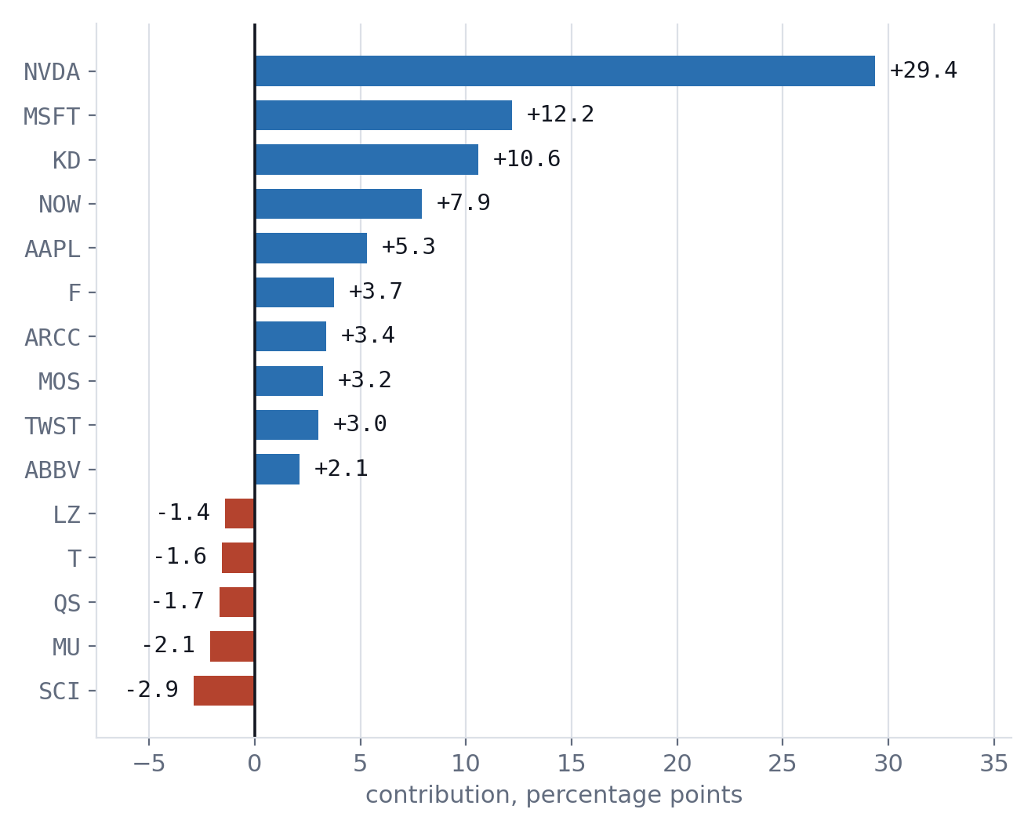
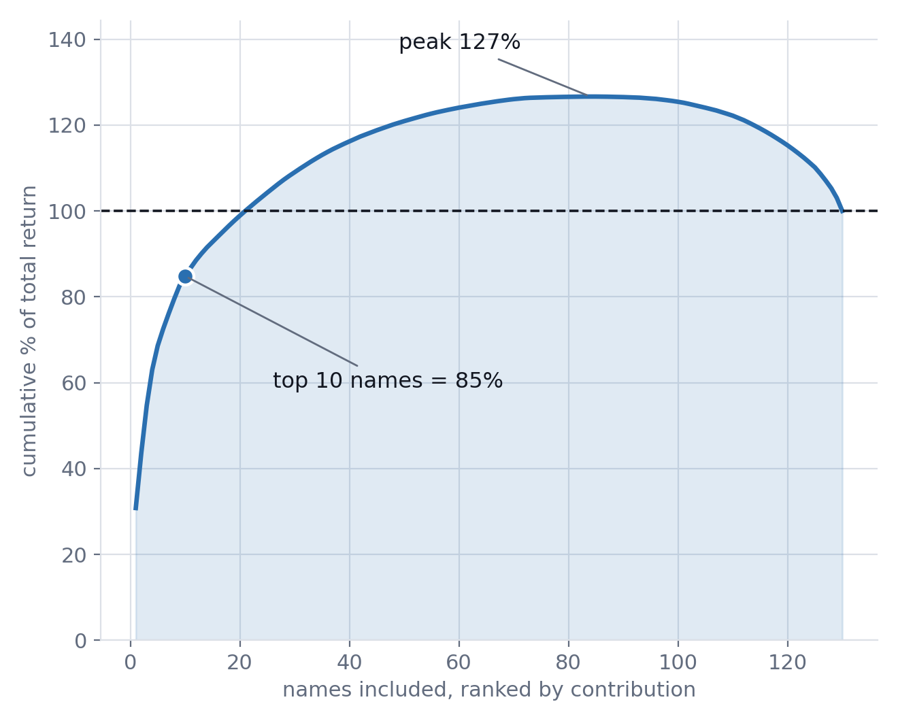
WHAT DROVE THE P&L
One stock is a third of the entire return
NVDA alone contributes 30.8% of the +95.3% total, held by two of the eight members. Ten names of 130 produce 85%. The curve peaks at 127% before the losing half drags it back — a large gross gain net of a substantial gross loss.
QF600 · Congressional trading alpha · 10

Slide 12
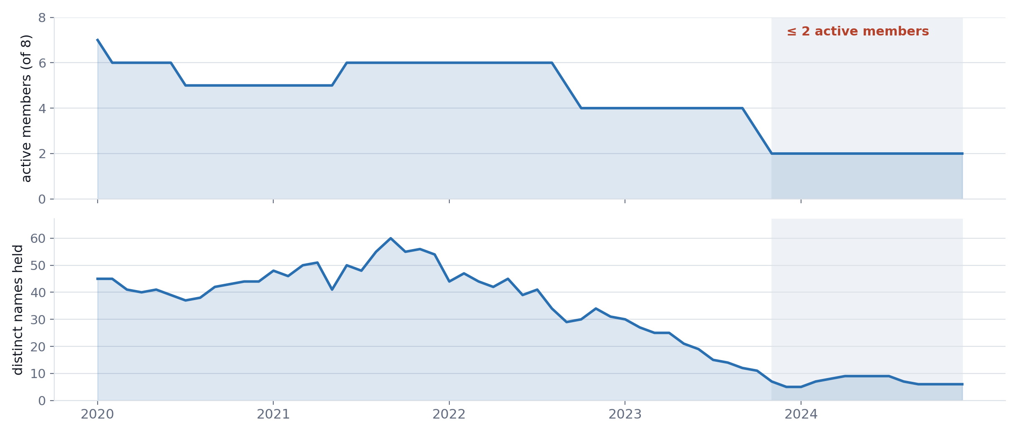
THE STRUCTURAL WEAKNESS
The portfolio thins to two members
14 of 60 evaluation months have two or fewer active members.
Positions roll off 12 months after disclosure and are never replaced once a member stops filing. By 2024 the “top quartile of congressional traders” is two people holding about seven stocks — so the last quarter of the regression window measures something far smaller than the group it claims to test.
QF600 · Congressional trading alpha · 11

Slide 13
LIMITATIONS
Stated, not hidden
Statistical power is the binding constraint.
Sixty monthly observations and eight members cannot resolve a plausible 2–3%/yr alpha. Most results are better described as underpowered than as null.
Delisting bias, and it is not neutral.
617 tickers have no retrievable price history — 10.5% of in-span trades — mostly acquisitions, which typically jump on announcement. This likely understates returns.
The committee→sector map is author-defined.
No dataset exists for it. Every row carries a written oversight rationale, and the conclusion survives both map-robustness variants (−3.86%, −3.64%).
Disclosed amounts are ranges, and sector labels are GICS-like, not licensed GICS.
Equal-weighting is the default for the first reason; the second is a current snapshot.
QF600 · Congressional trading alpha · 12

Slide 14
CONCLUSION
No risk-adjusted alpha in either track
Track A's positive point estimate is not significant, reverses sign under alternative split dates, and disappears entirely once market exposure is hedged out (long–short α = −0.40%, β falls 1.03 → −0.18).
Track B is negative throughout and survives every variation of the sector map. The single significant positive cell in 44 specifications is what a multiple-comparisons count predicts.
The correct conclusion is NOT “members of Congress have no skill” — this design lacks the power to establish that.
It is narrower and more defensible: on disclosed trades, entered when the public could actually have entered them, there is no evidence of returns the market factor cannot explain.
The information advantage, if it exists, does not survive the disclosure lag.
QF600 · Congressional trading alpha · 13

