Slide 1
gsDesign Explorer
Joint development of a
GUI interface for gsDesign
Merck Research Laboratories
REvolution Computing

Slide 2
gsDesign
An R package for group sequential design
  Available at CRAN web site (open source)
  Developed at Merck
  Package qualification by REvolution Computing (2008)
  Many capabilities
    Spending functions
    Graphics
  Programming interface

Slide 3
2009: Make gsDesign approachable to all!
Create GUI interface
Keep project open source
Add value through interactive design development!

Slide 4
Now for the good part!

Slide 5
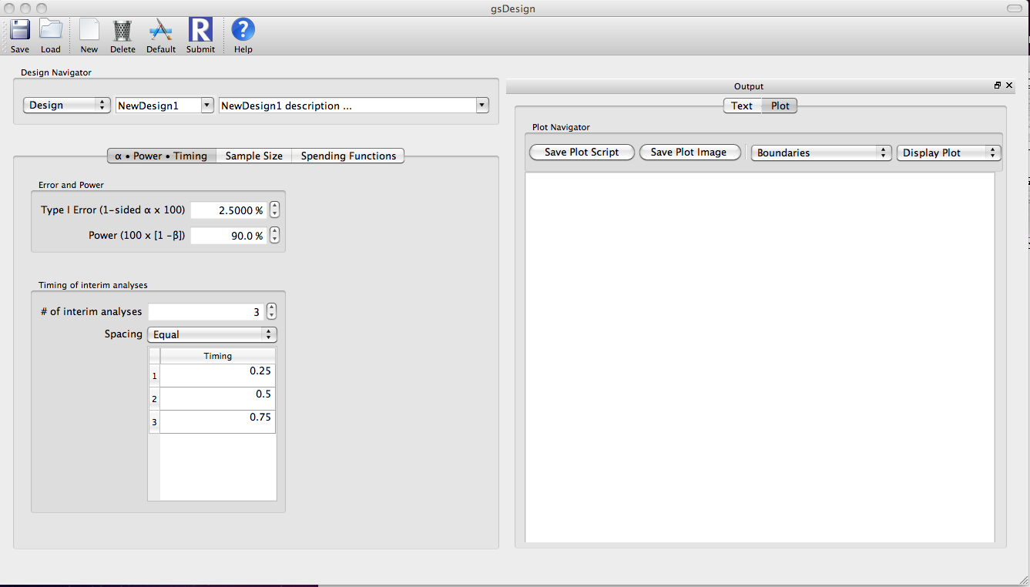
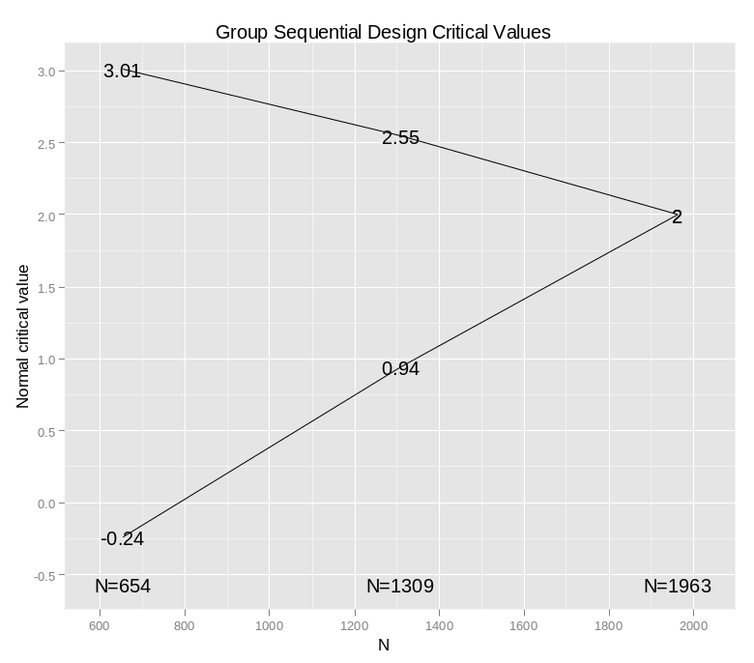
Opening Screen
Note: set default # interims=2 & equal spacing

Slide 6

Changing interims and power

Slide 7

Put in sample size for fixed design

Slide 8

Binomial Design Support

Slide 9

Time-to-Event Design Support
Minimum follow-up control needs work

Slide 10

Treatment Effect Plot
(hazard ratio for time-to-event)

Slide 11
Plot Controls
Default plot title should change for time-to-event trials

Slide 12
Plot title has now changed

Slide 13

Binomial Treatment Effect Plot
Note default y-axis label and main title

Slide 14

Non-inferiority Design
Delta box not working; this has non-inferiority margin of .025

Slide 15
Plots Available
Normal critical values
Boundary crossing probabilities
Conditional power
Spending functions
Expected sample size
B-values

Slide 16

Back to Binomial Superiority:
Text Output

Slide 17

Analysis: change # and timing of interims
Note: now power will change as you change interim analyses

Slide 18
Future: Simulation!!
(Intern/SIC proposal)

Slide 19
Some of our challenges
Interface builder selection: QT creator
  Cross-platform
  Generates open-source code consistent with R
Creating the R-QT communication channel
  Hopefully future additions will require less overhead development, and be less costly

Slide 20
Vision
Provide an interactive design platform
  Potentially could design with team in room
Provide example of open source platform for drug development
  Encourage future investments
  The “Public Option”
Future
  More capabilities:
    Many potential directions
    Which add value?

