Slide 1
UFO Sightings

Slide 2
How has the number of sightings changed over time?

Slide 3
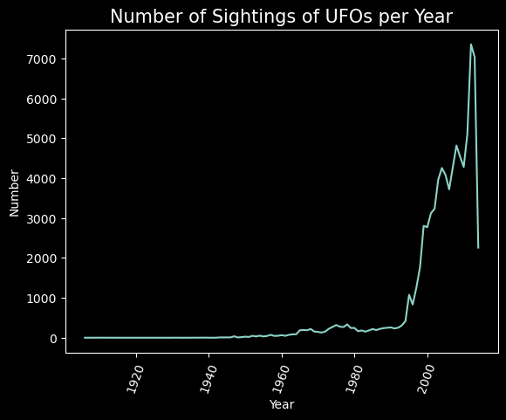

Slide 4
How does the number of sightings in the U.S. compare to the number of sightings in the rest of the world?

Slide 5
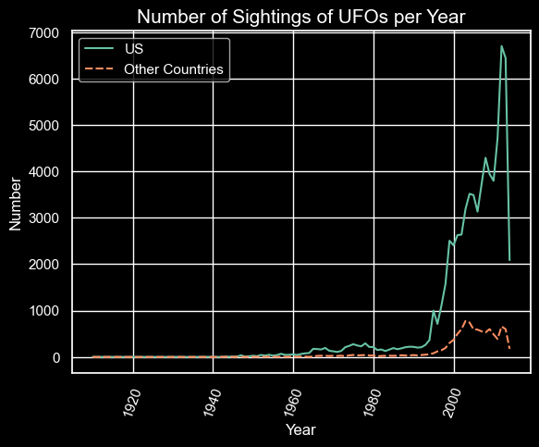

Slide 6
What shapes of UFOs are the most commonly reported ones?

Slide 7
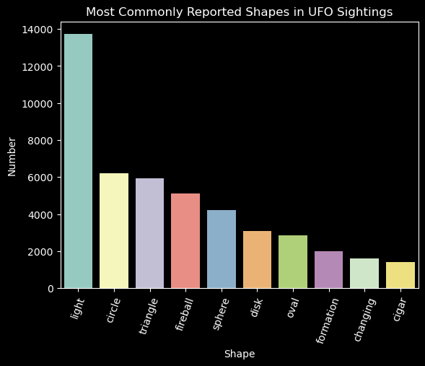

Slide 8
How have the shapes of UFOs changed over time?

Slide 9
