Slide 1
Predicting Health Outcomes from Environmental Pollutants

Slide 2
Health Outcomes Predicted
Asthma
Cancer
COPD
Congestive Heart Failure
Kidney Disease
Stroke

Slide 3
Environmental Data Used
Percent 1960 housing (lead paint indicator)
Proximity to National Priorities List (NPL) [superfund] sites
Proximity to Risk Management Plan (RMP) facilities
Proximity to Treatment Storage and Disposal facilities
Indicator for major direct dischargers to water
Particulate matter 2.5 level in air
Ozone level in air
Diesel particulate matter level in air
Air toxics cancer risk
Air toxics respiratory hazard index
Traffic proximity and volume

Slide 4
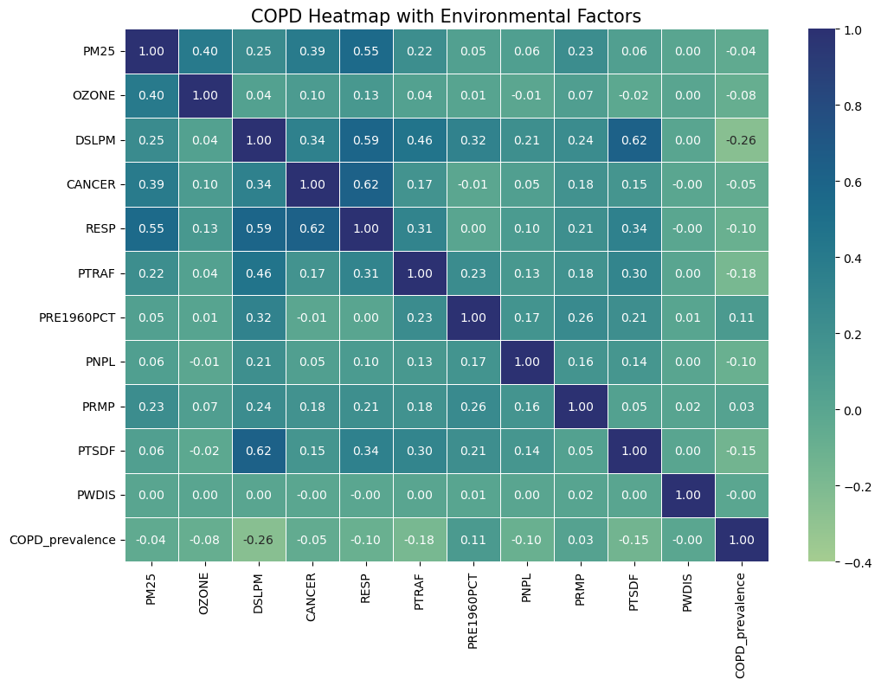
Exploratory Data Analysis

Slide 5
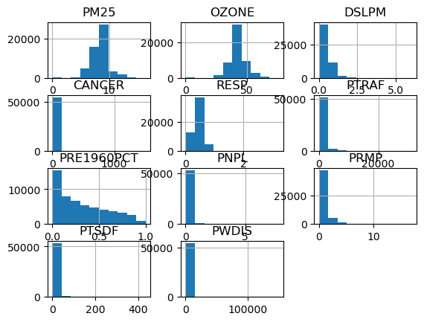
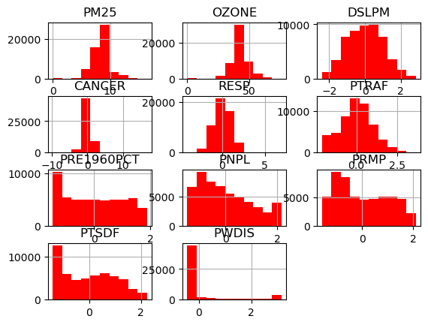
Normalizing Data
Before
After

Slide 6
Types of Regression Modeling
Multiple OLS
Random Forest
AdaBoost
Gradient Boost
XGBoost
LightGBM
SVM

Slide 7
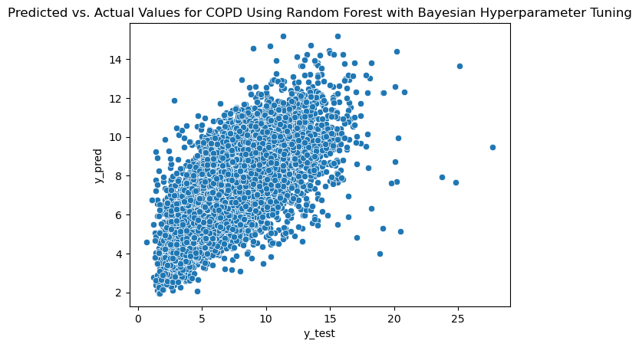

Slide 8
Best Model | Type of Tuning | R²
COPD | Random Forest | Bayesian | 0.568
Asthma | XGBoost | Bayesian | 0.554
CHD | Random Forest | Randomized | 0.513
Stroke | Random Forest | none | 0.506
Kidney | Random Forest | none | 0.481
Cancer | Random Forest | Randomized | 0.455

Slide 9
Analysis
None of the models are good predictors
(maximum R² value of 0.568)
The tree ensemble methods work better
than the SVM or OLS

Slide 10
Difficulties
Health outcomes data
Obtain objective health data
Environmental pollution over time
Include only people who have been living in the same census tract for 10 years
Use more than one year of environmental data

