Slide 1

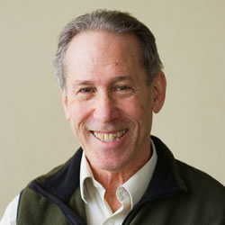
Boston University
RUML
Dr. Eric Braude
Researcher, Manager
Aviral Srivastava
CTO
We present you RUML - so that you can understand and collaborate over your large software code-bases.
 | Total | In-Person | Skype | Phone
New
Total

Slide 2
RUML
Software Engineers
Engineering Managers
Open Source Grants-Funding Organizations
Aeronautics
Health Sciences
FinTech
Crypto-currencies
Education
Large codebases involve collaboration and user on-boarding to understand them
Our product will reduce this time and pave the way for easier maintenance.
Software Engineering in many sectors cannot afford bugs - aeronautics, health-sciences, architecture, etc. This creates friction for agile development. Our product will reduce this friction by reducing the risk while developing softwares.
Try to think of 2 or 3 different applications or industries where your technology could be used and then who are the users and other people involved in any decision process.
For each of the people in the left column, think a little more about why the would be highly motivated to use / purchase your technology.

