Slide 1

Bay Area Bike Share: Where Are the Bikes Going?
A Model to Predict Where a Biker is Headed
DAT5 Final Project – Michael Keba

Slide 2
My Original Idea: Productize a Tool for Video Publishers
Price Floor Optimizer for Video Ad RTB Inventory©
Step 1: get historical ad data from video publisher
Step 2: build model
Step 3: ???
Step 4: profit!

Slide 3





The Problem: Too Much No
“I really want to help you out, but our higher ups don’t want to release data”
“Why don’t you just try using stock data as a stand in?”
“Sorry bro”
“This is definitely an area we’re interested in, let’s keep in touch as we might have a position open up in the near future”
?

Slide 4
Key Takeaway from OG Idea
“Let me check with our data team”
“I really want to help you out, but our higher ups don’t want to release data”
“Why don’t you just try using stock data as a stand in?”
“Sorry bro”
Proprietary Data is Gold!
?
I went on a bike ride to clear my head…

Slide 5
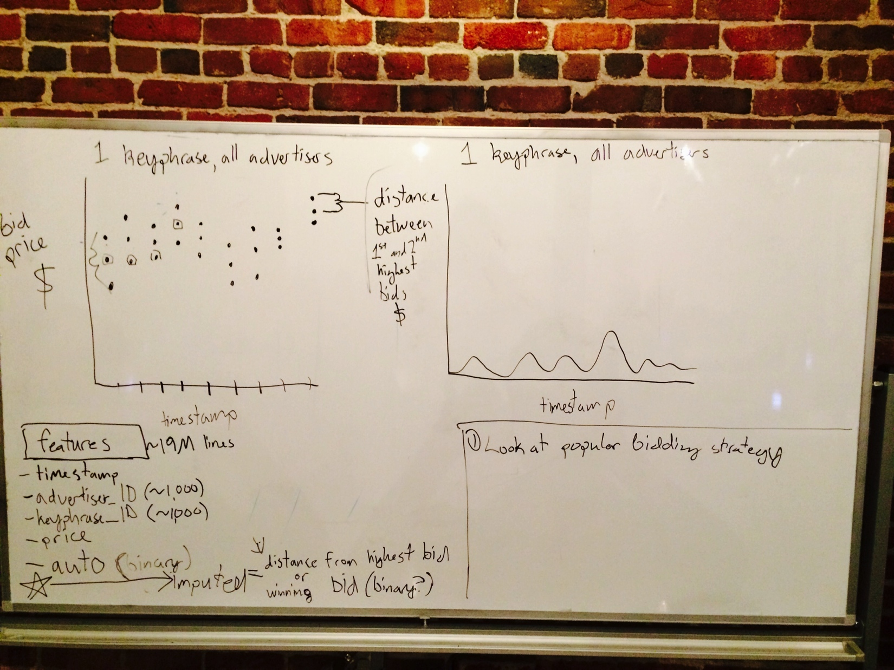
…Scrapped Original Project

Slide 6
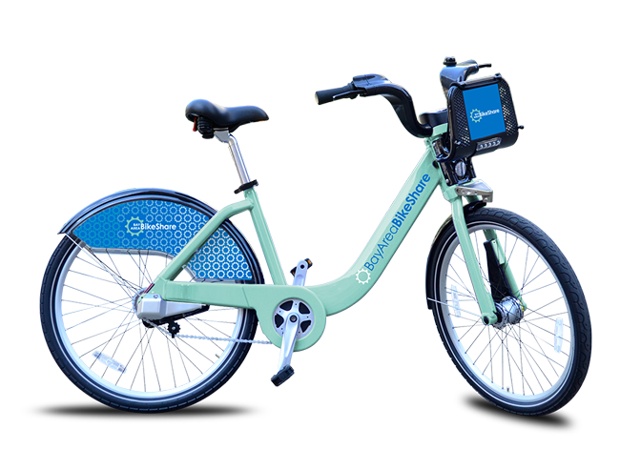
Back to Roots: Bikes!
Who: Bay Area Bike Share (BABS)
What: Open Data Challenge
When: August 2013 through February 2014
Where: competition over, but data set available on website
Why: no models like I envisioned were entered in competition

Slide 7
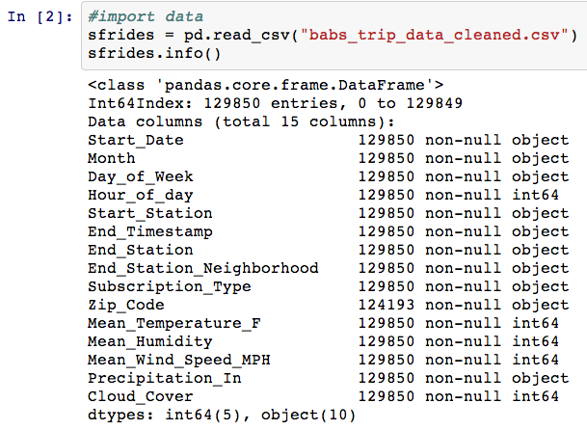
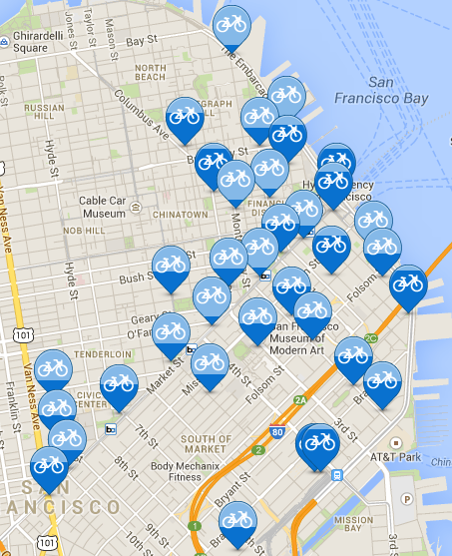
The Data: 130K Lines of Greatness
Dataset Features:
Bike number
Trip start day and time
Trip end day and time
Trip start station
Trip end station
Rider type – Annual or Casual
If annual, member’s home zip code
Daily weather info
* Start neighborhood
* End neighborhood
The SF BABS Universe

Slide 8
Question: Can I Predict Where You’re Going?
Destination from All Starting Points, All Times
Destination from Caltrain on Weekdays 7AM-10AM

Slide 9
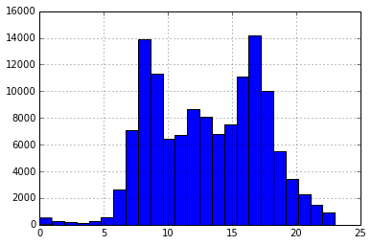
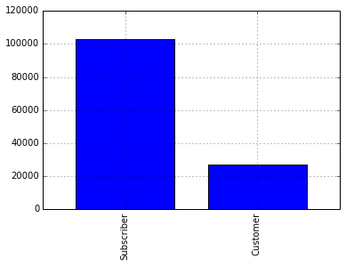
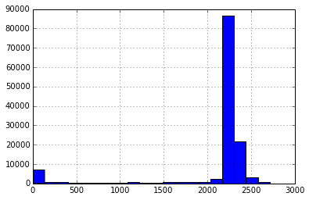
Exploratory Visualizations
Rides by:
Hour of day
Subscriber/Customer
Zip Code (Binned 20)

Slide 10
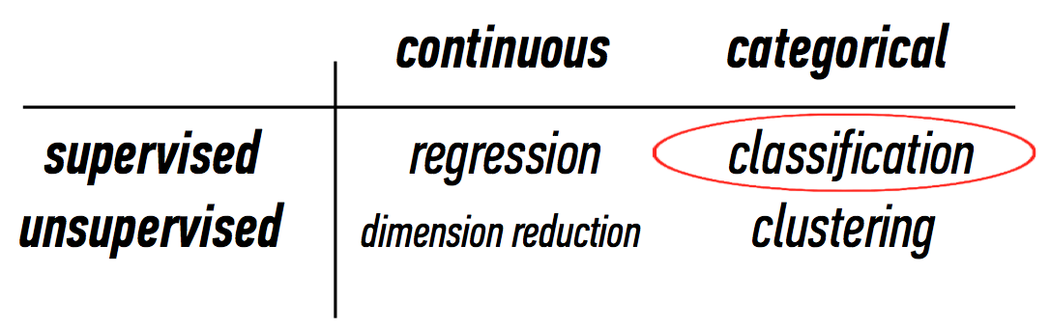
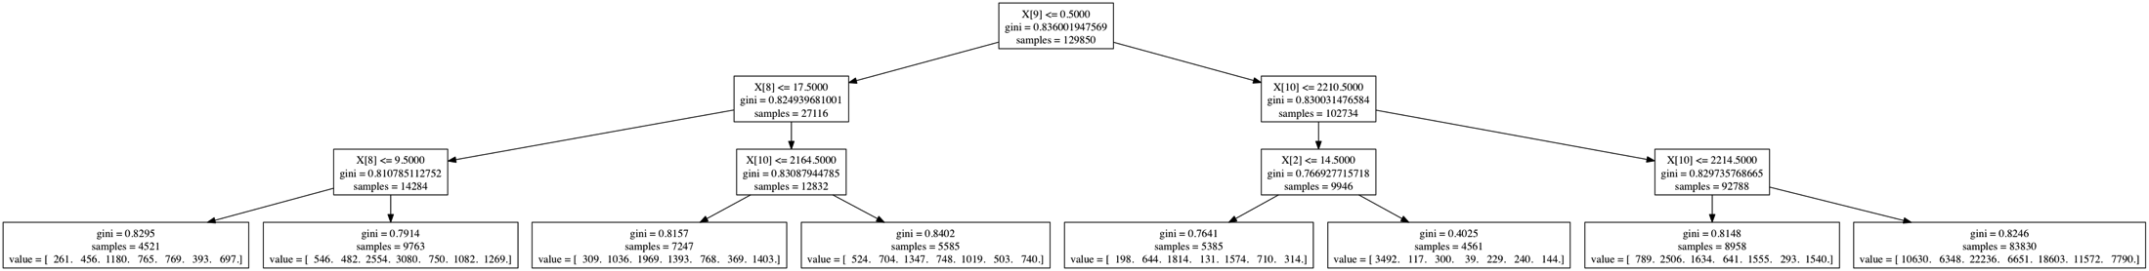
Model: Decision Trees
No distribution assumptions (Non-parametric)
Hierarchical

Slide 11
Preprocessing
Selected only SF data
Grouped stations by neighborhood
Used LabelEncoder for encoding categorical features
Weather metrics were continuous features
Caltrain
Civic Center/Mid-Market
FiDi
North Beach/Telegraph
Soma
South Beach
Union Square

Slide 12
Results: 10X Cross Validation Mean Scores
Max Tree Depth = 10
Decision Tree: 0.420
Random Forest: 0.399
No Max Tree Depth
Decision Tree: 0.509
Random Forest: 0.472

Slide 13
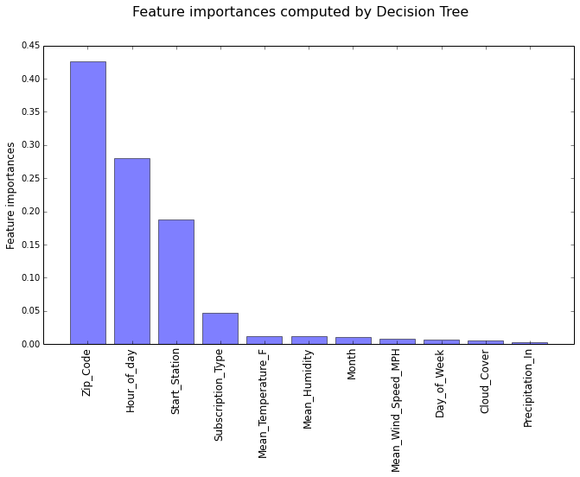
Discussion
~2.7K zip codes represented, long tail
Group by city/state?
How would PA/SJ data affect predictions?
Has consumer behavior changed after first 6 months to be more predictable?
Heard rumor that there’s London bike share data with customer ID

Slide 14
Questions?
mjkeba@gmail.com

