Slide 1





TEAM NUGGETS
Kevin Downes
Bobby Chang
PROJECT 01
PSEG RUTGERS ANALYTICS BOOTCAMP PROGRAM
PROJECT 01
Bhagya Prasad
Eliezer Flores
11 JANUARY 2024

Slide 2

INTRODUCTION
IDEA
Analyze how much NBA players statistics is used by the voters to determine the results of the MVP vote in season 2020-21
Voters are the basketball media correspondents and the broadcasters
PURPOSE
Analyze the accuracy the number of MVP votes cast by the voters
Learn and apply Python, API Management and Statistics concepts in determining the influence of the outcome

Slide 3
APPROACH | PROJECT LIFECYCLE
PROJECT ANALYSYS | API MANAGEMENT | DATA GATHERING | DATA PREPARATION | VISUALIZATION
Defining the purpose of the project Identify the data source Created the project framework Determine the key findings | Subscribe to NBA players statistics Establish the API Connectivity Determine the API dataset architecture Determine the data format | Collect players data and statistics Normalize/Filter to use only the subset of the data Apply data conversion techniques | Leverage Pandas dataframe to organize the required data Eliminate non-essential information Perform error handling | Build various graphs and charts based on the key finding and conclusions Used Pandas dataframe, Matplotlib, Pyplots libraries
 | RAPID API NBA | [names of the players, season, key categories] | [NaN, ]
Jupyter Notebook and GitHub integration for team collaboration and code management lifecycle efficiently

Slide 4
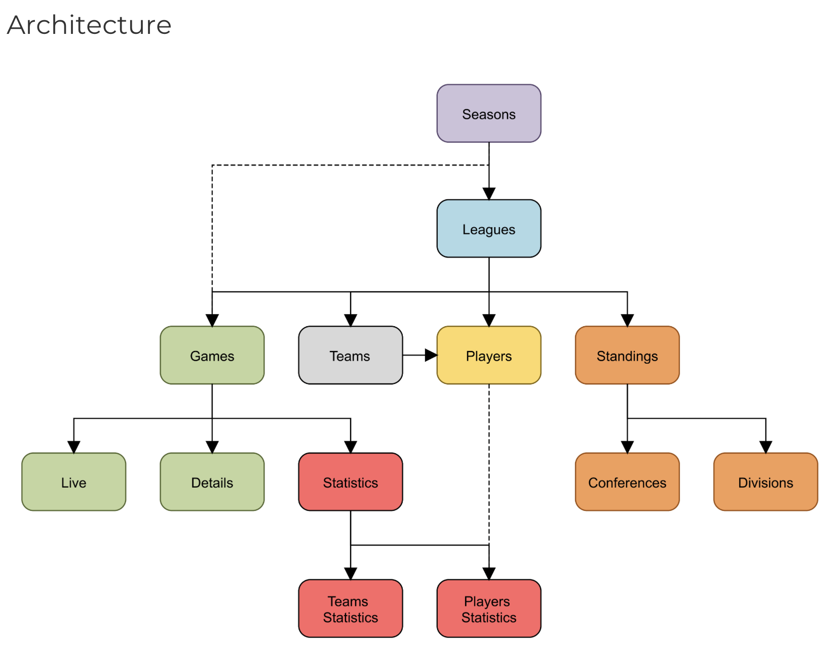
PLAYER STATISTICS DATA ARCHITECTURE – ENTITY DATA MAPPING
DATA ENTITY MAPPING
RAPID API NBA
Fine-grained analysis using entity data mapping from the data architecture
Narrow down data points and relationships

Slide 5
ABOUT NBA STATISTICS – PLAYER TEAM – FIELD NAME REFERENCE
Player ID | Player Name | Position | TEAM
20 | Giannis Antetokounmpo | Power Forward | Milwaukee Bucks
279 | Nikola Jokić | Center | Denver Nuggets
159 | Joel Embiid | Power Forward | Philadelphia 76ers
124 | Stephen Curry | Point Guard | Golden State Warriors
Player Name | points | fgp | ftp | tpp | offReb | defReb | assists | steals | blocks | plusMinus | mvpvotes
 | Points | Field Goal Percentage | Free Throw Percentage | Three Point Percentage | Offensive Rebound | Defensive Rebound | Assists | Steals | Blocks | Team performance player on the court | Most Valuable Player Votes
Giannis | 29.72 | 55.03735 | 70.49759 | 26.97711 | 2.036145 | 9.831325 | 5.879518 | 1.048193 | 1.301205 | 5.975904 | 348
Jokić | 26.72 | 59.87711 | 78.97229 | 33.87831 | 2.795181 | 10.75904 | 7.686747 | 1.445783 | 0.879518 | 4.927711 | 971
Joel | 29.1 | 49.70633 | 82.47468 | 34.73924 | 2.075949 | 9.189873 | 3.911392 | 1.012658 | 1.291139 | 4.835443 | 586
Curry | 27.36 | 46.38621 | 82.52759 | 40.16667 | 0.528736 | 4.908046 | 6.264368 | 1.436782 | 0.37931 | 7.563218 | 453
NBA STATISTICS GLOSSARY

Slide 6
OBSTACLES | SOLUTIONS
CATEGORY | CHALLENGES | SOLUTION/WORKAROUND
API | Number of hits [more than 100 hits is chargeable] | Limited the number of players and picked only one season Monitored the number of hits per API Key
 | Parent id/key same across all tables ["id"] that made it difficult to build relationships between the two tables | Resorted to pulled data by player and merging individual dataframes
DATATYPE CONVERSION | API response contained composite data preventing from adding a column in a dataframe. | Used df.sum(numeric_only = True) to apply the sum for number type only
 | Converting the time from hh:mm format to mm in a dataframe
DATA VISUALIZATION | Creating slides using the image file | Near realtime data visualization directly from the visualization tool [Power BI]
 | Collaborating on Jupyter notebook | The chart output needs to be generated on each individual notebooks

Slide 7
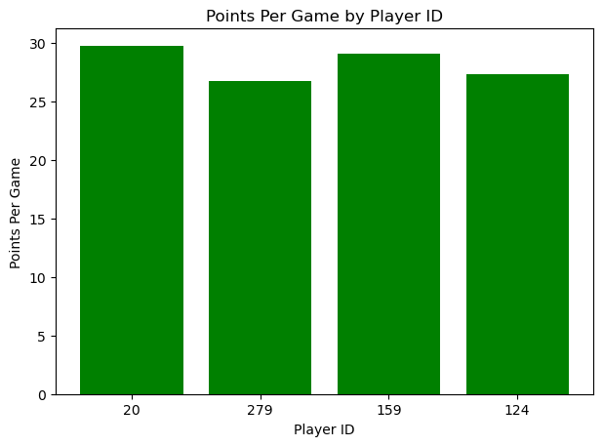
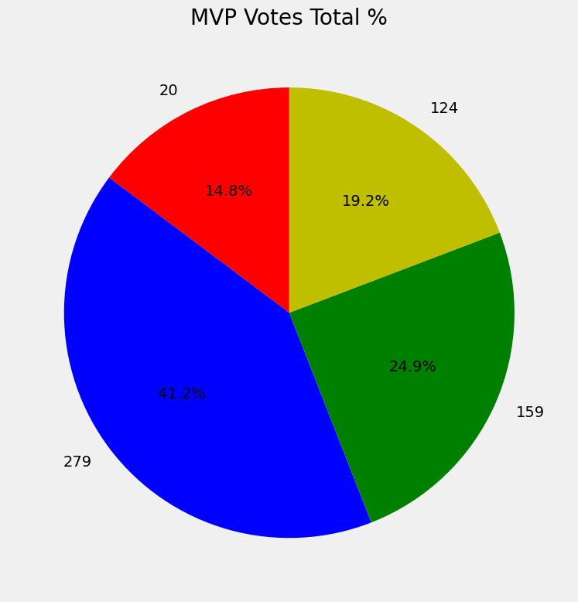
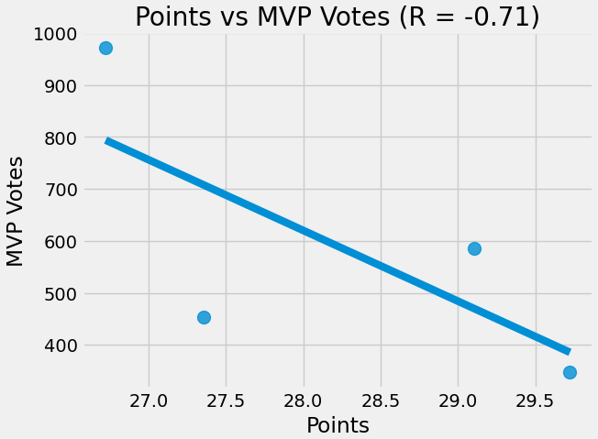
KEY FINDINGS 1– IMPACT OF MVP VOTES on PLAYER SELECTION
Points per game did not impact the MVP voters in their player selection.
Lowest scoring player [279] won the most MVP votes
PLAYERID NAME
20 Antetokounmpo
279 Jokic
159 Embiid
124 Curry

Slide 8
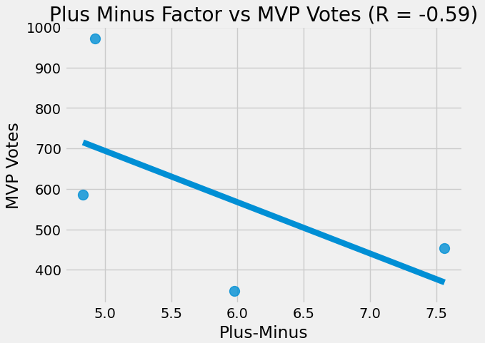
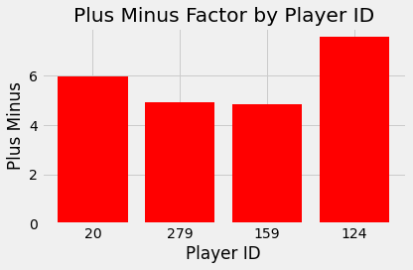
KEY FINDINGS 2 – IMPACT OF PLUS MINOR FACTOR on MVP VOTES
Plus Minus did not have any influence on the voters while casting their vote for the season’s MVP.
PLAYERID NAME
20 Antetokounmpo
279 Jokic
159 Embiid
124 Curry
Plus-minus is a measure of a player's impact on the score of a game while they are on the court. It is calculated by taking the point differential when a player is on the court and subtracting the point differential when the player is off the court.
The plus-minus statistic provides insights into how well a team performs with a particular player on the floor.

Slide 9
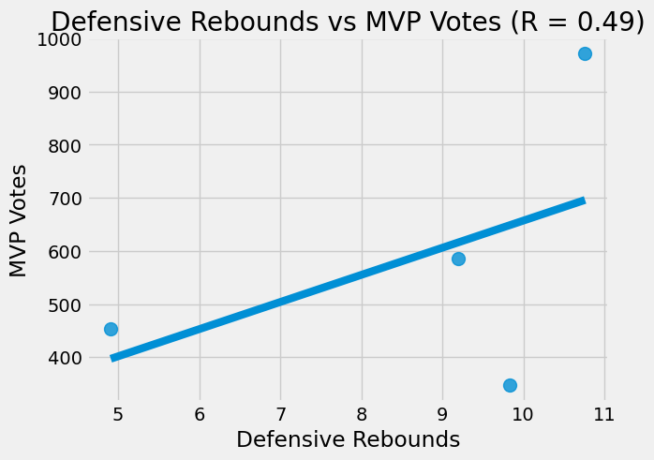
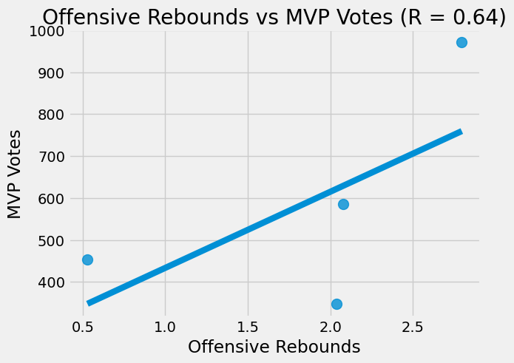
KEY FINDINGS 3 – IMPACT OF REBOUNDS on MVP VOTES
Rebounding statistics have a bigger impact with the voters that benefits the players who are forwards or center over guard position
PLAYERID NAME
20 Antetokounmpo
279 Jokic
159 Embiid
124 Curry

Slide 10
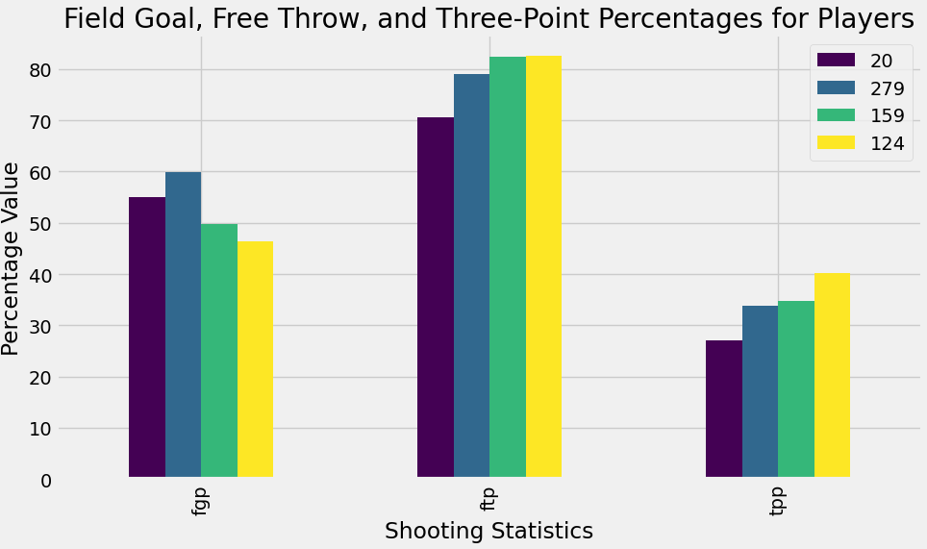
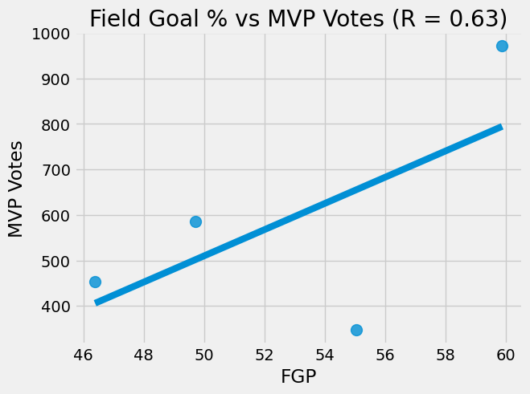
KEY FINDINGS 4 – IMPACT OF FIELD GOAL % on MVP VOTES
Shooting accuracy has a bigger impact with the voters
PLAYERID NAME
20 Antetokounmpo
279 Jokic
159 Embiid
124 Curry

Slide 11
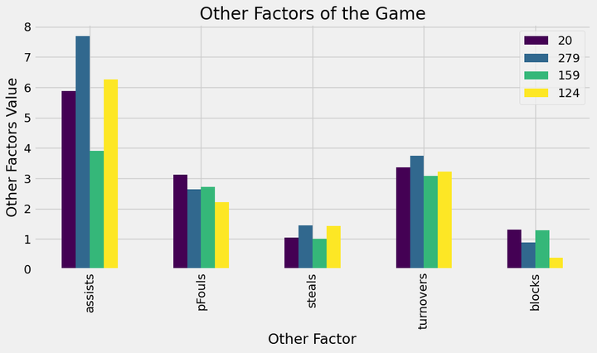
KEY FINDINGS 5 – IMPACT OF OTHER FACTORS on MVP VOTES
Amongst other factors, ASSISTS and STEALS shows a significantly higher influence on voting as compared to PERSONAL FOULS and BLOCKS
PLAYERID NAME
20 Antetokounmpo
279 Jokic
159 Embiid
124 Curry

Slide 12





CONCLUSION | ACKNOWLEDGEMENTS
Directions for future work
More in-person collaboration
Defining the choice of tools
Cost analysis & potential impact
Data Labeling on the charts and plots
Enkhsanaa Sommers
Kourt Bailey
Raina Gustafson
Sheri Rosalia
Jeanette Luu

Slide 13
APPENDIX

Slide 14
MORE KEY FINDINGS – IMPACT OF OTHER KEYS on MVP VOTES
Comparison | Correlation | Category
Plus Minus vs Steals | 0.39 | Defensive
Plus Minus vs Assists | 0.17 | Offensive
Plus Minus vs Points | -0.15 | Offensive
Plus Minus vs Field Goal % | -0.62 | Offensive
Plus Minus vs Blocks | -0.73 | Defensive
Plus Minus vs Defensive Rebounds | -0.89 | Defensive
Plus Minus vs Offensive Rebounds | -0.92 | Offensive
Plus Minus vs MVP Votes | -0.59 | Overall
Comparison | Correlation | Category
Offensive Rebounds vs MVP Votes | 0.64 | Offensive
Field Goal % vs MVP Votes | 0.63 | Offensive
Assists vs MVP Votes | 0.51 | Offensive
Steals vs MVP Votes | 0.51 | Defensive
Defensive Rebounds vs MVP Votes | 0.49 | Defensive
Blocks vs MVP Votes | -0.1 | Defensive
Points vs MVP Votes | -0.71 | Offensive
Plus Minus vs MVP Votes | -0.59 | Overall
While the Plus Minus statistic is used to measure overall impact on the game, it has limitations. Voters seems to look holistically when casting their votes as the MVP winner had the second lowest plus minus, although assists, steals, offensive rebounds, defensive rebounds, and field goal % were highest.

